Slide 1
Fish Passage Outcome
Mary Andrews
NOAA Restoration Center

Slide 2
Overview of updated key actions
What actions or performance targets have been removed? Have been added? Why? None added.
  Have there been science/data/tool advancements? Chesapeake Fish Passage Prioritization Tool has been updated to new platform with new feature – dam rankings are generally the same.
  Are there new funding opportunities? FPWG is aware of several older sources -NFWF, NOAA Community-based Restoration, USFWS Fish Passage, PA Growing Greener.
What will be the focus of your new Workplan?
  Are you focusing on creating a more manageable and immediately actionable workplan? Keeping it close to the same? No planned major changes for the work plan
How do these changes reflect the asks you presented to the MB? No major changes.

Slide 3
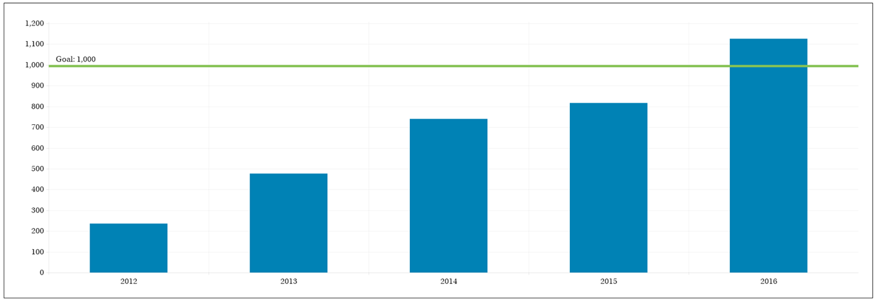
Are you close to reaching the outcome and planning to work to finish it?

Slide 4
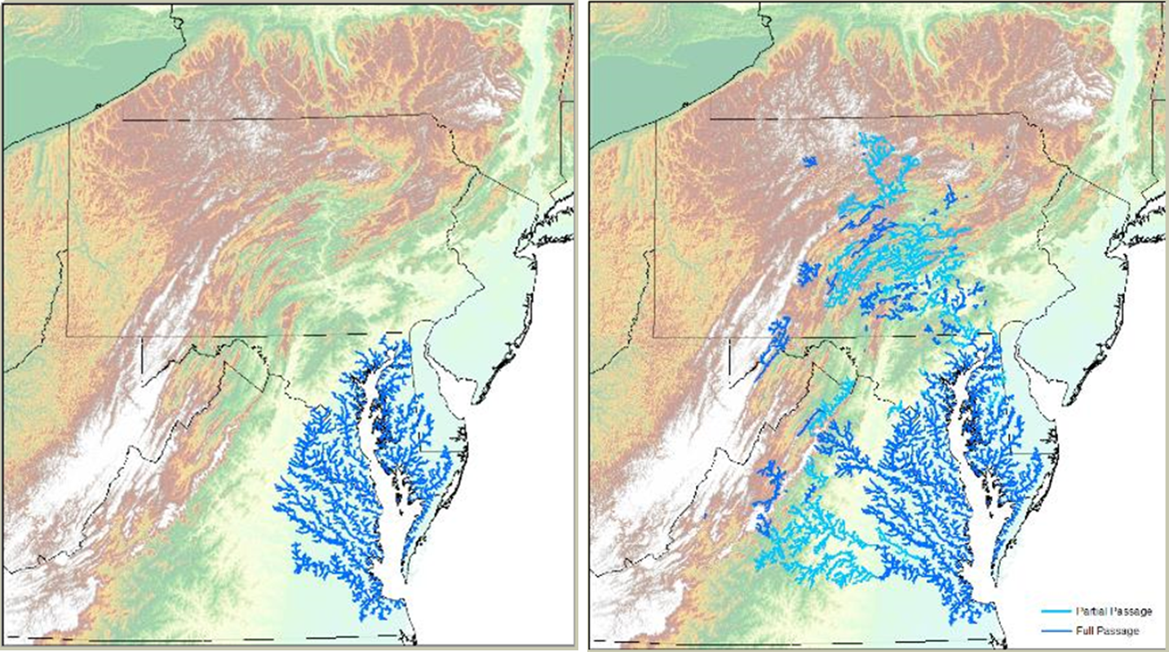
1989
2016

Slide 5
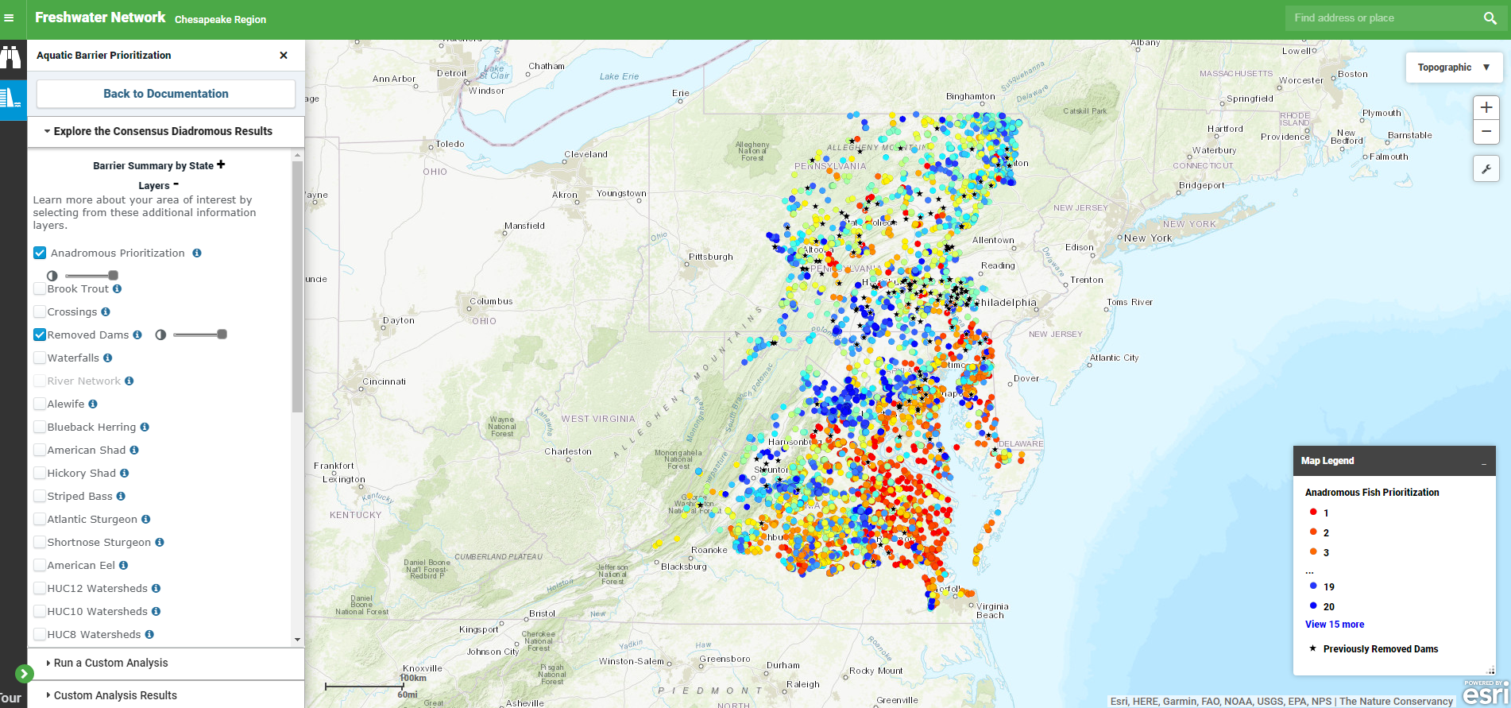
  Are you planning to focus action and work in a particular geographic area? Priority dam removal via the Chesapeake Fish Passage Prioritization Tool

Slide 6
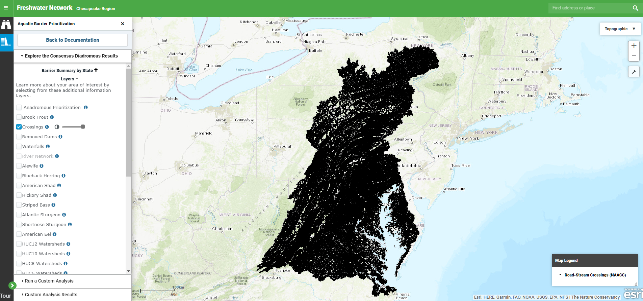

Slide 7
Remaining gaps and barriers
What gaps and barriers will exist even after these key action updates? Why?
Community/Landowner Willingness, Incentivize or Mandate Barrier Removal Projects - Obtaining permission from dam owners to move forward with projects has proven to be complicated with many private dam owners opting to keep their dams in place.
Understanding the Ancillary Benefits of Dam Removal (Policy Makers, Dam Owners and Local Government) - Dam removal projects provide many ancillary benefits beyond restoring habitat for target fish species. Flood reduction benefits can be realized in some cases and can result in less nuisance flooding of roadways and bridges.
Funding - the ability to achieve change through fish passage projects is largely limited by a lack of resources.

Slide 8
Addressing gaps and barriers
How do you plan on addressing these gaps/barriers?
  Are these needs that the Habitat GIT or Management Board could address? Yes
Community/Landowner Willingness, Incentivize or Mandate Barrier Removal Projects - each state handles this differently. PA sets example of how dam safety and PFBC work together. MD investigating PA’s process.
Understanding the Ancillary Benefits of Dam Removal (Policy Makers, Dam Owners and Local Government) - Flood reduction benefits can be realized in some dam removals and can result in less nuisance flooding of roadways and bridges. Investigate culvert projects for fish passage and flood reduction benefits.
Funding – Ensure Bay Program funding includes dam removal and culvert replacements are priorities for funding.

