Slide 1
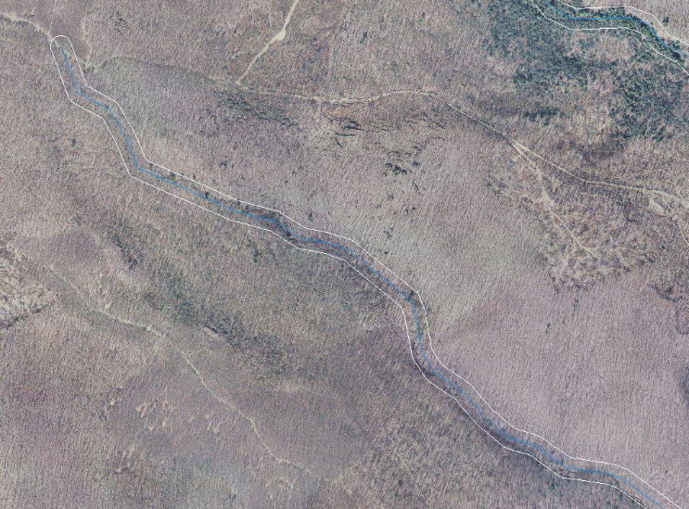
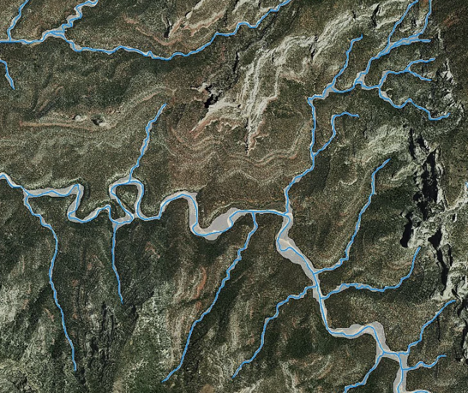
% Riparian Natural Cover
30m Buffer vs Variable Width
Notes:
Percent of the Riparian Area that is Natural Cover (Forest, Shrub, Grassland) These data shown here are based on a 30 meter fixed with riparian buffer. We are currently working with Sinan Abood, a USFS research fellow, and USGS to develop a variable width riparian buffer using the 50yr flood for the Contential US. This new buffer should be finished in late March

Slide 2


National Riparian Areas Base Map
3,167,500+ miles of streams processed
NHD streams type: artificial rivers, connectors & stream rivers were processed. Ephemeral streams.
50-year flood height--the hydrological descriptor of riparian areas. More than 26,000 USGS water gauges used.
Riparian Buffer Delineation Model (RBDM)v5.2 used on ESRI ArcPro to develop variable width riparian areas. For more details www.riparian.solutions.

Slide 3
National Riparian Areas Base Map Data Inputs
Input Data | Sources
Streams Watersheds | USGS National Hydrology Dataset (NHD) 1:100K http://nhd.usgs.gov/
Lakes | USGS National Hydrology Dataset (NHD) http://nhd.usgs.gov/
National Wetlands Inventory | National Wetlands Inventory (NWI) http://www.fws.gov/wetlands/Data/Data-Download.html
10m DEMs | The National Map https://viewer.nationalmap.gov/basic/#startUp
Land Cover | National Land Cover Database http://www.mrlc.gov/ 2006 & 2011
50-Year Flood Height | 50-year flood height value is calculated using Mason (2007) approach utilizing available USGS water gauges at: https://maps.waterdata.usgs.gov/mapper/index.html
Notes:
Free available geospatial data utilized to delineate variable width riparian areas.
We use 10m DEM as default because it is available conus wide.

