Slide 1
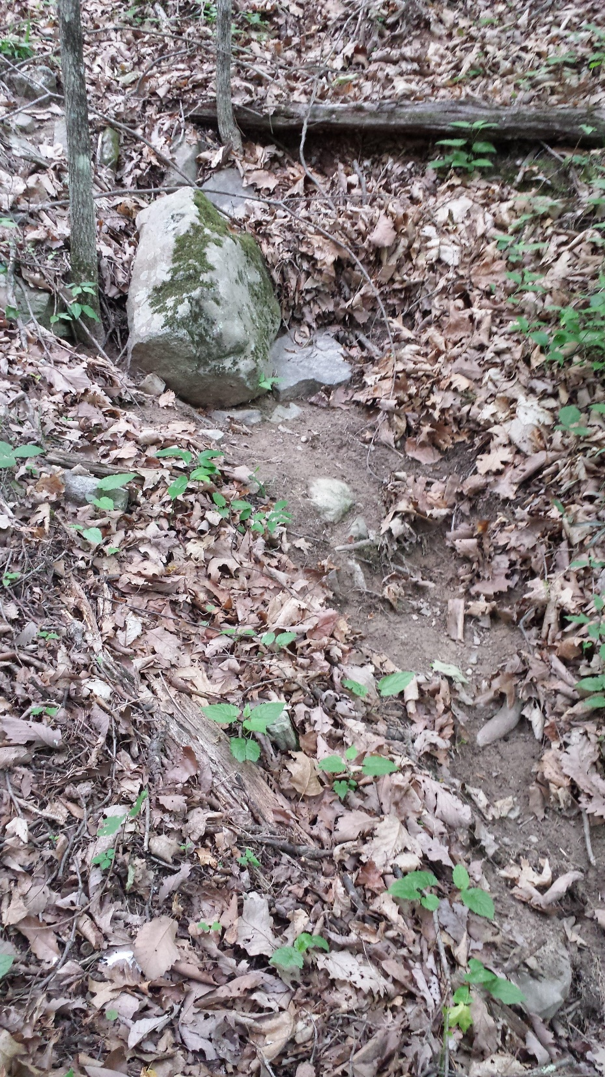




Development of Automated Methods for Channel Extraction From LiDAR in Chesapeake Bay Watersheds
David Saavedra
CBP Forestry Workgroup Meeting, April 03 2019

Slide 2
Talk Overview
Project background
Field data collection
Evaluation of existing methods
Development of new methods
Data products
Notes:
General overview of contents in slideshow

Slide 3
Project Background
Chesapeake Bay Trust – development of objective, scalable methods to map stream channels across heterogeneous Chesapeake Bay watershed
1.5 year project
Field data collection
Literature review
Method evaluation, development, and implementation at pilot sites
Report writing
Chesapeake Bay Program – implementation of methods developed under CBT
6 year project
Automated channel extraction Bay-wide
Manual QA/QC
Accuracy assessment
Notes:
Background on projects
Puts them in context

Slide 4
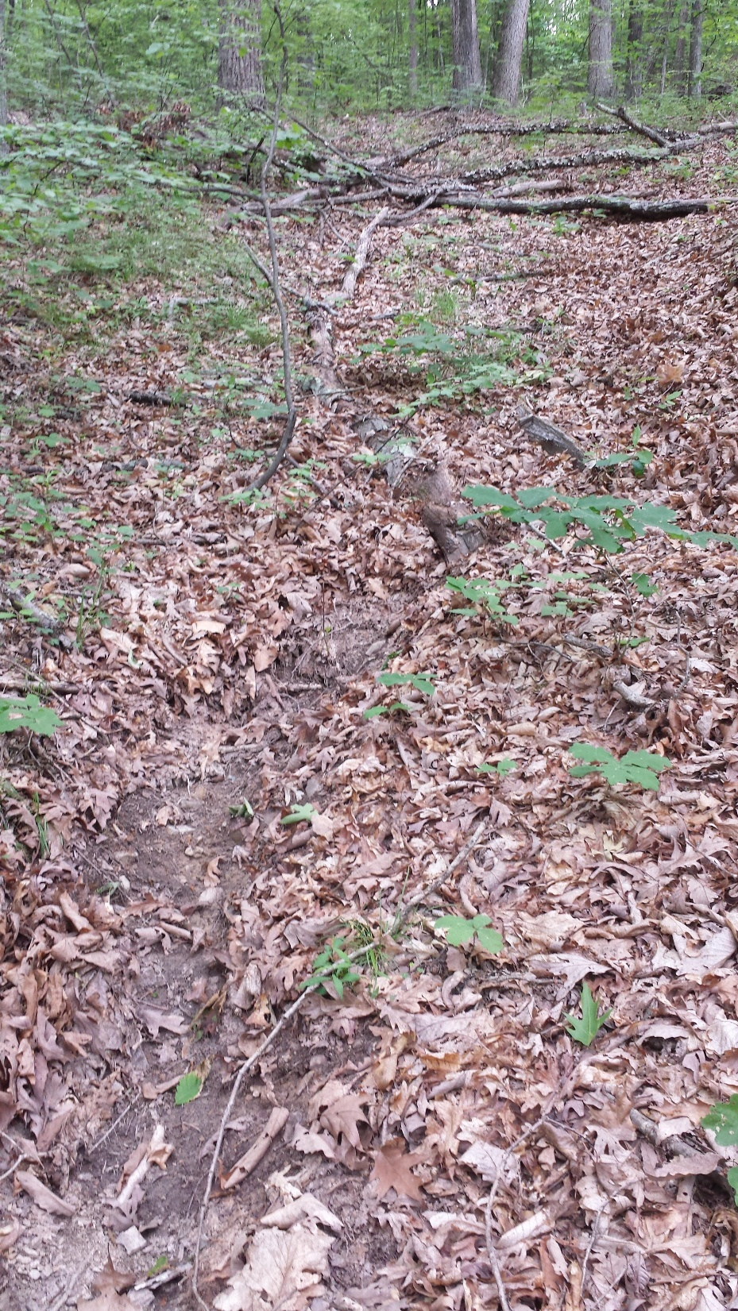
Field Data Collection
14 local landscapes throughout CBW
Stratified by physiographic province
CP, PD, AM, low-relief, glaciated, karst
Examples of local land use
Forest, Agriculture, Urban
Range of LiDAR Quality
Walked up stream networks, located and photographed stream heads
148 observations
Notes:
To start we needed a basis for understanding variation both in what it takes to generate a stream and how well various predictions did.
We wanted to incorporate variation in landscape physiography/geology/climate, major land uses, and to the extent practicable, their interaction.
At each local site, we walked up stream networks, locating and photographing channel heads and the initiation of flow.
The goal here was to obtain a limited sample from a broad range of locations. We did not expect to predict every different type of feature, but wanted a sense of the relative ability of each prediction method as well as a way to visually interpret/extrapolate signals in existing lidar data.

Slide 5


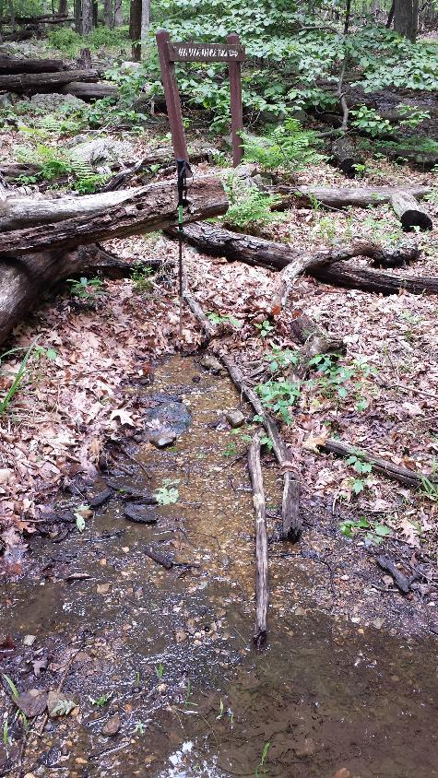
Notes:
Flow wash type, elevation break (traditional head), seep/spring.

Slide 6
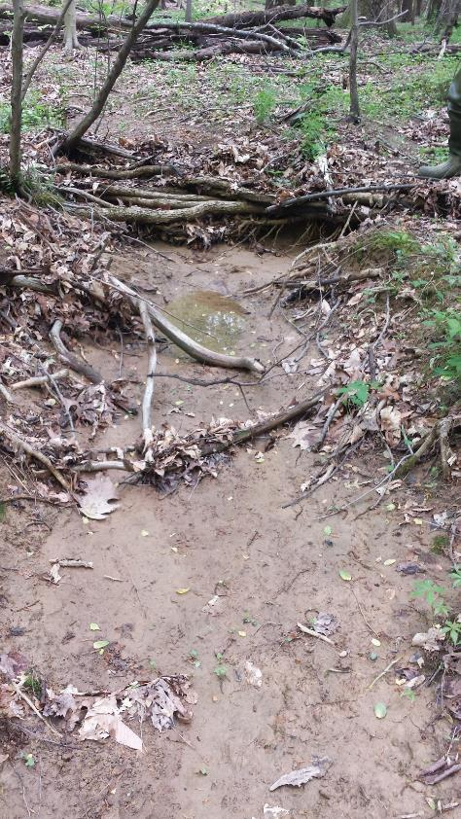
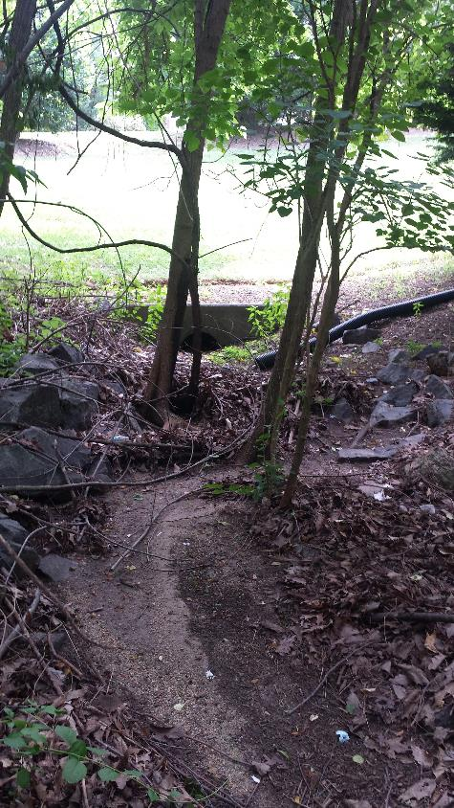
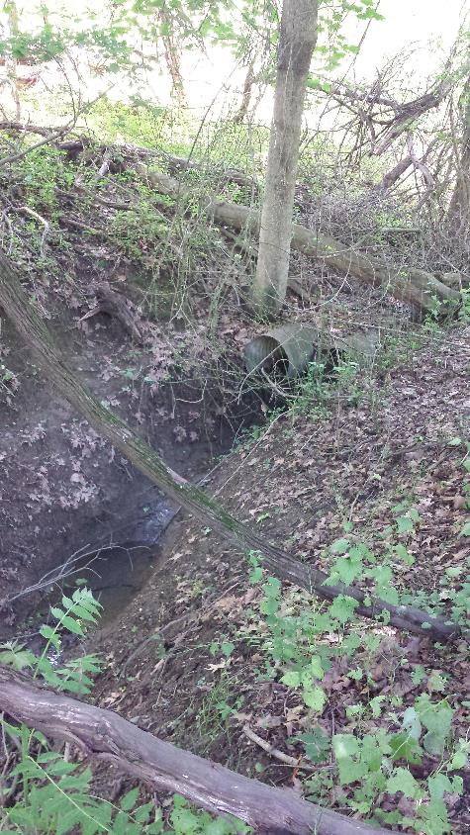
Notes:
Concentrated flow mixing surface wash and seepage; lawn wash augmented by piped runoff; storm sewer discharge

Slide 7
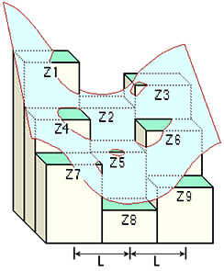
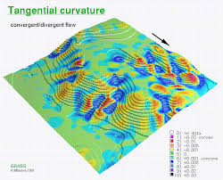
Previous Delineation Approaches: Process-based and Direct detection
Accumulation of upslope drainage (optionally modified by slope)
Band 1986; Montgomery & Dietrich 1988, 1992
Seek channel–like depressions
Peuker & Douglas 1975; Tarboton & Ames 2001
Terrain curvature (local)
Passalacqua et al. 2010; Pelletier 2013
Topographic Openness (variable)
Yokoyama et al. 2002; Molloy & Stepinski 2007; Sofia et al. 2011
Notes:
Modern detection uses a number of techniques.
Must contrast local estimate of curvature and self-adapting window.
Discuss strengths/weaknesses of process based and direct detection techniques.

Slide 8
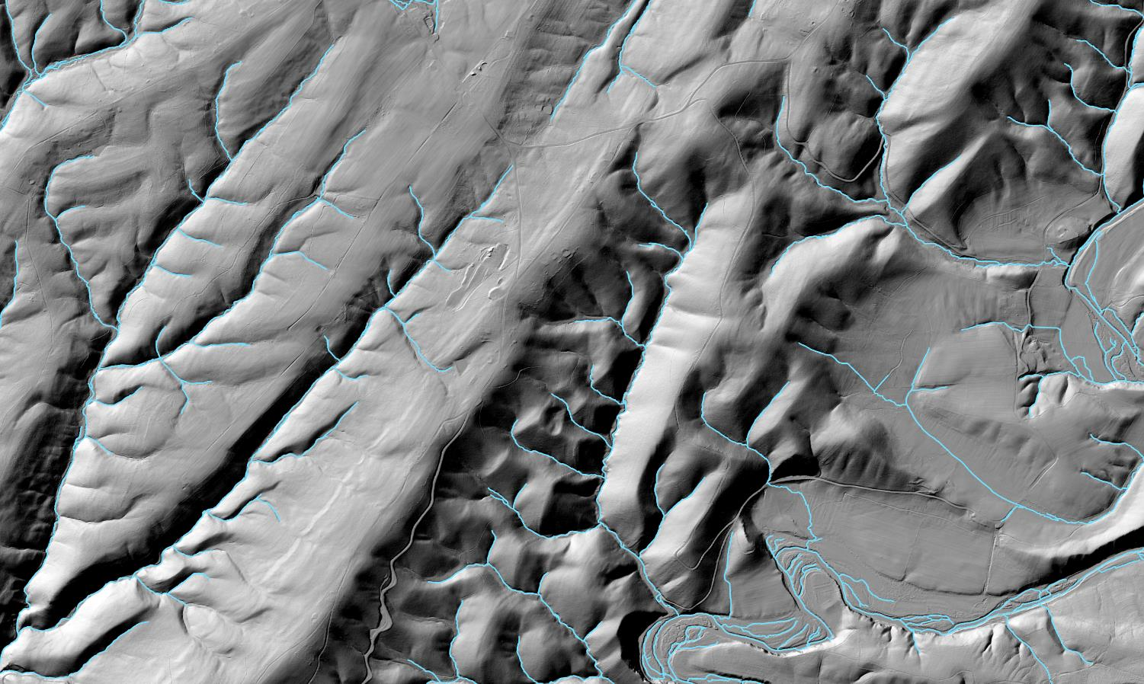
A Novel Development: Geomorphons Jasiewicz & Stepinski 2013
Tessellates and classifies entire landscape
Detects strongest signal within search radius
Key Insight: can manipulate search parameters for different objectives
Valleys delineated with 200 m search and 20 m skip; Channels 20 m search and 1 pixel skip.
Notes:
Can spread this out over multiple slides.
First need to describe what it is and what it does.
Then some key behaviors related to parameter selection, This needs its own figure
Then outputs and options.

Slide 9
Valleys and Channels: Context and Contiguity
Valleys delineated as process domains from 10m DEM within 200 m radius
Provides context for interpretation of channel-like features
Valley networks determined from valleys contiguous with 1:24K NHD; no need to verify existing delineations
Channel-like features delineated from hi-res DEM within 20 m radius
Valley network used to filter channel-like feature: contiguity
Notes:
Talk about the general strategy: flipping the idea of delineating coarse networks from fine scale aggregations– we delineate the coarse scale networks as a constraint on fine scale patterns.
Depressions more likely to be a channel when in a valley. Outside of a valley we can have channels, but they have a different formation process…a distinct process domain. Where does this get described?

Slide 10
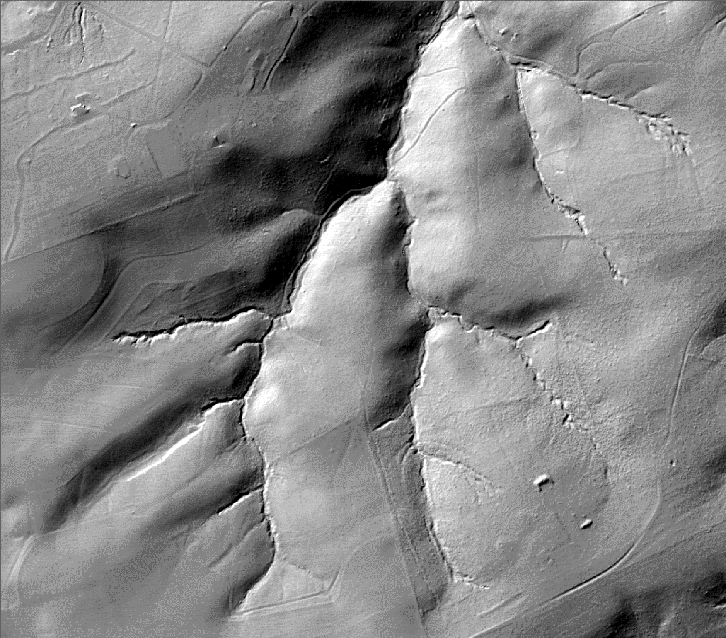
Valleys and Channels: Context and Contiguity
1. LiDAR elevation
2. Classify terrain - 10 meter
3. Delineate valley network
4. Classify terrain - 1 meter
5. Extract channels – contiguity with valley network
Notes:
Click through the five general steps to demonstrate workflow:
elevation,
10-m geomorphon classification,
valley networking,
1-m geomorphon classification,
and channel delination based on contiguity

Slide 11
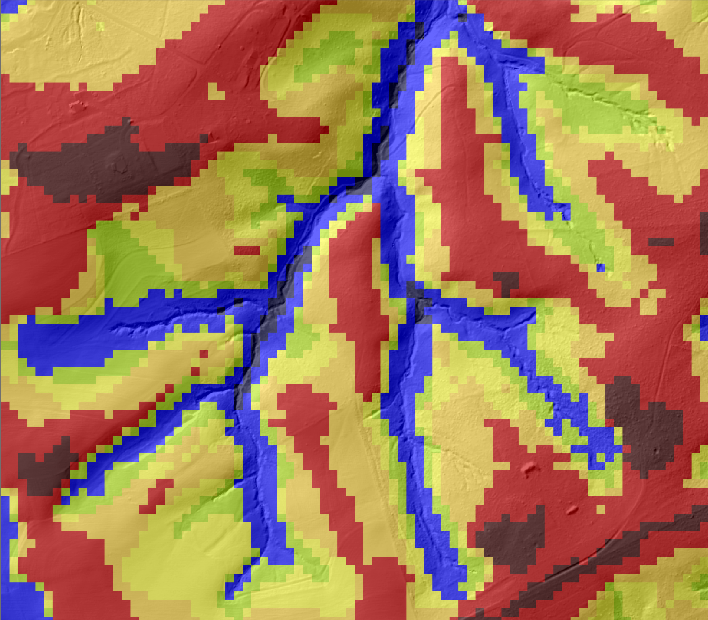
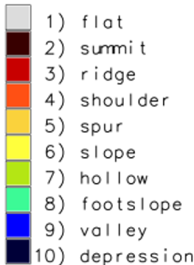
Valleys and Channels: Context and Contiguity
1. LiDAR elevation
2. Classify terrain - 10 meter
3. Delineate valley network
4. Classify terrain - 1 meter
5. Extract channels – contiguity with valley network
Notes:
Click through the five general steps to demonstrate workflow:
elevation,
10-m geomorphon classification,
valley networking,
1-m geomorphon classification,
and channel delination based on contiguity

Slide 12
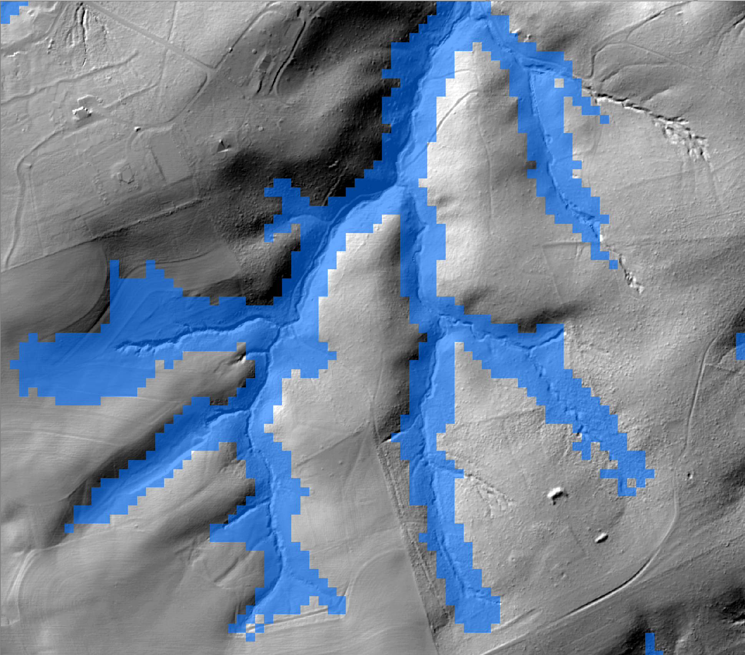
Valleys and Channels: Context and Contiguity
1. LiDAR elevation
2. Classify terrain - 10 meter
3. Delineate valley network
4. Classify terrain - 1 meter
5. Extract channels – contiguity with valley network
Notes:
Click through the five general steps to demonstrate workflow:
elevation,
10-m geomorphon classification,
valley networking,
1-m geomorphon classification,
and channel delination based on contiguity

Slide 13
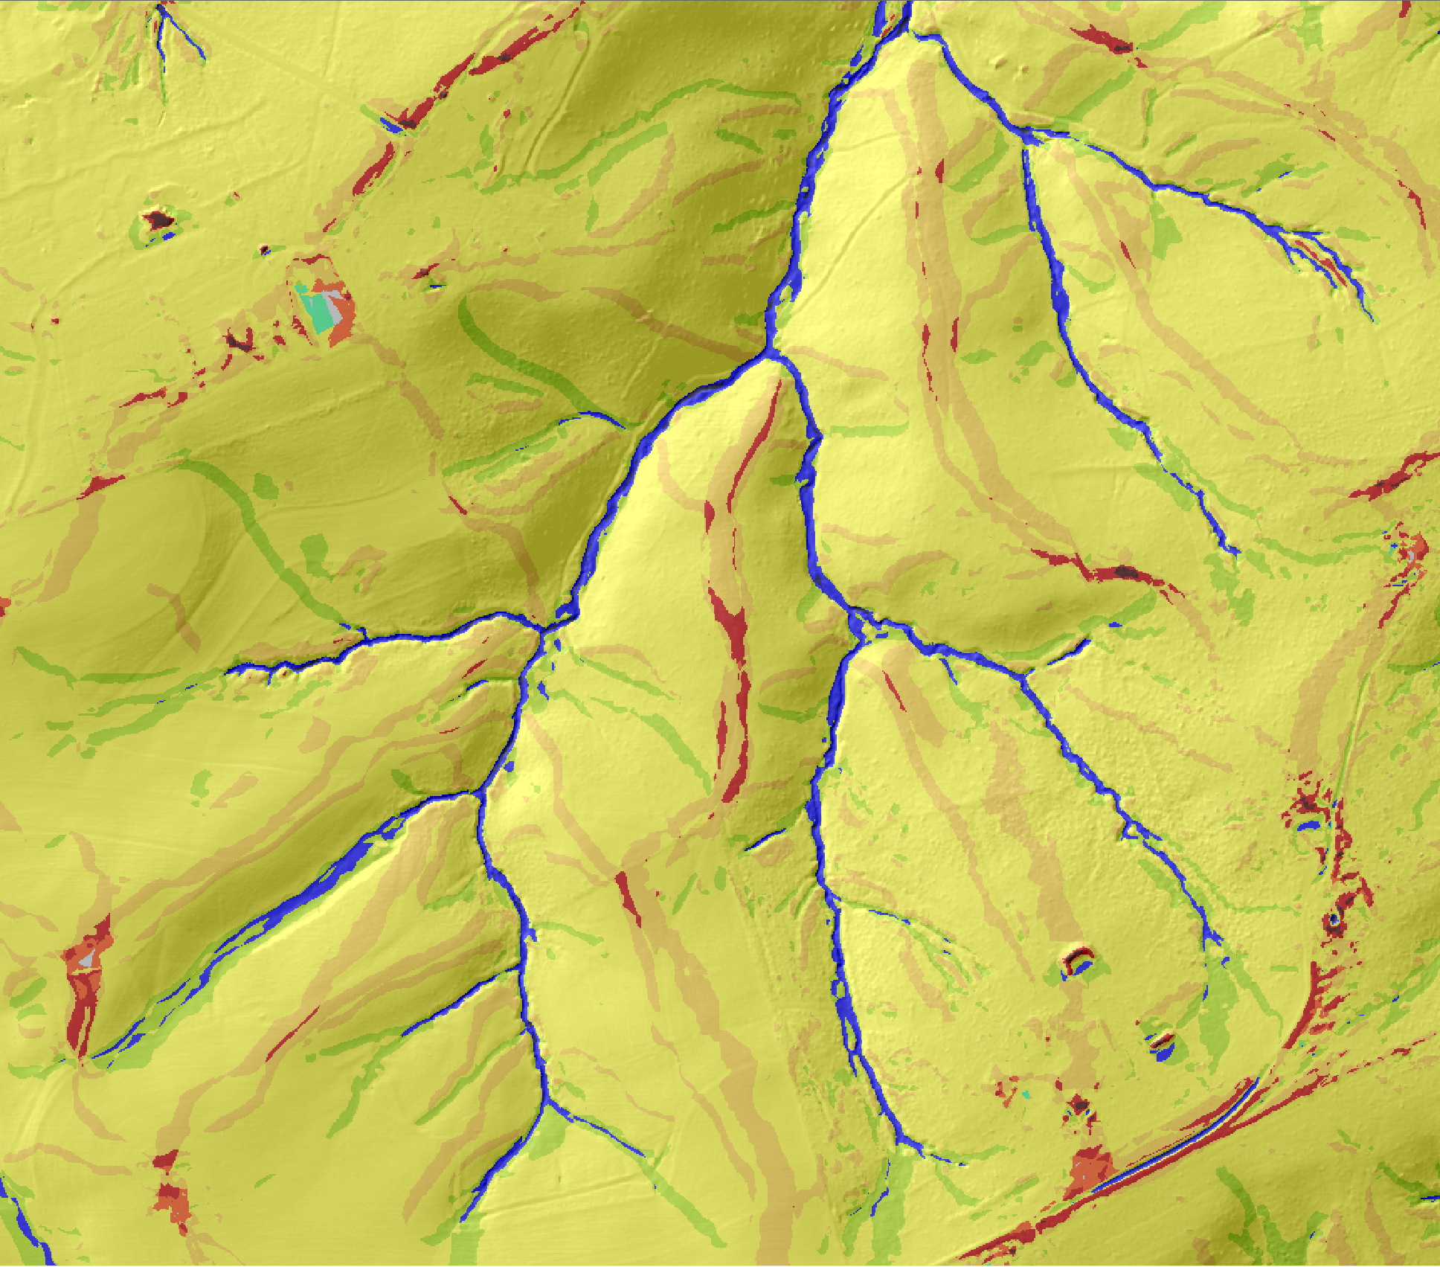
Valleys and Channels: Context and Contiguity
1. LiDAR elevation
2. Classify terrain - 10 meter
3. Delineate valley network
4. Classify terrain - 1 meter
5. Extract channels – contiguity with valley network
Notes:
Click through the five general steps to demonstrate workflow:
elevation,
10-m geomorphon classification,
valley networking,
1-m geomorphon classification,
and channel delination based on contiguity

Slide 14
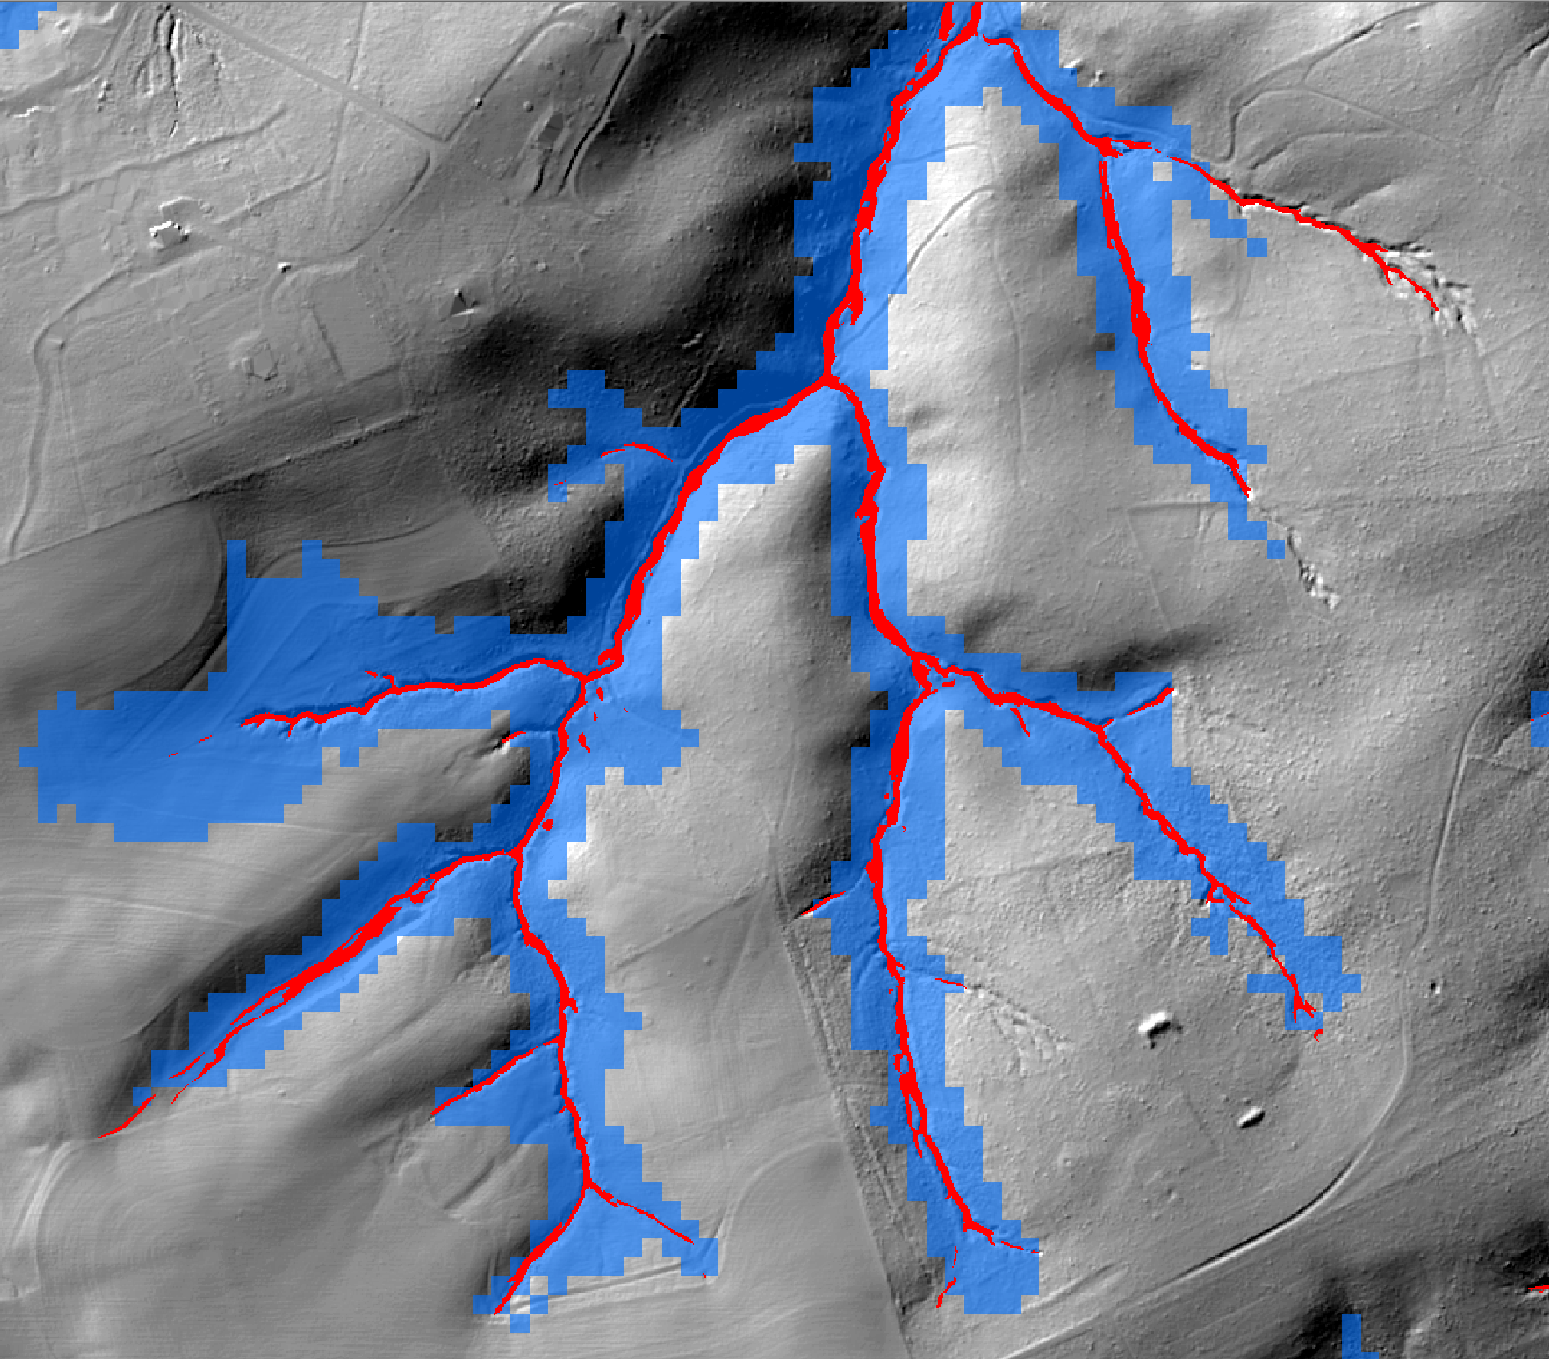
Valleys and Channels: Context and Contiguity
1. LiDAR elevation
2. Classify terrain - 10 meter
3. Delineate valley network
4. Classify terrain - 1 meter
5. Extract channels – contiguity with valley network
Notes:
Click through the five general steps to demonstrate workflow:
elevation,
10-m geomorphon classification,
valley networking,
1-m geomorphon classification,
and channel delination based on contiguity

Slide 15
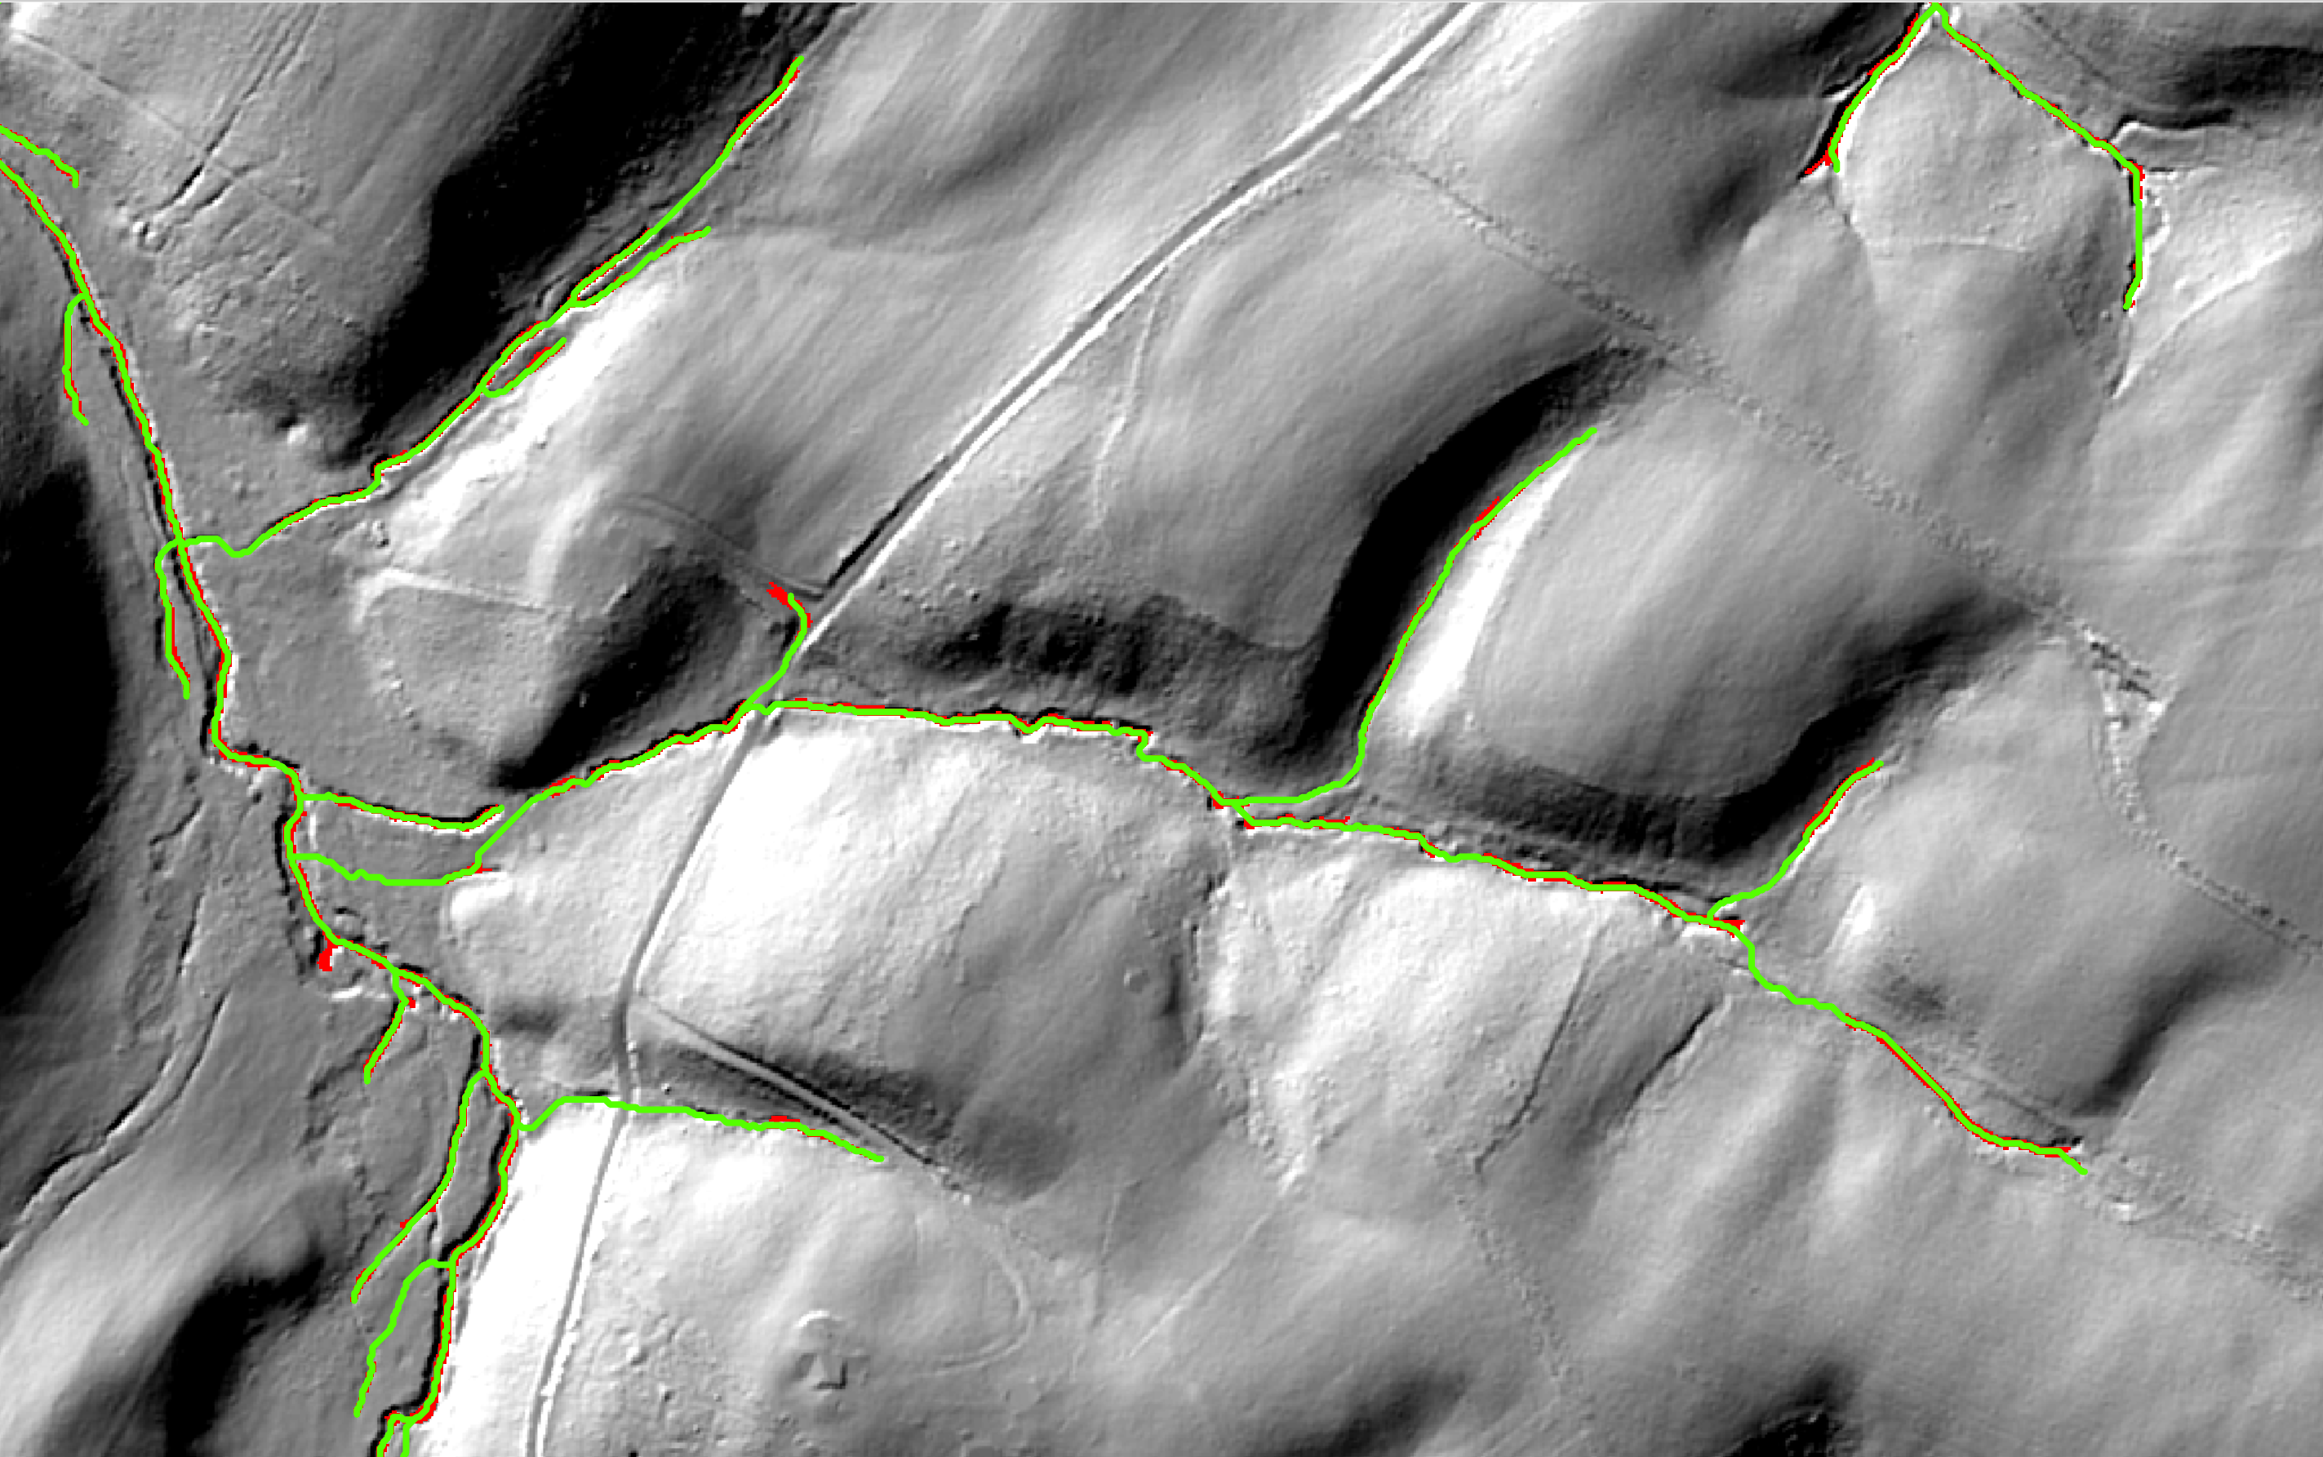
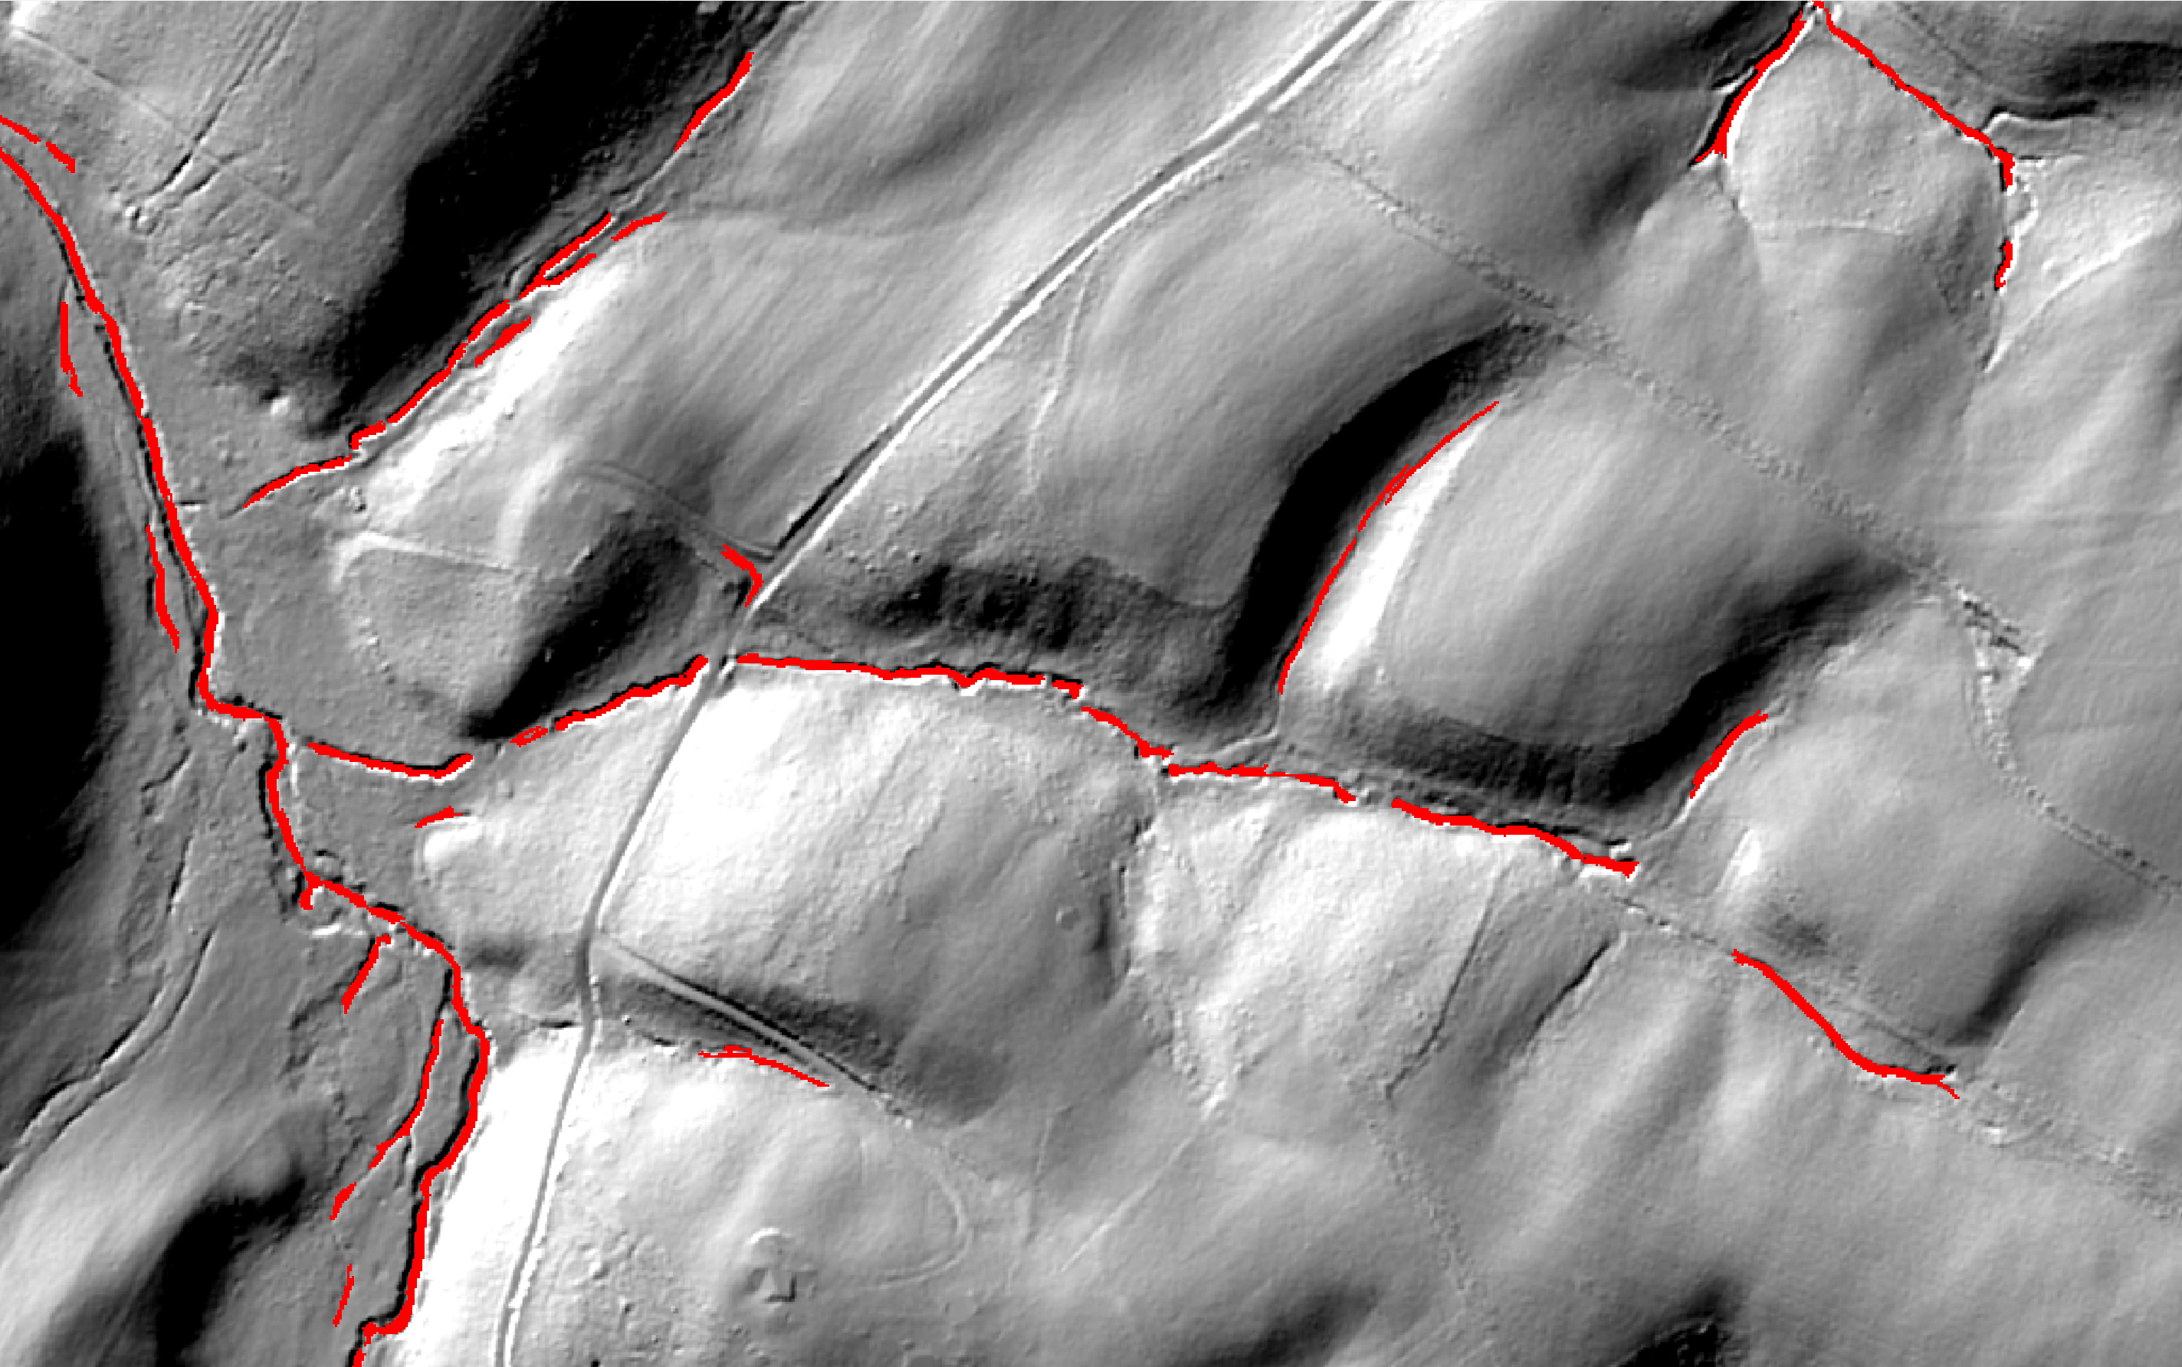
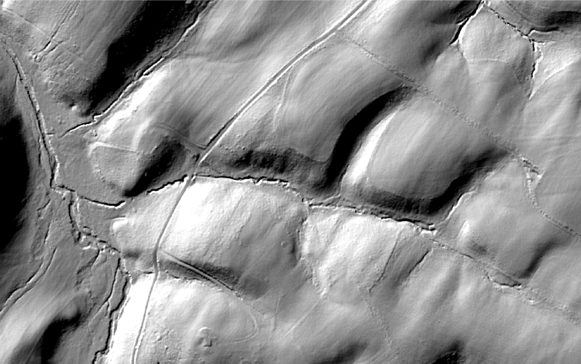
Data Products
Raster – channel skeleton
2-dimensional depiction of channels
Preserves width, discontinuities, etc.
Can incorporate with land cover
Vector – linear network
Discontinuities are connected along least cost paths
Reach-scale attribution: width, bank height, flow permanence, etc.
Notes:
Describe general data products/applications
Click through animation to show elevation → skeleton → least cost connectivity

Slide 16
Contact Info
David Saavedra:
dsaavedra@chesapeakeconservancy.org
443-321-3610

