Slide 1
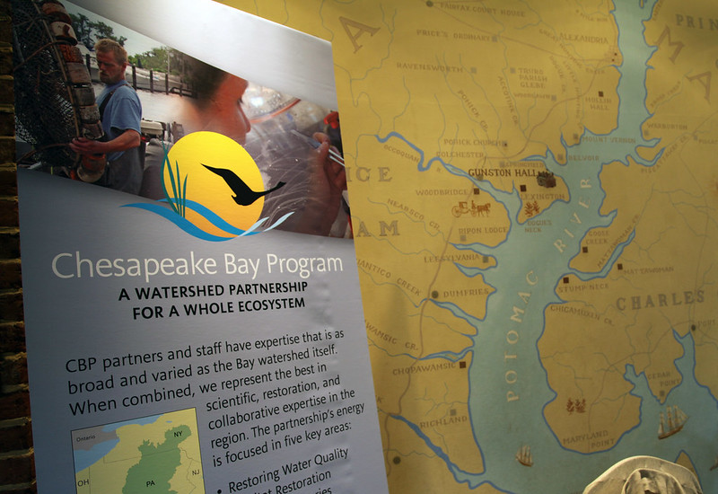
The Chesapeake Bay Program
Fostering Chesapeake Stewardship
Goal Implementation Team (GIT) 5

Slide 2
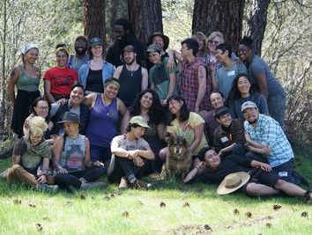
Stewardship (incl Diversity)
Climate Resiliency
Environmental Literacy
Water Quality
Land Conservation
Vital Habitats
Healthy Watersheds
Public Access
Sustainable Fisheries
Toxic Contaminants
18 million people in the watershed
= GIT 5 Fostering Chesapeake Stewardship

Slide 3
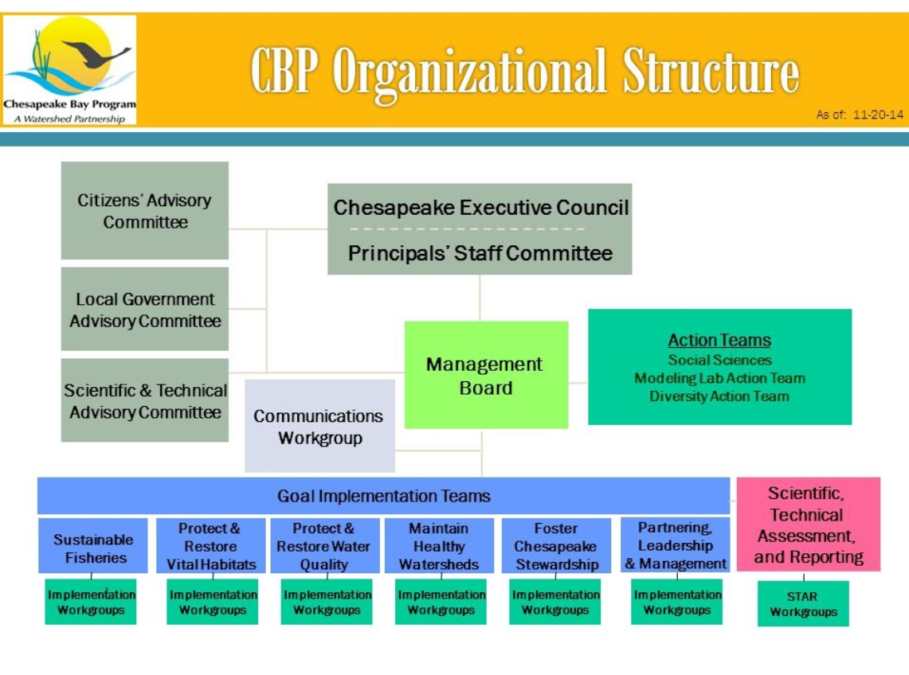
Federal Office
Directors

Slide 4
CBP GIT Implementation Workgroup Structure 10/1/2020
Goal Implementation Teams
Other Workgroups
Sustainable
Fisheries
Protect & Restore
Vital Habitats
Protect &
Restore Water
Quality
Maintain
Healthy
Watersheds
Foster
Chesapeake
Stewardship
Enhance
Partnering,
Leadership
& Management
Communications
Workgroup
1
2
3
4
5
6
No sub groups
Ches. Bay
Stock Assessment Committee
Fish Passage Workgroup
Agriculture Workgroup
No sub groups
Education Workgroup
Local Leadership Workgroup
Forestry Workgroup
Public Access Planning Action Team
Budget and Finance Workgroup
Scientific
Technical,
Assessment and
Reporting
Stream Health Workgroup
Maryland and Virginia Interagency Oyster Teams
Land Use Workgroup
Submerged Aquatic Vegetation Workgroup
Chesapeake Conservation Partnership/ Protected Lands
Urban Stormwater Workgroup
Integrated Monitoring Networks Workgroup
Invasive Catfish Workgroup
Wastewater Treatment Workgroup
Wetland Workgroup
Citizen Stewardship Workgroup
Status and Trends
Workgroup
Fish Habitat Action Team
Brook Trout Action Team
Watershed Technical Workgroup
Diversity Workgroup
Data Integrity Workgroup
Forage Fish Action Team
Black Duck Action Team
Milestone Workgroup
Integrated Trends Analysis Team
Trading and Offsets Workgroup
Modeling Workgroup
BMP Verification Committee
Climate Resiliency Workgroup
Toxic Contaminants Workgroup
Criteria Assessment Protocol Workgroup
Federal Facilities Workgroup

Slide 5
This is us!
Stewardship Work Group
Stewardship Goal: Increase the number and diversity of stewards [community members] and local governments that actively support and carry out conservation and restoration…
Public Access Goal: Expand public access to the Bay and its tributaries ...
Environmental Literacy Goal: Enable students in the region to graduate with the knowledge and skills to act responsibly to protect and restore their local watershed.
Land Conservation Goal: Conserve treasured landscapes ... Protected Lands Outcome: By 2025, protect an additional two million acres of lands throughout the watershed…
1 GIT * 4 Goals * 7 Outcomes * 5 Workgroups
Notes:
Stewardship Goal: Increase the number and the diversity of stewards [residents / community members] and local governments that actively support and carry out the conservation and restoration activities that achieve healthy local streams, rivers and a vibrant Chesapeake Bay.
Public Access Goal: Expand public access to the Bay and its tributaries through existing and new local, state and federal parks, refuges, reserves, trails and partner sites.
Environmental Literacy Goal: Enable students in the region to graduate with the knowledge and skills to act responsibly to protect and restore their local watershed.
Land Conservation Goal: Conserve treasured landscapes in order to maintain water quality and habitat; sustain working forests, farms and maritime communities; and conserve lands of cultural, indigenous and community value. Protected Lands Outcome: By 2025, protect an additional two million acres of lands throughout the watershed…

Slide 6
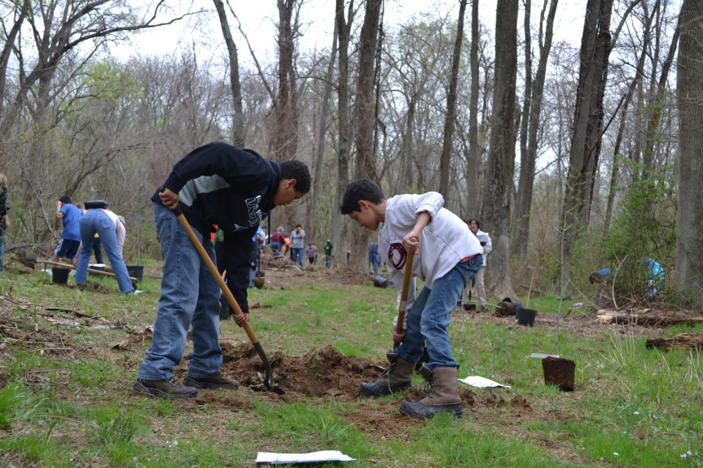
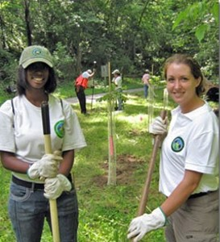
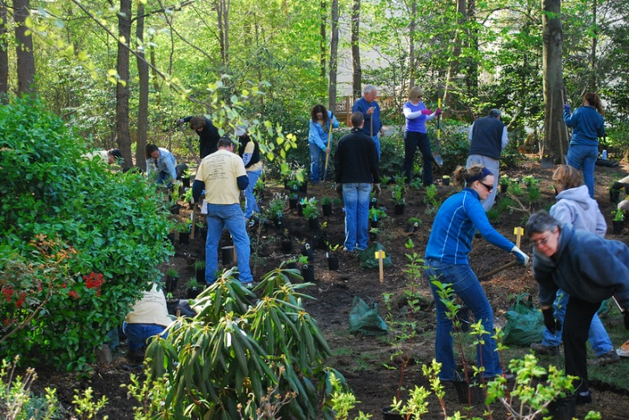
Stewardship
Workgroup
Stewardship Goal:
Stewardship Outcome: Increase the number and diversity of trained and mobilized citizen volunteers with the knowledge and skills needed to enhance the health of their local watersheds.
Diversity Outcome: Identify stakeholder groups not currently represented in the leadership, decision-making or implementation of conservation and restoration… and create meaningful opportunities and programs to recruit and engage these groups ...
Local Leadership Outcome (under GIT6): Continually increase the knowledge and capacity of local officials on issues related to water resources and in the implementation of economic and policy incentives that will support local conservation actions

Slide 7
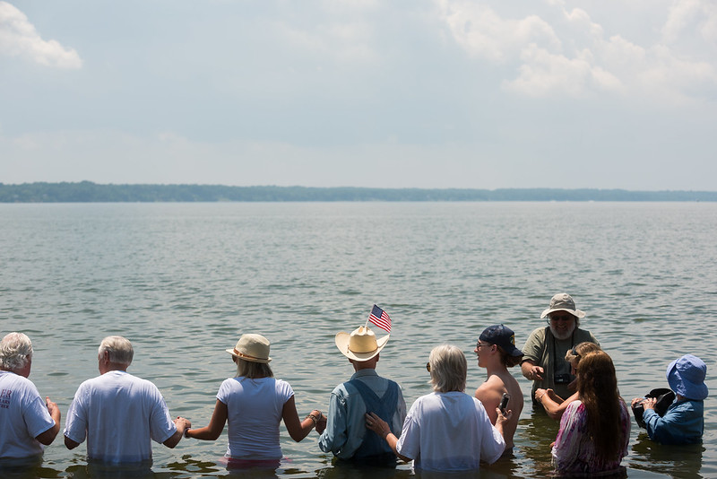
Stewardship
Workgroup
Stewardship OUTCOME – Management Approaches:
Establish mechanisms to measure impact and track progress of stewardship programs;
Provide assistance to help develop and implement effective programs for maximum impact on stewardship;
Increase capacity to expand the number and diversity of community volunteers and community leaders;
Recruit, train, and support more community leaders and local champions (Expand number and diversity of community leaders and local champions).
And collaborate with the work being done to achieve the other outcomes.
Notes:
MA1: Establish mechanisms to measure impact and track progress of stewardship programs;
MA2: Provide assistance to help develop and implement [highly effective] programs for maximum impact on stewardship;
MA 3 and 4: Increase capacity to expand the number and diversity of community volunteers and community leaders;
MA 5: Recruit, train, and support more community leaders and local champions (Expand the number and diversity of community leaders and local champions).
Partners will also collaborate with the work being done to achieve the other outcomes.
Monitoring and assessing progress toward the outcome will occur through the stewardship index, which includes a measure of individual behavior change. The 2017 survey results serves as a baseline from which progress will be measured in subsequent surveys every 3-5 years [next one 2022].

Slide 8
enjoyment * education * engagement * opportunities * access

