Slide 1

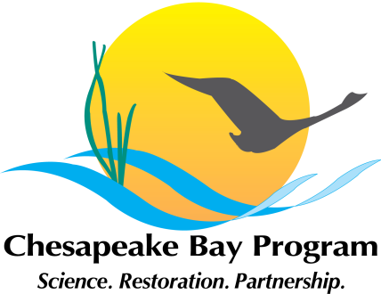

Update on the Oyster BMP Expert Panel’s Draft Recommendations for the Second Incremental Report
CAC meeting
February 23, 2018
Emily French, Oyster Recovery Partnership
Julie Reichert-Nguyen, Oyster BMP Expert Panel Coordinator
Jeff Cornwell, Panel Chair

Slide 2
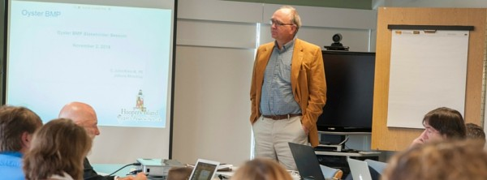
Oyster BMP Expert Panel Charge
Panel convened September 2015
Charge
  Establish a decision framework to determine the nutrient and suspended sediment reduction effectiveness of oyster BMPs
  Use the framework to evaluate oyster practices with available science
    Created a framework
    Evaluated oyster practices using it; approved private oyster aquaculture BMPs for oyster tissue
    First shellfish BMPs available for use to help meet water quality standards in Chesapeake Bay
Notes:
Framework is important because these are the first shellfish BMPs being evaluated for use in meeting water quality goals in Chesapeake Bay. Framework was approved in the first report. The Panel is continuing to use the framework to evaluate the practice-protocol combinations that were identified that could reduce N, P, and suspended sediments.

Slide 3
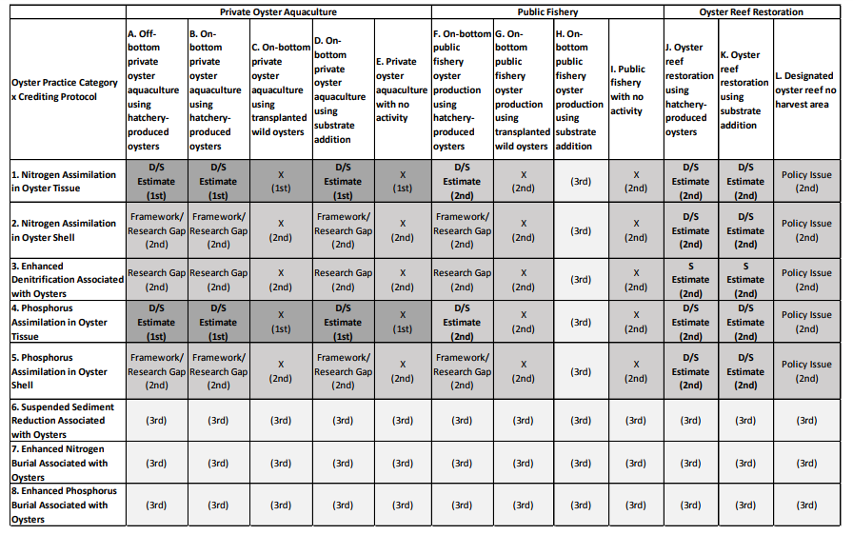

Slide 4
Report 1

Slide 5
Report 2

Slide 6
Report 2
Structure:
Complete Recommendations
Framework Only Recommendations
Informational Recommendations

Slide 7
Report 2
Complete Recommendations
Nitrogen and phosphorus assimilation in oyster tissue and shell for restoration practices
Nitrogen removal via enhanced denitrification as a result of oyster presence for restoration practices
Nitrogen and phosphorus assimilation in oyster tissue for hatchery produced oyster additions in public fishery

Slide 8

N and P Assimilation in Oyster Shell- Notes for Multiple Practice/ Protocol Combinations
1. Can shell weight be reliably determined from shell length measurements?
Yes Can use same approach as tissue for default values
2. Can N and P content in shell be quantified?
Yes
3. Is assimilation in shell that stays in water legal within the Clean Water Act?
Yes
4. Dissolution Approach: Can a reasonable estimate of dissolution losses be obtained from the literature?
No, not feasible at this time due to research gap
5. Is there a way to track shell from harvested oysters? Their fate may be to be deposited back into the Bay
No, not feasible at this time due to research gap
Result: For oyster restoration where shells stay in water, only standing stock receives credit for assimilation
Result: It is not possible to credit shell from harvested oysters at this time
Notes:
Emily note: This is the strategy the panel is recommending to address the concern with disincentivizing putting shell back into the Bay. Walk through- at this time, the panel decided that they can’t determine how much reduction of N and P is associated with shell until more research is done to understand dissolution. Once those research gaps are filled, steps 5 and 6 can be assessed. This all hinges on whether the legal team determines whether sequestration, which is a temporary removal, is legal for in-water BMPs.
Stakeholder concern was that crediting would disincentivize shell recycling. To address concern, Panel built into the reduction effectiveness determination framework that 100% of the shell removed will be returned to the Bay. Therefore the reduction effectiveness will include a deduction based on shell dissolution.
Point out research and policy gap. The Panel believes a reduction could be associated with this protocol for oyster aquaculture, but research and policy gaps would have to be sorted out.

Slide 9
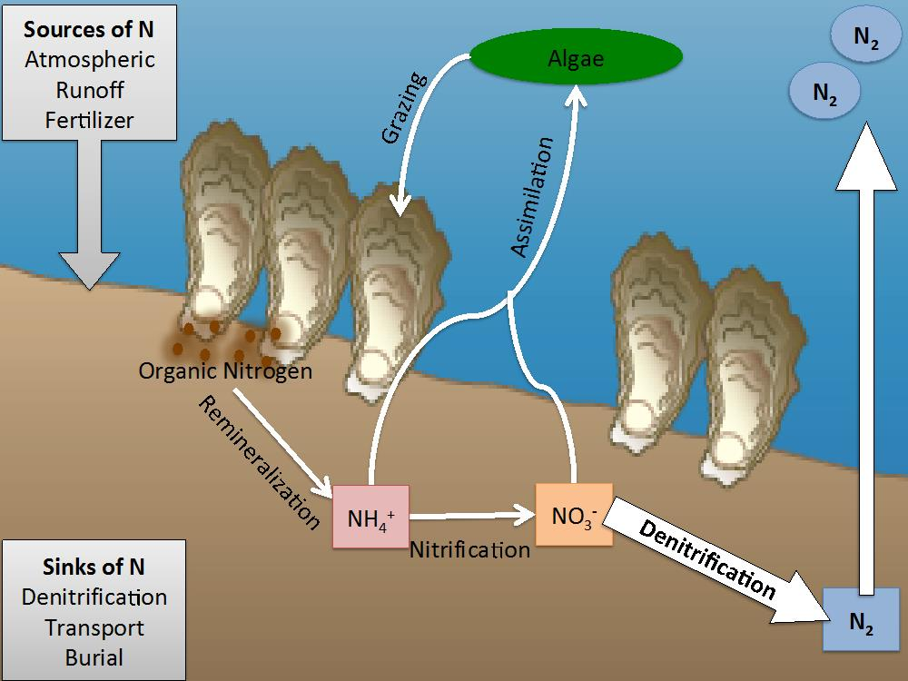
Enhanced Denitrification Associated with Oysters – Concept
Algae contains nitrogen, which can become bioavailable though remineralization.
Oysters filter algae from the water column, decreasing the potential for remineralization and transferring the process to the sediments via biodeposits.
Through this process, denitrification can be enhanced (N₂ gas is released).
Enhanced denitrification is defined as the amount of new denitrification that can occur because of the presence of oysters.
Image Credit: Ashely Smyth, jappliedecologyblog.wordpress.com/2015/05/20/location-matters-for-oyster-reef-ecosystem-services/
Notes:
Emily note: Now I’m going to talk about the panel’s recommendations for enhanced DNF associated with oysters, but before jumping into the details I’ll go over concepts the panel is considering.
Point out that oysters don’t do the denitrifying, but moves the N and P from the water column by filtering and biodepositing the organic N and P to the bottom where denitrifying organisms are. Also, recent studies have shown that the oyster reef itself provides habitat for denitrifying organisms.

Slide 10
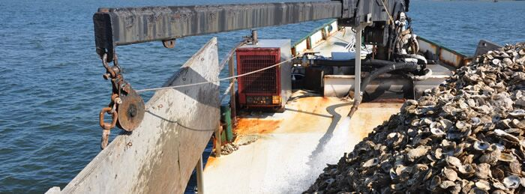
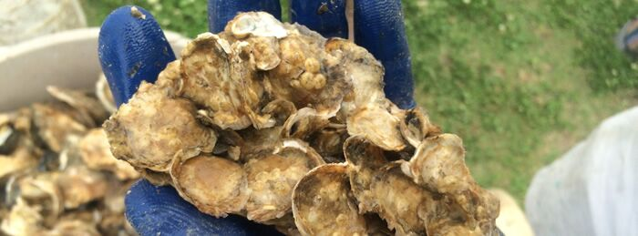
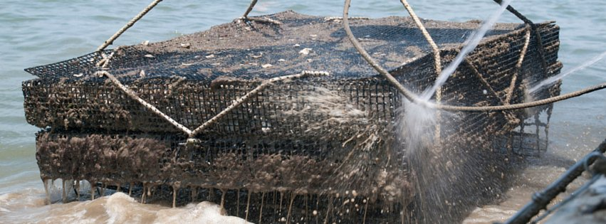
How to Keep Informed of Panel Efforts
ORP webpage summarizing Panel effort
oysterrecovery.org/water-quality-improvement
First report available at
oysterrecovery.org/oyster-bmp-first-report/
Contact Information: jreichert@oysterrecovery.org
QUESTIONS?

Slide 11
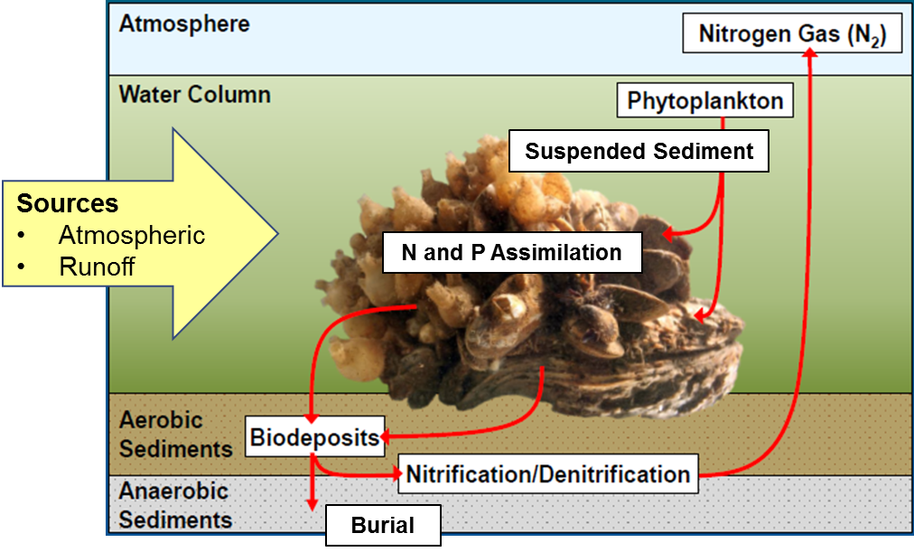
Reduction Effectiveness Protocols based on Oyster-Associated Nutrient/Suspended Sediment Reduction Processes
Oyster-Associated Reduction Processes
Reduction Effectiveness Protocols
1. Nitrogen Assimilation in Oyster Tissue
2. Nitrogen Assimilation in Oyster Shell
3. Enhanced Denitrification Associated with Oysters
4. Phosphorus Assimilation in Oyster Tissue
5. Phosphorus Assimilation in Oyster Shell
6. Sediment Reduction Associated with Oysters
7. Enhanced Nitrogen Burial Associated with Oysters
8. Enhanced Phosphorus Burial Associated with Oysters
Notes:
Emily Note: First I’ll be talking about the panel’s evaluation of N and P assim in shell for private oyster aquaculture practices, and then their evaluation of enhanced DNF associated with both oyster aquaculture and oyster reef restoration.
Protocols based on oyster-associated processes that can reduce N, P, and suspended sediment.

Slide 12
Method to Determine Conservative Default Values for the Amount of Nitrogen and Phosphorus Stored in Oyster Shell
Step 1: Determine the oyster shell height to shell dry weight relationship using quantile regression.
    Shell dry weight needed to determine the amount of N and P stored in shell.
    Quantile regression uses the median of the data—less influenced by extremes (good statistical approach to use with highly variable data).
    Allows for consideration of various oyster growth influencing factors: ploidy, culture method and type, location/environment, and season.
Step 2: Oyster size class ranges from first report are used to calculate the oyster shell dry weight with regression equations from Step 1.
Step 3: The amount of N and P sequestered for the different size classes is determined by multiplying the shell weights from Step 2 by percent nitrogen and phosphorus content in oyster shell.
Notes:
Emily note: Read title, oyster shell height is a common measurement used in these practices, but shell dry weight is needed to determine the N and P content of shell. So… read step 1.
Panel opted to use an empirical approach to determine the reduction effectiveness related to N and P assimilation in oyster tissue. Shell height is a common measurement in aquaculture, but to determine the amount of N and P assimilated need to know the dry weight (% N and P content in tissue is based on dry weight).

Slide 13
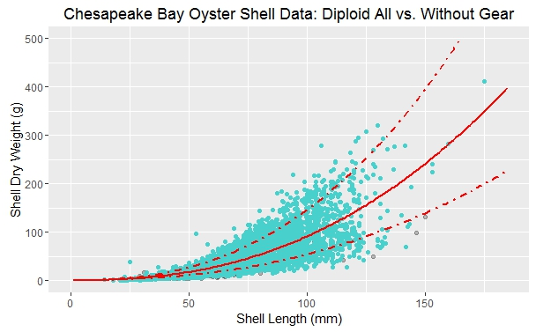
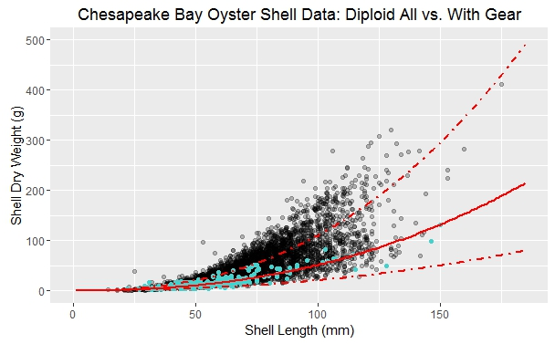
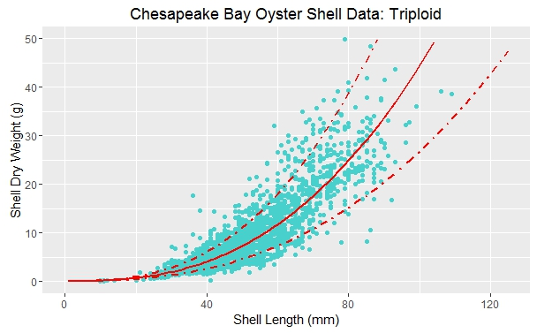
Method to Determine Amount of N and P Stored in Shell
Diploids Grown Without Gear
Diploids Grown in Gear
0.5 Quantile of Data Subset
n = 503 oysters
Error
All data
Data subset
n = 4,296 oysters
Shell Height (mm)
Shell Height (mm)
Triploids Grown in Gear
Panel conclusions so far:
Agreed that there is sufficient data to reliably determine shell weights from shell height data.
Agreed that ploidy (diploid and triploid) and culture methods (with and without gear) should have separate regression equations.
Season and location effects currently being evaluated
Literature review showed that average N content in shell = 0.20% and P = 0.04%
n = 2,332 oysters (in gear)
n = 0 oysters (without gear)
Shell Height (mm)
Notes:
Emily note: These are examples of quantile regressions that use all the available relevant shell data. The data fit into 3 categories according to ploidy and culture methods, which influenced the relationship between shell height and shell weight.. Shell height- x, shell weight- y. Based on these analyses, the panel decided there is sufficient data to reliably determine shell weights from shell height data. Literature review showed that average N content in shell = 0.20% and P = 0.04%
(with gear produces thinner, lighter shells; using all data would overestimate reduction for off-bottom aquaculture practices).

Slide 14
Evaluation of Shell Dissolution Literature
  Five studies evaluated loss of carbonate shell structure but not the loss of N and P, and some studies did not differentiate between shell loss from dissolution and shell loss from burial.
  One study (Waldbusser et al. 2011) measured carbonate dissolution rates directly, but may not adequately account for what is happening in the field because it was a laboratory study over a short period of time.
  With existing science, the Panel is not confident in assigning a default reduction to account for N and P that may dissolve back into the water when shells are returned to the Bay.
Notes:
Mention how the Panel evaluated dissolution to address concern of shell not being returned to the bay. Assumption all removed shell is returned to the Bay. Deduct from the credit a value based on how long N an P would be sequestered in the shell.

Slide 15
Conclusions So Far: N and P Assimilated in Oyster Shell Protocol for Private Oyster Aquaculture
There is a potential reduction associated with the amount of N and P sequestered in harvested shell, but the reduction effectiveness can’t be determined at this time due to lack of information on dissolution rates for shells returned to the Bay.
Panel recommends separate shell height to shell weight regression equations for diploid with gear and diploid without gear.
Panel recommends a separate triploid regression equation using available triploid with gear data.
Literature review showed that average N content in shell = 0.20% and P = 0.04%

Slide 16
Enhanced Denitrification Associated with Oysters –
Data Availability and Challenges
Direct measurement of net flux of N₂-N per unit area is needed
  Denitrification would be measured at an area with oysters and a control site without oysters to calculate the nitrogen reduction potential from enhanced denitrification at the site level.
In the Chesapeake Bay, we have more data on denitrification associated with oyster restoration and aquaculture than any other region.
  There are still a relatively few studies.
  Given variability in data, site-specific estimates are recommended at this time until adequate data become available to determine a default rate.
Determining the total nitrogen reduction potential from enhanced denitrification requires knowing the fate of biodeposits.
  Biodeposits could be denitrified elsewhere (few data exist for this parameter—research gap); measured denitrification likely underestimates the reduction.

Slide 17
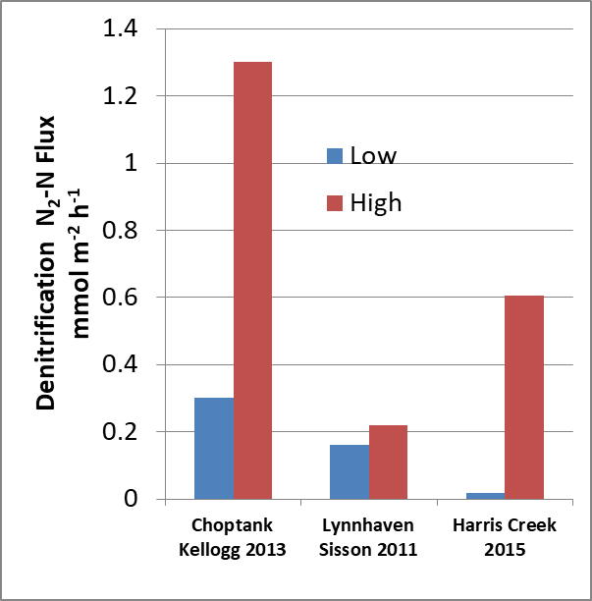
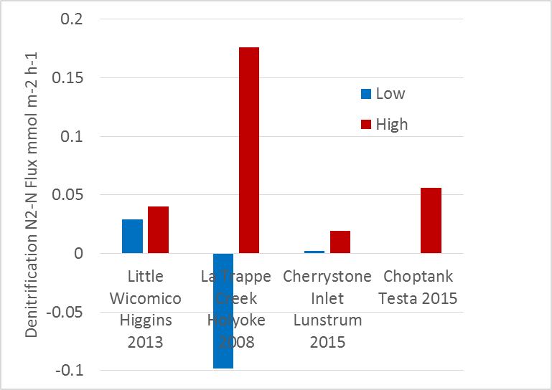
Denitrification Literature Review – High Variability
Chesapeake Bay, Restoration-Related
Chesapeake Bay, Aquaculture-Related
Conclusion: Minimum data and high variability supports the need for site-specific estimates at this time.
Low = minimum rate observed
High = maximum rate observed
Notes:
Point out the high variability in denitrification rates across studies – rationale for site-specific estimates.
Emily: these are the data available in the Bay now, doesn’t make sense to do a default estimate because of high variability, would need more data over seasons at different sites.

Slide 18
Enhanced Denitrification Associated with Oysters –
Reduction Effectiveness Determination Strategy
Simple Approach
(likely under-estimates reduction)
Simple: Apply the method that would capture the minimum enhanced denitrification rates based on literature methods (oyster site minus control site DNF rates).
Complex: Apply method that would also take into consideration the fate of biodeposits (method does not exist; research gap).
Complex Approach
(likely more representative of the actual reduction)
Notes:
Point out that site-specific estimates would allow the application on the simple approach now (likely underestimates the reduction effectiveness). The complex approach that includes the consideration of biodeposits fate could happen after research gaps are filled (this likely would be most representative of the reduction effectiveness).
Emily note: simple approach (already in literature) underestimates reduction happening.

Slide 19
Enhanced Denitrification Associated with Oysters –
Measurements Needed for Simple Approach
Oyster site and nearby control site (suitable for oyster growth/restoration and outside the area of expected oyster practice impact).
Different seasons to capture seasonal variability.
A minimum number of replicates at oyster and control sites during each season to understand variability.
All measurements should include dark incubation; if area gets sufficient light for photosynthesis, then light incubations should also be done or daylight hours should not be counted.
Measurement to define “oyster presence” (e.g., oyster biomass).
Notes:
Emily note: the panel is currently working out the details of each of these measurements that are needed

Slide 20
Conclusions So Far: Enhanced Denitrification Associated with Oysters
At present, site-specific estimates of enhanced denitrification are needed because few studies have directly measured net flux of N₂-N per unit area and resulting data are highly variable.
If future studies identify significant relationships between oyster site characteristics and denitrification rates, default enhanced denitrification estimates could be developed.
Accurately estimating total denitrification enhancement requires knowing the fate of all biodeposits produced, an assessment that is beyond the scope of current measurement techniques. However, the Panel believes comparison of oyster sites to control sites likely underestimates total enhancement, making this a conservative approach.
  Panel currently working on strategies to incorporate data variance to ensure estimates are conservative.

Slide 21
Panel Next Steps
December 2017—Tentative timeframe to resolve sequestration legal question for in-water BMPs
  BMP consideration for shell assimilation and burial protocols would depend on these conclusions.
January/February 2018—Tentative release of Panel’s 2nd incremental draft report for 30-day review
  Opportunity for the Chesapeake Bay Program Partnership and public/stakeholders to provide comments on the Panel’s recommendations.

