Slide 1
Exploratory Land Use Change Assessment
Allie Wagner, CRC
Forestry Workgroup
April 3, 2019

Slide 2
Land Use Methods and Metrics Outcome: Action 1.2
Assess land use change throughout the Bay Watershed and Bay States from the early 1980's through mid-2010's using the CBP 2013 high-res land use coupled with the Land Change Monitoring, Assessment, and Projection Database, National Land Cover Database, NRCS National Resources Inventory, and the USFS's Forest Inventory and Assessment data.
Responsible party: USGS, CRC Staffers
Expected timeline: Summer 2019

Slide 3
Initial Methodology
Analyze the USGS National Land Cover Dataset (2001, 2006, 2011) + 2016 when released in May
Include complete Mid-Atlantic states (DC, DE, MD, NJ, NY, PA, VA, WV)
Simplify classification: reclass data from 16 to 10 classes
Stack all data together and identify “top 10” land use changes per state (i.e., changes encompassing the most area)
Use Google Earth’s historical imagery to help identify change classes
Notes:
Used an excel function (=AND) in excel to see change/no change
Sorted by state, change, and count to get the t

Slide 4
Percent Change Represented
DE | DC | MD | NY | PA | VA | WV
65% | 86% | 45% | 49% | 56% | 80% | 72%
Percentage of changed acres represented by the top 10 changed acres.

Slide 5
Highest Change by Acres
DE | DC | MD | NY | PA | VA | WV
Farmland Conversion | Intensification | Silviculture | Silviculture | Silviculture | Silviculture | Silviculture
51% | 96% | 43% | 53% | 66% | 87% | 58%
 |  | H = 79% S = 21% | H = 78% S = 22% | H = 76% S = 24% | H = 75% S = 25% | H = 88% S = 12%
Harvest = H
Succession = S
Percentages represent the percentage of Top 10 changed acres.

Slide 6
Second Highest Change by Acres
DE | DC | MD | NY | PA | VA | WV
Silviculture | Forest Conversion | Farmland Conversion | Forest Conversion | Farmland Conversion | Afforestation | Mining
38% | 4% | 24% | 21% | 18% | 4% | 32%
H = 76% S = 24%
Harvest = H
Succession = S
Percentages represent the percentage of Top 10 changed acres.

Slide 7
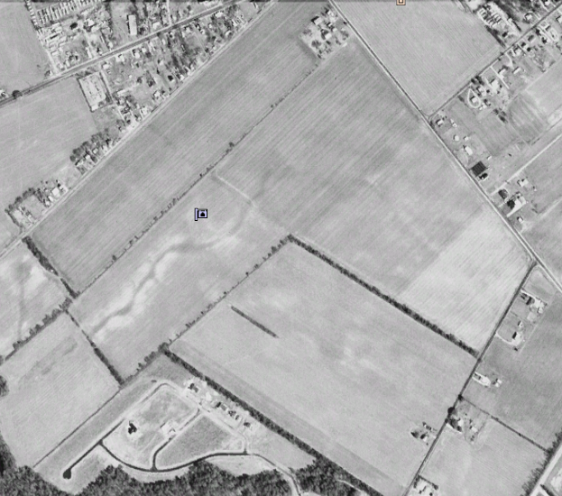
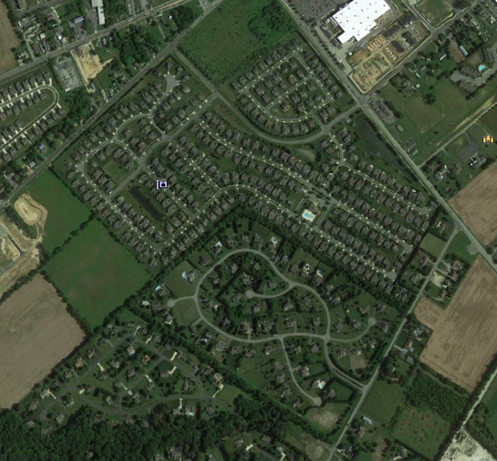
Farmland Conversion in DE
1992 2018
Notes:
Near Lewes Beach, DE

Slide 8
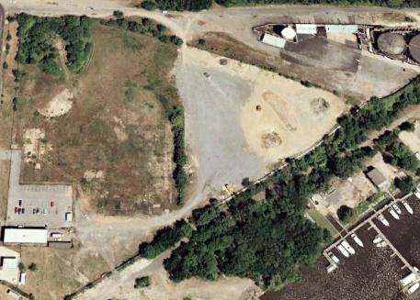
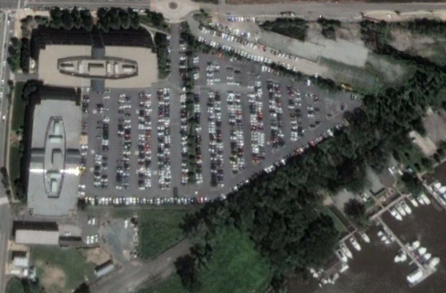
Intensification in DC
1999 2018
Notes:
Maritime Plaza in D.C near the Capitals stadium

Slide 9
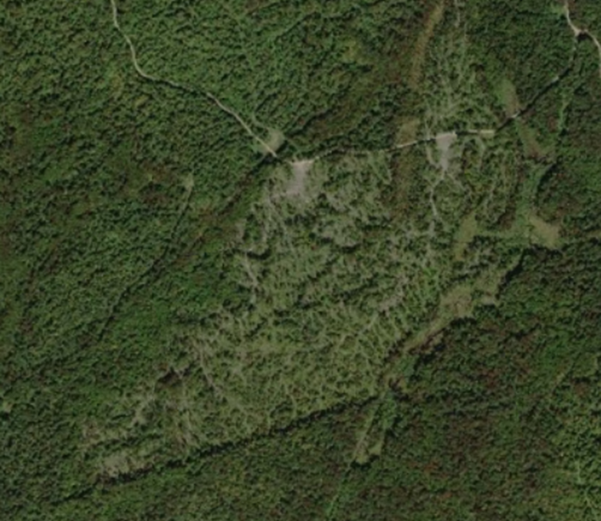
Silviculture in New York

Slide 10
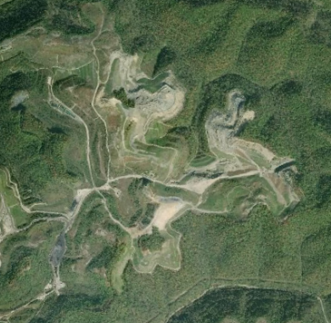

West Virginia Mining

Slide 11
Next Steps
Summarize 100% of the change in each state- not just top 10
Automate the process and develop a per-pixel classification
Repeat using annual land change data: 1986 – 2017
Perform similar analyses at the state-wide level using NRCS’ National Resources Inventory and USFS’ Forest Inventory and Analysis data

Slide 12
Questions and Feedback
What classes to include? E.g., silviculture, harvest, succession, afforestation
What temporal or spatial rules to consider? E.g., minimum patch size to qualify as silviculture
Can forests transition into wetlands? – or were they previously misclassified and always wetlands?
Are forests being cleared for new agriculture in Virginia?
Does agriculture transition to forest in Virginia?
Email: wagner.alexandra@epa.gov

