Slide 1
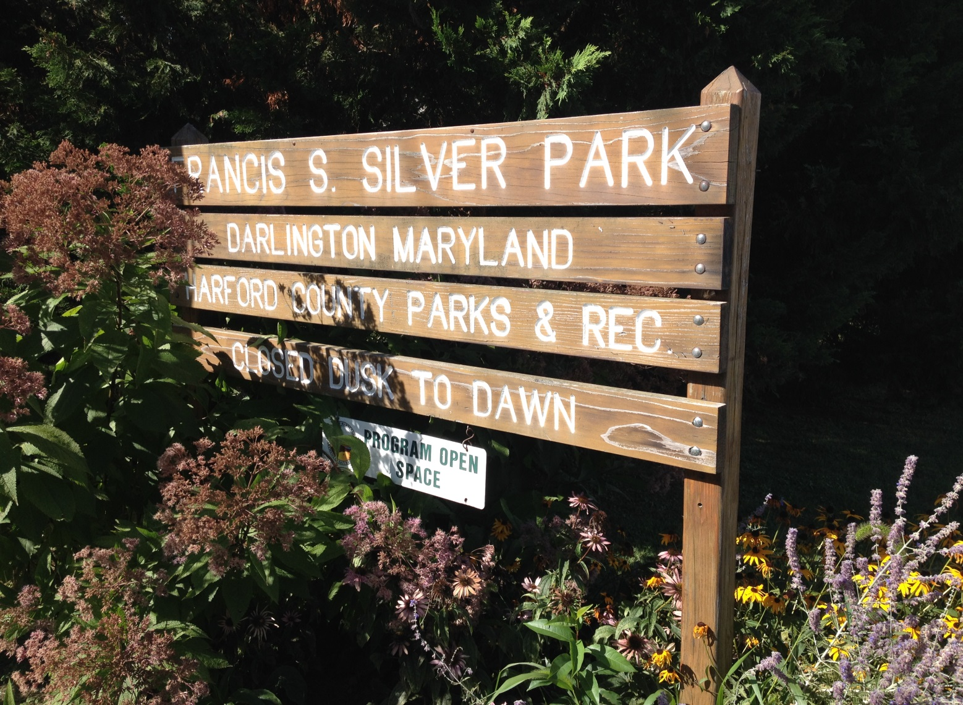
Parks & Rec Community Garden 2014
Dublin Darlington Rec Council in cooperation with
the Friends of the Darlington Library,
Harford County Master Gardeners, Darlington Lions’ Leos Club

Slide 2
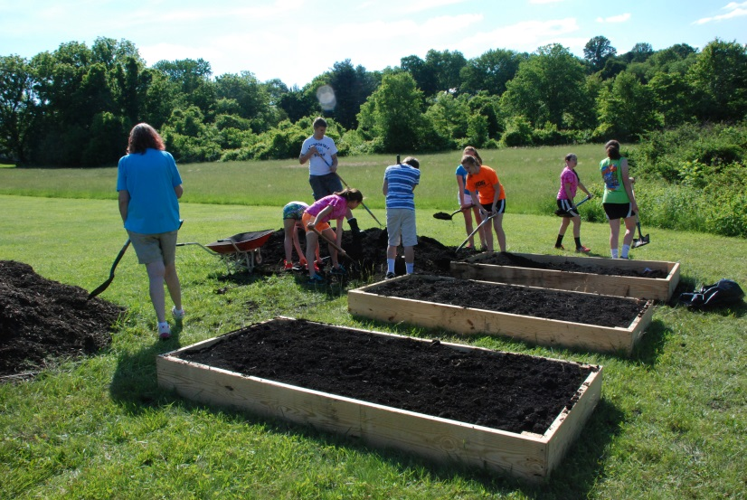
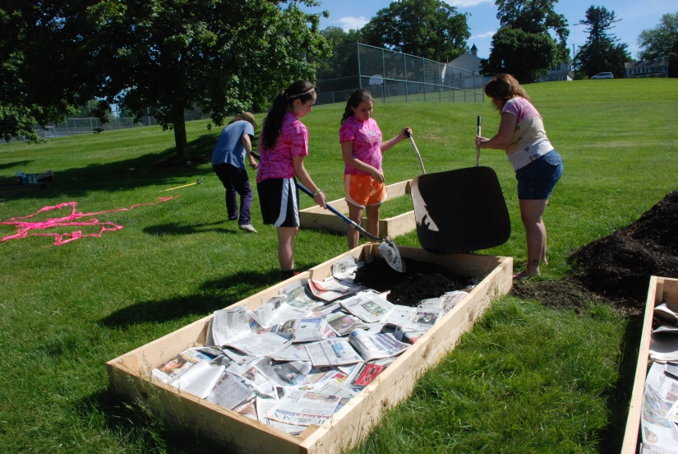
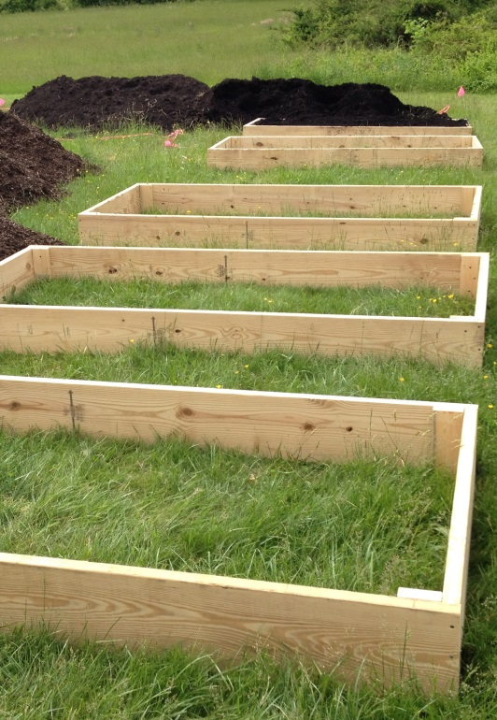
First things first!
A soil test was performed last winter to assay soil fertility, pH and possible contaminants.
The garden was designed to enclose 50’ x 50’ with 24 total raised beds.
A wider aisle forms a criss cross (plus sign) dividing the garden into four quadrants. 6 beds (25%) were built the first year.
Beds measure 4’ x 8’.
2” x 10” by 8’ untreated white pine was used to build the beds.
In subsequent years, more quadrants will be built. The wider central aisles can be used for taller, wheel chair accessible beds.
See http://extension.umd.edu/growit
For a video of building the beds. No need to till. Turf is smothered with newsprint.

Slide 3
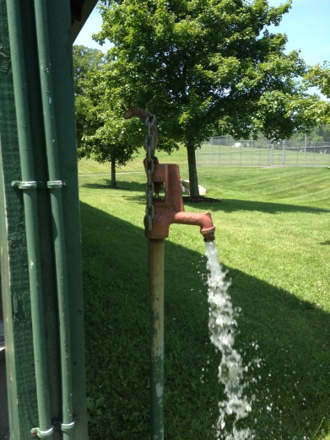
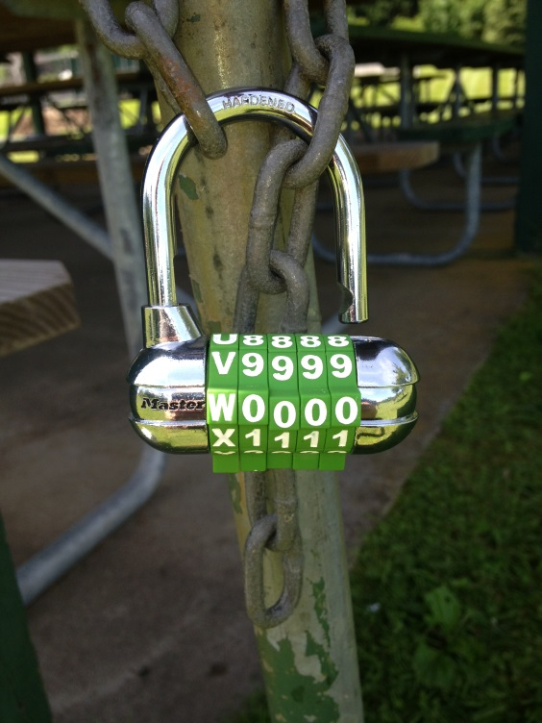
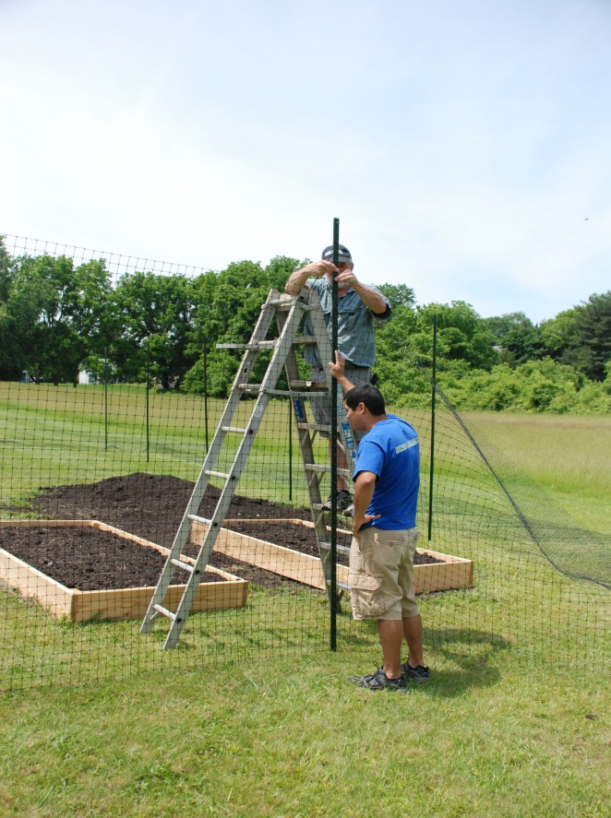
Several preliminary meetings were held last winter to select the current site.
Site selection needs to include level ground, a water source, unrestricted sunlight, and parking area.
Deer fencing is highly recommended in most areas of Harford County. More substantial fencing may also be advised in urbanized areas.
We used heavy weight 8’ plastic deer fence and 10’ metal fence posts.
Beds were filled entirely with compost from Scarboro Landfill. The beds were eventually surrounded by mulch from the same source.
Reflective ribbon was tied to all fence posts to distract marauding wildlife.

Slide 4
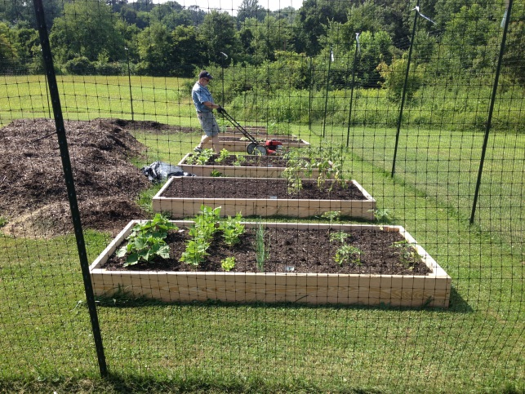
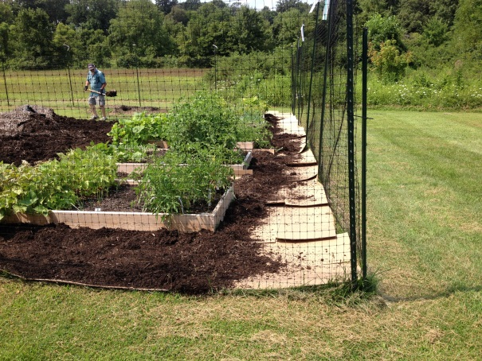
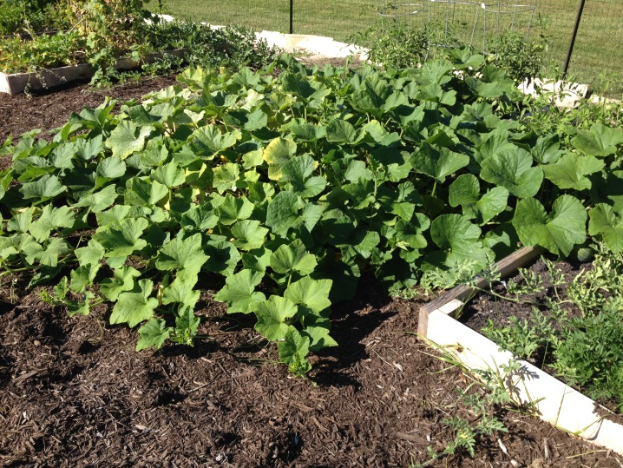
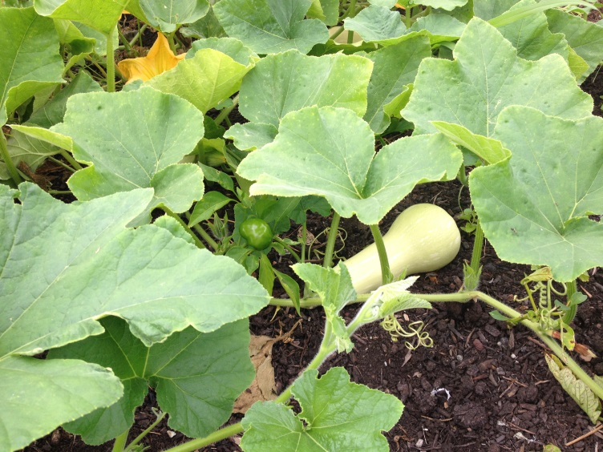
Rainfall was plentiful and well timed for most of the summer.
Initially, the turf between beds was mowed, as needed, until the butternut squash took over the pathways.
A layer of heavy cardboard was snugly fit into the space and covered generously with mulch.
Families who rented the beds were on call to keep the weeds down in their own space and adjacent walkways.
See contract hand out.
See Community Garden Consulting Group hand out.

Slide 5
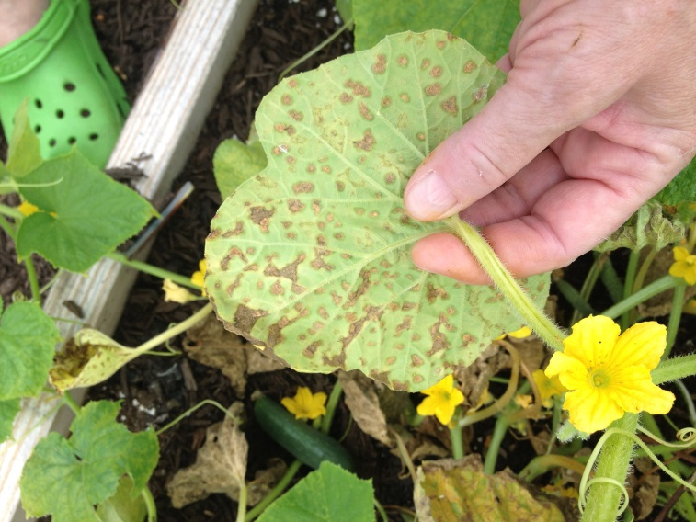
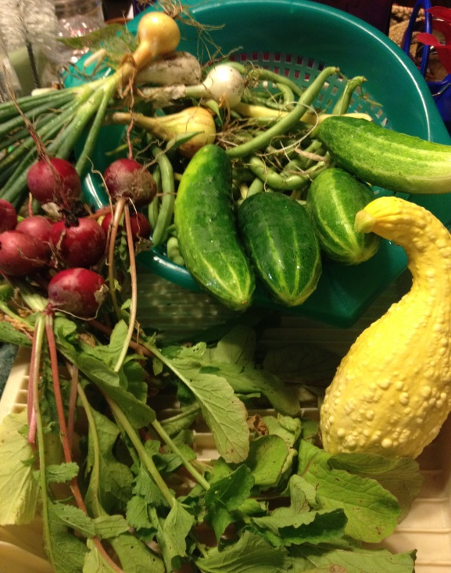
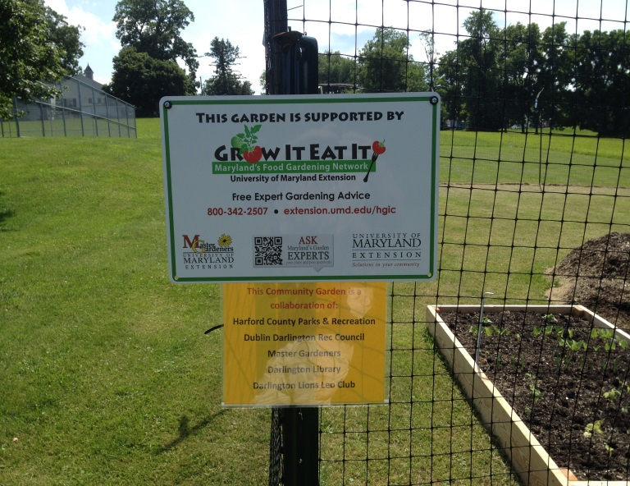
Contact Information:
Jane Howe janehowe@aol.com
410-457-4849
Expenses: $972.64
Lumber - $228.33
Fence - $385.00
Posts – 281.78
Ties - $27.53
Misc. - $50 + (soil test, screws, glue, PVC pipe, combination lock)
Donated – Compost and mulch
Biggest problems:
Cucumber downy mildew wiped out some, but not all, cucumbers.
Mexican bean beetles were a nuisance.
Two minor incidents of vandalism.
Wish List for 2015:
Compost bin
Lockable tool storage shed
Tools
Permanent Sign

Slide 6
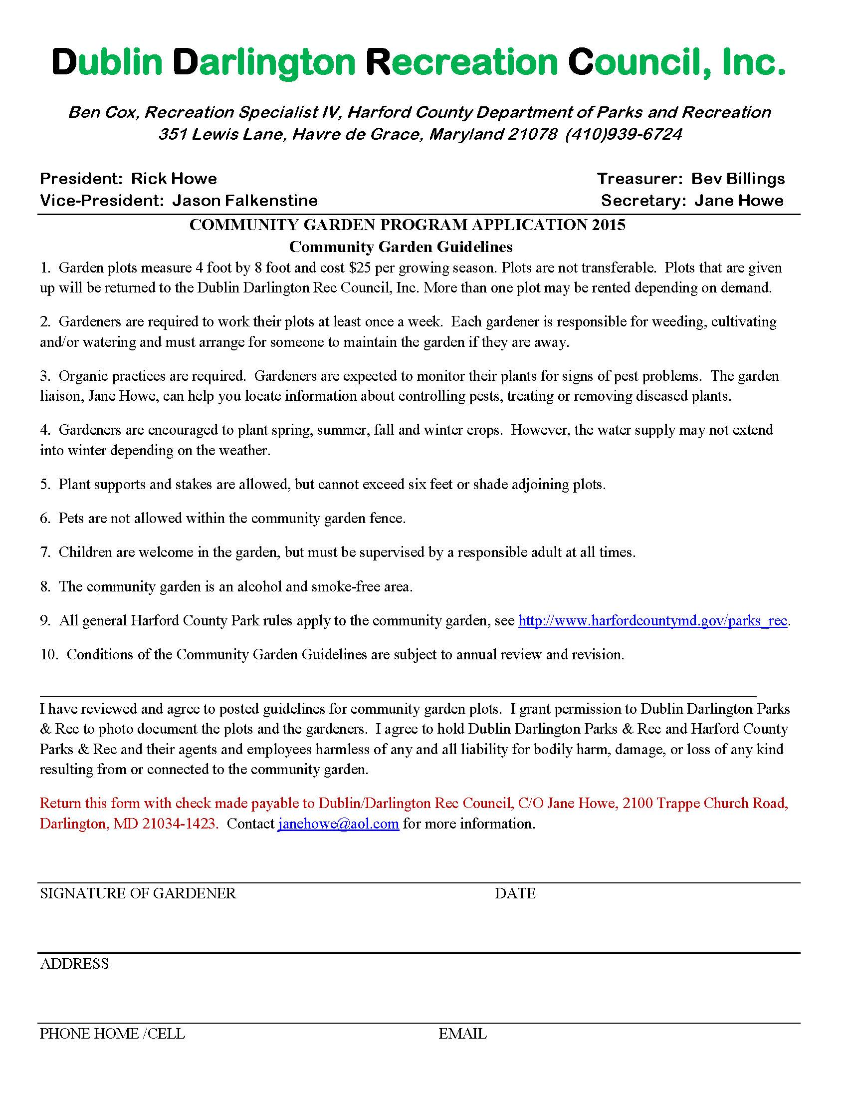

Slide 7
