Slide 1
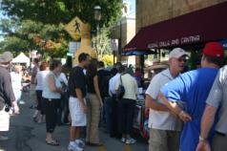
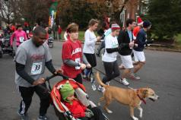
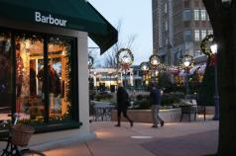
Growth Management and Land Use Tools
The Montgomery County PA Approach
Joint Meeting of the Citizens and Local Government Advisory Committees
Alliance for the Chesapeake Bay
May 21, 2015
MCPC

Slide 2

Regional Context
MCPC
MCPC

Slide 3
Growth Trends
MCPC
MCPC

Slide 4
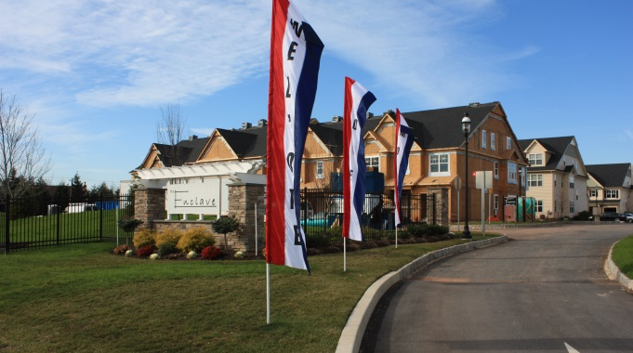
Growth Trends
96,000 new residents by 2040
39,000 more homes by 2040
MCPC
MCPC

Slide 5
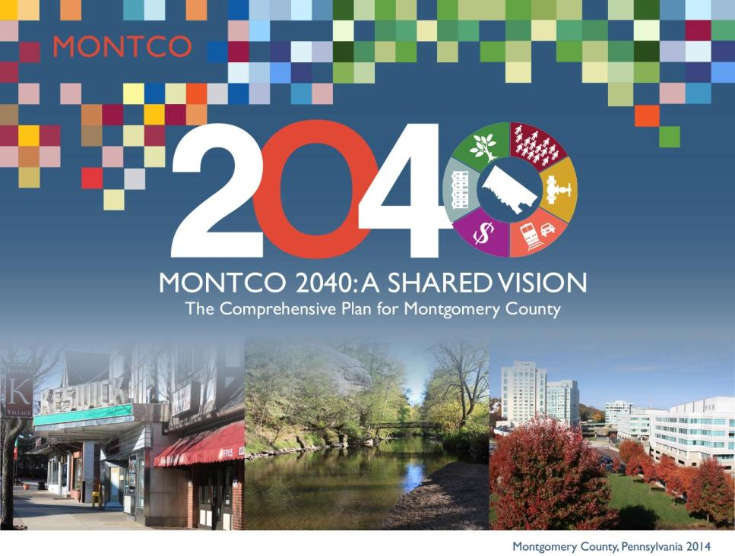
MCPC
MCPC
Montgomery County, Pennsylvania 2015

Slide 6

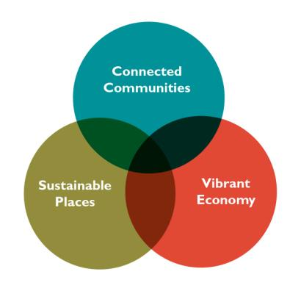
THE NEW
COMPREHENSIVE PLAN
FOR MONTGOMERY COUNTY
MCPC
MCPC

Slide 7
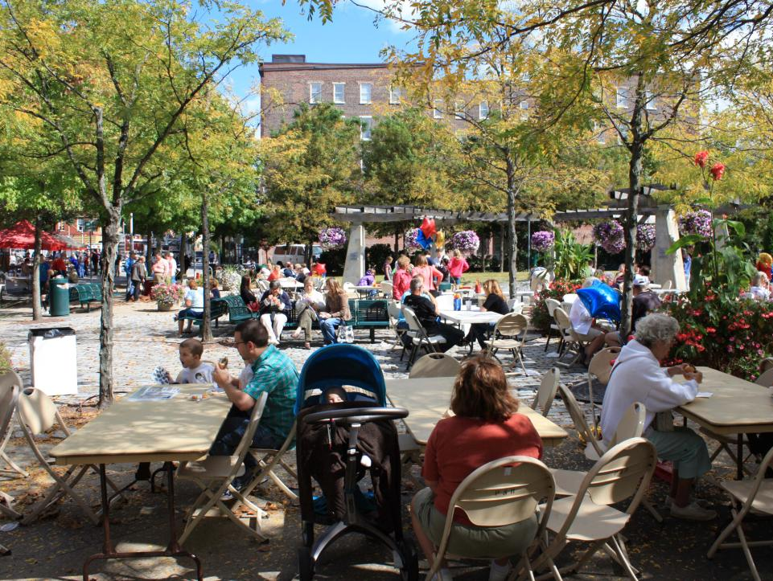
2040 VISION
MCPC
MCPC

Slide 8
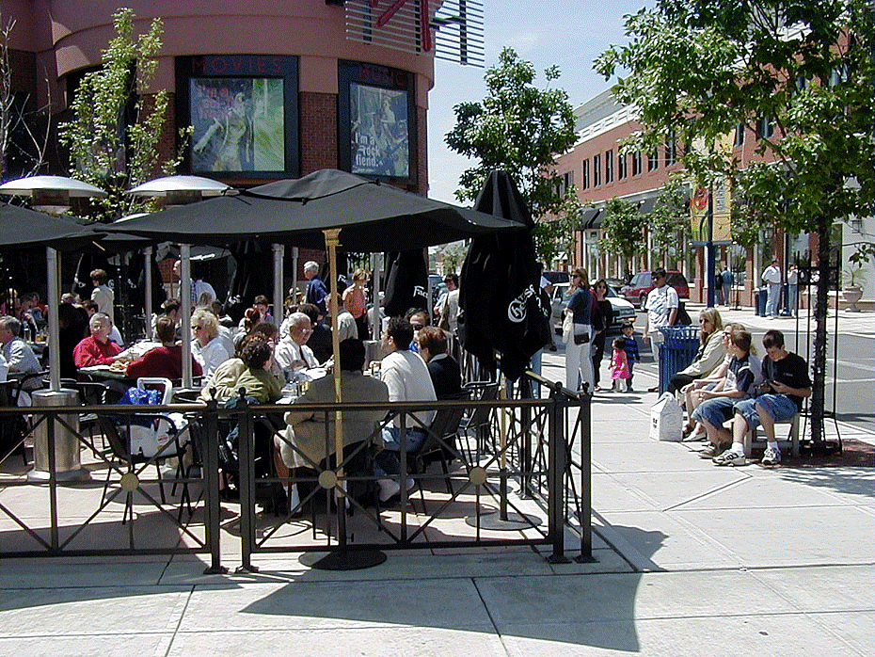
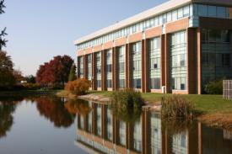
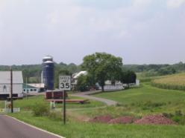
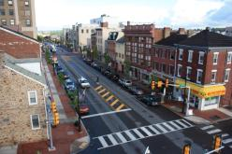
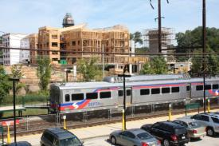
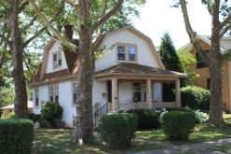
2040 Vision
Land Use Vision
Modern, walkable, and mixed use commercial and community cores
New development in research centers and business parks
Traditional rural landscapes
Vibrant downtowns and village centers
Transit-oriented development around train stations
Attractive and accessible residential neighborhoods
MCPC

Slide 9
2040 Vision
Land Use Vision
MCPC

Slide 10
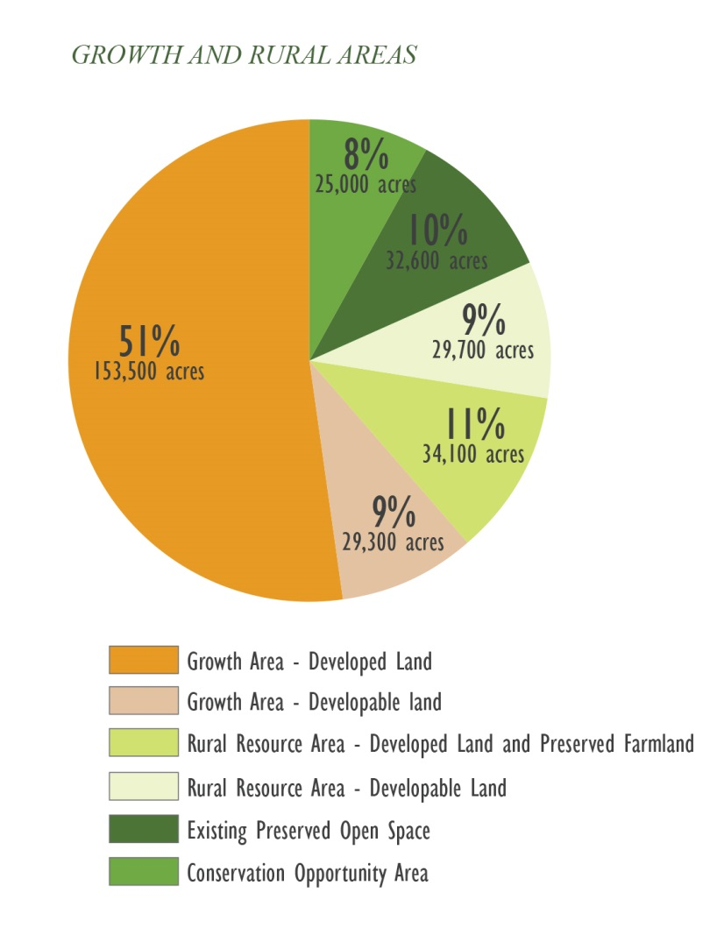
2040 Vision
Land Use Vision
Almost all new non-residential in Growth Areas
95% of new residential dwellings in Growth Areas
29,000 acres available for growth
MCPC

Slide 11
2040 Vision
Land Use Vision
MCPC

Slide 12
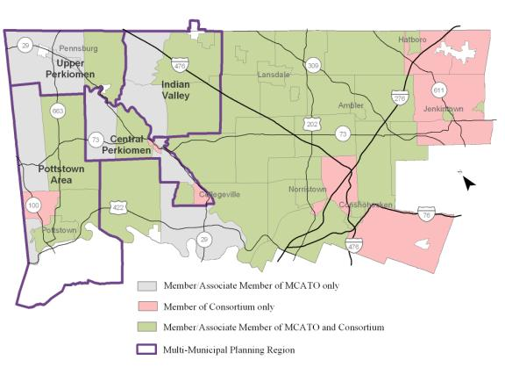
2040 Vision
Multi-Municipal Cooperation
MCPC

Slide 13
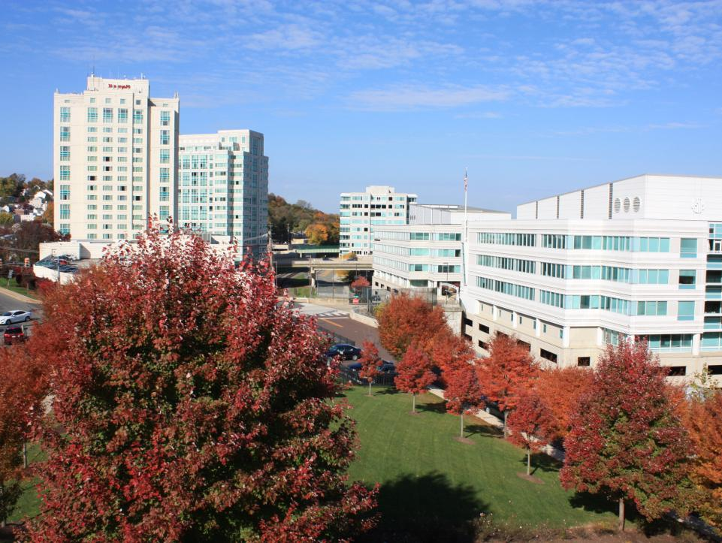
GROWTH MANAGEMENT TOOLS

Slide 14
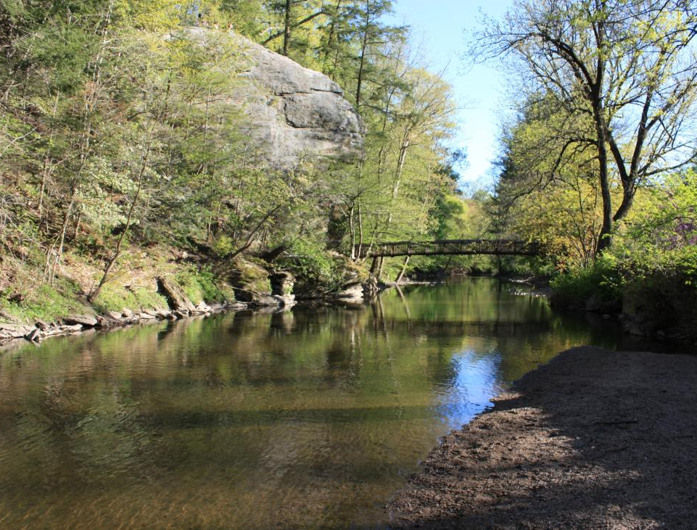
2040 Vision
Growth Management Tools
Infrastructure Investment
Preservation Tools
Growth Area Zoning
MCPC

Slide 15
2040 Vision
Infrastructure Investment
MCPC

Slide 16
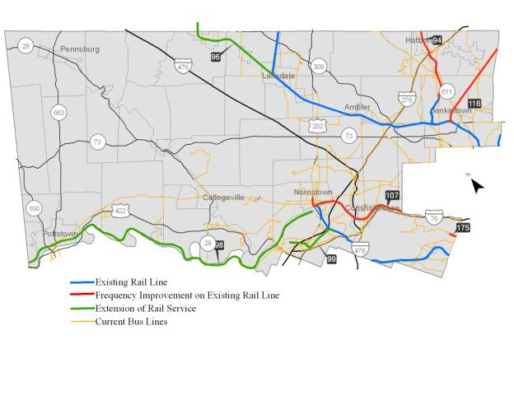
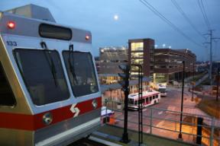
2040 Vision
Infrastructure Investment
MCPC

Slide 17
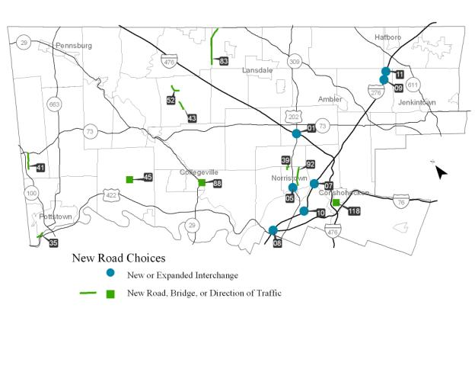
2040 Vision
Infrastructure Investment
MCPC

Slide 18
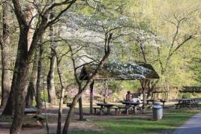
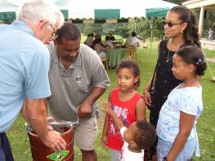
2040 Vision
Preservation Tools
Farm Zoning
Transfer of Development Rights
Farm Preservation Programs
Open Space Purchase
Land Preservation Ordinances
Large Lot Zoning
Environmentally Based Density
Natural Features Preservation
Local Food Initiatives
Historic Preservation Ordinances
Village Commercial Zoning
MCPC

Slide 19
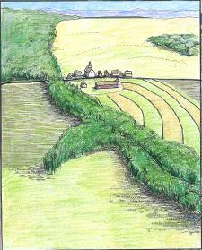
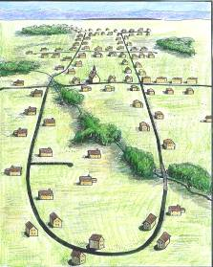
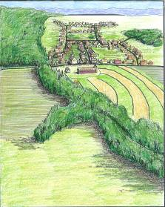
2040 Vision
Preservation Tools
TDR zoning transfers development from a preservation part of a community to a growth area.
This is a market driven process
New development in growth area must meet zoning standards
Normally, residential development is transferred
Existing Landscape
Normal Development
TDR Development
MCPC

Slide 20
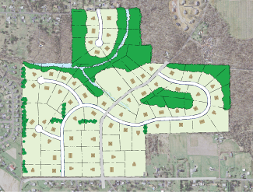
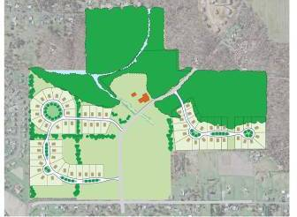
2040 Vision
Preservation Tools
Land Preservation Districts are cluster ordinances for rural areas that preserves significant open space and include:
75% open space
15,000 square foot single-family detached lots
One home per 2 developable acres
Central or public sewers and water
Normal Development
Land Preservation Development
MCPC

Slide 21
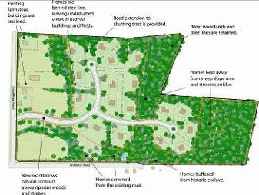
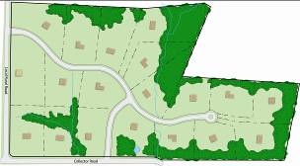
2040 Vision
Preservation Tools
Rural Residential zoning preserves key scenic, historic, and environmental areas and includes:
Home placement that preserves most important site features
30,000 square foot lots
One home per 2 developable acres
Possibility of on-site sewer and water
Normal Development
MCPC
Rural Residential Development

Slide 22
2040 Vision
Growth Area Zoning
Town Center Zoning
Village Commercial Zoning
Mixed Residential Zoning
Mixed Use Zoning
Transit Oriented Development
Form Based Zoning
Business Park Reinvestment
Brownfield Redevelopment
Grayfield Redevelopment
Green Infrastructure
MCPC

Slide 23
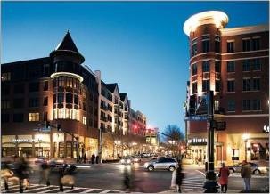
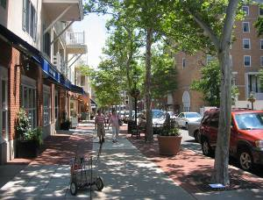
2040 Vision
Growth Area Zoning
New Town Mixed Use zoning is designed for places where compact, walkable, mixed use development is appropriate, such as near train stations, historic downtowns, old shopping centers, and underutilized industrial land.
Mix of uses required on larger tracts
Walkable building design
Compact development with FAR of 1.5 and height of 6 stories
Parking garages and parking lots are hidden from view
Central plazas and open space
Rockville Town Square
MCPC
Princeton, New Jersey

Slide 24
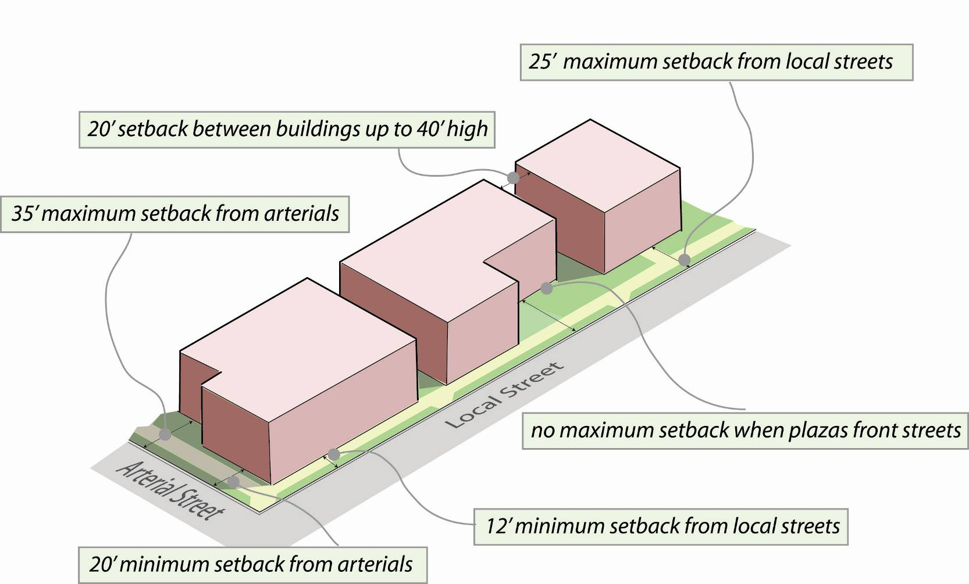
2040 Vision
Growth Area Zoning
MCPC

Slide 25
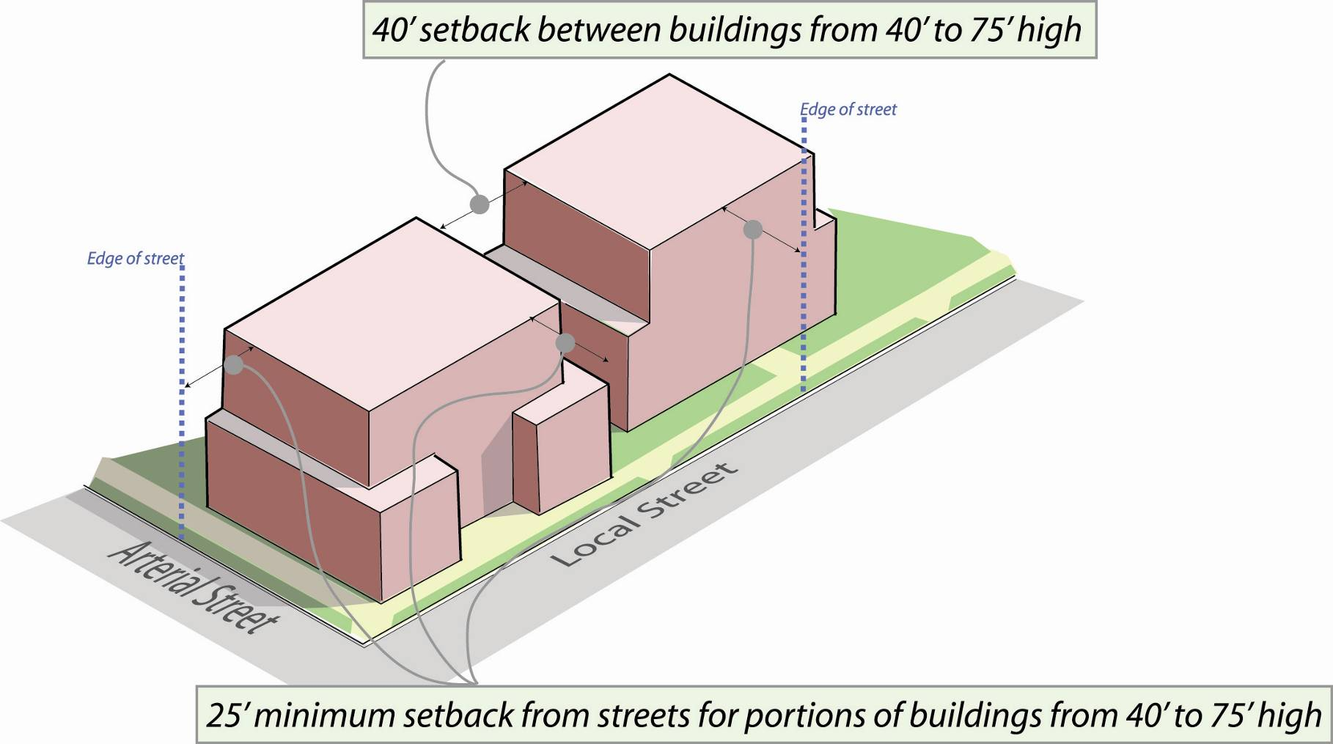
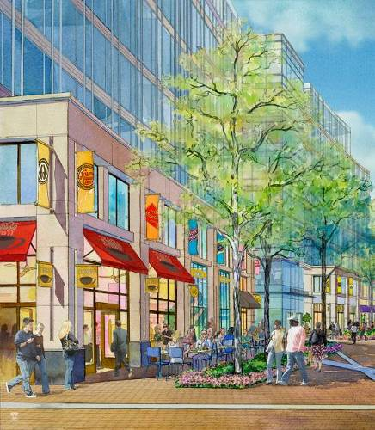
2040 Vision
Growth Area Zoning
MCPC

Slide 26
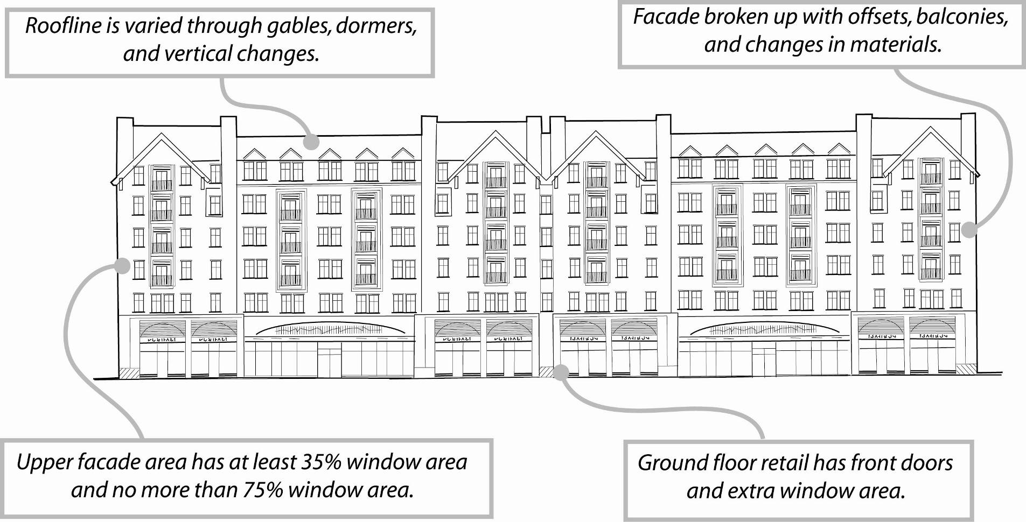
2040 Vision
Growth Area Zoning
MCPC

Slide 27
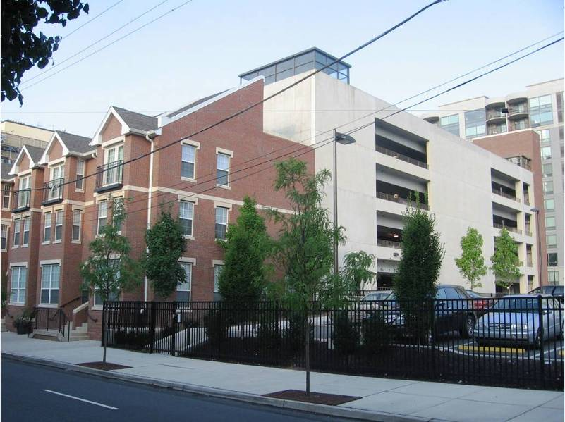
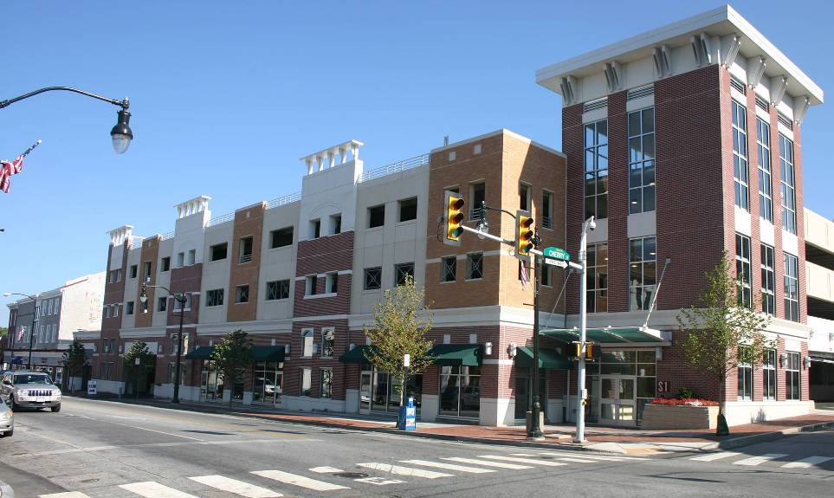
2040 Vision
Growth Area Zoning
“Wrapping” parking structures with other uses is ideal, but the basic goal is to conceal the parking element as much as possible
Active uses should occupy at least 70% of the first floor of parking garages that front a public street
Exposed parking structures should have design treatments to create the appearance of an occupied building
Cars should be visually screened
MCPC

Slide 28
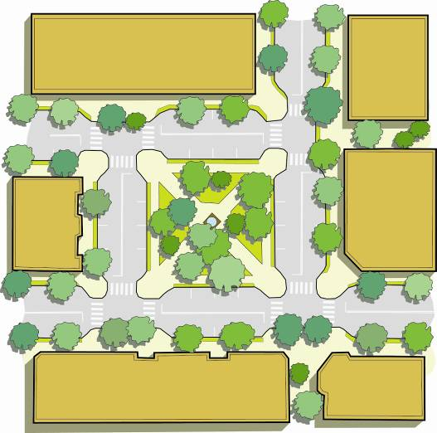
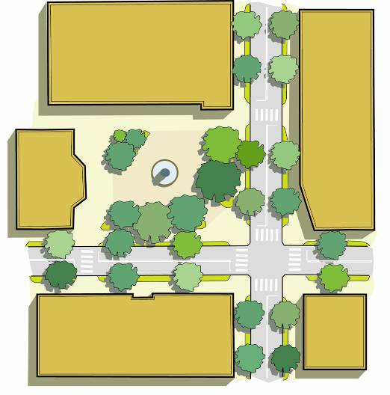
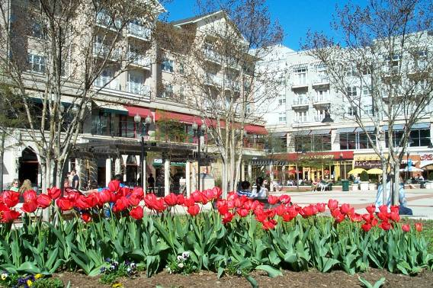
2040 Vision
Growth Area Zoning
CENTRAL PLAZA SURROUNDED BY ROADS
CENTRAL PLAZA ON CORNER
MCPC

Slide 29
The county’s 16 model ordinances provide guidance for improving the quality of new development. These models can be accessed online at:
www.planning.montcopa.org/ModelOrdinances
To see the county comprehensive plan, Montco 2040: A Shared Vision, go to the MCPC website at www.montcopa.org/Montco2040
Brian O’Leary, AICP, Section Chief of County Planning
boleary@montcopa.org
610-278-3728
MCPC

