Slide 1
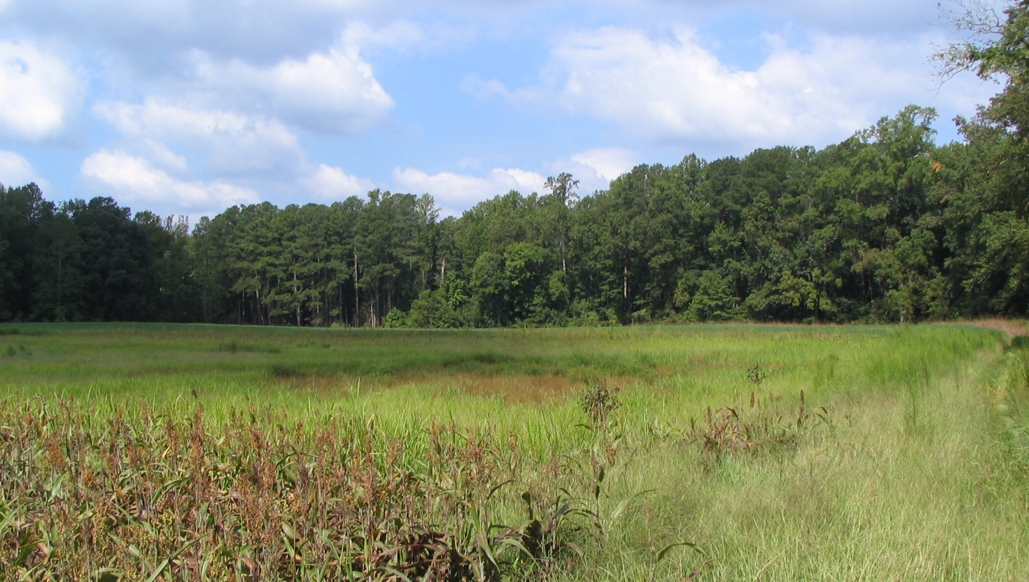
Status and preview of forthcoming Wetland Expert Panel recommendations
Jeremy Hanson, Panel Coordinator, Virginia Tech
Photo courtesy of UMD-Extension

Slide 2
Recap
Fall 2014: Wetland expert panel convened, CWP coordinating
Spring 2015: Virginia Tech begins coordinating panel
Fall 2015: Partnership approves two nontidal wetland land uses for Phase 6 watershed model: Floodplain and Other
May 26 2016: Wetland Workgroup
June-September 2016: Partnership review of wetland expert panel’s recommendations
September 30, 2016: Deadline for BMP panel recommendations for input into Phase 6 Watershed Model

Slide 3
Disclaimer
Anything presented in this presentation is still deliberative and draft. It does NOT represent a recommendation from the panel until presented as such in the panel’s forthcoming report. The panel is in its final stages and has some critical decisions left to make.

Slide 4
Preview: Wetland BMP category definitions
Proposed BMP Category | Proposed CBP Definition (for Phase 6 CBWM) | CBP will count the BMP acres as... | Practice and Project Examples (Still some flux in this column. Some of these practices may fit in more than one place, and this table will never be comprehensive.)
Restoration | Re-establish The manipulation of the physical, chemical, or biological characteristics of a site with the goal of returning natural/historic functions to a former wetland. | Acreage gain (toward Watershed Agreement outcome of 85,000 acre wetland gain and in Phase 6 annual progress runs) | Restore hydrology to prior-converted agricultural land (cropland or pasture); re-establishing needed vegetation on cropland with wetland hydrology; native wetland meadow planting; elevate subsided marsh and re-vegetate; ditch plugging on cropland; Legacy Sediment Removal(?) NRCS Practice 657
Creation | Establish (or Create) The manipulation of the physical, chemical, or biological characteristics present to develop a wetland that did not previously exist at a site. | Acreage gain (toward Watershed Agreement outcome of 85,000 acre wetland gain and in Phase 6 progress runs) | Modifications to shallow waters or uplands to create new wetlands. Placement of fill material or excavation of upland to establish proper elevations for tidal wetland; Hydrologic measures such as impoundment, water diversion and/or excavation of upland to establish nontidal wetlands NRCS Practice 658

Slide 5
Preview: Wetland BMP category definitions
Enhancement | Enhance The manipulation of the physical, chemical, or biological characteristics of a wetland to heighten, intensify, or improve a specific function(s). | Function gain (toward 150,000 acre outcome and Phase 6 annual progress runs) | Flood seasonal wetland for waterfowl benefit; regulate flow velocity for increased nutrient uptake; NRCS Practice 659
Rehabilitation | Rehabilitate The manipulation of the physical, chemical, or biological characteristics of a site with the goal of repairing natural/historic functions to a degraded wetland. | Function gain (toward 150,000 acre outcome and Phase 6 annual progress runs) | Restore tidal flow to degraded wetland; ditch plugging in a forested wetland area; moist soil management*; invasive species removal, floodplain reconnection May include some NRCS Code 657 practices . *Moist soil management should only be counted if there are predominantly native wetland plants; and site can sustain itself as wetland without active management, meaning whether water control structure is operated or not.

Slide 6
Preview: Wetland Reestablishment BMP
Panel has framework to credit reestablishment practices based on characteristics of non-tidal wetlands in 6 HGM subregions
Tidal restoration practices will be credited in estuarine model, not the Watershed Model. Tidal re-establishment TN, TP and TSS reductions will be based on Shoreline Management panel’s protocols 2, 3 and 4:
 |  | TN (lbs/ac) | TP (lbs/ac) | TSS (lbs/ac)
Protocol 2 – Denitrification | Acres of re-vegetation | 85 | NA | NA
Protocol 3 - Sedimentation | Acres of re-vegetation | NA | 5.289 | 6,959
Protocol 4 – Marsh Redfield Ratio | Acres of re-vegetation | 6.83 | 0.3 | NA
Proposed credit for Phase 6 tidal wetland re-establishment BMP | Acres | 91.83 | 5.589 | 6,959

Slide 7
Six HGM subregions for non-tidal wetland restoration
Coastal Plain West dissected
Coastal Plain East well drained
Coastal Plain East poorly drained
Coastal Plain lowland
Piedmont
Plateau, Ridge & Valley
Coastal Plain nontidal wetland acres > Piedmont + Plateau, R&V acres

Slide 8
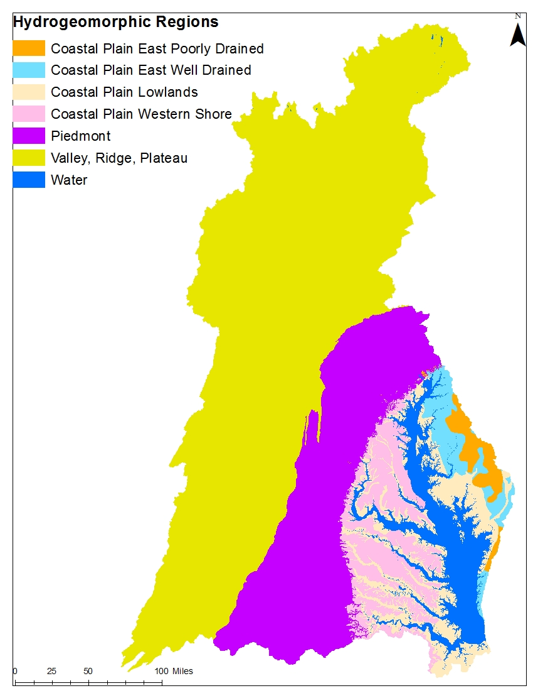

Slide 9
 |  | Retention Efficiency
Physiographic Subregion | Other | TN | TP | TSS
CP West incised | Y (Headwaters) | H | M | M
CP East well drained | Y (Headwaters) | L | M | M
CP East poorly drained | Y (Delmarva Bays) | M | M | M
CP lowland | Y (Flats) | M/H | M | M
Piedmont | ? (Headwaters) | M | M | M
Plateau, R&V | ? (Headwaters) | H | M | M
Physiographic Subregion | Floodplain | TN | TP | TSS
CP West incised | Y (Overbank) | M | H | H
CP East well drained | Y (Overbank) | M | H | H
CP East poorly drained | Y (Overbank) | M | H | H
CP lowland | Y (Backwater) | M | H | H
Piedmont | Y (Overbank) | M | H | H
Plateau, R&V | Y (Overbank) | M | H | H

Slide 10
 |  | Retention Efficiency |  |  | Acres Treated
Physiographic Subregion | Other | TN | TP | TSS | TN | TP | TSS
CP West incised | Y (Headwaters) | H | M | M | 4 | 2 | 2
CP East well drained | Y (Headwaters) | L | M | M | 2 | 2 | 2
CP East poorly drained | Y (Delmarva Bays) | M | M | M | 1 | 1 | 1
CP lowland | Y (Flats) | M/H | M | M | 1 | 1 | 1
Piedmont | ? (Headwaters) | M | M | M | 4 | 4 | 4
Plateau, R&V | ? (Headwaters) | H | M | M | 8 | 8 | 8
Physiographic Subregion | Floodplain | TN | TP | TSS | TN | TP | TSS
CP West incised | Y (Overbank) | M | H | H | 8 | 4 | 4 | *tentative acres for Floodplain
CP East well drained | Y (Overbank) | M | H | H | 4 | 4 | 4
CP East poorly drained | Y (Overbank) | M | H | H | 2 | 2 | 2
CP lowland | Y (Backwater) | M | H | H | 2 | 2 | 2
Piedmont | Y (Overbank) | M | H | H | 8 | 8 | 8
Plateau, R&V | Y (Overbank) | M | H | H | 16 | 16 | 16

Slide 11
Coming soon…
Determine efficiencies (numeric % reduction for TN, TP and TSS)
Literature is highly variable, but lit review suggests that on average TN removal is ~20-25% at the low end; 40-44% at the higher end
TP is similar; roughly 25% at the low end; mid-30s to low-40s at the medium-higher end
TSS % removal seems to converge around high-20s and low-30s on average

Slide 12
Other components
Land use recommendations
Wetland creation (establishment)
Different definition; tracks as acreage gain toward same 85,000 acre Agreement outcome.
Wetland enhancement & wetland rehabilitation
Both are functional gains, but have different definitions and potential benefits. Time and resources not available to recommend TN, TP and TSS benefits at this time; will be recommended that another BMP panel be convened by end of 2016 or very early 2017 to determine those values.
Accountability: Tracking, reporting and verification
Potential unintended consequences and qualifying conditions
Future research and management needs

Slide 13
Next steps/goals
Panel needs to make decisions on some final key items; wrap up draft report
Release report, begin initial 30-day comment period
Respond to comments
Describe responses and any revisions to workgroups; seek their approval of panel’s recommendations
Receive WQGIT approval by end of September

Slide 14
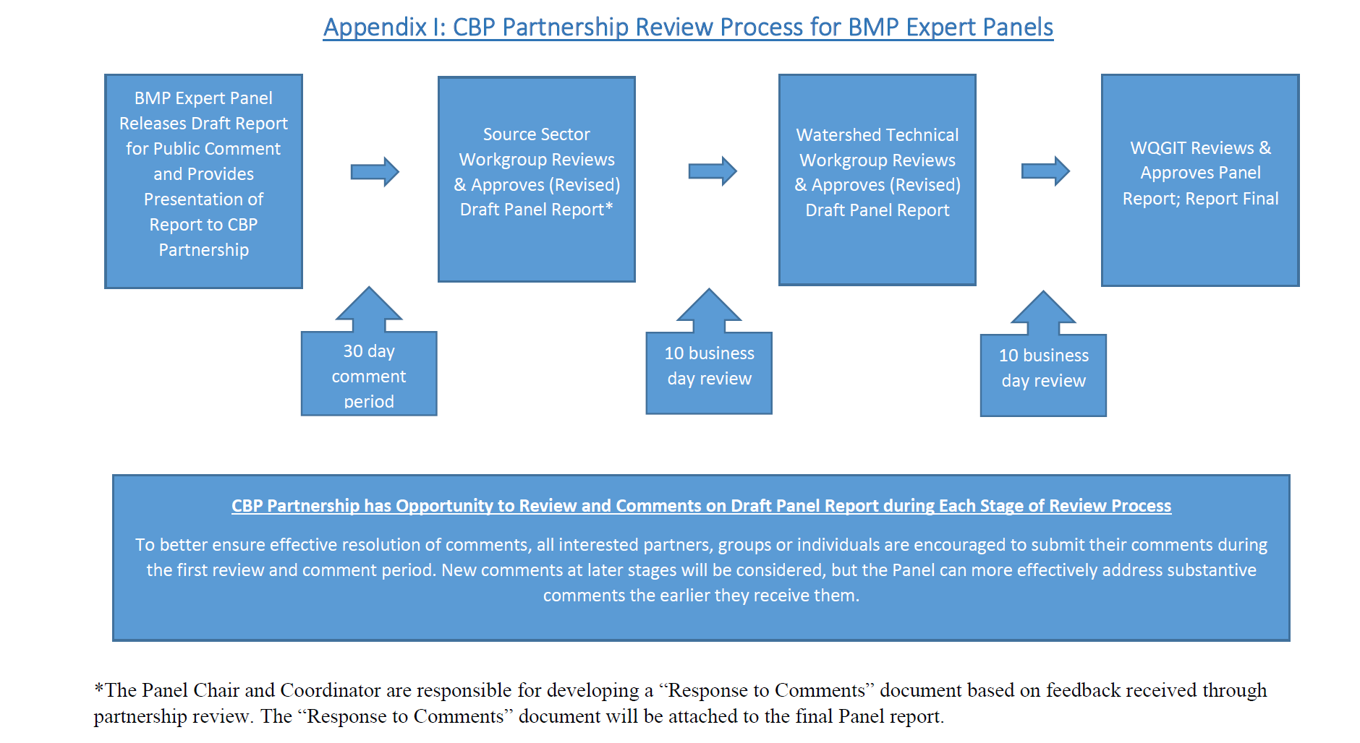

Slide 15
Tentative timeline
June 14: Target date to release panel report; begin initial 30-day comment period
TBD, late June or early July:
Schedule call for Wetland Workgroup to discuss panel report in more detail, prior to--
The panel hosts a 2-hour webinar with detailed presentation of the panel's methods and recommendations, followed by Q&A. All interested groups are invited; webinar is recorded for anyone who misses the live broadcast.
TBD, July 18-July 22: Initial 30-day comment period closes. Jeremy and panel chairs work to respond to comments, working with panel members. This takes a few weeks.
August 4: Brief Watershed Technical Workgroup
August 18: Brief Ag Workgroup.
Note: May also want to brief Urban Stormwater Workgroup and Modeling Workgroup (August timeframe). USWG is scheduled on August 16. Modeling Quarterly scheduled on August 9-10
Mid-August: Seek Wetland Workgroup approval.
September 1: Seek Watershed Technical Workgroup approval
September 12 or September 26: Seek WQGIT approval.

Slide 16
Thank you!
Contact Jeremy with any questions or comments
jchanson@vt.edu
410-267-5753

