Slide 1
Chesapeake Bay Watershed Agreement Outcomes and Phase III WIPs
Are we making progress?
Gina Hunt
MD. Department of natural Resources

Slide 2
Process
Small Group of Outcome Coordinators was formed based on the Management Board recommendation. Led by Nicki Kasi (PA Board Member).
Bay Program surveyed the following partners to determine their interest: Virginia, Maryland, District of Columbia, West Virginia, Pennsylvania, Delaware, New York, Department of Defense/ Department of Navy

Slide 3
Survey Questions
Which outcomes would your jurisdiction be interested in incorporating into their Phase III WIP development and/or implementation?
Which outcomes would your jurisdiction be interested in incorporating into their Phase III WIP outreach and communication materials?
For each outcome, what kind of materials/tools would be helpful to your jurisdiction?

Slide 4
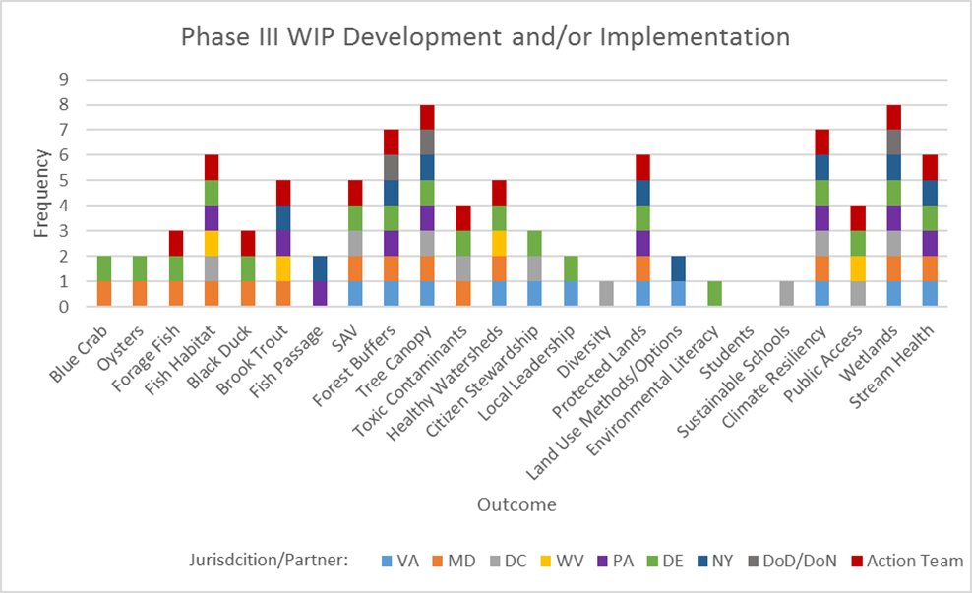
Phase III WIP Development or Implementation

Slide 5
Phase III WIP Development or Implementation
After reviewing the survey results, the action team decided to select outcomes that scored a four or above on the development/implementation graph. These are: fish habitat, brook trout, SAV, forest buffers, tree canopy, toxics, healthy watersheds, protected lands, climate resiliency, public access, wetlands, and stream health

Slide 6
What kind of materials/tools would be helpful to your jurisdiction?
Fact sheets are good for practitioners (MD, PA)
Local government fact sheet (WV, PA)
Info sheets and PSAs (DE, VA, WV, PA)
Quantitative data on co-benefits and cost savings (DC)
Data that can be integrated into CAST (DC)
Strawman CAST scenarios (WV)
Economic growth associated with cleaning up a fishery (WV)
Webinar trainings for CAST, MAST (WV)
Case studies (DC, VA)
Technical, funding sources (DC)
Tools/materials to help farmers understand the benefits and cost-effectiveness of
buffers (DE)
Summary of actions across watershed to demonstrate partner involvement (VA, PA)
Concise summary of multi-benefit BMPs and policy approaches (WV, NY, DoD/DoN, PA)
Focus on local stream health and flood protection (NY)
Website of searchable BMPs (WV)
Weighting of practices relative to their benefits (Simple summary of Tetratech Project) (PA)
Supplement BMP Compendium now being done with Benefits and Outcome Information (PA)

Slide 7
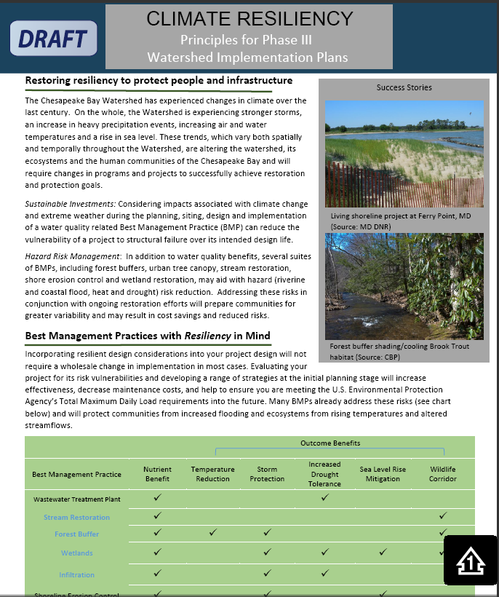
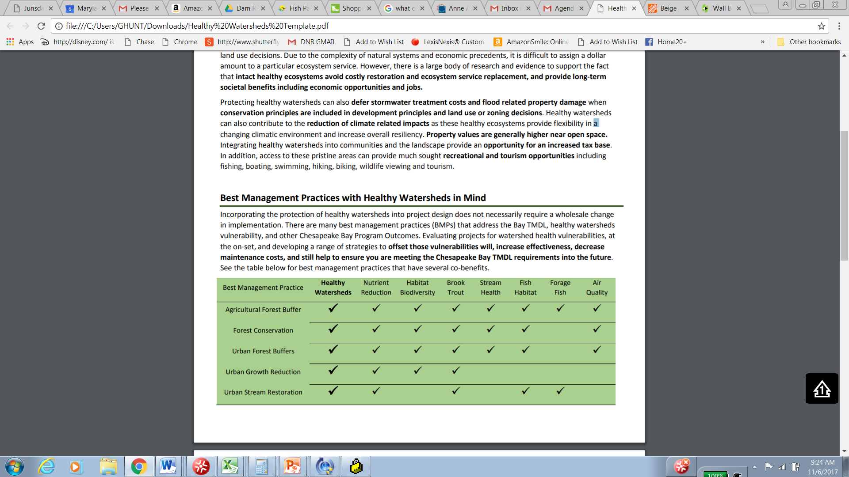
Materials in Process
Fact sheets are good for practitioners (MD, PA)
Local government fact sheet (WV, PA)
Info sheets and PSAs (DE, VA, WV, PA)
Weighting of practices relative to their benefits (Simple summary of Tetratech Project) (PA)
Supplement BMP Compendium now being done with Benefits and Outcome Information (PA)

Slide 8
Next Steps
Discuss weighted table of BMPs practices relative to their benefits (Simple summary of Tetratech Project)
Develop Co-Benefits language for the WIP Document
Develop Fact sheets for each requested Outcome.

