Slide 1
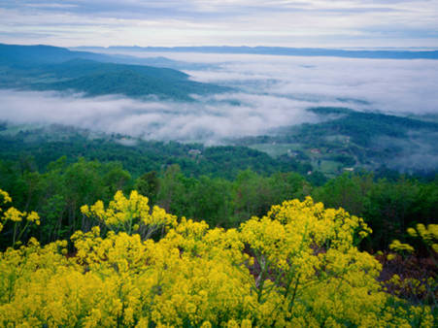
Evolving USGS Chesapeake Activities – 2018/2019
Scott Phillips and Ken Hyer
November 8, 2017
Notes:
Today I’ll characterize how we plan to evolve some of our Chesapeake activities to best align with current DOI, USGS, and partner guidance on science priorities…
Apologies that Scott couldn’t participate, but we felt it important to get this information in front of the GIT.

Slide 2
Why Evolve Chesapeake Studies
Several major items completed in 2017-18
New administration priorities
Existing Federal responsibilities
Unmet partners needs of Bay Agreement
Reduced Federal resources
Notes:
There is a need to evolve the USGS Chesapeake science in 2018-19 based on these considerations:
Completing several major activities in 2018. During FY2018 the USGS is completing several major activities of its existing science plan, including: (1) water-quality science to support the Mid-Point Assessment (MPA) of the Chesapeake Total Maximum Daily Load (TMDL); (2) land classifications and change activities associated with the MPA, (3) the current phase of the Chesapeake EDC project, and (4) studies related to unconventional oil and gas production.
New USGS priorities. The USGS has evolved their science priorities based on the directions of the New Administration and Department of Interior. The new USGS science priorities released in the Bureau Guidance for 2018 are (1) Science for Natural Resources Decision Making, (2) Science to inform Land and Water Management, and (3) Science to protect public safety, health, and property.
Continue to meet Federal responsibilities in the Chesapeake Bay restoration. While needs and funds evolve, there are ongoing responsibilities that must be met by the Federal Government. USGS science is needed to inform decisions to support the Chesapeake Bay Agreement, Migratory Bird Act, Clean Water Act, Endangered Species Act, and managing Inter-jurisdictional fisheries.
Addressing unmet partner needs of the Chesapeake Watershed Agreement. The Chesapeake Bay Program (CBP) established the Agreement with goals to be met during 2014-25. The major focus is to improve conditions for fish, wildlife, and people (figure1.1). The USGS is addressing selected outcomes of the Agreement and evolving efforts to consider critical unmet science needs.
Reduced Federal resources. The Administration proposed reduced funding to restore and protect the Chesapeake Bay. Congress may restore some of the proposed reductions, however, less funding is expected in the future.
The USGS Chesapeake Bay studies will evolve our science to better align with the new USGS/DOI priorities while still addressing Federal responsibilities and unmet needs of the Chesapeake Watershed Agreement. We do not anticipate preparing a new Science Strategy but will refine our Themes and Objectives during 2018-19.

Slide 3
Advisory Team
Who: USGS Mission Areas and CBP Leaders
What: Input to help evolve USGS Chesapeake Bay Efforts.
Best alignment of USGS directions and needs of Chesapeake Watershed Agreement
When: Evolution will occur over FY2018-19.
Notes:
Wanted to get input from representatives of each of the USGS Mission Areas, and leaders of each of the CBP Goal Teams. The charge of the team, and who was on it, was posted as part of the materials for the workshop. Met Aug 1, and much the presentation you will hear today, is what was provided to them and the outcomes of meeting.
The Advisory Team will provide input and suggestions on relative priorities for evolving USGS Chesapeake activities in 2018-19. The Advisory Team comments will be used to refine future USGS Chesapeake Themes and activities, as well as rebalancing within the science portfolio, so as to continue to optimize our science activities and provide the greatest mutual benefit to partners and USGS Programs. Feedback from the Advisory Team will help inform development of subsequent Chesapeake Bay Annual Work Plans, in collaboration with the standing USGS Chesapeake Bay Science Team.

Slide 4
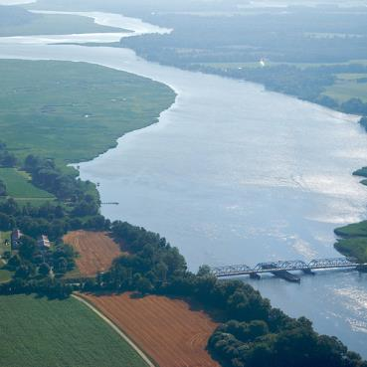
Current USGS Chesapeake Science Themes
Fish, wildlife, and habitats
Water quality and links to ecologic responses
Climate and land change
Synthesize and provide science for ecosystem management
Notes:
provide them some overview of our four current science themes but quickly moved into evolving directions.

Slide 5
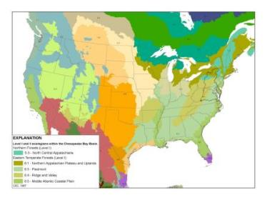
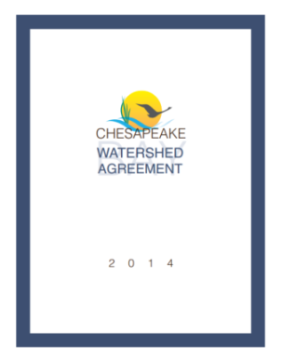
New Considerations
DOI priorities
Energy
Infrastructure
Lands
Trust responsibilities
USGS
Natural resources (energy)
Land and water management
Public Safety, health, and property
Bay Agreement
Goals
Outcomes
Notes:
Our new Chesapeake Science plan were developed to achieve a balance (use bullets) between meeting the and new priorities of DOI and USGS MAs, and unmet needs of CB Agreement.
As of January 2017, the new administration has been providing new guidance and influencing the priorities of DOI and USGS.
DOI is heavily focused on:
-National Energy and Infrastructure issues
-Management of Federal Lands and Water issues
-Trust species (those with federal authorities)
USGS has released bureau guidance that took these issues into consideration and is focused on these 3 high-level topical priorities
Goals of the CBP Watershed Agreement have not changed.
Our revised challenge is to plan our activities to align with as many priorities as possible – how do we set priorities that check everyone’s box.

Slide 6
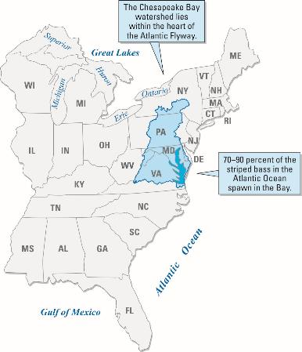
Bay Agreement
Restoration response
“Unmet” science needs
Largest needs
USGS capabilities
Watershed Agreement
Fish
Habitats and waterfowl
Water quality
Toxic contaminants
Healthy watersheds
Land conservation
Stewardship
Access
Env. literacy
Climate resilience
Notes:
As we evolve and move forward, there are 2 major opportunities we are still working towards:
Document the effects of management actions on the living resource – there is a large need to document ecosystem recovery and response, particularly to more complex processes and Nth order associations. Chesapeake is unique in our opportunity because of the partnership, our history and understanding.
Despite evolution over time, there remains an awful lot that we don’t understand. We’re working closely with partners within the partnership to align and evolve our science with the needs of the partnership, in addition to those of DOI and USGS)
Highlighted are the Agreement outcomes that line up with the new USGS priorities and have the greatest unmet science needs. Clearly there’s great alignment of topics, need to dig deeper to get into how we prioritize elements.

Slide 7
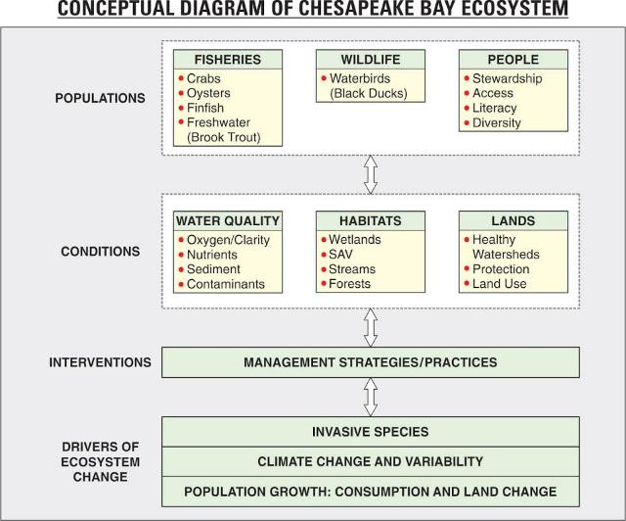
Potential Refined Chesapeake Themes
Fisheries and habitat
Migratory waterbirds
People and lands
Integrate and inform
Notes:
STRESS TO GIT that I will only cover the first 2 topics today and will largely gloss over the last 2 for time constraints.
We will step through these proposed themes during the rest of the presentation, describe out plans and thinking, then solicit feedback from everyone here.
Need to emphasize that this isn’t all new, it’s a refinement of the existing activities.
Fisheries: multiple species and the aquatic and habitat conditions that support them
Waterfowl: Multiple species and their coastal habitat conditions, effects of climate and land change
People: healthy watersheds and lands that provide benefits. Could consider also drinking water and energy
Now, we’ll step into Theme 1 – this is likely the largest and most complex Theme and will take a little time to work through.

Slide 8
SCIENCE TO SUPPORT FRESHWATER Fisheries and THEIR Habitat
Proposed Chesapeake Science Theme:
Notes:
Restoring and protecting populations of fish and wildlife is a fundamental priority of the DOI.
Fisheries and waterfowl are also two key biological communities highlighted in the Chesapeake Agreement.

Slide 9
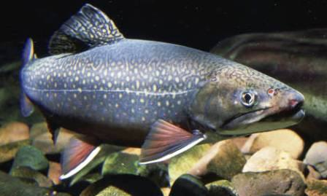
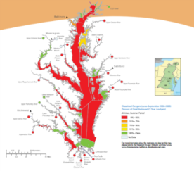
Theme: Fisheries and Habitat
Current Efforts:
Freshwater fish and habitats
Brook trout
UOGs
Toxic contaminants and stresses
EDCs and toxic contaminants
Water quality
Improve conditions for tidal fisheries
Nutrient and sediment sources, change, and delivery for Bay TMDL
Land classification
Notes:
Items from three of our existing science themes related to the new potential theme on fisheries and habitat. There are:
1. Brook Trout studies on climate change and invasive species. Also addressing effects of UOG but work will be completed in 2017
2. Large effort on toxic contaminants and stressors. The primary effort is a project on the effects of EDC, that primarily funded by the Env. Health Mission Area will be completed in 2018.
3. We have significant efforts on improving water-quality for tidal fisheries. This is a map of DO conditions during a typical summer in the Chesapeake. Low DO results annual fish kills. To address the problem, the CBP partners are working to reduce nutrients and sediment under the Bay TMDL.. TMDL began in 2010 and all practices needs to be in place by 2025. We have significant science effort to support the MPA. Much of the work will be completed in 2018. funded both by the Water, Eco MA, EPA, and the states. Related to the MPA was a large effort have an improved land classification for water-quality models supporting the TMDL. Supported by the Land and Climate MA and EPA..
Appreciating that land-use change is a MAJOR driver of the fisheries and ecological health.

Slide 10
Fisheries and Habitat
Evolve to …..
Integrated science to support recreational fisheries for current and future generations
Aquatic conditions for freshwater and tidal fisheries
Fish health to enhance recreational activities and safer consumption
Notes:
Wanted to frame these efforts into 3 more integrated topics focused on
1, recreational fisheries, with a focus on their habitat
2. aquatic conditions to support fisheries.
3. evolve fish health studies to focus on these same recreational species and consider relative safety for human consumption.
We will spend time on each of these topics

Slide 11
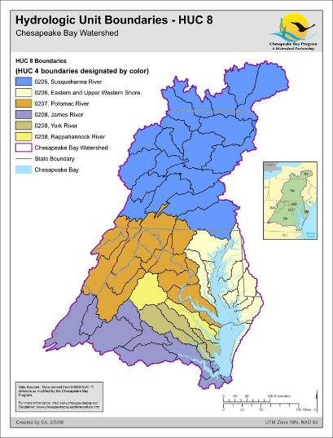
Recreational Fisheries and Habitat
“Headwaters to tidewater”
Multiple recreational species
Brook trout, bass
Shad, herring, eels
Endangered, Invasive, &
those of concern
CBP outcomes:
Fish habitat, fish passage, stream health, brook trout
USGS: Land management
Notes:
The Chesapeake ecosystem is important for both recreational fisheries in the watershed and tidal waters, as well as commercial fisheries in tidal waters.
We want to focus USGS efforts on species from headwaters to tidal freshwater areas, which is dictated by authorities for DOI manage species in these areas. (have one or two to mention: Atlantic States Marine Fisheries Commission Compact, Fish and Wildlife Coordination Act, Atlantic Coast Fisheries Cooperative Management Act)…. Point is there is broad authority for DOI and USGS to be working in these areas.
We will evolve from single species science to multiple species that occur in streams and rivers. Some of these species include…..
Endangered species and those of concern include…..(need to find). Also include Invasive Species in here.
The proposed work would address multiple CBP outcomes and several USGS science priorities under land management.
Here is a way to illustrate what we would address

Slide 12
Recreational Fisheries:
Multiple species
-Coldwater systems (trout)
-Riverine (SMB, LMB)
-Diadromous (Shad, Herring, Eel)
-Endangered and species of concern
Habitat
Health
Aquatic stressors:
Geomorphology
Sediment
Flow
Temperature
Chemistry
Landuse
Climate change
Biotic Factors:
Benthic condition
Stream health
Disease
Pathogens
Parasites
Competition
Invasive species
Notes:
The vitality of the recreational species I just mentioned is related both to habitat and health. Our science needs to focus on the aquatic stress and biologic factors that affect species, their habitat and health.
Some of the aquatic stressors could include….
Biologic factors could include….
We can’t do work on all of these topics so want to have you help prioritize which we should address. The next slide lists some potential topics.

Slide 13
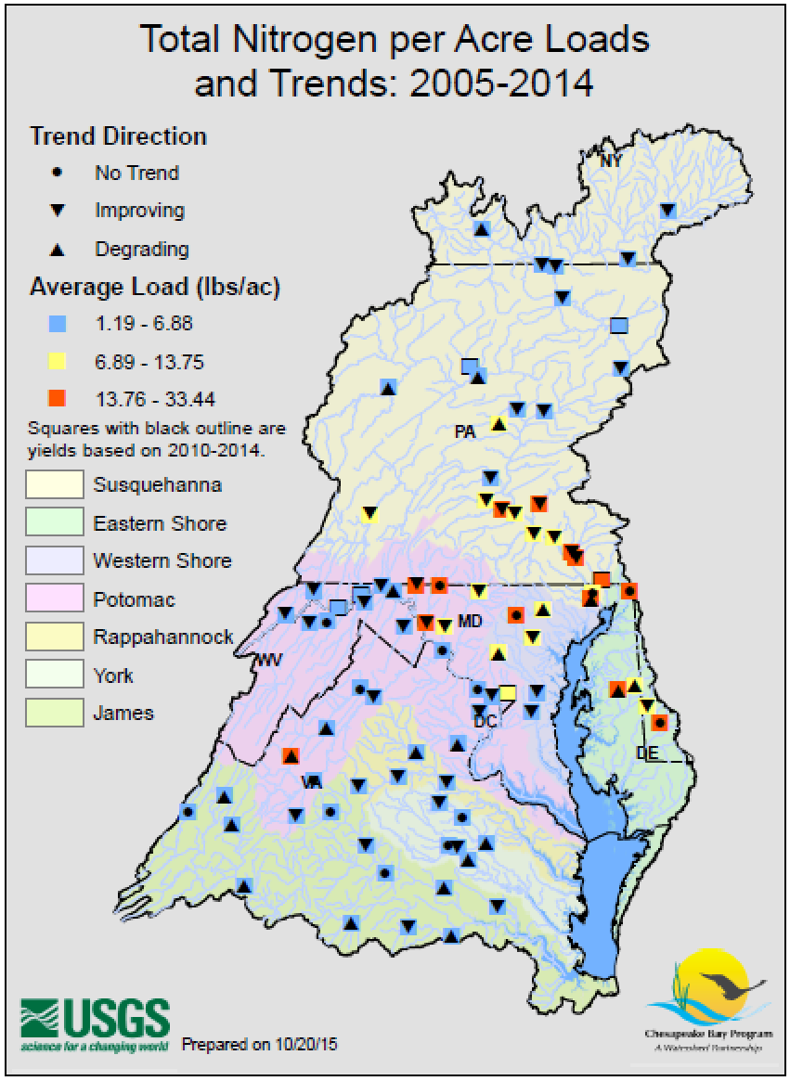
Evolve: Aquatic Conditions for Fisheries
Better link the patterns in the nontidal system with both:
Recreational fisheries
Observed response in the tidal system (e.g. DO, SAV)
CBP outcomes: WIPs; water- quality monitoring and assessment, fish habitat
USGS priorities: Land and Water Management
Notes:
As we complete out MPA commitments, we can better link our Aquatic Condition work to both Obj 1 on recreational fisheries and also addressing the Bay TMDL.
This is in good alignment with existing USGS and CBP needs.

Slide 14
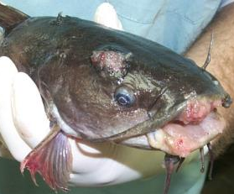
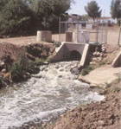
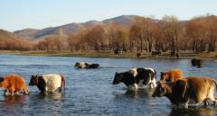
Fish Health and Consumption
Degraded health and fish kills in watershed - EDC Study
Evolve Activities:
Fish health & recreational species
Safer for human consumption
Effects of disease, contaminants, pathogens
Co-benefits of nutrients/sediment reduction
CBP: fish habitat, toxic contaminants,
WIP 2025
USGS: Land & water management
public health
Notes:
1. Evidence of degraded health include (1) tumors in bottom-dwelling fish (2) feminization (intersex conditions), (3) reduced reproductive success in both fish and wildlife. Contaminants one of the primary factors.
2. High levels of contaminants, primarily PCBs and mercury, have led to fish consumption advisories that restrict the amount of striped bass (and other valuable species) that can be eaten each month.
USGS is doing more work in the Susq. and Potomac basin to determine the extent of poor fish and wildlife conditions and which contaminants are the most likely cause. EDCs, which include PCBs, pesticides, and newer contaminants are the primary focus since they effect the reproductive system of fish and wildlife. We are setting up and carrying out approaches to find out how much of the problem is related to waste water treatment plants and animal agricultural. Once we better id the sources, the CBP partners can take advantage of the efforts to reduce nutrients and sediment and achieve additional benefits to reduce contaminants. These efforts will largely be completed in 2019 so need to evolve afterwards.
Evolved activities will better connect with the proposed recreational fish and habitat efforts, and even contribute a human-health component (related to consumption)
Want them to be well integrated with studies on additional stressors on fish. We feel contaminants could compromising the immune system of fish making them more susceptible infectious disease and parasites causing fish kills.

Slide 15
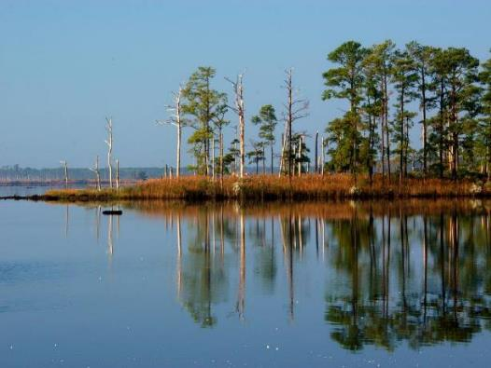
Proposed Chesapeake Science Theme:
MIGRATORY WATERBIRDS AND COASTAL HABITATS
Notes:
The Bay lies in the heart of the Mid-Atlantic flyway so very important for waterfowl species such as black ducks. Black ducks are an indicator species since there is an effort to restore populations along the entire East Coast.
Authorities for this work are strong under the Migratory Bird Act
Restoring and protecting populations of waterfowl is a fundamental priority of the DOI and the Chesapeake Agreement. Goal is to provide wintering habitat for 100,000 black ducks. Shown is Blackwater Refuge.

Slide 16
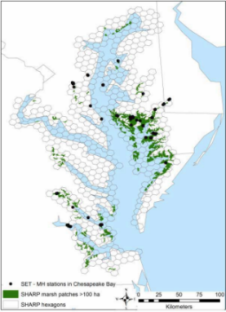
Migratory Waterbirds and Habitats
Current USGS activities
Black Duck as indicator species
Food requirements and modeling
Sea-level rise and BD habitat mapping
FWS Refuges
2018 commitments
CBP: Black ducks, wetlands
USGS: Land management
Notes:
The USGS is working with FWS to develop models of the habitat requirements of black ducks to help guide restoration on refuges. We are also involved in looking at waterbird populations coming back as Popular Island and other near shore habitat is restored.
In 2015-6, we increased our work to support wetland restoration. The focus is on the potential impact of sea-level rise and development on areas close to the Bay. The results would be used to help with restoration of wetlands and islands in the Bay and consider adaptation strategies to address longer-term impacts. This black duck work is scheduled for completion in 2018.

Slide 17
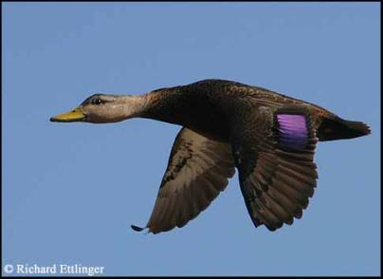
Migratory Waterbirds and Habitats
Evolve
Multiple species
Regional coastal habitats
Land change, SLR, & wetland adaptation (incl SAV)
CBP: Black ducks, wetlands
USGS: Land management
Notes:
Evolution - we’re considering a broadening related to multiple species, more diverse coastal habitats, and incorporating the effects of land change.
Multiple migratory waterbirds and their habitats. Priority topics from the Advisory Team include:
choose several species that represent important waterbird classes,
focus on the regional coastal habitat that support the species,
inform wetland adaptation and restoration,
focus largely on DOI lands.

Slide 18
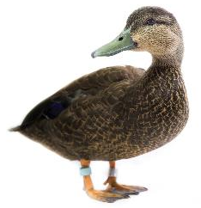
Migratory Waterbirds and Habitats
Multiple species and their habitats - potentially:
Black ducks – coastal salt marshes
Lesser Scaup - shallow waters
Surf Scoters – deeper/open waters
Wood Ducks – freshwater systems
Other?
Appl. of bioenergetics models to other
systems (SF Bay, maybe DE Bay)
Continue to track Land Change
and SLR
Continue wetland adaptation and restoration
Notes:
So, what might this expanded consideration of multiple Migratory Waterbirds across multiple habitats actually look like?
-Black Ducks as representatives of coastal salt marshes – this work is essentially completed – published in 2018
-Lesser Scaup as representatives of shallow water systems – this work is recently funded in Chesapeake and SF Bays – related to water quality and food source effects (clams, mussels)
-Surf Scoter as a representative of Sea ducks and deeper/open water systems. This work is completed – Alicia was working on the monograph (effects of oyster restoration)
-Wood Ducks as representatives of upland freshwater systems. This would be brand new work and is unfunded as of now)
The application of the bioenergetics model to SF Bay is part of the recently funded Lesser Scaup work Alicia has with Chris Williams (Univ of DE). Note that they’ve had to put the application to Delaware Bay on the back burner for now.
As part of the advisory Team Guidance, we’re going to continue some of our other critical efforts related to: Land Change, SLR, and Wetland Adaptation to inform restoration

Slide 19
How can you participate in this evolution?
Current Activities (2018)
Synthesis of completed activities
Communicate and inform
Continue selected efforts
Planning to evolve
Planning (during 2018)
Management issues and science needs
Science questions
Integration activities
Themes and objectives
Projects and resources
Science Team
Scientists
MAs and Managers
CBP Stakeholders
Implement (2019)
Work plan
Funds (MAs)
2018: Some new activities begin
Notes:
Current science activities in 2018 have 4 major items:
Those that are being completed and results are being synthesized. Examples include the MPA, aspects of the EDC Project, Black duck modeling on Refuges
We have an emphasis on communicating the findings of the synthesis efforts to inform management decisions.
Selected efforts will continue, such as updating water-quality trends to inform fishery decision and wetlands as critical habitat for waterfowl,
Also during 2018 we will plan how to evolve efforts
Planning
Those efforts that are evolving to meet unmet science needs and priorities. The process will include:
Identification of management issues and science needs, according to the Mission Areas and CBP – this was completed through the Chesapeake Bay Advisory Team. The Science Team is also gathering some additional information to refine science needs of management issues
The Science Team will work with the Chesapeake scientists and managers to receive input on how we take the highest priority management needs and craft our revised research questions (including Themes, Objectives, and Integration Activities)
The Science Team will iterate with the CB scientists and managers to develop planned science activities based on the revised Integration Activities and work with MAs on potential funding to support efforts in 2019.
Implement
Will reflect the revised activities in the 2019 work plan
The Chesapeake Coordinators Work closely with USGS MAs to fund activities. We will work with the Science Team to optimize our 2019 PES allocations, leveraging funds as much as possible with other MA and partner funding.
Some selected activities will begin during 2018, in particular the development of the Fish and Fish Habitat efforts.

Slide 20
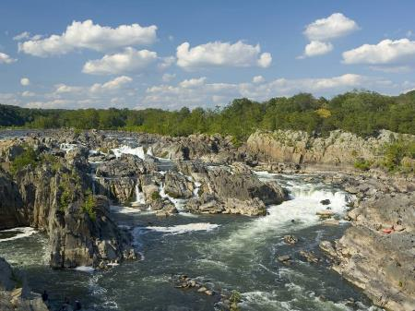
Questions?

