Slide 1
High Resolution Land Cover Data in the Chesapeake Bay
Chesapeake Conservancy

Slide 2
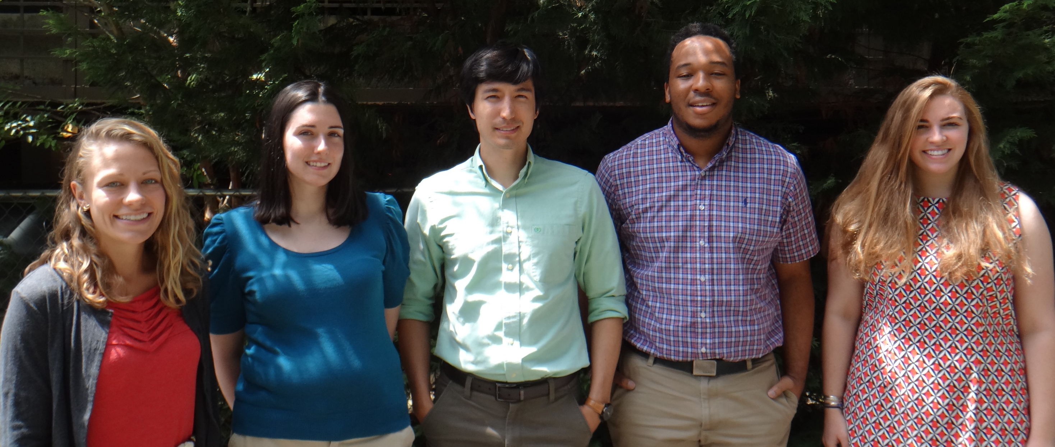
Project Team

Slide 3
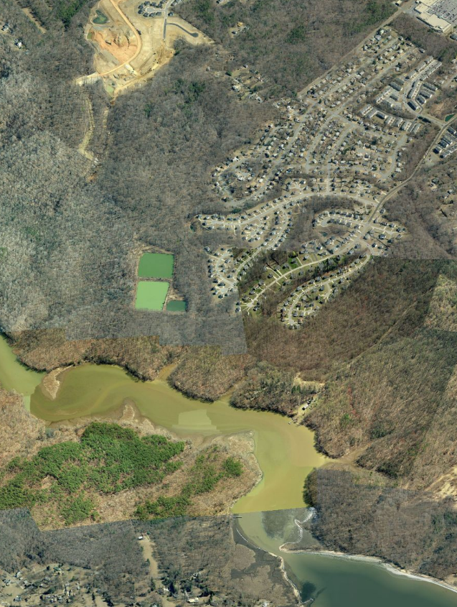
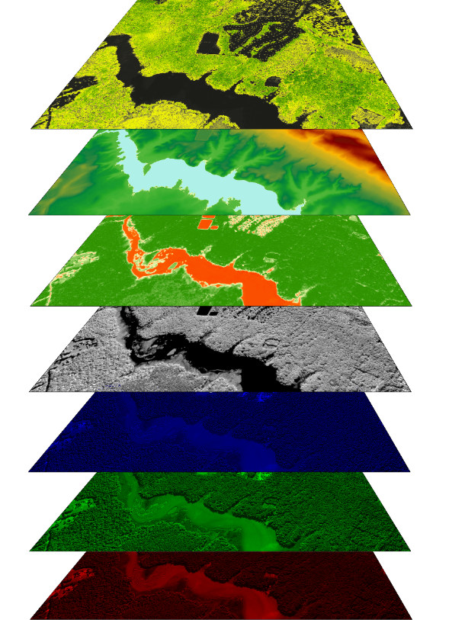
High-resolution Land Cover Classification
nDSM
We are using remote sensing and GIS modeling to generate a 1m resolution land cover dataset for all watershed counties in NY, PA, MD, DE, DC, and WV
nDTM
NDVI
NIR
Blue
Green
Red

Slide 4
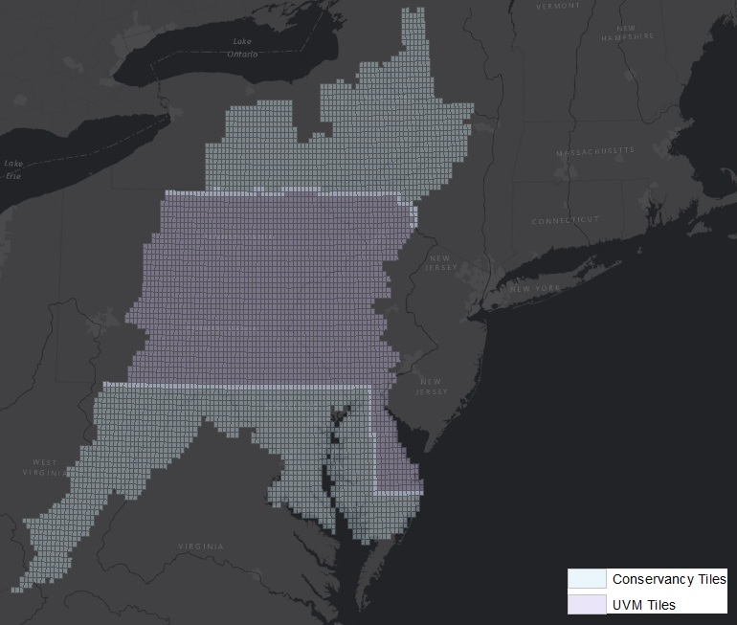
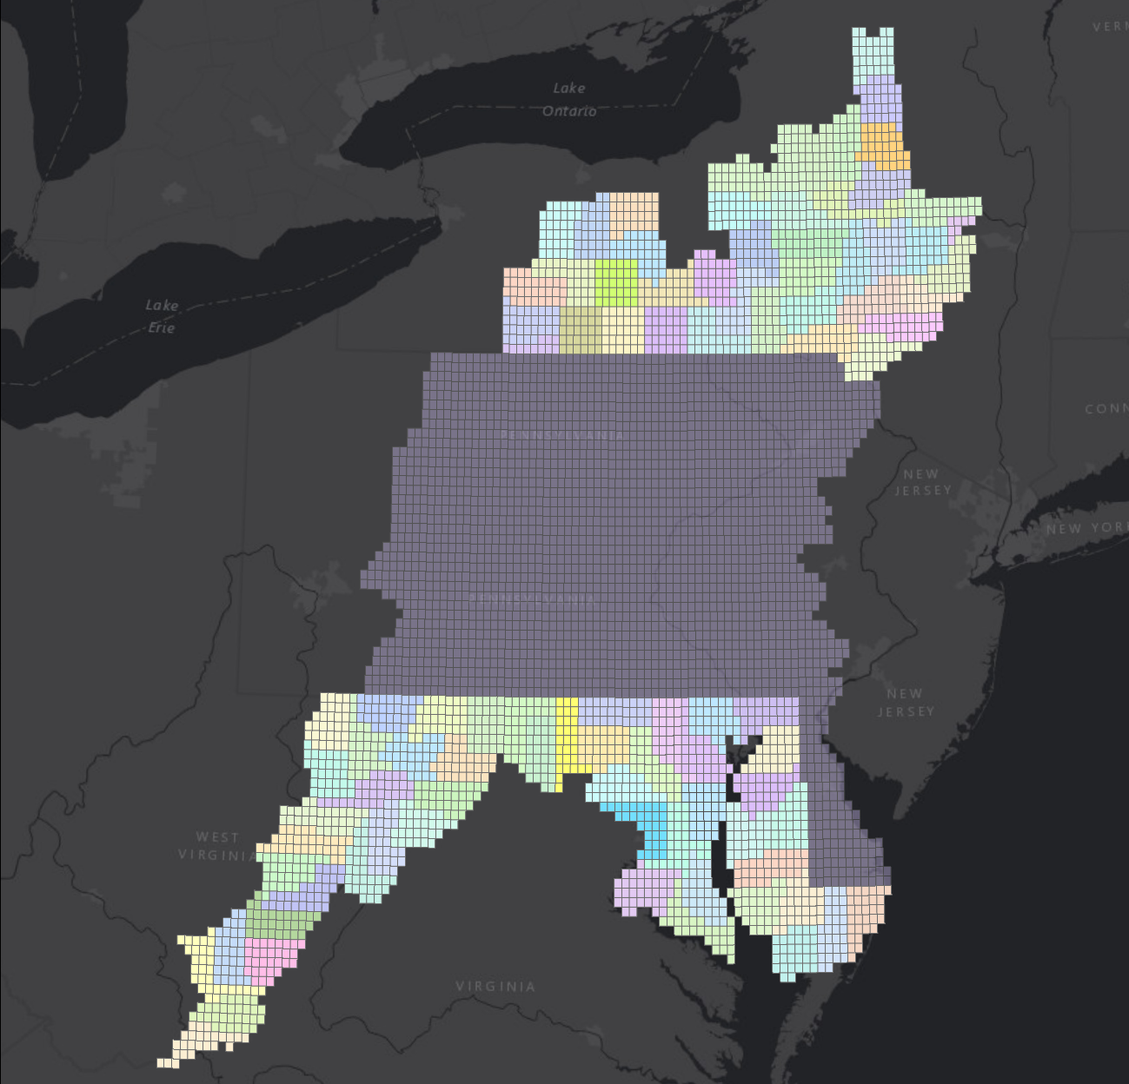
Project Area

Slide 5
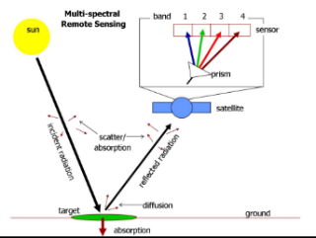
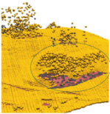
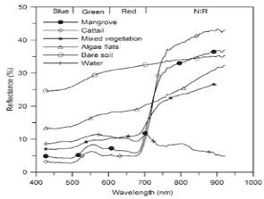
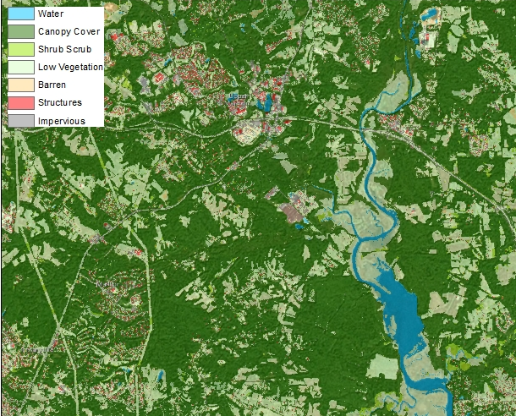
High-resolution Land Cover Classification
Our rule-based, object oriented image classification will identify 10 land cover types with 900x the resolution of National Land Cover Dataset (NLCD)

Slide 6
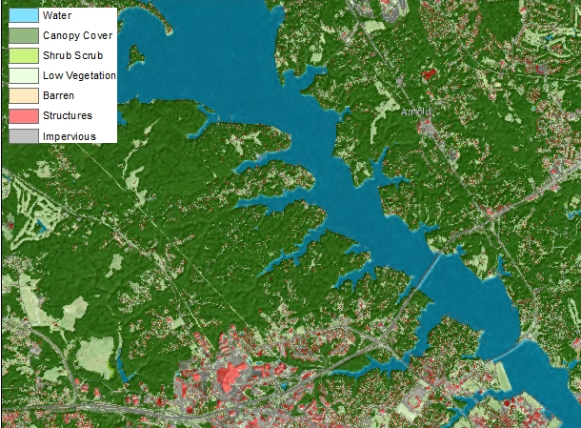
High-resolution Land Cover Classification
Water
Emergent Wetlands*
Tree canopy
Scrub-shrub
Herbaceous/Grass
Barren
Impervious surfaces- Roads*
Impervious surfaces- Other*
Impervious surfaces- structures
Impervious surfaces- obscured by tree canopy*
* Classes will be extracted by intersecting leaf-off classification and planimetric data with leaf-on classification data

Slide 7
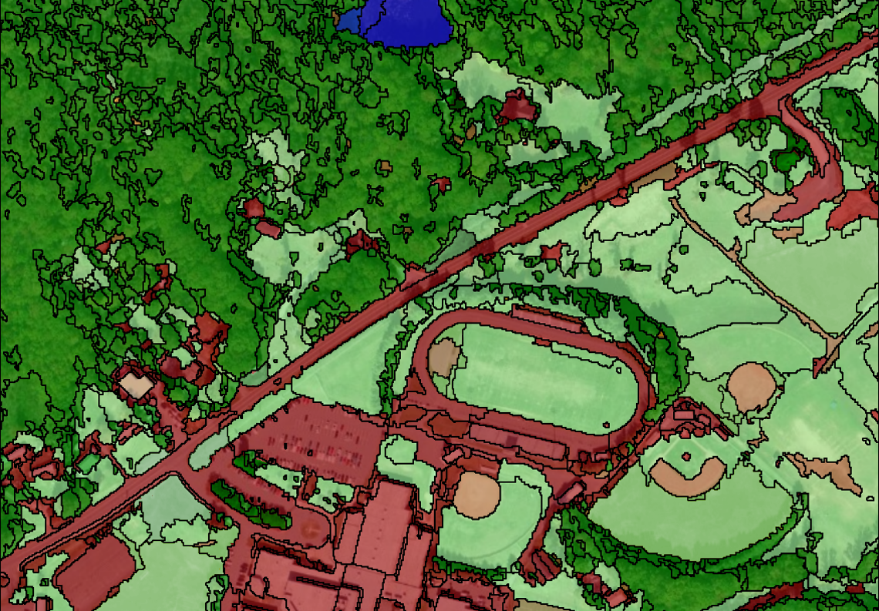
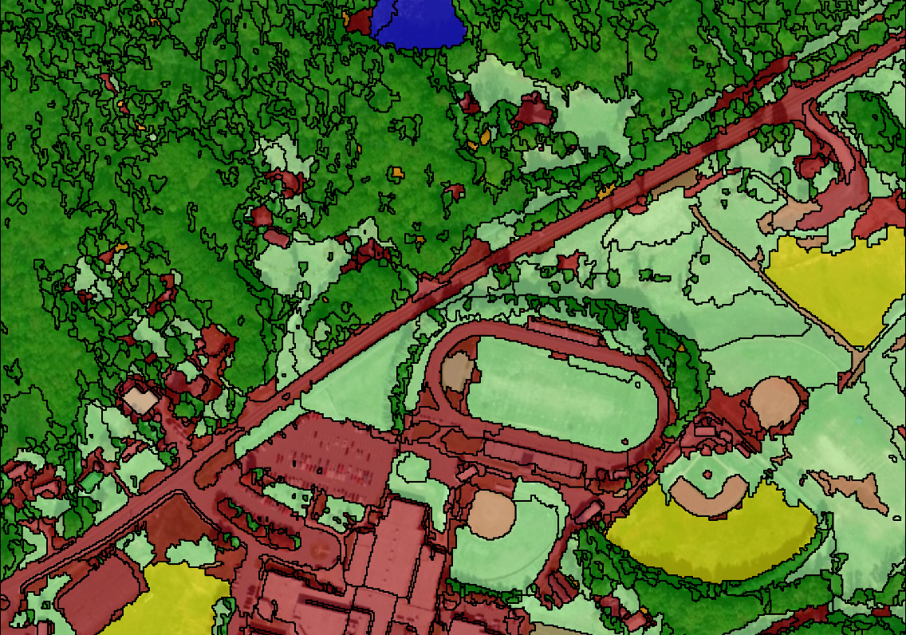
High-resolution Land Use Classification
2-stage process:
Initial semi-automated feature extraction
Manual reclassification to improve overall accuracy (~95% accuracy)
Currently incorporates LiDAR data but we have an alternate method that still produces high accuracy data for areas where LiDAR has not been collected

Slide 8
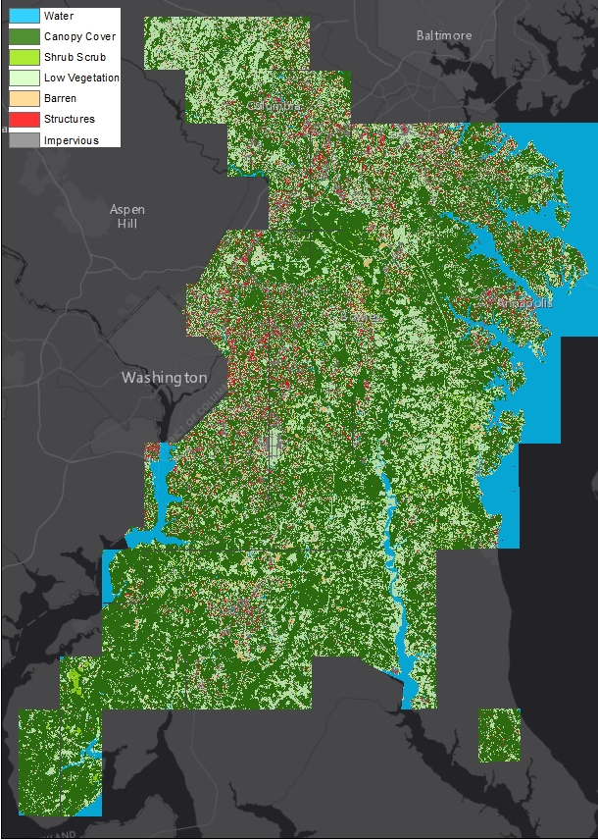
Progress to Date

Slide 9
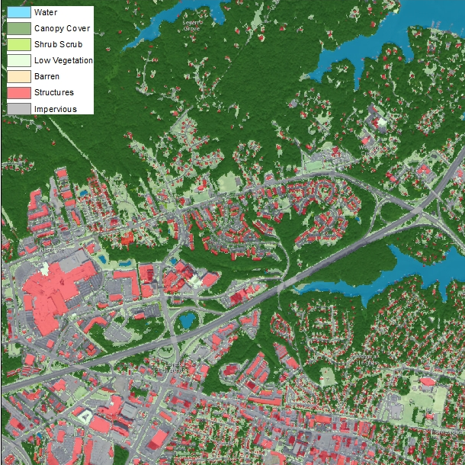
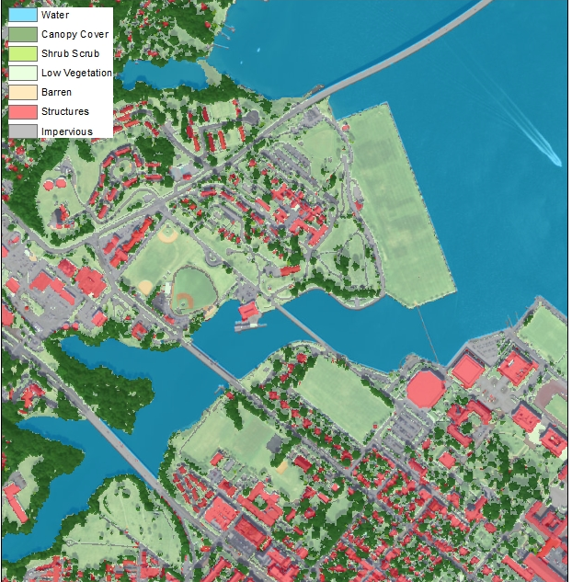
Examples of Land Cover Product Outputs

Slide 10
Roles in Developing the Phase 6 Mapped Land Use Classes
Chesapeake Conservancy
University of Vermont
Land Use Workgroup
Mapped P6 Classes
Impervious Roads
Impervious Roads
Impervious Structures, etc.
Impervious Non-roads
Tree Canopy over Impervious
Tree Canopy over Impervious
Tree Canopy over Pervious
Forest
Tree Canopy over Herbaceous
Tree Canopy over Scrub-shrub
Open Space
Turf Grass
Potential Agricultural Area
Scrub-shrub
GIS Analysis
Developed Land Use
Barren
Herbaceous
Water
Tidal wetlands
Palustrine forested
Palustrine scrub-shrub
Palustrine emergent
Water
Wetlands (emergent)
Overlay with NWI and NHD-H

