Slide 1

STAC Summary for the Principals’ Staff Committee
Andrew Miller, Chair
October 8, 2020

Slide 2
A few key points from the Executive Council presentation
We stand with the other Advisory Committees in offering continuing support during the COVID-19 crisis
We applaud the watershed partners’ commitment to the 2025 restoration goals
We support the Executive Council’s endorsement of the Bay Program’s Diversity, Equity, Inclusion and Justice Statement
We endorse the recommendations of the other Advisory Committees
Our guidance and collective expertise continues to be a resource for making important decisions toward an environmentally and economically sustainable Bay

Slide 3
Looking toward the future…
Lessons to be learned from COVID-19
Recent STAC workshops that may affect future restoration strategies:
Microplastics → Plastics Pollution Action Team
Freshwater Mussels
BMP Spatial Targeting
BMP Nutrient Species Targeting
Two ongoing science synthesis projects:
Impacts of climate change on BMP effectiveness
Impacts of climate change on dissolved oxygen in shallow waters
Comprehensive Evaluation of System Response
The future Chesapeake Bay: chasing a moving target

Slide 4
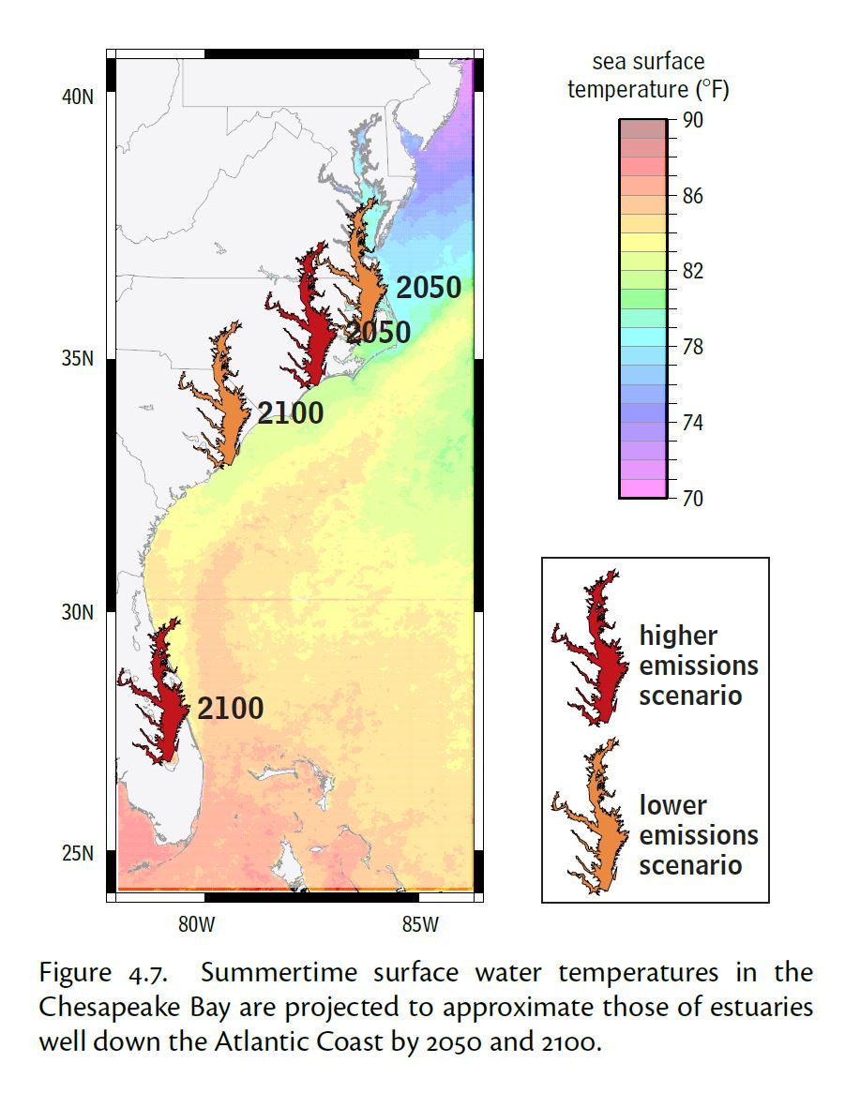
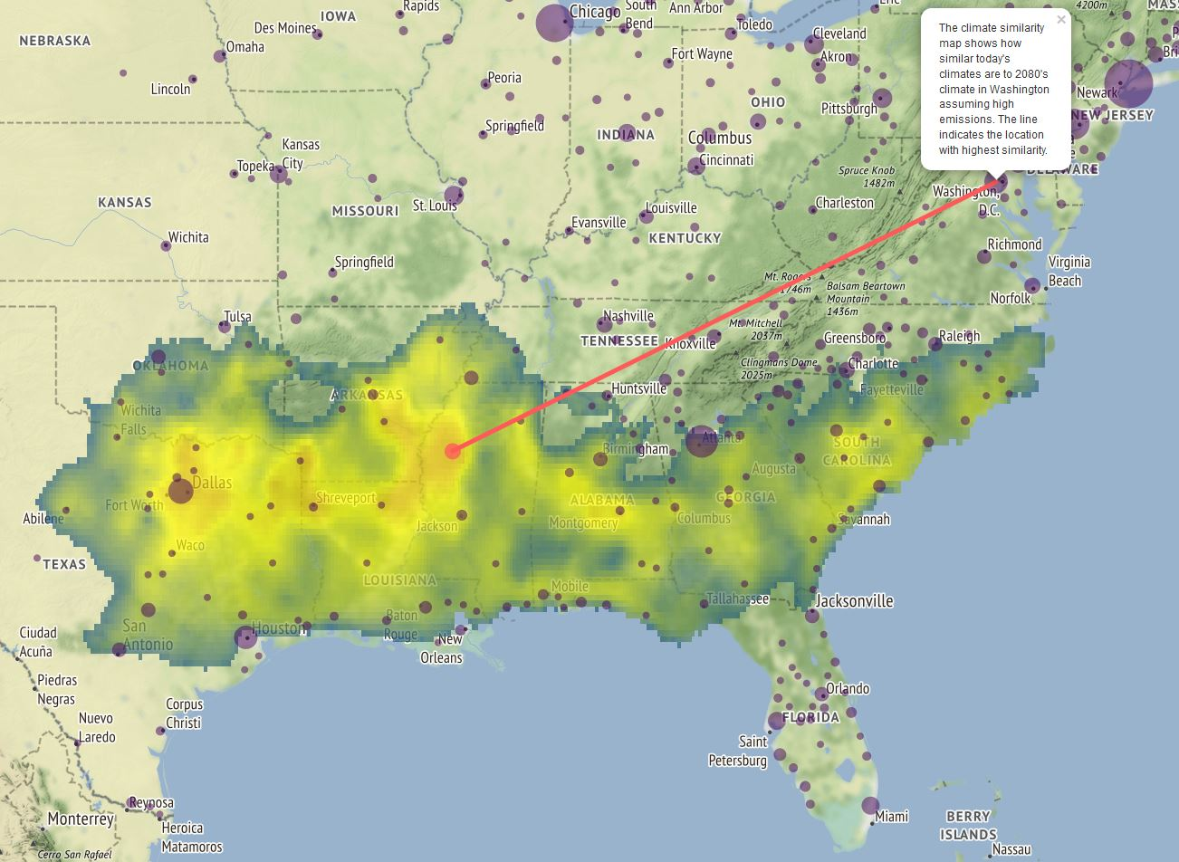
Future Urban Climates project – Washington, D.C. in 2080 resembles Greenwood, Mississippi of 2020
Global Warming in the Free State, 2008

Slide 5
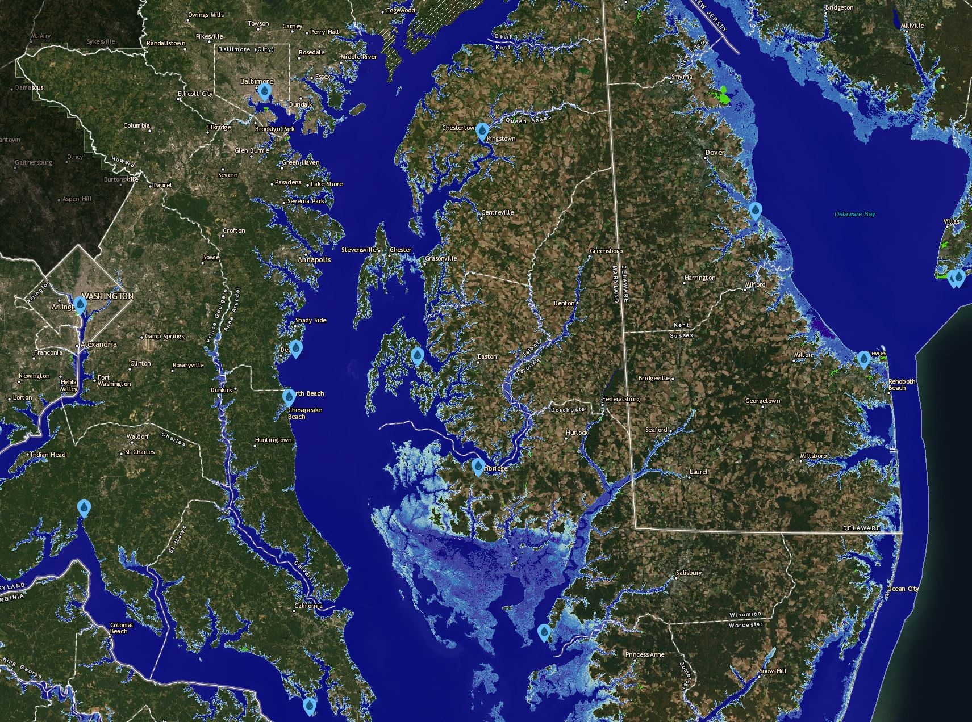
NOAA Sea-Level
Rise Viewer
Chesapeake Bay in 2080: intermediate forecast of +3.12 ft

