Slide 1

Achieving the Goal of Stewardship
2014 Chesapeake Watershed Agreement
Developing a Citizen Stewardship Indicator
Survey Questionnaire Review
September 9, 2015

Slide 2

Measuring
Stewardship Behavior

Slide 3
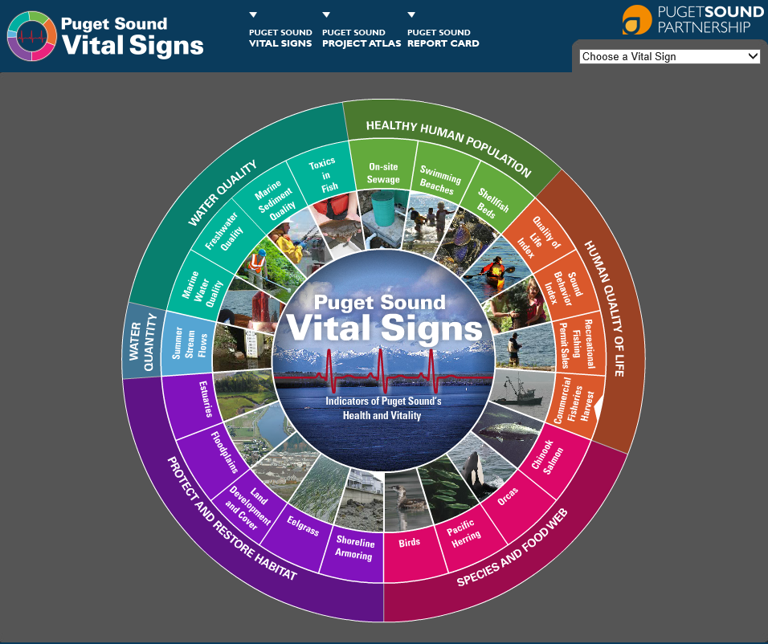
Puget Sound Behavior Index
Measures both positive and negative behaviors.
28 behaviors
Stratified for 12 counties
Scale: Never, Seldom, Sometimes, Usually, Always

Slide 4
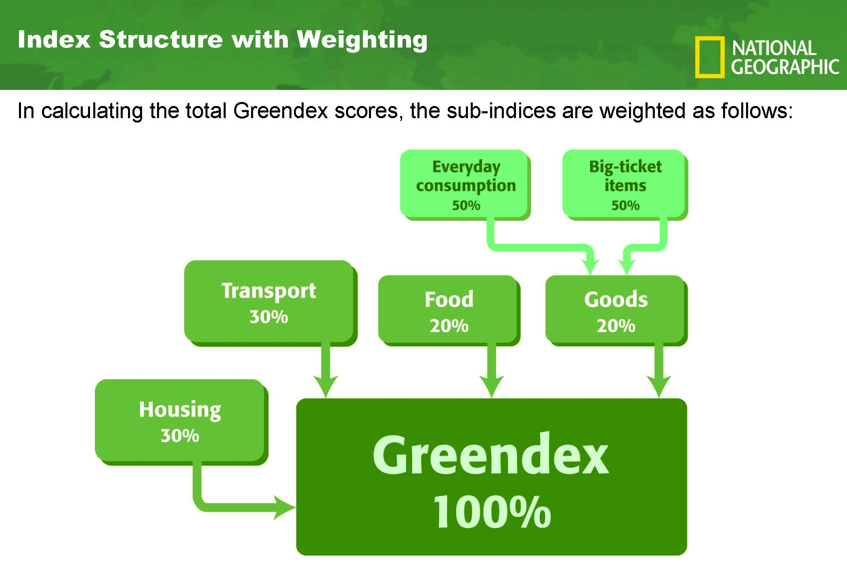
Meta-index with 4 sub-indices.
Internally weighted.
65 variables.

Slide 5
From Our Previous Meetings
2025 time horizon for this Indicator.
Tracking human behavior.
Measure: Stewardship Behaviors, Volunteerism, Civic Engagement.
Include a scaled measure of frequency and/or future likelihood.
Leadership not measured here because incidence too small.
This is a meta-index.

Slide 6
What This Survey Tool is Not
The citizen stewardship index will NOT verify implementation of behaviors or practices per Bay Program protocols. Other tools like the Smart Tracker exist for this purpose.
It will NOT answer why questions.
It will NOT measure public policy preferences.
It will not measure perceptions and attitudes, except those that directly drive stewardship behavior.

Slide 7
Questionnaire Structure
Introduction and Screening
Stewardship Behaviors
Cues to Individual Engagement
Volunteerism
Civic Engagement
Classification

Slide 8
Citizen Stewardship Indicator Virginia
SAMPLE

Slide 9
From Our Previous Meetings
Behaviors to Measure
Pet waste
Fertilizer use
Pesticide use
Leaves/Lawn clippings
Rain barrels
Conservation landscaping/Rain gardens
Tree planting
Fats, grease, contaminants down the drain
Septic systems
Litter
Downspout disconnect

Slide 10
Questionnaire Review

Slide 11
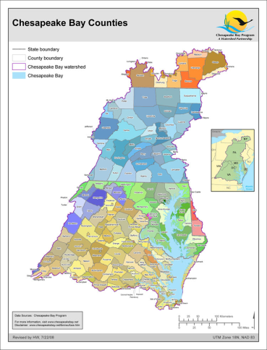
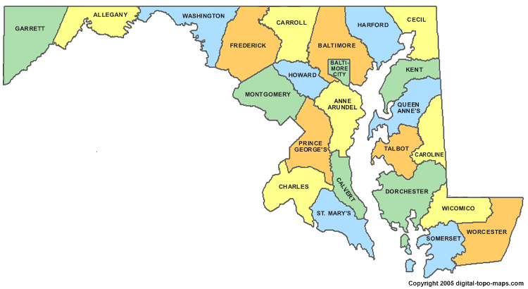
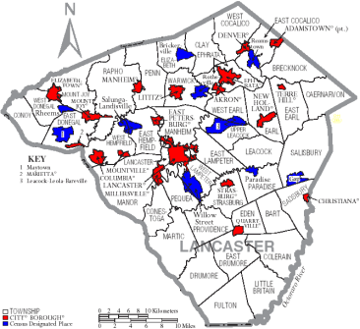
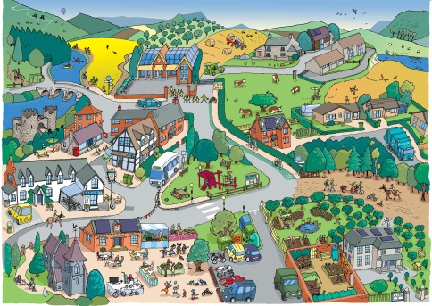
Citizen Stewardship Index
Measuring Stewardship Progress
 | Regional Index | State or Jurisdiction Index | County or Municipality Index | Community Index
Tool | Index Survey | Index Survey | Index Survey | Baysurvey.org
Date | Pilot Winter 2015 | Pilot Winter 2015 | TBD | Ongoing
Result | Pilot (+/- 2.2%) | Pilot (+/- 4.9% to 9.8%) | Pilot NA | Needs update
Base- line | 2016 GIT request | 2016 GIT request + partner match | County match as interested | Ongoing

Slide 12
Citizen Stewardship Index
Sampling Methodology
 | Pilot program (2015) | Rollout Option 1 (2016+)
 | N=2,000 | All states statistically significant N=5,200
MD | 400 (±4.9%) | 1,000 (±3.1%)
VA | 400 (±4.9%) | 1,000 (±3.1%)
PA | 400 (±4.9%) | 1,000 (±3.1%)
DC | 400 (±4.9%) | 800 (±3.5%)
WV | 200 (±6.9%) | 600 (±4.0%)
NY | 100 (±9.8%) | 400 (±4.9%)
DE | 100 (±9.8%) | 400 (±4.9%)

Slide 13
Next Steps

