Slide 1
Strategic Communications Plan: Initial Findings
June 10, 2016

Slide 2
Feedback Collected From…
Survey
Focus Group Sessions
One-on-one Interviews
Notes:
We collected feedback from a variety of sources – 13 one-on-one interviews with CBP stakeholders which included representatives from non-profits, workgroups, state and local government.
We had three focus groups sessions – the first consisted of CBP leadership; the second representatives from the Citizens’ Advisory Committee; and the third, the GIT Liason, representatives from the Local Government Advisory Committee, and federal staff (non-EPA).
Our survey was sent to 157 people, encompassing folks across all of our workgroups and goal teams, including the comm workgroup. Thank you again to those who participated! Overall we received 62 responses, which included 31 communicators. Survey participants were divided into 3 groups – and basically it was just members of the Communications Workgroups in one group, etc.

Slide 3
Survey Results
Sent to 157 participants in three groups
Group 1 – Communications Workgroup
Group 2 – Goal Implementation Teams, LGAC, CAC, STAC and STAR
Group 3 – PSC and Management Board
62 total respondents

Slide 4
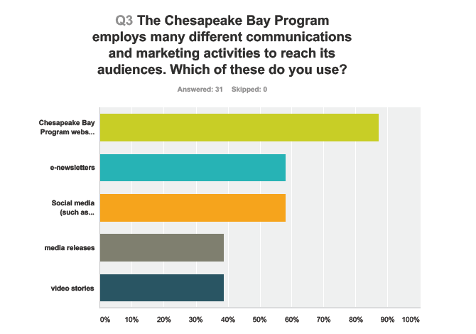
Survey Results
Our website – chesapeakebay.net – is our most popular communications tool, with 88% of our audience using it on a regular basis.
Notes:
Out of four main communications tools – our newsletters, social media, website, and videos – our website, chesapeakebay.net is our most popular tool with 88% of our audience using it on a regular basis. Another statistic that surprised us – 35% of our fellow communicators NEVER check our social media. We do utilize Facebook, Twitter, and Instagram as ways to communicate with our audiences. We don’t know if that’s because they didn’t know they existed or if they prefer not to.

Slide 5
Survey Results
More than half of survey respondents reported that our ability to communicate our work is only ‘fair’.

Slide 6
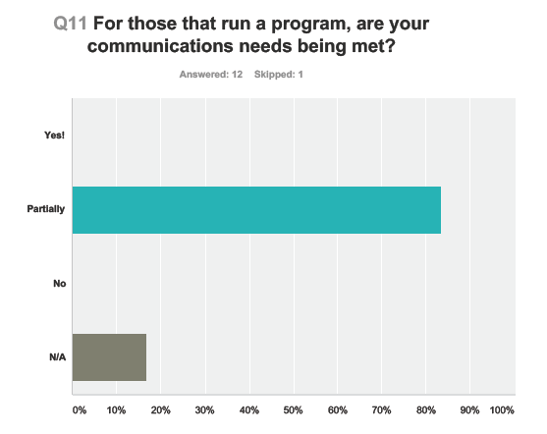
Survey Results
10 out of 12 respondents replied that their communications needs were only partially met.
Notes:
These respondents were PSC members and state leaders.

Slide 7
Focus Groups
Three Focus Groups
Group 1 - CBP leadership
Group 2 – Citizens Advisory Committee
Group 3 - Goal Implementation Team Liaison, Federal and Local Government Advisory Committee

Slide 8
Focus Groups
Increase our reach to diverse and underserved groups and communities to bring in different perspectives and cultural values.
Better engagement with local governments and non-profits.
Be more targeted in our communications and issue-specific.
Enhance internal communications amongst our partners.
Notes:
These comments are an aggregation of our focus groups – we found common themes across the board.

Slide 9
Focus Groups
“In the past, the Chesapeake Bay Program was a place of innovation and partnership to share ideas with cutting-edge science and policy. Then it became process-oriented; but not implementing or sharing information in a way that it can be distilled to local level folks who need it.”

Slide 10
One-on-One Interviews
Increase outreach to local government.
Enhance communications to partners.
Better reach the general public.
Notes:
Our one-on-one interviews were conducted with a variety of CBP stakeholders – included folks from the workgroups, states, non-profits, etc.
We did have a lot of conflicting messages that we’ll have to deal with. We’ve heard that the general public should not be one of our target audiences, but then others have said that we need to increase our outreach and communications to them.
Another example is in regard to water quality and TMDL. Multiple people said we focus too much on these elements and ignore other indicators and outcomes. On the flip side, increased communications on the TMDL was requested because what is currently out there is too scientific and hard to understand.

Slide 11
One-on-One Interviews
“We’ve seen success with some of our communications effort when we focus locally—we focus on local tributaries that people can see every day. The Chesapeake Bay Program needs to support local water efforts.”

Slide 12
What’s Next
Final report and recommendations from The Hatcher Group – expected mid-to-late June 2016.
Draft strategic plan by mid-July 2016.
Notes:
We are already combing through the findings and beginning to sketch an outline of what the plan will look like. With the final report due in a few weeks, then we’ll be busy discussing the recommendations and writing the final report. We will bring you a more detailed presentation about the plan in a future meeting.

Slide 13
Questions?
Rachel Felver, Director of Communications
Chesapeake Bay Program
rfelver@chesapeakebay.net
(410) 267-5740

