Slide 1
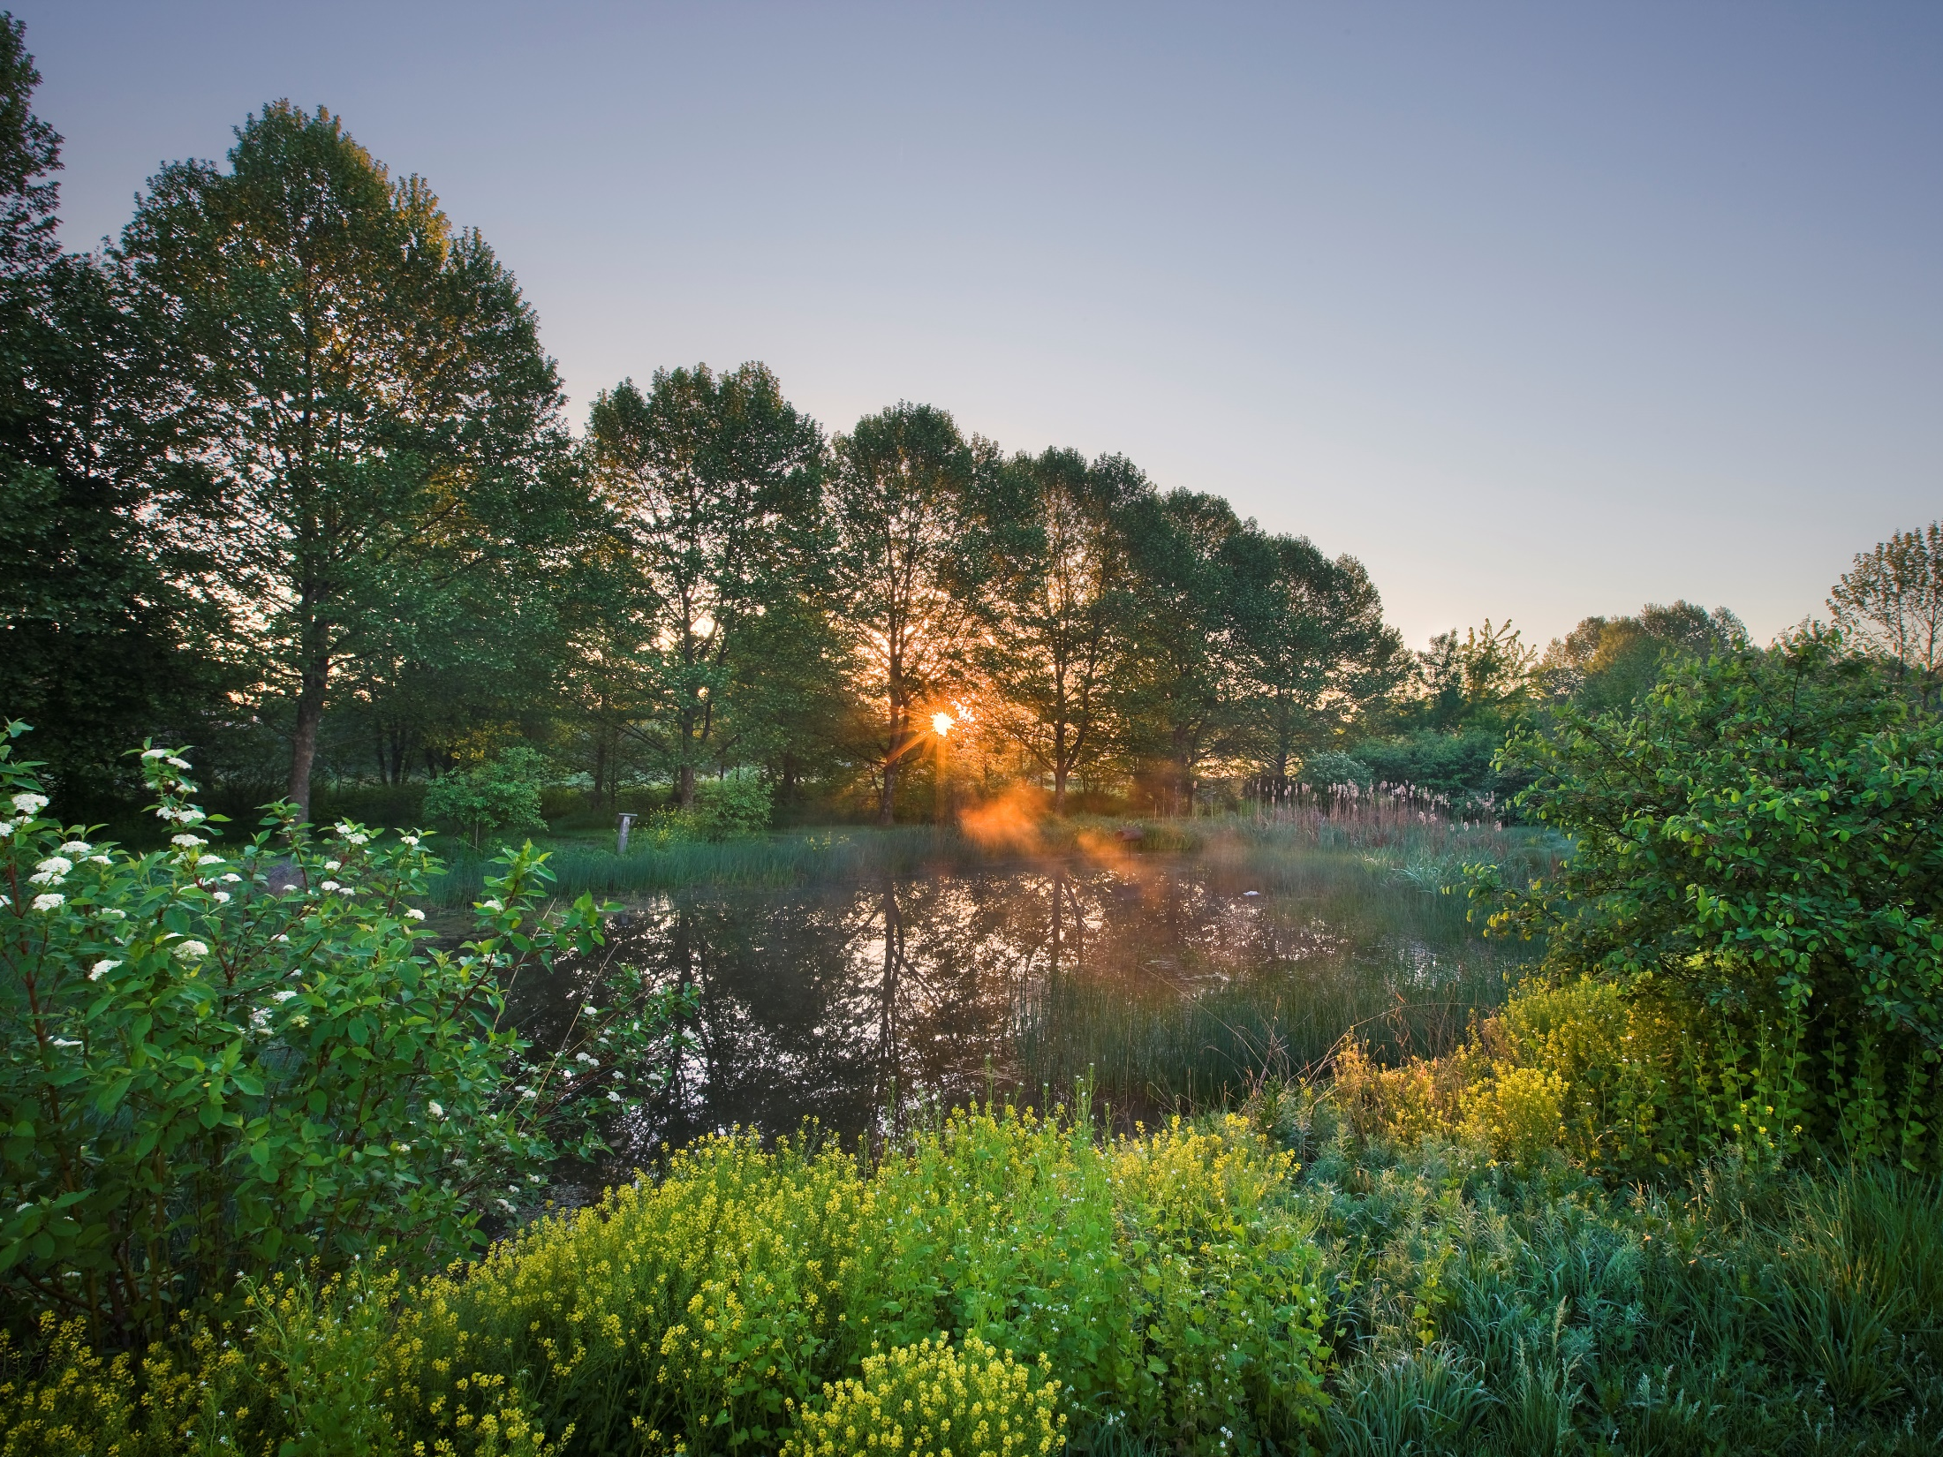

Healthy Watershed Tour
Lititz Run Watershed
Kelly Gutshall, RLA
December 14, 2017 | LGAC Meeting | Lancaster PA

Slide 2
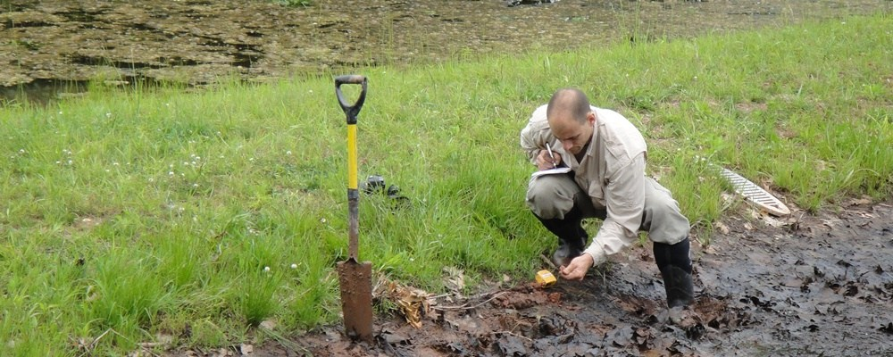

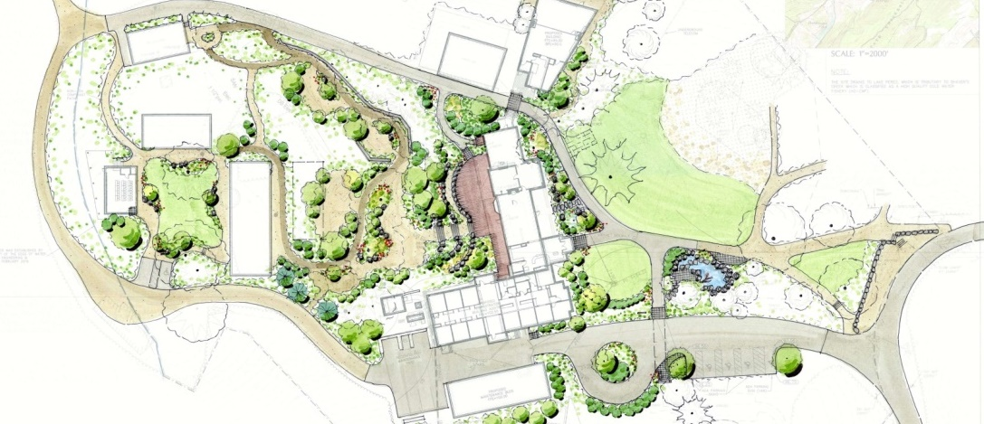
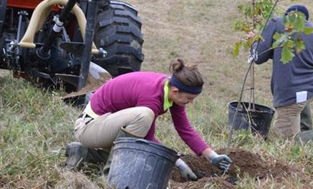
Science
water resource engineers
environmental scientists
geomorphologists
Design
landscape architects
environmental planners
restoration specialists
Shavers Creek Environmental Center
Field Operations
construction managers
installation and maintenance
certified pesticide applicators

Slide 3
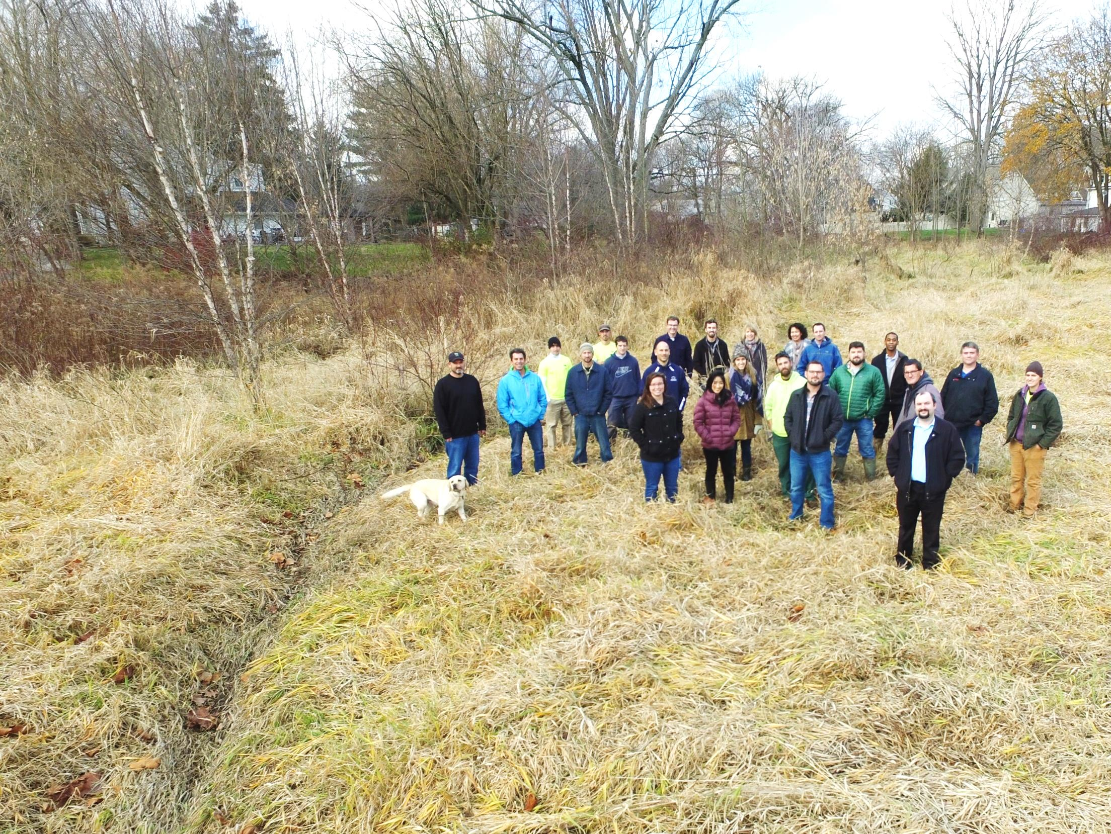
Our Mission:
is to utilize an experienced team approach to realize our vision for the benefit of our environment, clients, employees and community.

Slide 4
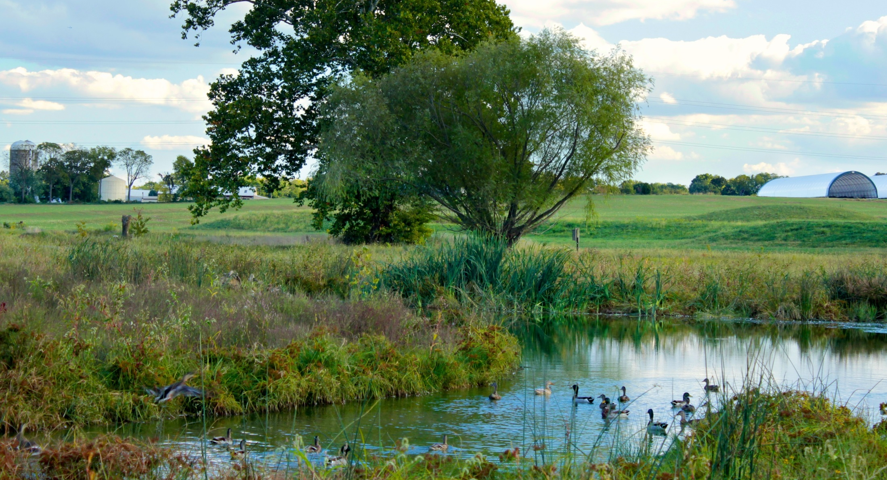
Solution:
An approach that identifies and implements strategic, cost effective, regional BMP’s
Creating regional, sustainable, functional,
natural systems that provide long term benefits.

Slide 5


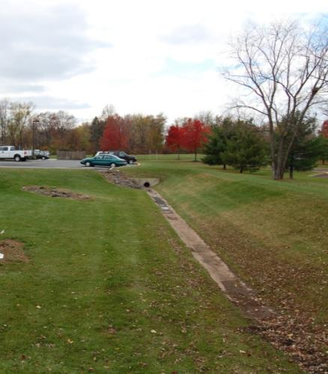
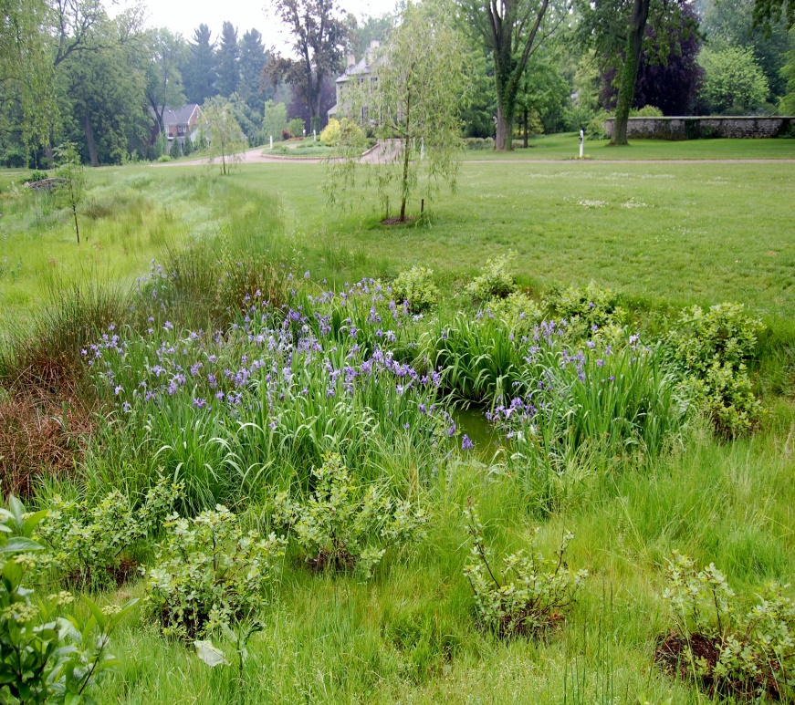
Single Function
Multiple Function

Slide 6

Multiple Benefits
Stormwater Management
Flood Reduction
Riparian Buffers
Sediment and Nutrient Reduction
Groundwater Recharge
Wetland Creation
Pollution Reduction
Wildlife Habitat Improvement
Invasive Plant Species Removal
Consistent Hydrology
Aesthetic Enhancement
Topsoil Generation
Environmental Education

Slide 7
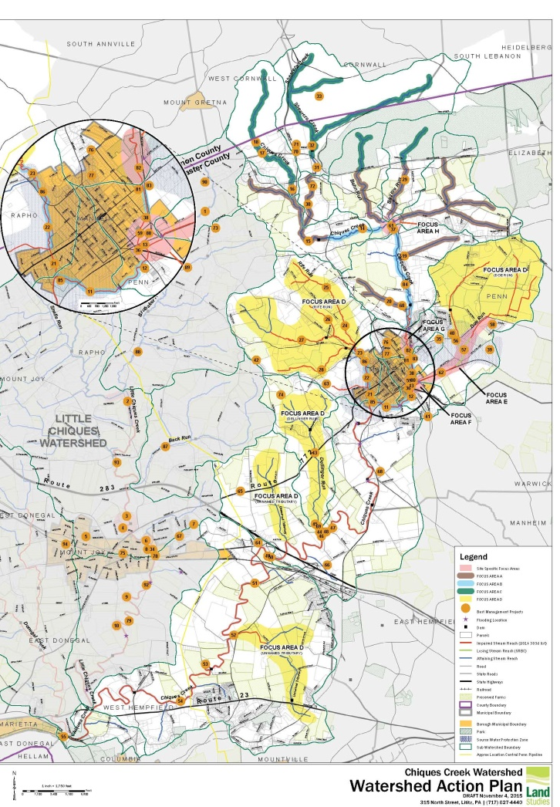
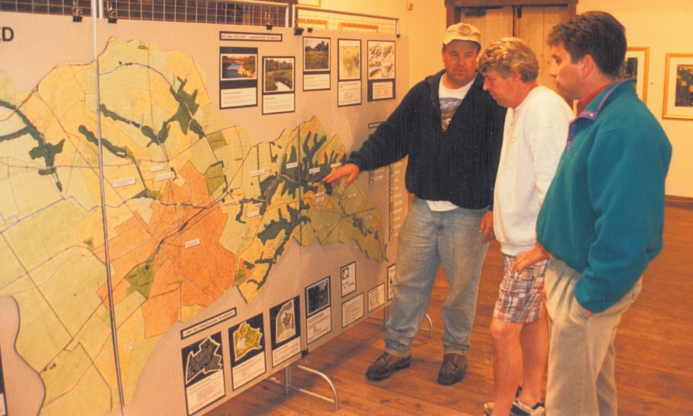
Watershed
Planning
Approach that encourages regional solutions in PA
1989
2016

Slide 8
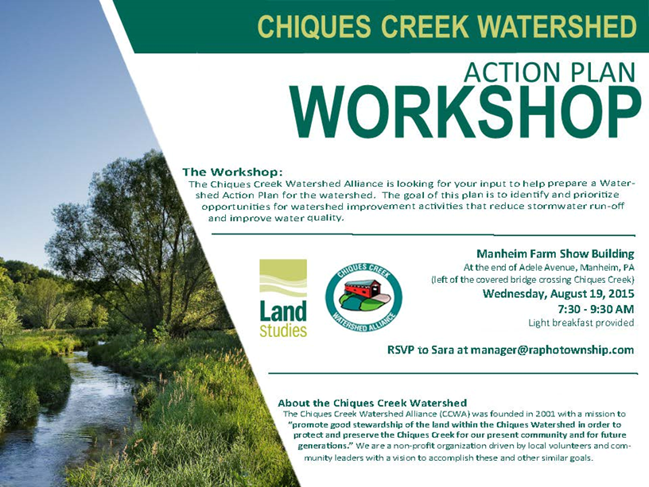
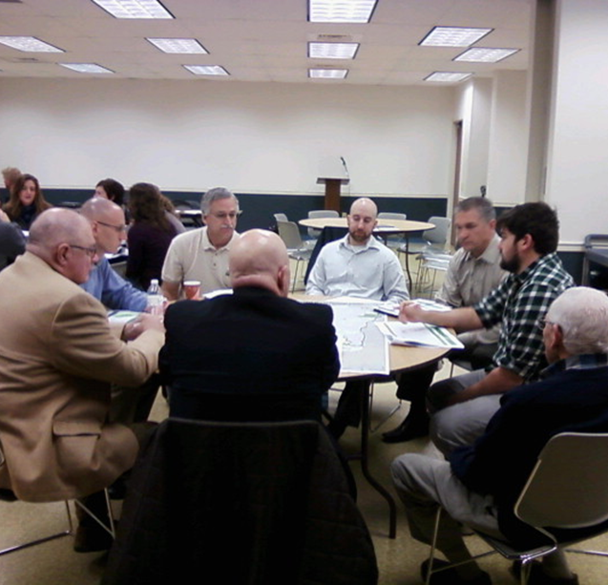
Tool: Watershed Action Plan
Grounded in Stakeholder input
Provides an Action Plan for Implementation

Slide 9
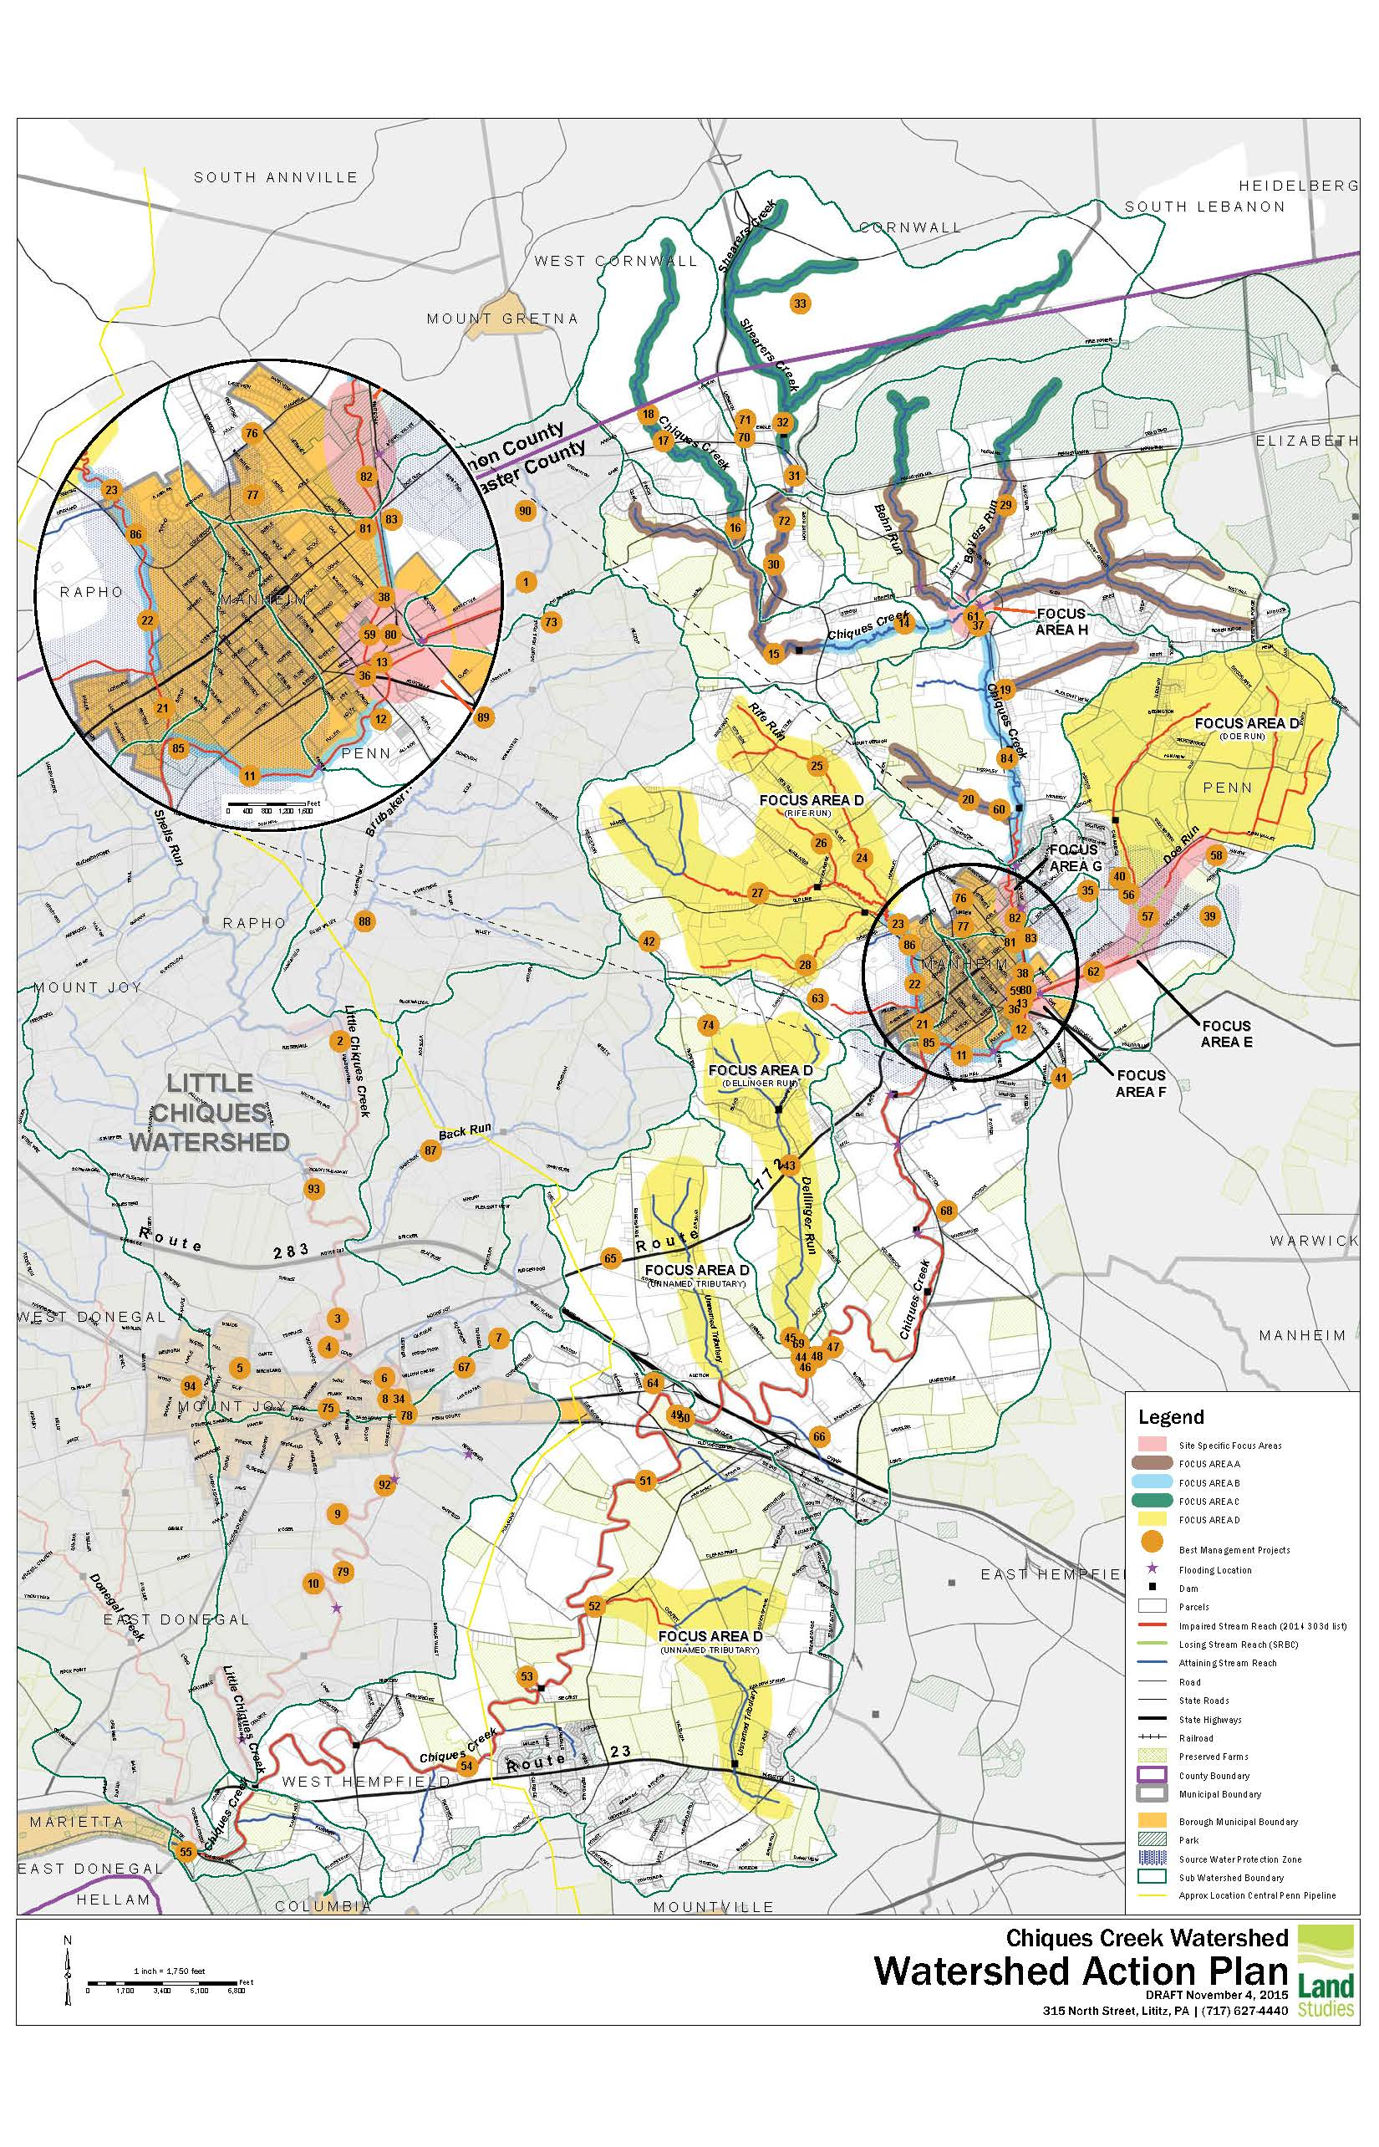
Watershed Action Plan
BMP Types
Basin Retrofit
Bioswale
Floodplain Restoration
Riparian Buffer
Streambank Stabilization
Rain Garden / Bioretention
Pervious Asphalt
Streambank fencing
Prioritization
Multiple Benefits - water quality, flood reduction, habitat restoration, etc.
MS4 / Urban Areas
Cost Benefit
Parks and Municipal Facilities
Willingness of Landowner
Replicability
Constructability
Funding potential

Slide 10
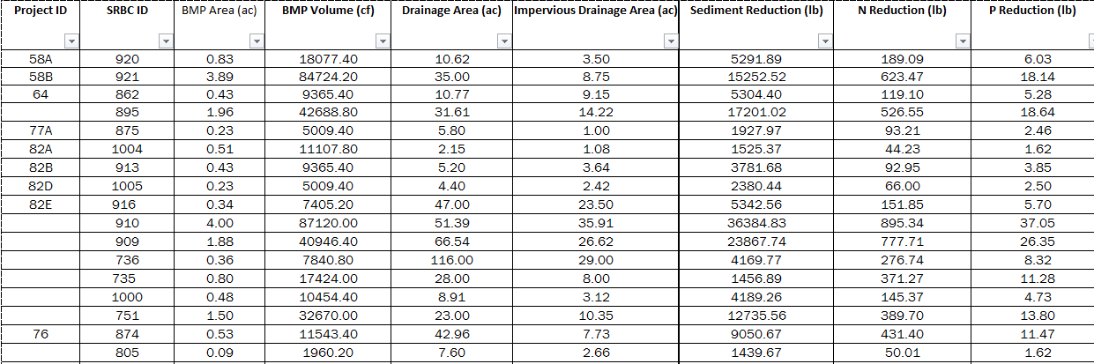
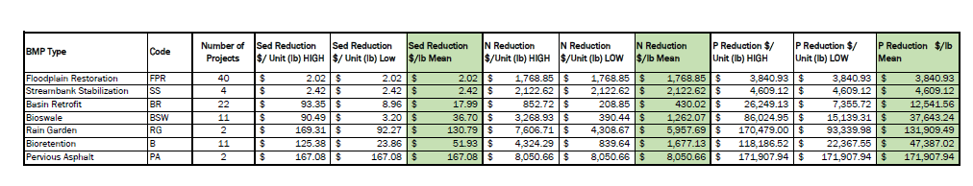
Prioritization Data Analysis
Project ID
Project Size
Drainage Area
Pollutant Reduction Potential
BMP Type: Cost per Pound of Pollutant Reduction

Slide 11
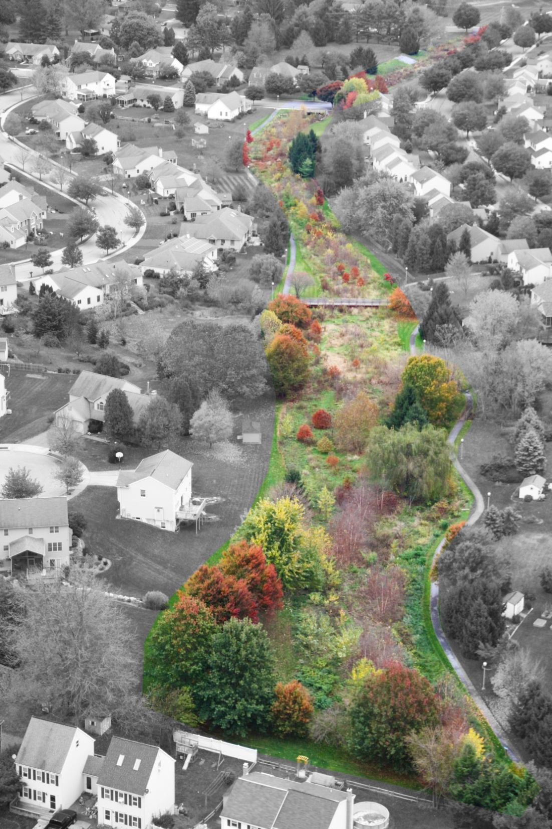
Prioritization
Considerations
Pollution Reduction
Cost verses Benefit
Willingness of Landowners
Long-term operation and maintenance
Municipal Facilities
(MS4 requirement) –
includes parks, greenways and trails

Slide 12
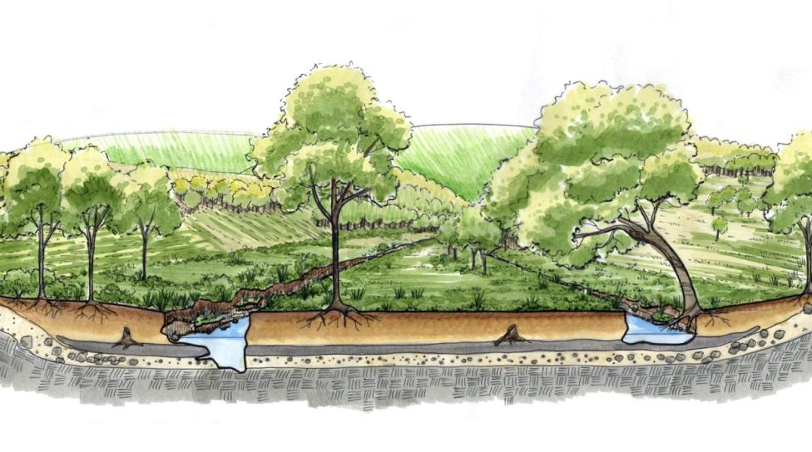
Typical Existing Floodplain Conditions
Historical
Floodplain Soils
Cobble/Gravel
Bedrock

Slide 13
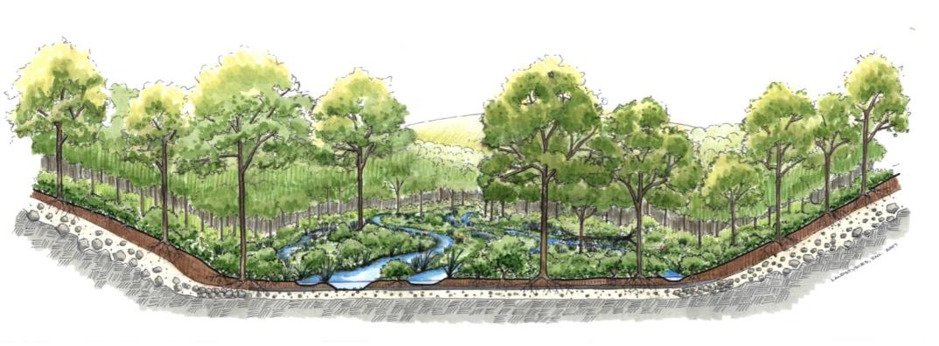
Historical Floodplain
Roots extend to groundwater
Cobble/Gravel Bed
(Groundwater)
Bedrock
Floodplain Soils –Shallow, Peaty, Organic, & Porous

Slide 14
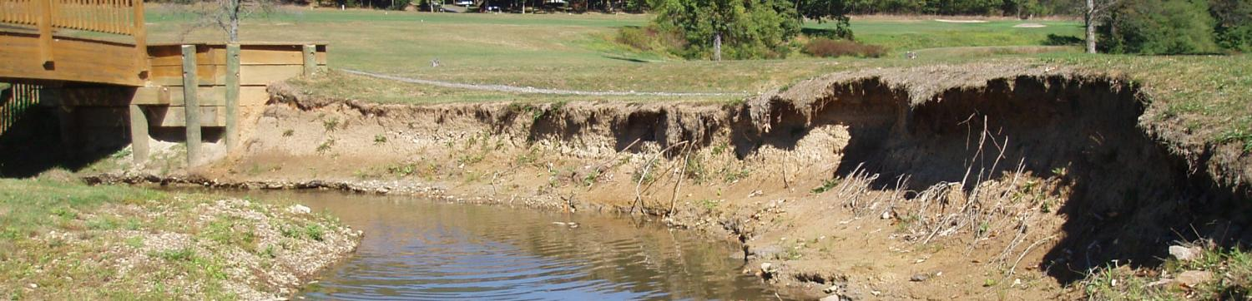
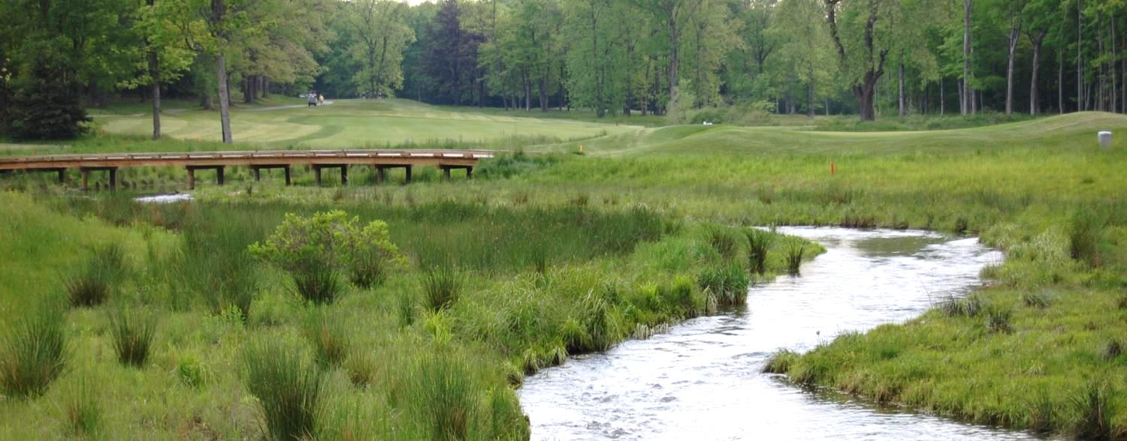
Functional, Natural System
Bedford Springs Resort Floodplain Restoration

Slide 15
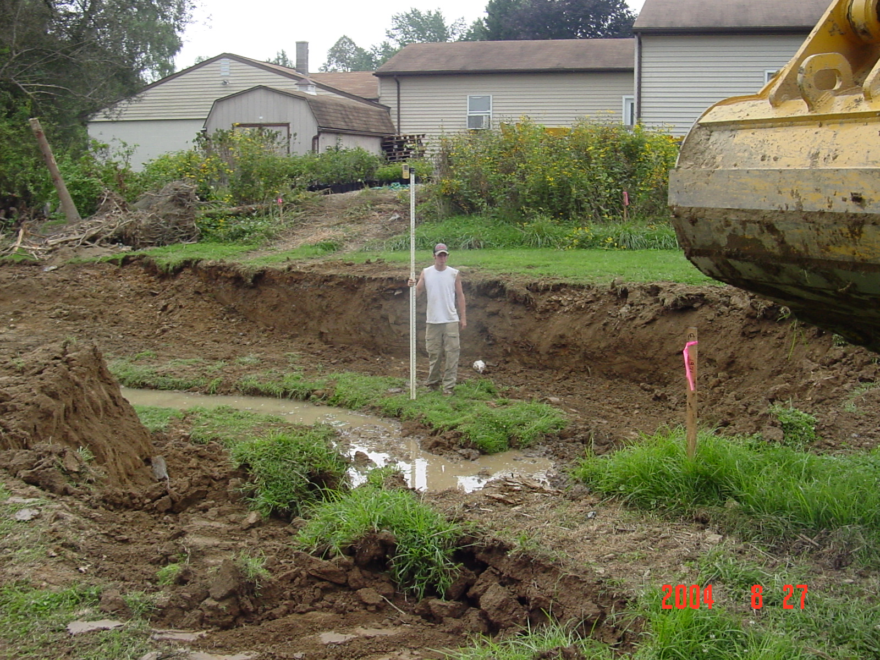

Slide 16
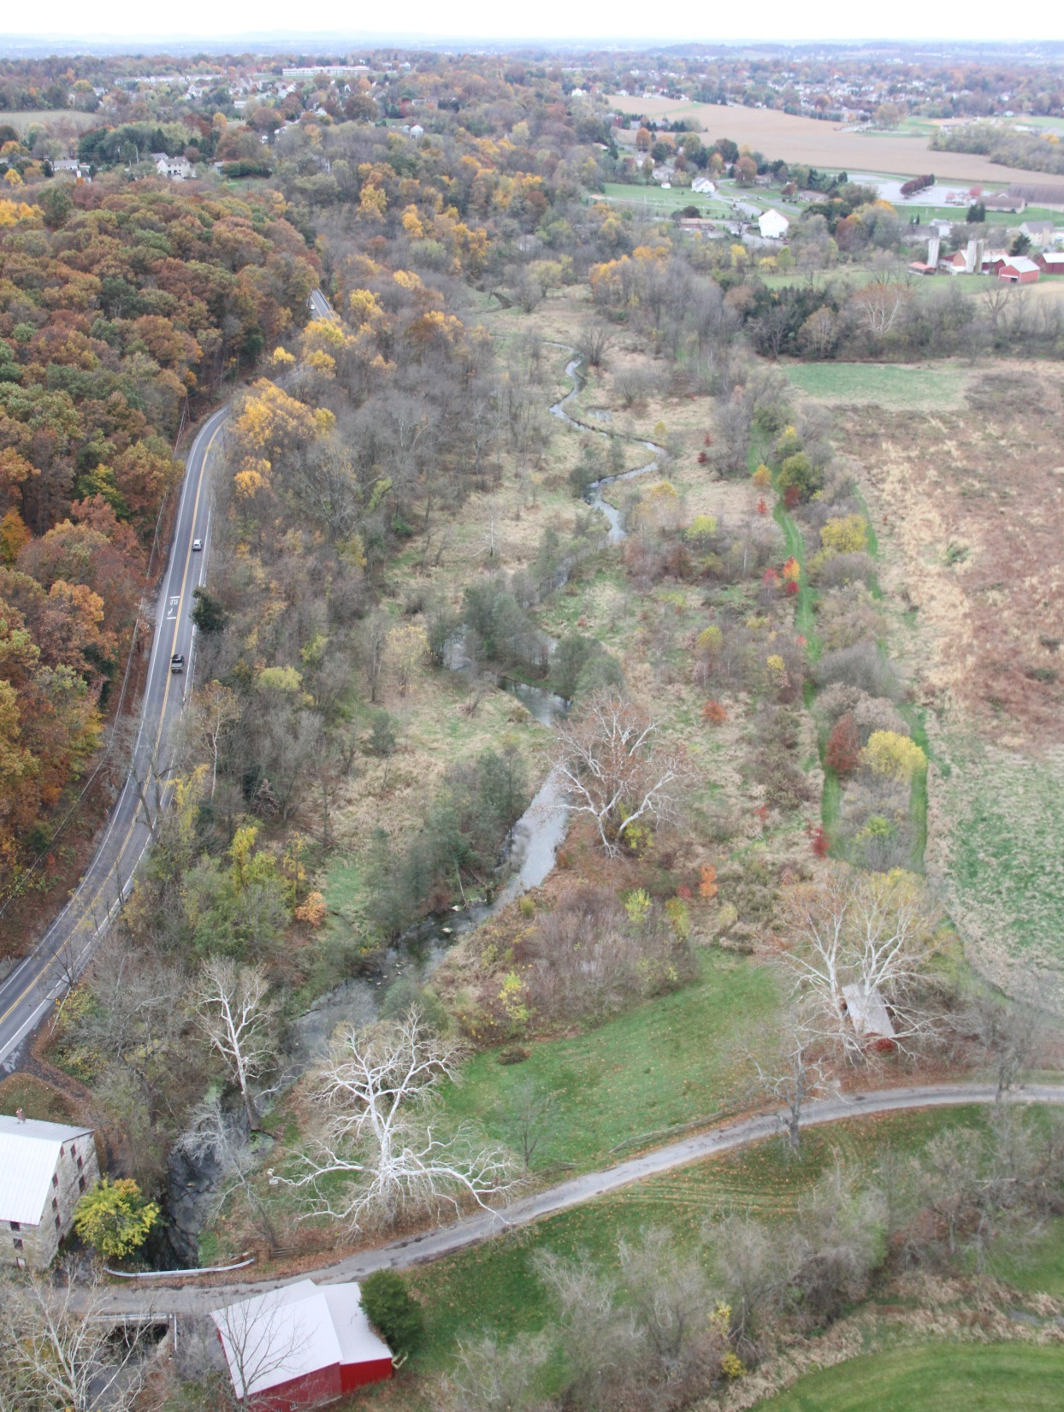
Lititz Run Watershed
How this community improved its water quality.

Slide 17
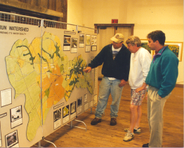
It all began in 1998
Notes:
Approach
Community based planning brings together a diverse group of local citizens who actively participate in the planning process.
The planning approach includes four components: community organization, public outreach and education, management and planning, and project implementation

Slide 18
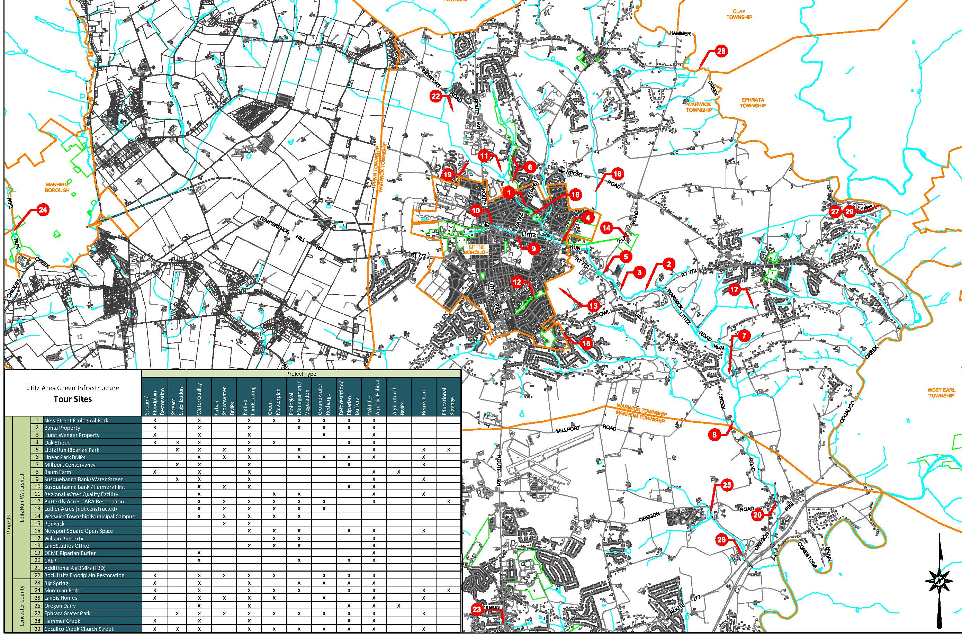
Over 35 projects implemented and continuing

Slide 19
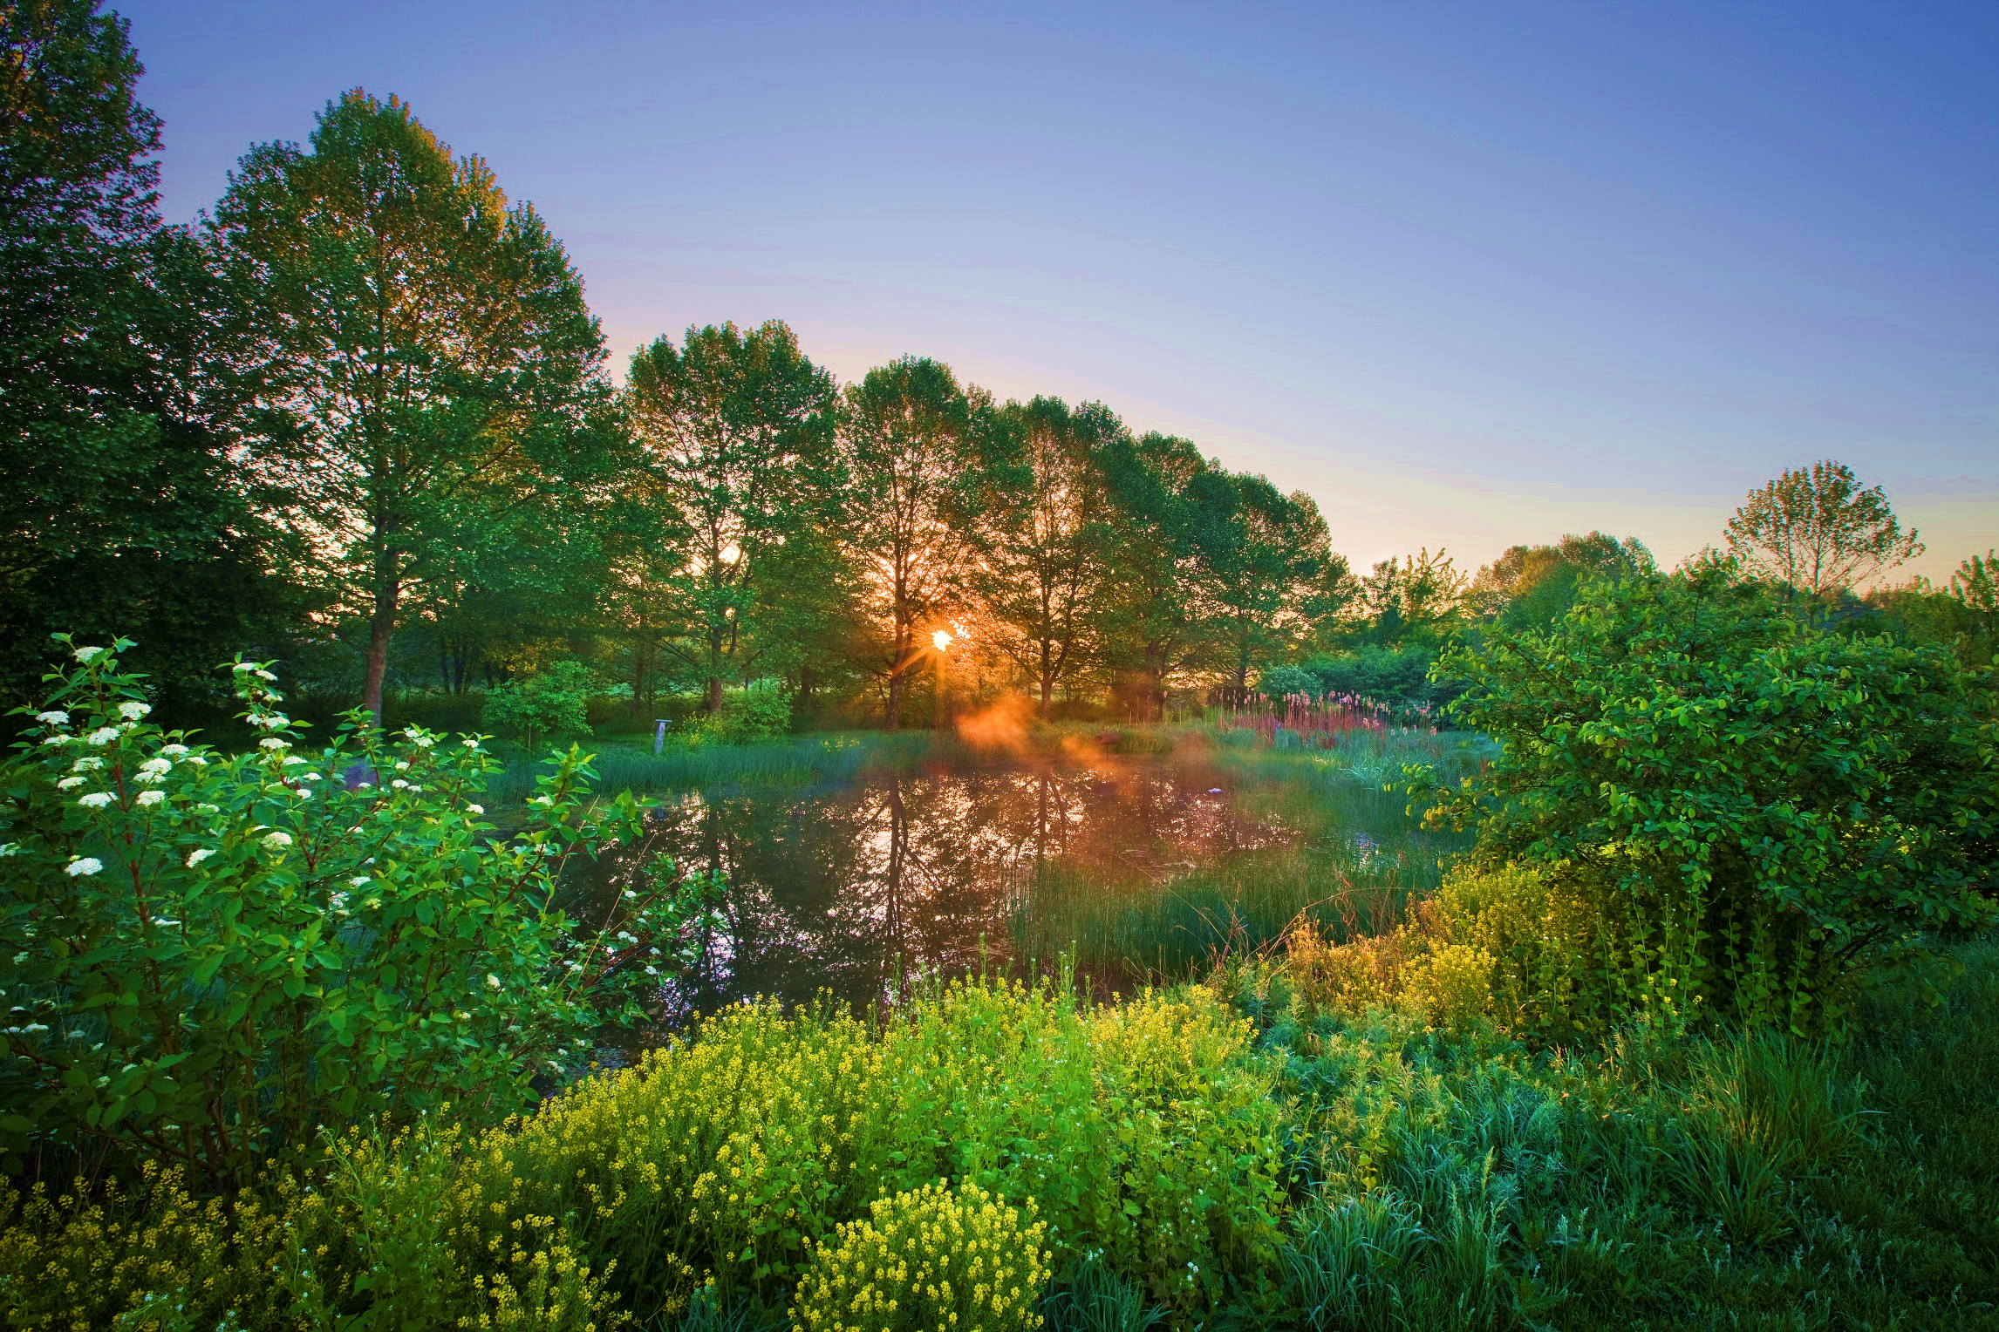
The Model: Lititz Run Watershed Action Plan
Achievements Since 2000
Re-designated a Cold Water Fishery (CWF), upgraded from its previous designation as a Warm Water Fishery (WWF) in 2008.
Over 7 miles of stream and riparian corridor restored.
Over 20 acres of wetlands have been created to reduce flooding and improve water quality.
Hundreds of community residents have volunteered their time and contributed money to help in the restoration effort.
Warwick School District and Millersville University integrated education curriculum related to the watershed.
MS4 Permit Compliance achieved
First Critical Aquifer Recharge Area (CARA) restoration in Pennsylvania.
First regional water quality facility in Pennsylvania
> 3 Million in funding

Slide 20
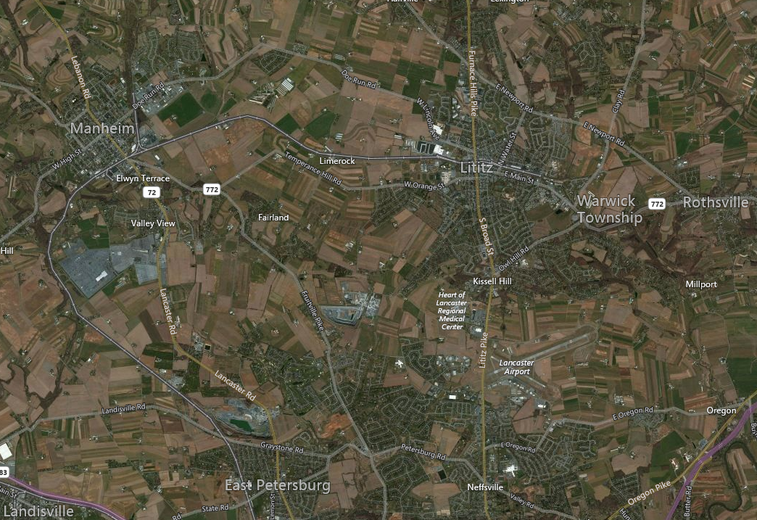
3
Rock
Lititz
Logan
Park
3
2
Butterfly Acres
Landis Homes
1

Slide 21
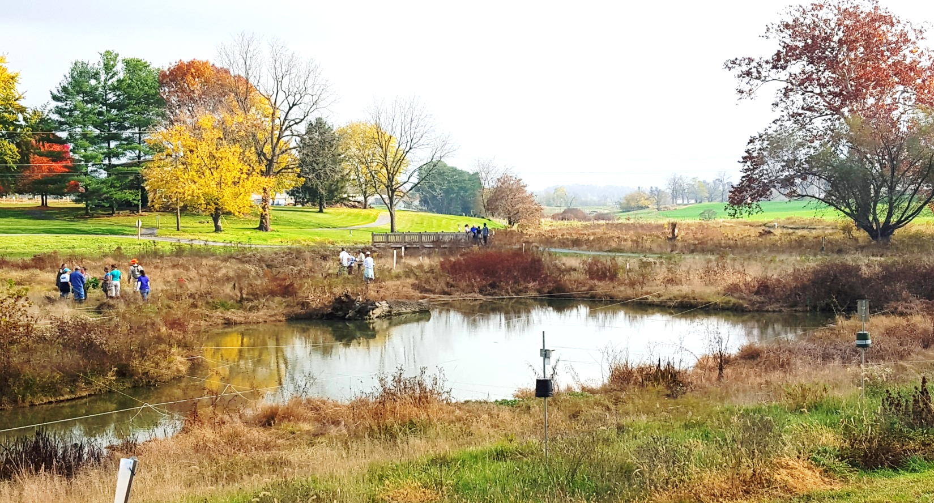
Landis Homes Retirement Community
“A Mission of Sustainability”

Slide 22
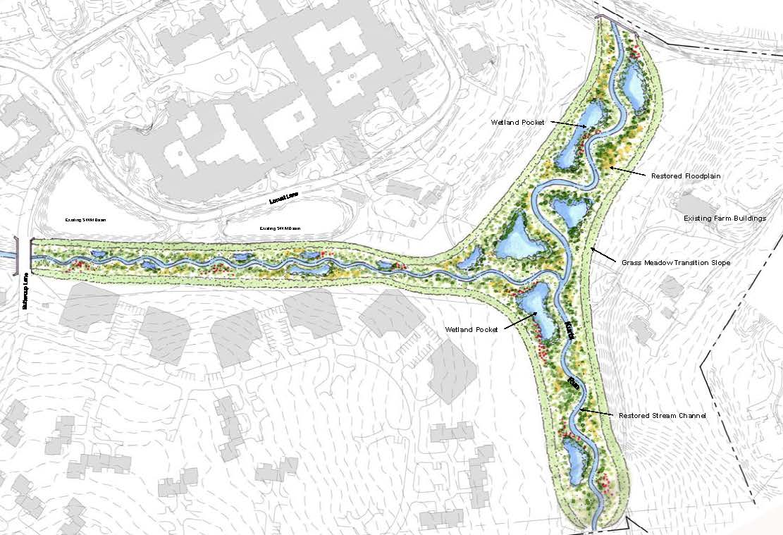

Case Study: Regional SWM
Landis Homes Retirement Community - Floodplain Restoration

Slide 23
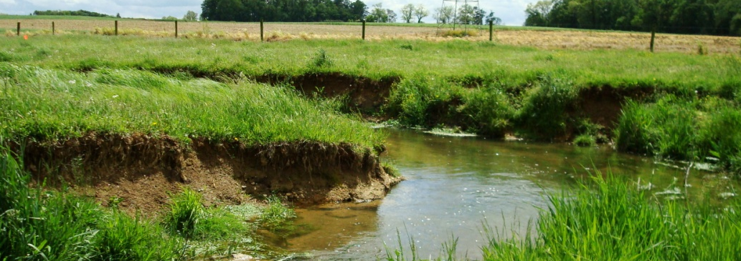
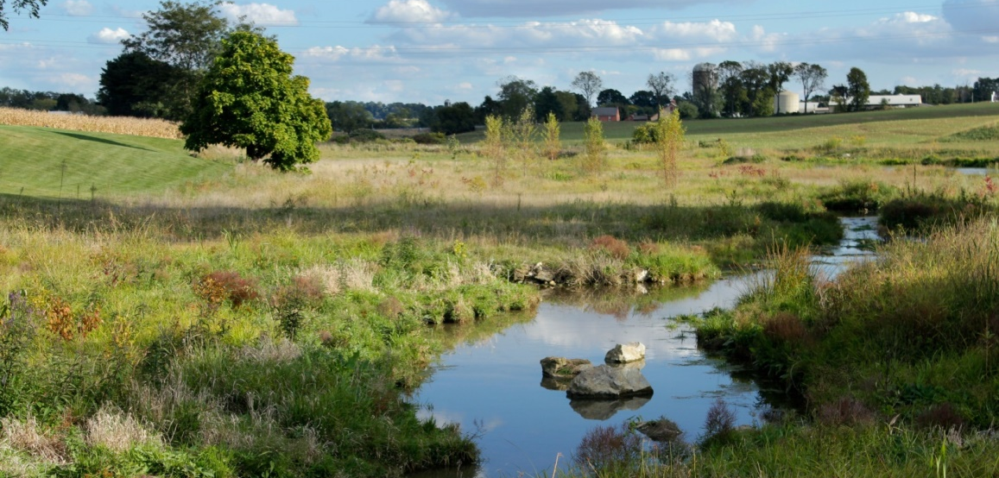
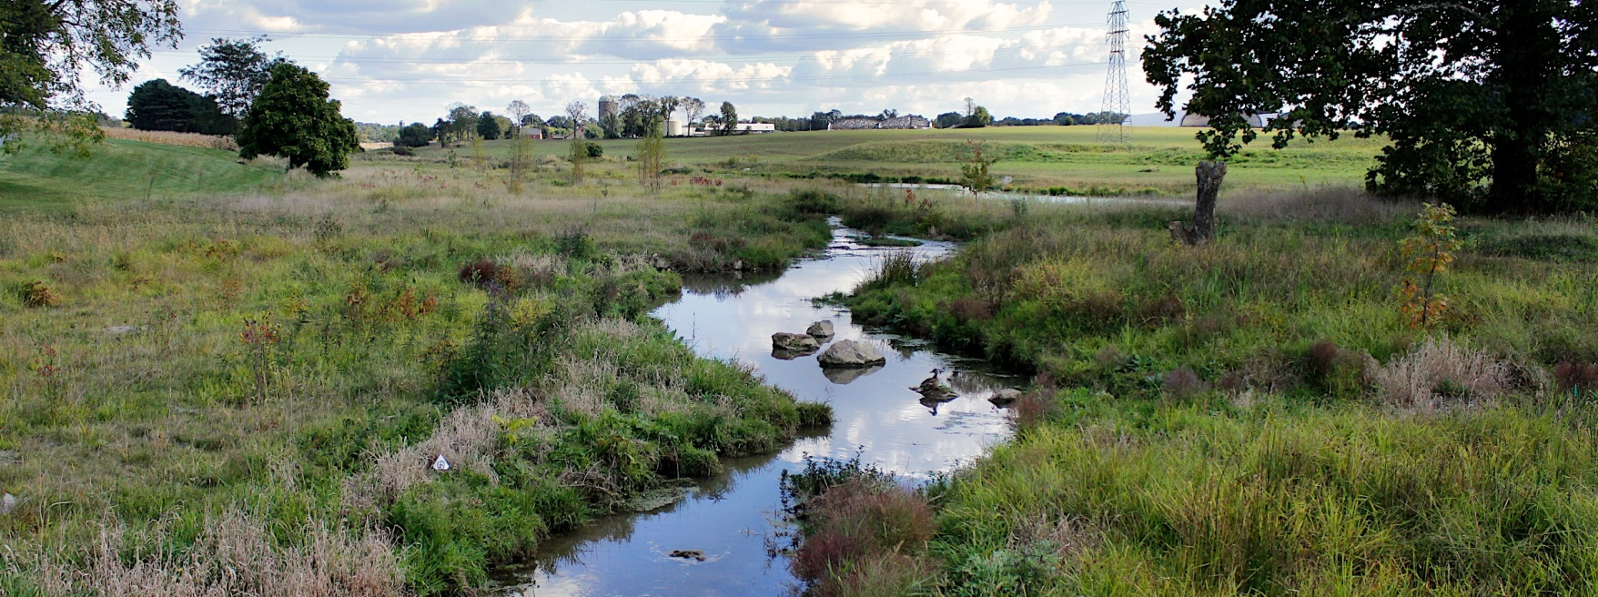
Before
After
Landis Homes Retirement Community Floodplain Restoration

Slide 24
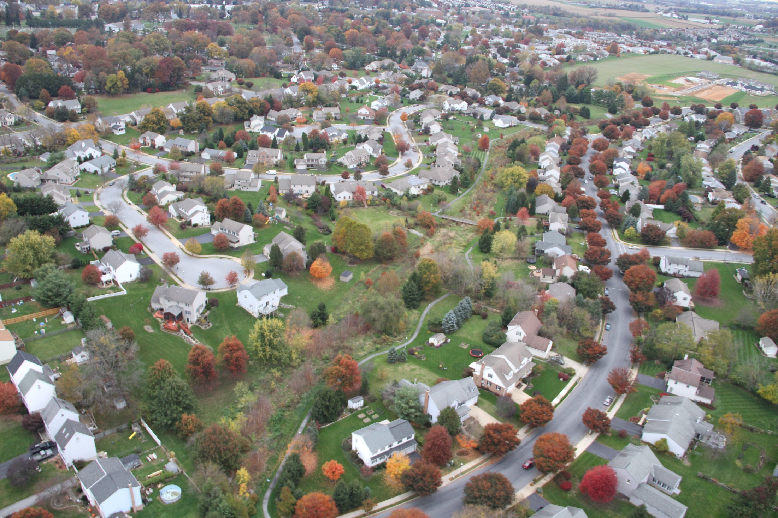
2
Butterfly Acres

Slide 25

2
Butterfly Acres
regional aquifer recharge area
regional bio-retention
natural habitat corridor
park and recreation

Slide 26
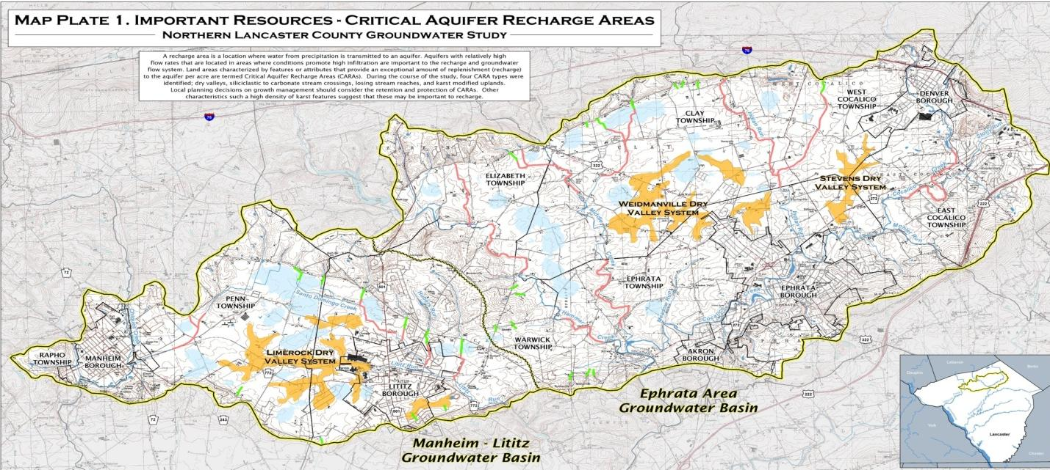

2
Butterfly Acres
Critical Aquifer Recharge Area (CARA) Restoration

Slide 27
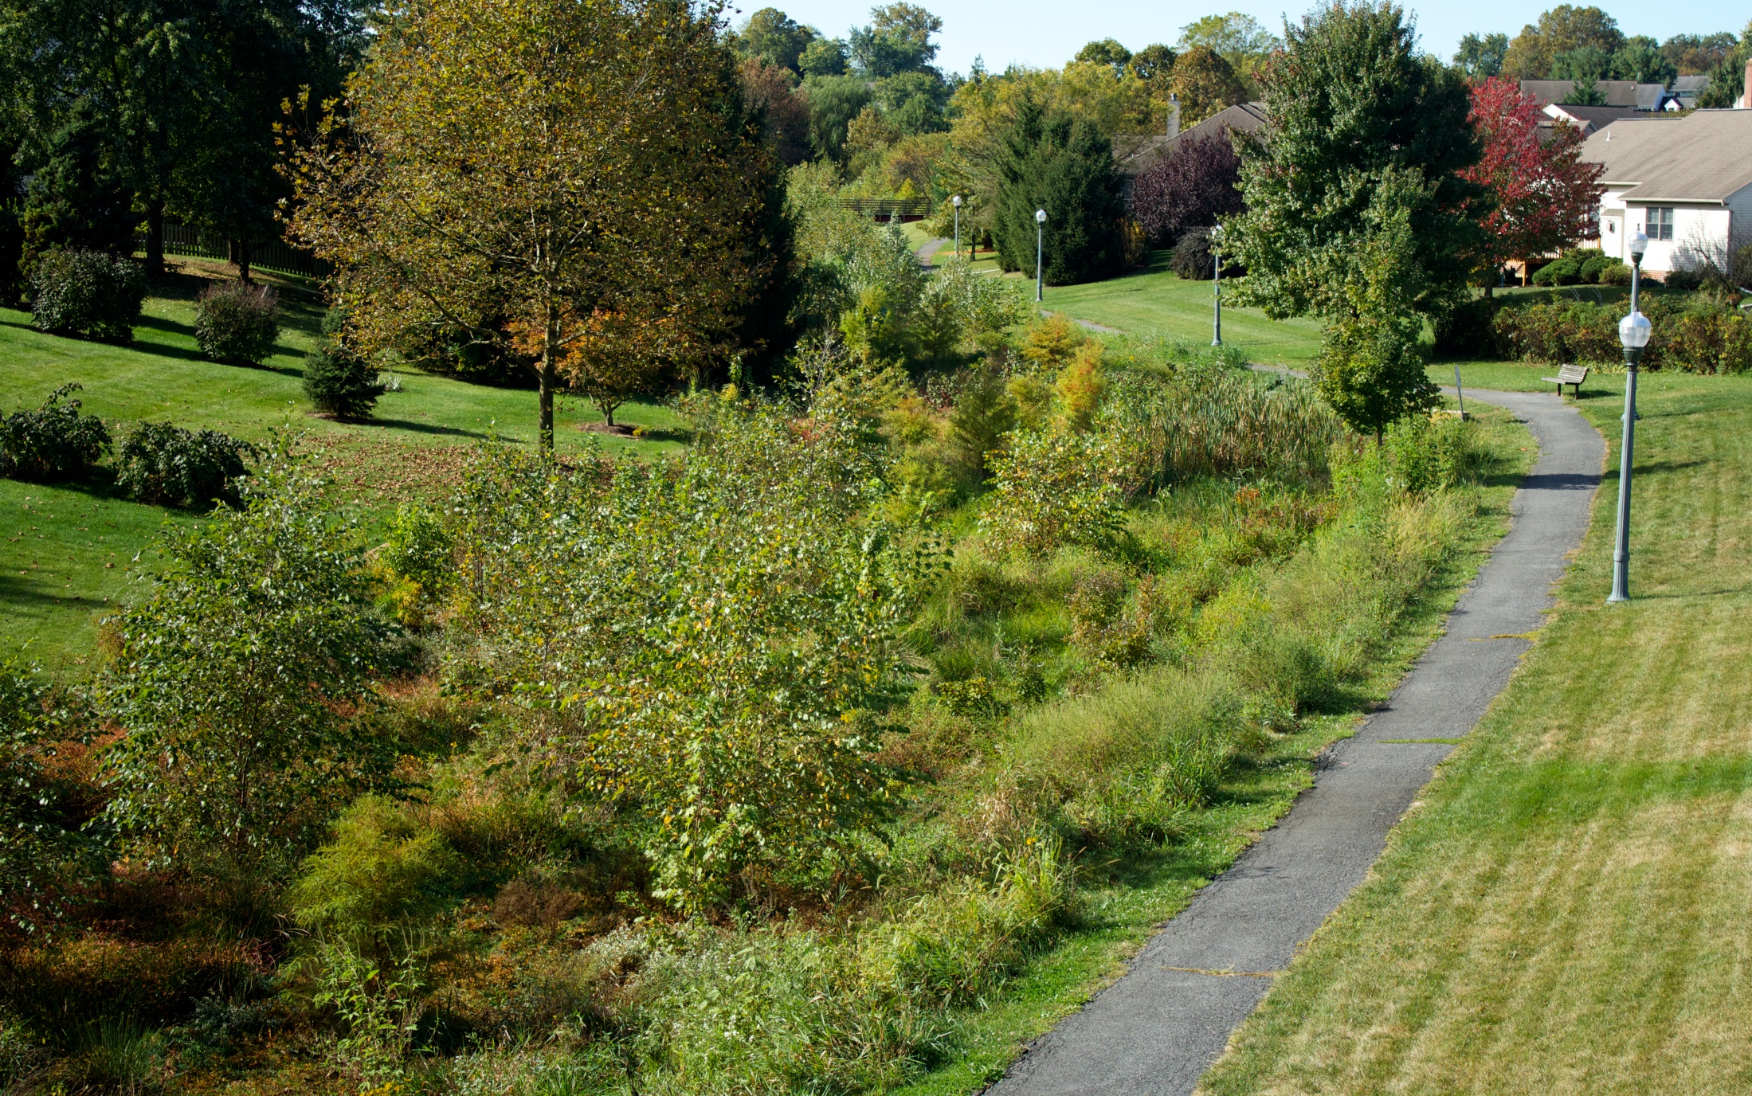
2
Butterfly Acres - after

Slide 28
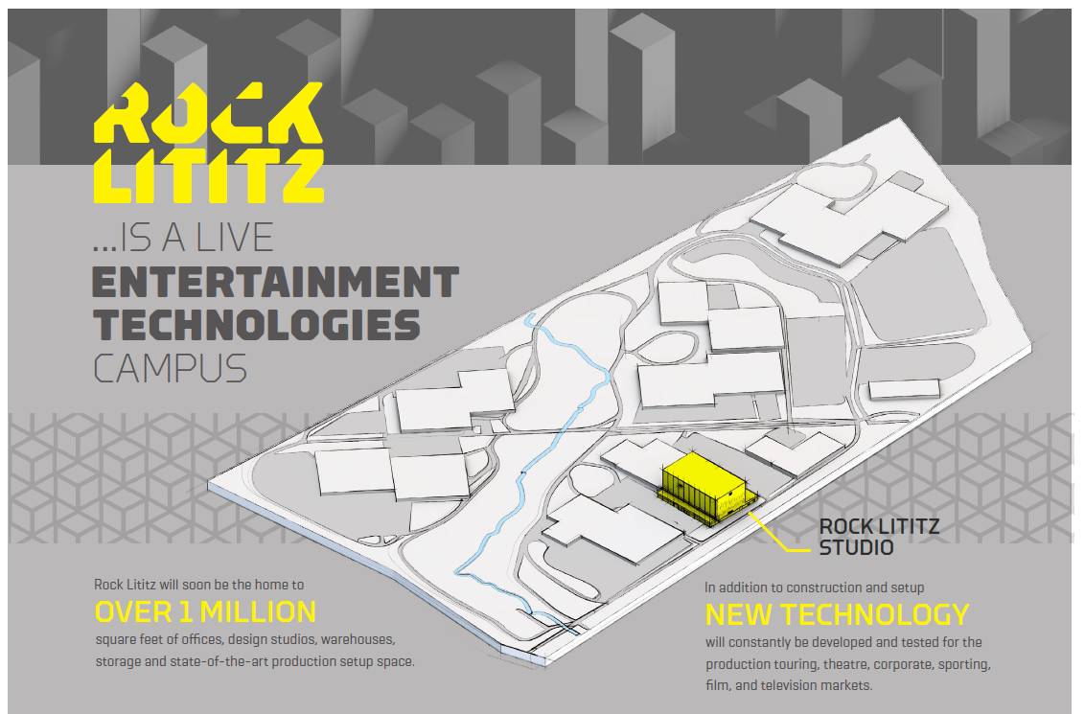
4
Rock Lititz

Slide 29
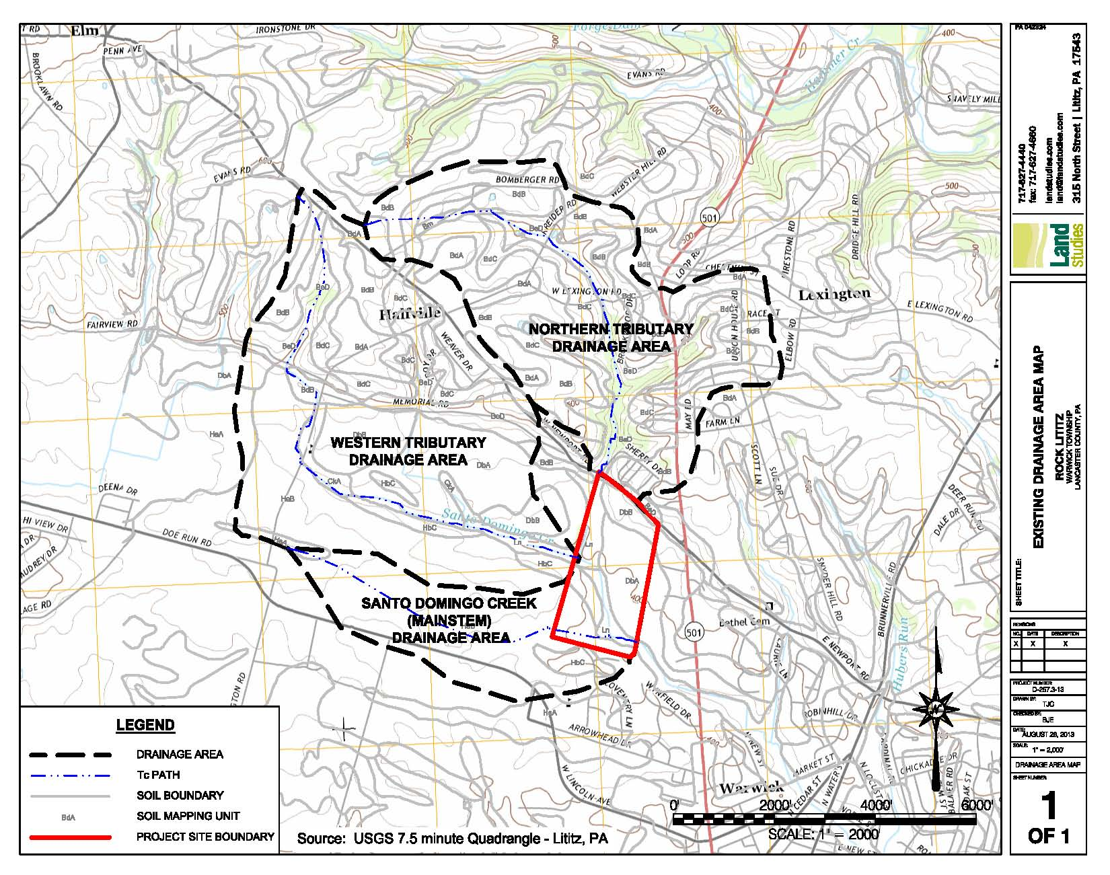
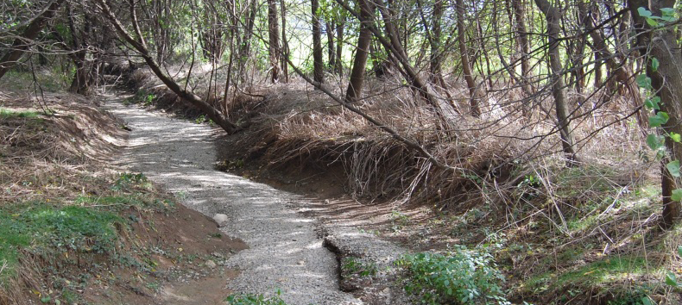
4
Rock Lititz - before

Slide 30
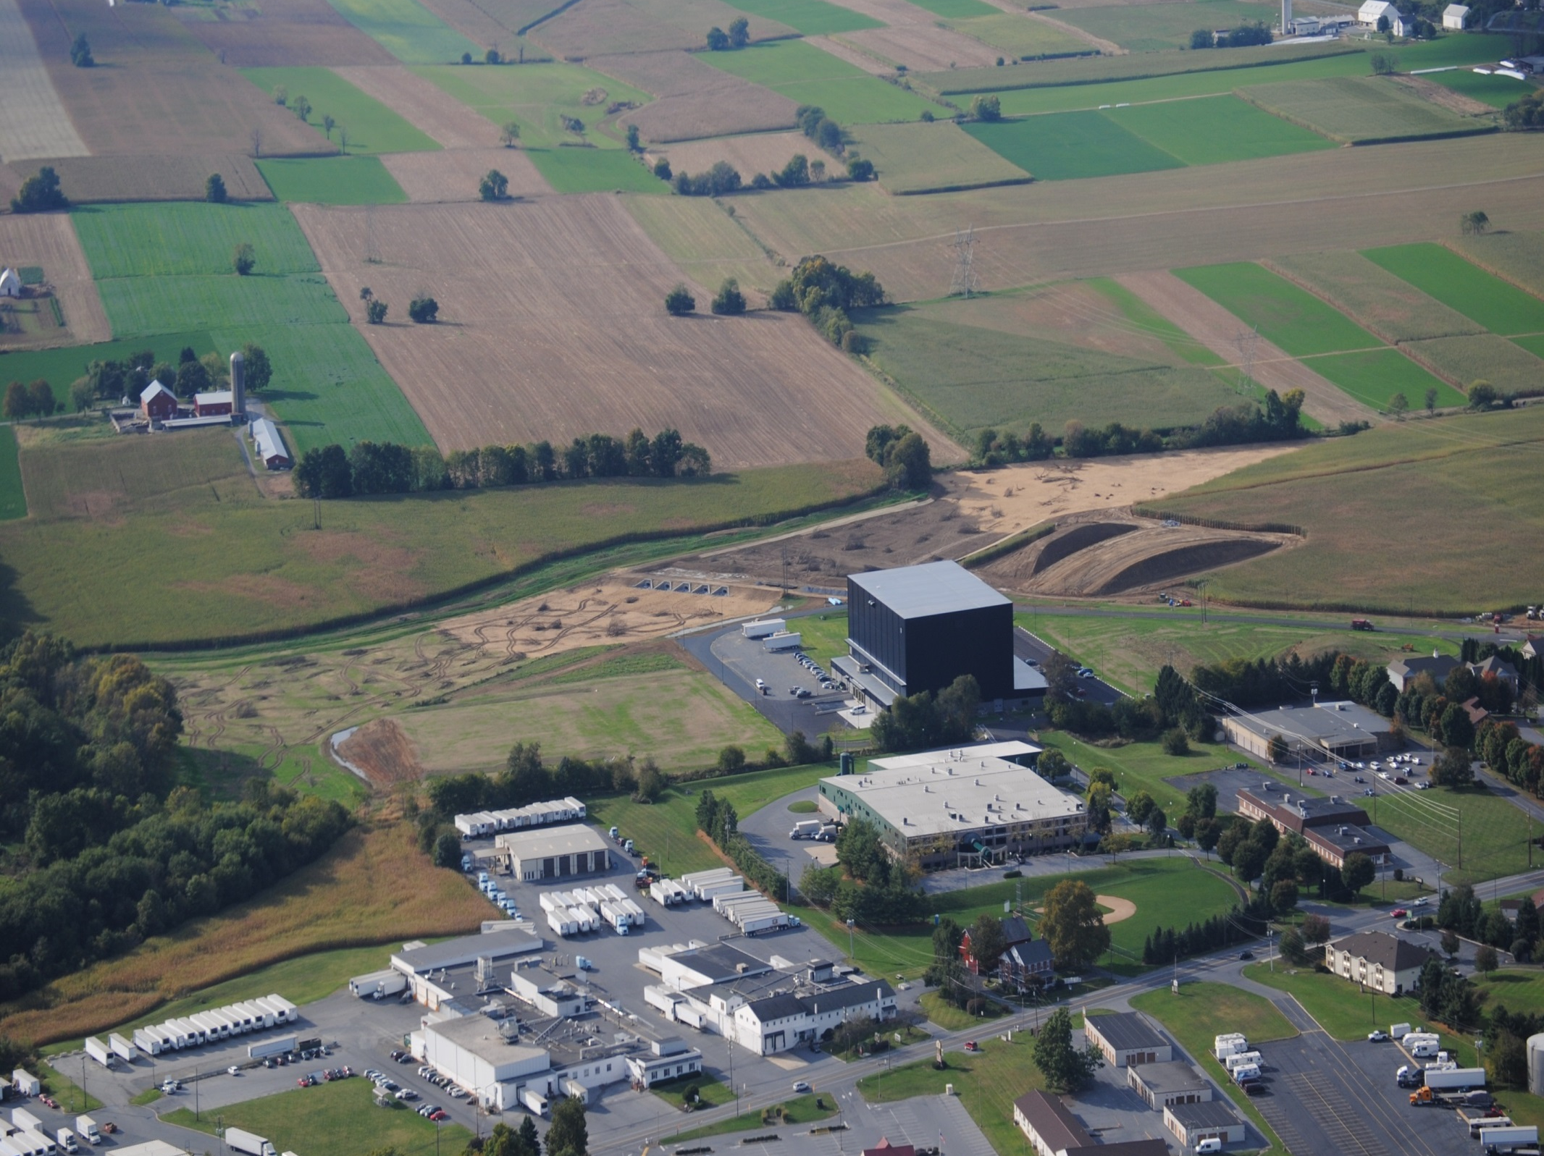
Stormwater Management Facility (site & regional) –
17 acres

Slide 31
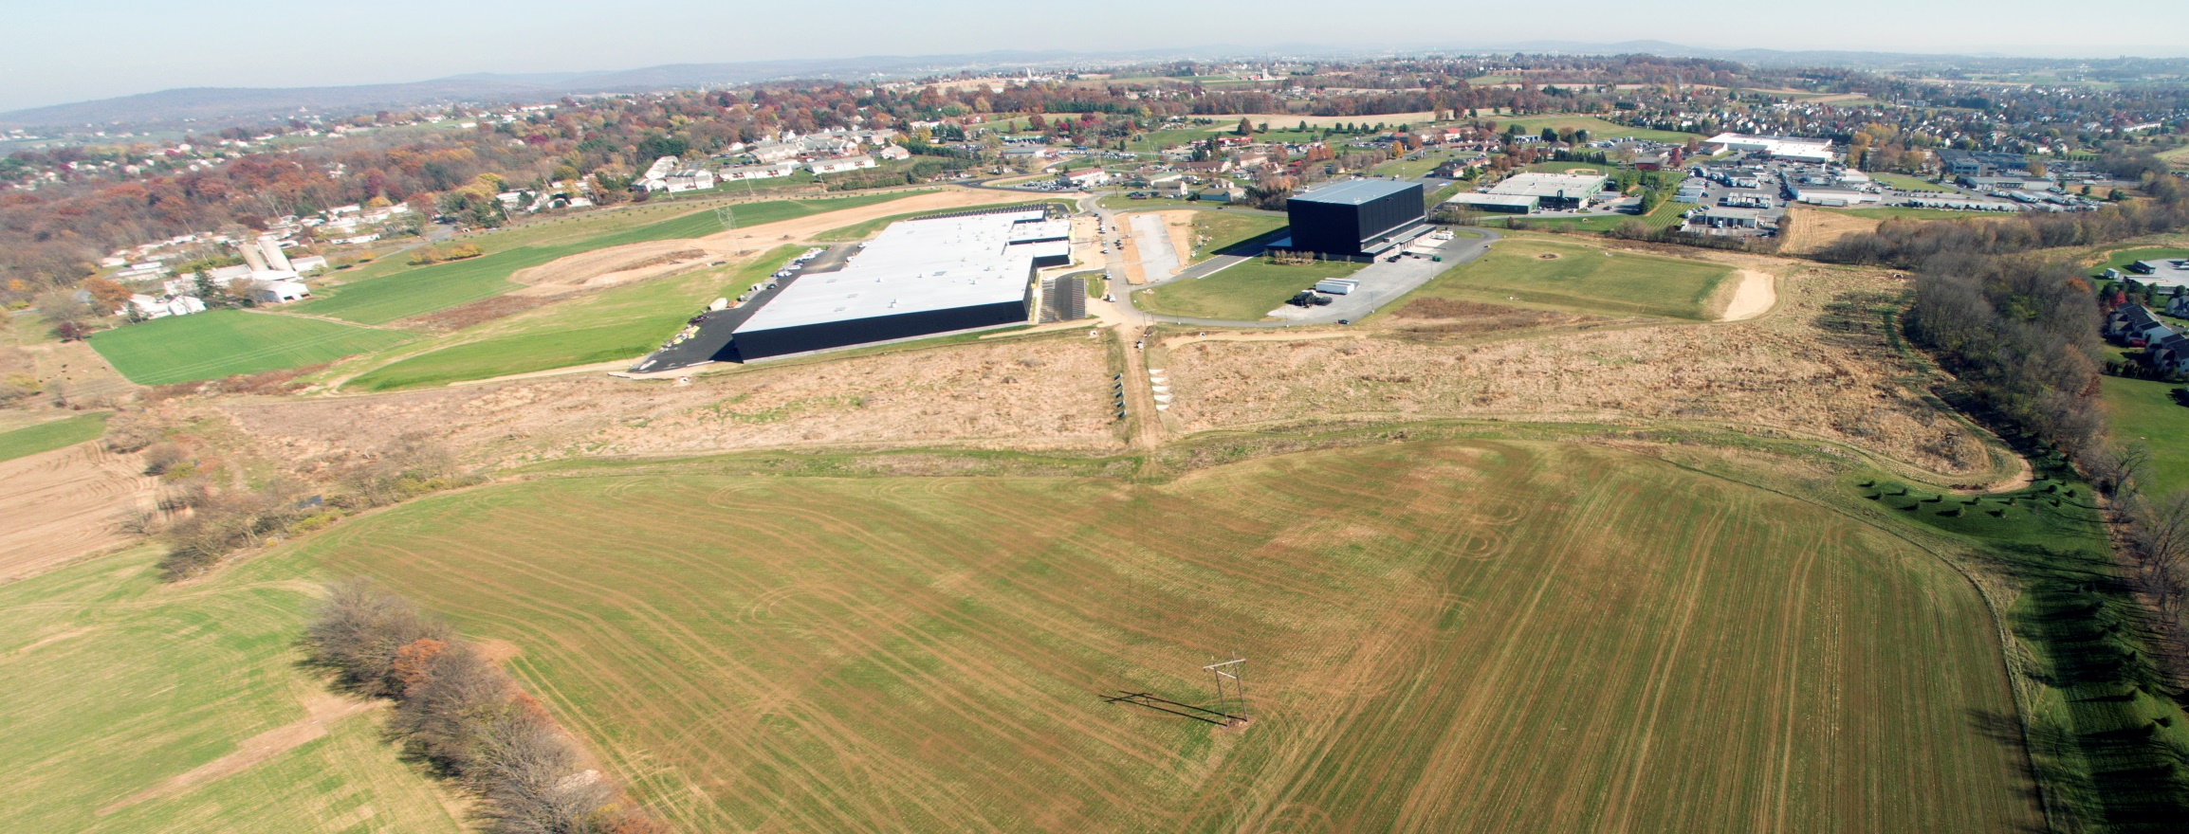
4
Rock Lititz
Economic Ecology
Development Gain:
9 acres of land
180,000 s.f. building
Return on Investment
182% or $3.1 Million
Annual Pollution Reduction:
250,000 lbs of Sediment
1,000 lbs of Nitrogen
173 lbs of Phosphorus

Slide 32
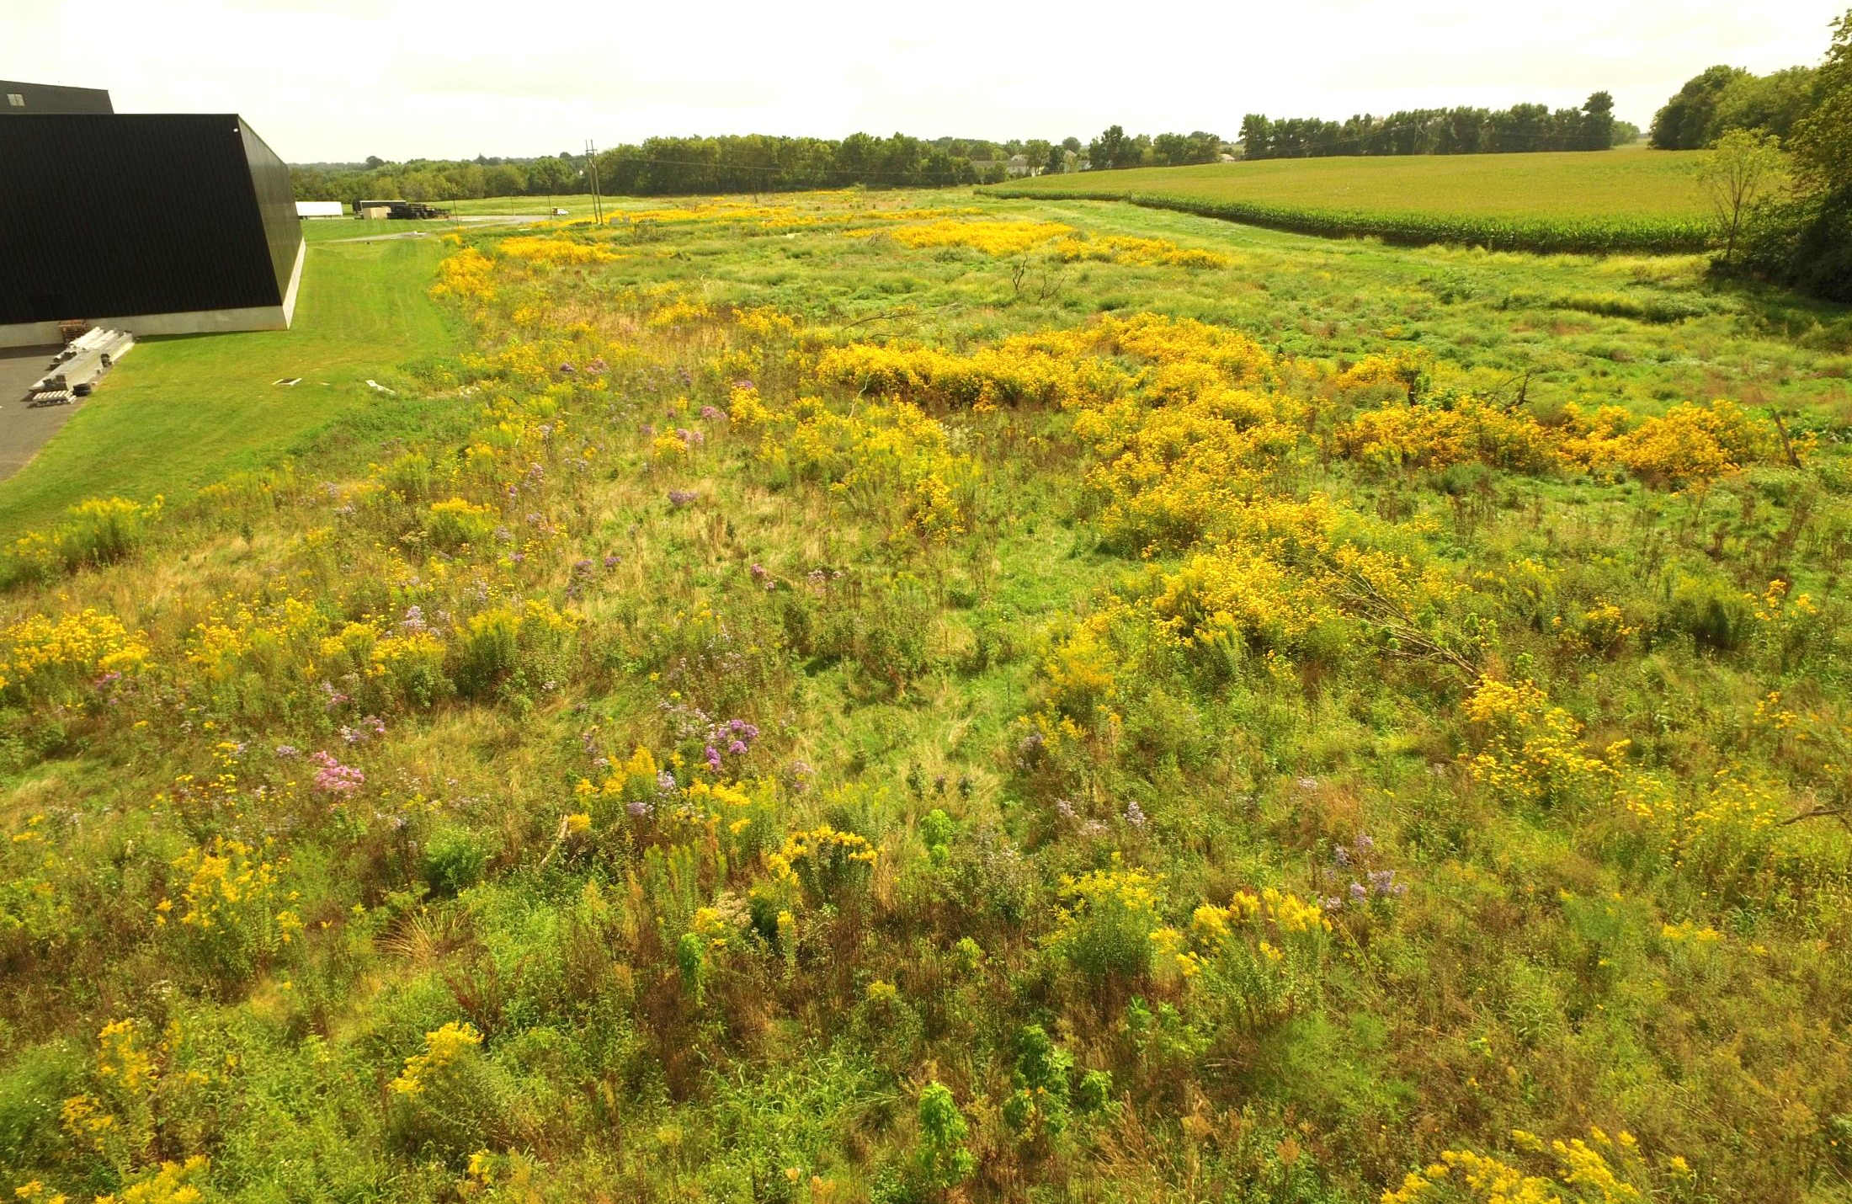
4
Rock Lititz

Slide 33
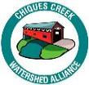
Case Study:
Chiques Creek
Watershed Action Plan
Lancaster County, PA
2
Goals
Documents existing and planned BMP’s - Best Management Practices:
Water quality improvement
Flood reduction / flood hazard mitigation
Ecosystem and habitat improvement
Platform to engage the community
Prioritizes opportunities
Provides a guide for funding
1
Notes:
Kelly Speak

Slide 34
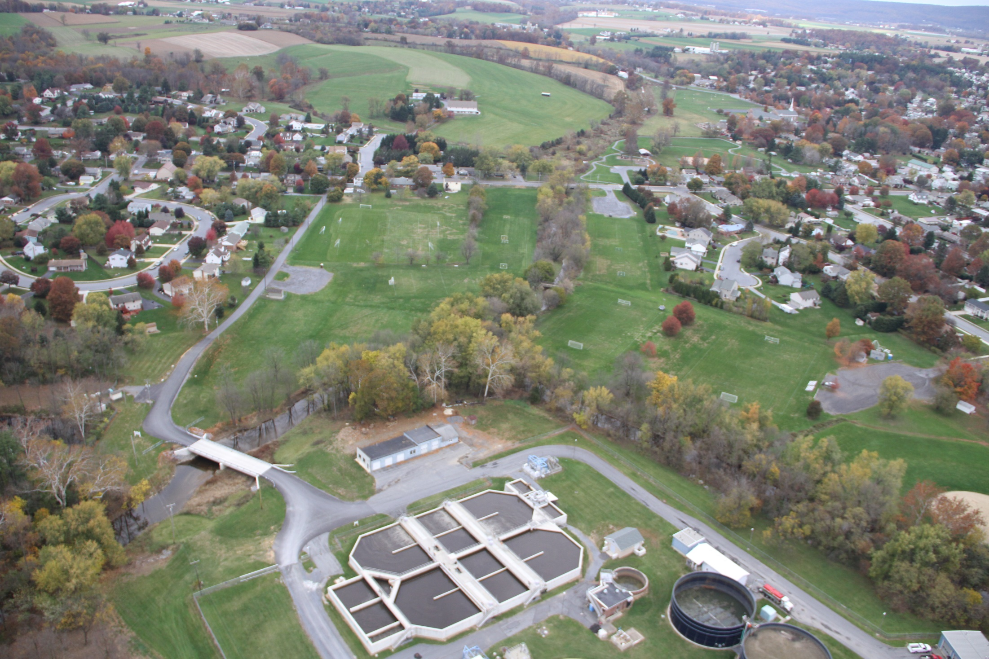

Case Study: Logan Park Floodplain Restoration
Chiques Creek Watershed Alliance | Manheim Borough | Rapho Township
Builds upon upstream restoration at Mummau Park
Improve water quality
Improve bio-diversity
Addresses drainage issues – soccer fields are flooded or frequently too wet use
Provide passive and active recreational opportunities
High visibility and accessible
1
Watershed Action Plan - BMP Project #21
Notes:
Kelly speak

Slide 35
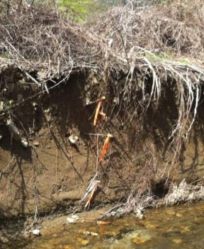
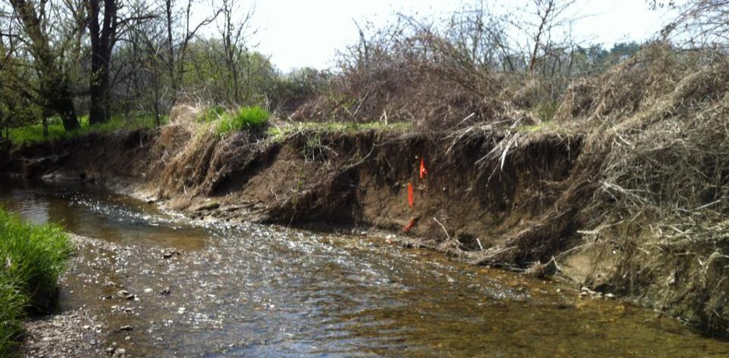
Before–
Logan Park Floodplain Restoration
Notes:
Kelly speak

Slide 36
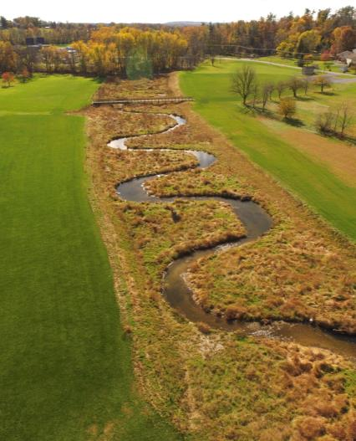
Quantifiable Benefits Logan Park Floodplain Restoration
Site: 22 acre park
Restoration Area: 2.25 acre
Wetlands Created: 1.8 acres
Stream Stabilized: 1,033 LF
Pollution Reduction*
236 Tons / yr
Sediment Load Reduction
2,212 lb / yr
Nitrogen Load Reduction
584 lb/yr
Phosphorus Load Reduction
*Source: “Recommendation of the Expert Panel to Define Removal Rates for Individual Stream Restoration Projects” by the Chesapeake Bay Partnership (April 1, 2013)
Notes:
Kelly speak

Slide 37
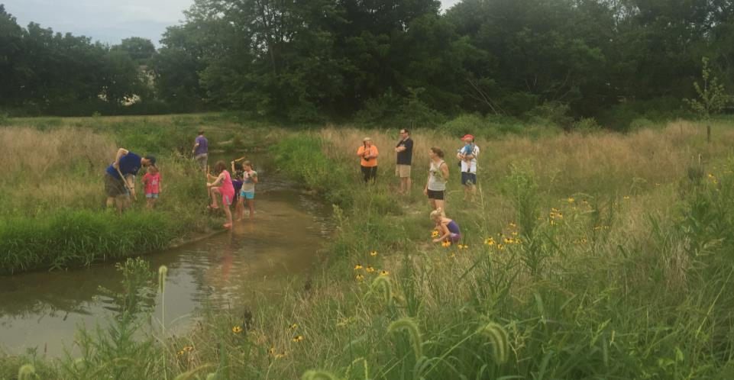
Environmental Education Logan Park Floodplain Restoration
Notes:
Kelly speak

Slide 38
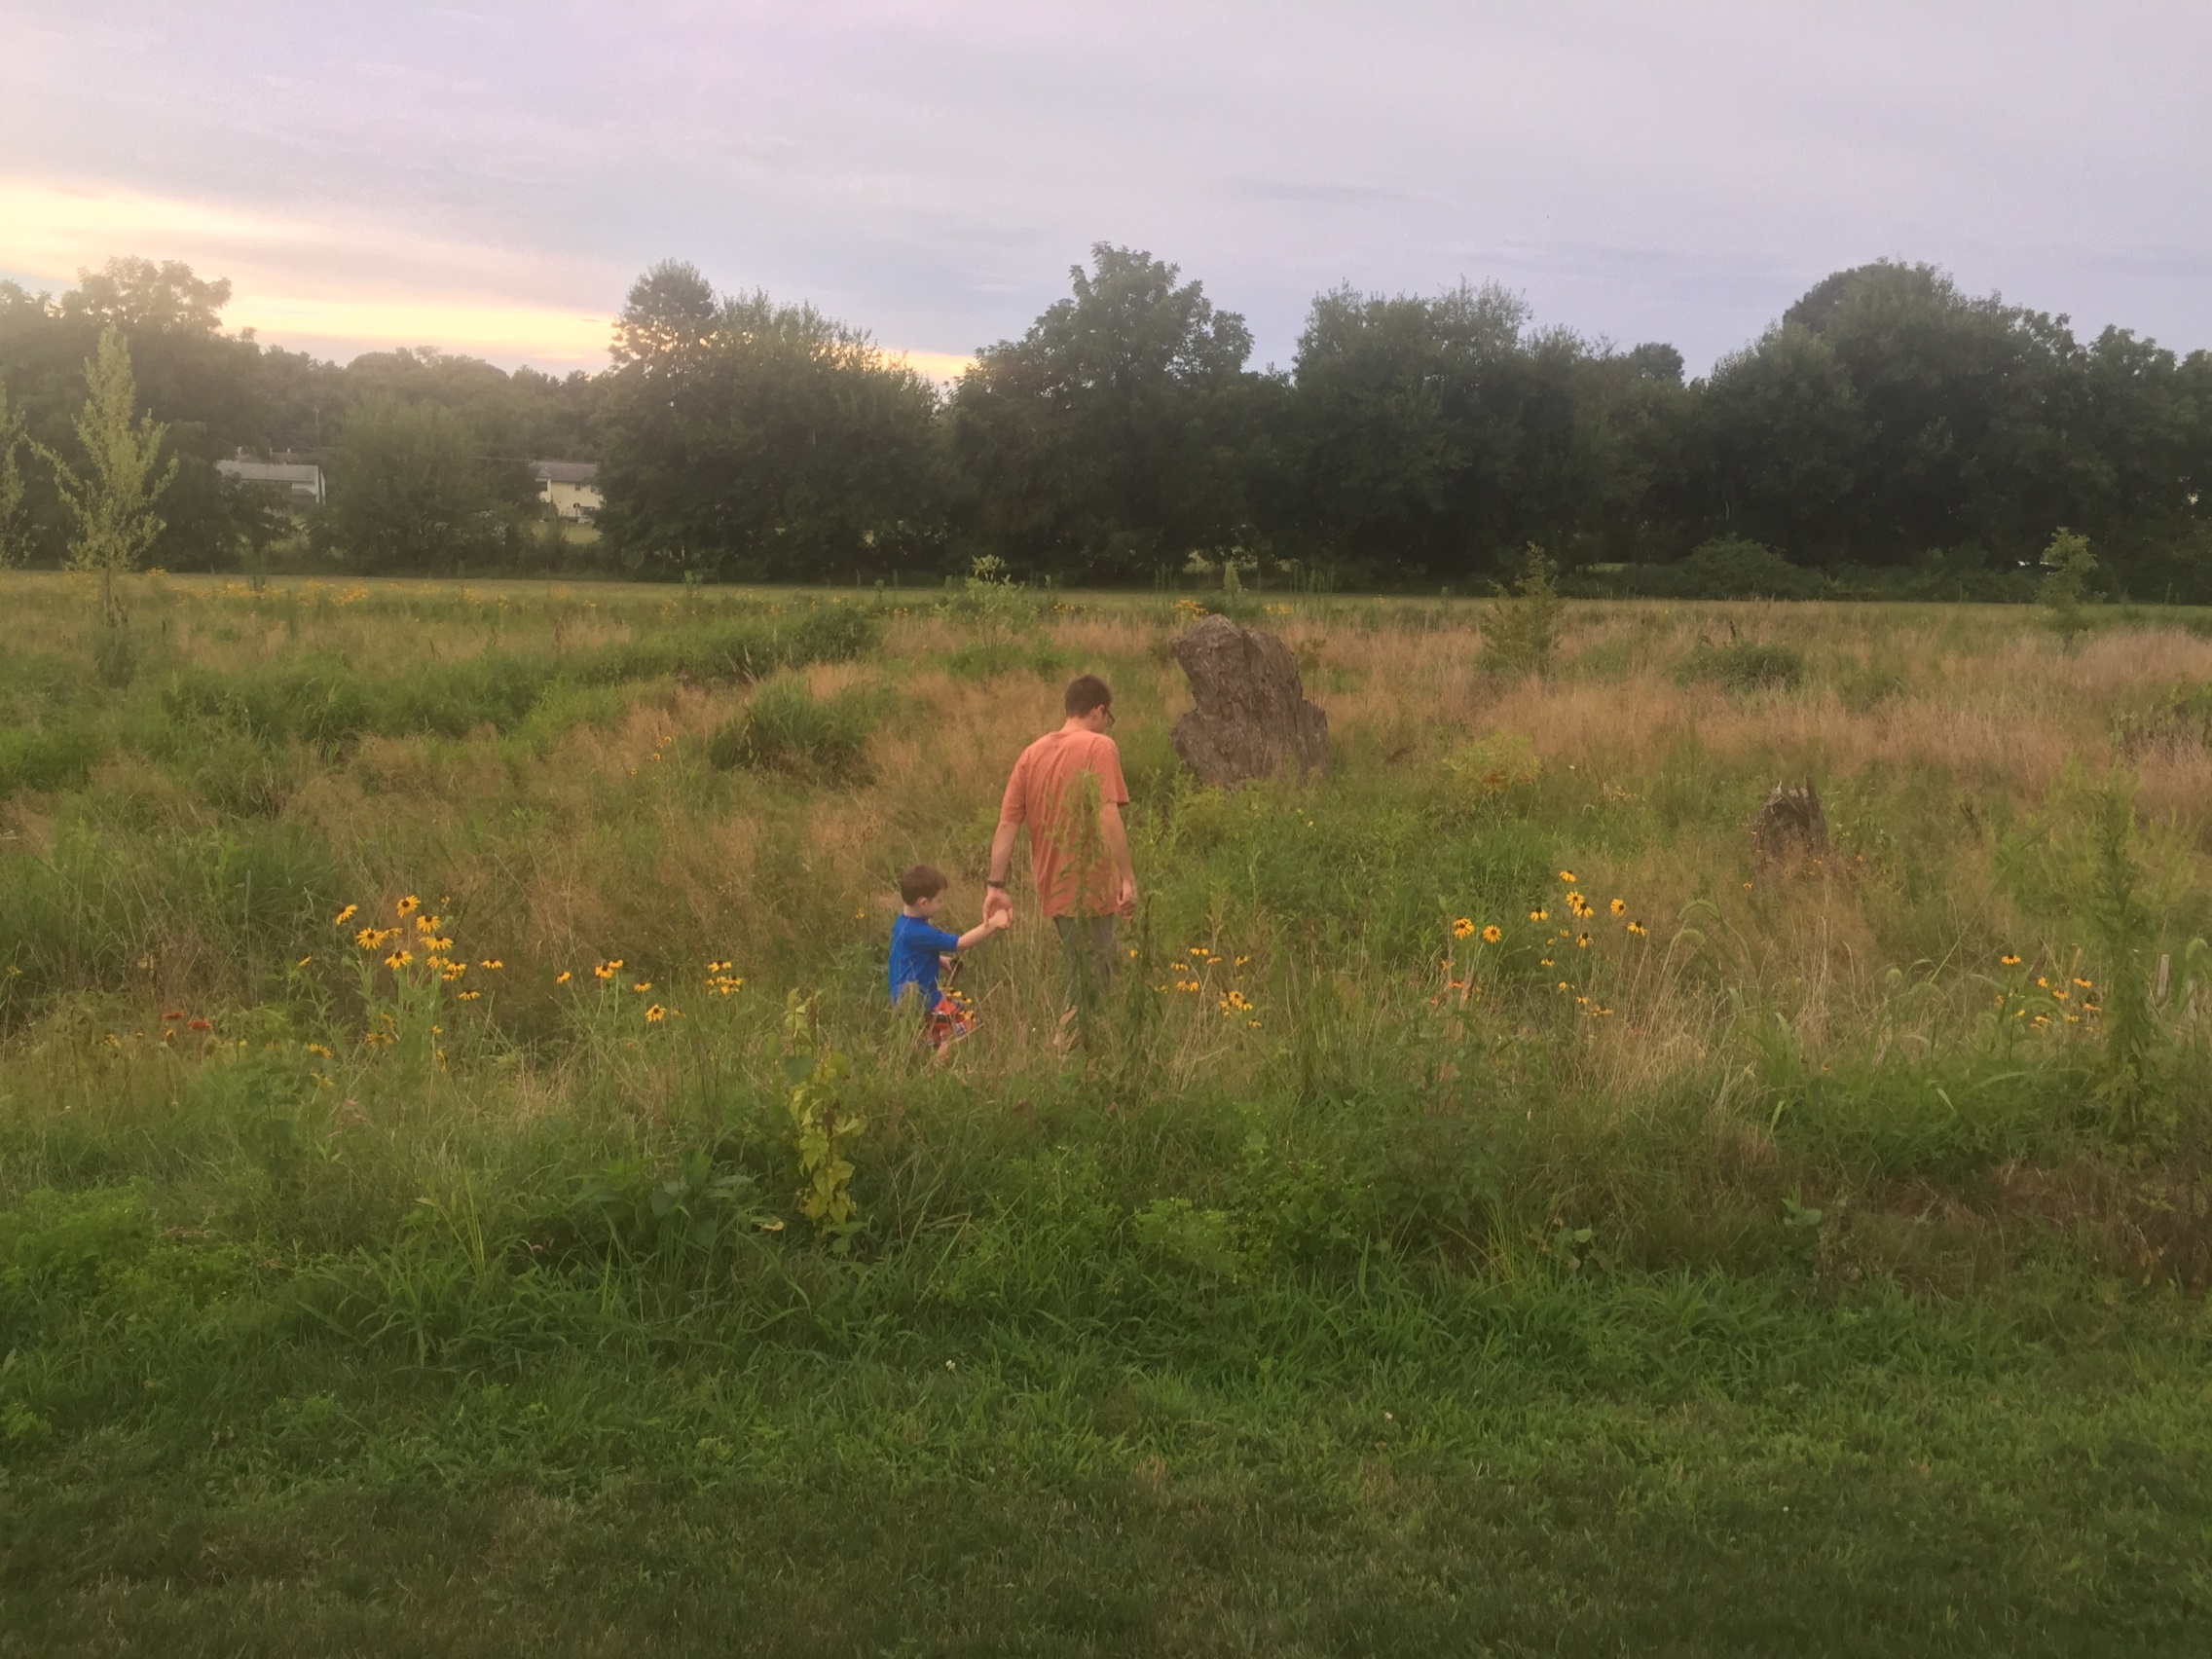



www.landstudies.com
315 North Street
Lititz, PA
Science | Design | Construction

