Slide 1
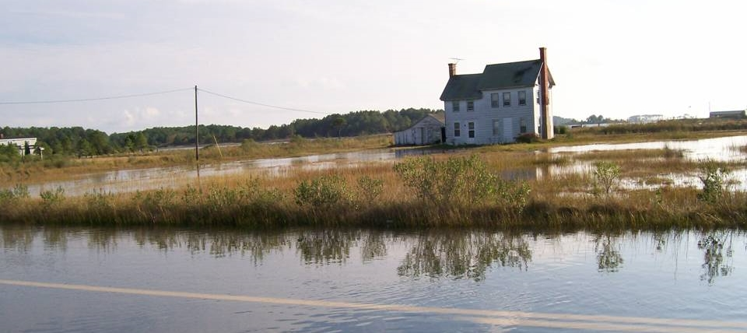
Maryland’s Coastal Resiliency Assessment Nicole Carlozo, MD DNR October 14, 2015
Re: Applying landscape-level tools in management and decision-making
Habitat Goal Implementation Team
Notes:
Good afternoon. I’m here today to provide some information on Maryland’s Coastal Resiliency Assessment, which is a statewide modeling effort that will be completed in March 2016. I’d like to give a run down of the project Goals and Scope before speaking to model development and management applications for the state of Maryland.

Slide 2
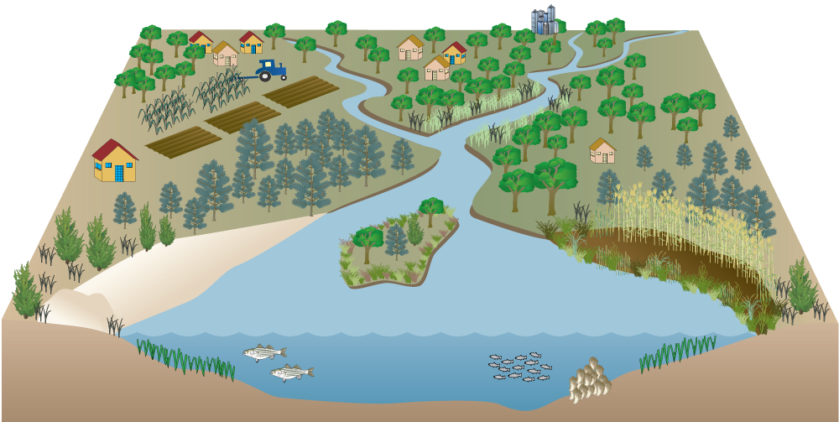

Coastal Resiliency Goal
Evaluate the risk reduction benefits of existing natural infrastructure and establish priorities for conservation/restoration of natural features to enhance resiliency of vulnerable coastal communities.
FOCUS: Protection Benefits to People
Notes:
MD DNR’s CCS is partnering with The Nature Conservancy to complete a Statewide Coastal Resiliency Assessment.
The goal of the Assessment is to 1) evaluate the risk-reduction benefits of existing natural infrastructure, and 2) to establish priorities for conservation/restoration of natural features that enhance resiliency of coastal human communities.
This project will allow DNR to integrate risk-reduction considerations into our statewide conservation and restoration targeting. Our current restoration and conservation frameworks target areas for ecological and water quality benefits, but do not specifically consider the protection benefits that these features provide to adjacent human communities. This project will allow us to integrate resiliency into future conservation, management and restoration decisions.

Slide 3
Chesapeake Bay Resiliency Goal
Goal: Increase the resiliency of the Chesapeake Bay watershed, including its living resources, habitats, public infrastructure and communities, to withstand adverse impacts from changing environmental and climate conditions.
Adaptation Outcome: Continually pursue, design, and construct restoration and protection projects to enhance the resiliency of bay and aquatic ecosystems from the impacts of coastal erosion, coastal flooding, more intense and more frequent storms and sea level rise.
Notes:
Products will also support the 2014 Chesapeake Bay Agreement Climate Resiliency Goal – specifically the Adaptation Outcome by directing the location of future resiliency projects and identifying potential demonstration projects for monitoring and quantifying the capacity of habitats to adapt to climate change while providing protection benefits to adjacent coastal communities.

Slide 4
Defining Terms: Natural Infrastructure
(Figure from US Army Corps 2015, Use of NNBF for Coastal Resilience)
Notes:
In this project, when we use the term “natural infrastructure,” we’re referring to both blue and green infrastructure, including natural features such as tidal wetlands and marshes, vegetated buffers, oyster reefs, SAV, Bay islands, beaches, and dunes. All of these features provide coastal resiliency benefits to human communities. This diagram is from an Army Corps report that outlines some of the benefits that these features provide to nearby human communities – for example, wave attenuation, infiltration, and sediment stabilization. Although these natural practices provide a multitude of benefits beyond risk-reduction (i.e. habitat and water quality), for this Assessment we are qualitatively evaluating their benefits that relate to coastal community risk reduction.

Slide 5
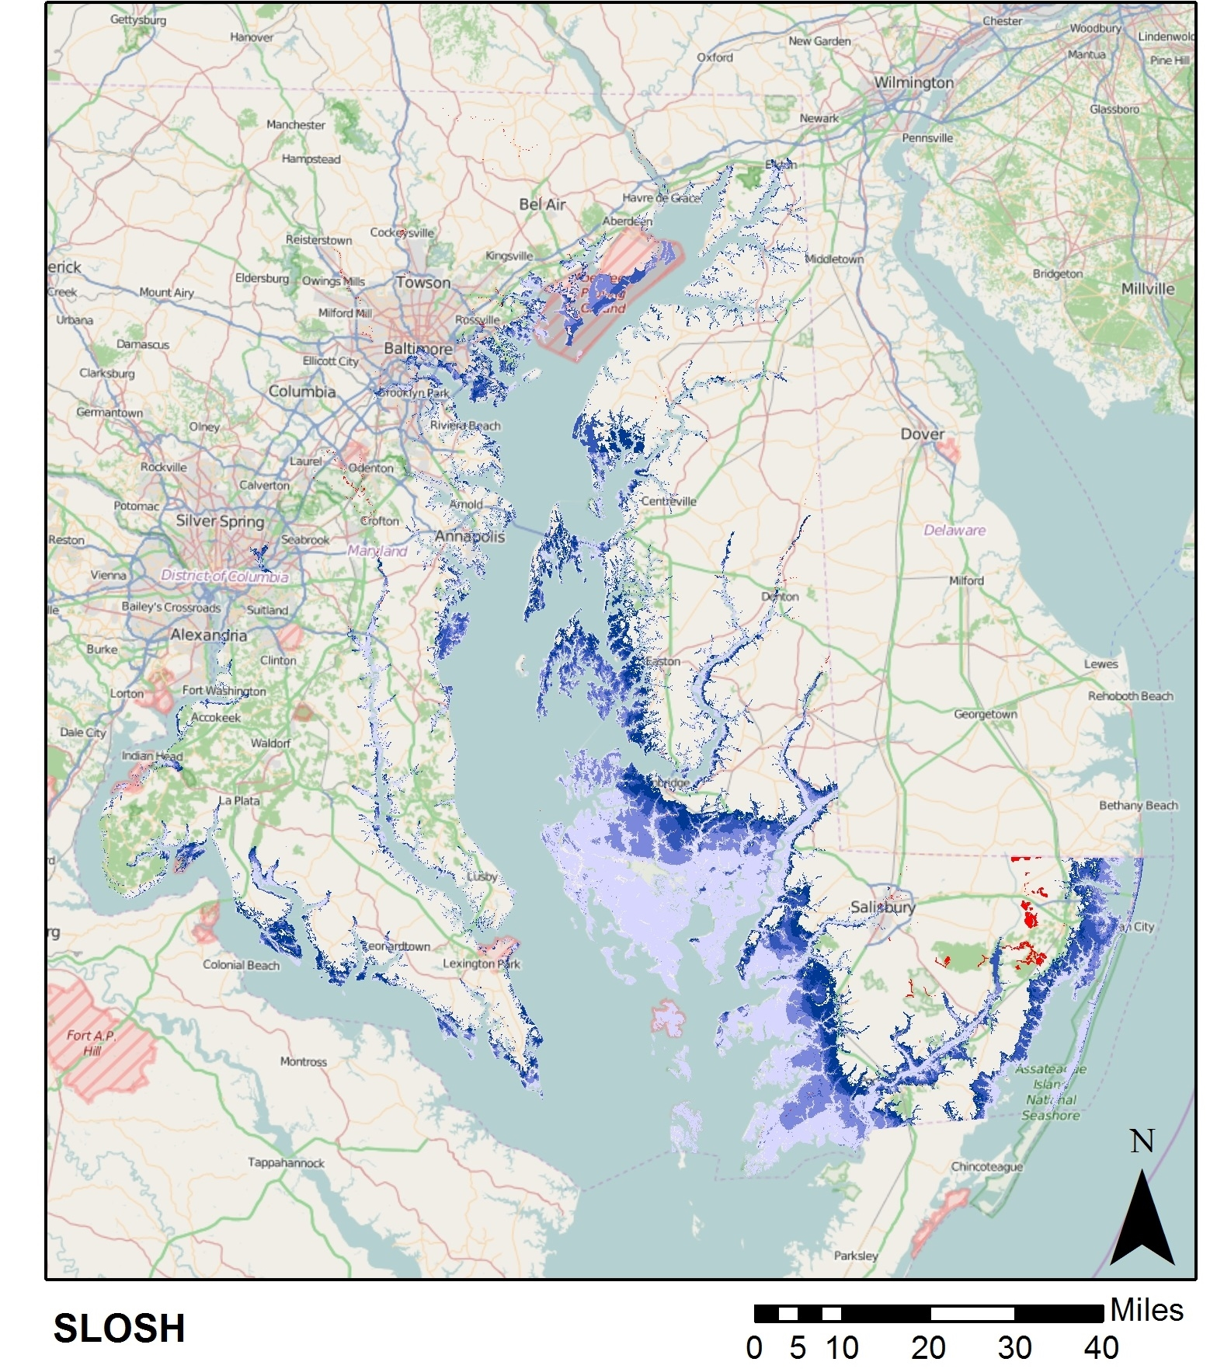
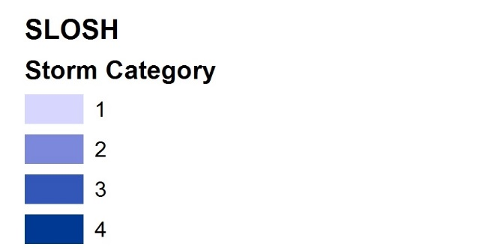
Study Area
Furthest extent of flood hazard event: Hurricane Events Category 1-4
Sea, Level, and Overland Surges from Hurricanes Model
Notes:
STUDY AREA. The study area for the Assessment includes tidal areas of Maryland’s coastal zone. For the We are including the furthest extent of a flood hazard event as identified by the SLOSH model Category 4 storm surge area. Through this approach, we are considering elevation (difference between western and eastern shores) and we are not using a static buffer from the shoreline.

Slide 6
Model Development
Natural Features Analysis
Identify natural infrastructure and assess value as risk-reduction techniques
National Model: InVEST Coastal Vulnerability Model
Community Risk Analysis
Identify communities that are at-risk to coastal hazards
Regional Model: North Atlantic Coast Comprehensive Study
*Integrate results to identify Conservation and Restoration Priorities
Notes:
This assessment has been broken into 2 modeling efforts. First, a Natural Features Analysis to identify existing natural infrastructure and assess its value as risk-reduction techniques along the shoreline. Second, a Community Risk Analysis to identify human communities that are at-risk to coastal hazards. The results of those models will be integrated to identify conservation and restoration priorities along MD’s shoreline, where implementation will increase community resiliency.
To conduct these analyses, we are drawing on 2 models that were previously run at national or regional scales – the InVEST Coastal Vulnerability Model and the North Atlantic Coast Comprehensive study. We are currently altering these models to re-run them with MD-specific data at a Maryland-appropriate scale.

Slide 7
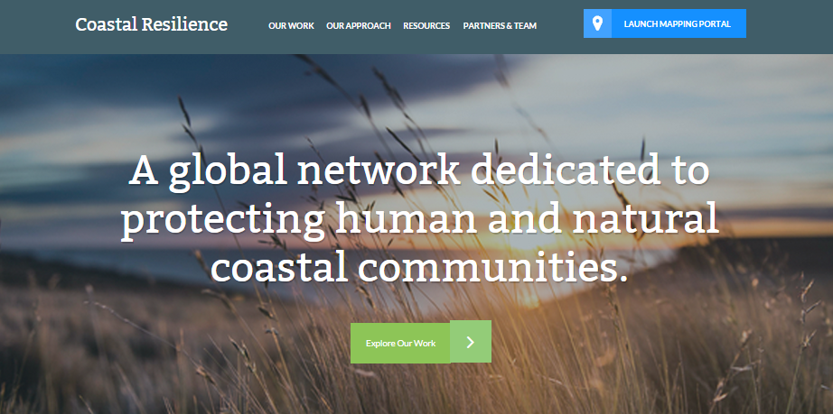
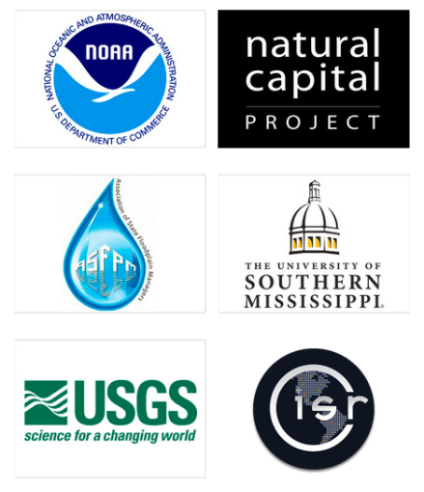
TNC Toolbox
1) Natural Features Analysis
CoastalResilience.org
Notes:
To conduct the Natural Features Analysis we are partnering with The Nature Conservancy, which offers a suite of web-based mapping tools on their Coastal Resilience website. TNC has conducted Coastal Resilience projects in 12 states and is working with MD to complete the Coastal Resiliency Assessment by March of 2016. We will be drawing on previous resilience models and mapping efforts to assess Maryland’s coastal risk and identify resiliency solutions.

Slide 8
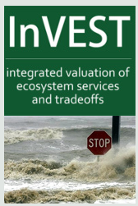
InVEST Coastal Vulnerability
Qualitative estimate of coastal exposure:
Elevation/Relief
Sea Level Change
Wave Exposure (USACE Coastal Hazards System)
Surge Potential (SLOSH Category 2 MOM wave heights
Erosion (MGS Shoreline Erosion Rates)
Shoreline Type/Geomorphology (NOAA ESI/ VIMS Shoreline Inventory)
Habitat Presence/Absence
Low Exposure
High Exposure
1
2
3
4
5
Notes:
TNC has partnered previously with The Natural Capital Project to run the InVEST Coastal Vulnerability Model, which qualitatively ranks exposure along the shoreline based on a number of parameters…This model is being run for MD at a 250 meter scale (quarter kilometer). Each 250-meter shoreline segment is given a rank from 1 – 5 that corresponds to all of these parameters, with 1 indicating low exposure and 5 indicating high exposure.
For relief, SLC, Wave exposure, surge potential, and erosion, the rank is based on reclassifying the data into Quantiles. For shoreline type and habitat presence, the rank is based on shoreline conditions and how that shoreline might fair against high energy events.
(Mean SL Trend/MD Historical Rate) * 2100 high SLR scenario)

Slide 9
Relative Habitat Ranks
Habitat | Rank | Distance from Shore (m) | Data Source
Coastal forest | 1 | 500 | NWI, UMD 1meter
Marshes | 2 | 250 | NWI, DNR wetlands
Dunes | 3 | 300 | Assateague Island National Seashore dunes
Seagrass beds | 4 | 500 | VIMS SAV data, 11 year composite (2004 – 2014)
Oyster Reefs | 4 | 250 | DNR Restored Oyster Reefs
No Habitat | 5 | N/A | N/A
Low Exposure
High Exposure
1
2
3
4
5
Notes:
For example, this table displays a variety of MD habitat types and the relative rank provided to each habitat based its ability to provide resiliency benefits such as wave attenuation or sediment stabilization. These ranks were designated based on the national InVEST model, regional expert interviews, and a literature review conducted by The Nature Conservancy.
Ranking is based on the fact that fixed and stiff habitats and sand dunes are the most effective in protecting coastal communities. Flexible and seasonal habitats, such as seagrass, reduce flows when they can withstand their force, and encourage accretion of sediments. Therefore, these habitats receive a lower ranking than fixed habitats.
We also designated a protective distance for each of these features. For each shoreline segment, the model determines which habitats are present based on a search distance and then calculates the overall habitat score.
Chesapeake Bay spatial data that identifies these habitat areas, and studies that quantify the risk-reduction benefits of these features, will be vital in future iterations of this model, as we strive to make it more accurate and representative of MD’s habitats and natural processes.

Slide 10
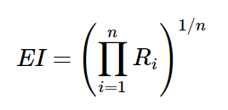
Relative Ranking
Exposure Index:
[(Rank_{Geomorphology})(R_{Relief})(R_{Habitat})(R_{SLR})(R_{Wave})(R_{Surge})(R_{Erosion})]^{1/7}
What if habitats were lost?
R_{Habitat} = 5 (high exposure) for all shoreline segments
Notes:
All shoreline ranks are then combined for each shoreline segment using the formula shown here to calculate the geometric mean of the variable ranks. We then ask the question – what if shoreline habitats are lost? To answer this question, we re-run the model, but set the Habitat rank for all shoreline segments as 5.

Slide 11
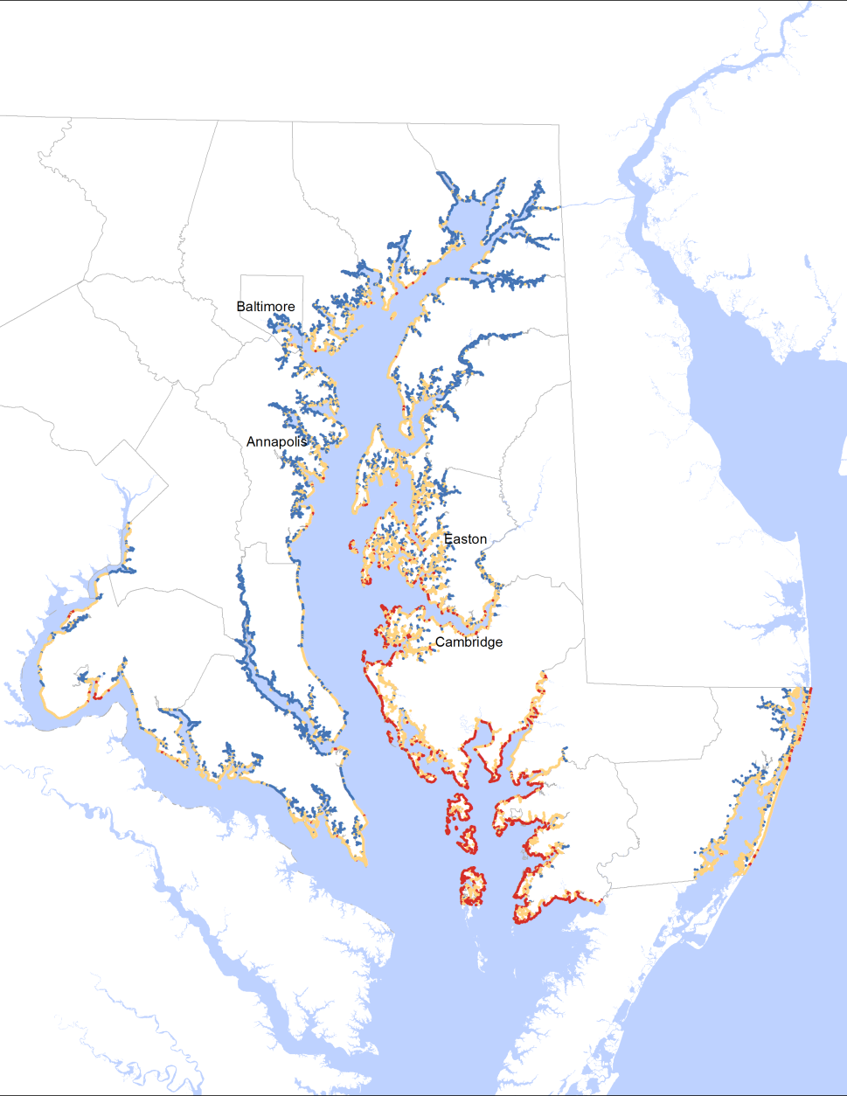
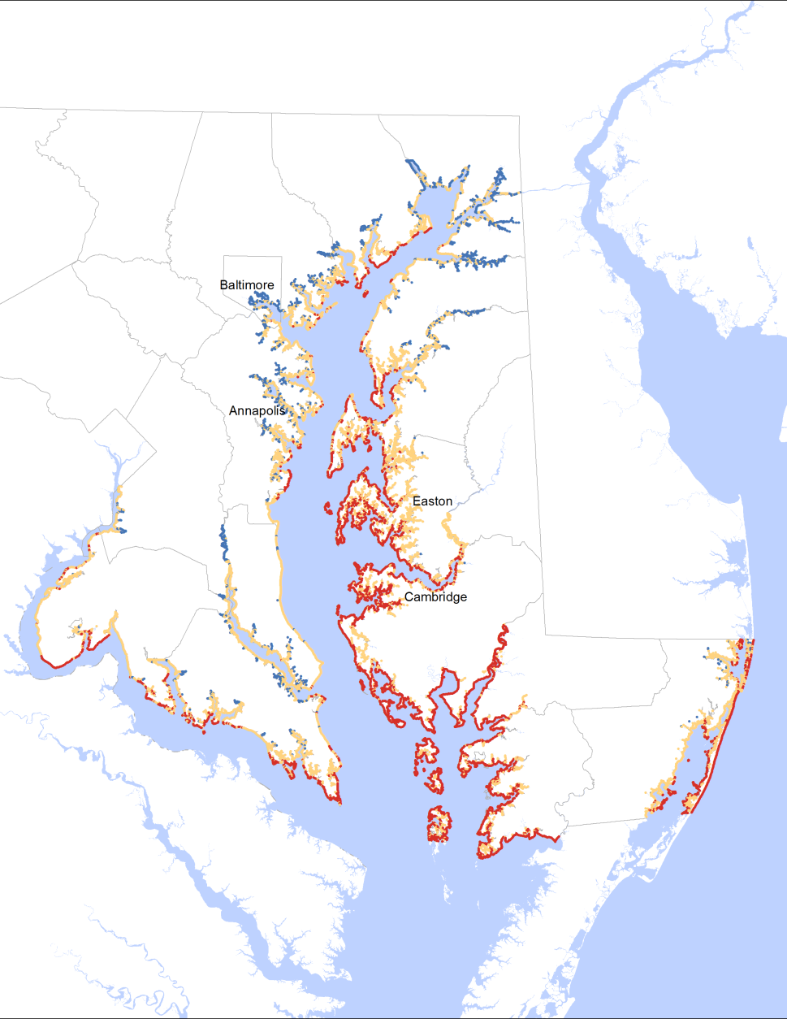
Interpreting Results
Initial Run
Habitats Lost
DRAFT
Notes:
By comparing the difference between the initial model run and the “Habitat Lost” scenario, we can determine which shoreline habitats are providing the greatest hazard reduction.

Slide 12
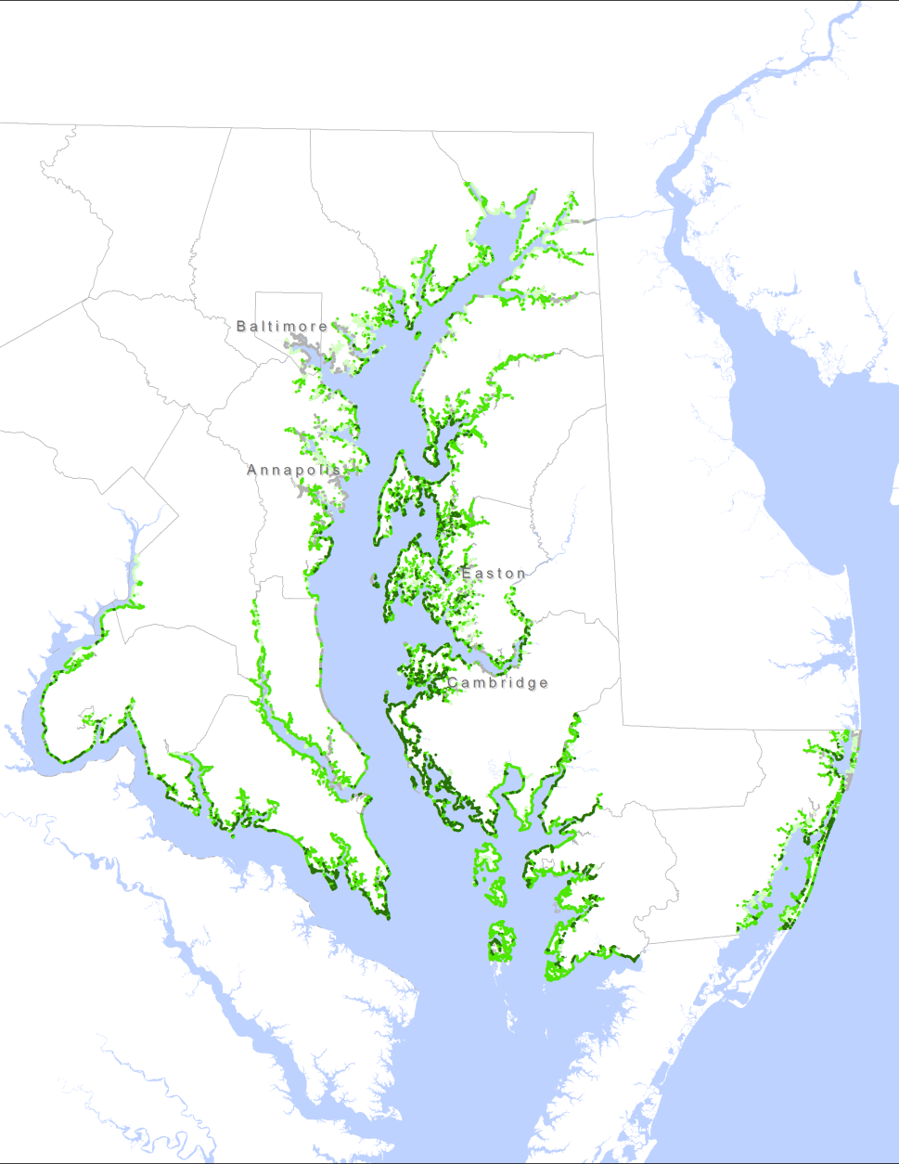
DRAFT
Initial Results:
14,328 shoreline segments total
13,541 where habitats reduce hazards
Hazard Reduction (relative values)
0-2.6 low (bottom 25%)
2.6-3.5 moderate (central 50%)
>3.5 high (upper 25%)
Notes:
This map shows the magnitude of hazard reduction by habitats, with the darkest green indicating the greatest reduction. Shoreline segments that provide high hazard reduction may be prioritized for conservation activities. Those that provide moderate reduction may be prioritized for restoration in order to enhance protective value to the greatest extent possible. Those with low or no hazard reduction roles may be evaluated for a hybrid “grey-green” approach to risk reduction. These models are still under development and the Steering Committee is still determining the best ways to apply the model results.

Slide 13
Model Development
Natural Features Analysis
Identify natural infrastructure and assess value as risk-reduction techniques
National Model: InVEST Coastal Vulnerability Model
Community Risk Analysis
Identify communities that are at-risk to coastal hazards
Regional Model: North Atlantic Coast Comprehensive Study
*Integrate results to identify Conservation and Restoration Priorities
Notes:
I also want to take a step back to remind everyone that this project does focus on coastal human communities and the protective values that natural features provide to coastal populations. Therefore, to prioritize future conservation or restoration approaches, we also need to identify communities that are at risk to coastal hazards. To do this, we are drawing on the NACCS that was released earlier this year by the Army Corps.

Slide 14
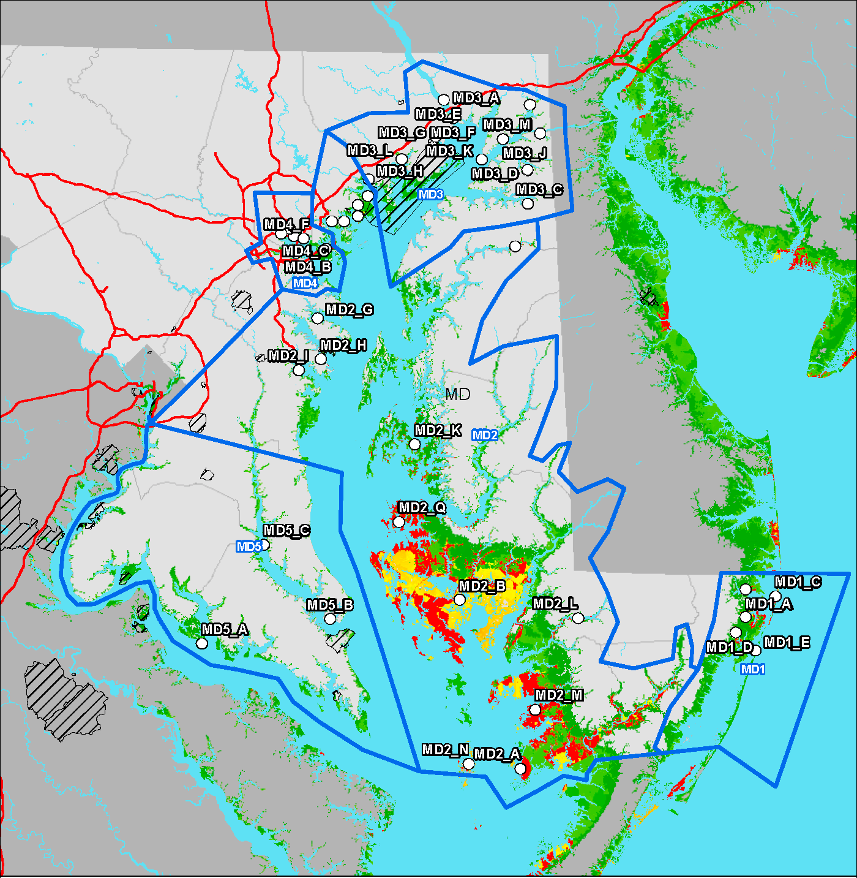
Risk Analysis
Identify communities that are at-risk to coastal hazards:
Where are the people?
Population Density Index
Social Vulnerability Index (Age, Income, Language Proficiency)
Where are the probable flood events? (100-year, 500-year)
(PDI + SVI) X (Probability of Exposure) = RISK
Notes:
To identify communities that are at risk to coastal hazards, we used the North Atlantic Coastal Comprehensive Study methodology as a framework for the MD Assessment. Image shows the final Regional Risk Assessment (red to green – or high to low risk areas relative to entire North Atlantic region). The methodology involves identifying coastal community populations that occur in flood inundation areas and may be less equipped to prepare for, respond to, or recover from hazard events.
This equation is used to determine the Risk Areas, where PDI = Population Density Index, and SVI = Social Vulnerability Index.
Across the study area, we developed a Population Density Index and a Social Vulnerability Index. The Population Density Index was developed with US Census Bureau data and MDP land use land cover data, which helped us to identify residential areas. The Social Vulnerability Index was developed by determining the percent of the population identified as youth, elderly, in poverty, and non-proficient in the English language. These indices were then multiplied by probability of exposure based on floodplain data to obtain the final Risk Areas.

Slide 15
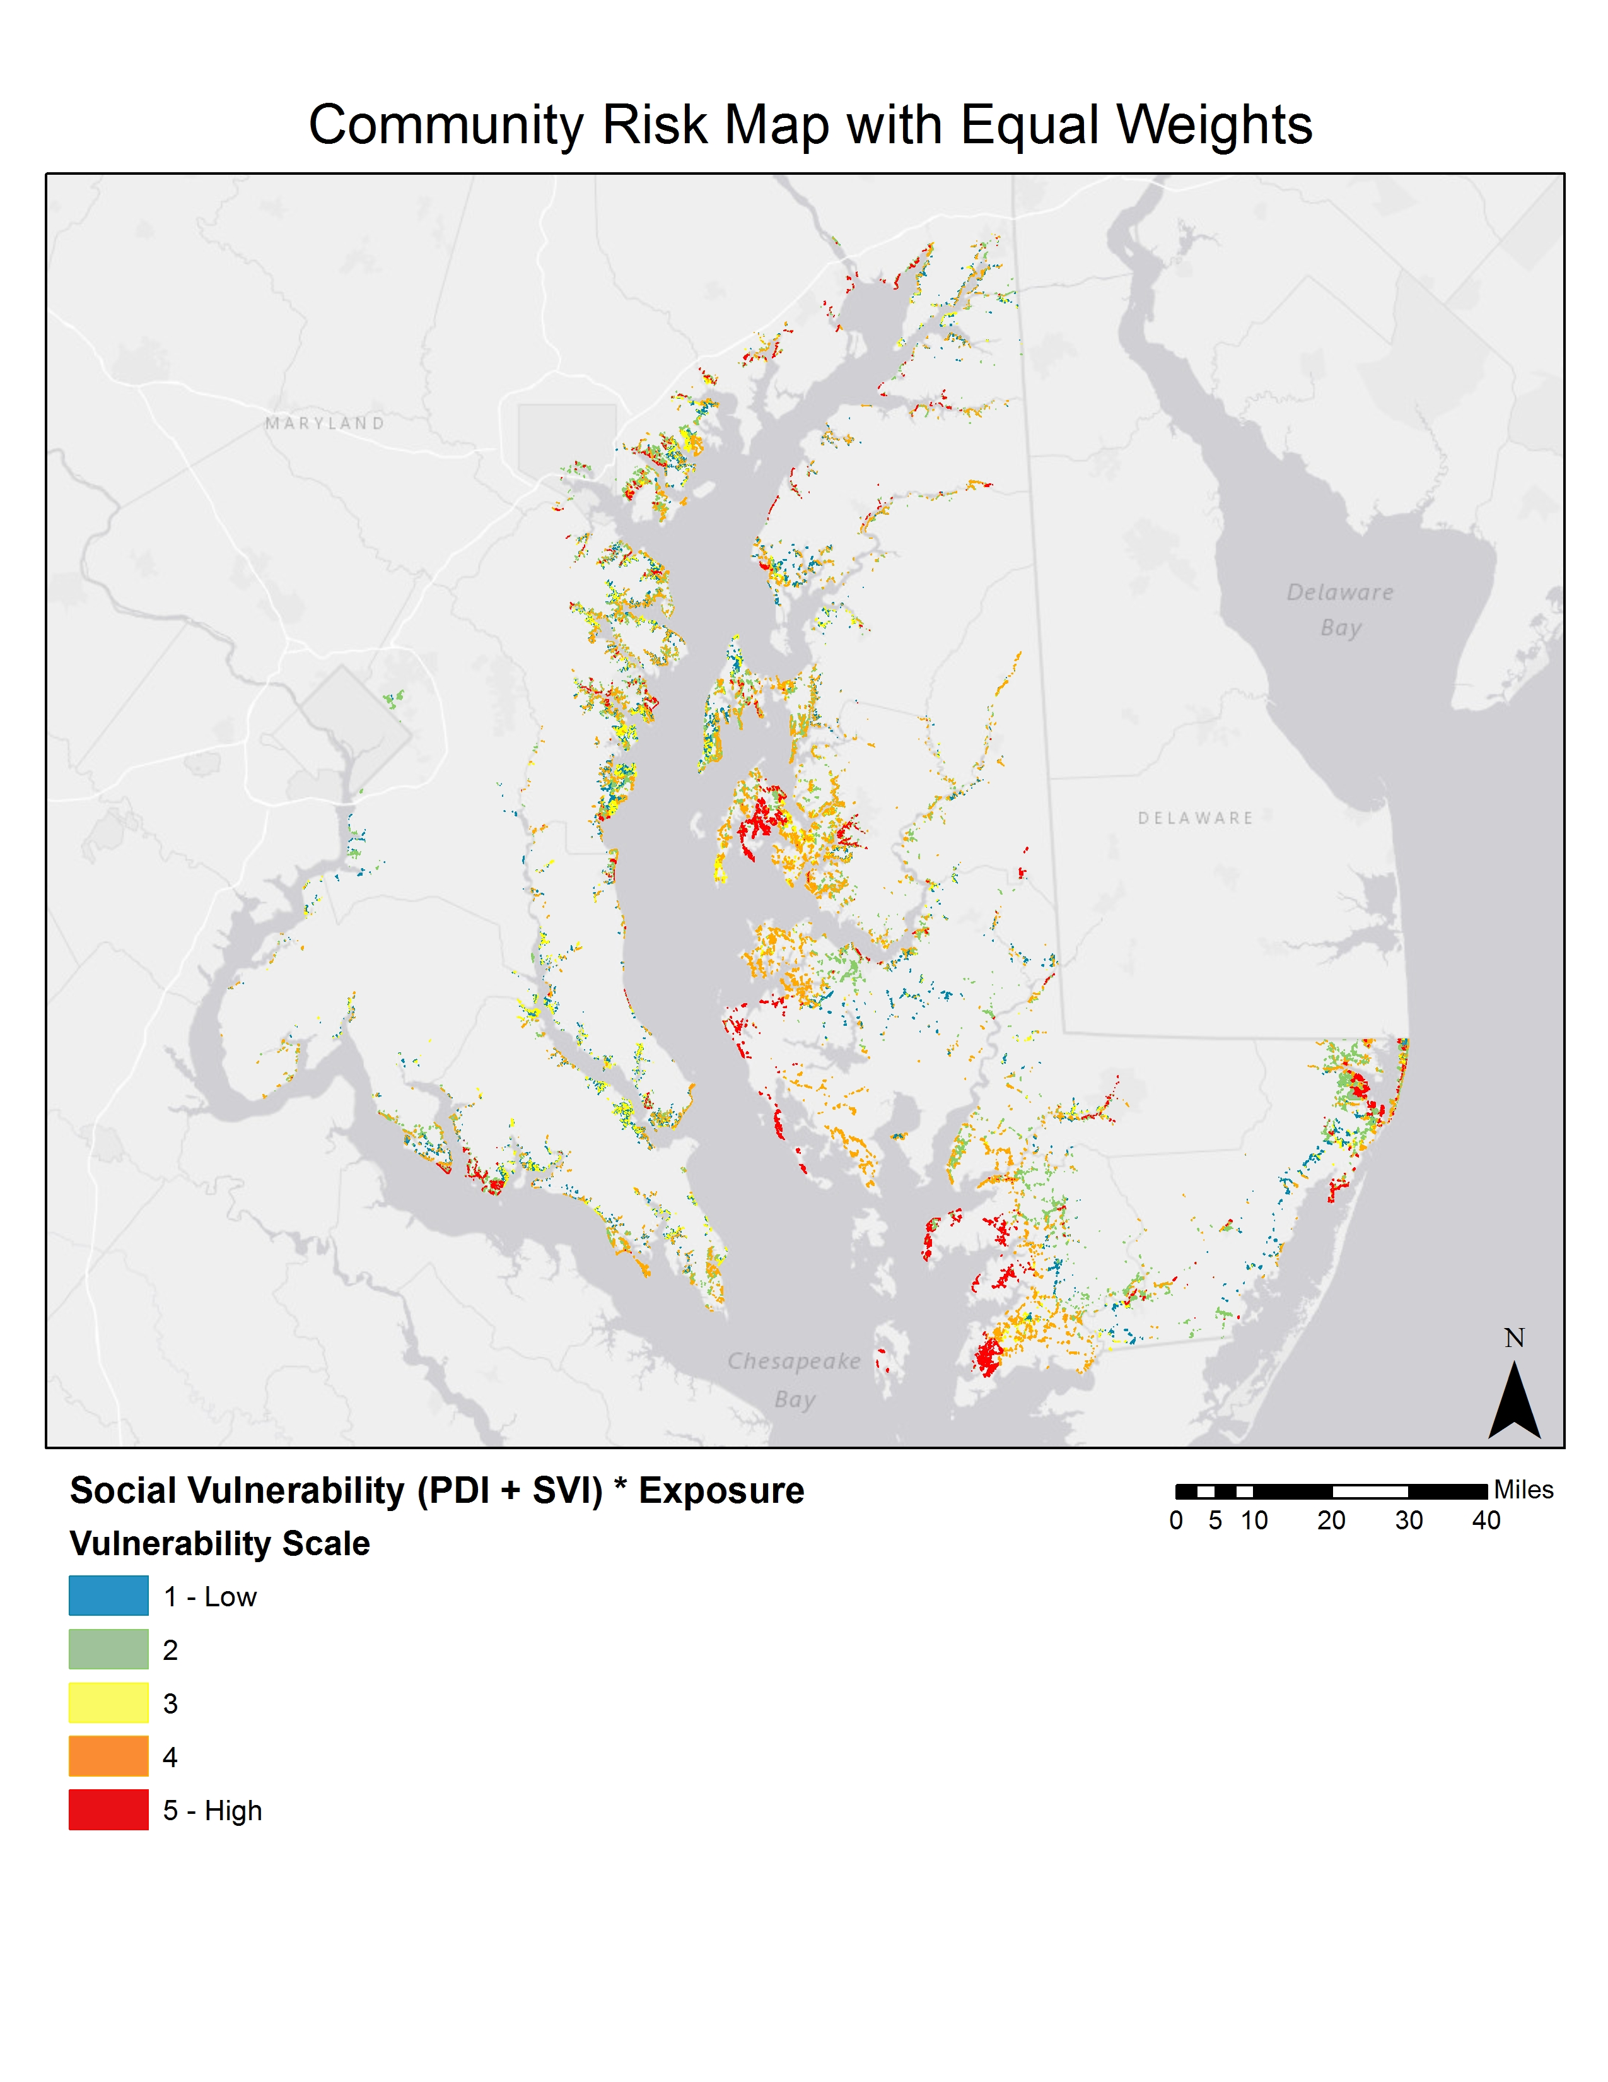
Draft Risk Areas
DRAFT
Where does natural infrastructure occur in relation to vulnerable coastal communities?
Notes:
The Risk Analysis gives us a map similar to this one where residential areas are ranked from low to high based on population density, social vulnerability, and probability of inundation by a flood event within the study area.
Once we have identified the vulnerable coastal communities, then we evaluate where natural infrastructure occurs in relation to these high risk areas.

Slide 16
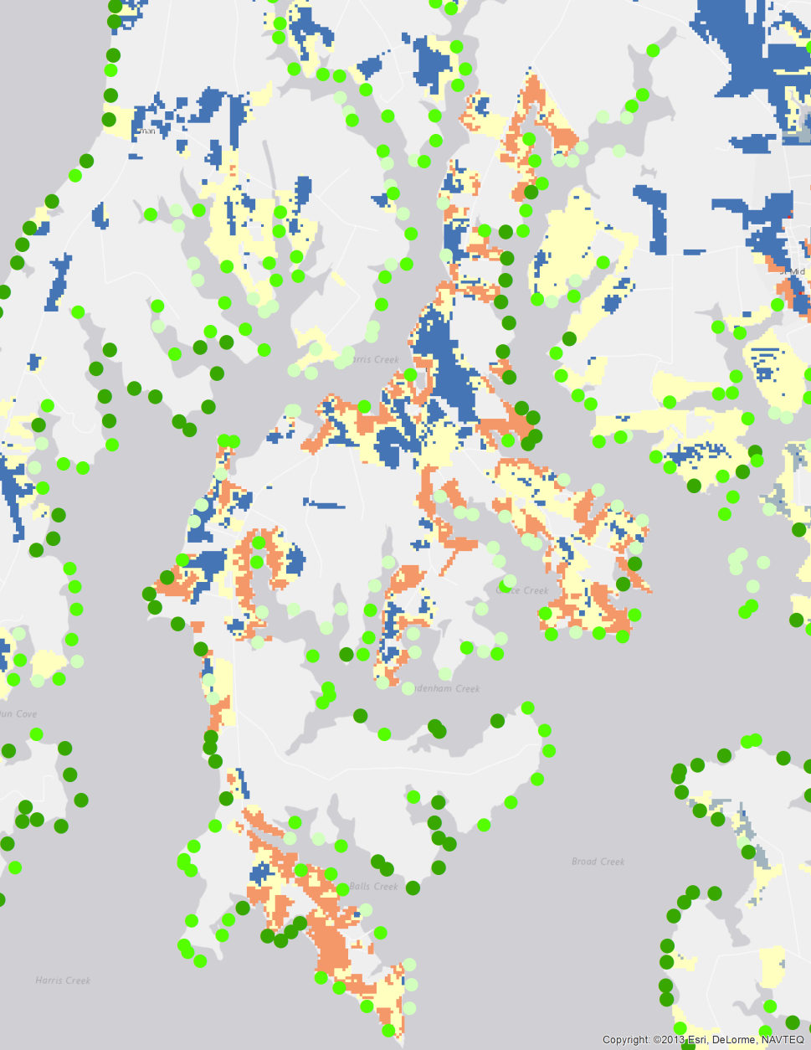
Conservation Priority Areas
Community
Risk Analysis
Natural Features Risk Reduction Analysis
Conservation Priorities
Notes:
We are still working to integrate the model results into a useable output. However, this slide shows just one way of thinking about the Assessment results. The goal of the project is to protect and manage habitats providing the most hazard reduction near vulnerable populations. When considering the Risk Analysis and the Natural features Risk Reduction Analysis, we want to prioritize conservation along shorelines with the highest risk reduction potential that also occur near the most vulnerable populations (dark green dots near orange and red population areas).
Moving forward, we will also evaluate restoration opportunities near vulnerable populations where habitats are not currently providing high levels of risk reduction.

Slide 17
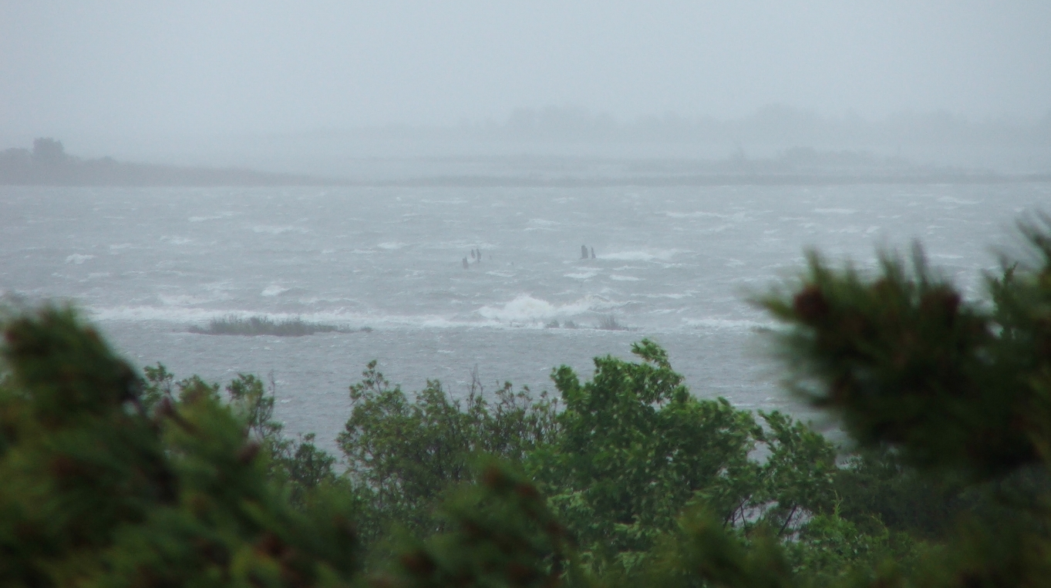
Thank You!
Questions?
Nicole Carlozo, MD DNR
nicole.carlozo@maryland.gov
Fact Sheet Available at: http://dnr2.maryland.gov/ccs/Documents/NF_MDResAssess_FactSheet.pdf

