Slide 1


Review:
CBP Finance & Investment Forum
Laurel Abowd, Technical Lead
Budget & Finance Workgroup
April 29, 2020

Slide 2
Forum Logistics
Date: March 11, 2020
Location: STAMP Student Union, UMD
Attendees: 78 Total Attendees
60 members of Chesapeake Bay Program partnership (70 RSVP’d)
13 finance coaches (17 invited and on retainer)
5 speakers
7 breakout tables

Slide 3
Key terms
Financing: capital is provided with the expectation of it being repaid, often with a percentage of interest. If you are purchasing a home, your mortgage is the financing mechanism.
Funding: capital is provided, often without contractual requirements, without the expectation of it being repaid. In the house analogy, your job is what funds your mortgage payments.
Notes:
The Forum originally resulted from a FY17 GIT Funding proposal that was revived. The project resulted directly from the Strategy Review System process. Various outcomes, including blue crab, forage fish, oysters, SAV and projected, requested financing expertise from the Management Board during the Quarterly Progress Reviews.
The RFP was designed between two contractors: ERG and The Alliance for the Chesapeake Bay. ERG was responsible for coordinating with the finance experts and the Alliance handled the logistical components of organizing a one day Forum. The CBP technical lead coordinated small internal planning meetings to plan the content of the Forum.

Slide 4
Forum Objective
(As written on the March 11 agenda)
Today is designed as a forum for constant engagement and discussion with finance coaches. We want you to walk out with an understanding of how the Bay Program can integrate itself better into the financing system; understand what our roles are; and identify who can lead the financing effort individually or collectively on conservation objects.
Objectives: To learn about finance, to help finance people learn about the Bay restoration objectives, to understand your role, and evaluate whether finance can affect what you want to do. You don’t need to be a finance expert, you simply need to know your area.
Notes:
The Forum originally resulted from a FY17 GIT Funding proposal that was revived. The project resulted directly from the Strategy Review System process. Various outcomes, including blue crab, forage fish, oysters, SAV and projected, requested financing expertise from the Management Board during the Quarterly Progress Reviews.
The RFP was designed between two contractors: ERG and The Alliance for the Chesapeake Bay. ERG was responsible for coordinating with the finance experts and the Alliance handled the logistical components of organizing a one day Forum. The CBP technical lead coordinated small internal planning meetings to plan the content of the Forum.

Slide 5
Forum Agenda
Morning: March 11
9:05 – Case Study In search of cost-effective nutrient loss reductions from the ag sector The role of pay-for-performance conservation Jon Winsten, speaker, Winrock International
9:25 – Finance 301 A crash course in conservation finance (This is where you learn the concepts) Definition of key terms, identification of enabling conditions, strategy framework Ashley Allen Jones, finance coach, i2 Capital
10:15 – Oyster Ignite Talks Three short talks highlighting the potential oysters offer for innovative financing Restoration and Ecosystem Services: Sean Corson, Fish GIT, NOAA Oyster Aquaculture and Fishery: Jason Ruth, speaker, Harris Seafood Innovation: Erik Michelsen, speaker Anne Arundel County
11:10 –Meet the Coaches and Application of learning

Slide 6
In Search of Cost-Effective Nutrient Loss Reductions from Agriculture:
The Case of
Pay-for-Performance Conservation
Jonathan Winsten, Ph.D.
Winrock International
March 11th, 2020
Notes:
Ag economist
Working with Winrock since 2001
Been working on PFP around US and in Canada
Dad had a dairy farm
Live in Shelburne
VT Ag is important to me, as is Lake Champlain

Slide 7
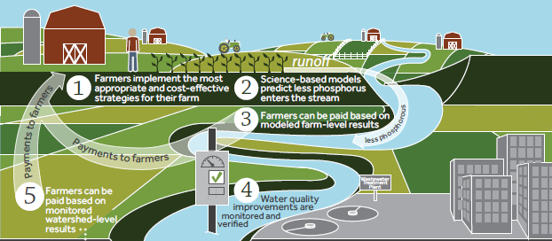

New Approach: “Pay-for-Performance” Conservation
Payments based on estimated outcome
www.winrock.org
7
Notes:
7
New approach uses scientific advances in simulation modeling and outcome-based incentives.
Pays farmers for achieving nutrient reduction goals;
Farmers choose how to best reduce nutrient loss from their specific fields;
Incentivizes farmers to choose the most cost-effective actions BECAUSE becoming more cost-effective increases net farm income.

Slide 8
Why Pay-for-Performance?
Address market failure
Motivate farmers
Create specific goals
Increase farm profits
Quantify outcomes
Meet WQ goals given budget constraints
Notes:
Markets imply the existence of prices
Producers and consumers use prices to make decisions

Slide 9
Lessons Learned
Low-hanging fruit remains
Perf-based incentives inspire new ideas
Farmer motivation varies
Boots on the ground is essential
Transaction Costs < Program Benefits
Models: a necessary evil??
Policy change is slow
Notes:
9

Slide 10
Chesapeake Bay Watershed
Agriculture contributes:
38% N, 45% P, 60% sediment
Practice-based approach 6x more costly the pay-for-performance.
Ribaudo et al. 2014
How to achieve TMDL goals?
Most cost-effective solutions from agriculture.
Notes:
10

Slide 11
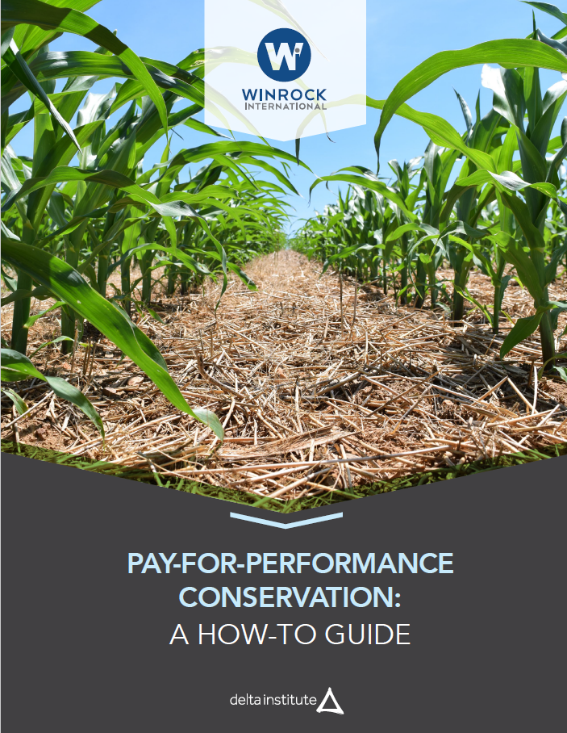
Pay-for-Performance Conservation: A How-To Guide
Describes steps and data needs
Goals:
Reduce transaction costs
Create opportunities for scale
Funded by Great Lakes Protection Fund
https://www.winrock.org/project/running-off-pollution-paying-midwestern-farmers-to-improve-water-quality/

Slide 12
Case Study take away messages
Having the right policies in place can help advance finance investment opportunities
Important to understand the nuances of each location for pay-for-performance financing
For the pilot projects, it was critical to develop a relationship and provide specific data to each individual farmer
“Model at the farm, measure at the watershed”

Slide 13
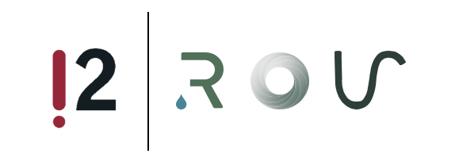
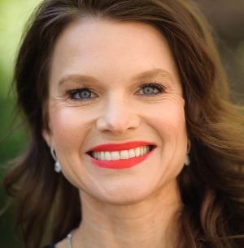
CHESAPEAKE BAY PROGRAM
FINANCE & INVESTMENT FORUM
CONSERVATION FINANCE 301
Ashley Allen Jones
CEO and Founder, i2 Capital
University of Maryland
March 11, 2020
For CBP Program Use Only: Please do not duplicate without attribution.
1

Slide 14
Sources of Water Conservation Funding
Federal
Foundation/
Corporate + State Grants
Compliance Markets
Beneficiary + Consumer Markets
Input Funding
Federal Agencies fund conservation through support for land conservation, technical assistance and implementation of agriculture, stormwater, and wastewater projects.
Local, regional and national grant-making efforts; emerging focus on watershed-wide planning and restoration.
EPA regulates TMDLs in waterbodies: MS4 regulations mandate reductions in sediment, nitrogen, phosphorous and bacteria; NEPA regulates Federal Projects.
Businesses that benefit from water quality and quantity may invest in green infrastructure to reduce operating costs and address catastrophic risks; consumers invest in environmentally friendly products and services.
Outcomes Funding
Grant Funded Solutions
Market Based Solutions
Conservation: How can I coalesce more money for conservation?
Investment: How can I achieve financial returns and help the environment?
Conservation Finance: How can I increase the pace and scale of conservation outcomes through capital market innovations? How can I address market gaps?
5

Slide 15
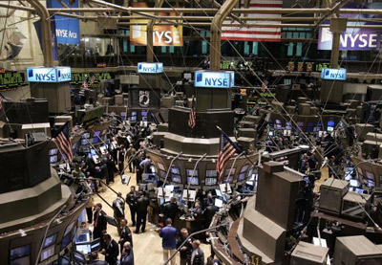
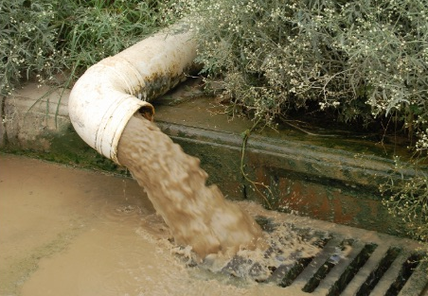
Market-Based Solutions: Definitions
Major Terms
Capitalism
Law of supply and demand
Factors of production
Capex; Opex
Capital markets
Equity; Debt
Net present value (NPV)
Cost of capital
Externalities
Natural Capital
Pros & Cons
Largest expansion in GDP and standard of living known to humankind
Does not take into full account external costs (externalities) such as air pollution, water pollution and loss of bio-diversity
Over time system depletes natural resources (Tragedy of the Commons)
6
Notes:
Major Terms
Capialism: an economic system in which the means of production of goods and services are privately owned and operated for a profit.
Law of supply and demand: prices set by market -- supply rises with price; demand falls with price;
Factors of production: entrepreneurship, capital, natural resources, labor;
CAPEX, or capital expenditure, is the funds used by a company to acquire, maintain or update fixed assets such as physical property, vehicles, equipment or land.
OPEX, or operating expenditure, is the ongoing expenses a company incurs through its normal business operations such as sales, general and administrative expenses
Capital markets The part of the financial system in which money is channeled into productive investment via equity, debt and other medium to long-term instruments
Equity: ownership; Debt – borrowed money
Externality: a side effect or consequence of an industrial or commercial activity that affects other parties without this being reflected in the cost of the goods or services involved, such as the pollination of surrounding crops by bees kept for honey.
Natural capital The world’s stocks of natural assets, which include geology, soil, air, water and all living things. Humans derive a wide range of services from natural capital, often called ecosystem services, which make human life possibleli.
Pros & Cons
Largest expansion in GDP and standard of living known to humankind.
System largely ignores external costs, such as pollution and climate change.
Over time, system depletes natural resources, lowers the quality of life in the affected areas, and increases costs for everyone.

Slide 16
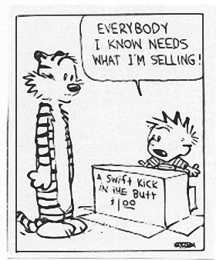
Enabling Conditions
Risk Reduction
Profit Enhancement
ESG Alignment
Investment Analytics
Regulatory Compliance
Relevant Capital Pools
Aligned Intellectual Capital
Consumer Demand
Who pays for the
“Tragedy of the Commons?”
7

Slide 17
Conservation Finance Innovations
Finance Vehicles
State Revolving Funds
Ohio Turkey Creek Estuary Project
Wilmington Wetlands Project
Collateralized Loan Funds
TNC Conservation Notes
TCF Green Bonds
Corporate + Muni Green Bonds
PepsiCo Green Bond
Wastewater Infrastructure
Private Equity Funds
Sustainable Food & Fiber
Wetlands
Mitigation Banks
Blended Finance Funds
TerraSilva Carbon Fund
Revolving Water Fund
Pay-for- Success Contracts
First Loss Capital
Guaranteed Purchase Pool
Insurance Products
Loan Guarantee
Risk Reduction Tools
9
Notes:
Ohio Turkey Creek Estuary: In April 2016, Northeast Ohio Regional Sewer District (NEORSD) + Land interest rate discount totaling $6,944,994 on this WPCLF infrastructure loan, WRRSP funding in the amount of $2,951,500 was applied toward acquiring and protecting the Turkey Creek Estuary.
$25 million construction; The 20-acre wetlands project will create a stormwater management facility that will help to reduce flooding, restore and enhance existing wetlands, and create a new open recreational space; Funding includes $21 million from the State’s Clean Water Revolving Fund; $3 million from NOAA/National Fish and Wildlife Foundation; $1 million in brownfield funding from the federal and state governments; and a $25,000 grant from the Nature Conservancy.
TNC: $25mn offering, PRI Notes, unsecured general obligation debt. Packard Foundation did $10mn. 0 – 2% notes, Aa2. The Notes are unsecured general obligations of the Conservancy and are not deposits or obligations of, or guaranteed or endorsed by, any bank. The Conservancy has other outstanding unsecured general obligations as well as secured obligations.
TCF: $150 million of ten-year bonds, rated A3 by Moody’s, in September 2019. all proceeds into Working Forest Fund® projects to accelerate the scale and speed of our mission impact. In addition, we hope to significantly increase the level of philanthropic capital for this urgent mission to leverage the bond proceeds across more projects, and re-invest those proceeds more than once
PepsiCo Inc. (NASDAQ:PEP The net proceeds from the US$1 billion Green Bond offering will fund a series of key initiatives to advance PepsiCo's sustainability agenda + the Global Sustainable Plastics team and Global Sustainable Operations team.
$90 million impact investing collaborative designed to respond to the challenges of global climate change. Terra Silva will make investments focused on the conservation, restoration, and sustainable management of critical tropical forests worldwide.

Slide 18
Framework For Creating Financing Strategy
Demand Drivers
Who benefits from the solution?
Business Model
Sources of revenue
Financial Model
Revenue
Can you quantify the benefit?
Is there a regulatory driver?
Total market opportunity
Operating requirements
Cost of Goods Sold
Operating Profit
Financing Potential
% Profit (Loss)
Risk Reduction Tools
Sources of Capital
12

Slide 19
Finance 301 take away messages
Presentation provided a new perspective and strong grounding for the day’s finance discussion
“Conservation Finance: How can I increase the pace and scale of conservation outcomes through capital market innovations? How can I address market gaps?”
The two morning presentations illustrated two components of finance: policy and investors

Slide 20
Oyster ignite talks
Format shifted gears from broad perspective to narrowing in on oysters as an example for conservation finance
The three ignite talks provided background on oyster ecosystem services, oyster public fisheries, and areas for innovation.
The ignite talks offered a launch point for the morning breakout table discussions

Slide 21
Forum Agenda
Afternoon: March 11
1:00 – “Oysters Etc.” Panel The panel will provide a report out on how the morning’s learning and discussions could be applied to oysters, as well as other environmental outcomes. Moderator: Dan Nees (University of Maryland) Panelists: Stephan Abel (Ferry Cove Shellfish), Mark Bryer (The Nature Conservancy) David Tepper (Forest Trends)
2:00 – Breakout Sessions GIT members and finance experts work together to identify where there may be opportunities for a financing strategy and what type of information would be needed to create such a strategy. A framework to guide the discussion provided (This is where you understand your role, evaluate where finance can affect what you want to achieve, and engagement with the expert happens)
4:00 – Summary and End of Day Introduction of Conservation Mutual Fund and breakout table report outs

Slide 22
“Oysters Etc.” Panel
Three tiers: sanctuary (conservation funds), public fishery (public goods and resources), aquaculture (commercial business)
Factors influencing ability to attract investors
Efficiency, Risk (real and imagined), and Scale
Projects with multiple ways of generating revenue reduce risk
Provide as much certainty to investors as possible
Notes:
Efficiency: can private finance bring more efficiencies to the market?
Risk: private finance can likely take on greater risk and lower the risk to the public sector
Scale: increasing scale of project can attract investors

Slide 23
Breakout Sessions
7 groups: Fisheries, Wetlands/Habitat, Stormwater/Ag, Forestry, Land Conservation, Stewardship, Climate
Breakout tables worked through finance strategy questions and a template
Documents available on CBP Calendar page:
https://www.chesapeakebay.net/what/event/chesapeake_bay_trust_finance_and_investment_forum_march_11_2020

Slide 24
Sample breakout session questions
Within your GIT, please list one to two outcomes which you believe could be ready for a financing strategy.
Based on your answer, what marketable good or service would you promote with a financing strategy?
Besides the conservation community, what other entities would be willing to invest in your good or service of interest?

Slide 25
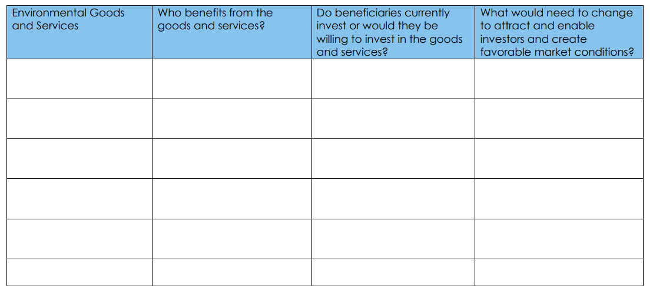
Finance Strategy Worksheet
Notes:
Also asked about other related goods and services and if you could demonstrate risk to an investor

Slide 26
Breakout group report outs
Fisheries: Govt. could release RFP to attract partnerships and new ideas to reduce risk.
Habitat: Myriad of wetlands beneficiaries that could invest. What needs to change to attract their investment?
Water Quality: Interested in engaging corporate beneficiaries, including development industry.
Forestry: Planting trees is profitable: credits, cost avoidance, and consumable products.

Slide 27
Breakout group report outs
Climate: Interested in collaborating with projects that already have markets.
Stewardship: Tourism and insurance industry could be potential beneficiaries.
Land Conservation: Discussed co-benefits, regulatory boundaries, and various finance incentives available.
At end of day, we introduced the concept of a Conservation Mutual Fund

Slide 28
Next Steps
BFWG approval of coach assignments and timeline for utilizing coaching hours
Discussion of how BFWG will continue the progress made from the Forum

Slide 29
Draft Guidance and Timeline
May 4, 2020 – August 3, 2020 (3 months)
10 hours per coach; 20 hours per group.
Hours must be requested in advance and support one of the outcomes of the Agreement
Groups may use coaches assigned to them, or request to collaborate with another group.
May appeal for more hours prior to Aug. 3

Slide 30
Draft Guidance and Timeline
August 3, 2020 – October 30, 2020 (3 months)
Each coach is increased from 10 to 24 hours and each group is increased from 20 to 48 hours
By August 3, technical lead and BFWG will assess if groups are not utilizing coaches and will shift hours to other coaches based on demand
End of contract: BFWG report on groups’ progress

Slide 31
Future plans
November 2020 – May 2021 (6 months)
BFWG facilitates sharing the ideas and progress made through the groups’ various coaching
Prepare for a finance agenda item during the May 2021 Biennial SRS meeting
Fundable Bundles
Conservation Mutual Fund

Slide 32
Thank you!
Laurel Abowd, Technical Lead
April 29, 2020

