Slide 1
CBP Biennial Strategy Review System:
Update Enhance Partnering, Leadership and Management
Goal Implementation Team Meeting
October 10-11, 2017

Slide 2
Biennial Strategy Review System
Today’s Objectives:
1) Fast refresher on the “What”, “Why”, “Who”, and
“How” of the Strategy Review System (SRS)
2) Where are we in the process?
3) What’s happened so far?
a) Actions / Decisions on the Reviewed Outcomes
- Outcome-specific actions
- Cross-cutting actions
b) Process improvements
4) Is it working?

Slide 3
Biennial Strategy Review System
Fast Refresher
What are we trying to accomplish?
Improve the success at meeting our Watershed Agreement Goals and Outcomes by implementing a transparent, accountable, and effective adaptive management process.

Slide 4
Biennial Strategy Review System
Fast Refresher
Why are we trying to accomplish it?
Answer A: It makes common sense to do it.
Answer B: We already said we would do it.
“The signatories and other partners shall thereafter update and/or modify such commitments every two years.”
“Goal Implementation Teams will re-evaluate biennially and update strategies as necessary, with attention to changing environmental and economic conditions. Partners may identify policy changes to address these conditions and minimize obstacles to achieve Outcomes.”
2014 Chesapeake Watershed Agreement

Slide 5

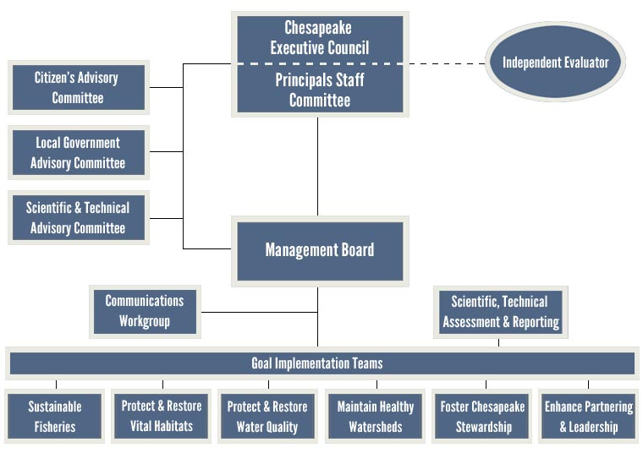


Biennial Strategy Review System
Fast Refresher
Who is working to accomplish it?
The Management Board needs to be managers, not just interested stakeholders.

Slide 6
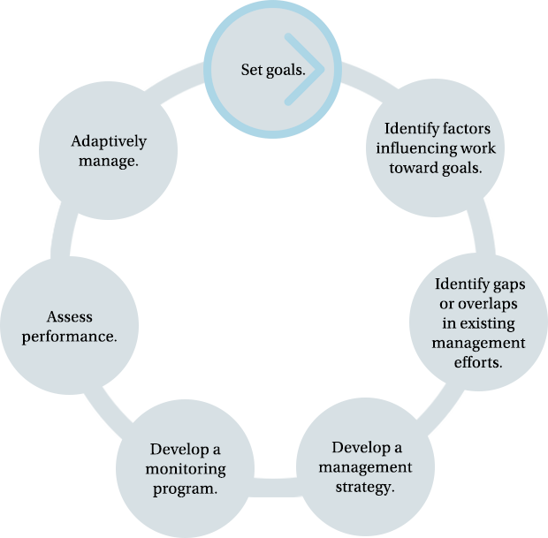
Biennial Strategy Review System
Fast Refresher
How are we accomplishing it?
By developing a process to implement the Decision Framework as approved by the Principal’s Staff Committee:
The logic of the Decision Framework needs to become systemic, not merely another quarterly reporting format.

Slide 7



Biennial Strategy Review System
Where are we in the process?

Slide 8
Biennial Strategy Review System
What has happened so far?
1) 2-Day Biennial Review Meeting (Feb 8-9, 2017)
2) 2 Quarterly Progress Review meetings and subsequent follow-up
Reviewed 11 of our 31 Outcomes
Identified and discussed 23 recommended actions
11 Outcome-specific recommendations
12 Multi-Outcome recommendations (4 categories)
3) Large variety of process improvements

Slide 9
Biennial Strategy Review System
What has happened so far?:
Outcome-specific Recommendations
Outcome
Recommendation
Action
Healthy
Watersheds
Evaluation of how existing monitoring efforts can be leveraged by the GIT to assess healthy watershed status.
MB Directed STAR to evaluate current efforts for improving monitoring, including the new organizational study/tool, Tetra Tech’s anticipated report, and corollary benefits and avoided costs.
Protected Lands
Support and effectively credit land conservation in the updates to the Bay Models and TMDL.
MB asked that Protected Lands workgroup review suggestions made by Peter Clagett and then bring back to MB for more specific discussion and action.

Slide 10
Biennial Strategy Review System
What has happened so far?:
Outcome-specific Recommendations
Outcome
Recommendation
Action
Stream Health
Workgroup is in need of new co-chairs.
Funding is needed to analyze data necessary to establish baseline.
New co-chairs were named at Sept 21 MB meeting.
$18,000 was set aside to meet analysis need.
Brook Trout
Technical assistance is required to better collaborate and make more efficient use of monitoring data.
MB directed STAR to evaluate better methods to improve collaborative monitoring efforts.
Fish Passage
Assistance in creating incentive programs for dam removal.
Assistance in including ecological considerations (in addition to public safety) in dam removal prioritization
MB recommended that Fish Passage workgroup work with Ches. Bay Commission on possible state legislative approaches.

Slide 11
Biennial Strategy Review System
What has happened so far?:
Outcome-specific Recommendations
Outcome
Recommendation
Action
Blue Crab Management
Recommended that evaluation of allocation based fishery management approach has been completed.
GIT leadership will seek consensus from members. If consensus is achieved, MB will approve action as “complete”.
Oysters
Recommend sharing oyster restoration successes as presentation at EC meeting.
NOAA “Substrate paper” will be shared with MB when ready, then PSC, then (maybe) EC.
Forage Fish
Request STAC to conduct tidal shoreline threshold analysis.
Request STAR to develop forage monitoring strategy.
GIT funded study to be completed by Jan, 2019.
Forage monitoring strategy to be incorporated into other monitoring needs following Finance Workshop.

Slide 12
Biennial Strategy Review System
What has happened so far?:
Multi-Outcome Recommendations
Outcomes
Recommendation
Action
Healthy Watersheds
Brook Trout
Fish Habitat
Oyster
SAV
Outcomes need assistance communicating their successes and challenges to a broader audience.
Communications Office is working with Outcome leads on outreach strategies.
Blue Crab
Oyster
SAV
Forage Fish
Assistance in developing a financing strategy.
Finance and Budget WG will work with SAV Outcome as proof of concept and follow-up with others.
Healthy Watersheds
Brook Trout
Need greater participation by key partners.
GIT 6 will develop proposal to MB to realize greater participation.
Healthy Watersheds
Fish Habitat
Requested inclusion of Outcome objectives and co-benefits in Phase III WIP local engagement.
Development of Action Team to develop recommendations to MB on how to best achieve request.

Slide 13
Biennial Strategy Review System
What has happened so far?:
Process Improvements
STAR offers “dress rehearsal” 2 weeks prior.
Recommendations as specific as possible.
Spread decision-making over 2 MB meetings.
MB = “Lead Decision-maker and problem solver”
GIT 6 = “Lead SRS coordinator and advisor to MB”
Answers to finance questions added to pre-meeting materials.
Responsible GIT Chairs attend and present/introduce materials to MB.
Logic Table revised to be more user-friendly.
Updated Logic Table can serve also as updated Workplan.
Identification of “Adaptive Management Mentors”
Changing Outcomes? Not yet, but role for PSC if it happens.

Slide 14


Biennial Strategy Review System
Is it working?
“I’ll admit I was very skeptical going into the process. Actually going through it, we identified a lot of things that I don’t think we would have if we didn’t have a systemic process. It surprised me.”
Jim Edward, Sept 21, 2017
The logic of the Decision Framework needs to become systemic, not merely another quarterly reporting format.

