Slide 1
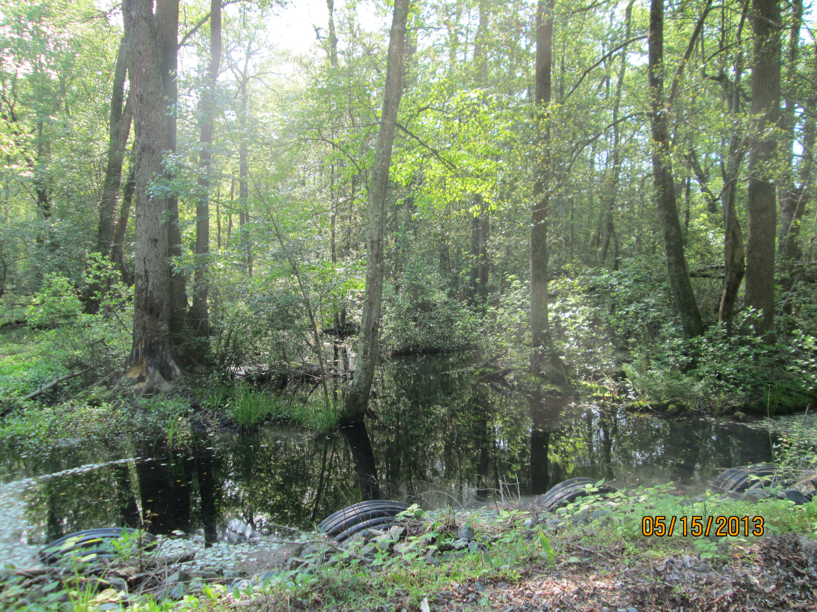
Wetland Workgroup Meeting
May 26, 2016

Slide 2
Agenda
1:00 Introductions from Wetland Workgroup members / Review of goals and agenda
Input from Wetland Workgroup – At least one cool wetland update from your state or organization.
1:10 Quick Updates
    2015 Progress toward Wetland Outcome goals – Amy Jacobs
    Pennsylvania wetland mapping update – Jill Whitcomb
    Habitat GIT Spring Meeting report – Erin McLaughlin
    Cross-Goal Climate Resiliency Analysis project – Zoe Johnson, NOAA – Chesapeake Bay Climate Coordinator
1:30 Guest Presentation: Landowner Attitudes toward Wetland Restoration - Steve Raabe of OpinionWorks
2:00 Wetland Expert Panel – Jeremy Hanson, Coordinator of the Wetland Expert Panel
3:00 Adjourn

Slide 3
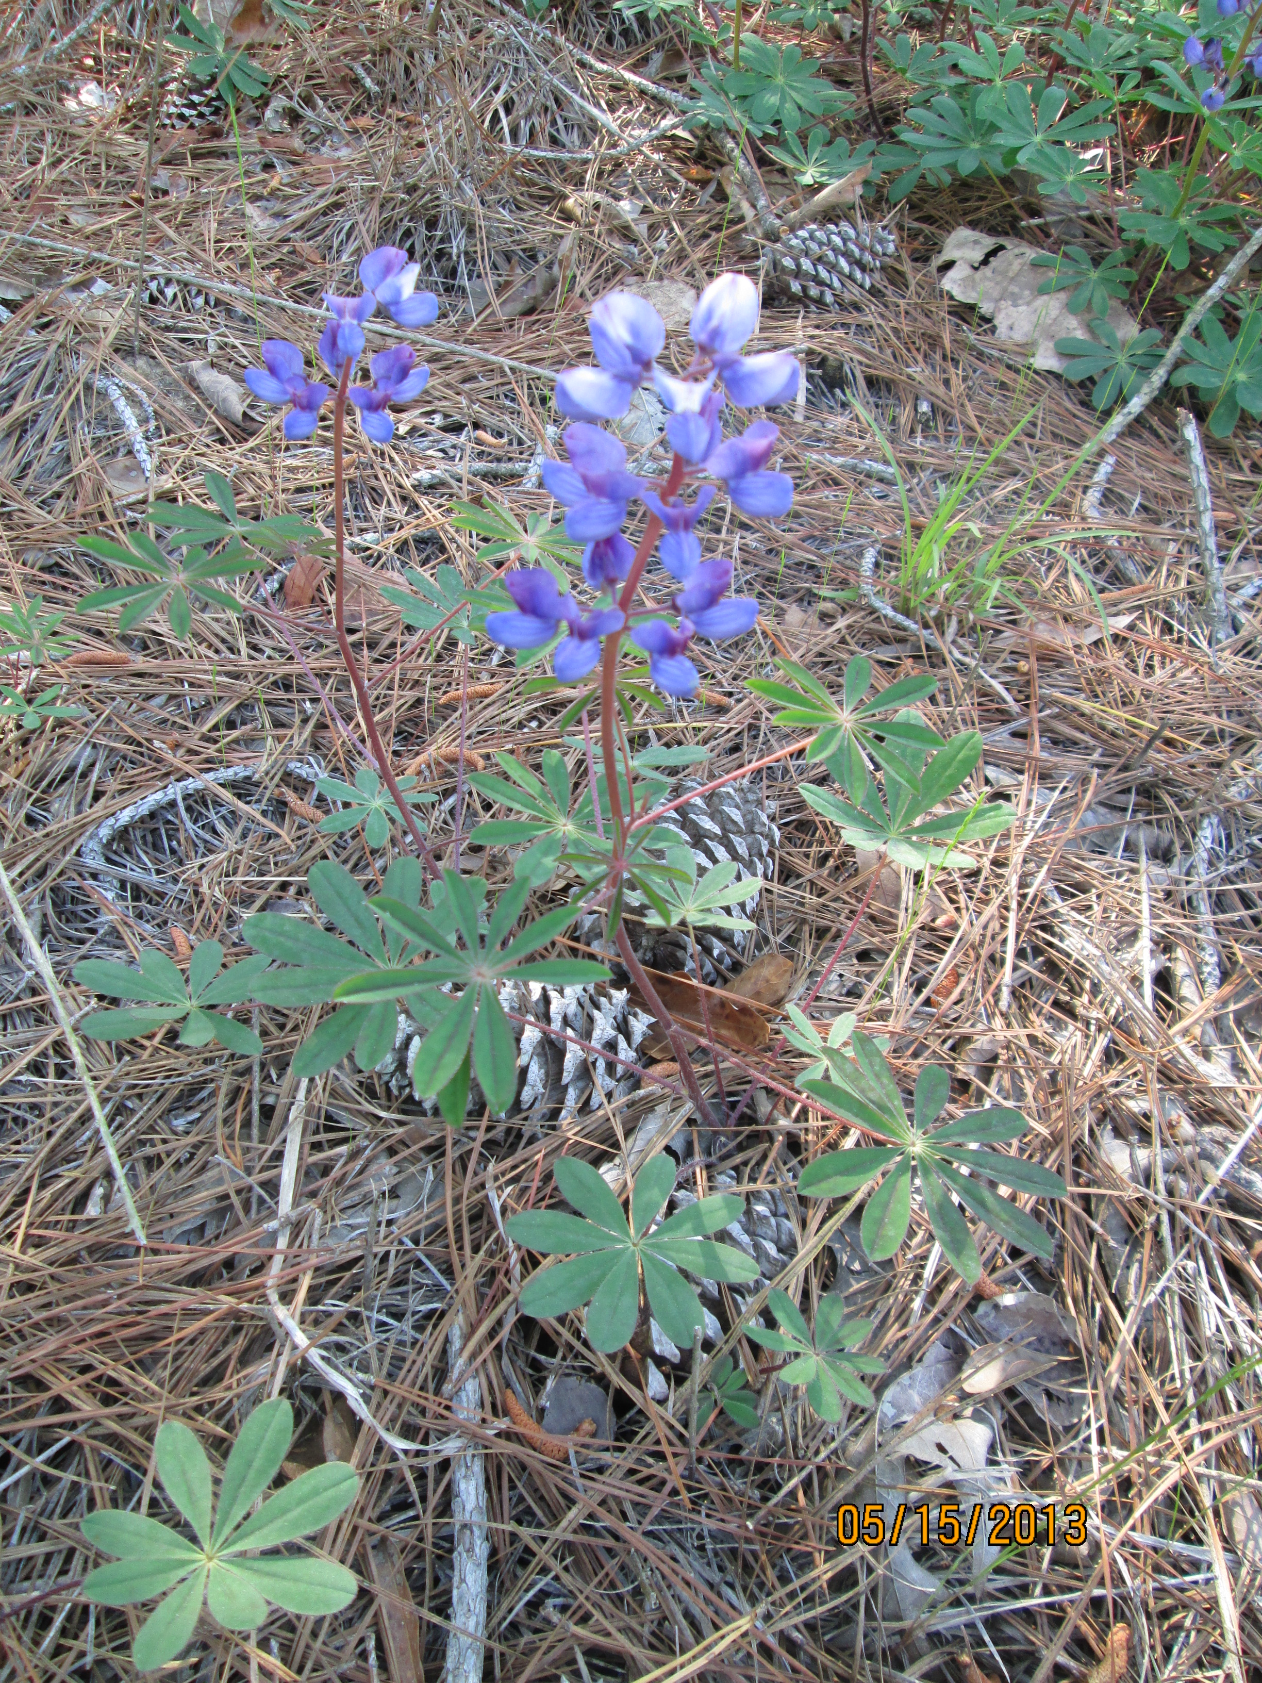
Quick Updates

Slide 5
Chesapeake Bay Wetland Progress Toward Goals
 | 2009 | 2010 | 2011 | 2012 | 2013 | 2014 | 2015 | 2025 WIP Goal | Yearly acres needed to meet 2025 Goal (2016 to 2025)
NY | 5,360 | 5,725 | 6,363 | 6,216 | 6,278 | 6,307 | 6,320 | 13,792 | 756
PA | 3,837 | 4,708 | 4,709 | 4,549 ª | 3,857ª | 3,858 | 3,985 | 54,135 | 5,015
MD | 7,716 | 8,248 | 8,614 | 9,037 | 9,260 | 9,284 | 9,729 | 12,849 | 312
VA | 214 | 213 | 411 | 420 | 420 | 452 | 452 | 19,215 | 1,876
WV | 203 | 203 | 203 | 203 | 203 | 208 | 220 | 406 | 19
DE | 286 | 438 | 588 | 2,694 | 2,697 | 2,699 | 2,717 | 5,725 | 301
Totals: | 17,616 | 19,536 | 20,888 | 23,119 | 22,715 | 22,808 | 23,423 | 106,122 | 8,279

Slide 6
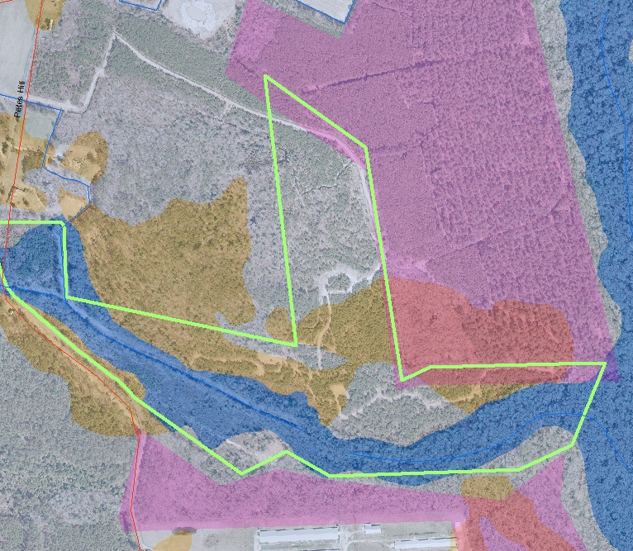
    Pennsylvania wetland mapping update
    Jill Whitcomb

Slide 7
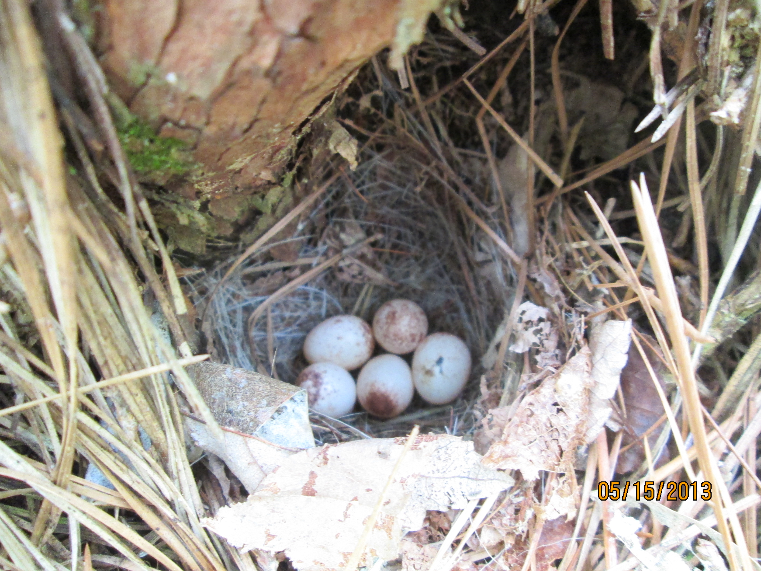
Habitat GIT Meeting Summary
Erin McLaughlin

Slide 8
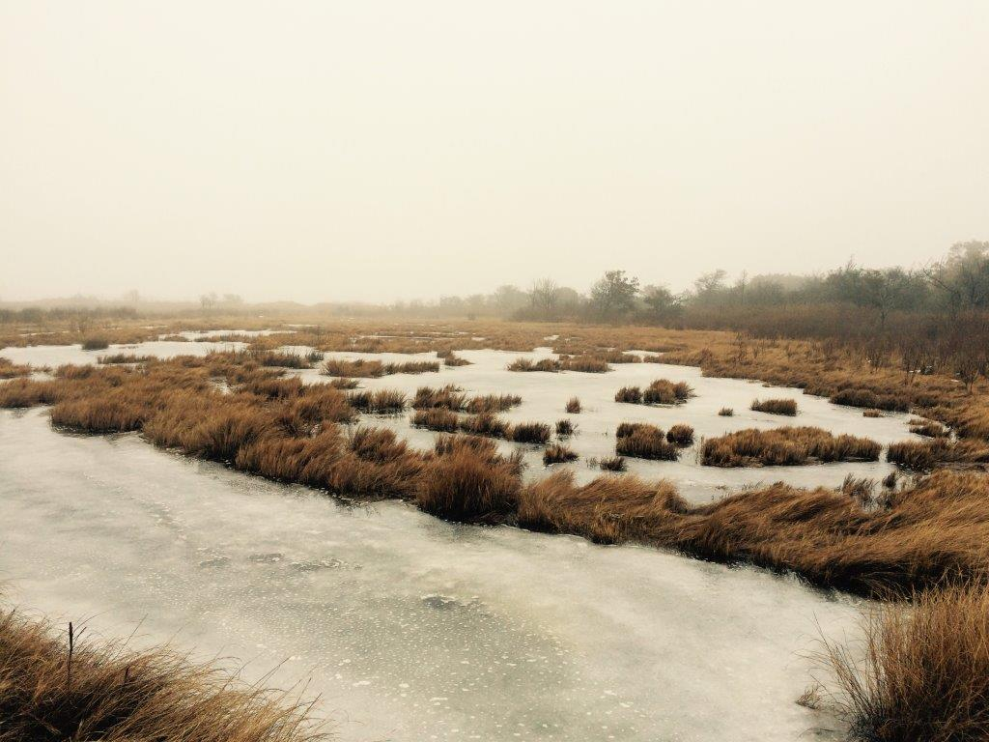
Cross-Goal Climate Resiliency Analysis project – Zoe Johnson

Slide 9
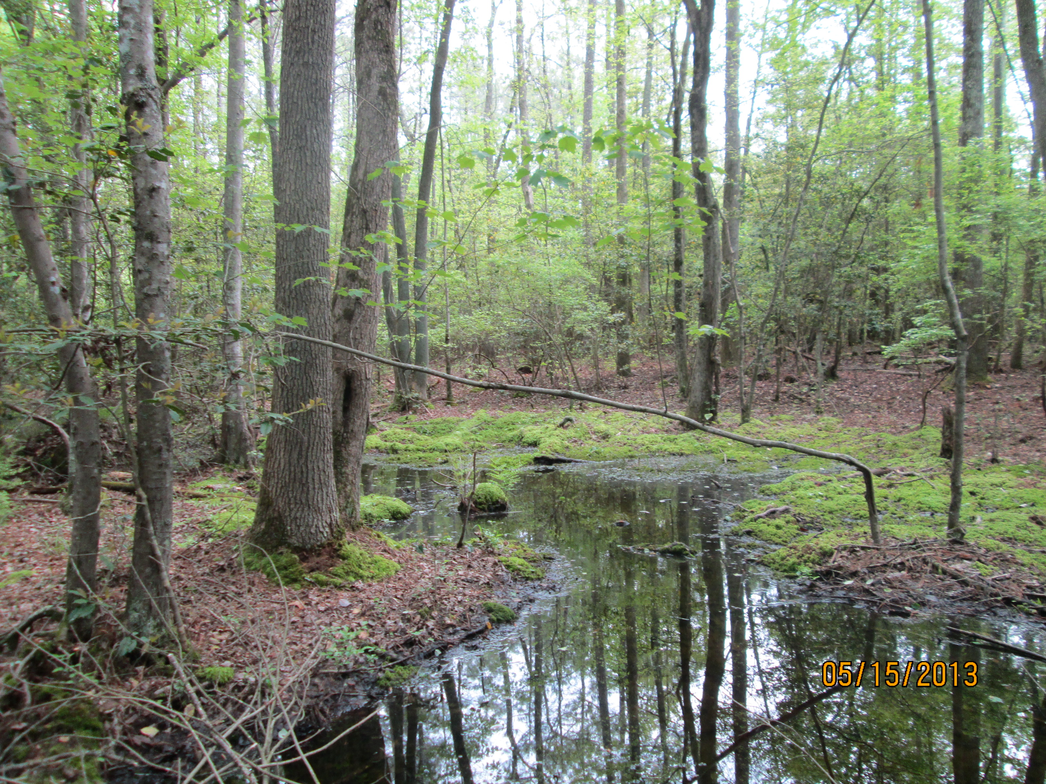
Landowner Attitudes toward Wetland Restoration
Steve Raabe of OpinionWorks

Slide 10
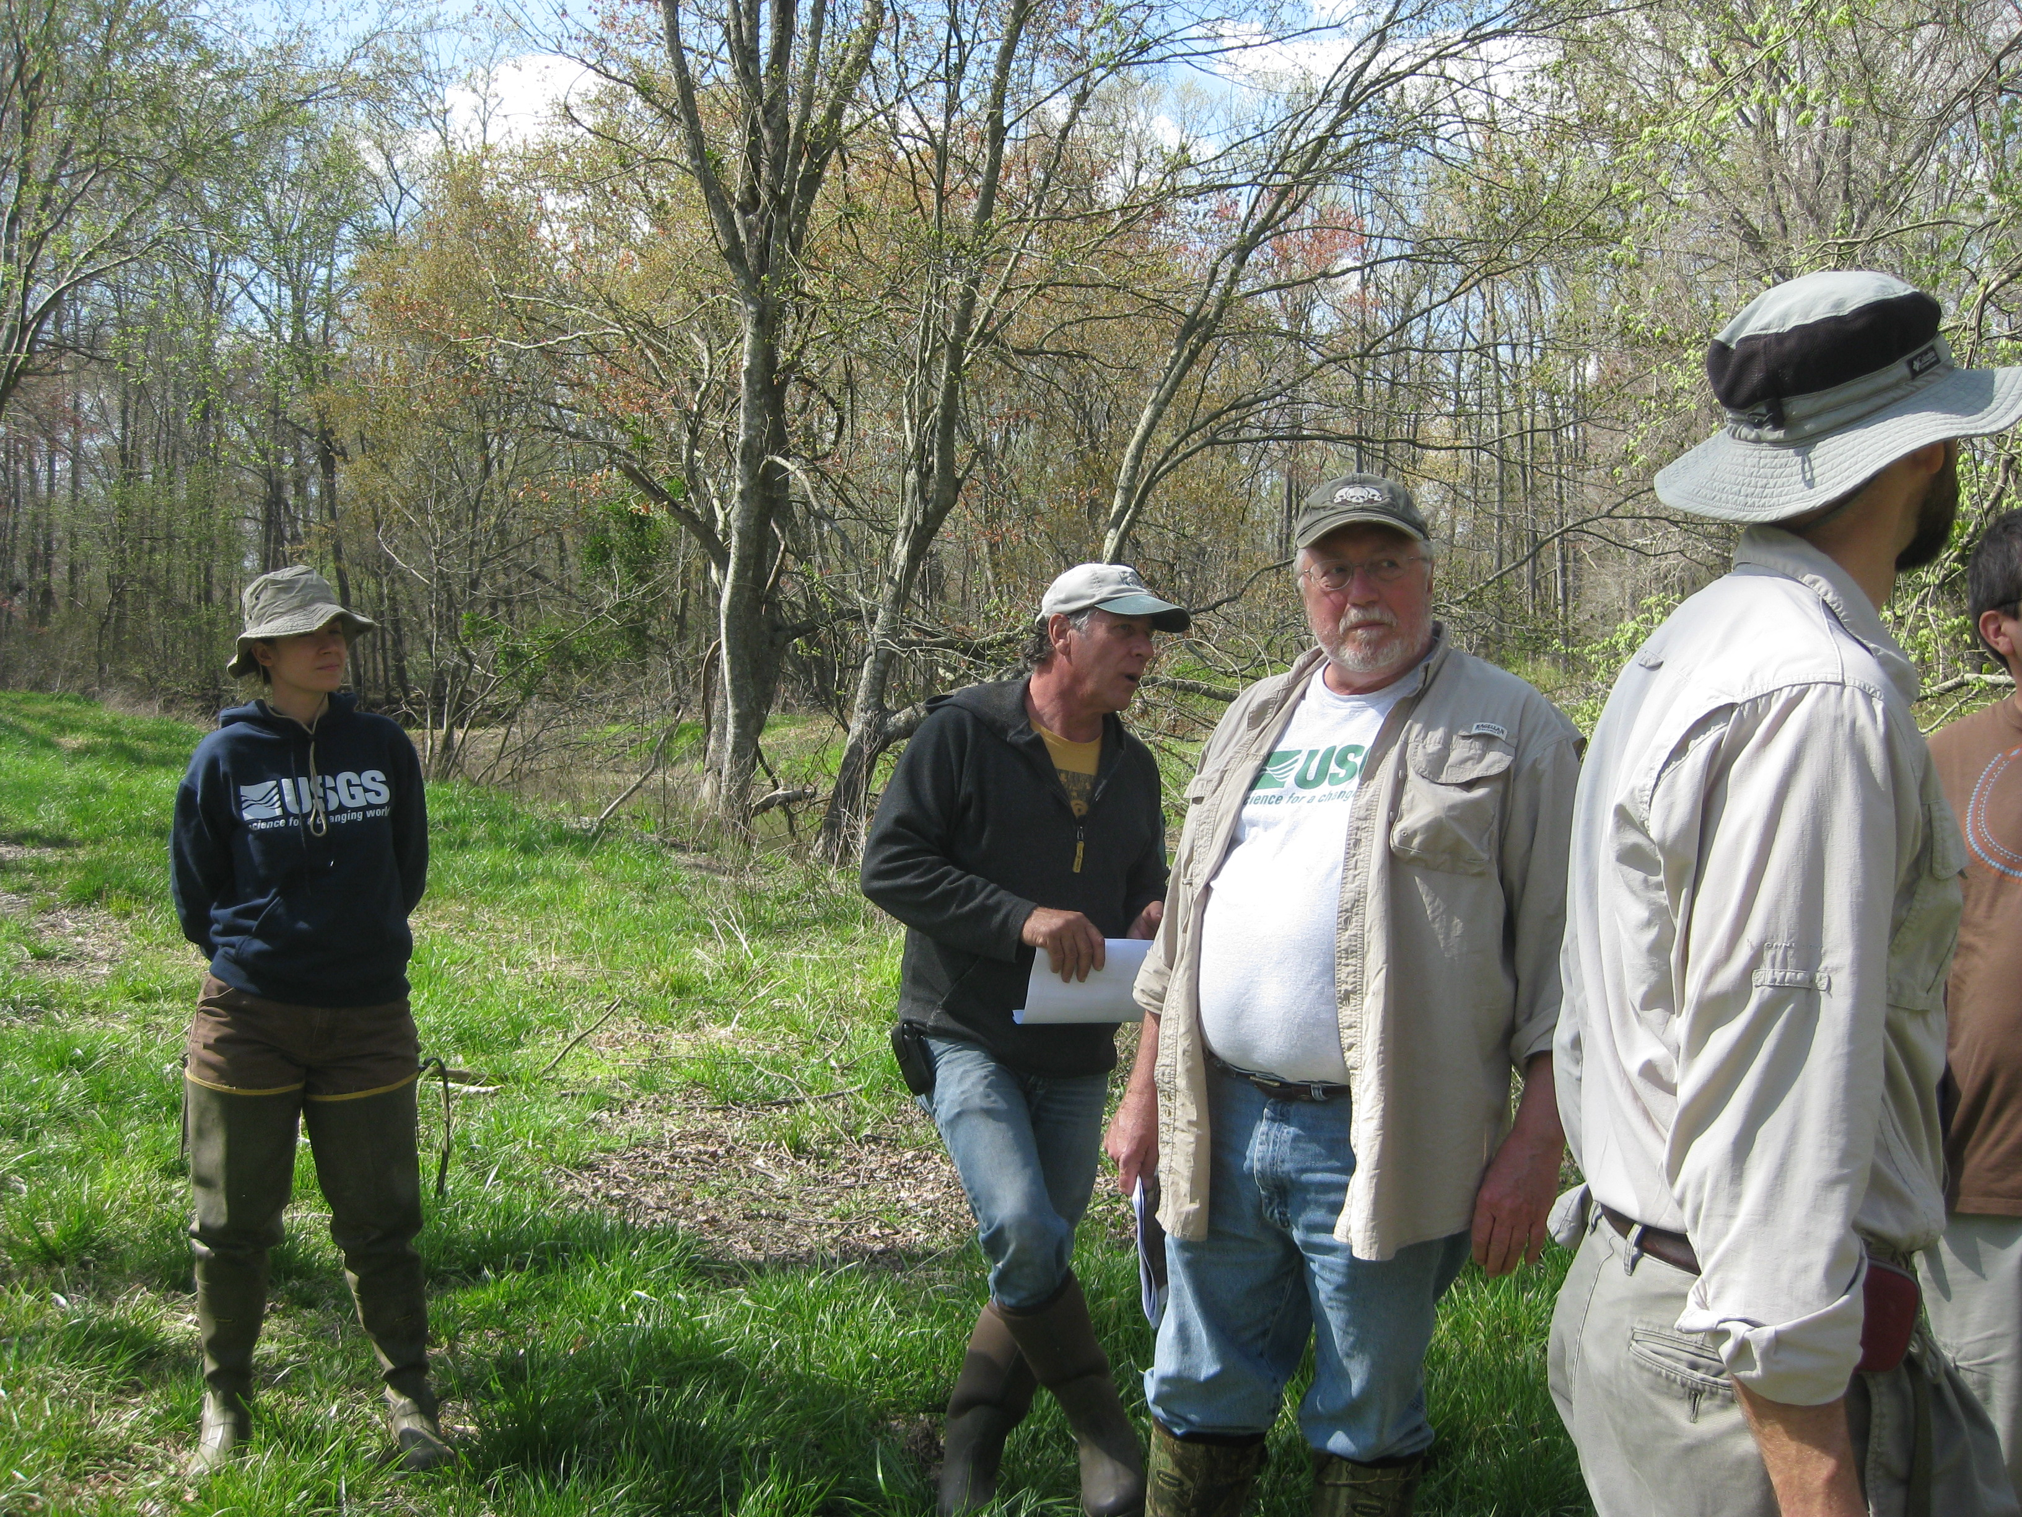
Expert Panel Update

Slide 11
Panel Charge
  Assessment and recommendation of wetland land use(s) for the Phase 6 Watershed Model
  Wetland land use efficiencies
  Wetland restoration and enhancement sediment and nutrient load reduction efficiencies (BMPs)

Slide 12
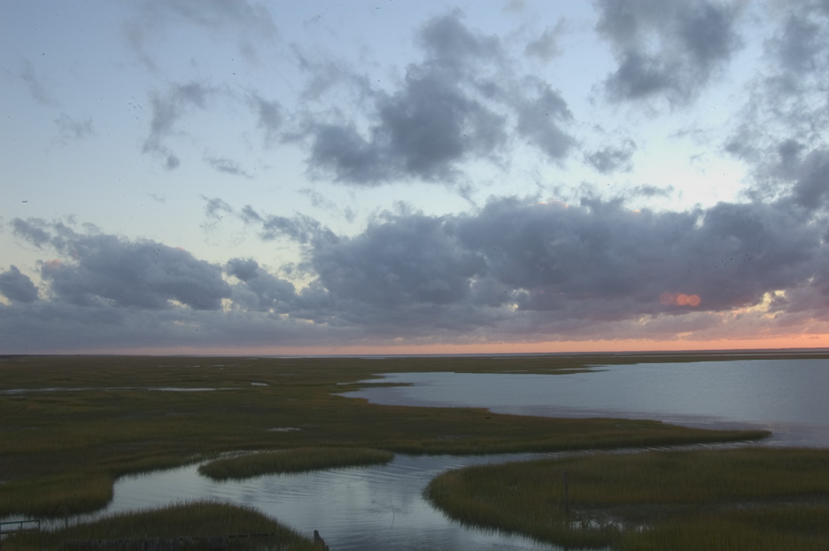
Wrap-up/ Next Meeting
© Hal Brindley.com
Notes:
The Nature Conservancy is committed to conserving the lands and waters on which all life depends and are committed to finding effective solutions and are long lasting. We are currently working with TFI in several places around the country and would welcome new opportunities to bring together industry and environmental perspectives to continue to make progress. Working on the ground in all 50 states with landowners, industry, and environmental groups provides for a great opportunity to work with TFI on solutions that can achieve the scale needed to face the immense challenges that we are facing.

