Slide 1
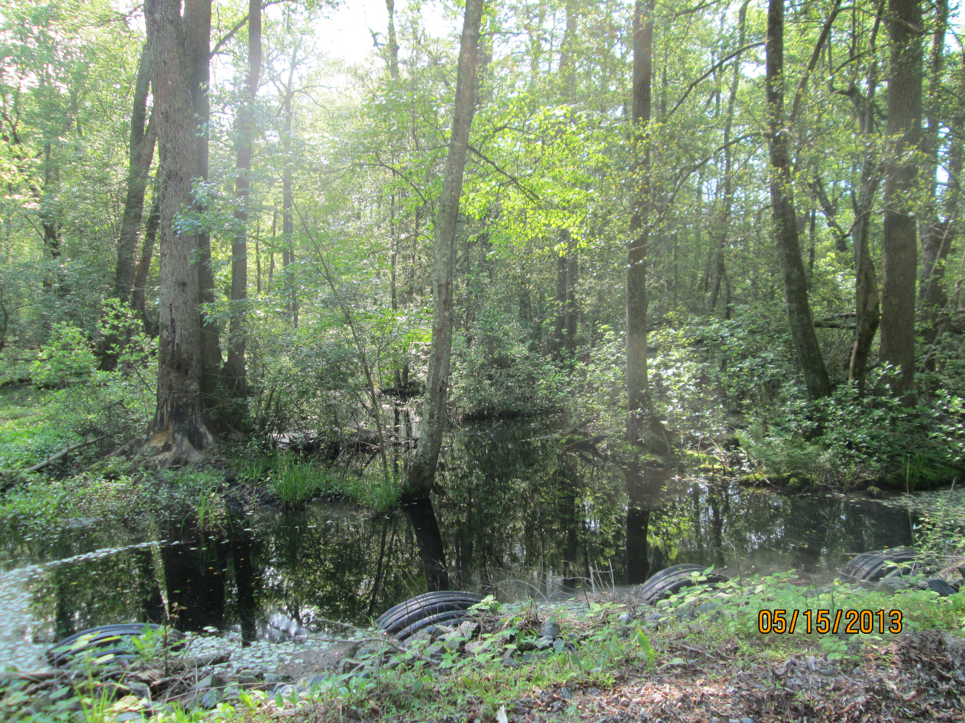
Wetland Workgroup Meeting
November 19, 2015

Slide 2
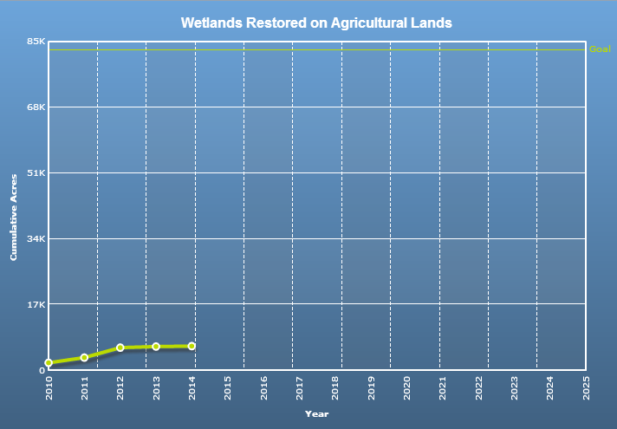

Slide 3
Chesapeake Bay Wetland Progress Toward Goals
 | 2009 | 2010 | 2011 | 2012 | 2013 | 2014 | 2025 WIP Goal | Yearly acres needed to meet 2025 Goal (2015 to 2025)
NY | 5,360 | 5,725 | 6,363 | 6,216 | 6,278 | 6,307 | 13,792 | 680
PA | 3,837 | 4,708 | 4,709 | 4,549 ª | 3,857ª | 3,858 | 54,135 | 4,570
MD | 7,716 | 8,248 | 8,614 | 9,037 | 9,260 | 9,284 | 12,849 | 324
VA | 214 | 213 | 411 | 420 | 420 | 452 | 19,215 | 1,705
WV | 203 | 203 | 203 | 203 | 203 | 208 | 406 | 18
DE | 286 | 438 | 588 | 2,694 | 2,697 | 2,699 | 5,725 | 275
Totals: | 17,616 | 19,536 | 20,888 | 23,119 | 22,715 | 22,808 | 106,122 | 7,574

Slide 4
Agenda
1:00 Introductions and Updates from Partners on Restoration Activity
1:15 September Field Meeting Recap
1:20 Wetland Expert Panel Update
1:35 Wetland Workgroup 2-Year Workplan and STAC Opportunity
2:00 Landowners Attitudes toward Wetland Restoration Survey Preliminary Findings
2:15 Wetland Mapping Updates – Presentation by Patrick Raney, Upper Susquehanna Coalition
3:00 Wrap-up / Next Meeting

Slide 5
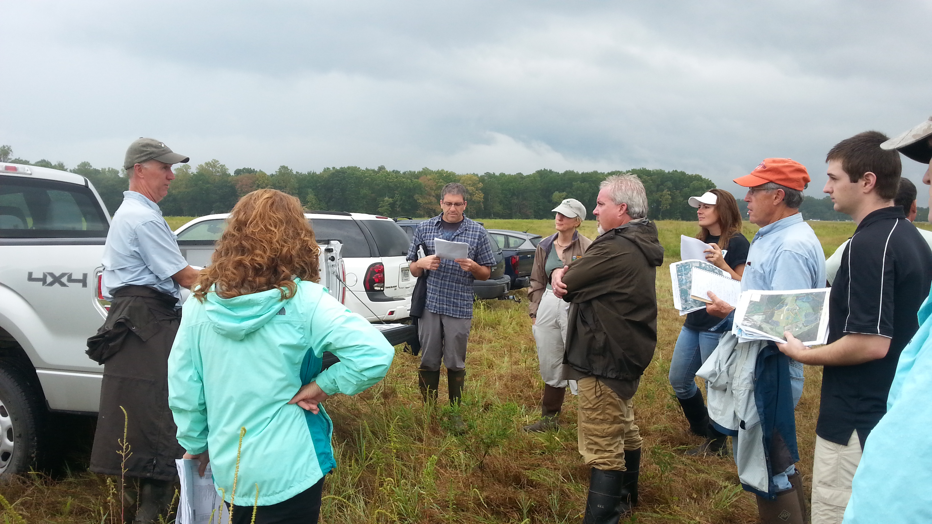

Slide 6
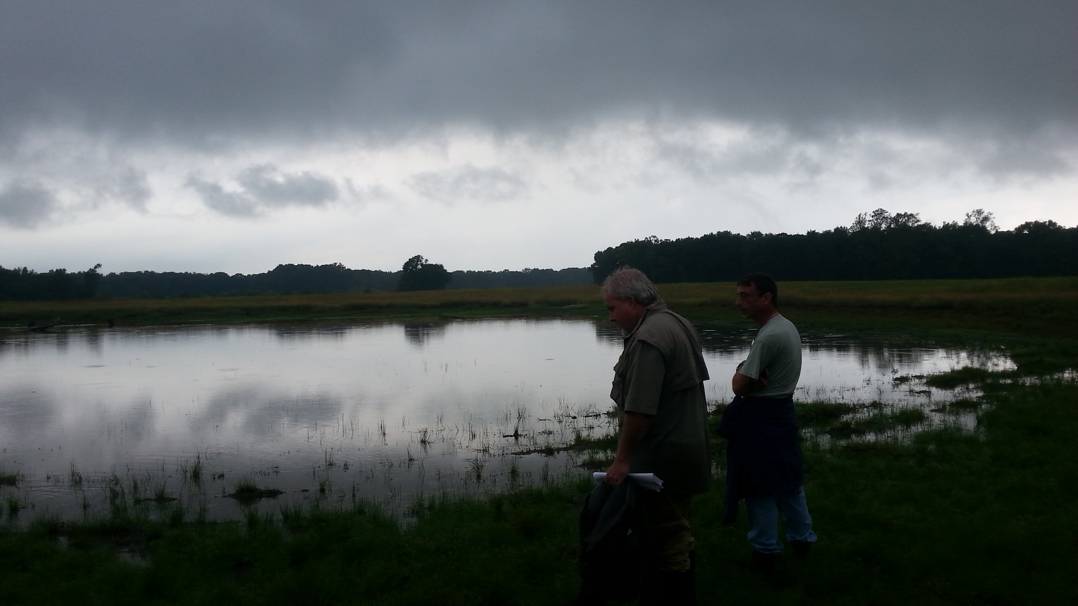

Slide 7
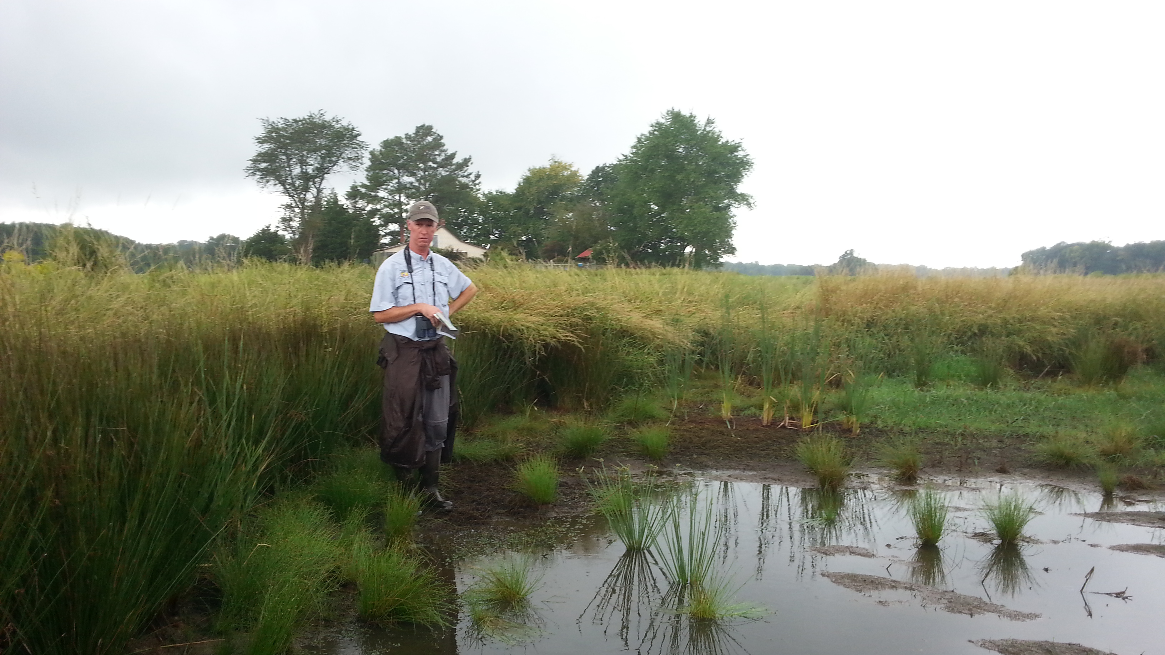

Slide 8
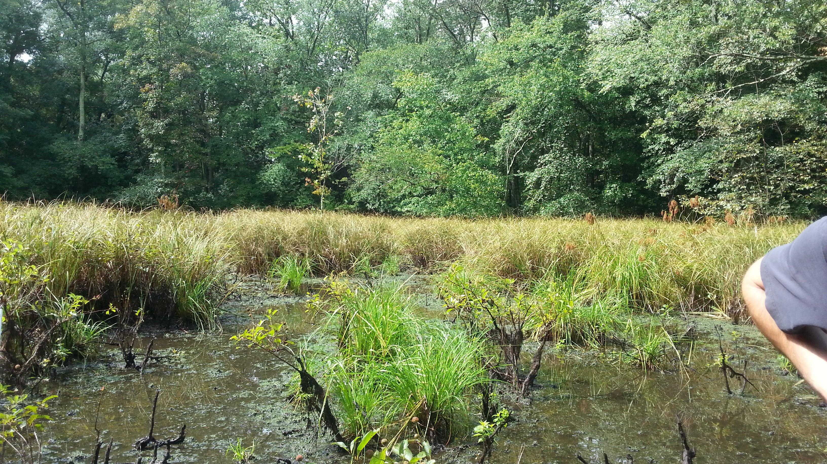

Slide 9
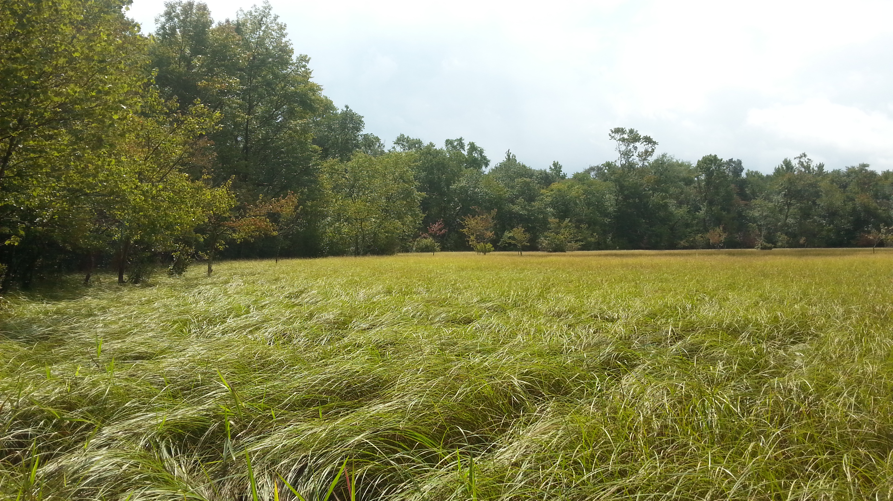

Slide 10
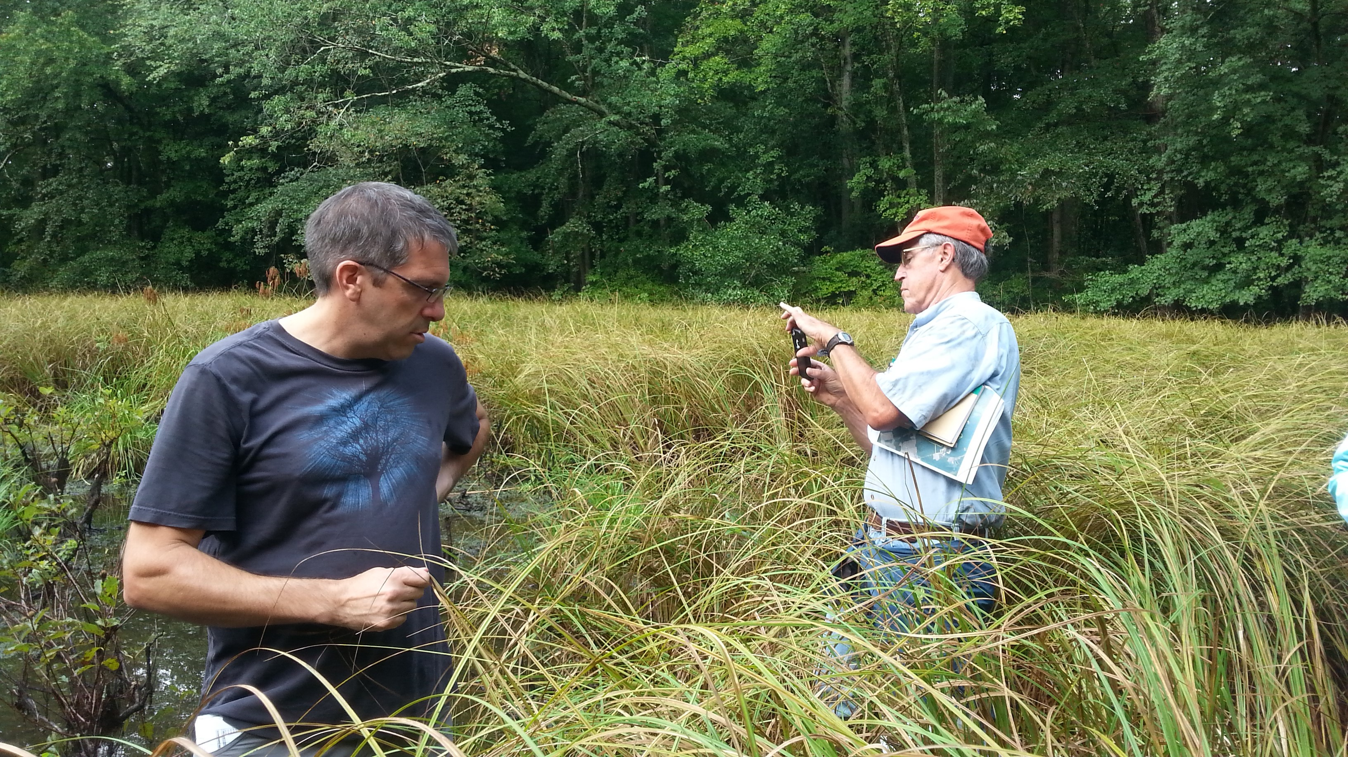

Slide 11
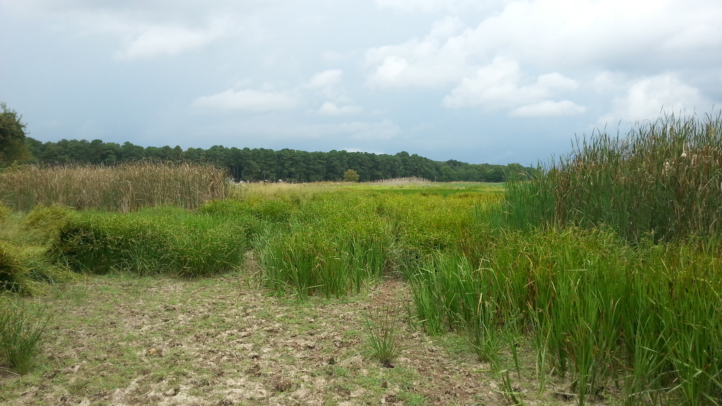

Slide 12
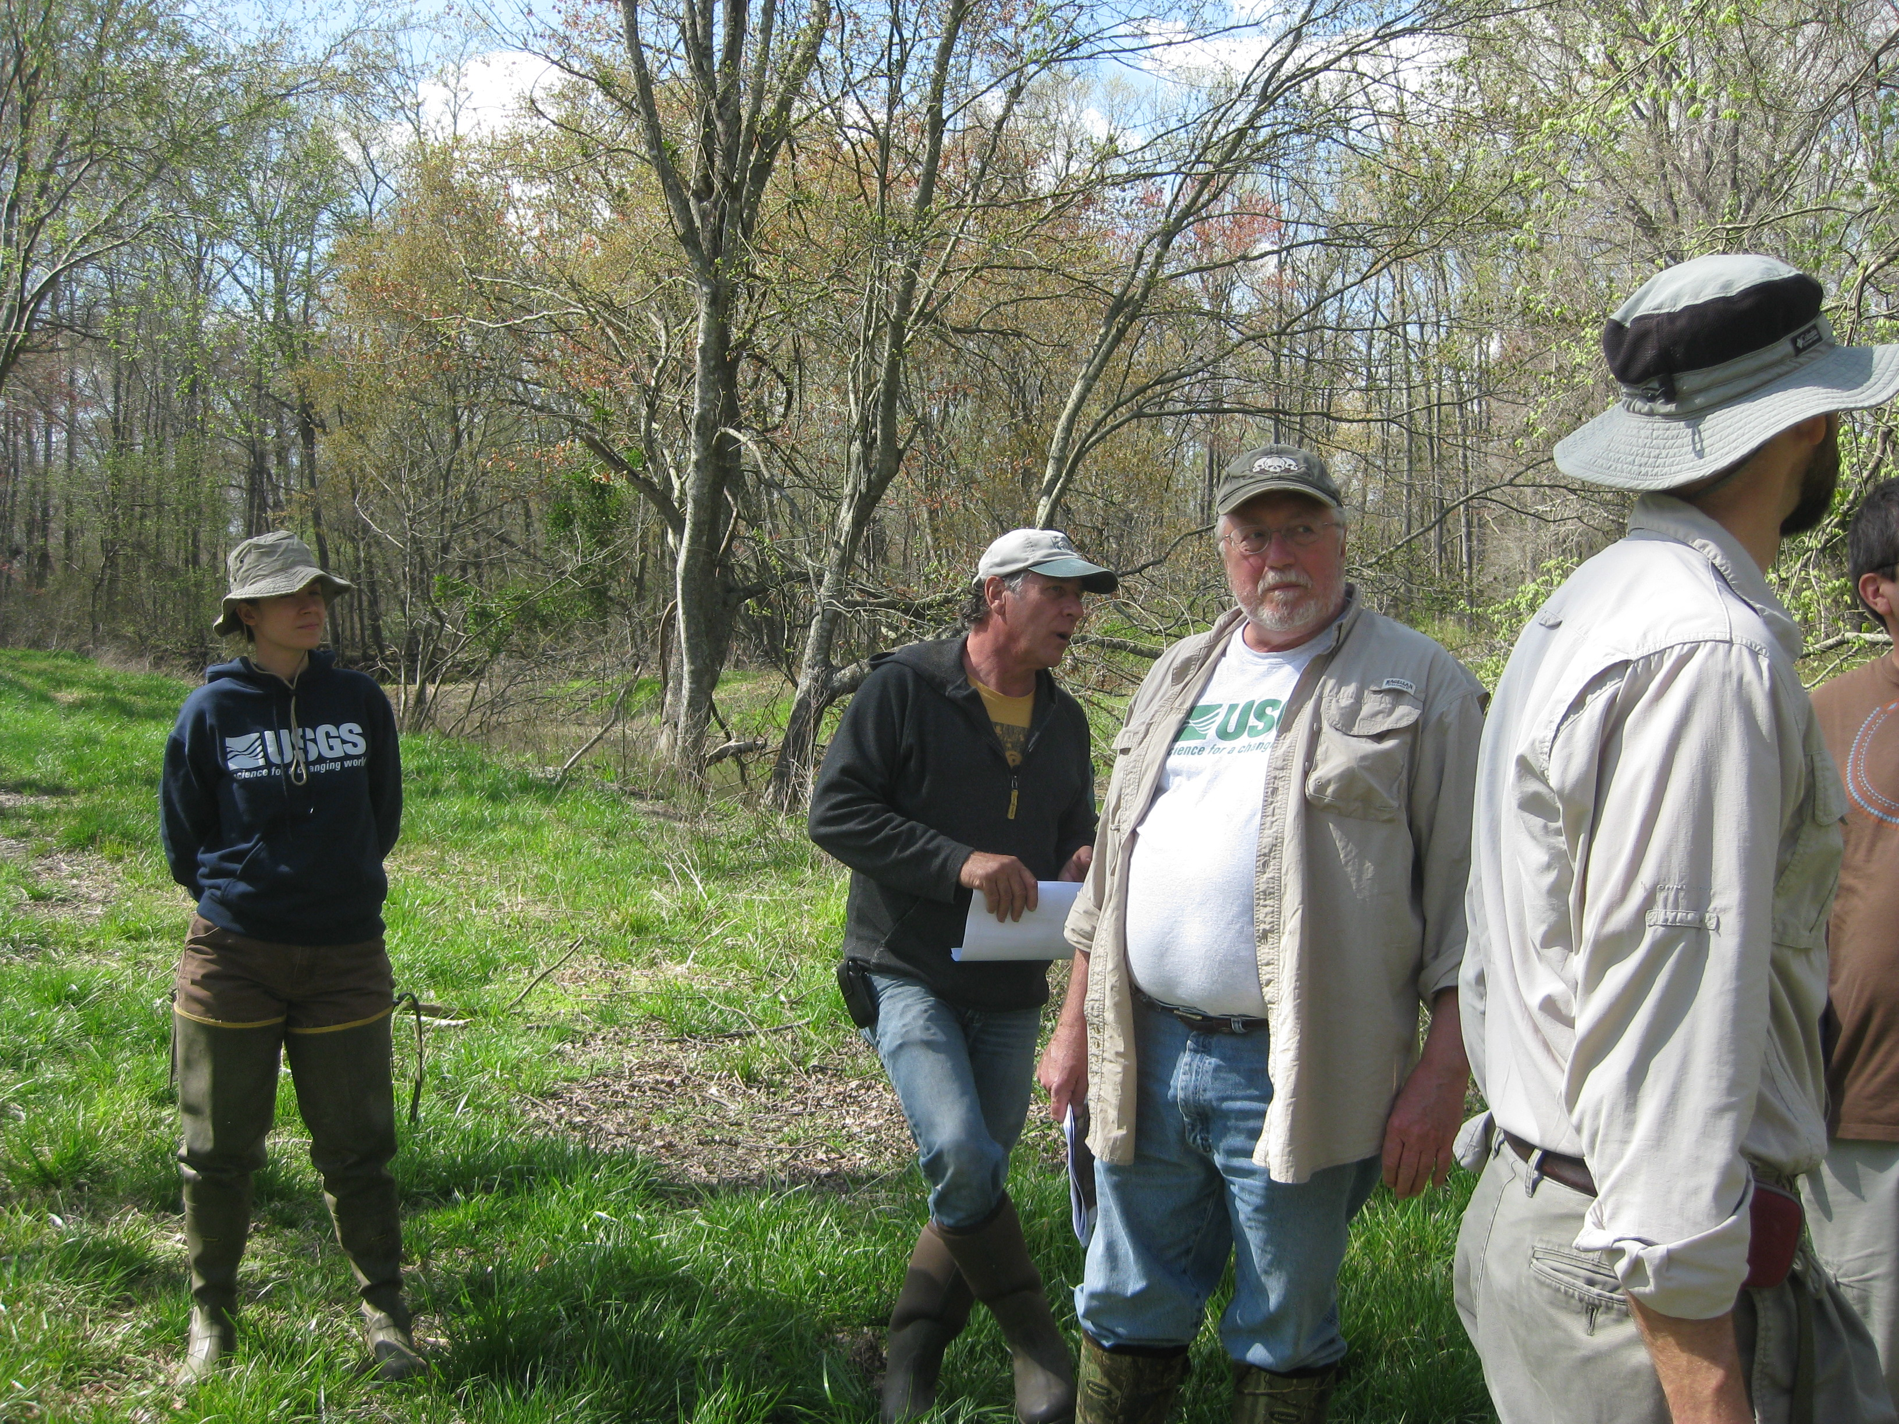
Expert Panel Update

Slide 13

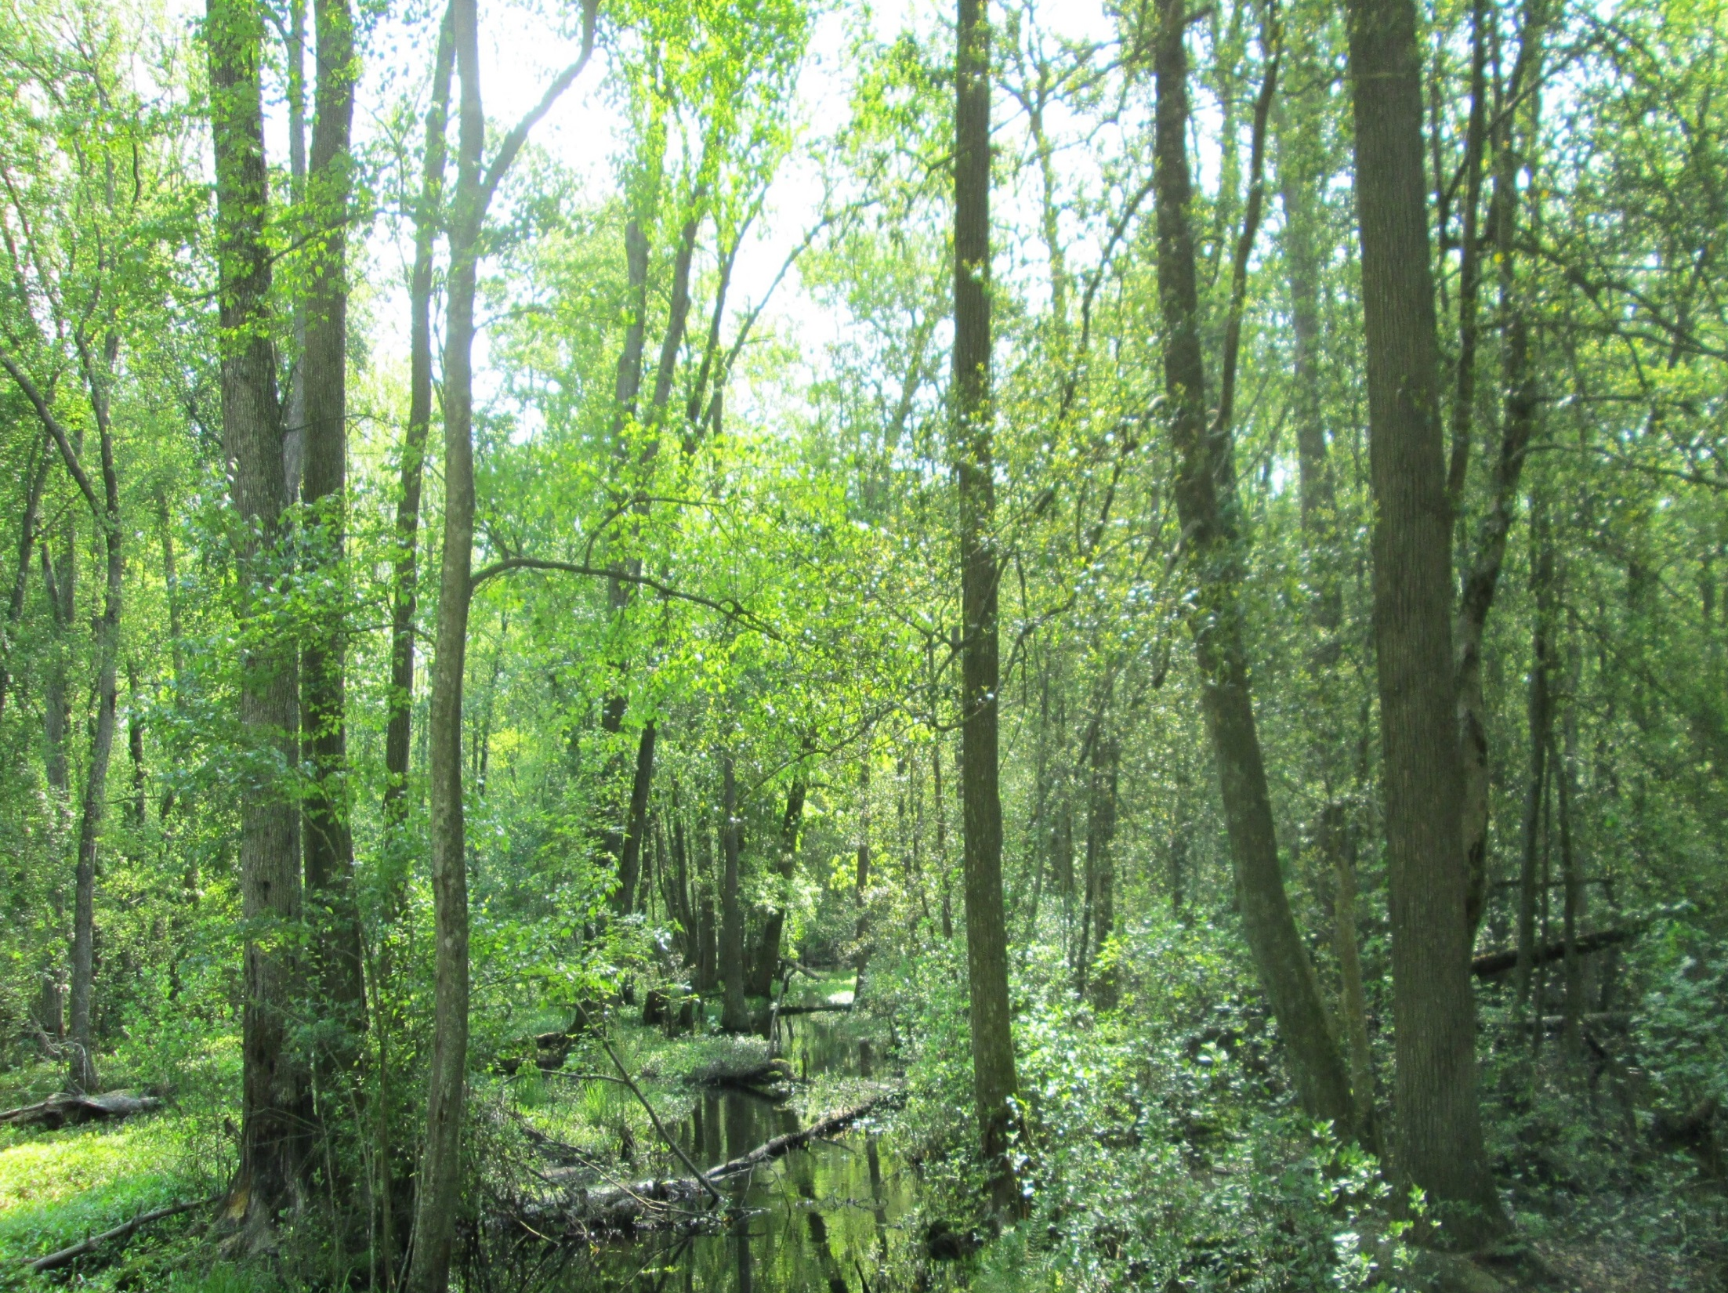
Wetland Expert Panel Update
Wetland Expert Panel Recommendations
Wetland Mapping
Panel Timeline
Wetland Restoration Practices

Slide 14
Panel Charge
Assessment and recommendation of wetland land use(s) for the Phase 6 Watershed Model
Wetland land use efficiencies
Wetland restoration and enhancement sediment and nutrient load reduction efficiencies (BMPs)

Slide 15
Panel Recommendations (September)
The Expert Panel recommended two nontidal wetland land use classes:
Floodplain wetlands (surface water dominated systems)
Other wetlands (ground water dominated systems)
The loading rate from the wetland acres is equal to the TN, TP and TSS rates for Forest
Wetland land use efficiencies and wetland BMPs are still under consideration by the panel and will be presented for partnership review/approval for a later calibration
Tidal wetlands will NOT be a land use in the Phase 6 Watershed Model. They will be simulated in the Estuarine Water Quality and Sediment Transport Model
These wetlands interact with the tidal water column so the Modeling Workgroup is working to simulate their effects in the estuarine model

Slide 16
Summary of recommendations
Table 1. Recommended land use classes and relative loading rates for nontidal wetlands in the Phase 6 Watershed Model
Proposed wetland land uses for Phase 6 Watershed Model | Relative Loading Rate (TN) | Relative Loading Rate (TP) | Relative Loading Rate (Sediment)
Floodplain | 100% Forest | 100% Forest | 100% Forest
Other | 100% Forest | 100% Forest | 100% Forest

Slide 17
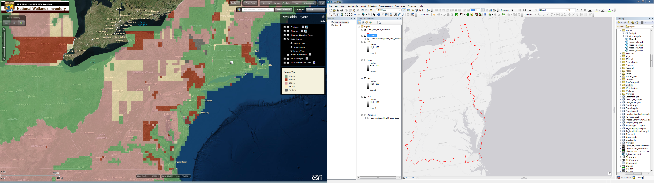
Wetland Mapping

Slide 18
Discussions
Pennsylvania and Virginia voiced concerns about outdated, inaccurate, and inconsistent NWI data
Pennsylvania DEP is considering a proposal from Upper Susquehanna Coalition
Other suggestions:
National LULC, NHD, LiDAR, and hydric soils
Penn State data
Virginia will have new leaf-off imagery flown in early 2016

Slide 19
Panel Timeline
November 2015 – finalize literature review
To be separated between constructed/restored and natural wetlands
December 10, 2015 – Panel call to refine BMP definitions
Wetland Workgroup to review list of Wetland Restoration Practices
Modelers to begin SPARROW analysis
January 2016 – discuss updated nutrient/sediment literature review and SPARROW analysis
March 2016 – work to complete first full draft of report
April 2016 – begin comment/review/approval process
Present recommendations to Wetland Workgroup, Habitat GIT, Watershed Technical WG, Water Quality GIT, etc.
September 2016 – All model inputs must be final.
October 2, 2016 – Final Phase 6 CB Watershed Model calibration.

Slide 20
Wetland Restoration Practices
NRCS Practices
643 – Restoration and management of rare and declining habitats
644 – Wetland wildlife habitat management
646 – Shallow water development and management
656 – Constructed wetlands (not stormwater treatment wetlands)
657 – Wetland restoration
658 – Wetland creation
659 – Wetland enhancement
Other Project Types
Floodplain reconnection
Ditch plugging
Invasive species removal
Restoration of prior converted wetlands on ag fields
Riparian tree plantings
Native wetland meadow plantings
Legacy sediment removal projects (floodplain excavation)
Regenerative stormwater conveyance (RSC)
Wetland bench/active floodplain (Rosgen, Natural Channel Design)
Living shoreline projects

Slide 21
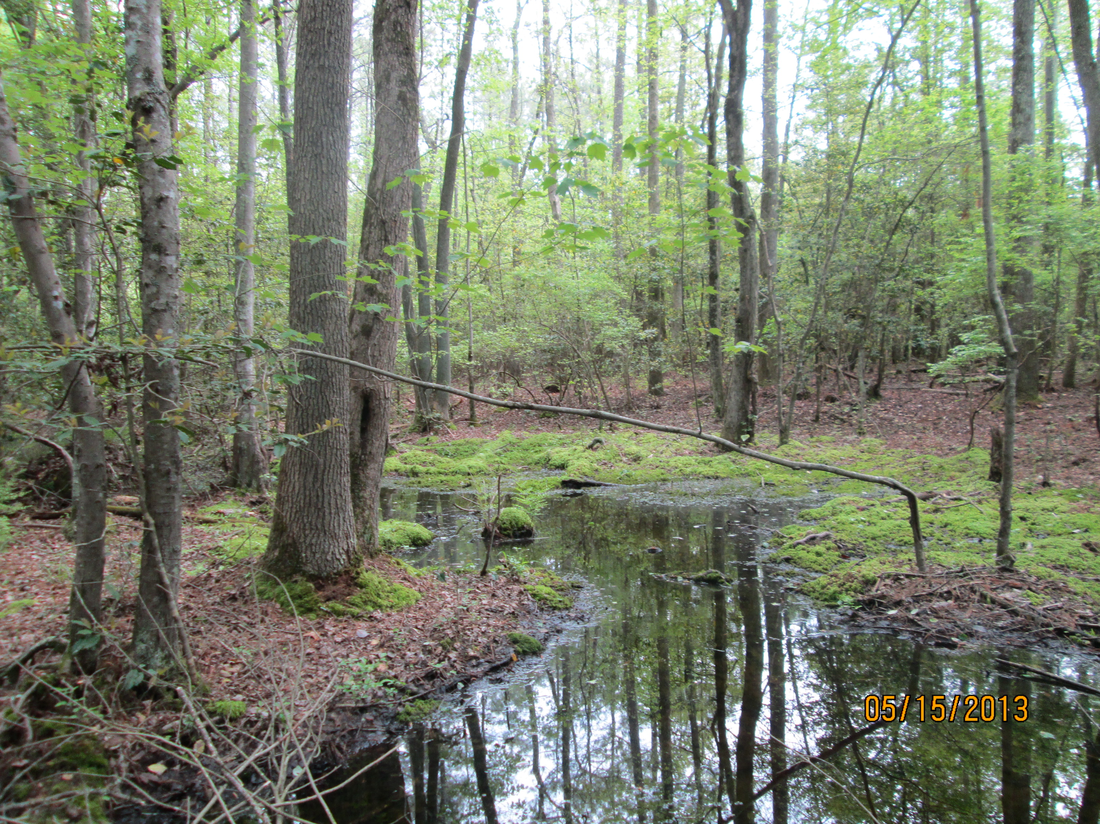
Wetland Workgroup 2-year Workplan

Slide 22
Biennial Work Plan
Management Approach 1: Improve wetland mapping, and the wetland restoration reporting and tracking process.
Key Actions
Collaborate with Wetland Expert Panel and Modeling Team to improve wetland mapping for Chesapeake Bay Watershed
Streamline NEIEN data collection for each State.
Confirm the accuracy of information reported.
Improve mapping of tidal wetlands to document loss due to sea level rise and other factors
Several USGS initiatives: resiliency of tidal freshwater wetlands, forecasting land development and potential wetland loss, documenting long-term changes in wetland acreage due to climate variability

Slide 23
Biennial Work Plan
Management Approach 2: Identify barriers to wetland restoration and develop solutions to address them.
Key Actions:
Identify barriers to wetland restoration for practitioners.
Identify barriers to landowner willingness for agricultural landowners.
Workshop at Delaware Wetland Conference to refine marketing and outreach strategies.
Develop solutions to address barriers and improve outreach.

Slide 24
Biennial Work Plan
Management Approach 3: Increase our technical understanding of the factors influencing restoration success.
Key Actions:
Continue to include technical presentations at Wetland Workgroup meetings.
Conduct research to optimize nontidal wetland restoration designs (USGS)
Management Approach 4: Prioritize areas for wetland restoration.
Key Actions:
Coordinate with Black Duck Workgroup.
Identify areas where wetland restoration would greatly benefit water quality and habitat.
Identify opportunities to restore large wetland acreages.

Slide 25
Biennial Work Plan
Management Approach 5: Expand the involvement of local stakeholders.
Key Actions:
STAC Workshop - "Enhancing Capacity"

Slide 26
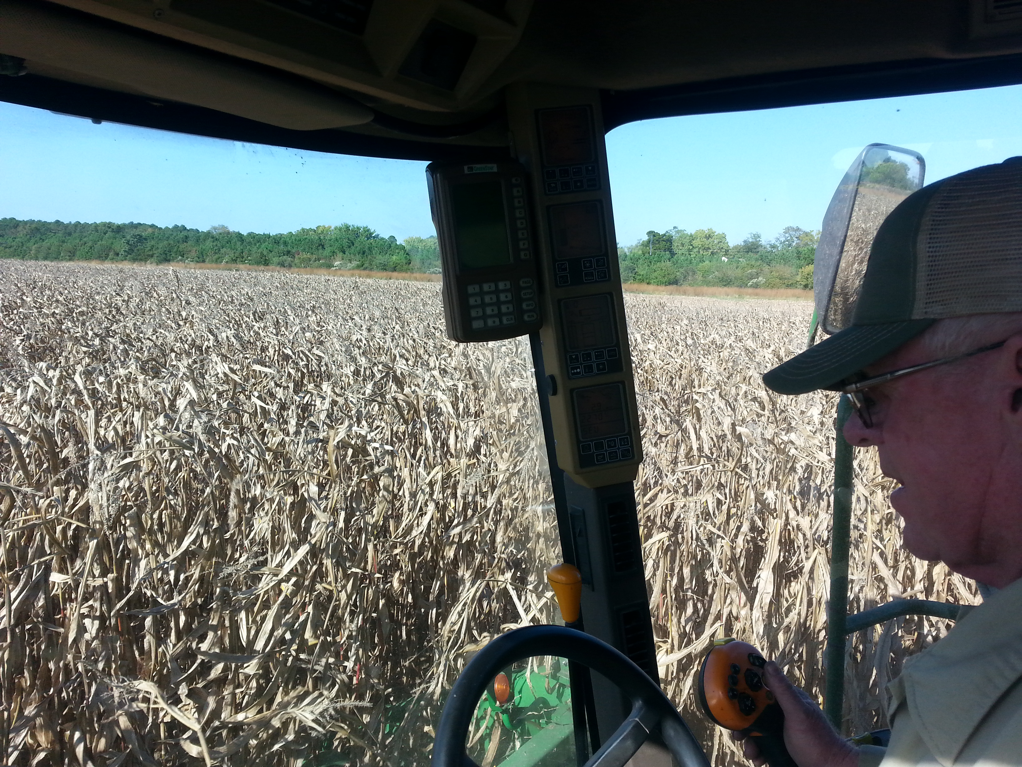
Landowner Attitude Survey

Slide 27

August 2015; N=409 (200 phone, 209 mail)
Phone Mail Caroline, MD 10% 12%
Dorchester, MD 8% 6%
Juniata, PA 18% 7%
Kent, MD 6% 8%
Lancaster, PA 15% 17%
Somerset, MD 4% 6%
Wicomico, MD 12% 10%
Worcester, MD 8% 7%
York, PA 14% 24%
Talbot, MD *% 7%
Other county in Maryland or Pennsylvania (Record county.) 6% 3%

Slide 28
Wet Areas of Your Land
Do you have any areas that are normally saturated with water such a shallow pond, wetland, marsh, or wet woods?
Phone Mail
Yes 46% 54%
No 52% 42%
Not sure 2% 4%
Do you have any farm fields where the yield is lower because they are prone to occasional flooding?
Phone Mail
Yes 19% 22%
No 80% 70%
Not sure 1% 8%

Slide 29
Are you aware of any programs that are meant to help you preserve wet areas on your land, or restore them to natural habitat, through technical or financial assistance? Such programs might be offered by agencies such as the Natural Resources Conservation Service, Farm Service Agency, or your state’s Department of Agriculture, or through private grantors such as Ducks Unlimited or the Chesapeake Bay Trust.
Phone Mail
Yes, aware 58% 61%
No, not aware/ Not sure 42% 39%

Slide 30
Which of these would come the closest to describing why you might consider participating in such a program? (Allow multiple but do not probe for multiple.)
Phone Mail
To receive a rental payment for the land that is in the program 36% 32%
To create wildlife habitat, for example, for hunting
28% 30%
To improve water quality in nearby streams and creeks 37% 35%
Or another reason (Specify.) 6% 6%
(Do not read): None of those/ Not sure 32% 33%

Slide 31
If you were told about a program to help you preserve or restore wet areas on your land as a way of providing wildlife habitat and protecting local streams, and if the program paid enough to cover your costs of participating, without forcing you to give up too much control of what happens on your land, how likely would you be to seriously consider it?
Phone Mail
Definitely would 5% 11%
Probably would 17% 29%
Might or might not 35% 35%
Probably would not 23% 13%
Definitely would not 20% 11%

Slide 32
General Observations:
There are the expected reservations and suspicions about dealing with government agencies. One or two horror stories were told, and there was a general consensus that government needs more “common sense.”
But many ag landowners in MD are already engaged with government programs. They understand that such programs come with strings attached and are savvy about navigating that world. “Everybody knows if you’re going to take government money, you’re going to give up something.”
There is very little outreach to these landowners. The ones who have investigated this concept have reached out themselves.
Many of these folks, especially in Salisbury, exhibited extreme indecisiveness. Suggests that some handholding needs to be part of this process, and some social vetting with their peers.
These programs needs to be linked to farmers’ underlying perspective that all land must be “useful.”

Slide 33
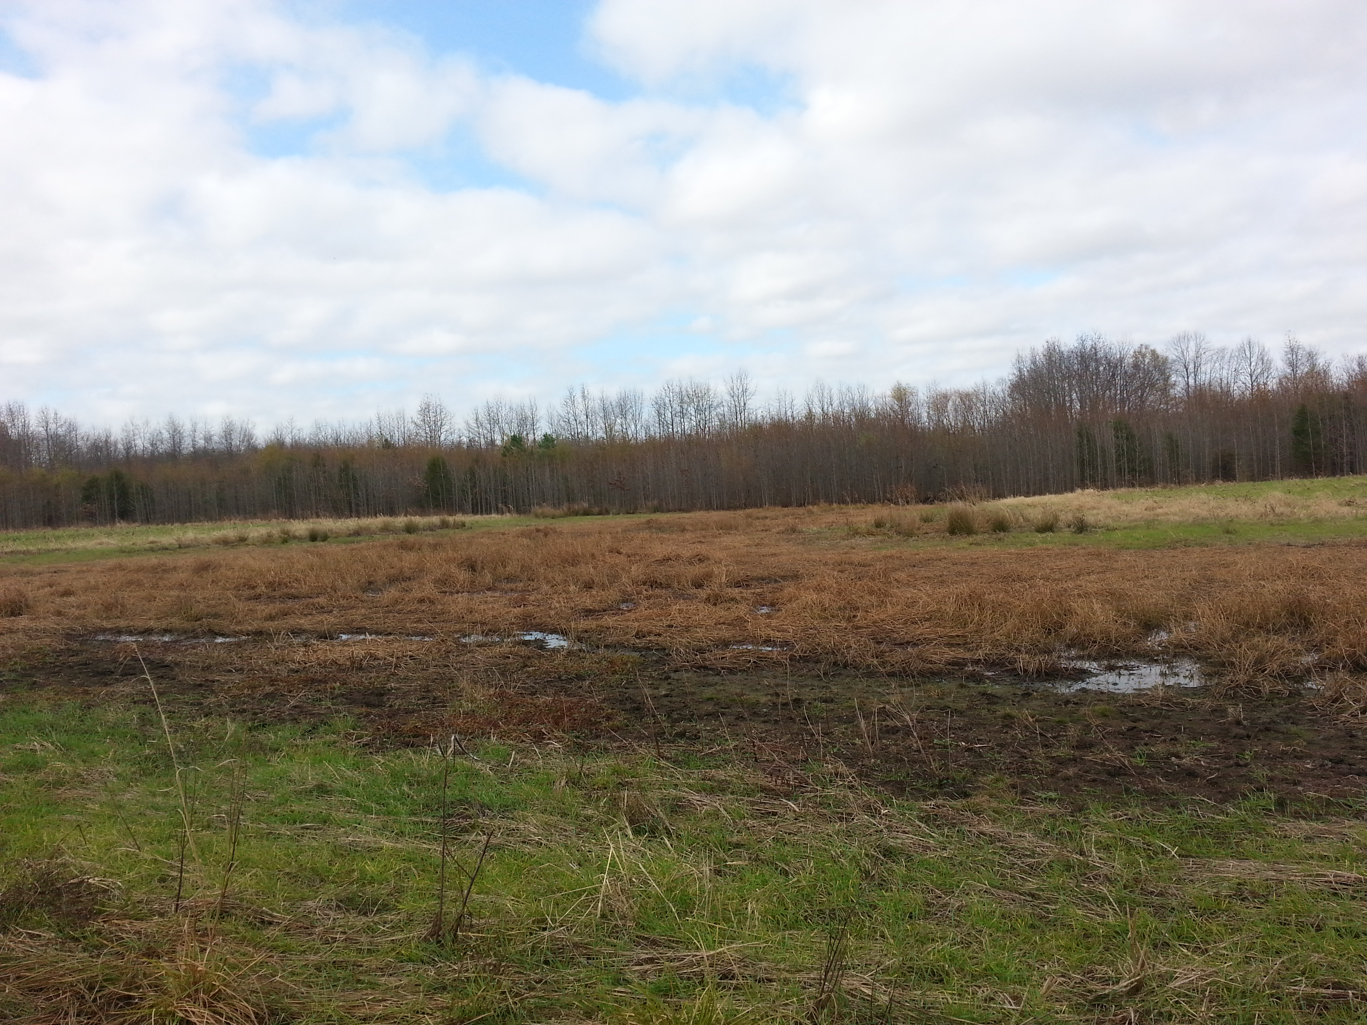
Wetland Mapping

Slide 34
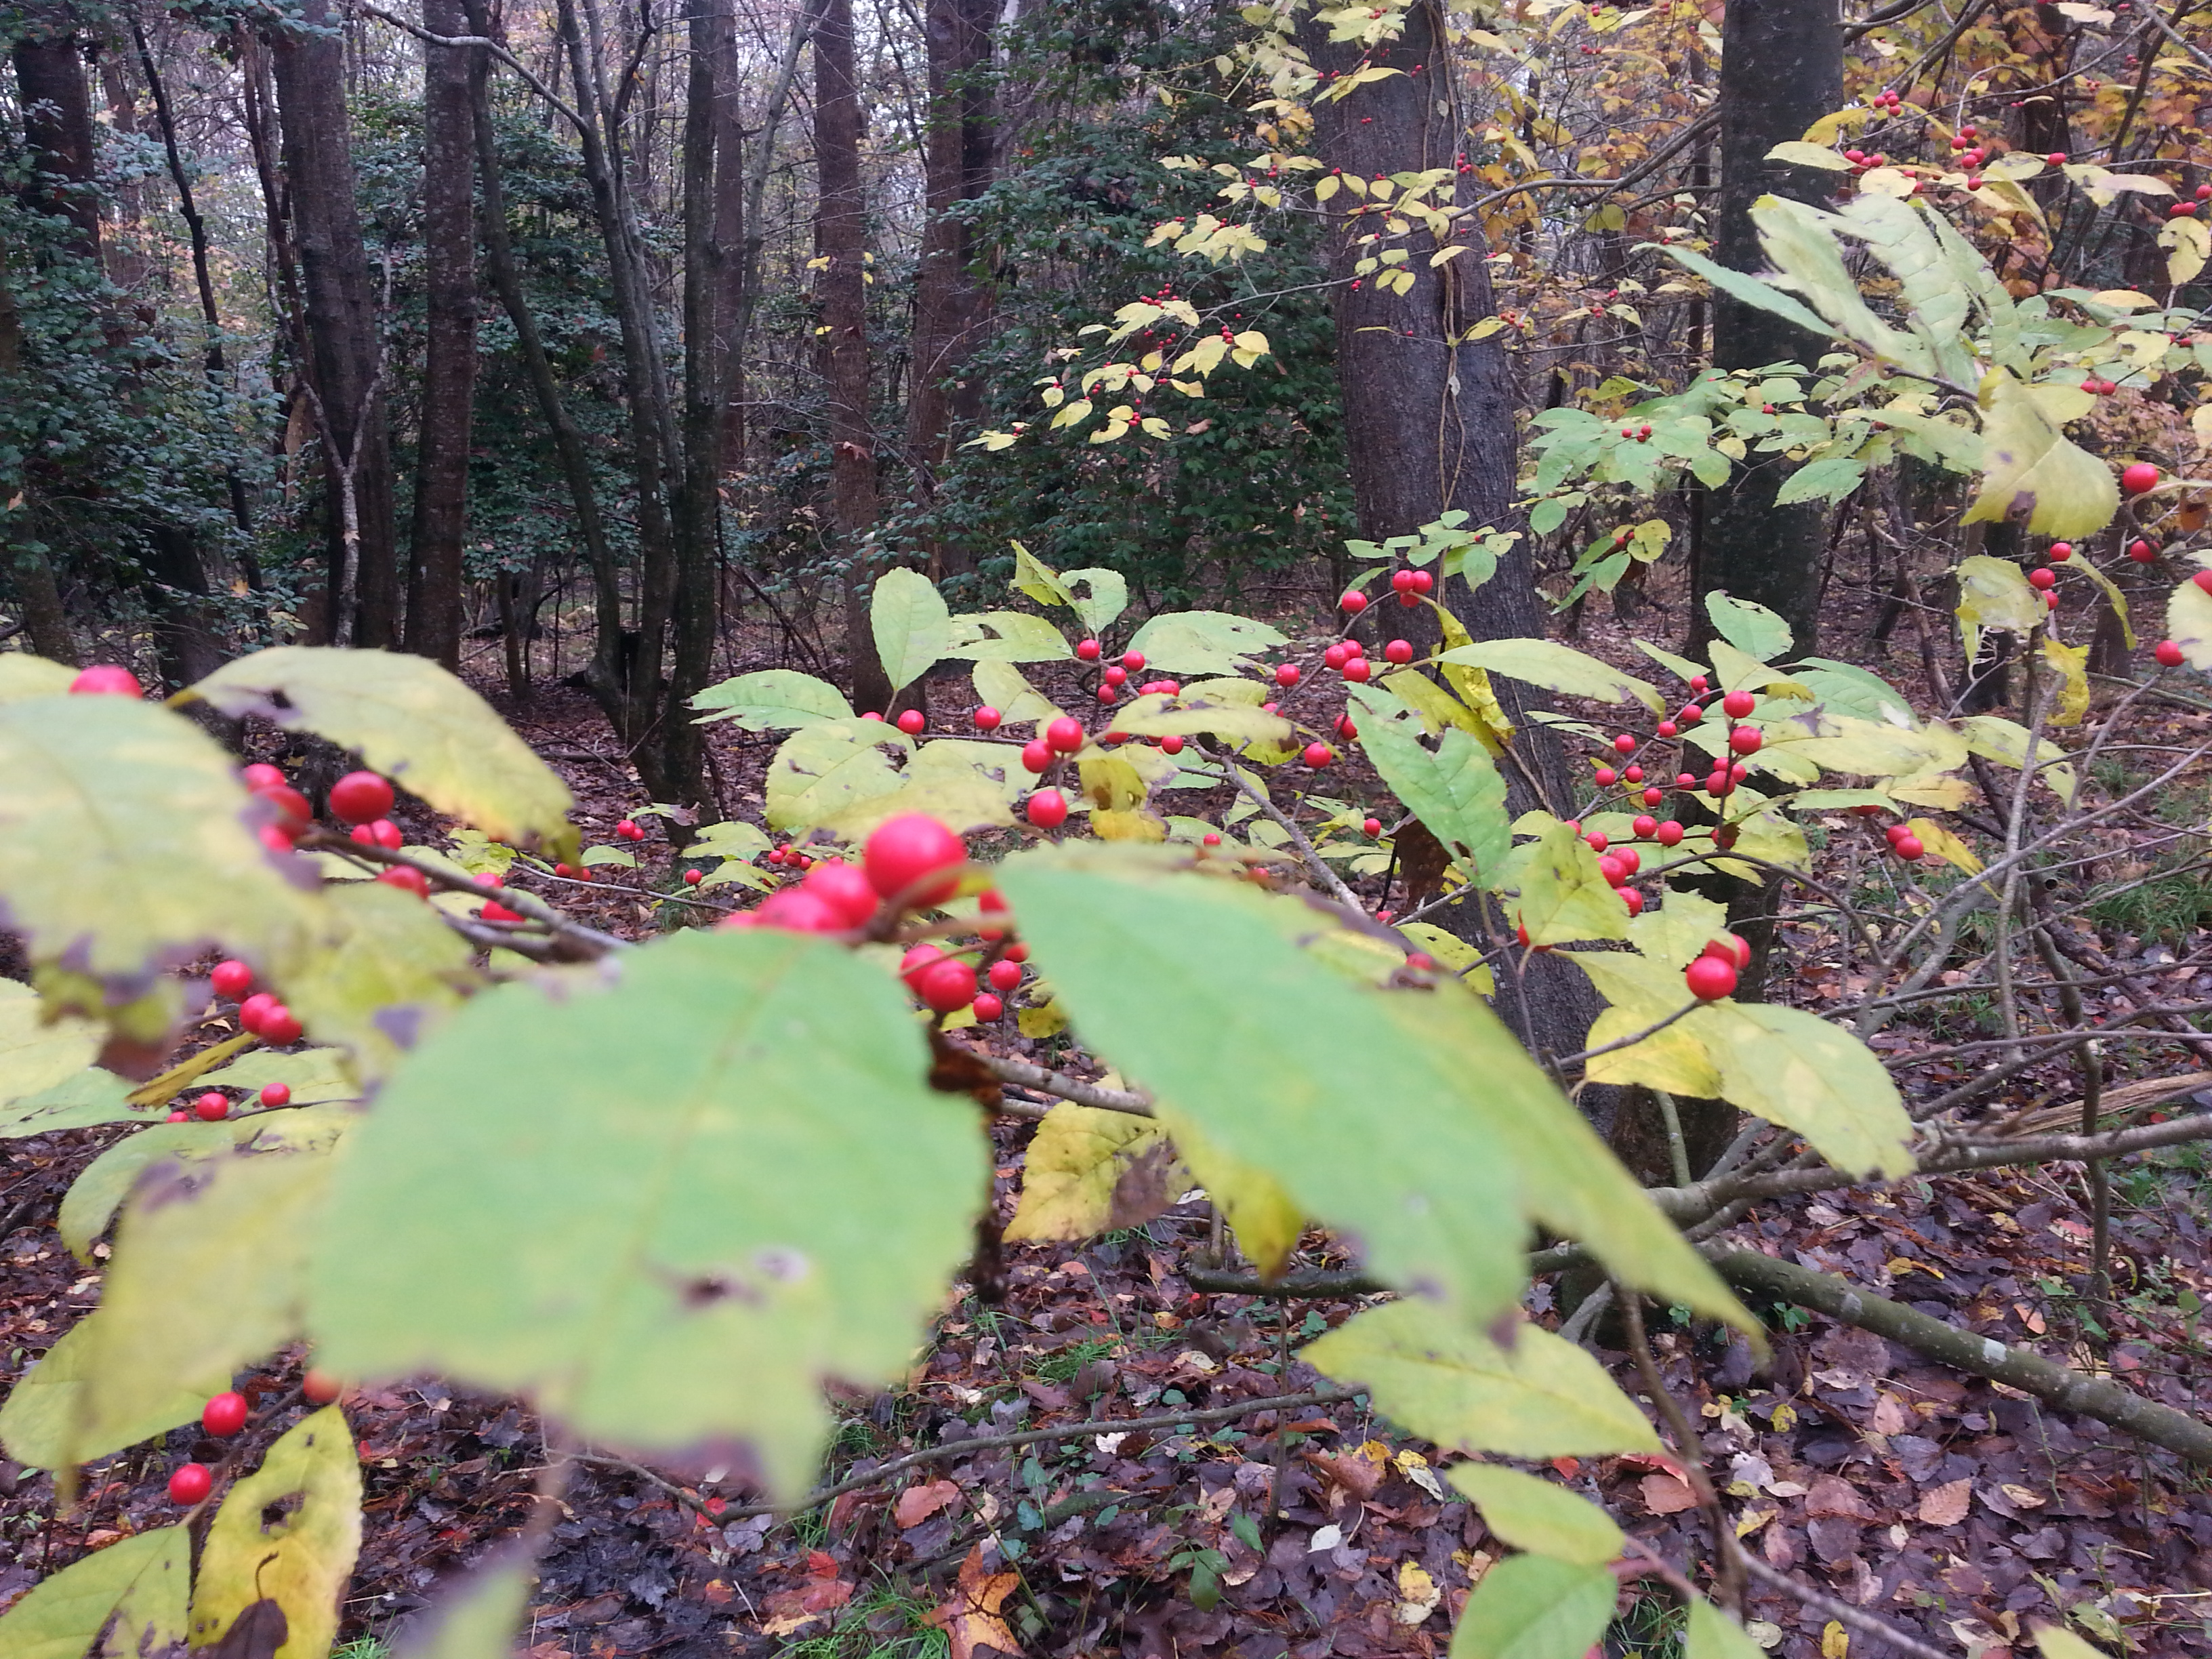
Wrap-up/ Next Meeting January

