Slide 1

The Chesapeake Bay Stewardship Fund and CAC Engagement
Citizen’s Advisory Committee
Thursday, November 20, 2014
Jake Reilly
Director, Chesapeake Bay Programs
National Fish and Wildlife Foundation

Slide 2
What’s being funded and where?
What’s working?
How can CAC be more engaged in CBSF grants programs?

Slide 3
NFWF’s Chesapeake Bay Business Plan
Business Plan Strategies
Focus on High Priority Targeted Watersheds
Using a science-based approach, NFWF has identified 17 watersheds where investments will result in measurable increases in species populations, and improvements in water quality and local stream health.
2. Support Innovation on Cross Cutting Issues
Invest in innovative methods and new technologies that hold the promise to drive down costs, expand the effectiveness of restoration practices and accelerate the pace of recovery.
3. Advance Local Government Green Infrastructure Solutions
Over 1800 units of local government have authority over decisions that will determine the future of the Chesapeake Bay. NFWF helps local governments restore their rivers and streams while meeting the challenges posed by Chesapeake restoration.

Slide 4

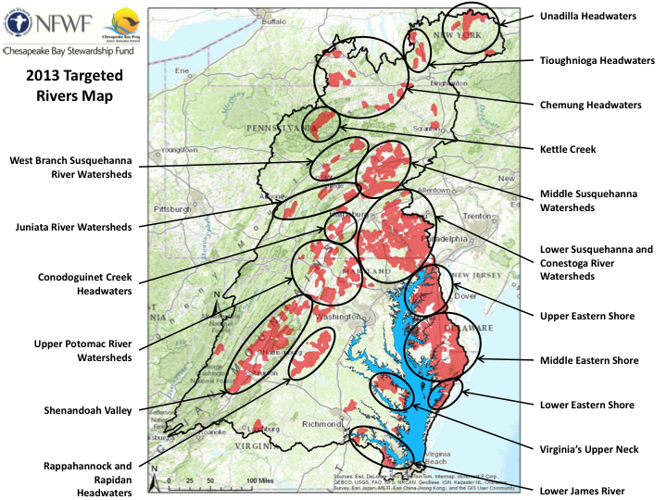
CBSF Program Delivery Cycle
Assess Conservation Needs and Capacity
CBSF “Technical Capacity” Grants Programs
Ag Networking Forum
Receive Feedback through Networking and Information Sharing
Build Local Capacity for Restoration
Small Watershed Grants
Monitor and Assess Project Implementation
Support On-The-Ground Restoration and Conservation Efforts
Innovation Grants
NFWF Monitoring and Assessment Pilot

Slide 5
CBSF Program Delivery Cycle
Assess Conservation Needs and Capacity
CBSF “Technical Capacity” Grants Programs
Ag Networking Forum
Receive Feedback through Networking and Information Sharing
Build Local Capacity for Restoration
Small Watershed Grants
Monitor and Assess Project Implementation
Support On-The-Ground Restoration and Conservation Efforts
Innovation Grants
NFWF Monitoring and Assessment Pilot

Slide 6
CBSF Implementation Grants
Small Watershed Grants
Grants of $20k-$200k
25% match requirement
State agencies are not eligible
Improve local waters that contribute to Bay health
About $3 million awarded per year to c. 30 grantees
Approx. 25-30% of proposals are funded
Innovative Nutrient and Sediment Reduction Grants
Grants of $200k - $500k
1:1 match requirement
State agencies are eligible
Innovative approaches to reduce N/P/S to the Bay
$6 - $8 million awarded per year to 15-20 grantees
15-20% of proposals are funded

Slide 7
CBSF Implementation Grants
2014 Implementation Grant Priorities
Targeted River and Watershed Restoration: Special focus on the Choptank and Nanticoke, Juniata, Shenandoah and Upper Potomac, and VA Middle Peninsula and Northern Neck
Green Infrastructure in Urban Landscapes:
MS4 Communities: Integrating “green infrastructure” approaches into capital programs
Non-MS4: Assisting local governments in the demonstration and development of projects and programs that mitigate stormwater impacts
Residential and Commercial Properties: Increase adoption of green infrastructure practices on residential and commercial properties in targeted communities.
Innovation on Crosscutting Issues: New technologies for stormwater management and agricultural conservation
How these align with CAC priorities for implementation grant funding?

Slide 8
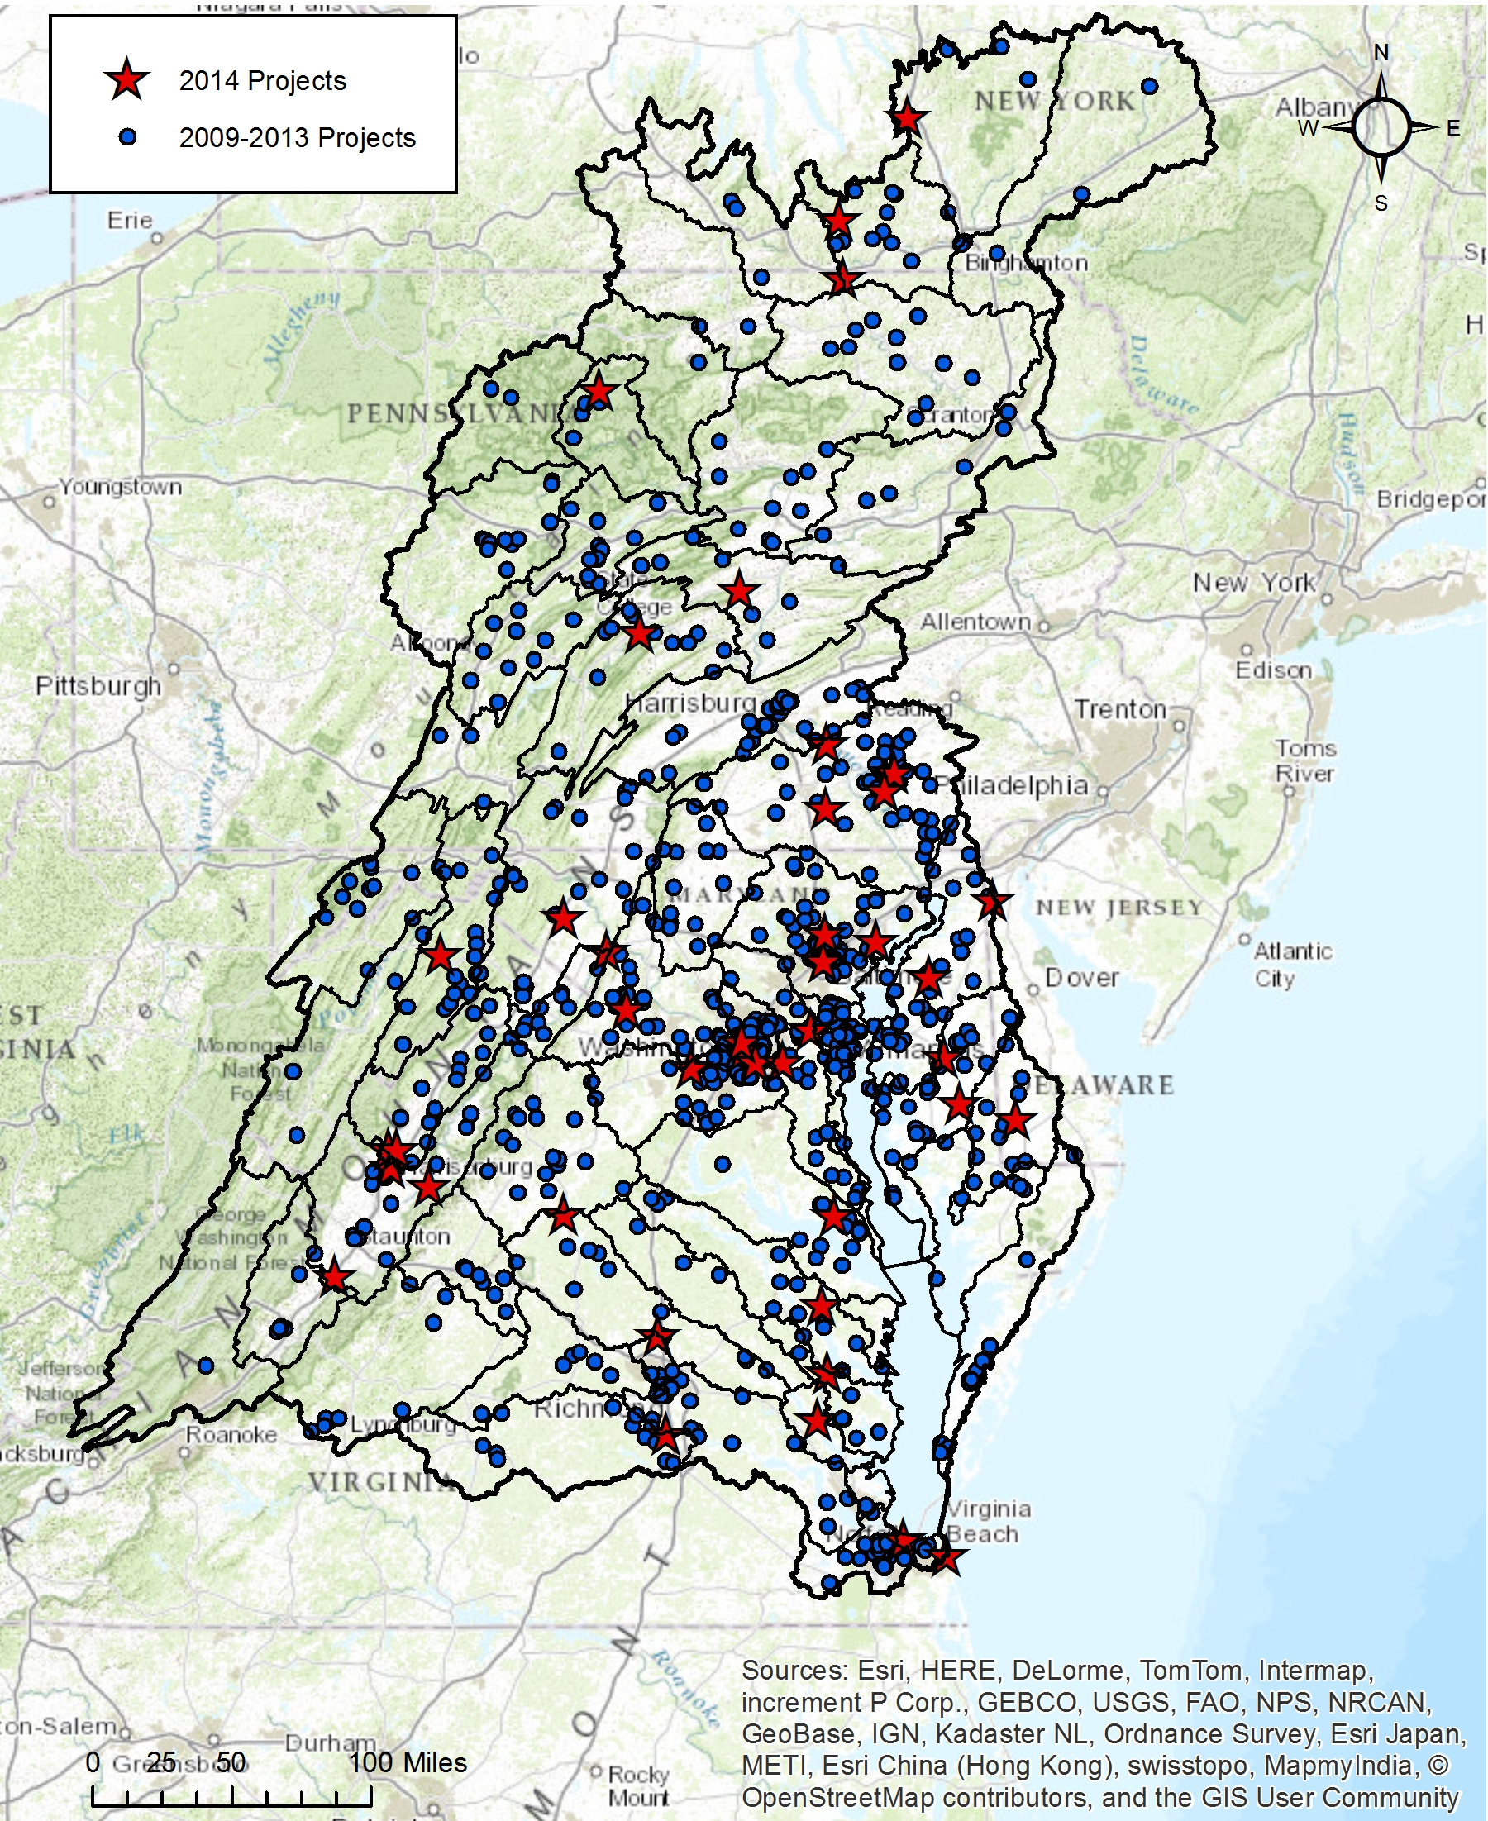
CBSF Implementation Grants
2014 Grant Investments
$9.8 million in awards
$7.8 million in EPA funding
$700k in other Federal funding (USFS, NRCS, NOAA)
$1.25 million in private funding
45 grants
INSR: $5.8 million to 18 projects
SWG: $3.9 million to 27 projects
Leveraging roughly $19 million in local match

Slide 9
CBSF Implementation Grants

Slide 10
CBSF Program Delivery Cycle
Assess Conservation Needs and Capacity
CBSF “Technical Capacity” Grants Programs
Ag Networking Forum
Receive Feedback through Networking and Information Sharing
Build Local Capacity for Restoration
Small Watershed Grants
Monitor and Assess Project Implementation
Support On-The-Ground Restoration and Conservation Efforts
Innovation Grants
NFWF Monitoring and Assessment Pilot

Slide 11
History of CBSF Investment in Building Local Capacity for Restoration
Targeted at activities that precipitate local implementation efforts (via planning, design, assessment, prioritization, etc.)
Generally smaller awards and shorter term projects, focused primarily at urban stormwater management challenges
Delivered through a cadre of registered “Technical Assistance Providers”
Eligibility similar to SWG -- restricted to local governments, “small” conservation/watershed organizations, and conservation districts
Many iterations over the years, evolving recently into a competitive “technical assistance” grants program
Need to refine and formalize this program to enhance the impact and strategic alignment with NFWF and partner objectives

Slide 12
Revamped “Technical Capacity” Program
Proposed Program Goals:
Deliver technical capacity to local partners for water quality and stewardship implementation projects through CBSF and other funding sources
Catalyze increased and more targeted local investment of restoration and protection project funding through strategic planning, design, assessment, and prioritization efforts
Support the establishment of long-term strategies for program delivery and implementation through program design and review, financing strategies, etc.
Proposed Program Details:
Annual RFP, with staged application periods for each “sector”
Conservation districts are explicitly eligible
Awards capped at $40,000
Projects capped at 12 months
How can this program best serve CAC’s priorities?

Slide 13
So… What’s working?
Driving new technologies in stormwater and agricultural conservation to accelerate water quality improvements at lower cost, with greater ease of use, etc.
New tools and approaches for targeting restoration investments for maximizing cost-effectiveness
Growing municipal interest in and adoption of sustainably-financed stormwater management programs
Cases of targeted, cross-sector restoration in critical areas
Regionalized delivery of stormwater management assistance
More robust approaches to promote behavior change amongst citizens, farms, etc.

Slide 14
Engaging CAC in CBSF Grant Programs
Ideas for consideration:
Formal role in developing implementation and technical capacity grants RFP priorities (late fall and late winter)
Formal role in reviewing grant applications in areas of CAC interest (early summer)
Opportunities to help frame content at networking and information-sharing events (ongoing)
Others?

