Slide 1
EPA Program Update
Jim Edward, Deputy Director
EPA, Chesapeake Bay Program Office
CAC Meeting
February 18, 2016

Slide 2
Chesapeake Bay Program Updates
Updates on the Jurisdictions BMP Verification Plans
Midpoint Assessment and 2-Year Milestones Calendars
EPA CBP Budget Highlights
Agreement Workplans Timeline, Public Input and Comment Resolution
Release of 2014-15 Bay Barometer

Slide 3
BMP Verification Program Update
CBP BMP Verification Schedule
November 15th: Jurisdictions submit their revised BMP verification program plans to EPA
January - April 2016: EPA approves the jurisdictions’ BMP verification program plans or requests specific changes prior to approval
2016-2017: Two year ‘ramp-up’ period
2018: Only verified practices will be credited in the future

Slide 4
BMP Verification Program Update
BMP Verification Program Plan Approval
Three Possible Decisions by EPA:
Approval
Conditional approval
Return to jurisdiction with comments
Approval: addresses all the Panel’s feedback as well as workgroup coordinators and initial EPA feedback; provides plans and schedules for development of additional BMP verification protocols and procedures in those cases where protocols and procedures are not proposed; written and presented in a public friendly, easy to understand format/text

Slide 5
BMP Verification Program Update
CBP BMP Verification Schedule
Conditional Approval: addresses most of the Panel’s/workgroup coordinator’s/EPA initial feedback but some limited ‘holes’ in the documentation which the reviewer feels can be easily addressed by the jurisdiction; generally written and presented in a public friendly, easy to understand format/text
Return to Jurisdiction with Comments: the jurisdiction did not address a significant number of the Panel’s/workgroup coordinator’s/EPA initial sets of feedback; provided documentation is incomplete, provided documentation is not written and presented in a public friendly, easy to understand format/text

Slide 6
BMP Verification Program Update
January 2016 Status
Approved | Conditionally Approved
District of Columbia Maryland | Delaware New York Pennsylvania Virginia West Virginia
Approval
Addressed all the Panel’s feedback as well as workgroup coordinators and initial EPA feedback;
Provided plans and schedules for development of additional BMP verification protocols and procedures in those cases where protocols and procedures are not proposed;
Was written and presented in a public friendly, easy to understand format/text.
Can apply for 2016 WIP assistance funds and the state is approved to work with EPA on the award of 2016 Chesapeake Bay Implementation Grant and Chesapeake Bay Regulatory and Accountability Grant.
Conditional Approval
Addressed most of the Panel’s/workgroup coordinator’s/EPA initial feedback
Some limited ‘holes’ in the documentation which EPA feels can be easily addressed by the jurisdiction
Plan was generally written and presented in a public friendly, easy to understand format/text.
Can apply for 2016 WIP assistance funds. Prior to award of 2016 Chesapeake Bay Implementation Grant and Chesapeake Bay Regulatory and Accountability Grant, EPA will need to be in a position to fully approve final revised BMP verification program plan.

Slide 7
Delaware
EPA Decision:
Conditional Approval
Delaware’s BMP verification program plan provides an excellent level of documentation using text and formats easily readable and understandable by a wide audience.
Delaware was very clear in documenting its choices of verification protocols and the rigor in their protocols in relationship to the BMPs and their contribution to overall nutrient and sediment reductions called for in their Phase II WIPs.
Delaware needs to spell out the specific timeframes for developing verification protocols for their low and medium priority BMPs.
Delaware needs to provide more documentation on their future plans for on-farm verification of implementation of nutrient management plans.
Delaware needs to document how they plan to translate the findings from the tillage and cover crop statistical surveys into the actual numbers and geographical distribution of practices submitted for crediting through the Partnership’s annual progress runs.

Slide 8
District of Columbia
EPA Decision:
Approval
The District’s revised program plan provides the right balance of detailed documentation along with numerous links to other even more detailed documentation.
Plan provides a great foundation for the next two years of implementation of their enhanced verification program.

Slide 9
Maryland
EPA Decision:
Approval
Excellent format and content, very easy to read and follow, well-structured and follows all the format and content guidance within the basinwide framework.
Maryland has specific documentation for independent reviews for each BMP across all source sectors.
Maryland provided EPA with a further revised BMP verification program plan in early January, addressing the comments EPA shared with them in mid-December.

Slide 10
New York
EPA Decision:
Conditional Approval
New York has a strong commitment to on-farm verification through commitments to conducting whole farm visual assessments. However, the details on the actual agricultural verification protocols were lacking.
Urban stormwater described the data tracking and reporting processes in detail, with limited references to actual BMP verification protocols.
New York has provided EPA very detailed responses to the remaining comments and committed to further revising their draft program plan.

Slide 11
Pennsylvania
EPA Decision:
Conditional Approval
Pennsylvania’s program plan format and context provides an excellent level of transparency into their ongoing and planned BMP verification actions.
Excellent documentation of quantifying their priority BMPs and linking them to WIP goals.
EPA continues to point to Pennsylvania’s documentation as a model for others to follow.
Although Pennsylvania acknowledges plans to develop additional BMP verification protocols for their lower priority BMPs, it does not provide any specific timeframes.
It is still unclear as to whether Pennsylvania has fully addressed their gaps in the verification of their animal waste management, manure transport, animal waste management systems, and manure management plans.
Documentation of how Pennsylvania plans to translate the findings from its statistical surveys into the actual numbers and geographical distribution of practices submitted for crediting is missing.
Pennsylvania’s forestry BMP verification protocols are not consistent with the Forestry Workgroup’s guidance.

Slide 12
Virginia
EPA Decision:
Conditional Approval
Virginia has outlined a very solid verification framework, but needs to provide more documentation and links to existing procedures to provide full transparency.
Virginia is recommending a statistical sampling based approach to verification of agricultural practices which relies on a range of percent samplings based on different categories of BMPs. This approach has been reviewed and supported by statistical survey design experts, but the documentation of the underlying rationale is limited.
When using a statistical sampling based verification protocol, Virginia needs to clearly document how they plan to translate the findings from the statistical survey into actual numbers and geographical distribution of practices to be reported for crediting.
EPA expects to see detailed documentation on verification of farms being accepted into Virginia’s excellent agricultural certainty program.
Virginia needs to provide more detailed descriptions of its actual BMP verification protocols throughout the text and provide URL links to the written protocols.
Virginia provided EPA detailed responses to the major comments EPA shared with Virginia in mid December.

Slide 13
West Virginia
EPA Decision:
Conditional Approval
West Virginia’s BMP verification program plan provides an excellent level of documentation using text and formats easily readable and understandable by a wide audience.
West Virginia did not provide a listing of BMPs for which verification protocols have not been developed and a schedule for when such protocols will be developed.
Evaluation of the implementation of nutrient management plans and manure transport are still based on paperwork assessments that appears to be done in the office, without field visits or onsite verification of records - need to see a commitment to transition to verification based on on-farm visits.
West Virginia needs put more emphasis on measurement of functionality, not just presence of the stream restoration project itself, as called for in the Partnership’s Stream Health Workgroup’s stream restoration verification guidance.

Slide 14
BMP Verification Program Update
Next Steps:
Jurisdictions with “Conditional Approval” resubmit revised plans to EPA for final review by April 2016.
Results of reviews incorporated into 2014/2015 milestones evaluations.
If approved, jurisdictions will be eligible for award of 2016 CBIG & CBRAP state grants.
EPA will work with each jurisdiction on building in specific milestones into their 2016-2017 milestones for addressing any significant BMP verification program enhancements that the jurisdiction needs to work on during the Partnership’s agreed to 2-year ramp up period, in 2016-2017.
http://www.chesapeakebay.net/about/programs/bmp/additional_resources

Slide 15
Two-Year Milestones Evaluations Calendar All Dates 2016 Unless Otherwise Noted
December 1, 2015: Jurisdictions submit 2015 implementation progress data. CBPO starts to process data
January 15: Final 2014-2015 programmatic milestone results and draft 2016-2017 milestone commitments due to EPA
January - March: EPA evaluates whether jurisdictions achieved 2014-2015 milestones and if 2016-2017 milestones meet 60% by 2017 goal
February 2016: Final opportunity for jurisdictions to submit 2015 implementation progress data
April: Chesapeake Bay Program releases 2015 Reducing Pollution Indicator (aka 2015 progress run)
Early April: EPA provides jurisdictions with draft milestone evaluations
Late April: Jurisdictions submit final 2016-2017 milestones
June: EPA releases 2014-2015 and 2016-2017 milestones evaluations

Slide 16
Midpoint Assessment Calendar
January 2016 – December 2016: Review of Phase 6 modeling tools (Phase 6 models final in Jan 2017)
July 2016: Local review of Phase 6 land use data concludes
December 2016: Preliminary results on long-term monitoring trends; explanation of WQ standards attainment patterns
January 2017: Partnership decision on how to address climate change and Conowingo in Phase III WIPs
June 2017: EPA releases final expectations for Phase III WIPs (could be earlier)
December 2017: EPA releases final Phase III WIP planning targets
June 2018: Draft Phase III WIPs due
December 2018: Final Phase III WIPs due

Slide 17
FY 2015-2017 EPA CBP Budget Highlights
FY 2015 - $73 million
FY 2016 - $73 million
FY 2017 (PresBud) - $70 million

Slide 18
FY 2016 EPA CBP Budget Highlights
$73 Million Total
$6 million - Innovative Nutrient and Sediment Reduction Grants
$6 million - Small Watershed Grants
$29.3 million - State Implementation and Accountability Program Grants
$12.6 million - Chesapeake Bay Implementation Grants (CBIG)
$11.2 million - Chesapeake Bay Regulatory and Accountability Grants (CBRAP)
$5.0 million - Local Government Assistance Grants
$4.9 million - State Tidal and Non-Tidal Monitoring Grants
$385,000 - SAV Monitoring Aerial Survey
$400,000 - Citizen Monitoring Network
$250,000 - High Resolution Land Cover Data
$285,000 - EFC Financing Workshops
$500,000 - State WIP Assistance Funds
$350,000 - BMP Expert Panels
$900,000 - Goal Team Funding for Workplan Implementation

Slide 19
Agreement Workplans Timeline, Public Input and Comment Resolution
Timeline – Your are here
Direct stakeholder outreach
MS & Workplan Dashboard
Online structured input tools
Collecting & Tracking Input received

Slide 21
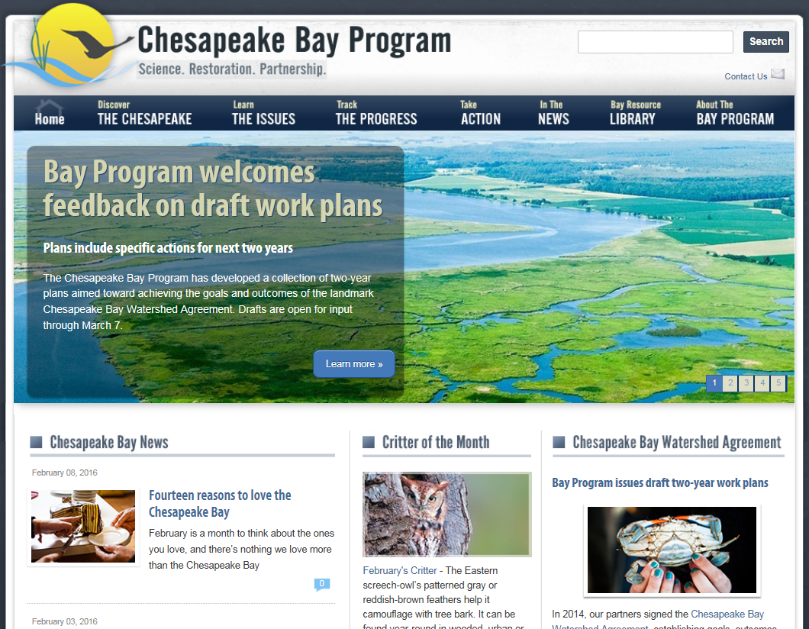
updated
updated

Slide 22
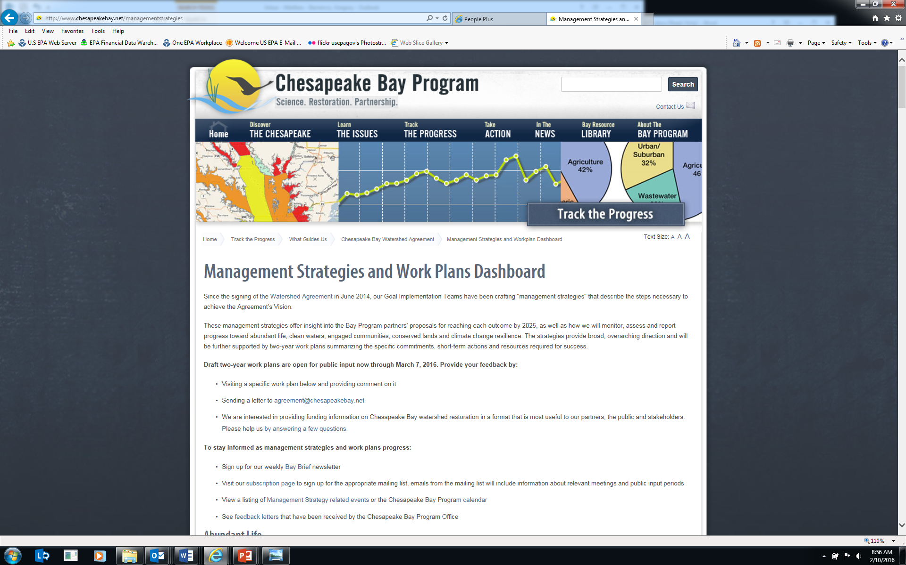
Requesting input: Online
http://www.chesapeakebay.net/managementstrategies

Slide 23
Send a letter

Slide 24
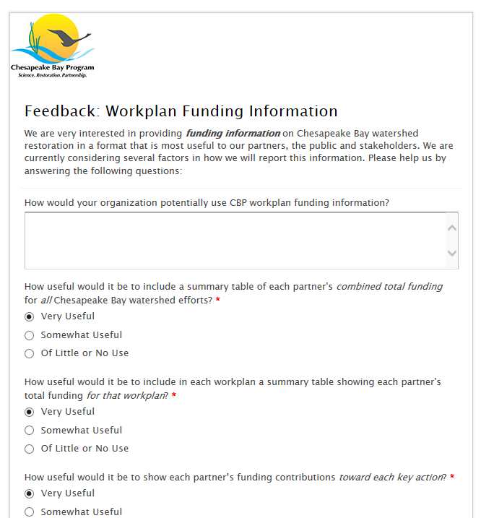

Slide 25
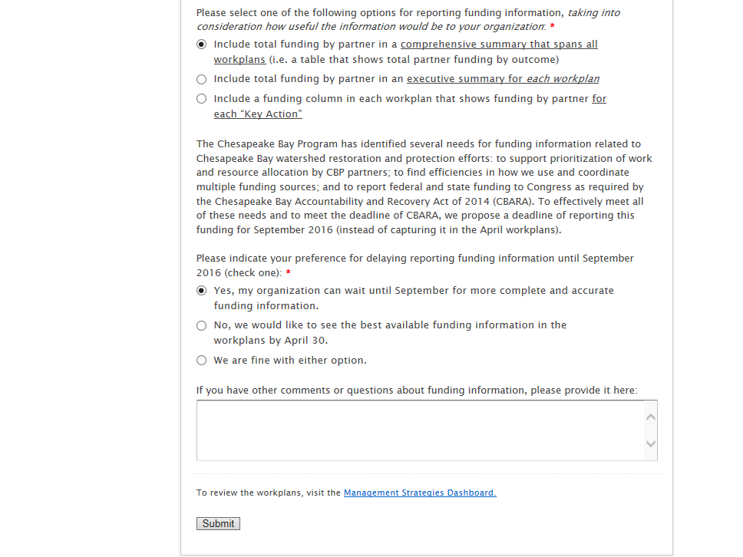

Slide 26
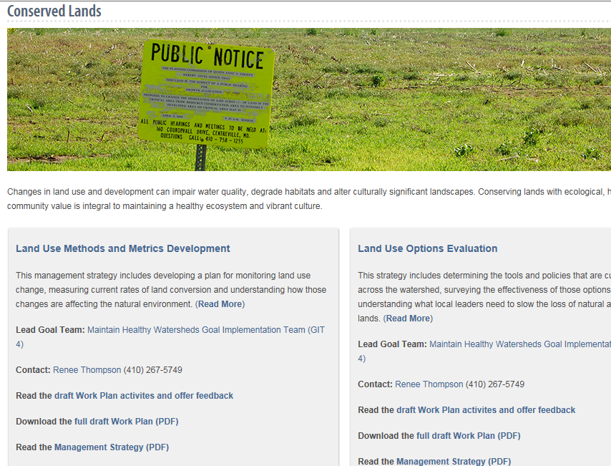

Slide 27
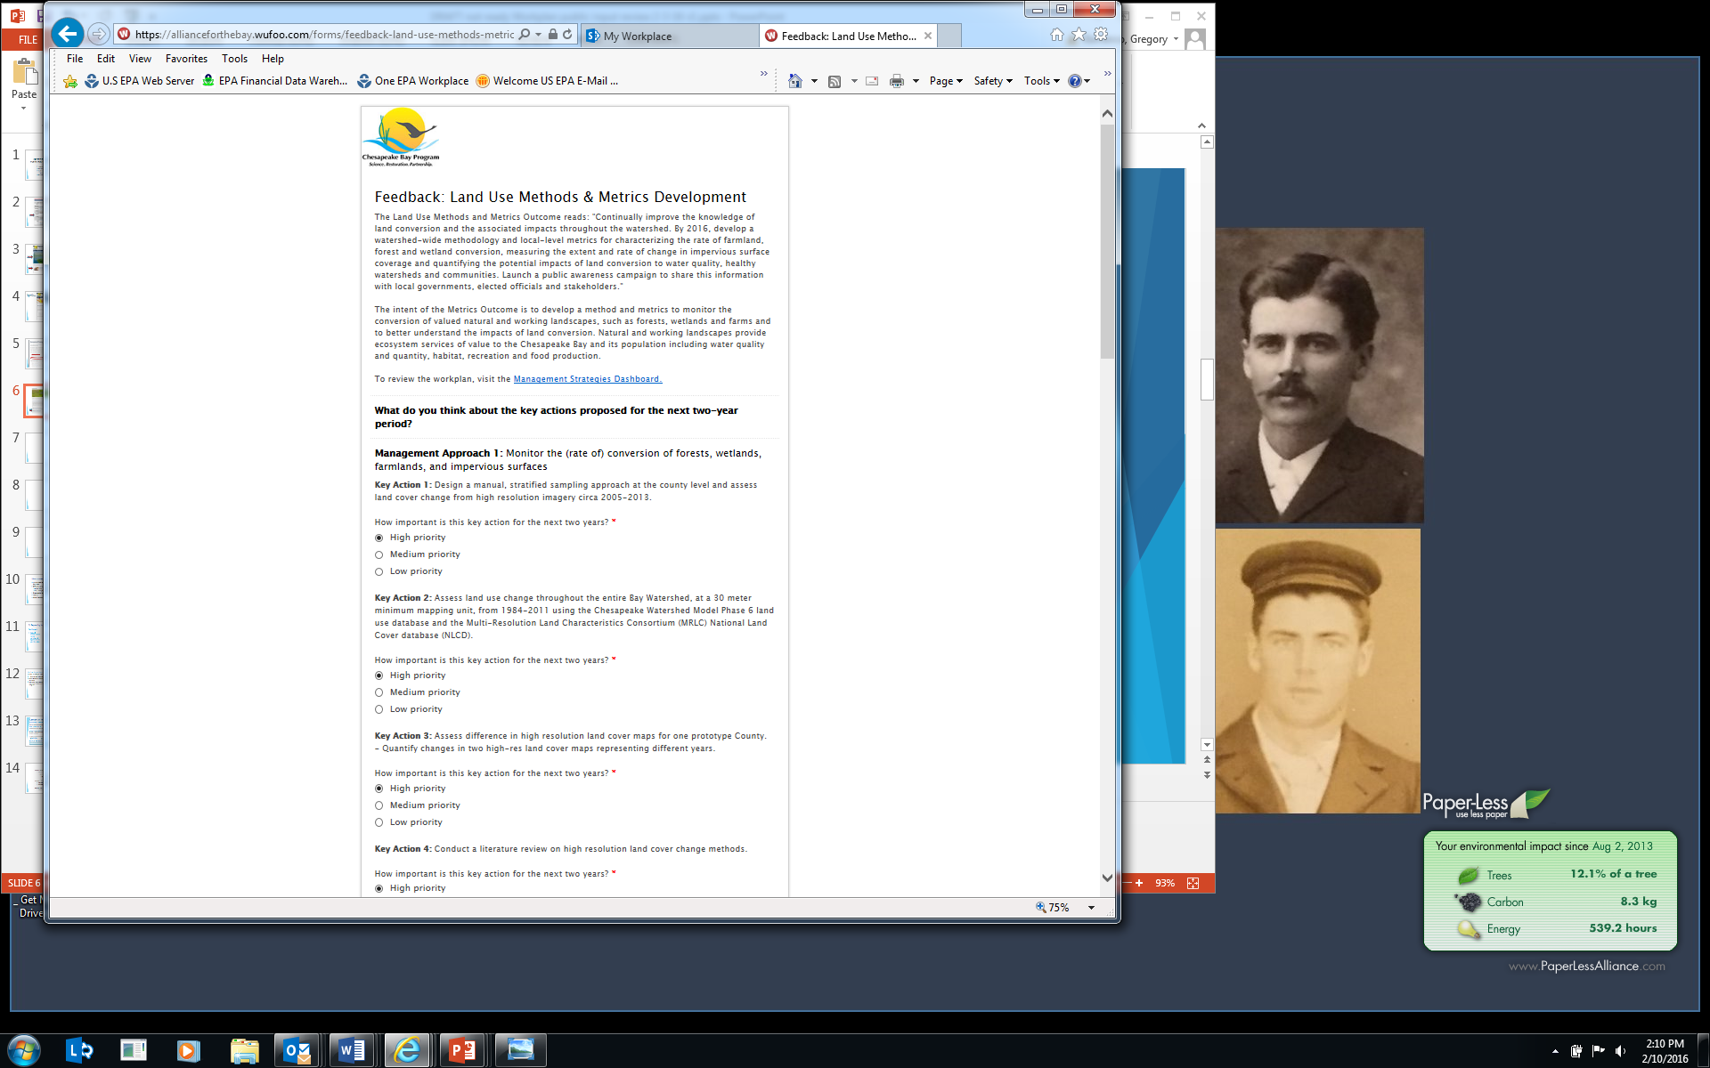

Slide 28
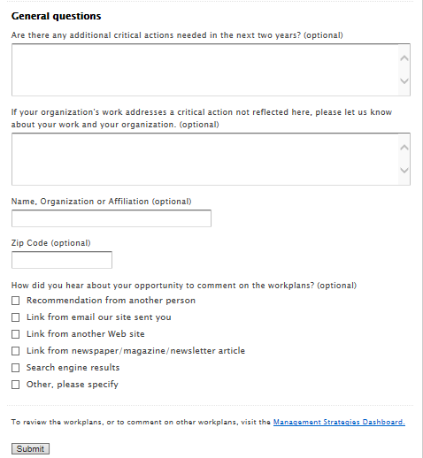

Slide 29
Direct outreach to interested stakeholders
Outreach
MB, Advisory Committees, etc.
Choose Clean Water Coalition, Bay Foundation, Alliance
GITs sent to teams, workgroups, stakeholder lists
GITs doing direct outreach to stakeholder groups
Chesapeake Network posting
State Webinar
Diversity Webinar

Slide 30

Diversity Webinar

Slide 31
Comment Resolution
Comments received on website or letters received – thru March 8
Comm Office scans for appropriateness
Posts letters on webpage
Forwards comments to GITs, workgroups
March 8 – March 25 - GIT Review
March 25 – GITs send to MB for review and edits
April 14 – MB meeting
April 22 – MB comments to GITs; GITs incorporate edits
April 30 – Workplans final; post to CBP website

Slide 32

2014-2015 Bay Barometer

Slide 33
2014-2015 BB Highlights
Abundant Life: Habitats
Between 2012 and 2015, 817 stream miles were opened to fish passage, including almost 300 miles in Virginia and more than 500 miles in Pennsylvania. This marks an 82 percent achievement of the 1,000-mile goal.
Between 2013 and 2014, the abundance of underwater grasses in the Chesapeake Bay rose 26 percent , from 59,711 to 75,835 acres. This marks an achievement of 41 percent of our 185,000-acre goal.
Abundant Life: Fish and Shellfish
Between 2014 and 2015, the abundance of adult female blue crabs in the Chesapeake Bay rose 47 percent, from 68.5 million to 101 million. This number is below the 215 million target but above the 70 million overfishing threshold.
Between 2000 and 2014, the abundance of American shad as measured in five Chesapeake Bay tributaries increased from 11 percent to 44 percent of the goal. The Potomac River has shown the most consistent rise in returning shad.
Clean Water
Between October 2013 and September 2014, nitrogen, phosphorus and sediment loads were below the long-term average: approximately 285 million pounds of nitrogen, 17.5 million pounds of phosphorus and 3.62 million tons of sediment reached the Chesapeake Bay.
During the 2012 to 2014 assessment period, 34 percent of the water quality standards for dissolved oxygen, water clarity or underwater grasses, and chlorophyll a for the Chesapeake Bay and its tidal tributaries were met. While this is below the 100 percent attainment needed for a healthy Bay, it marks a 17 percent rise from the percentage of clean water criteria attained during the previous assessment period.

Slide 34
2014-2015 BB Highlights
Protected Lands
Between 2010 and 2013, close to 572,000 acres of land in the Chesapeake Bay watershed were permanently protected from development. This marks an achievement of 29 percent of the goal to protect an additional two million acres from the 2010 baseline, and brings the total amount of protected land in the watershed to 8.37 million acres.
Engaged Communities
Between 2010 and 2014, 86 public access sites were opened in the Chesapeake Bay watershed, bringing the total number of access sites in the region to 1,225. Virginia, Maryland and Pennsylvania have seen the biggest increases in access sites during this time, at 40, 20 and 16 new sites, respectively. The cumulative watershed-wide total marks a 29 percent achievement of the goal to add 300 new access sites to the region.

Slide 35

Questions?
Jim Edward
edward.james@epa.gov
www.ChesapeakeBay.net

