Slide 1
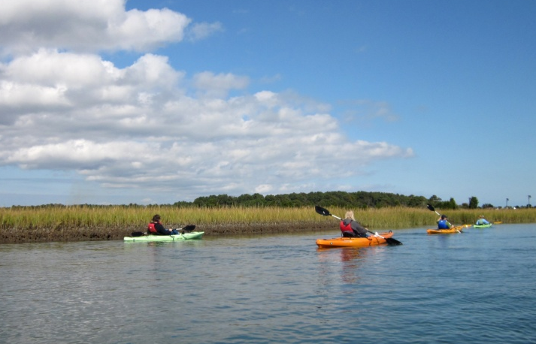

CBP Program Update
Citizens Advisory Committee
February 27, 2014
Jim Edward, Deputy Director
Chesapeake Bay Program
(EPA)

Slide 2
2013 CBP Report to Congress
Submitted by EPA on behalf of CBP every five years as a requirement of the Clean Water Act, Section 117(h) – covers 2008-2013 time frame
Status and Trends of the Chesapeake Bay Ecosystem
  Signs of Continuing Recovery
  Resilience
  Not Always Seeing Expected Response to Management Actions
Management Strategies Effectiveness
  Building an Effective Partnership
  Management Strategies
  The Transition Years
Recommendations for Improved Management (new Agreement)
Conclusion

Slide 3
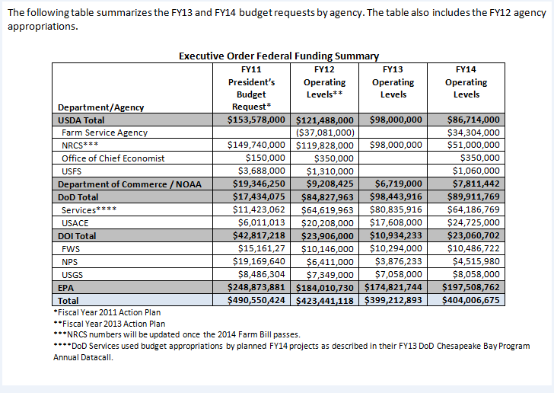
Federal Funding

Slide 4
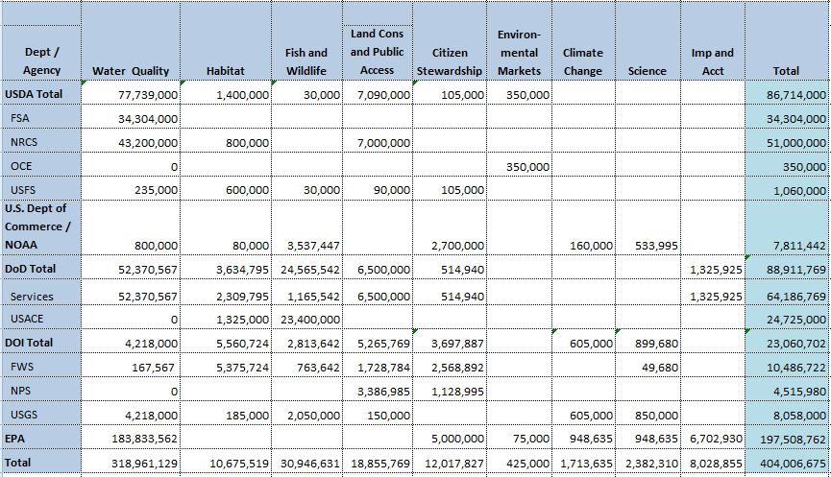
Funding by EO Goal Area

Slide 6
FY2014 CBP Budget
FY13 ($54 mil) FY14 ($70 mil)
  State Grants
  Almost 80% of increase going to state grants
  Local government “set-aside” for implementation
  Increase for New Agreement
    Headwaters states
    Signatory states
    Restore monitoring funding
    $5 mil for Innovative and $5 mil for Small Watershed grants

Slide 7
FY2014 CBP Budget
Other Investment Areas
  Goal Implementation Team Support
    Management Strategy Development
    Implementation Projects & Tools
  BMP Expert Panels
  BMP Verification Programs
  CAST/FAST Tools
  Climate Change
  Citizen Monitoring Initiative
  Trading Program Support ($1 mil)
  FY2015 - $73 million PresBud Request

Slide 8
Comments on Watershed Agreement by Jurisdiction
Issue | Total No. Comments | Md. | Va. | Pa. | D.C. | W.Va. | Unknown | Outside W-Shed
Accountability/ Enforcement | 2 | 1 | 1
Agriculture | 6 | 5 |  |  |  |  |  | 1
Chemicals | 21 | 6 | 4 | 3 | 1 | 1 | 5 | 1
Climate Change | 1 |  |  |  |  |  |  | 1
Clam Dredging | 1 | 1
Conowingo Dam | 1 | 1
Development/Population | 5 | 2 |  |  |  |  |  | 3
Environmental Literacy | 1 | 1
Fisheries | 2 | 2
Homeowner Incentives | 1 |  | 1
Invasive Species | 1 | 1
Lawn Care | 3 | 1 | 1 |  |  |  | 1
Menhaden | 1 |  | 1
Natural Gas Terminal | 2 | 2
Oysters | 3 | 2 | 1
Public Access | 3 | 1 |  | 1 |  |  | 1
Revenue Streams | 1 | 1
SAV | 1 | 1
Stormwater | 2 | 2
Support | 4 | 4
Wastewater Treatment | 1 | 1
Water Quality | 1 | 1
Notes:
No comments received from either New York or Delaware as of yet. Comments from outside the watershed from Florida, Kansas and Maine.

Slide 9
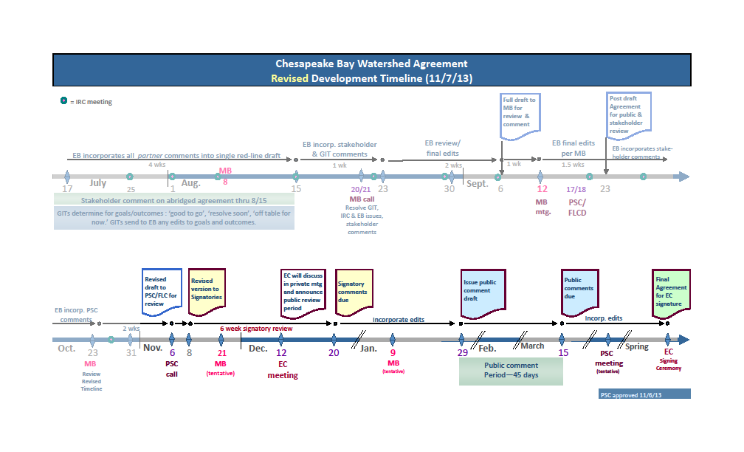

Slide 10
Timeline for Evaluation of 2012-2013 Milestones
and Development of 2014-2015 Milestones
2013/2015 - January 15, 2014: 2013 programmatic and 2015 programmatic and input decks due to EPA. All received except for VA 2015 programmatic and input deck (agreed to extension until 3/15). Drafts posted on EPA TMDL website.
  2015 – February 19, 2014: Virginia submits preliminary programmatic milestones.
2015 - March 15, 2014: Jurisdictions may choose to submit revised 2015 milestone input decks and programmatic commitments based on final 2013 Progress Scenario results.
- Virginia submits draft milestones (programmatic and numeric) for 14/15

Slide 11
Timeline for Evaluation of 2012-2013 Milestones
and Development of 2014-2015 Milestones
Mid-April 2014: Share informal draft evaluation of final 2013 and draft 2015 milestones (both numeric and programmatic) with jurisdictions.
2015 - May 15, 2014: Deadline for jurisdictions to submit final 2015 milestone input decks and programmatic commitments.
2015 - May 2014: EPA removes “draft” designation on the TMDL website for the links to the jurisdictions 2015 milestone input decks and programmatic commitments.
End of June 2014: EPA posts the Evaluation including the review of the final 2013 milestone progress, and the final 2015 milestone commitments on the TMDL website.

Slide 12
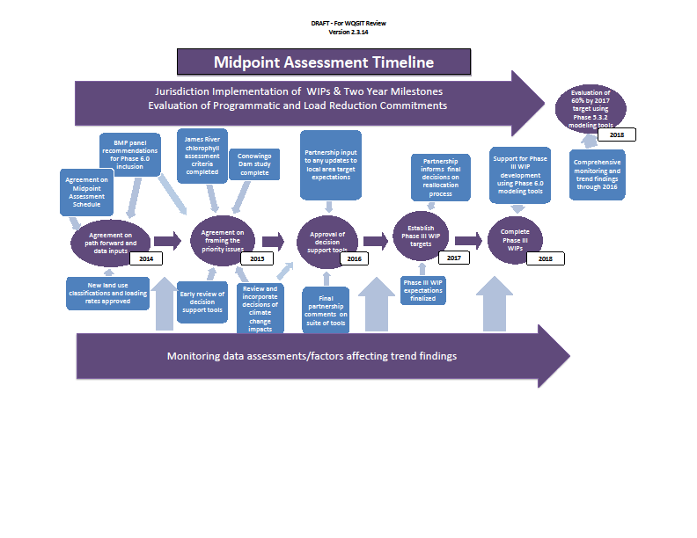

Slide 13
Homeowner BMP Crediting
Almost 50 communities and watershed groups offer incentives and/or technical assistance to homeowners in Chesapeake Watershed
Provides a way for individual residents to play a role in Bay restoration and could yield “green jobs”
Individual practices have small impact, but collectively may effectively reduce pollution
Credit: Chesapeake Stormwater Network
Notes:
Pilot:
Led by UMD Extension, Howard County, Chesapeake Stormwater Network. Congressman Sarbanes Office and EPA helped to convene
Mainly testing Stormwater Management and Restoration Tracker (SMART) reporting tool developed by UMD Extension
Howard County interested in linking homeowner BMPs to discount in stormwater fee – financial incentive
Protocol:
- Approved by Urban Stormwater WG in Dec 2013 and Watershed Technical WG in Feb 2014
- Consistent w/ Urban Stormwater WG’s proposed verification protocols
- PARTNERSHIP approval
Moving Forward
- EPA willing to work w/ stakeholders to explore how we/CBP can most help
- Giving credit toward TMDL?
- Recognition programs?

Slide 14
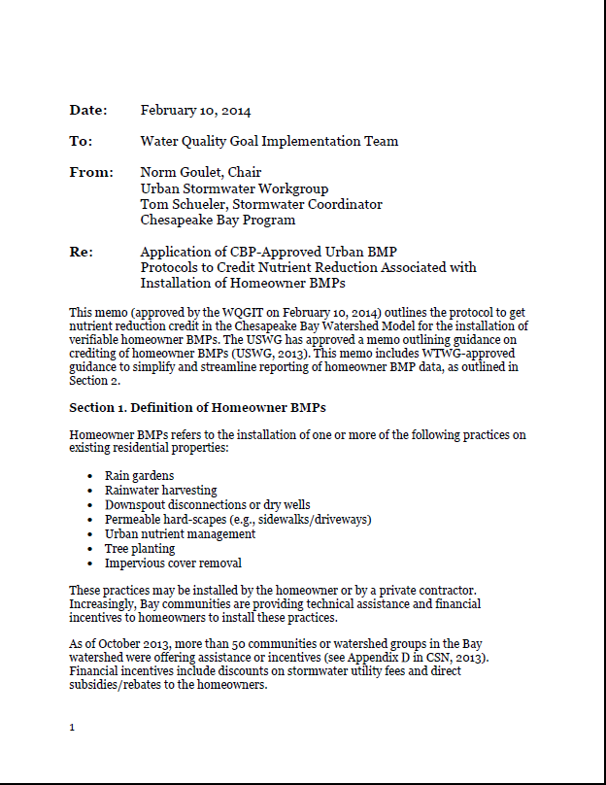
Recent Efforts
Summer/Fall 2013: Piloted use of innovative tracking tools and smart phone apps to streamline BMP reporting in Howard County, MD
February 2014: Water Quality Goal Implementation Team approved protocol for crediting homeowner BMPs in CBP models
Moving Forward: EPA willing to help convene stakeholders to identify strategies to support homeowner BMP programs
Notes:
Pilot:
Led by UMD Extension, Howard County, Chesapeake Stormwater Network. Congressman Sarbanes Office and EPA helped to convene
Mainly testing Stormwater Management and Restoration Tracker (SMART) reporting tool developed by UMD Extension
Howard County interested in linking homeowner BMPs to discount in stormwater fee – financial incentive
Protocol:
- Approved by Urban Stormwater WG in Dec 2013 and Watershed Technical WG in Feb 2014
- Consistent w/ Urban Stormwater WG’s proposed verification protocols
- PARTNERSHIP approval
Moving Forward
- EPA willing to work w/ stakeholders to explore how we/CBP can most help
- Giving credit toward TMDL?
- Recognition programs?

Slide 15
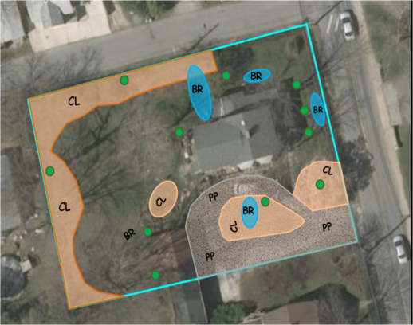
What Can Receive Credit
UNM Plan for 9200 Bradford Pear Lane: 0.5 acres
1 | Get Expert Lawn Advice | ✓
2 | Maintain Dense Cover on Turf | ✓
3 | Choose NOT to fertilize | ✓
4 | Recycle Lawn Clippings and Compost Fallen Leaves | ✓
5 | Correct Fertilizer Timing | N/A
6 | Use Slow Release Fertilizer | N/A
7 | Set Mower Height at 3 inches | ✓
8 | No off-target fertilization | N/A
9 | Fertilizer free buffer zones around water features | ✓
10 | Increase soil porosity and infiltration | ✓
Urban Nutrient Mgmt
Rain gardens
Rainwater Harvesting
Downspout Disconnection
Tree Planting
Permeable Driveways
Notes:
Homeowner BMPs can all be tied to practices that are currently simulated by the Chesapeake Bay Program models
Nutrient reduction values based on recent expert panel reports (Urban Nutrient Management - 2013, Urban Retrofits – 2012. Tree planting – existing values but expert panel underway

Slide 16
Reporting Process
Homeowner
Locality or 3rd Party Group
State
    Chesapeake Bay Program
Notes:
WQGIT homeowner BMP crediting protocol seeks balance b/t accountability and not overwhelming homeowners, localities, and states w/ burdensome reporting requirements
Homeowners install practice (can receive assistance) and report to locality or 3rd Party (eg, watershed group)
Locality or third party organization (eg, watershed group) verifies data, aggregates, and reports to state
Verification practices will need to be consistent w/ state verification protocols, which will be developed based on CBP verification guidelines that are currently under development
Options for verification given homeowner BMPs so small yet numerous.
State aggregates data across other localities and reports to CBP as part of annual progress run submission
Homeowner BMPs get special identifier in NEIEN
CBP calculates pollutant load reductions as part of progress run

