Slide 1


Chesapeake Bay Program Update Citizens Advisory Committee Meeting May 21, 2020
Jim Edward
Deputy Director
EPA Region III/Chesapeake Bay Program Office

Slide 2

Topics for Discussion
Potential Impacts of COVID-19 on CBP
EPA Draft Evaluations of Jurisdictions and Federal Agencies 2020-2021 Milestones
CBP Budget Update
Possible COVID Impacts
EPA FY20 $1 Million Budget Increase (INSR, SWG and Most Effective Basins)
Pennsylvania Funding
Diversity, Equity, Inclusion and Justice Strategy and DEIJ Statement

Slide 3

Potential Impacts of COVID-19 on CBP
EPA remains 100% committed to achieving the 2025 goals of the Bay TMDL as well as the other goals in the Chesapeake Bay Watershed Agreement. EPA still expects to meet all its deadlines to which we have committed for the work of the Chesapeake Bay Program partnership.
Check in to see if there are any partnership related deadlines or time frames that you may have difficulty meeting due to COVID-19 related impacts. We do not want any deadlines missed because of the COVID-19, if possible
Listed below are some of the key partnership dates agreed upon for this year, for which we would like to receive feedback from you.

Slide 4
Schedule for EPA Evaluations of Jurisdictions
and Federal Agencies
2020-2021 Milestones
PSC-Approved Two-Year Milestones Deliverables and Schedule
Annual Progress Data Submission Schedules
Quality Assurance Program Plans (QAPPs) for ongoing water quality monitoring
QAPPs for BMP verification
Submission of tidal and non-tidal water quality monitoring data

Slide 5
Schedule for EPA Evaluations of Jurisdictions
and Federal Agencies
2020-2021 Milestones
PSC-Approved Two-Year Milestones Deliverables and Schedule:
Jurisdictions submitted 2020-2021 programmatic milestones commitments for review by EPA. (March 1, 2020)
EPA shared its evaluations of 2018-2019 numeric and programmatic commitments and 2020-2021 numeric and programmatic commitments with the jurisdictions. (April 30, 2020)
Jurisdictions are to submit final 2021 programmatic milestones to EPA within 30 days of receiving draft evaluations. (No later than May 30, 2020).
Jurisdictions are to post final milestones to their websites within two weeks of submitting final milestones. (No later than June 13, 2020)
EPA will post its final evaluations to the Region III Bay TMDL website. (No later than July 29, 2020)

Slide 6
Other Potential Impacts of COVID-19 on CBP
Annual Progress Data Submission Schedules
Quality Assurance Program Plans (QAPPs) for ongoing water quality monitoring
QAPPs for BMP verification
Submission of tidal and non-tidal water quality monitoring data

Slide 7
CBP Budget Update: Most Effective Basins
EPA announced the allocation of $6 million to Chesapeake Bay states to improve water quality by reducing excess nitrogen from agricultural operations
The $6 million is part of a $12 million increase in the FY 2020 EPA Chesapeake Bay Program budget approved by Congress. The funds were designated for “state-based implementation in the most effective basins.”
EPA analyses have shown that reducing nitrogen through improved agricultural practices in the bay watershed is far less costly – and more effective – than reducing phosphorus to improve water quality.
The funding must be prioritized in each state to their most effective basins (allowing for the greatest impact from the reduction in nitrogen), and to those projects that implement agricultural “Best Management Practices” with the highest effectiveness.
Each of the 383 basins in the Chesapeake Bay watershed was evaluated as part of the relative effectiveness determination. A total of 26 of the top 30 most effective basins are located in Pennsylvania, including all of the top 15.
Grant Guidance Addendum on Bay TMDL website under “Funding Opportunities”

Slide 8
CBP Budget Update: Most Effective Basins
Each state in the Chesapeake Bay watershed recently submitted Phase III WIPs, in which they committed to reduce nitrogen loads from the agriculture sector from 2019 to 2025.
The following funding allocations were calculated as a percentage of the total of each bay jurisdictions’ ag WIP commitments:
Pennsylvania: $3,695,112
Virginia: $1,110,191
Maryland: $695,940
Delaware: $364,540
New York: $79,536
West Virginia: $54,681
DC: $0

Slide 9
CBP Budget Update: Pennsylvania Funding
EPA redirected the PA local government implementation funding of approximately $3.6 million to the National Fish and Wildlife Foundation (NFWF) through the EPA Small Watersheds Grant program.
EPA redirected $464,213 to PA. Fish & Boat Commission (PFBC) earlier this year and will be awarding $684,868 to PA Dept. of Conservation and Natural Resources (DCNR) which is expected this summer.
EPA is also planning on providing over $3.8 million to the PA State Conservation Commission (SCC) via the PADEP CBIG grant as a subaward. This is expected to be awarded this summer as well.
EPA is also awarding approximately $3.7 million of PA’s allocation of Most Effective Basins funding and is considering using a Request For Applications for this funding.

Slide 10
CBP Budget Update: COVID-19 Impacts
Request sent from RA to Jurisdictions and Federal Agencies April 24
First agenda item on May 22 PSC Conference Call
Summary of responses provided to CAC
EPA FY2020 Budget unaffected; FY21 and Beyond is Unknown

Slide 11
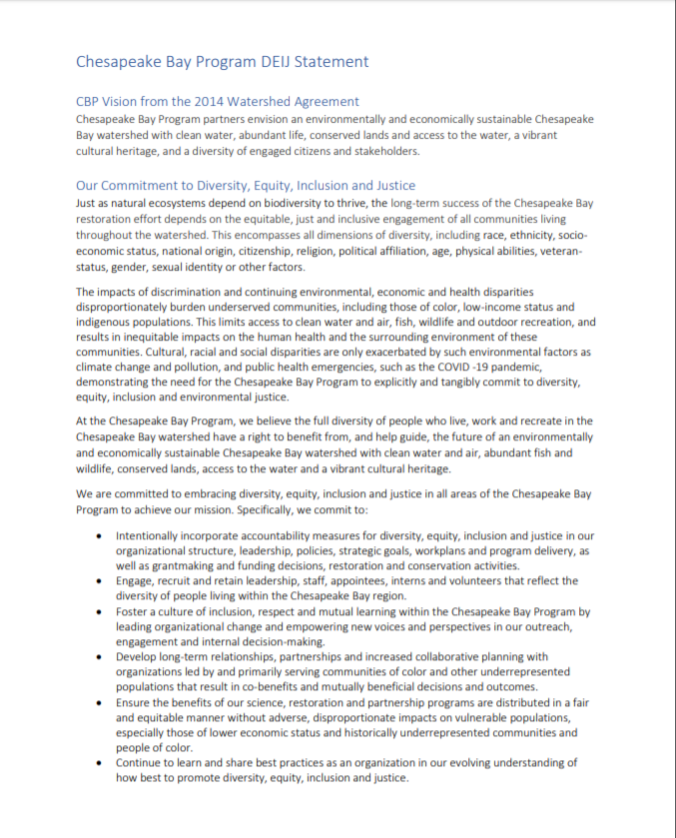
CBP DEIJ Statement
Notes:
This slide may not be necessary, but could be used to explain how we will do this (work with Rachel to distribute and get signatures).

Slide 12


Questions?
Learn more:
www.chesapeakebay.net
www.chesapeakeprogress.com
Facebook: Chesapeake Bay Program
Twitter: @chesbayprogram
Instagram: @chesbayprogram
Jim Edward,
Deputy Director, EPA/CBPO
410-267-5705
edward.james@epa.gov

