Slide 1


Chesapeake Bay Program Update Citizens Advisory Committee Meeting September 17, 2020
Jim Edward
Deputy Director
EPA Region III/Chesapeake Bay Program Office

Slide 2

EPA CBPO Program Update
The jurisdictions progress in meeting 2025 targets
Conowingo WIP Update
Most effective basins funding allocation methodology
Other?

Slide 3
Jurisdictions 2019 Progress Summary
Jurisdiction | Meeting 2025 Targets For: | NOT Meeting 2025 Targets For:
DE | P and S | N
DC | ALL
MD | S | N and P
NY | P | N and S
PA | NONE
VA | S | N and P
WV | ALL

Slide 4
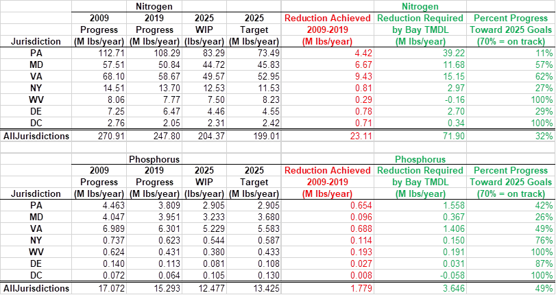
Jurisdictions’ Progress in Achieving 2025 Targets CAST 2017

Slide 5
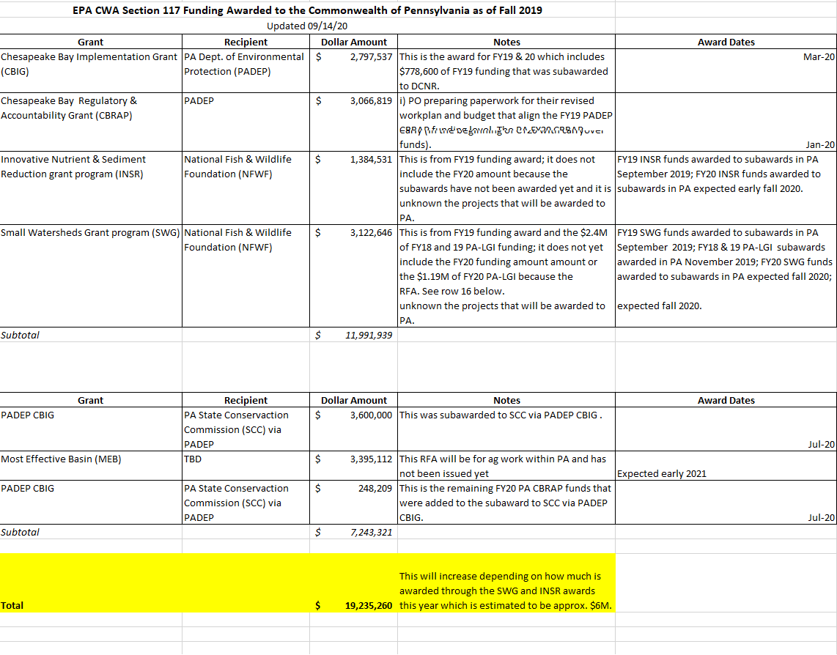

Slide 6
Draft Conowingo WIP Implementation Strategy
The Steering Committee and the PSC approved one “preferred” implementation scenario to target most nitrogen-effective practices in the Susquehanna River basin (PA, MD, & NY), which has the greatest relative influence on Dissolved Oxygen in the Bay.
The majority of implementation will occur in PA.
The cost per year is $53.3M (the range for the other 10 scenarios that were considered is $50M – $368M)
The primary WIP strategy supports restoration efforts in three core areas:
Natural filters (e.g., wetland restoration & riparian forest buffers)
Sustainable farm practices (e.g., prescribed grazing & conservation tillage)
Nutrient reduction practices (e.g., nutrient management & manure incorporation)

Slide 7
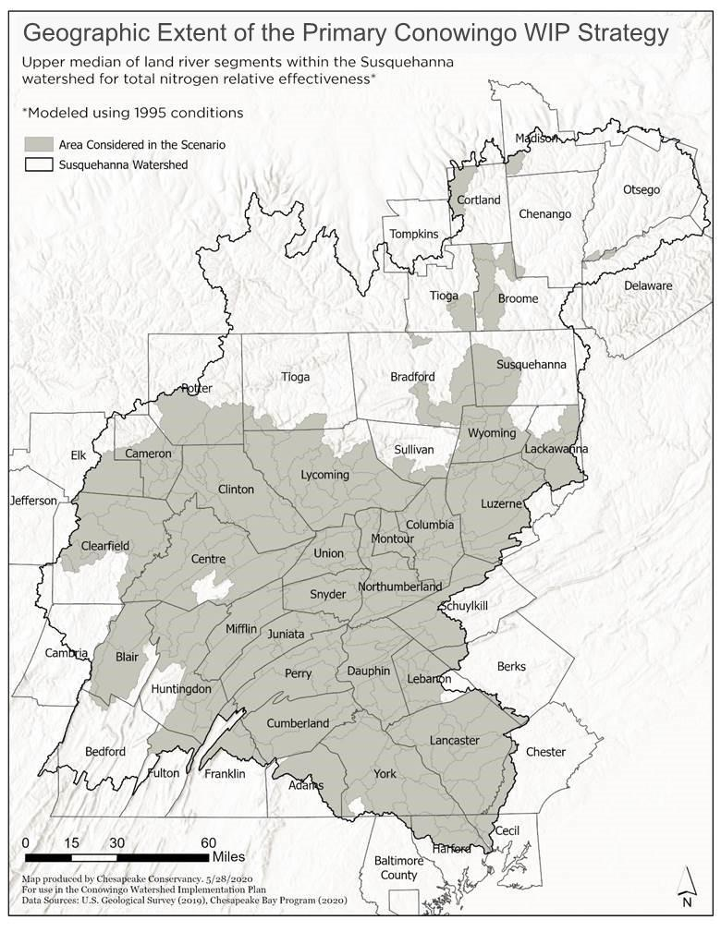

Slide 8
BMPs Implemented in the Primary CWIP Scenario
Practice | Duration | Unit | Amount (Thousands)
Agricultural Practices
Nutrient Application Management Core Nitrogen | annual | Acres | 223
Nutrient Application Management Rate Nitrogen | annual | Acres | 624
Nutrient Application Management Placement Nitrogen | annual | Acres | 207
Nutrient Application Management Timing Nitrogen | annual | Acres | 626
Conservation Tillage | annual | Acres | 216
High Residue Tillage | annual | Acres | 48
Low Residue Tillage | annual | Acres | 10
Prescribed Grazing | cumulative | Acres | 84
Forest Buffers | cumulative | Acres in Buffers | 20
Wetland Restoration | cumulative | Acres | 12
Grass Buffers | cumulative | Acres in Buffers | 21
Soil and Water Conservation Plan | cumulative | Acres | 113
Manure Incorporation | annual | Acres | 189
Barnyard Runoff Control | cumulative | Acres | 0.6
Urban Practices
Urban Forest Planting | cumulative | Acres | 49
Urban Forest Buffers | cumulative | Acres | 17

Slide 9
Nitrogen Load Reduction (Millions of Pounds) for the Primary CWIP Scenario
State | Sector | Baseline | Primary CWIP | N Reduction
MD | Agriculture | 0.85 | 0.68 | 0.17
 | Developed | 0.35 | 0.35 | 0.00
 | Natural | 0.26 | 0.26 | 0.01
 | Septic | 0.19 | 0.19 | 0.00
 | MD Total | 1.67 | 1.49 | 0.18
NY | Agriculture | 5.62 | 5.50 | 0.12
 | Developed | 1.52 | 1.52 | 0.01
 | Natural | 2.97 | 2.96 | 0.01
 | Septic | 0.19 | 0.19 | 0.00
 | NY Total | 12.39 | 12.26 | 0.13
PA | Agriculture | 39.20 | 33.51 | 5.69
 | Developed | 13.98 | 13.34 | 0.64
 | Natural | 16.51 | 16.42 | 0.09
 | Septic | 1.66 | 1.66 | 0.00
 | PA Total | 79.29 | 72.87 | 6.41
Total |  | 93.35 | 86.62 | 6.72

Slide 10
Conowingo WIP & Financing Strategy Timeline --Subject to Change--
Sept 15 – Oct 1: PSC Review of Draft Conowingo WIP
Oct 1 – Oct 9: Revisions to draft based on PSC comments
Oct 15: PSC approves public release of draft Conowingo WIP
Oct 16 – Dec 21: 60-day public review of draft Conowingo WIP
Includes EPA’s formal review and evaluation of draft WIP
**Steering Committee needs to determine schedule for finalizing the Conowingo WIP based on feedback received from the public comment period and EPA
Dec 2020: Draft financing strategy submitted to Steering Committee for review and comment
March 2021: Final financing strategy posted to CBP website
Winter 2022-2023: Implementation of financing activities

Slide 11
Chesapeake Bay Program Office Most Effective Basins Funding
Load effectiveness is a measure of the ability of management practices implemented in a given area (basin) to have a positive effect on dissolved oxygen in the Bay.
Load effectiveness is the combination of three factors: land to water, delivery, and dissolved oxygen response. There are 383 basins in the watershed being used for this methodology.

Slide 12
Chesapeake Bay Program Office Most Effective Basins Funding
Will provide this funding for nitrogen reduction from the most cost-effective BMPs in the agricultural sector to the Chesapeake Bay watershed jurisdictions that have committed to reducing the agricultural contribution of nitrogen in their Phase III WIPs, i.e. DE, MD, NY, PA, VA, WV.
Using the state Phase III WIPs, each identified nitrogen reduction commitment between now and 2025. The total load of these obligations to reduce nitrogen from agriculture was added and then a percentage for each jurisdictions was determined to allocate this $6 million of MEB funding.

Slide 13
Chesapeake Bay Program Office Most Effective Basins Funding
Table 1 shows, by jurisdiction, the percentage of agricultural sector implementation proposed in each WIP and the resulting MEB funding allocation.
Jurisdiction | Phase III WIP Ag Nitrogen Commitment (million pounds) | Percent of Total Nitrogen Commitment Proposed | MEB Funding Allocations ($)
DC | 0.0 | 0.00% | -
DE | 2.2 | 6.08% | $ 364,540
MD | 4.2 | 11.60% | $ 695,940
NY | 0.5 | 1.33% | $ 79,536
PA | 22.3 | 61.59% | $ 3,695,112
VA | 6.7 | 18.50% | $ 1,110,191
WV | 0.3 | 0.91% | $ 54,681
Totals | 36.2 | 100.00% | $ 6,000,000

Slide 14

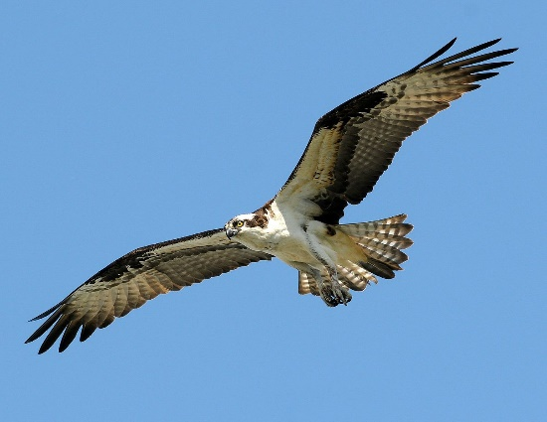
Questions?
Learn more:
www.chesapeakebay.net
www.chesapeakeprogress.com
www.epa.gov/chesapeake-bay-tmdl
Facebook: Chesapeake Bay Program
Twitter: @chesbayprogram
Instagram: @chesbayprogram
Jim Edward,
Deputy Director, EPA/CBPO
410-267-5705
edward.james@epa.gov

