Slide 1
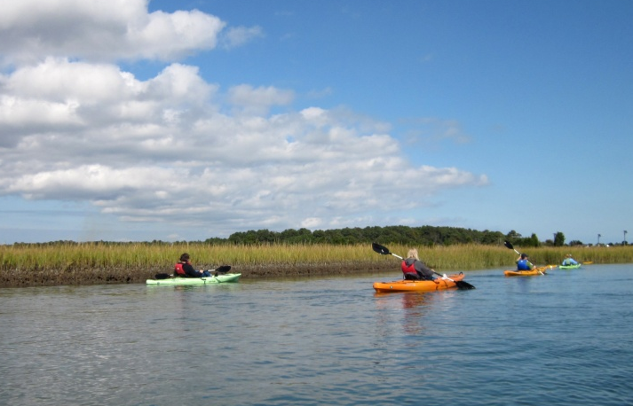

The Bay’s Health & Future: How it’s doing and What’s Next
The New Chesapeake Watershed Agreement:
Affirming Our Commitment &
Charting the Next Course
James Edward, Deputy Director
Chesapeake Bay Program
Environmental Protection Agency

Slide 2
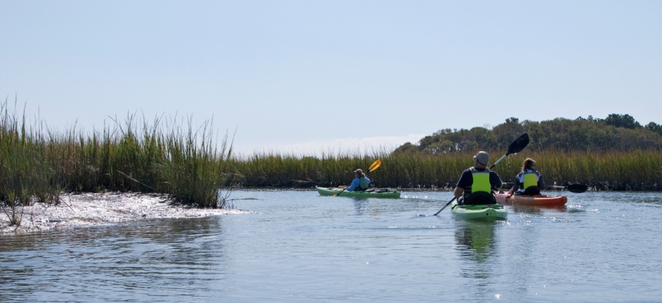
How did we get here?
2009 – Federal Executive Order was issued
2010 – CBP Agreement - Chesapeake 2000 (C2K) – Commitments largely met, expired or outdated.
2010 – FLC and CBP’s Top Leadership called for coordinating/integrating goals, outcomes, actions of the CBP with those in the EO Strategy
2011 - CBP EC and FLC-D agreed to a 3-year, 4 stage discussion and process
Stage 1: Use Goal Implementation Teams to
Set Direction (2011)
Stage 2: Develop Negotiation Protocols (2012)
Stage 3: Negotiate New Agreement (2013)
Stage 4: Implement New Agreement
(2013-2025)
Notes:
Top Leaders are:
Executive Council (EC)
Federal Leadership Committee
Stage 1: Goal Teams, which focus on specific Bay issues/areas such as Fisheries or Habitats, revisited and revised their goals for the future of CBP’s work
Stage 2: Established how we were going to go about getting to a new agreement
Since state reps were also hard at work on writing their WIP’s, we decided to hold off on this until the WIP process was complete
Stage 3: We are in it now. Goal for new agreement to be signed by EC at fall meeting 2013
Stage 4: Getting it done!

Slide 3
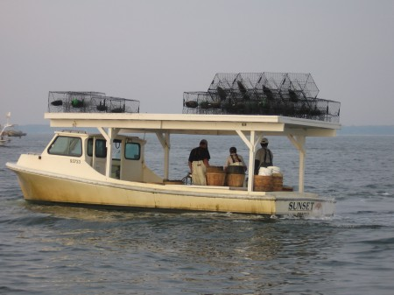
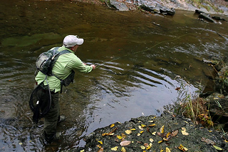
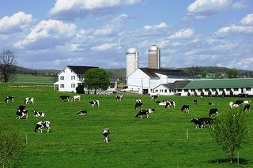
What’s Different?
Improved transparency, tracking & accountability
  Clearer goals, measurable numeric outcomes
  Partners set priorities & commit resources through management strategies
More flexible
  Use of adaptive management to adjust to changing conditions and circumstances
Strengthens Partnership
  Opportunity for headwaters to participate as full members
  Harmonizes the federal EO and TMDL and the Partnership Agreement
  Improves coordination, integration & collaboration among the partners
Notes:
Simplification
Goals are more clear (simpler) than those of C2K – therefore more understandable, measureable
Focus will be on higher priority goals and outcomes
Flexibility
Resource managers in each jurisdiction will be able to adapt their management strategies to better support their goals
This is not an “opt out” – it’s a sensible solution to the diverse ways that jurisdictions manage the equally diverse resources they have
Accountability
Annual reviews of partner management strategies and clear, simple goals on high priority issues will make it easier to track how efforts are going

Slide 4
Development Framework
ALL goals, outcomes and strategies derived from the CBP Goal Teams –
issue experts & stakeholders from across the jurisdictions / watershed.
GOAL
CBP’s Executive Council (EC)
to “agree” on overarching
GOALS & initial OUTCOMES
for the partnership
(This is the content of the new Watershed agreement)
OUTCOME
OUTCOME
CBP’s Principals’ Staff Committee (PSC) to track OUTCOMES ,
ensuring they are measureable & achievable; adapting as needed
OUTCOME
Mgmt
Strategy
Mgmt
Strategy
CBP’s Management Board (MB) to manage and track the STRATEGIES, adapting them as necessary over time for success
Mgmt
Strategy
Resource managers and decision makers will be guided by the strategies while retaining some flexibility to implement the practices that make the most sense for their region.
Notes:
New Watershed Agreement will include the overarching GOALS & initial OUTCOMES
Management strategies will be called for in the new watershed agreement – but not be drafted or finalized
There will be plenty of time for input on the development of these strategies

Slide 5
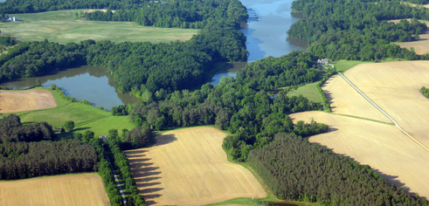
Management Strategy Elements
Elements
Outcome
Jurisdictions and agencies involved
Factors influencing ability to meet goal
Current efforts and gaps
Management Approach
Monitoring Progress
Assessing Progress
Adaptively Manage
GOAL
OUTCOME
Management
Strategy
Developed by GITs; built with stakeholder input
Approved by MB
Evaluated biennially
Progress tracked thru ChesapeakeStat

Slide 6
Development Bodies
Goal Teams – Goals and Outcomes
Editorial Board – Participatory language /Draft Agreement
Issues Resolution Committee – unresolved issues
MB and PSC – Set direction, recommend and approve language for including in new Agreement
Executive Council - Sign Final Agreement

Slide 7
Comments
Public, Partners
Comment Registry
MB
GITs
IRC
EB
Draft Agreement
MB/PSC
EC

Slide 8
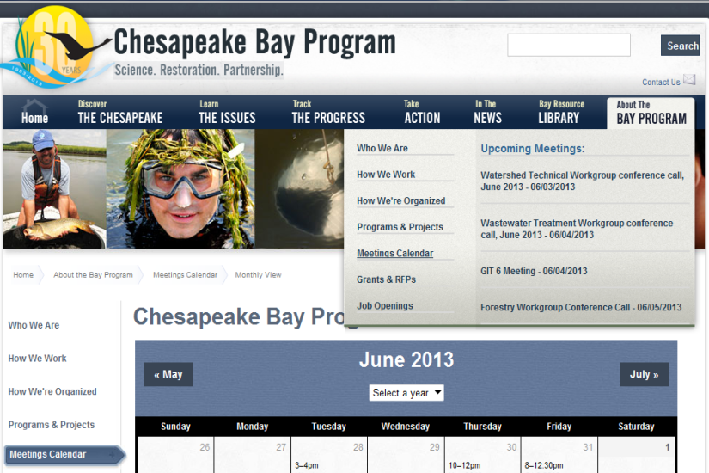
Development Timeline
  Management Board – 7/11
    - Stakeholder Input (2 hours)
  Management Board – 9/12
  PSC/FLCD – 9/17 or 18
  Draft issued for public comment period – 9/23 thru 10/23
  PSC/FLCD – 10/10
    2 hours set aside for public comments
  Revised Draft to PSC/FLCD for approval – 10/30
  MB/PSC/FLCD joint meeting – 11/6
  Final Agreement to EC – 11/15
  Executive Council Meeting and
  Agreement Signature (12/12)
  **All CBP meetings are open to the public
http://www.chesapeakebay.net/chesapeakebaywatershedagreement

Slide 9
Issues Resolution Committee
Issue | Resolution | Date Resolved
Conowingo Dam | Will not include in Agreement | 8/7/13
Fracking | Will not include in Agreement | 7/31/13
Climate Change | Will not include as a goal, will be addressed in management strategies | 7/31/13
Sound Land Use | Will not be a goal or outcome, but will be addressed in management strategies section
Toxic Contaminant Outcomes | Still under consideration
Local Leadership Goal | To be addressed by Management Board
Outcomes vs. Measuring Progress | Future agenda item
Data Management / Verification | recommend including in Preamble and intro to WQ section | 7/31/13
Management Strategies / Partner Participation | Future agenda item
Operational Commitments | Future agenda item
Communications / Outreach | Future agenda item
Social / Economic Indicators | Future agenda item
Independent Evaluation | Future agenda item

Slide 10
Public Comments on Initial Draft
July 11 - August 15 stakeholder input period
25 comments received on ChesapeakeBay.net during the public comment period
Also received 23 letters from organizations and individuals (posted online)
Second comment period on Full Draft in late September

Slide 11
Stakeholder Letters Received
Alliance for the Chesapeake Bay Albert H. Todd
West Virginia Rivers Coalition Angela Rosser
City of Lancaster J. Richard Gray
Choose Clean Water Coalition
Private Citizen Alyce Ortuzar
Trout Unlimited Kevin Anderson
Metropolitan Washington Council of Governments Penelope A. Gross
State Water Quality Advisory Committee Terry R. Matthews
Chesapeake Bay Foundation Kim Coble

Slide 12
Stakeholder Letters Received Con’t
Otsego County Soil and Water Conservation District Scott Fickbohm
Virginia Association of Municipal Wastewater Agencies Robert C. Steidel
Virginia Municipal Stormwater Association Randy Bartlett
Maryland Association of Municipal Wastewater Agencies Julie Pippel
Storm Water Association of Maryland Tim Whittie
Chesapeake Bay Trust Jana Davis
Mattawoman Watershed Society Jim Long
Virginia Institute of Marine Science Mark Luckenbach
American Rivers Liz Deardorff

Slide 13
Stakeholder Letters Received Con’t
Pennsylvania Farm Bureau John J. Bell
Sierra Club, Maryland Chapter Claudia Friedetzky
Susquehanna Greenway Partnership Trish Carothers
Environmental Defense Fund Matthew P. Mullin
The Nature Conservancy Mark Bryer

Slide 14
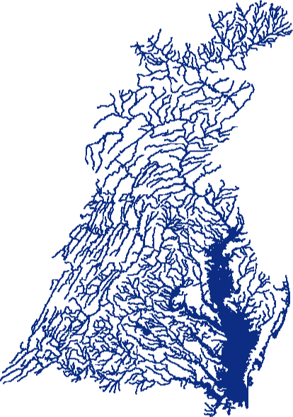
New Watershed Agreement in Summary
Forward looking agreement to address emerging challenges
Clearer goals and outcomes
Incorporates latest science and ecosystem management techniques
Better integration and coordination between CBP and EO goals for the Bay
Greater flexibility and improved accountability
Image courtesy Choose Clean Water Coalition

