Slide 1
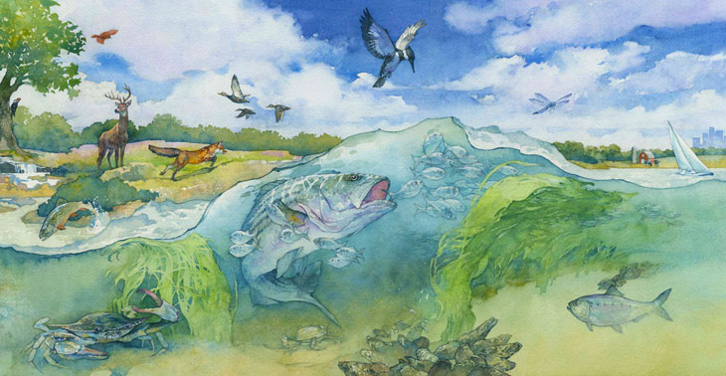

The Bay’s Health & Future: How it’s doing and What’s Next
The Chesapeake Bay Watershed Agreement Management Strategies
James Edward, Deputy Director
Chesapeake Bay Program Office
U.S. Environmental Protection Agency
November 20, 2014
Notes:
Today I will quickly talk about management strategies – the key elements and the process
Feel free to interrupt as I go to ask any questions

Slide 2
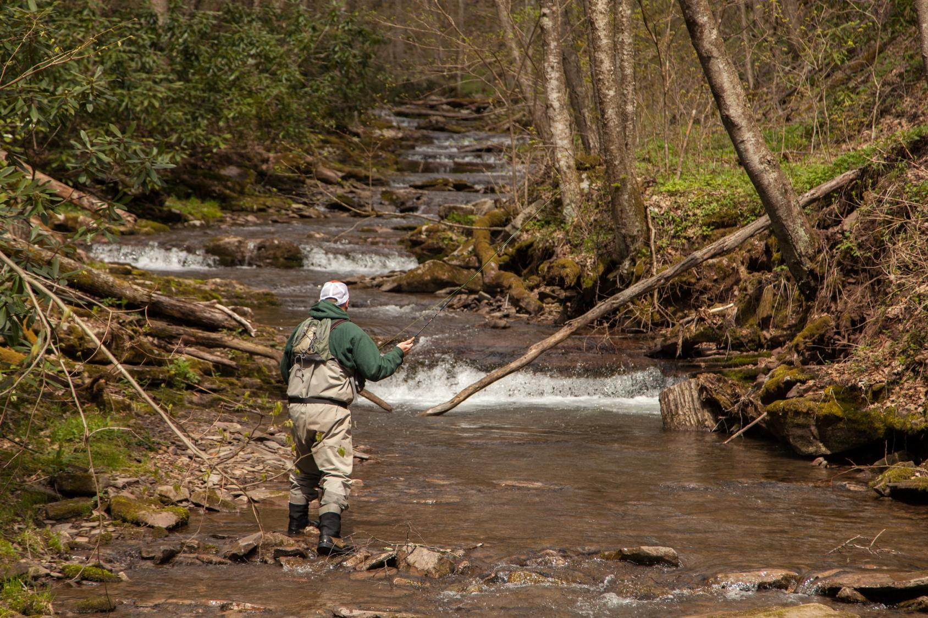
What’s different?
Clarity
Clearer goals and more well - defined outcomes than previous agreements
Flexibility
Allow us to adapt our thinking and management decisions to adjust to changing conditions and circumstances
Transparency & Accountability
Partners set priorities & commit resources through management strategies
Notes:
What the Agreement provides:
Simplification/Clarity
Goals are more clear (simpler) than those of C2K – therefore more understandable, measureable
Focus will be on higher priority goals and outcomes
Flexibility
Resource managers in each jurisdiction will be able to adapt their management strategies to better support their goals
This is not an “opt out” – it’s a sensible solution to the diverse ways that jurisdictions manage the equally diverse resources they have
Accountability
Annual reviews of partner management strategies and clear, simple goals on high priority issues will make it easier to track how efforts are going
Inclusiveness

Slide 3
How partners are working. . .
Vision
Principles
GOALS
CBP’s Executive Council (EC) agreed to
Watershed Agreement
GOALS & initial OUTCOMES
OUTCOME
OUTCOME
CBP’s Principals’ Staff Committee (PSC) tracks OUTCOMES ,
ensuring they are measureable & achievable; adapting as needed
OUTCOME
Mgmt.
Strategy
CBP’s Management Board (MB) to manage and track the STRATEGIES, adapting them as necessary over time for success
Mgmt.
Strategy
Mgmt.
Strategy
Notes:
The design of the new Watershed Agreement was to provide a balance between commitment to a particular goal or action and the flexibility required for adaptive management – to learn while you grow
The highest level of commitment, and the hardest to change, are the vision, the principles, the goals and outcomes, and the commitment to the process for establishing and implementing management strategies
New Watershed Agreement includes the overarching GOALS & initial OUTCOMES
Management strategies called for in the new watershed agreement – but not be drafted or finalized
Time is now, and over next 6-8 mos., for input on the development of these strategies
Management strategies will guide the work and will also allow some flexibility to implement the practices that make the most sense for each portion of the watershed.

Slide 4
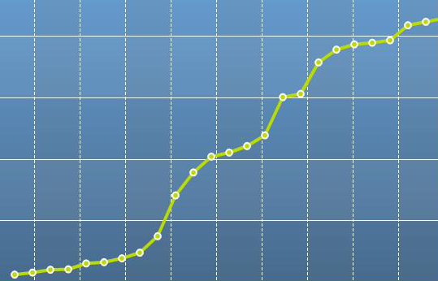
Our Plan:
Work toward
10 interrelated goals and 29 measurable, time-bound outcomes that will create a healthy watershed.
Goals articulate the high level aspects of the partners’ vision
Outcomes express specific, time-bound, measureable targets that directly contribute to achieving each goal.

Slide 5
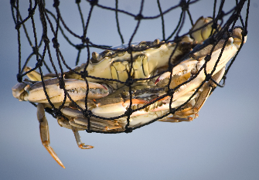
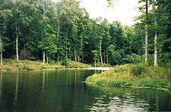
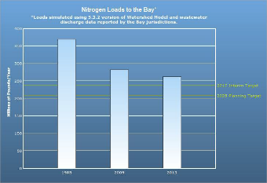
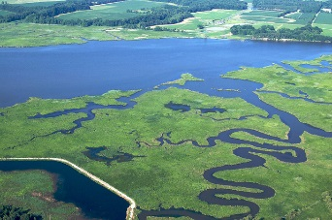
Goals and Outcomes
Sustainable Fisheries Goal Blue Crab Abundance Outcome Blue Crab Management Outcome Oyster Outcome Forage Fish Outcome Fish Habitat Outcome | Vital Habitat Goal Wetlands Outcome Black Duck Stream Health Outcome Brook Trout Fish Passage Outcome SAV Outcome Forest Buffer Outcome Tree Canopy Outcome
Water Quality Goal 2017 WIP Outcome 2025 WIP Outcome Water Quality Standards Attainment and Monitoring Outcome | Toxic Contaminants Goal Toxic Contaminant Research Outcome Toxic Contaminant Policy and Prevention Outcome
Healthy Watersheds Goal Healthy Watersheds Outcome | Stewardship Goal Citizen Stewardship Outcome Local Leadership Outcome Diversity Outcome
Notes:
Specific
Measurable
Attainable
Realistic
Timely

Slide 6
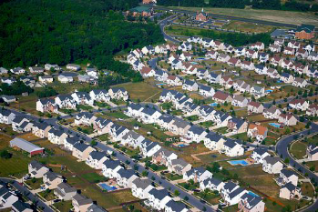
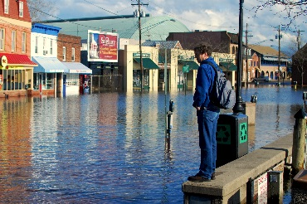
Goals and Outcomes
Land Conservation Goal Protected Lands Outcome Land Use Methods and Metrics Development Outcome Land Use Options Evaluation Outcome | Public Access Goal Public Access Site Development Outcome
Environmental Literacy Student Outcome Sustainable Schools Outcome Environmental Literacy Planning Outcome | Climate Resiliency Monitoring and Assessment Outcome Adaptation Outcome

Slide 7
What’s Next?
Management strategy –
A single document that summarizes the Partnership’s management process and the collective thinking for each outcome or related group of outcomes.

Slide 8
Key Elements of Management Strategies
Executive Summary Outcomes and Baselines Jurisdictions and agencies participating in the strategy Local engagement Factors influencing ability to meet the goal/outcome Current efforts and gaps Actions, tools or technical support needed to empower local government and others | Management Approach Local engagement Monitoring Progress Assessing Progress Adaptively Manage Biennial Workplan A summary of specific commitments, actions and resources each signatory and stakeholder will do to reach the two-year target for an outcome
Notes:
Each management strategy will address the same elements, using a framework based on adaptive management that the PSC originally approved at their May 10, 2011 meeting, adding a couple of key elements to that framework to make it a complete management strategy
This is to allow for a strategy that can be evaluated based on adaptive management principles.
Process to identify factors and rank them by importance (this should be done with whatever amount of science and info is available to you at the time and revise through adaptive management as more is learned) (STAC assistance)
Those key factors that can be managed through the GIT/workgroup or through one or more members of the GIT/workgroup
Those key factors that can be managed by another GIT/workgroup within the Partnership
Those key factors that can’t easily be managed
Current efforts and gaps – what is already happening, and what needs to happen to address the factors, including at the local level for those outcomes that require implementation at the local level to achieve the outcome
Monitoring Progress
Action tracking – Are we taking the actions we agreed to take
Environmental monitoring and tracking (are we on target to meet our outcome)
Assessing progress
Assessing whether actions taken were what we agreed to take
Identifying timeframe one would expect to see changes in environmental conditions based on those actions taken
Ensuring we are on track to taking the actions, and that we were right about the expected changes to environmental conditions

Slide 9
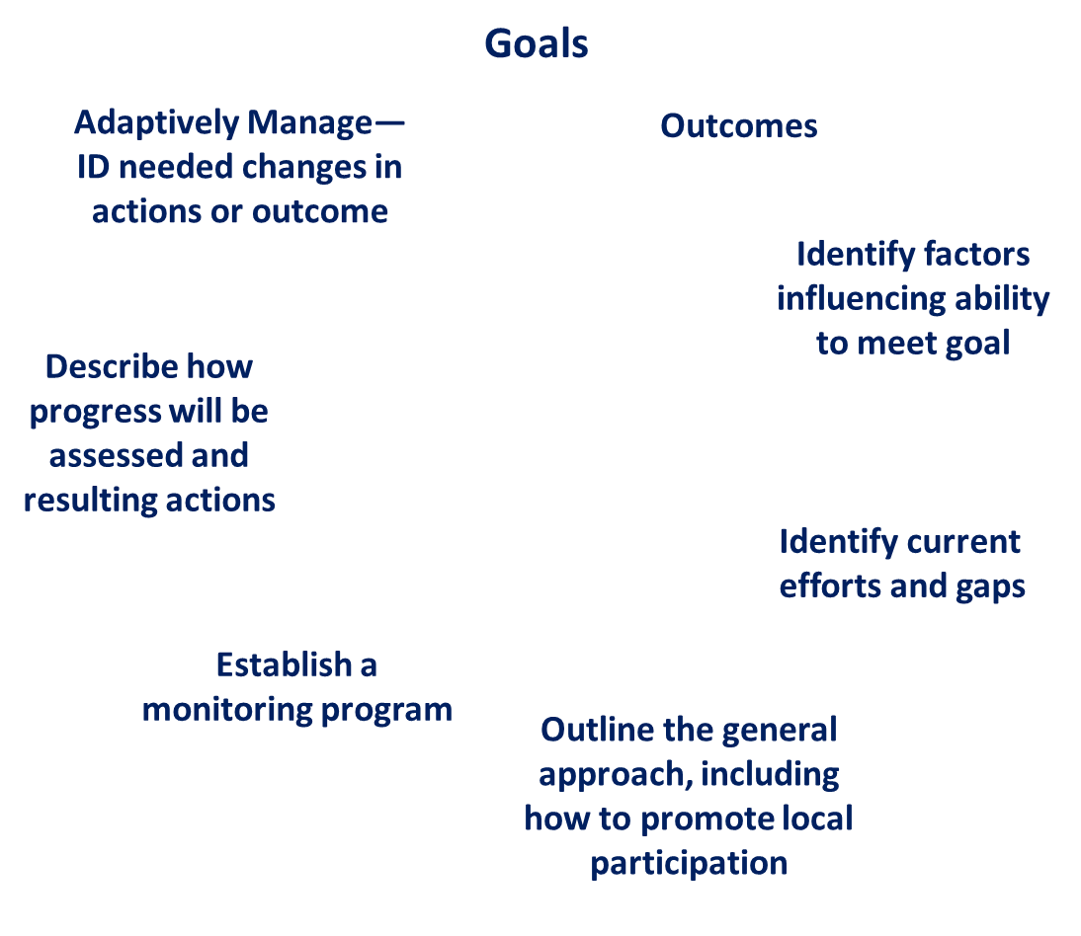

Management Strategy Framework
2 Year Workplan

Slide 10
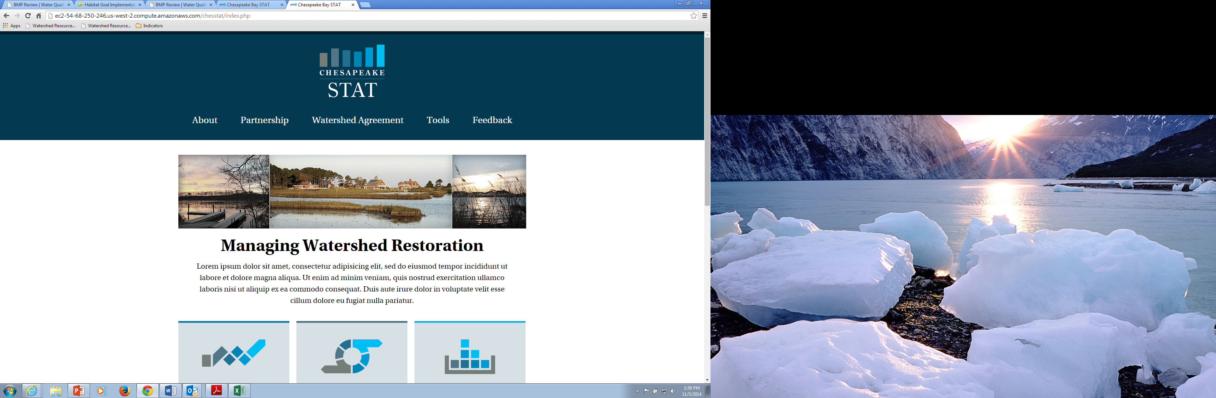
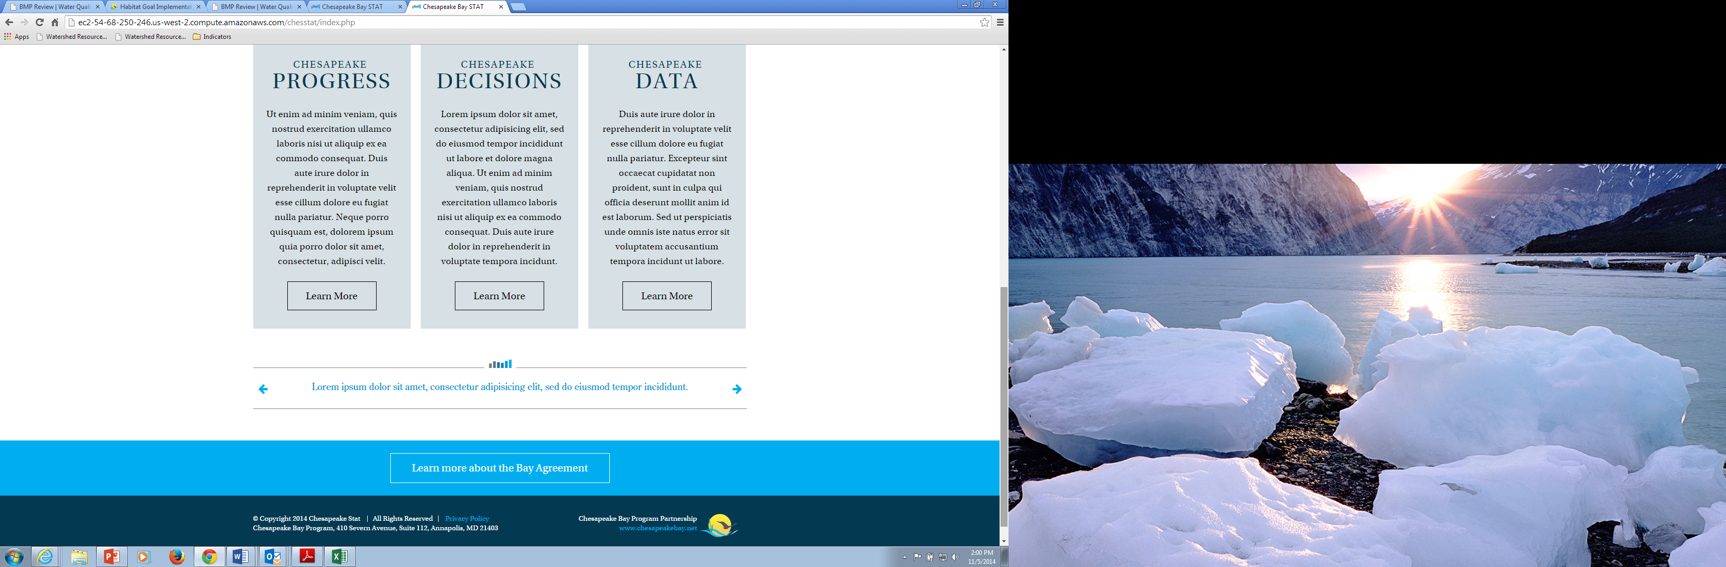
Assessing Progress
Action 1 – (VA)
Action 2 – (DE)
Action 3 – (GIT)

Slide 11
Adapting
Monitoring progress on actions/outcomes
Assessing that progress (every 2 years)
Determine if changes need to be made
to actions we are taking or
to assumptions related to condition response
Will know whether any issue in making progress is the likely result of
Actions not taken
Actions taken but expected outcome response not seen
Notes:
Determine if changes need to be made to either the actions we are taking or if the actions taken are not getting expected environmental results, go back to assumptions related to the importance of each of the factors influencing the ability to meet the goal

Slide 13
Process for Developing the Management Strategies
GIT funding for MS development and metric development
1st stage – Gathering the Players
Assigned to GIT/workgroup/Action Team (screen shot of org chart) – each with a chair, a coordinator, and a staffer.
Letter from Secretary Gill as PSC Chair
GIT expertise on identifying stakeholders
Web process for self-identified stakeholders

Slide 14
Who is developing management strategies?
Chesapeake Executive Council
Principals’ Staff Committee
Citizens’ Advisory
Committee
Local Government
Advisory Committee
Scientific & Technical
Advisory Committee
Management
Board
Action Teams
Communications
Workgroup
Science,
Technical Analysis,
and Reporting
Goal Implementation Teams
Sustainable
Fisheries
Protect &
Restore
Vital Habitats
Protect &
Restore Water
Quality
Maintain
Healthy
Watersheds
Foster
Stewardship
Enhance
Partnering,
Leadership
& Management
Workgroups
Stakeholders
Notes:
14
our Goal Teams – ea. one comprised of experts and stakeholders from across the w’shed—are the drivers for meeting the outcomes and developing the plans to get there – the management strategies.
For some of our newer outcomes, we have other groups – Action Teams – tackling the challenge.
Over 500 people are represented in our org chart

Slide 15
CBP Structure and Outcome Lead Placement 9-15-14
Goal Implementation Teams
Science Technical
Analysis and
Reporting
Sustainable
Fisheries
Protect & Restore
Vital Habitats
Protect & Restore Water Quality
(2017 WIP, 2025 WIP,
WQ Standards Attachment and Monitoring Outcomes)
Maintain Healthy
Watersheds
(Healthy Waters,
**Land Use Methods & Metrics Development, Land Use Options Evaluation Outcomes)
Foster
Chesapeake
Stewardship
Enhance
Partnering,
Leadership
& Management
Tidal Monitoring and Analysis Workgroup
Indicators Workgroup
Ches. Bay
Stock Assessment Committee
(Blue Crab Abundance, Blue Crab Management Outcomes)
Fish Passage Workgroup (Fish Passage Outcome)
Agriculture Workgroup
Tracking Workgroup
Education Workgroup (Student, Sustainable Schools, Environmental Literacy Planning Outcomes)
Decision Framework Implementation Workgroup
Modeling Workgroup
Forestry Workgroup (Forest Buffer, Tree Canopy Outcomes)
Local Engagement Workgroup
Evaluator Function Workgroup
Nontidal Water Quality Workgroup
Stream Health Workgroup (Stream Health, Brook Trout Outcomes)
**Land Use Workgroup
Public Access Planning Action Team (Public Access Site Development Outcome)
Local Leadership Workgroup (Local Leadership Outcome)
Analytical Methods & Quality Assurance Workgroup
Maryland and Virginia Interagency Oyster Teams
(Oyster Outcome)
Urban Stormwater Workgroup
Submerged Aquatic Vegetation Workgroup (SAV Outcome)
Wastewater Treatment Workgroup
Criteria Assessment Protocol Workgroup
Invasive Catfish Task Force
Wetland Workgroup (Wetlands, Black Duck Outcomes)
Land Conservation Action Team (Protected Lands Outcome)
Watershed Technical Workgroup
Building and Sustaining Integrated Networks (BASIN)
Fish Habitat Action Team
(Fish Habitat Outcome)
Milestone Workgroup
Citizen Stewardship Workgroup (Citizen Stewardship Outcome)
Climate Change Workgroup (Monitoring and Assessing, Adaptation Outcomes)
Trading and Offsets Workgroup
Forage Fish Action Team
(Forage Fish Outcome)
BMP Verification Committee
Toxics Contaminants Workgroup (Toxic Contaminants Research, Toxic Contaminants Policy and Prevention Outcomes)
Reports to MB
Diversity Action Team (Diversity Outcome)
**GIT4 to lead the Land Use Methods and Metrics MS with the assistance of the GIT3 Land Use Wkgrp.
= new workgroup/action team
Notes:
All Outcomes are in red font.
Red boxes indicate that a new workgroup/action team will be created.

Slide 16
Cross-team Collaboration and Multiple Benefits
Goal Implementation Teams
Sustainable Fisheries
Vital Habitats
Water Quality
Healthy Watersheds
MD & VA Interagency Oyster Teams
(Oyster Outcome)
Submerged Aquatic Vegetation Workgroup
Land Use Workgroup
Local Engagement Workgroup
Workplan
Management Strategy:
Oyster
Outcome

Slide 17
Outcome | Participating Jurisdictions/CBC | Participating Agencies
Sustainable Fisheries Goal
Blue Crab Abundance | MD, VA, CBC | NOAA
Blue Crab Management | MD, VA, CBC | NOAA
Oyster | MD, VA, CBC | NOAA, USACE, FWS
Forage Fish | MD, VA, DC, PA, CBC | NOAA,FWS
Fish Habitat | MD, VA, DC, DE, PA, NY, CBC | NOAA, DOI (FWS/USGS), USACE, NRCS
Vital Habitats Goal
Wetlands | MD, DC, DE, PA, VA, NY, CBC | DOI (FWS/USGS), NOAA, EPA, USACE, NRCS
Black Duck | MD, DC, DE, VA, NY, CBC | DOI (FWS/USGS), USACE, NRCS
Stream Health | MD, DC, PA, VA, NY, DE, CBC, | DOI (FWS/USGS), EPA, USACE, NPS, NRCS
Brook Trout | MD, PA, VA, NY, CBC | DOI (FWS/USGS), NPS, FS, USACE, NRCS
Fish Passage | MD, PA, VA, CBC | FWS, NOAA, USGS, USACE
Submerged Aquatic Vegetation | MD, DC, VA, CBC | FWS, EPA, USGS, USACE
Forest Buffer | MD, DC, DE, PA, VA, WV, NY, CBC | FS, EPA, FWS, NPS, NRCS, USACE, DoD
Tree Canopy | MD, DC, DE, PA, VA, WV, NY, CBC | FS, NPS, DoD
Water Quality Goal
2017 Watershed Implementation Plans | MD, DC, DE, PA, VA, WV, NY, CBC | EPA, DHS, USACE, NRCS, DoD
2025 WIP | MD, DC, DE, PA, VA, WV, NY, CBC | EPA, DHS, USACE, NRCS, DoD
Water Quality Standards Attainment and Monitoring | MD, DC, DE, PA, VA, WV, NY, CBC | EPA, USGS
Toxic Contaminants Goal
Toxic Contaminant Research | MD, DC, DE, PA, VA, WV, CBC | DOI (USGS/FWS), EPA, DHS
Toxic Contaminant Policy and Prevention | MD, DC, DE, PA, VA, WV, NY, CBC | EPA, NOAA, DHS, FWS
Healthy Watersheds Goal
Healthy Watersheds Outcome | MD, DC, DE, PA, VA, WV, NY, CBC | EPA, DOI (USGS/FWS), NOAA, EPA, FS, USACE
Stewardship Goal
Citizen Stewardship | MD, DC, DE, PA, VA, CBC | NPS, NOAA, EPA, NPS, FWS
Local Leadership | MD, DC, DE, PA, VA, CBC | EPA, NOAA, EPA, USACE, NRCS, FWS
Diversity | MD, DC, DE, PA, VA, CBC | EPA, DOI, NOAA, NRCS
Land Conservation Goal
Protected Lands | MD, DC, DE, PA, VA, NY, CBC | NPS, EPA, DOT, USGS, DoD, FS, NRCS, FWS
Land Use Methods and Metrics Development | MD, DC, DE, PA, VA, CBC | USGS, EPA, FWS
Land Use Options Evaluation | MD, DC, DE, PA, VA, CBC | EPA, USGS, NRCS, FWS
Public Access Goal
Public Access Site Development | MD, DC, DE, PA, VA, NY, CBC | NPS, FWS
Environmental Literacy
Student | MD, DC, DE, PA, VA, CBC | NOAA, DOI (FWS/NPS/USGS), EPA, FS
Sustainable Schools | MD, DC, DE, PA, VA, CBC | NOAA, EPA
Environmental Literacy Planning | MD, DC, DE, PA, VA, CBC | NOAA, NPS, EPA
Climate Resiliency Goal
Monitoring and Assessment Outcome | MD, DC, DE, PA, VA, CBC | DOI (USGS/FWS), NOAA, EPA, NPS, USACE
Adaptation | MD, DC, DE, PA, VA, NY, CBC | USACE, NOAA, FWS, EPA, DOT, DOI (FWS/NPS/USGS)
Participation in Management Strategy
Development –
Signatory Reps

Slide 18
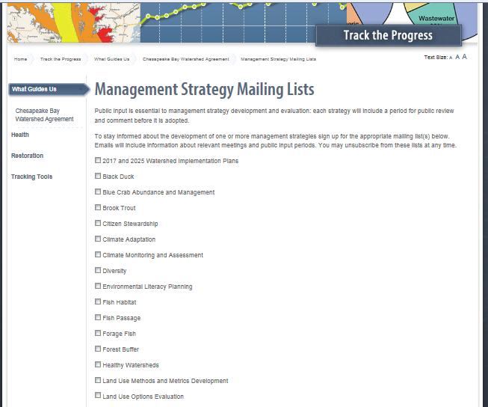
Participation in Management Strategy Development –
Self-Identified Stakeholders

Slide 19
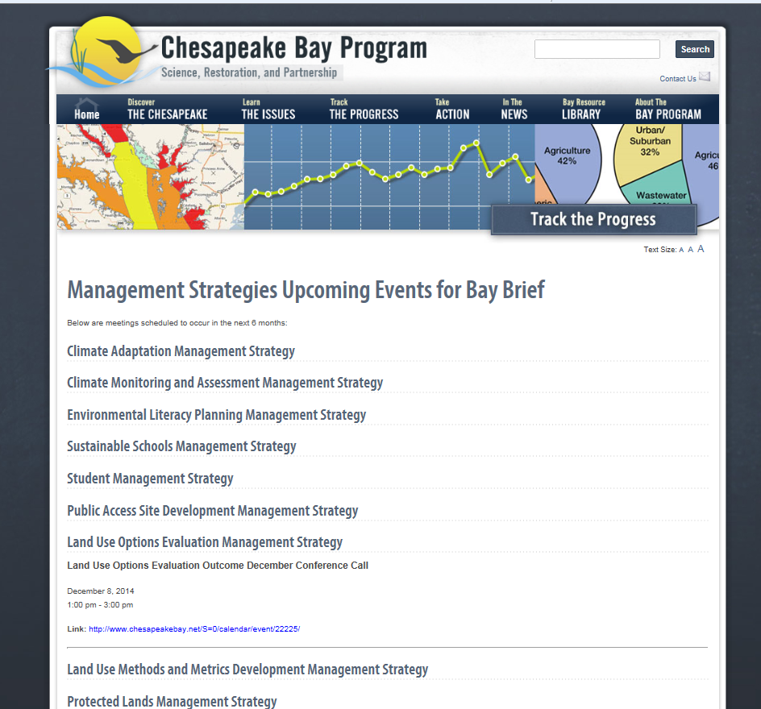
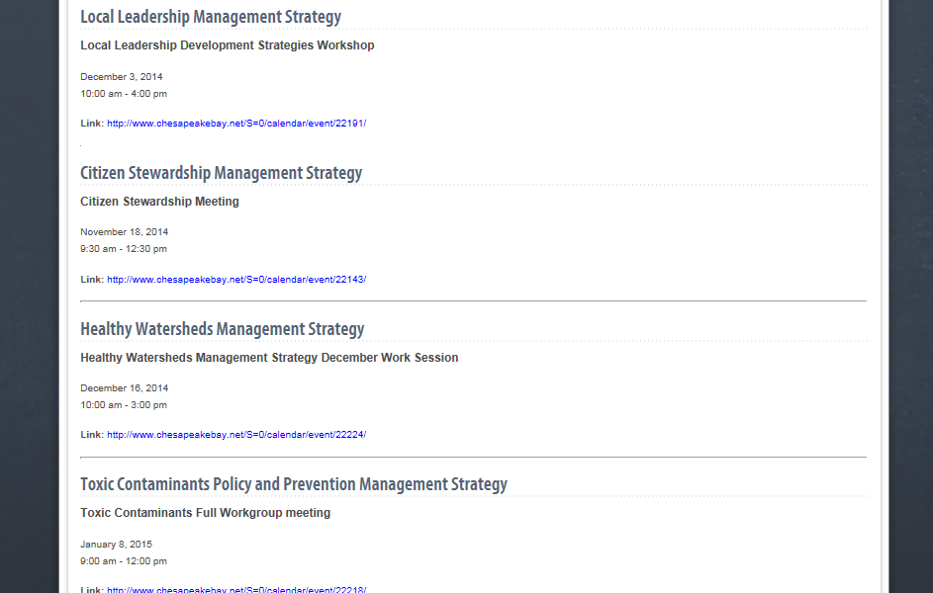
Management Strategy
Meetings Calendar
https://www.chesapeakebay.net/
managementstrategies/baybriefmeetings

Slide 20
Process for Developing the Management Strategies
2nd stage – Research/information collection - Each is slightly different.
Where there is a lot of history with a particular outcome in the CBP partnership, often use more traditional established workgroups to get the work done (e.g. SAV)
Where the MS requires more investment from stakeholders traditionally outside the CBP partnership (diversity, local leadership), more research and investment in up front understanding may be necessary (focus groups, workshops, etc)
3rd stage – Writing – Who holds the pen? Who is involved?
4th stage – Review – MB/public
5th stage – Edit/improve/release “finalize”

Slide 21
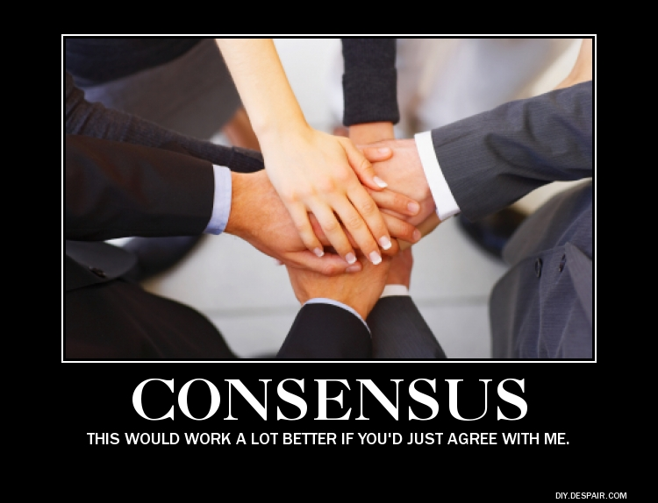

Decision-Making Process
OR, after substantial negotiations consensus can not be reached…

Slide 22
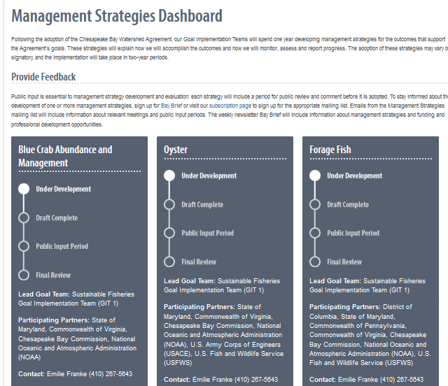
Tracking Progress
chesapeakebay.net/ managementstrategies
Notes:
Progress updates for generally interested stakeholders is available on the web site now

Slide 23
Notes:
Progress for the Management Board and the PSC is updated by the GITs prior to PSC meetings
Green – Complete / Partially Complete ; Yellow – Approaching deadline, not expected to be complete in time ; White – Not started ; Red – Not complete and deadline passed.

Slide 24


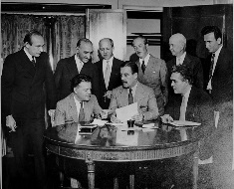
Review and Adoption
Notes:
GITs deliver to Management Board
Management Board Reviews for Completeness
PSC accepts MS and reports to EC at June 2015 meeting
MS are reviewed by GITs biennially, Workplan is updated and changes to overall management strategy or even outcome are identified, particularly as it relates to changing environmental or economic conditions
Considered living documents and development is an ongoing process

Slide 25

Learn more at
www.chesapeakebay.net/
watershedagreement
Join the discussions at
www.chesapeakebay.net/ managementstrategies

