Slide 1
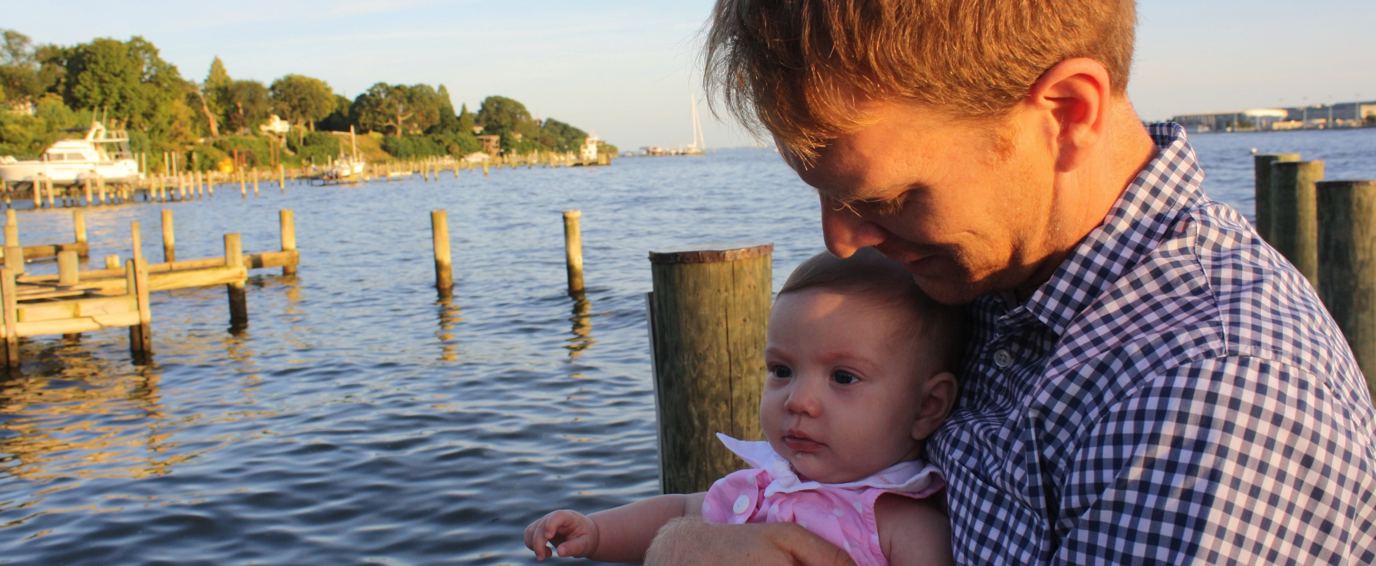

Slide 2
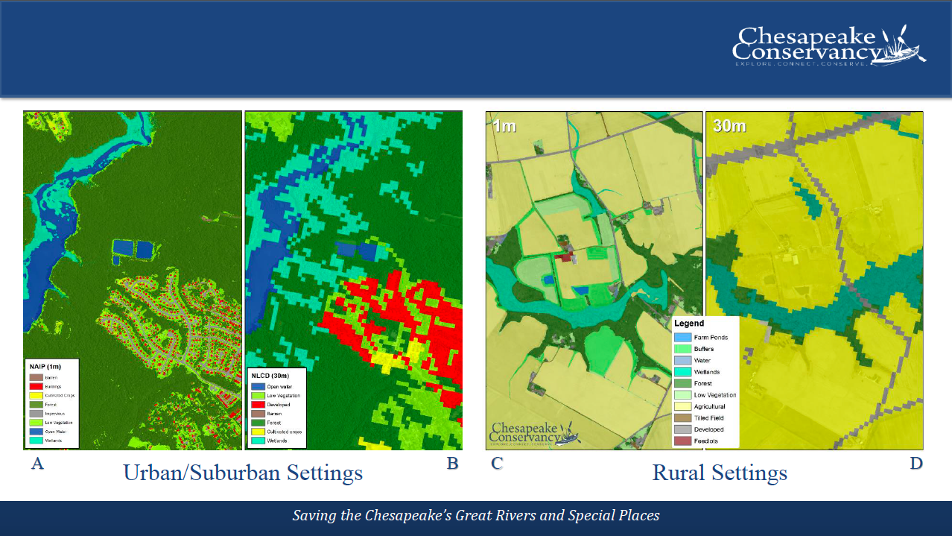

Slide 3
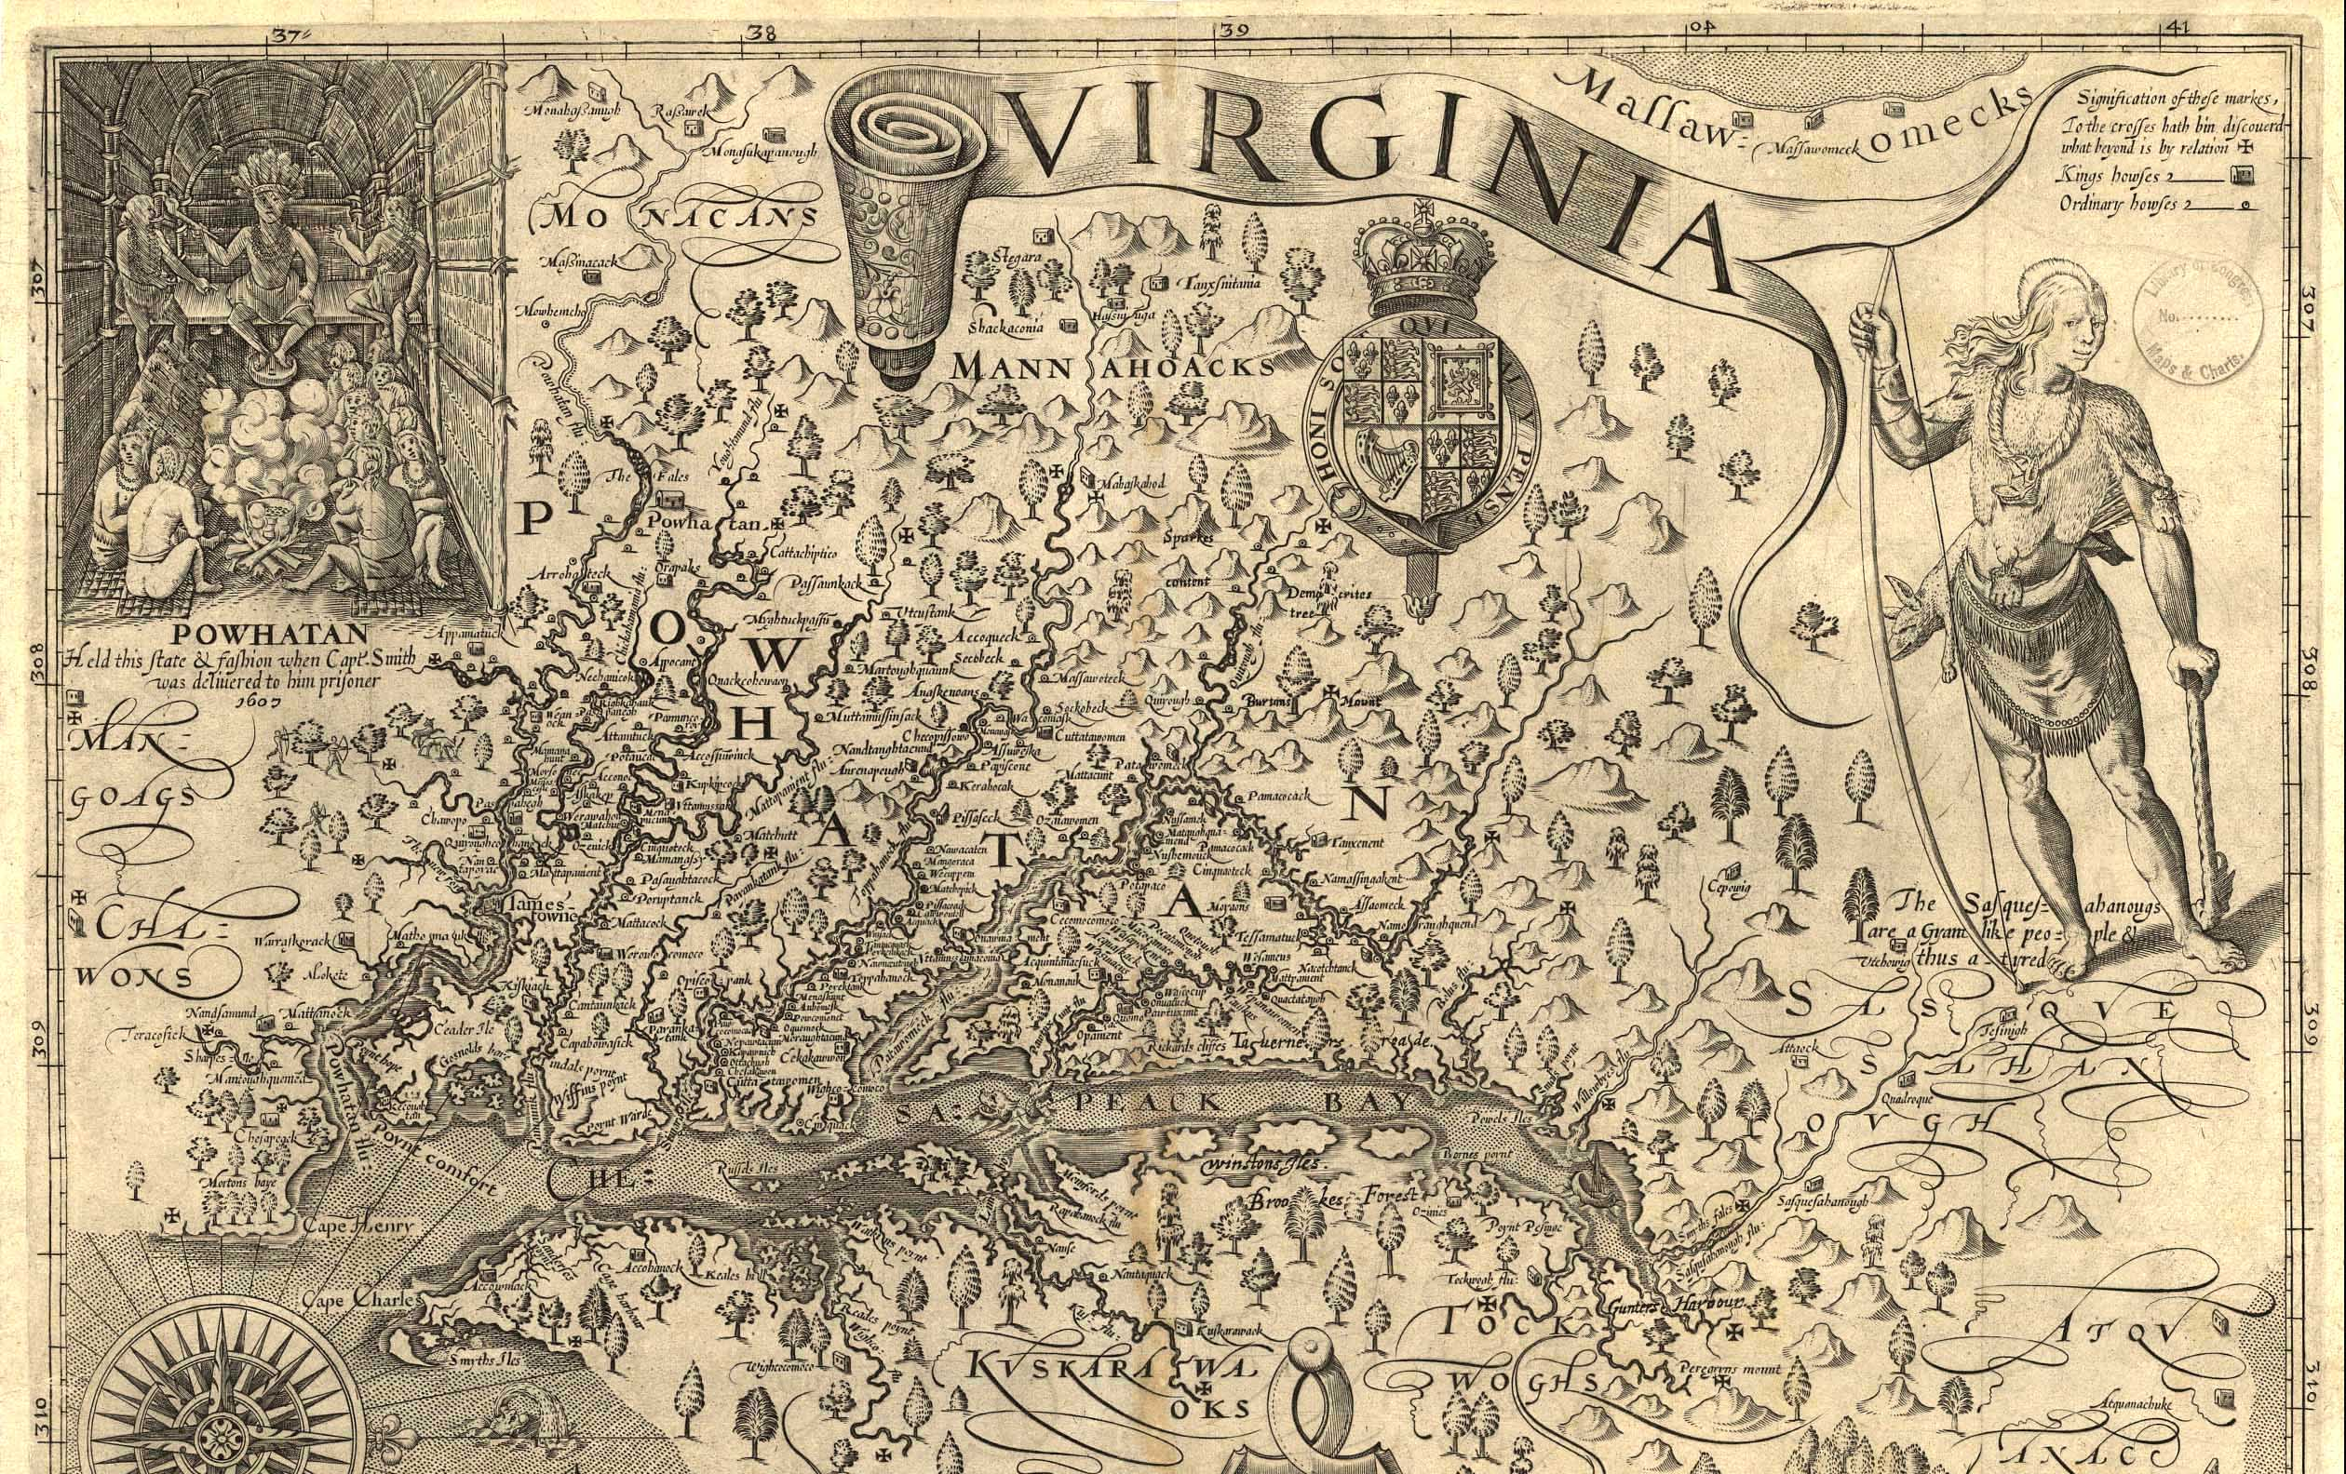
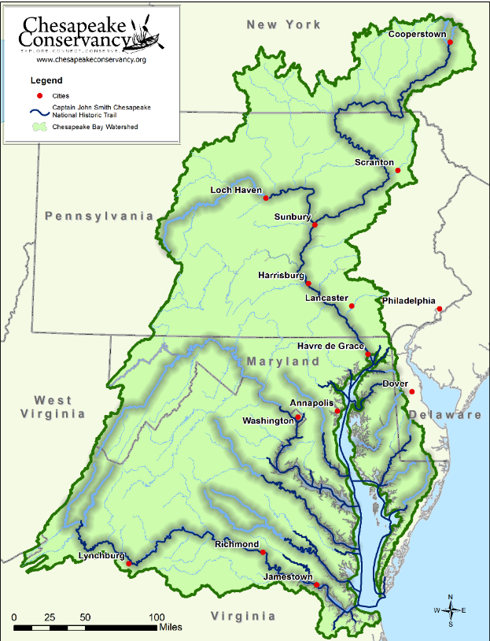

Community-Based Conservation
Conservation and Access along the John Smith Trail

Slide 4
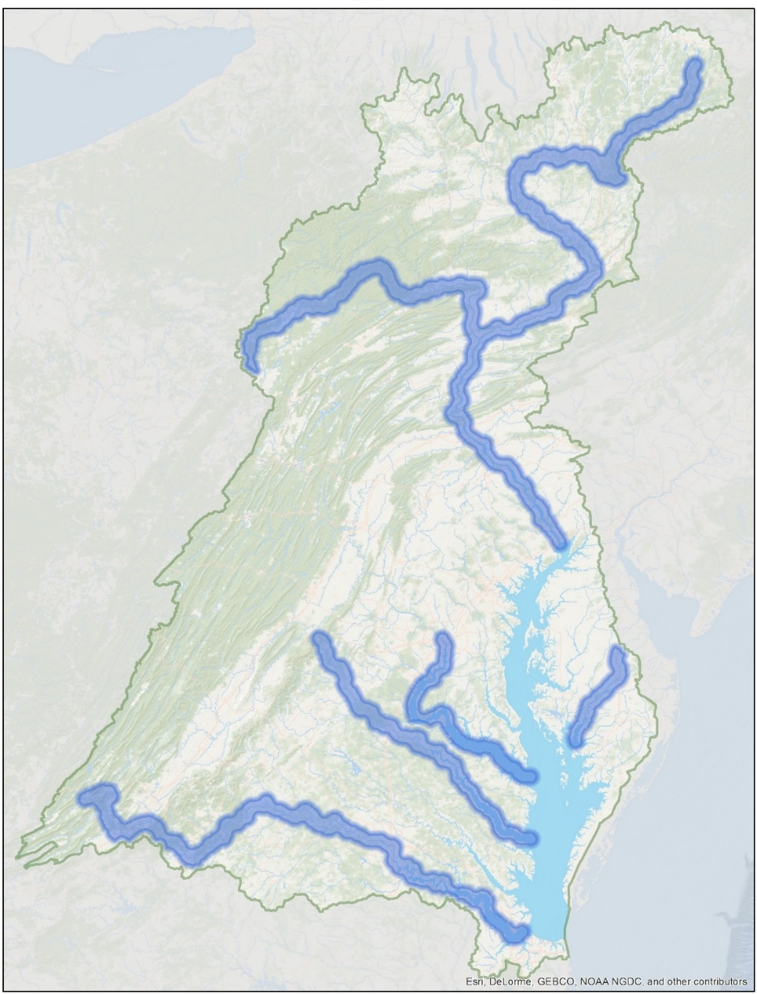
Trail Development Strategy
Great Rivers of the Chesapeake Corridor Conservation Planning
Envision the James
Envision the Susquehanna
Nanticoke Conservation Corridor
Potomac River Segment Plan
Rappahannock River Access Corridor

Slide 5
River Corridor Planning Process
Captain John Smith Chesapeake National Historic Trail
Partnership Development
1
6
Public Engagement
Envision the James
Evaluation/ Next Steps
2
Funding
Envision the Susquehanna
Political Influence
Communications
Nanticoke River Initiative
Implementation
3
5
Data & Services
Community Priority Setting
Potomac River Segment Plan
Envision the Choptank
Identifying Project Opportunities
4

Slide 6


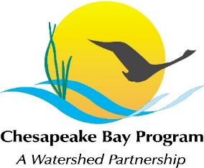


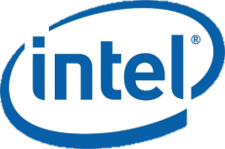







Partnership Development
Partnership Development
Evaluation/ Next Steps
Public Engagement
Funding
Political Influence
Communications
Implementation
Data & Services
Community Priority Setting
Identifying Project Opportunities

Slide 7

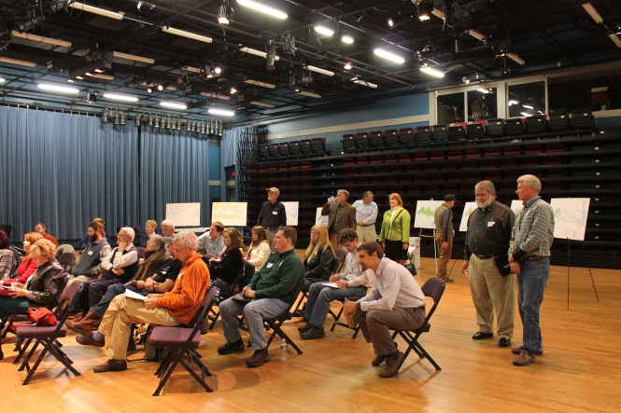

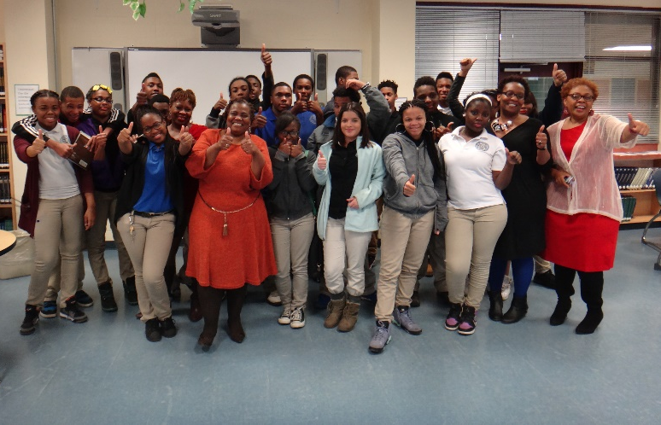
Public Engagement
Partnership Development
Evaluation/ Next Steps
Public Engagement
Funding
Political Influence
Communications
Implementation
Data & Services
Community Priority Setting
Identifying Project Opportunities

Slide 8
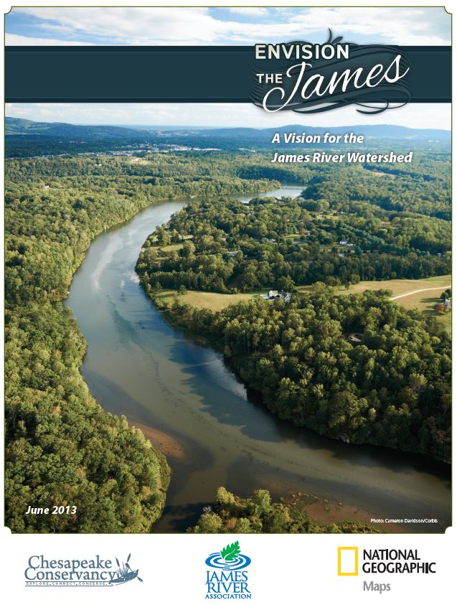
Priority Setting
Partnership Development
Evaluation/ Next Steps
Public Engagement
Funding
Political Influence
Communications
Implementation
Data & Services
Community Priority Setting
Identifying Project Opportunities

Slide 9
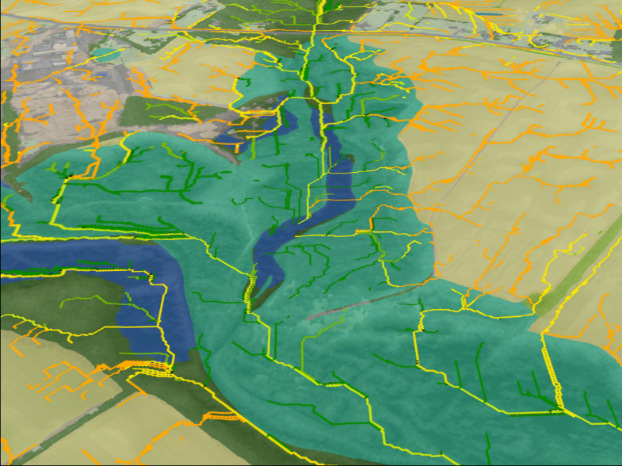
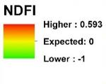
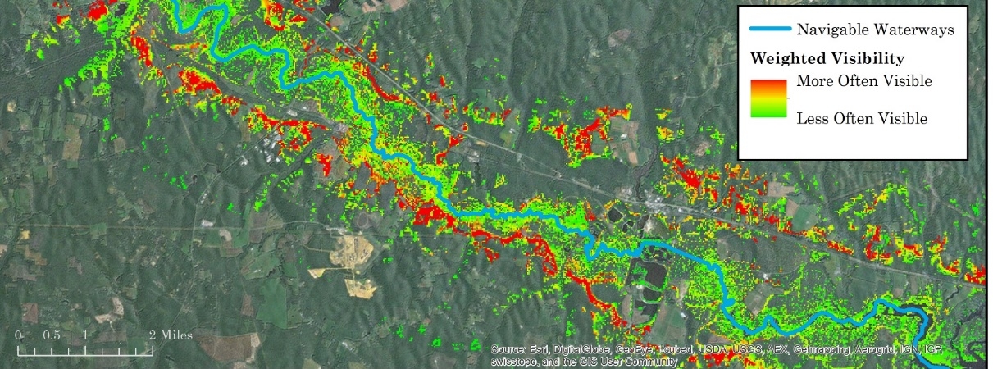
Identifying Opportunities
Partnership Development
Evaluation/ Next Steps
Public Engagement
Funding
Political Influence
Communications
Implementation
Data & Services
Community Priority Setting
Identifying Project Opportunities

Slide 10
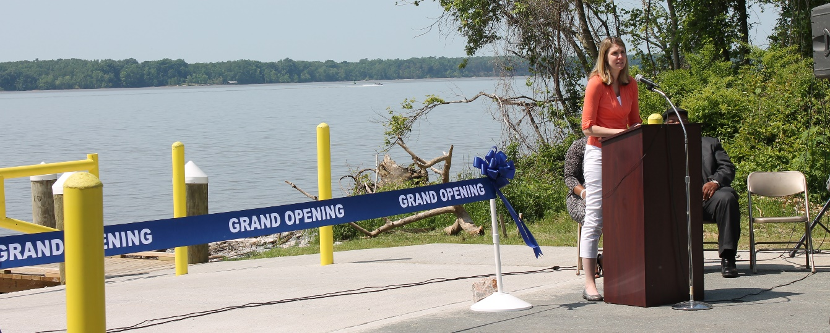
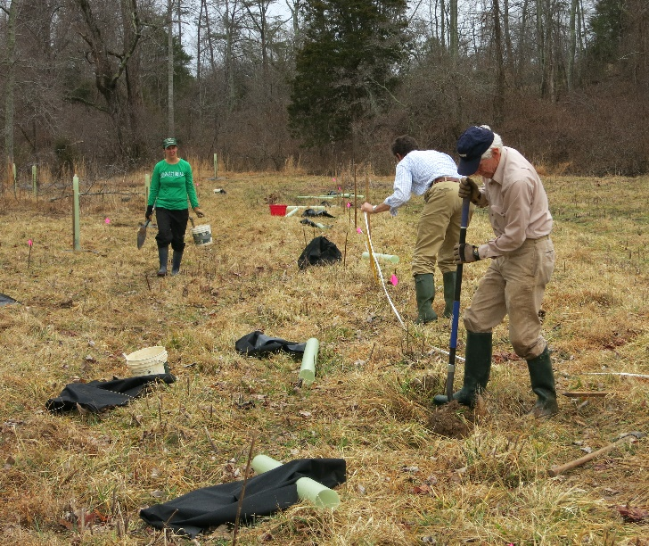
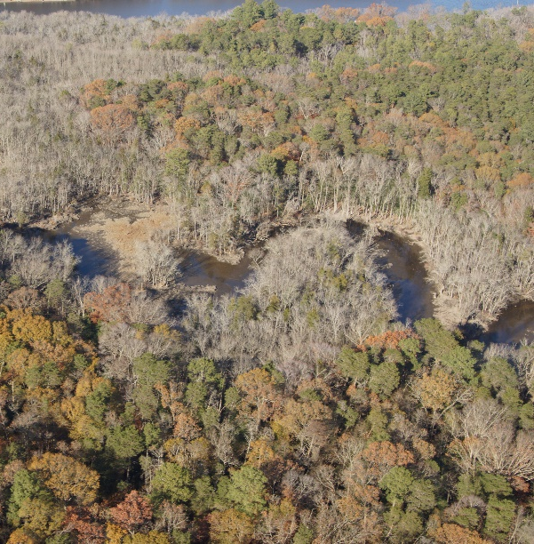
Implementation
Partnership Development
Evaluation/ Next Steps
Public Engagement
Funding
Political Influence
Communications
Implementation
Data & Services
Community Priority Setting
Identifying Project Opportunities

Slide 11
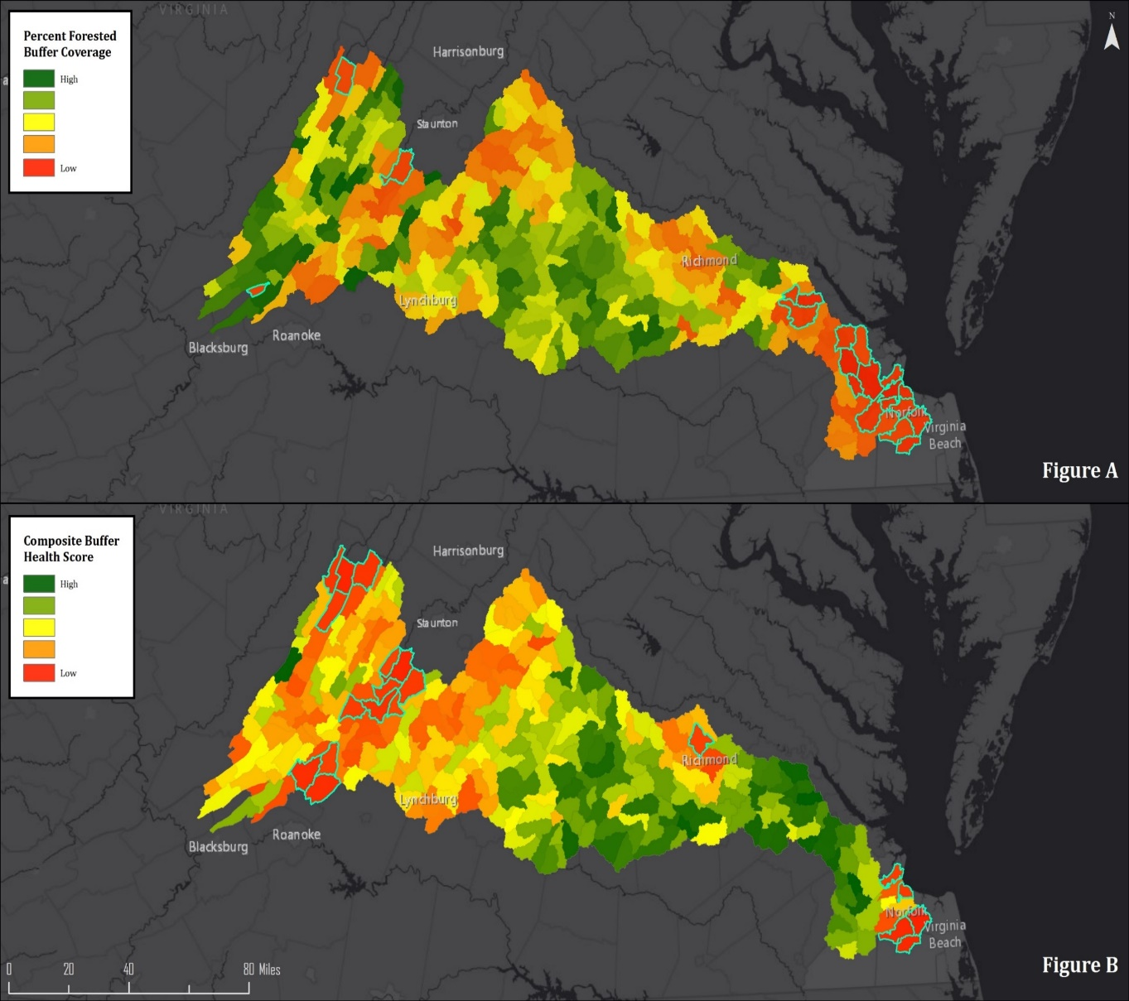
Evaluating/Next Steps
Partnership Development
Evaluation/ Next Steps
Public Engagement
Funding
Political Influence
Communications
Implementation
Data & Services
Community Priority Setting
Identifying Project Opportunities

Slide 12
Funding & Political Influence
Partnership Development
State and Federal
Evaluation/ Next Steps
Public Engagement
Funding
Foundation
Corporate and Individual
Political Influence
Communications
Implementation
Data & Services
Community Priority Setting
Identifying Project Opportunities

Slide 13
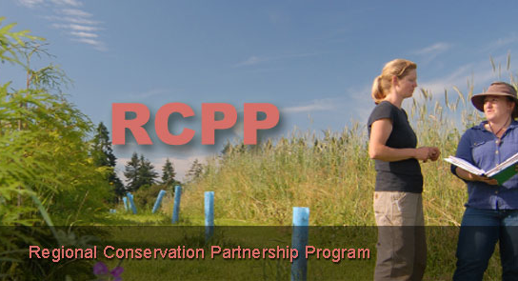
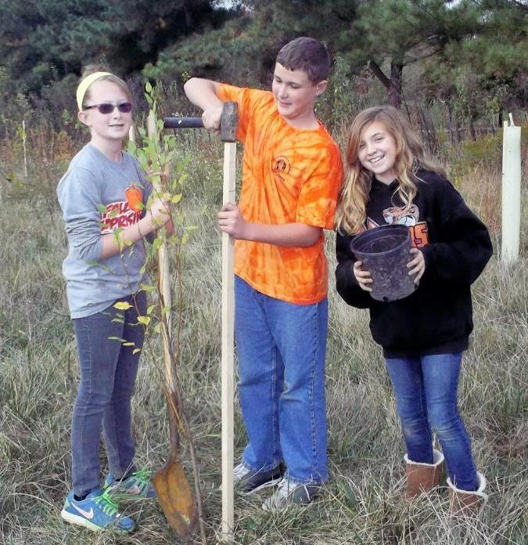

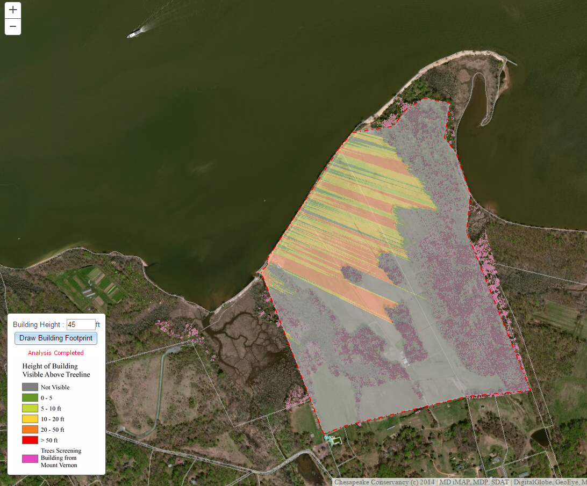
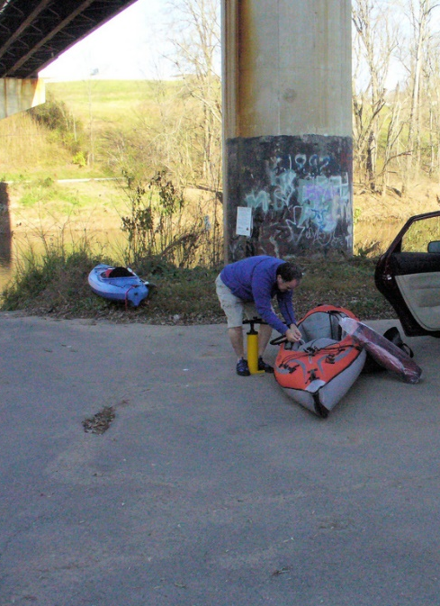
Funding & Data/Services
Partnership Development
Evaluation/ Next Steps
Public Engagement
Funding
Political Influence
Communications
Implementation
Data & Services
Community Priority Setting
Identifying Project Opportunities
Tom Coleman/Flickr CC

Slide 14
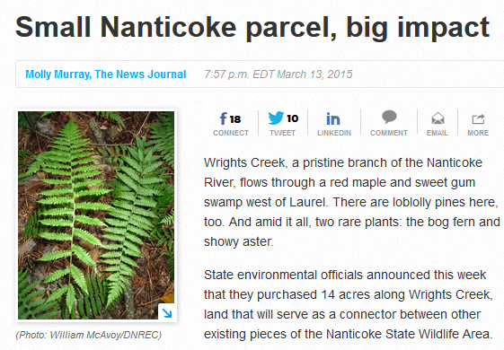

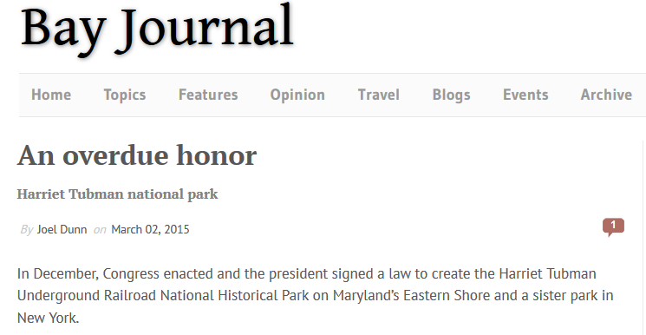
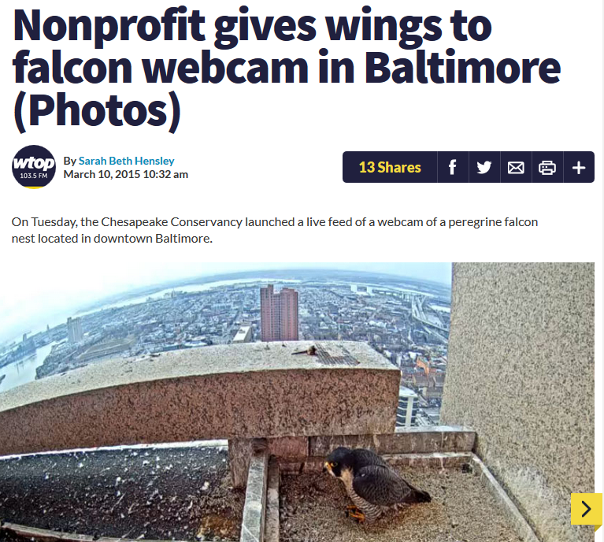
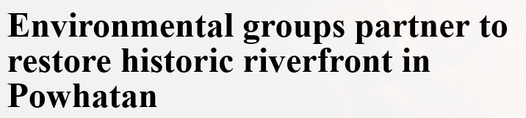

Funding & Communications
Partnership Development
Evaluation/ Next Steps
Public Engagement
Funding
Political Influence
Communications
Implementation
Data & Services
Community Priority Setting
Identifying Project Opportunities

