Slide 1

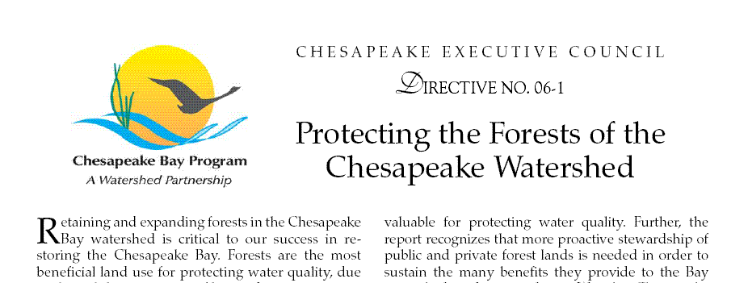
Update on Forest Goals and Progress in the Chesapeake Bay Partnership
Citizens Advisory Committee Meeting, 8/23/13
Sally Claggett & Julie Mawhorter, US Forest Service

Slide 2
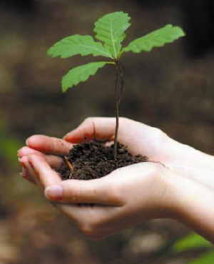
Forest Goals in the Bay
Chesapeake Executive Council Directives
Riparian Forest Buffers
1996, 2003, 2007
Urban Tree Canopy
2003, 2007
Forest Conservation
2007

Slide 3
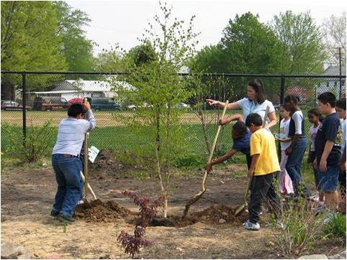
Urban Tree Canopy Goals
2003 Directive
By 2010, work with at least 5 local jurisdictions and communities in each state to complete an assessment of urban forests, adopt a local goal to increase
urban tree canopy cover and encourage measures to attain the established goals in order to enhance and extend forest buffer functions in urban areas.
2007 Directive
By 2020, accelerate reforestation and conservation in…urban and suburban areas, by increasing the number of communities with commitments to tree
canopy expansion goals to 120.

Slide 4
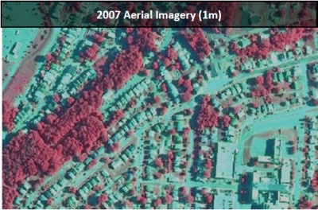
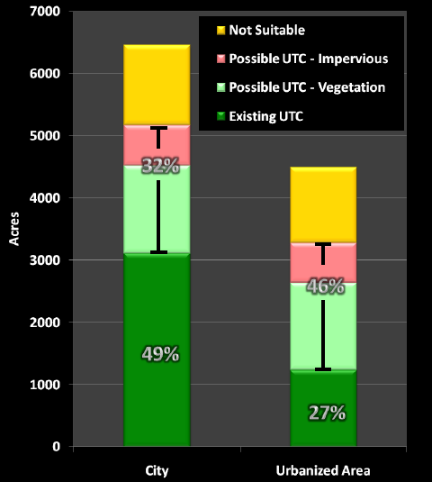
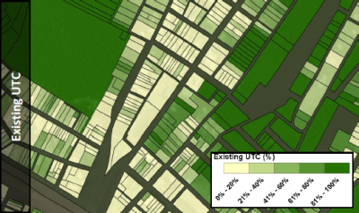
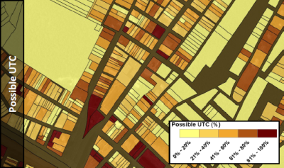
Urban Tree Canopy Assessment
(Cumberland, MD, J. O’Neil-Dunne)

Slide 5
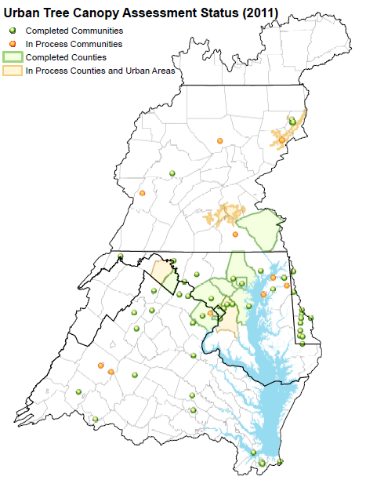
Urban Tree Canopy
UTC Assessments complete:
~70 communities, 9 counties
Canopy Goals set: 45
Implementation Plans: 23

Slide 6
Urban Tree Canopy Status & Goals

Slide 7
New Bay Agreement – Vital Habitats Goal
Forestry Outcome: [DRAFT, 8/21/13]
2. Expand urban tree canopy by 2,400 acres by 2025.
Notes:
Based on state estimates of achievable level of implementation
1 acre = 100 trees; so ~240,000 urban trees gained
Urban tree planting BMP credit - under review by expert panel
Local/state tracking mechanisms need to be developed
How to account for tree canopy losses to ensure net gain??
Check out tree canopy tools at www.itreetools.org

Slide 8
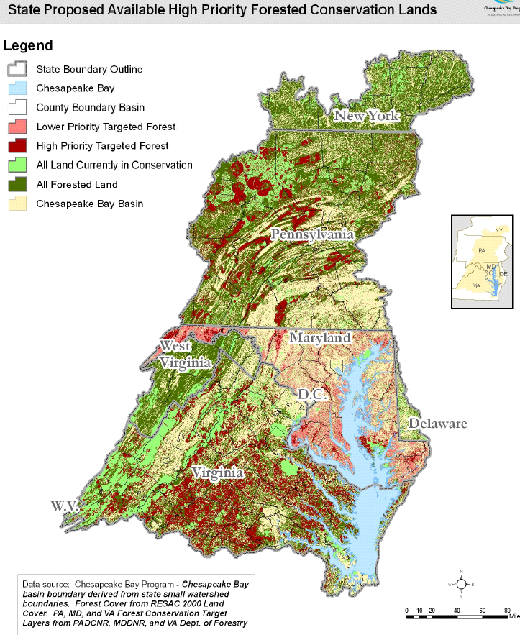

Forest Conservation Goal - 2007
By 2020, permanently protect an additional 695,000 acres of forest from conversion, targeting forests in areas of highest water quality value. As part of this goal, 266,400 acres of forest land under threat of conversion will be protected by 2012.

Slide 9
Forest Conservation Progress
As reported by States | All Forest | High Value
Delaware | 7,287 | no data
Maryland | 36,781 | 19,264
New York | 3,379 | 1,956
Pennsylvania | 28,634 | 25,680
Virginia | 184,640 | 56,167
West Virginia | 6,645 | 5,888
TOTAL | 267,366 | 106,999
Notes:
2012 Target: 266,400 acres of high value forest protected
Need better GIS-based tracking of protected forest and high value forest
Goal does not include other strategies to address loss of forests
CB Model credits only new forests restored, not conservation of existing

Slide 10
New Bay Agreement – Land Conservation Goal
Protected Lands Outcome: [DRAFT]
Protect an additional two million acres of lands throughout the watershed currently identified as high conservation priorities at the federal, state or local level by 2025, including 225,000 acres of wetlands and 695,000 acres of forest land of highest value for maintaining water quality (2010 baseline).

Slide 11
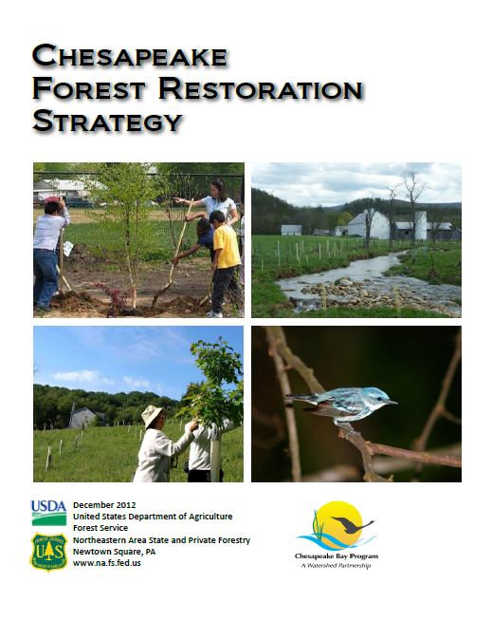
Chesapeake Forest Restoration Strategy (2012)
Executive Order Strategy
“By 2012, USDA will work with Dept. of Interior and other entities to develop a Chesapeake Bay watershed strategy to maximize forest restoration in priority areas…”
Wildlife habitat
Mine lands
Agroforestry
Urban/community forests
Brownfields
Available on Chesapeake Executive Order website
http://executiveorder.chesapeakebay.net/post/New-Forest-Restoration-Strategy-for-the-Chesapeake-Watershed.aspx

Slide 12
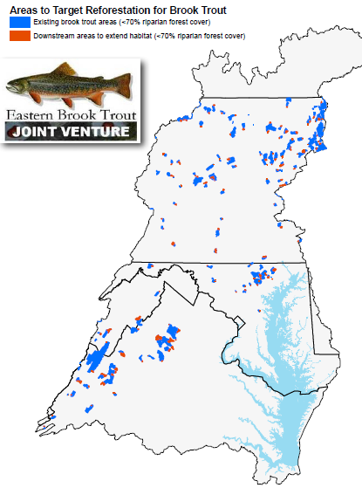
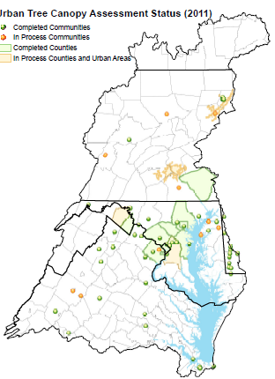
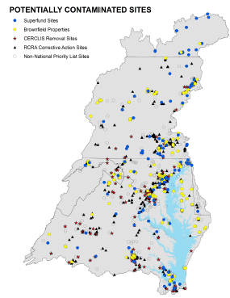
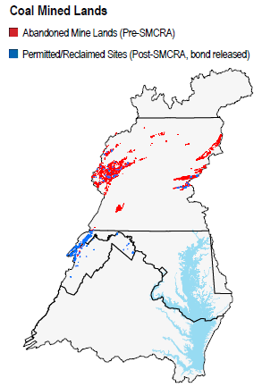
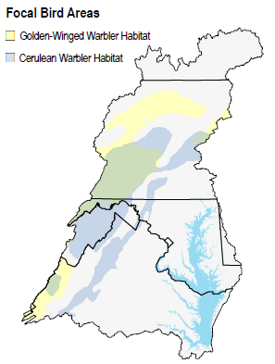
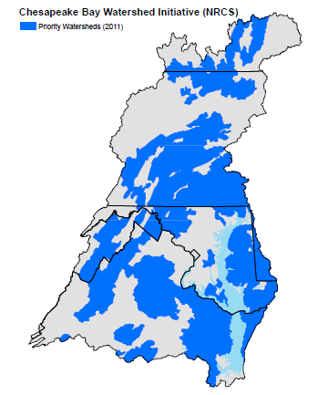
Brook Trout Priorities
Urban Tree Canopy
Contaminated Sites
Historic Coal Mined Lands
Priority Agricultural Watersheds
Focal Bird Areas
Forest Restoration Map layers will soon be available on USGS interactive mapping tool

Slide 13
Riparian Forest Buffer Goals
1996: 2,010 miles by 2010 (achieved in 2002)
2003:
Long-term goal – 70% of riparian areas in forest
Short-term target – 10,000 miles by 2010
= ~900 miles/year - VA, MD, PA, DC
2007:
recommit to 900 miles/year restored
DE, WV, NY also sign on
Progress reported 1996-2012: 7764 miles

Slide 14
New Bay Agreement – Vital Habitats Goal
Forestry Outcome: [DRAFT]
1. Restore 900 miles per year of riparian forest buffer and conserve buffers until at least 70% of riparian areas are forested.

Slide 15
Forest Buffer Targets in State WIPs: How acres relate to 900 mile goal
 | Total New Acres Needed 2012-2025 | Needed acres/year | Miles/year (assume 100 ft wide)
Delaware | 4,790 | 370 | 31
Maryland | 1,190 | 90 | 8
New York | 6,180 | 475 | 40
Pennsylvania | 89,630 | 6,895 | 575
Virginia | 80,820 | 6,215 | 518
West Virginia | 3,250 | 250 | 21
TOTAL | 185,860 | 14,295 | 1191
Exceeds 900 mile/year goal

Slide 16
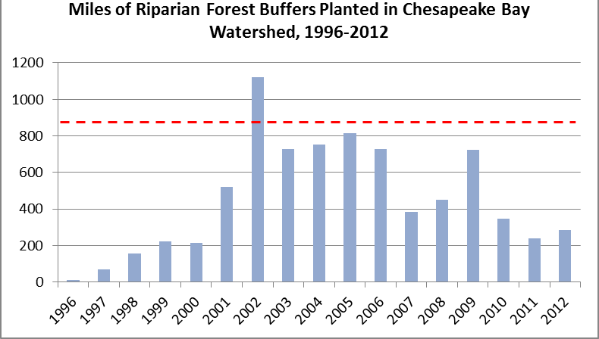
900 miles/year target
Data source: US Forest Service/Chesapeake Bay Program

Slide 17
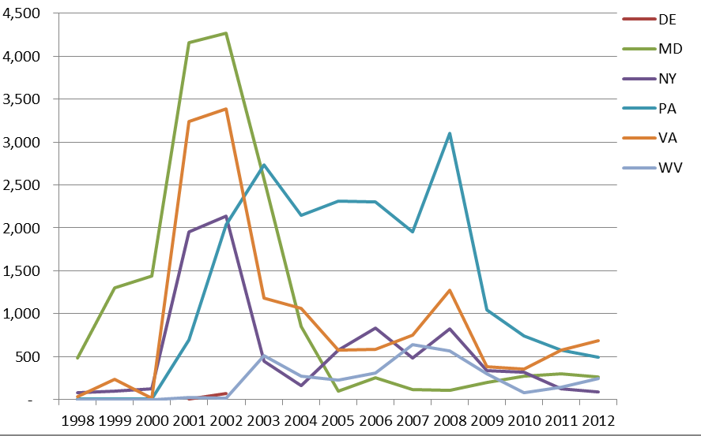
CREP Forest Buffer Acres by year
Data Source: USDA Farm Services Agency

Slide 18
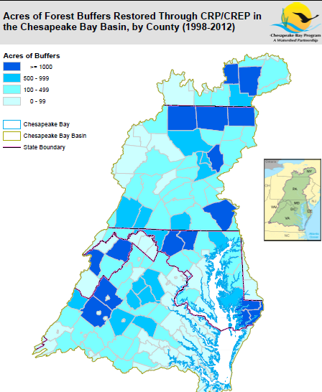
* 25% of the counties achieved 75% of the buffer acres restored
Data Source: USDA Farm Services Agency

Slide 19
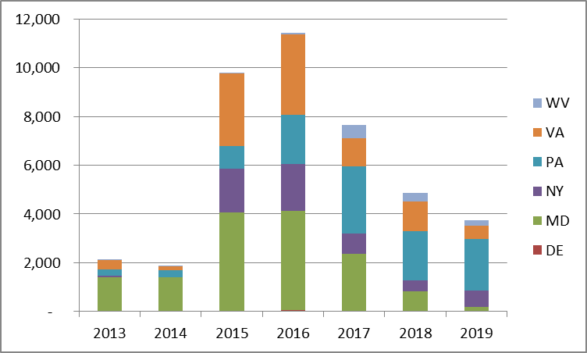
Emerging Issue: Expiring Contracts CP-22 Acres expiring 2013-2019
Data Source: USDA Farm Services Agency

Slide 20
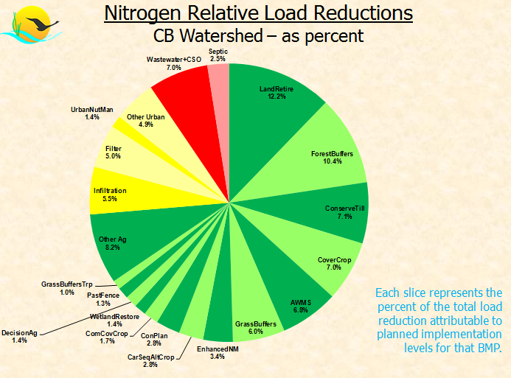
States relying on past and future acres
Forest Buffers rank second of all nonpoint source BMPs needed to meet TMDL targets.
- Includes both past CP-22 acres and planned 2013-2025
Data Source: Chesapeake Bay Program Modeling Team (Sweeney)

Slide 21
FSA
CREP Program, $$
NRCS
Landowner Contact,
Technical Assistance
Forest Buffer
Restoration
USFS
Coordination, info,
Grants to states/partners
Agency Partners
State, federal
Conservation districts
Other Partners
Conservation/watershed organizations, etc.
State Forestry
Forestry Assistance,
Tracking, Projects

