Slide 1
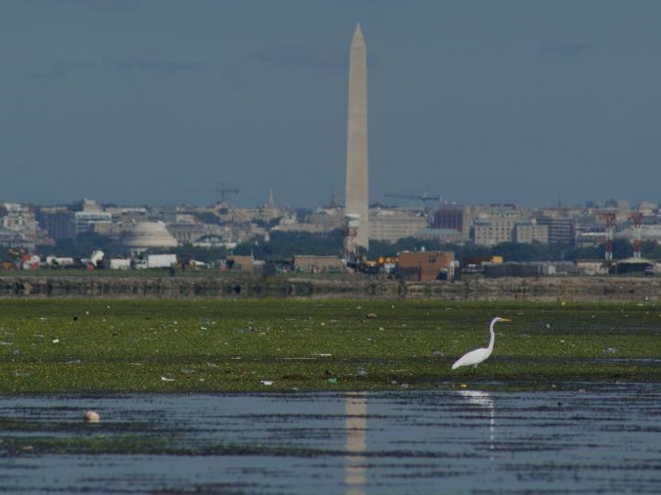
District of Columbia
Local Government Engagement and Communication Strategy
Katherine Antos, Chief
Partnering and Environmental Conservation Branch
District Department of Energy and Environment
October 5, 2017
Notes:
Please enter jurisdiction name (and agency logo/s)

Slide 2
Jurisdiction-Specific Considerations
DC is a State and a City
Most load permitted; over 90% wastewater
Notes:
Dual function of city and state
Over 90% load from wastewater
Virtually all load covered by BP and MS4 permits
Largely built out. CBP estimates 89% of growth by 2025 will be infill; we think it’s higher
Growth improves water quality
TREE CANOPY:
Mayoral mandate for 40% Canopy Cover by 2032,
- 2011: 35%. currently 39%
New MS4 permit: 33,525 trees in MS4 in next 5 years (6,705 per year)
DDOT is primary tree planting agency (~80%), DOEE awards & manages tree-planting grants (non-profits)
What are the unique characteristics of your jurisdiction as it relates to the challenge of effectively engaging local governments in your Phase III WIP development? For example,
What is the relative importance of local government in achieving pollutant reduction targets in your jurisdiction?
What do you need from local governments during WIP development and implementation?
What information do local government officials and staff need to be effective partners in WIP development? Implementation?
What is your timeline for communication and engagement?
Enter jurisdiction name

Slide 3
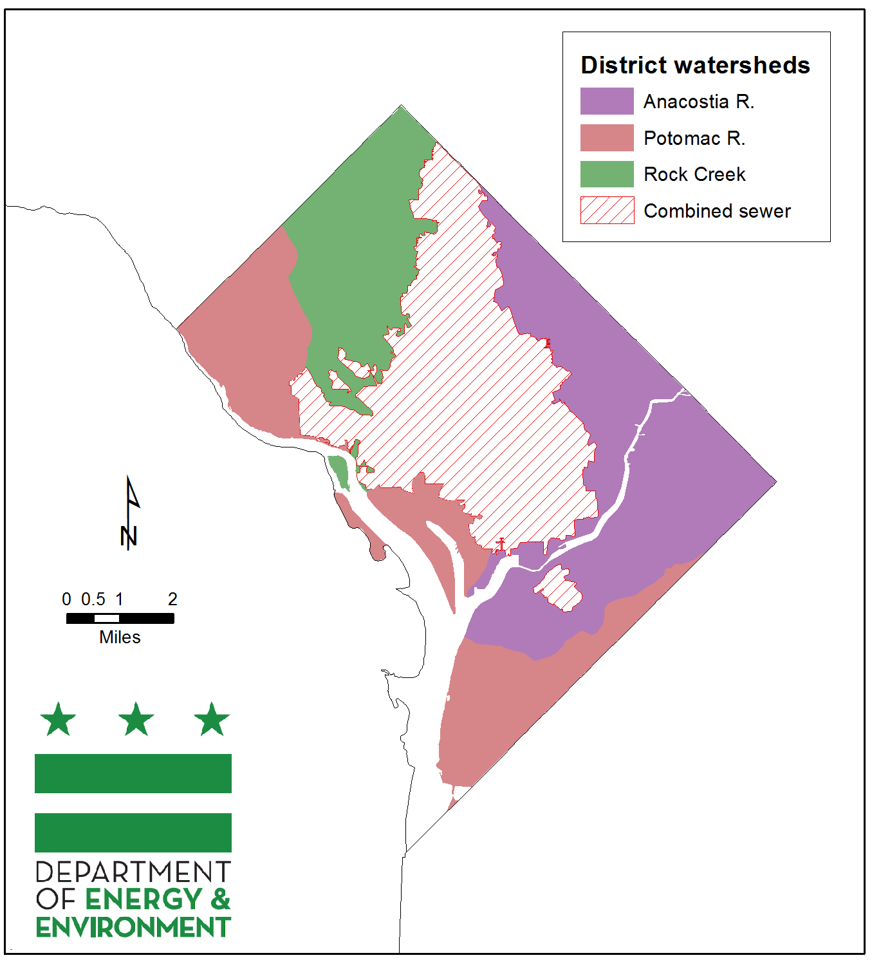
Geographic Targeting
Notes:
Bay L-R segs align with coarse target areas.
Clean Rivers Project addressing CSO
MS4 target areas of Potomac, Rock Creek, Anacostia. Specific stormwater management and tree planting targets for each.
We have more specific planning goals for subwatersheds based on local TMDLs and stream restoration efforts
Challenge is 2-fold: Implementing more, and maintaining what we’ve done

Slide 4
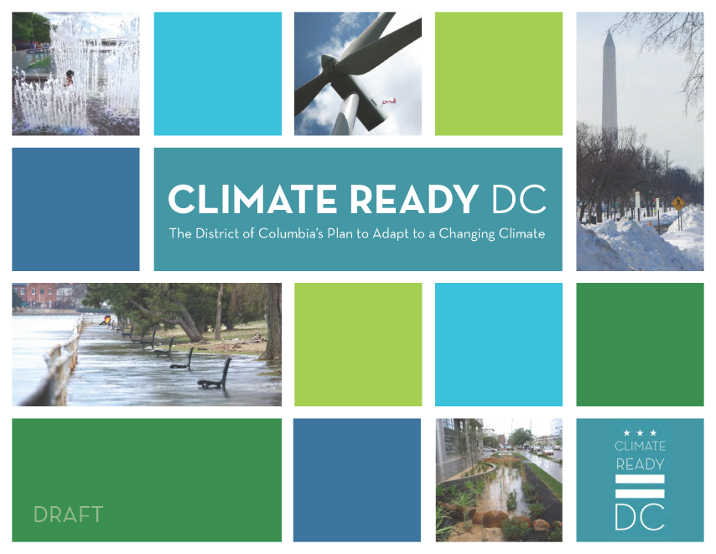
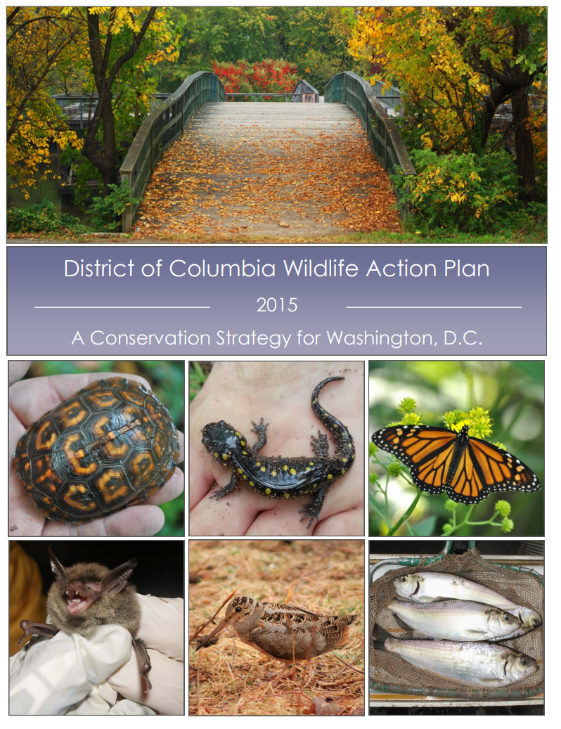
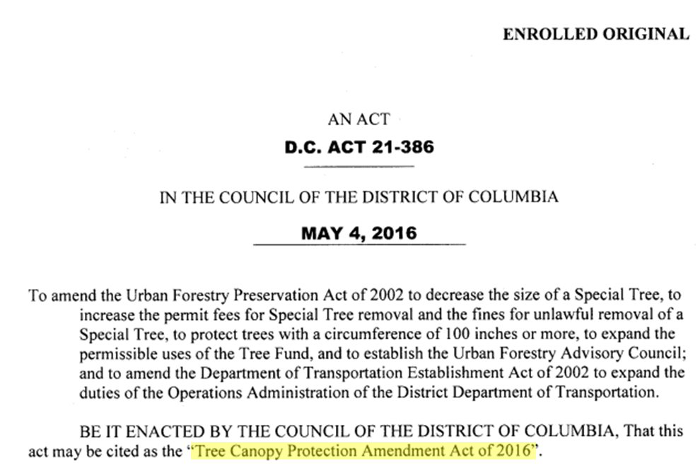
Leveraging Other Efforts
Notes:
CLIMATE READY DC:
- Equity Advisory Group and flood risk analysis in Watts Branch. This fall
- Sister agencies and fed faciliteis: under way
TREE CANOPY:
Mayoral mandate for 40% Canopy Cover by 2032,
- 2011: 35%. currently 39%
New MS4 permit: 33,525 trees in MS4 in next 5 years (6,705 per year)
DDOT is primary tree planting agency (~80%), DOEE awards & manages tree-planting grants (non-profits)

Slide 5
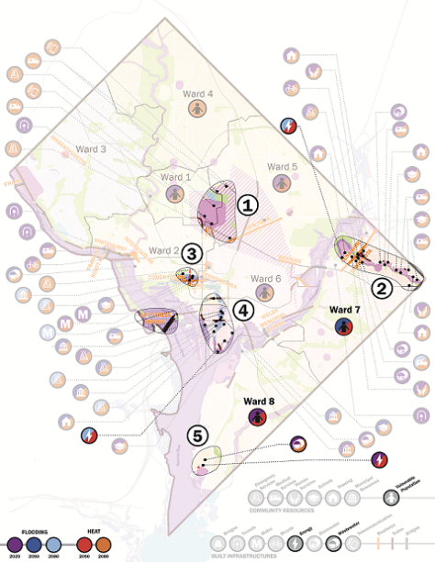
Engagement and Communication Goals
Cultivate partnerships to achieve local and Bay restoration goals
Choose strategies help address other priority needs, such as:
  Climate Resilience
  Public Access
  Pathways to Middle Class
  Wildlife
Notes:
Engagement = 2-way exchange; Communication = 1-way
What does your jurisdiction hope to achieve by implementing this local engagement strategy?
Examples may include:
Satisfy EPA Expectations regarding local engagement.
Increase public conversation about the need for reduced pollution.
Communicate key policy and technical decisions related to the WIPs, including timing and impact of model
Raise public awareness of WIP development and Bay restoration efforts
Identify what pollution reduction is already being done
Identify gaps and strategies to fill gaps that might yield multiple benefits
Enter jurisdiction name

Slide 6
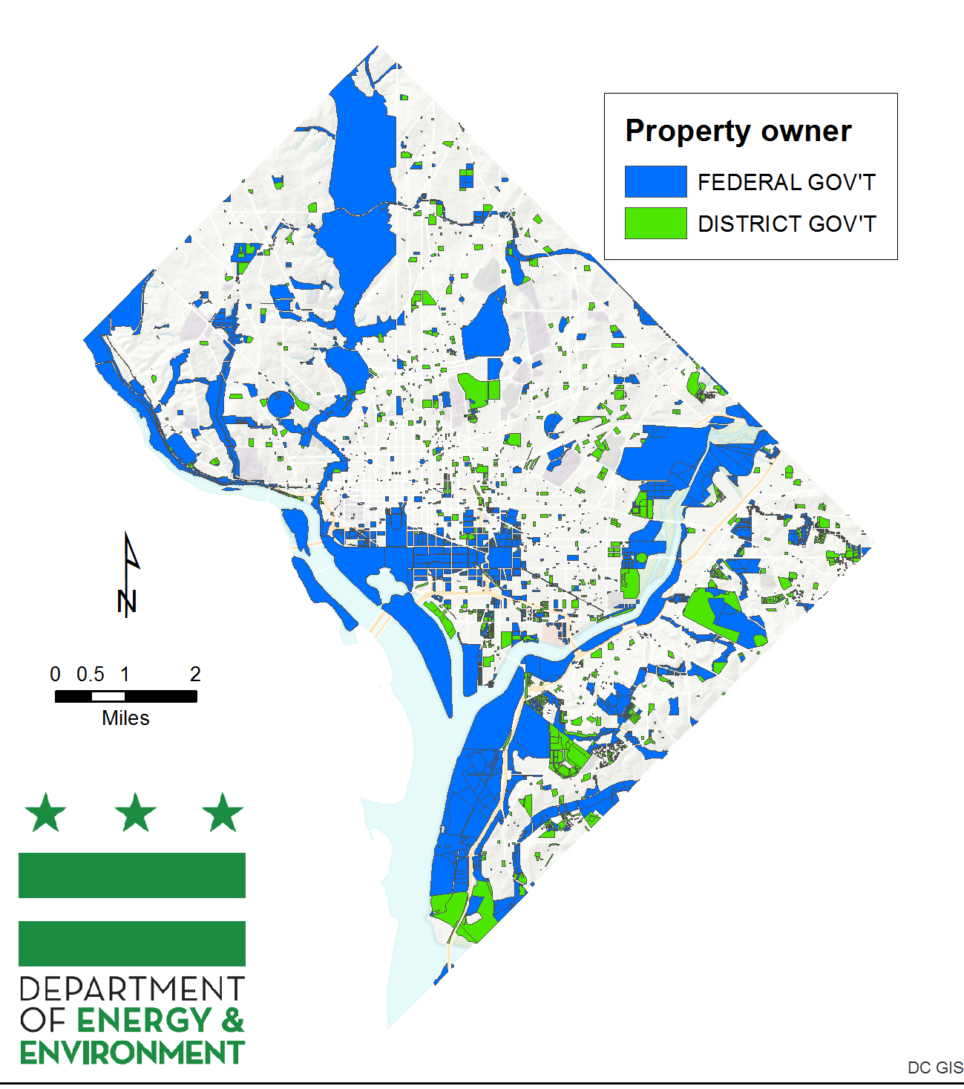
Target Audiences
DC Water
Federal facilities
Sister agencies
Property owners/ managers
Communities surrounding target restoration areas
Notes:
DDOT/UFD is the primary tree-planting and maintenance agency. We use the UFAC (Urban Forestry Advisory Council) to coordinate with UFD, other District gov agencies, Federal agencies (like NPS), non-profits, utilities, and District resident groups.
- Topics considered by UFAC include: overlap of solar policy and tree canopy; street tree maintenance; workforce training.
Describe the specific audiences you need to target, e.g. local leaders (officials and other leaders), local government staff (practitioners), associations of municipalities and counties, technical service providers, soil and water conservation districts)
Briefly explain the role of each target audience in your process.
Enter jurisdiction name

Slide 7
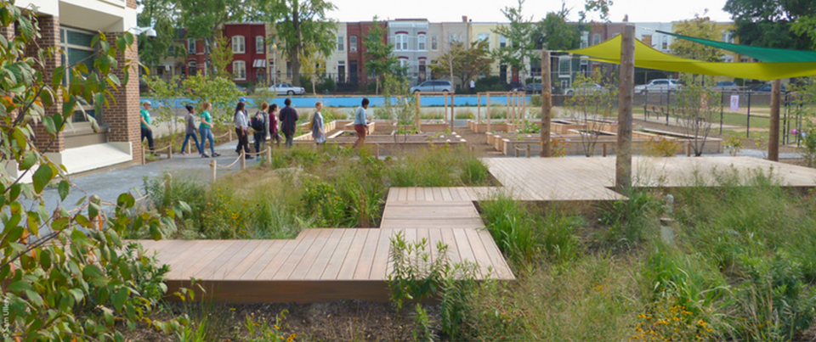
Key Messages
Healthy waters support healthy communities, and vice-versa
Need to further refine based on stakeholder input:
  Regulatory compliance
  Public health and public safety benefits
  Public access/recreation
  Cost savings
  Flood risk
  Public health
Notes:
What are the topics that are most important to communicate in your jurisdiction?
Examples may include:
Communities benefit economically and environmentally when local waterways are clean
Local governments should be actively involved in Phase III WIPs so they can tie-in their own local priorities and constraints
Local governments need to identify what resources they need so the Bay Program partnership can help
Local governments can take credit for practices and programs they are already doing
The Bay Model has improved, reflecting more refined local land use data
Tools are available to help implementation planning and decision-making processes for BMP funding, targeting, and implementation
Enter jurisdiction name

Slide 8
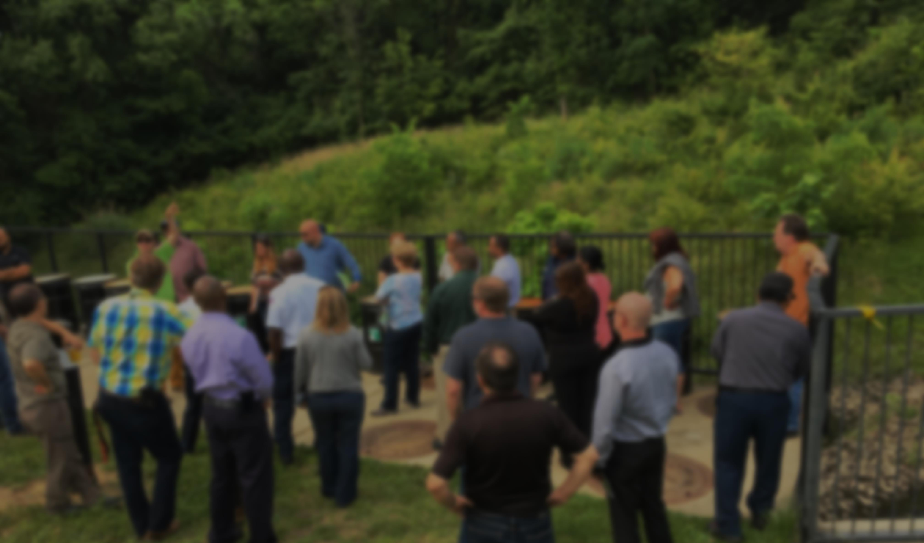
Key Messengers and Capacity
Federal Facilities Workgroup
Sister Agency Forums
ANCs, Civic Associations, Community-Based Organizations, Trade Associations
We will be looking for help to answer this question as we analyze target audiences
Notes:
Marketing RFP
O&M plan for MS4 permit
How can LGAC help

Slide 9
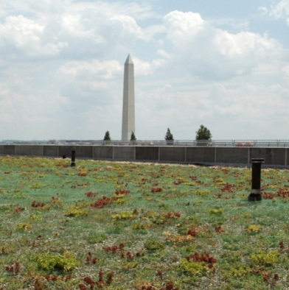
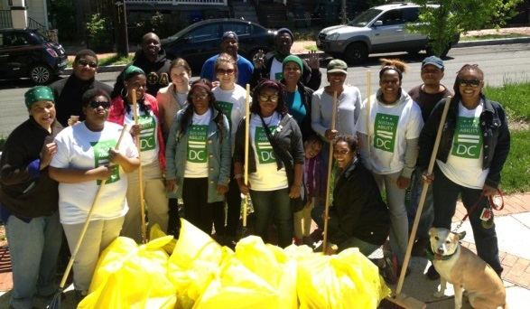
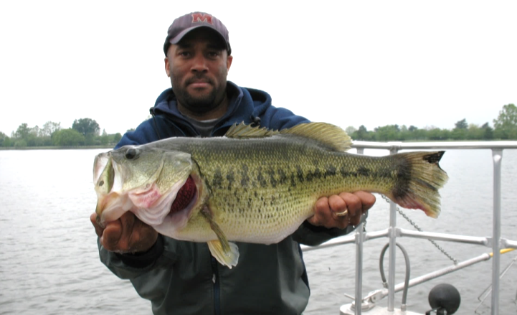
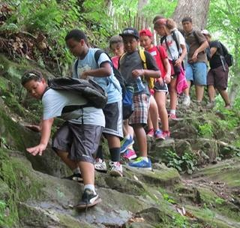


Questions?
Katherine Antos, Chief
Partnering and Environmental Conservation Branch
Katherine.Antos@dc.gov
202-574-7606
doee.dc.gov

