Slide 1
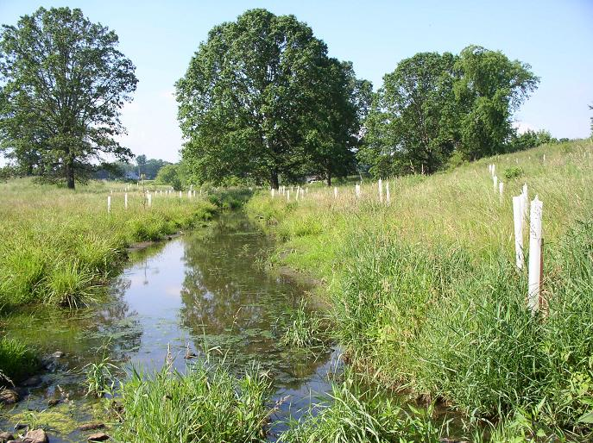
CREP BUFFERS IN Chesapeake Bay Region

Slide 2
Current CREP Enrollment in PA
Riparian Buffers
  24,884 Acres
  3,859 contracts
  6.5 acre average per contract

Slide 3
Expiring in 2013
160 contracts
1040 acres approximately

Slide 4
Expiring in 2014
58 contracts
377 acres approximately

Slide 5
Expiring in 2015
144 contracts
936 acres approximately

Slide 6
Expiring in 2016
465 contracts
3023 acres approximately

Slide 7
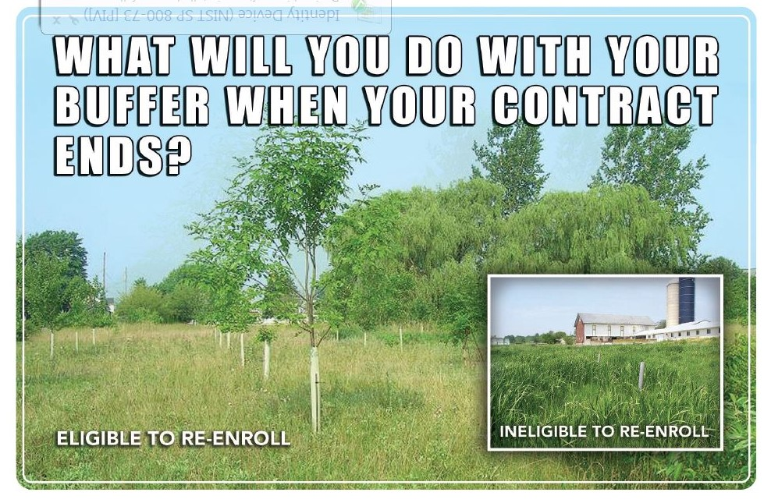
Postcard outreach

Slide 8
Postcard Stats
Sent out 830 for expiring contracts in 2013 through 2016.
Approximately 60% plan on re-enrolling and 40% are not re-enrolling their buffers

Slide 9
Barriers to re-enrollment and enrollment
Increased grain prices on the tilled portion of a buffer
Cost of maintaining buffer
Rental rates have changed
Small acre contracts don’t have a large enough annual payment.
Incentive rates for new buffers are appealing. There are not incentive rates offered for re-enrollment.

Slide 10
Partners – with NRCS CREP agreements
RC&D – In the past have done outreach
  Land owner workshops for grass and tree management along with weed control
  Created several fliers and brochures that are still in use
  Several of these are available – Contact Katrina Thompson, katrina.thompson@pa.usda.gov or call 717-237-2260

Slide 11
Partners – with NRCS CREP agreements
RC&D – Pocono, Community and Capitol RC&D all provide technical assistance to several counties.

Slide 12
Partners – with NRCS CREP agreements
Chesapeake Bay Foundation – Provides valuable technical assistance to land owners and promotes enrollment.
Pheasants Forever - Provides valuable technical assistance to land owners and promotes enrollment.

Slide 13
CREP Website
http://www.creppa.org
Joint effort to totally restructure and update
Goal – One stop shopping for CREP information

Slide 14
Statistics for CREP in PA
Total Acres in all CREP practices from 2000-2013 = 173,365 acres
CP 22 Riparian Forest Buffers
  3,859 contracts
  24,884 acres

Slide 15
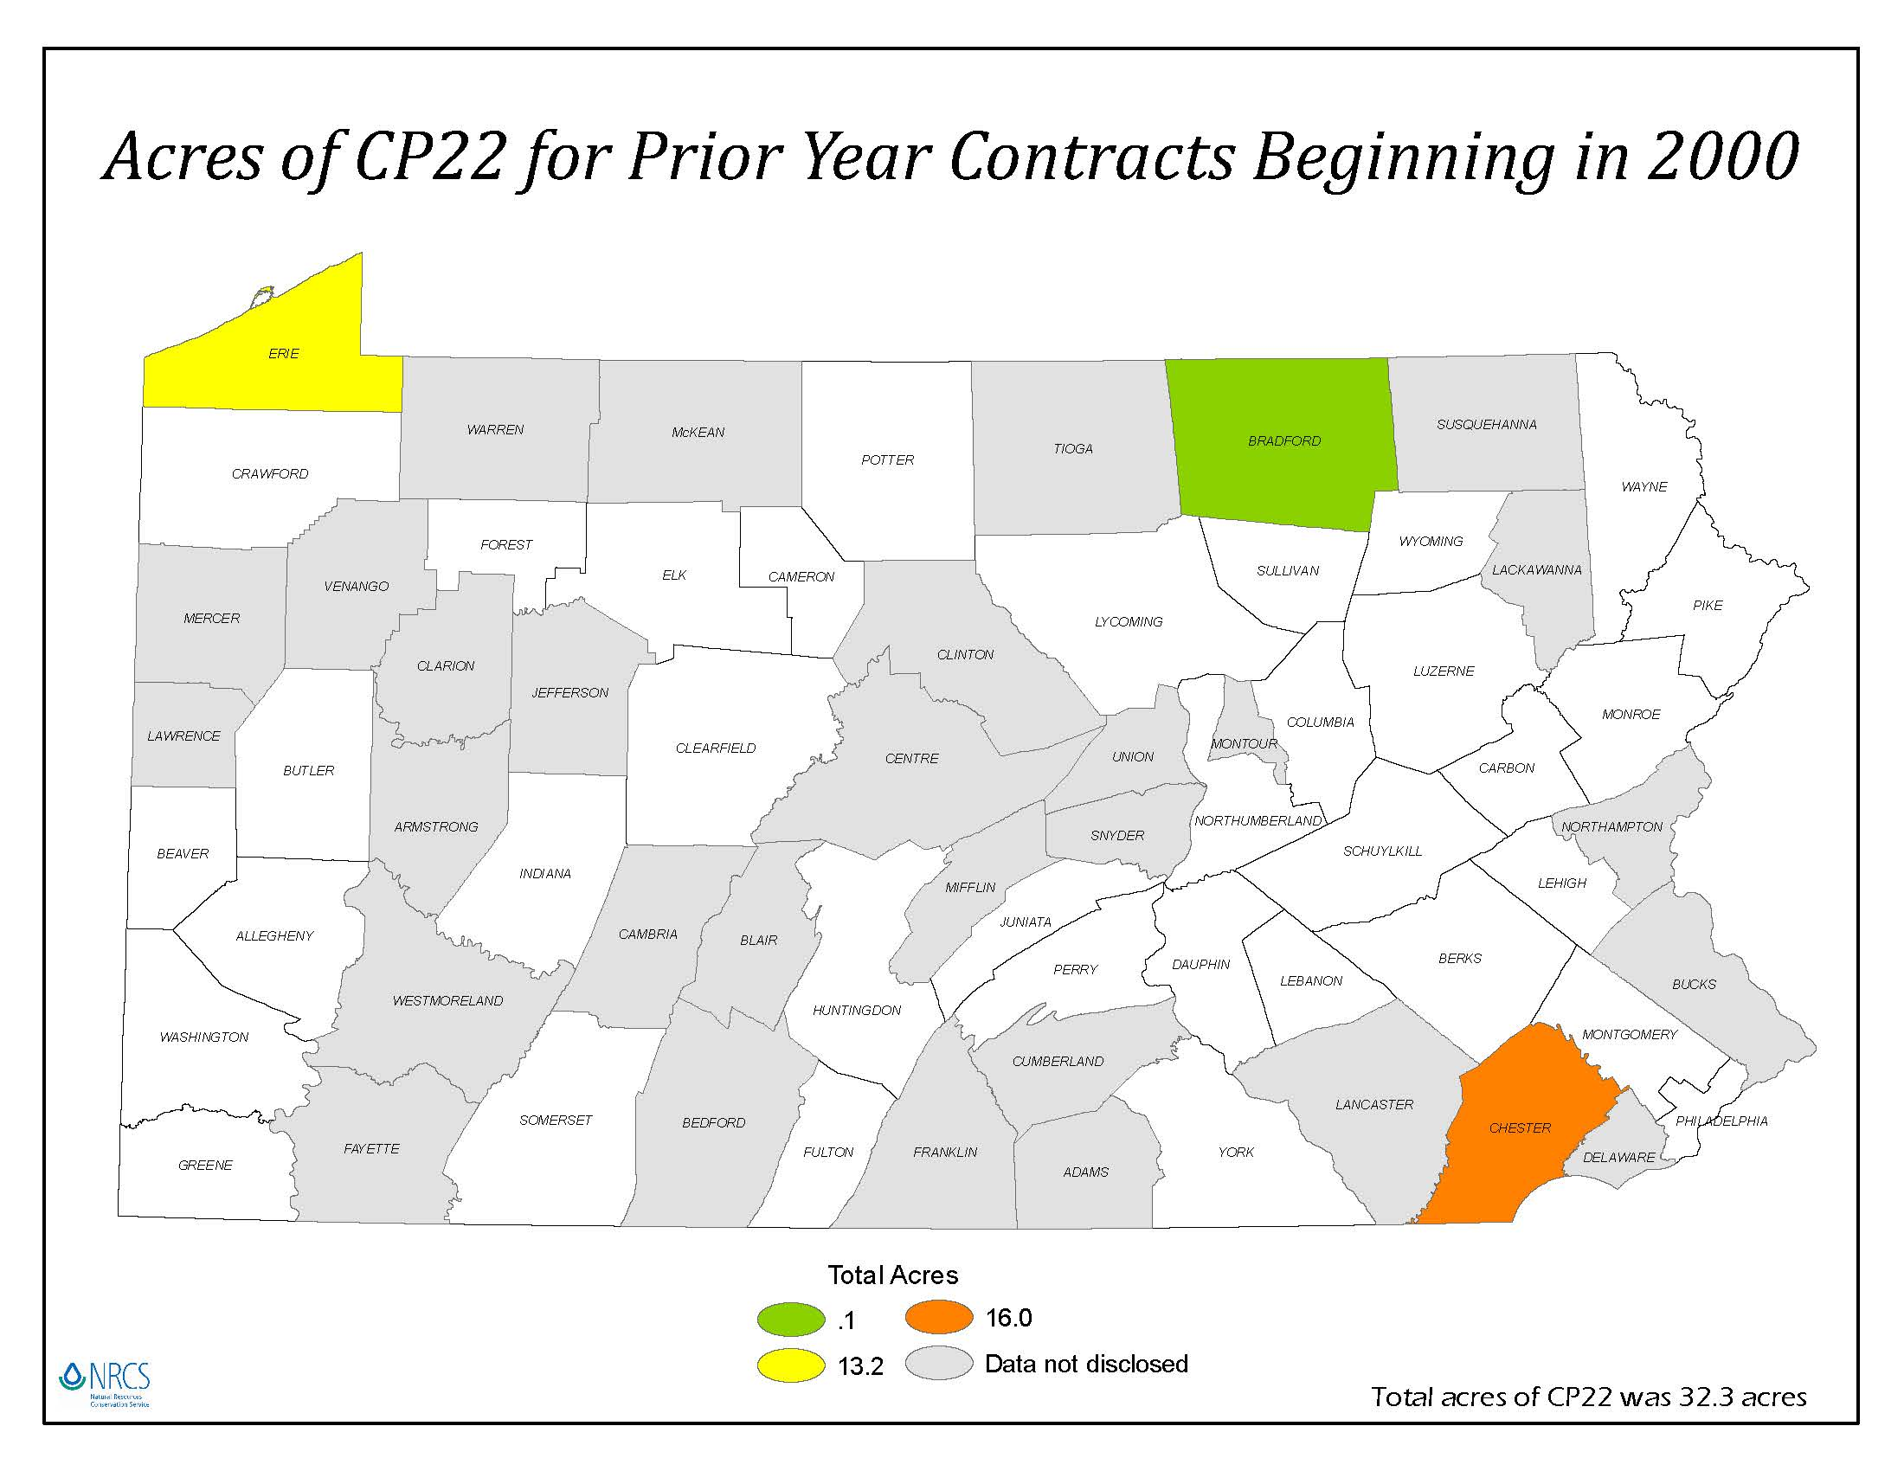

Slide 16
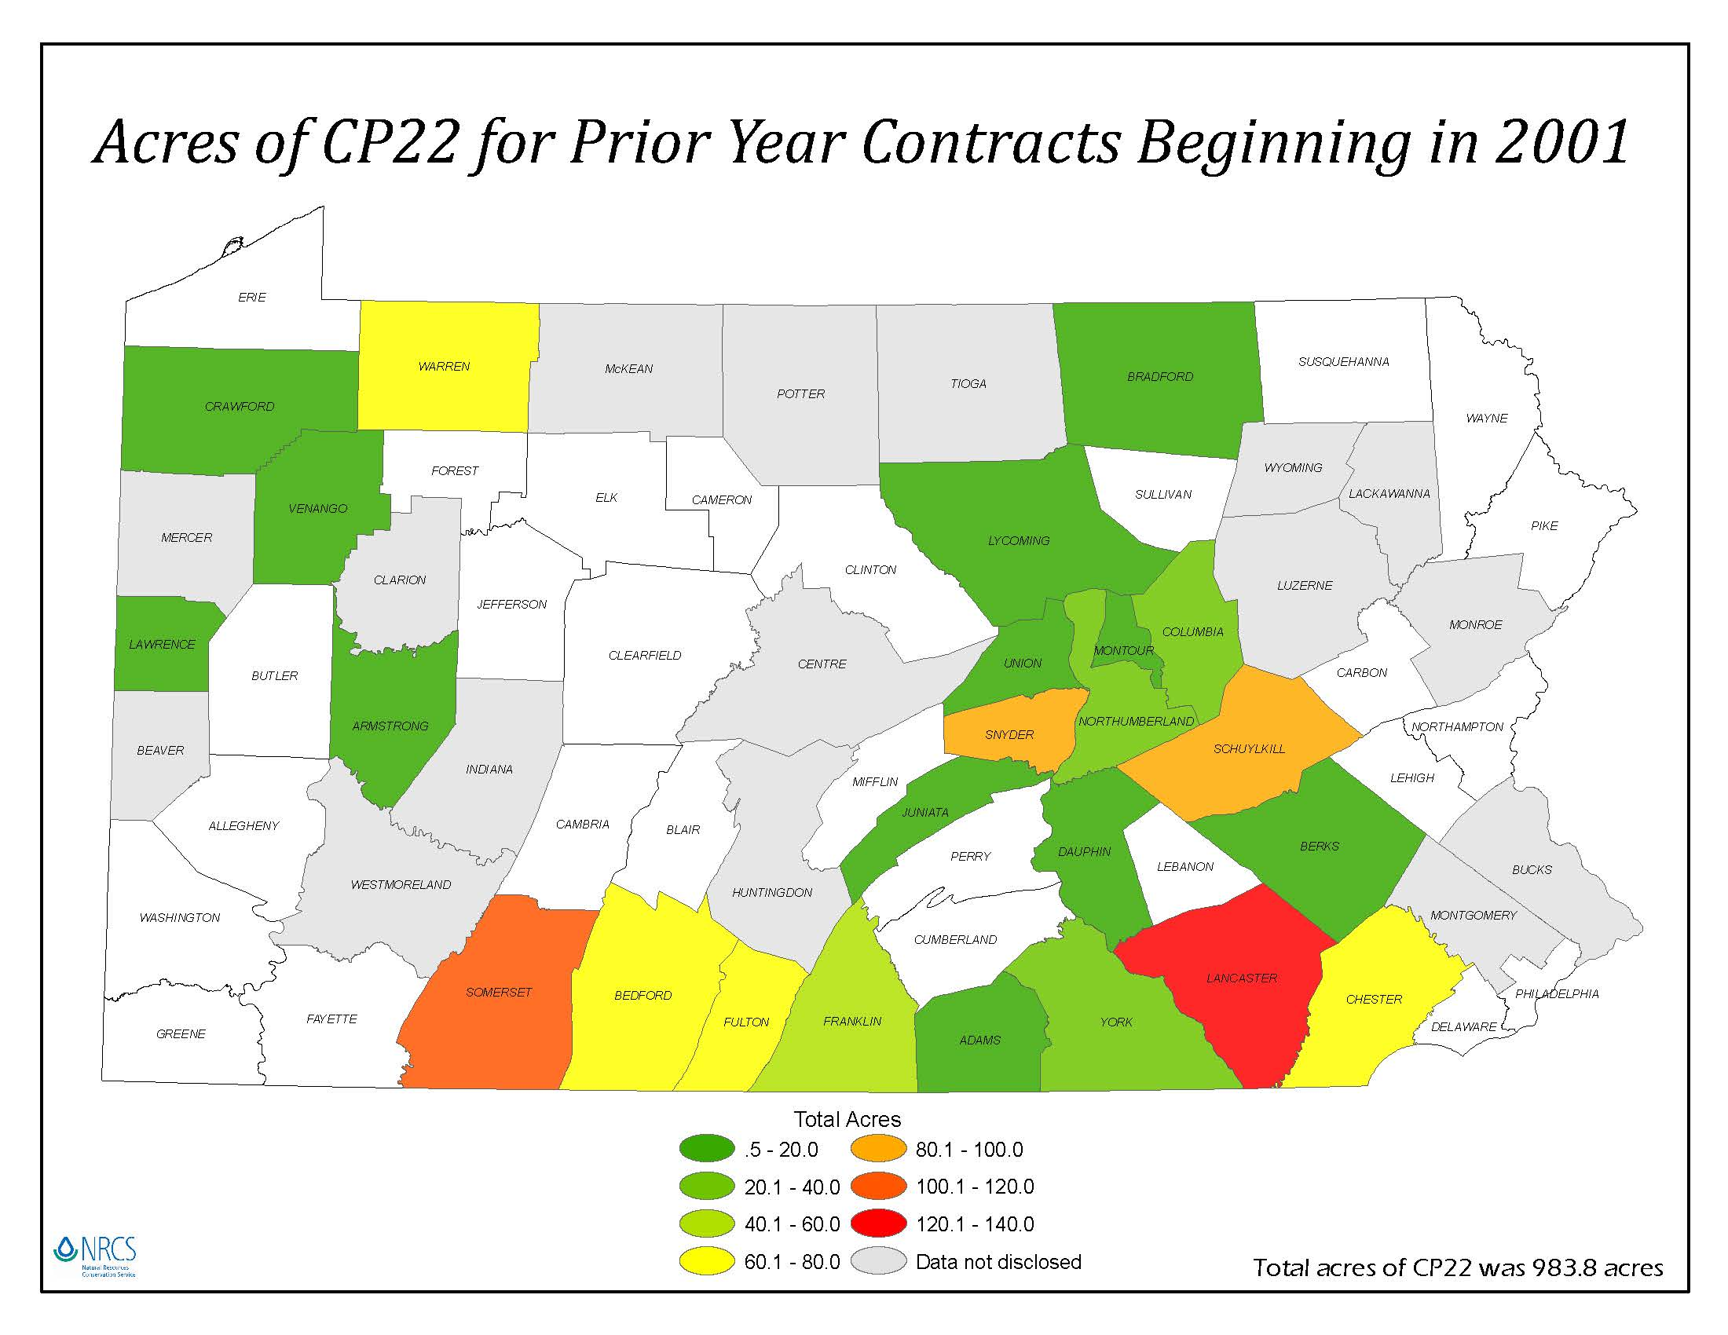

Slide 17
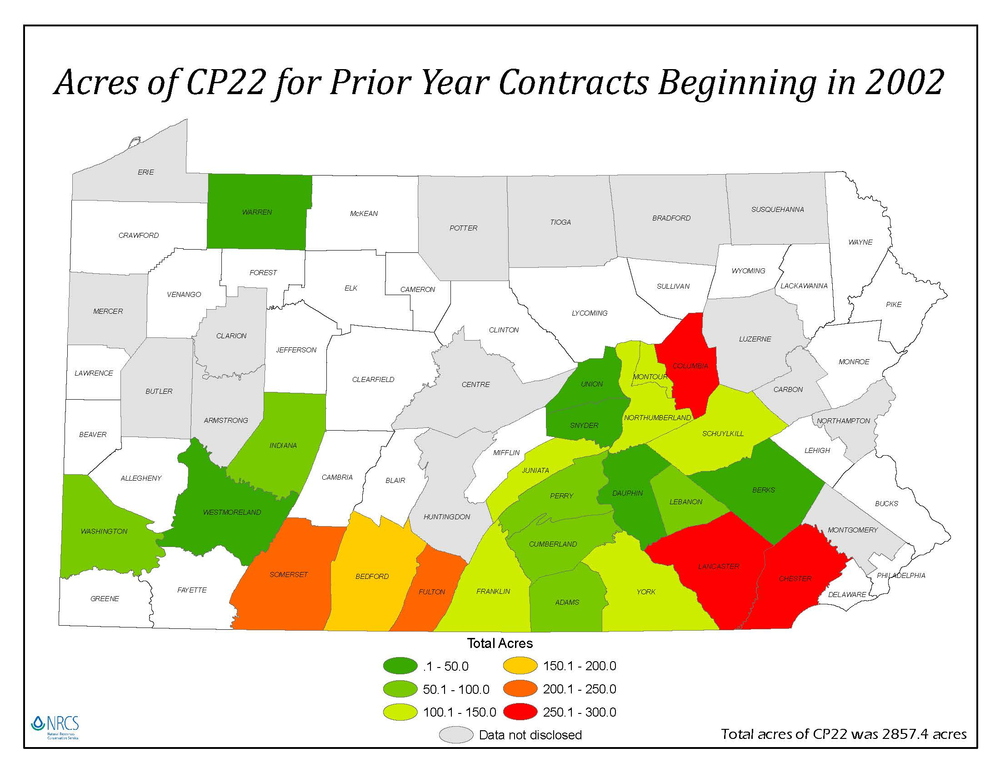

Slide 18
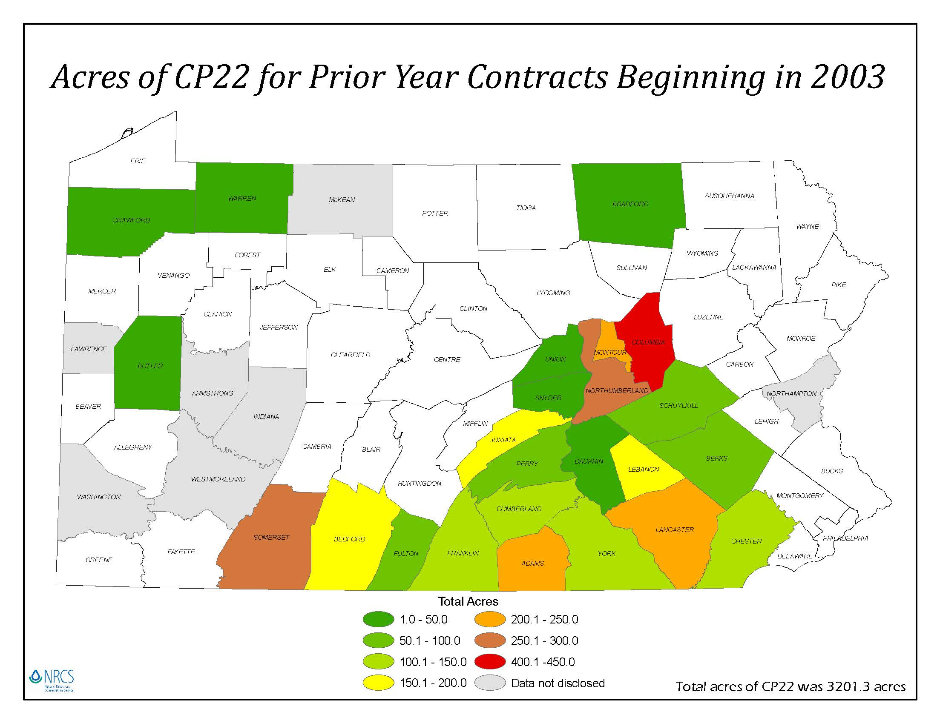

Slide 19
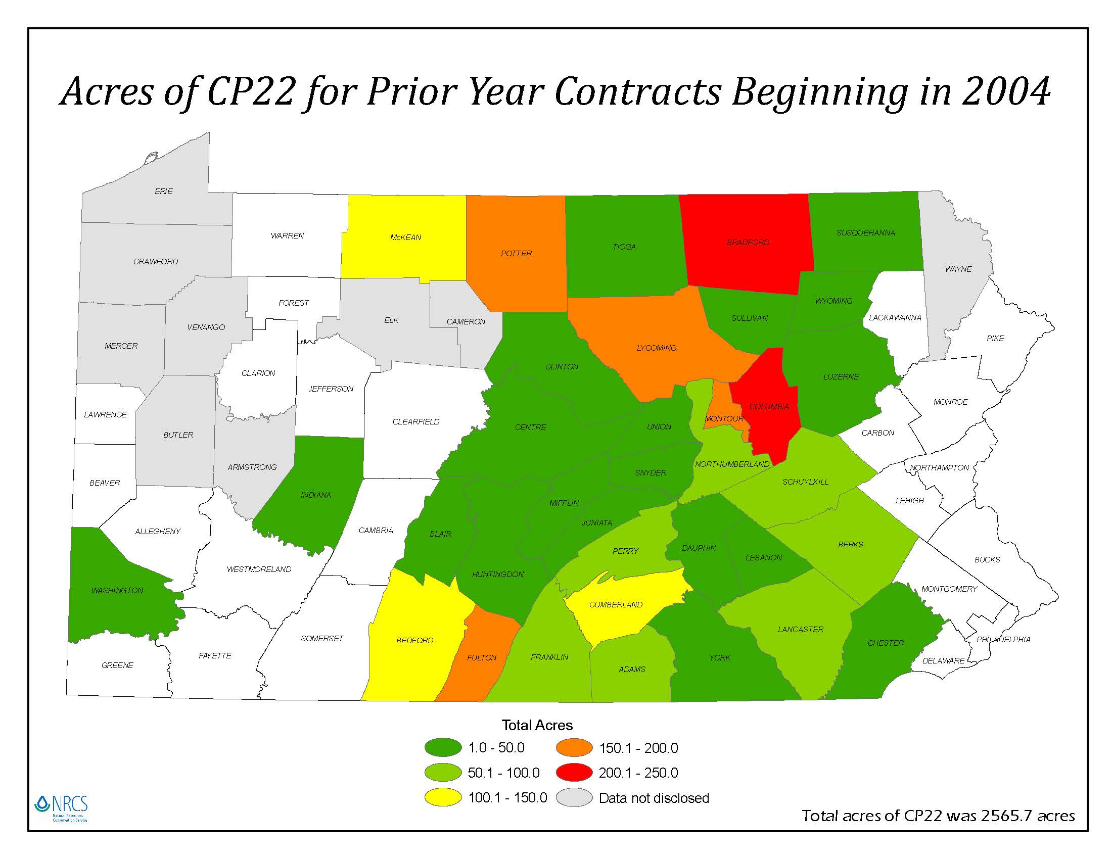

Slide 20
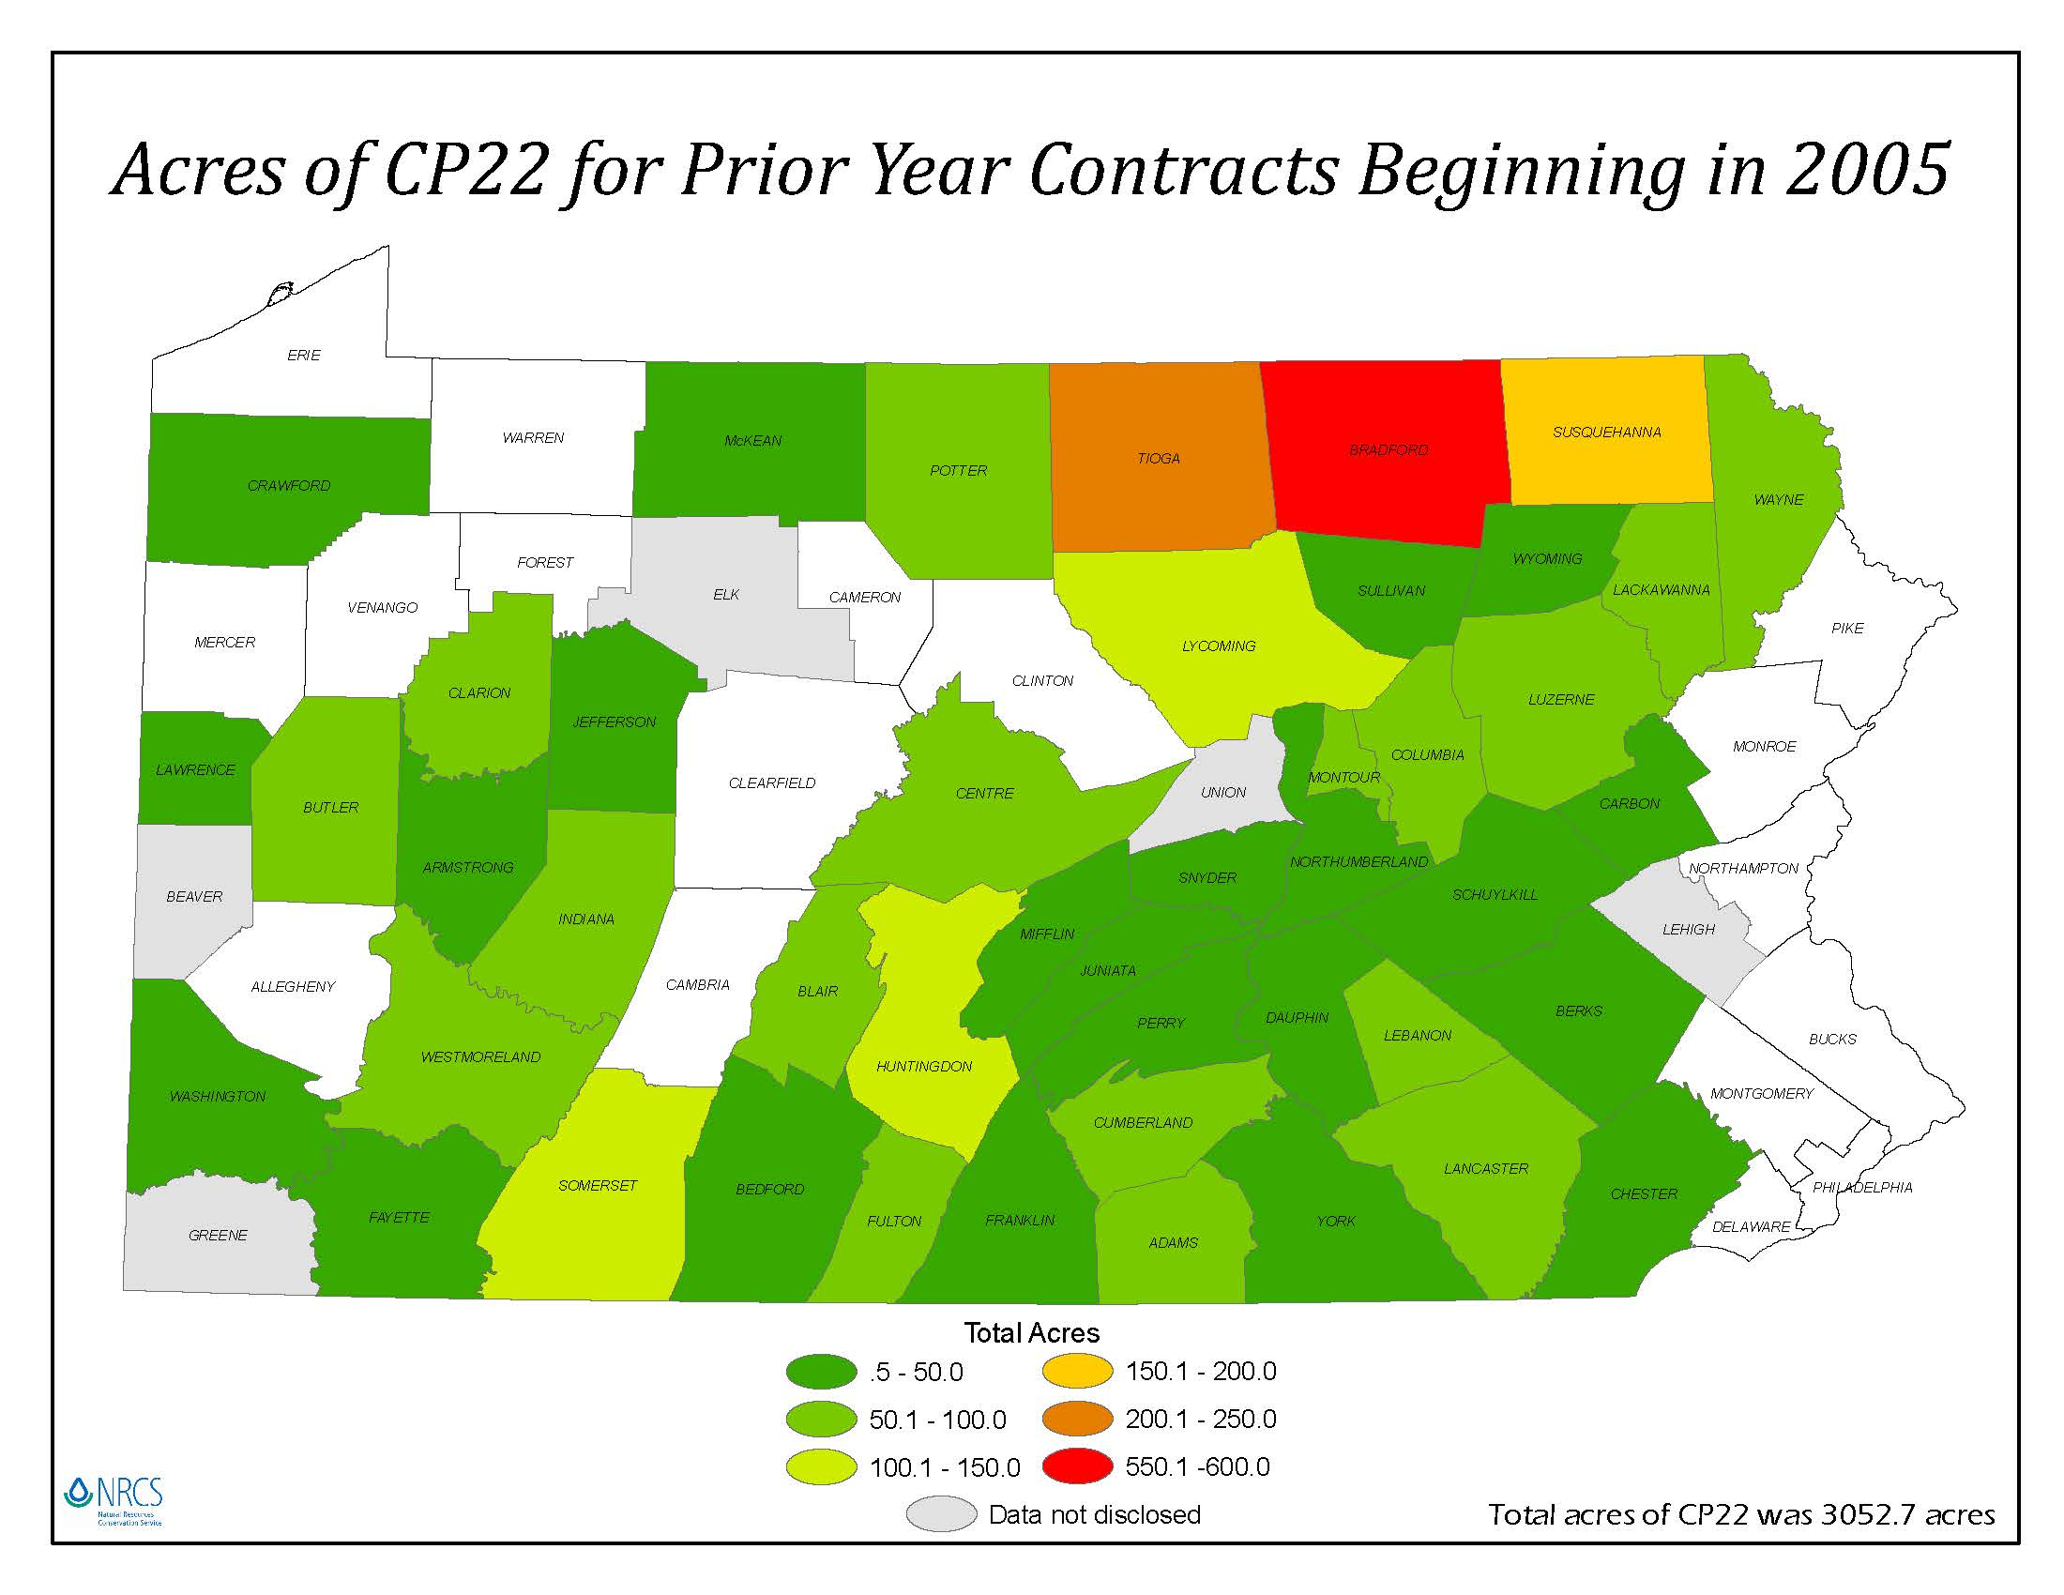

Slide 21
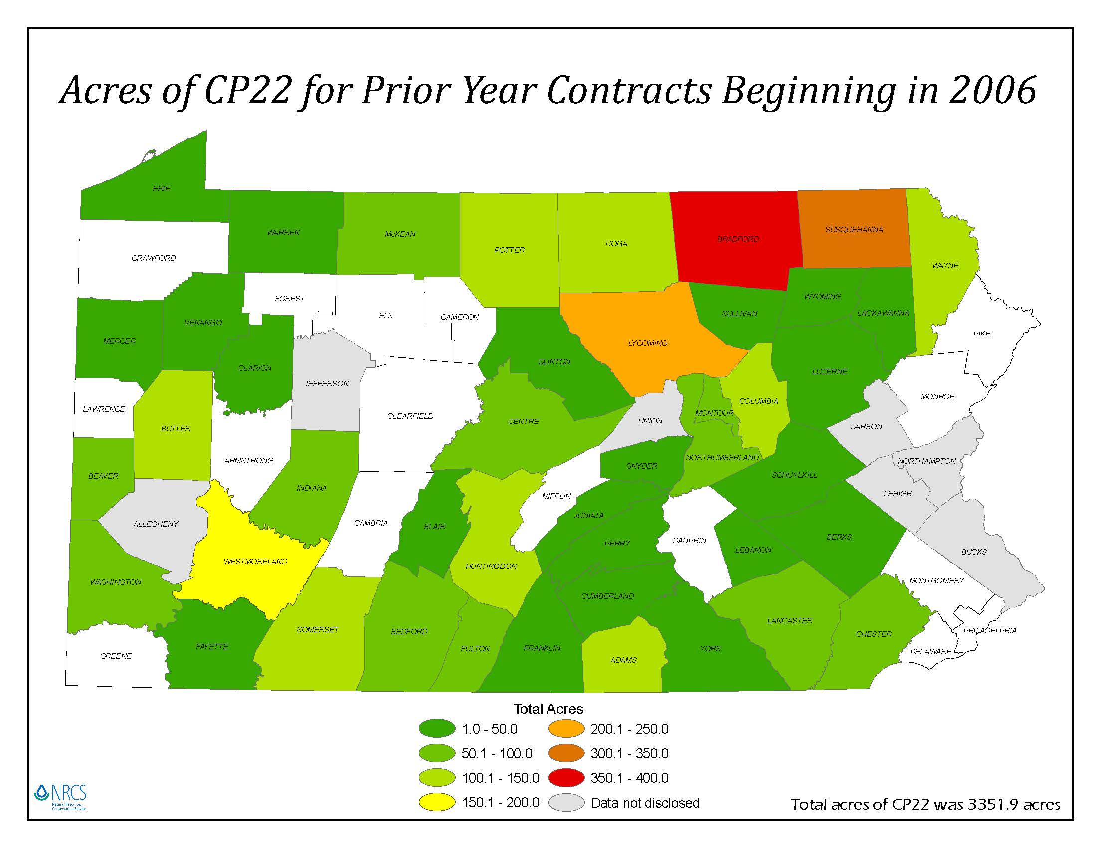

Slide 22
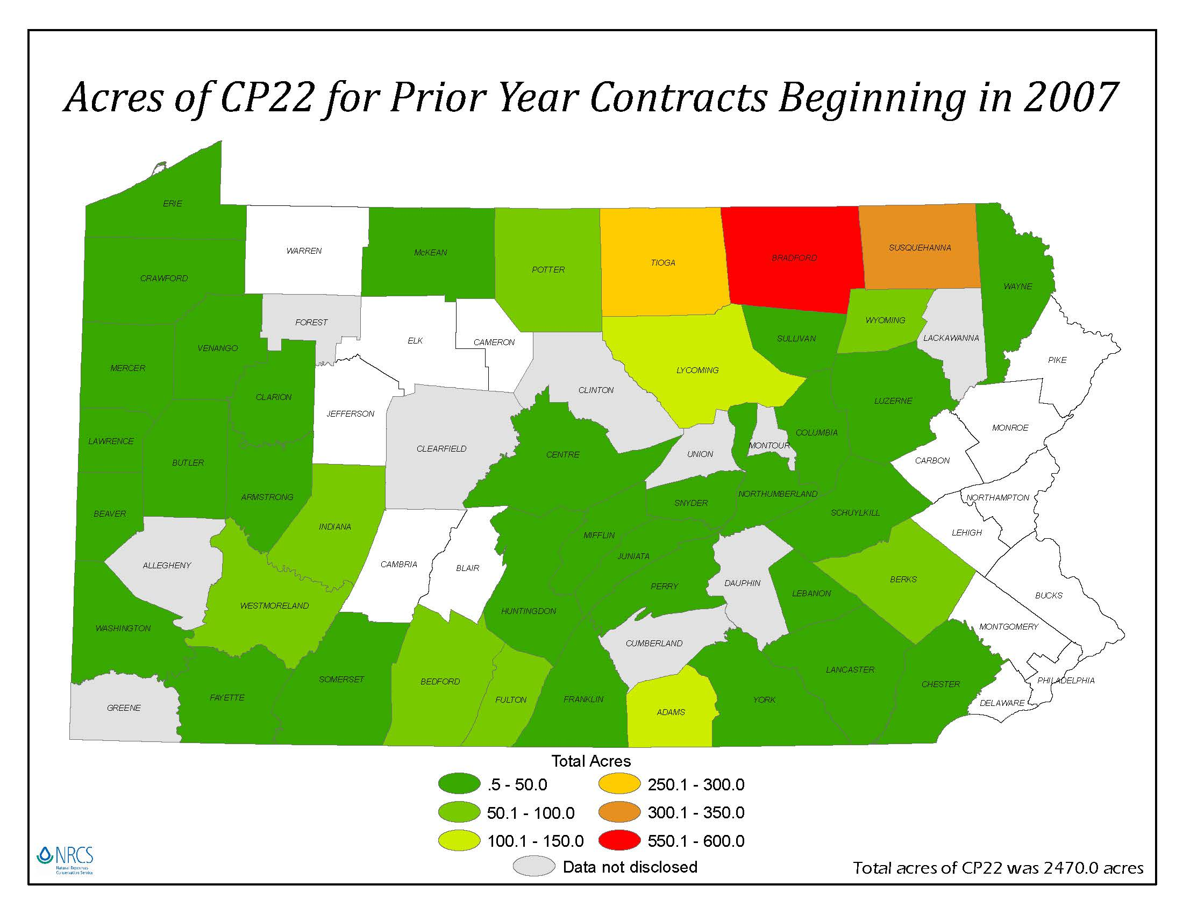

Slide 23
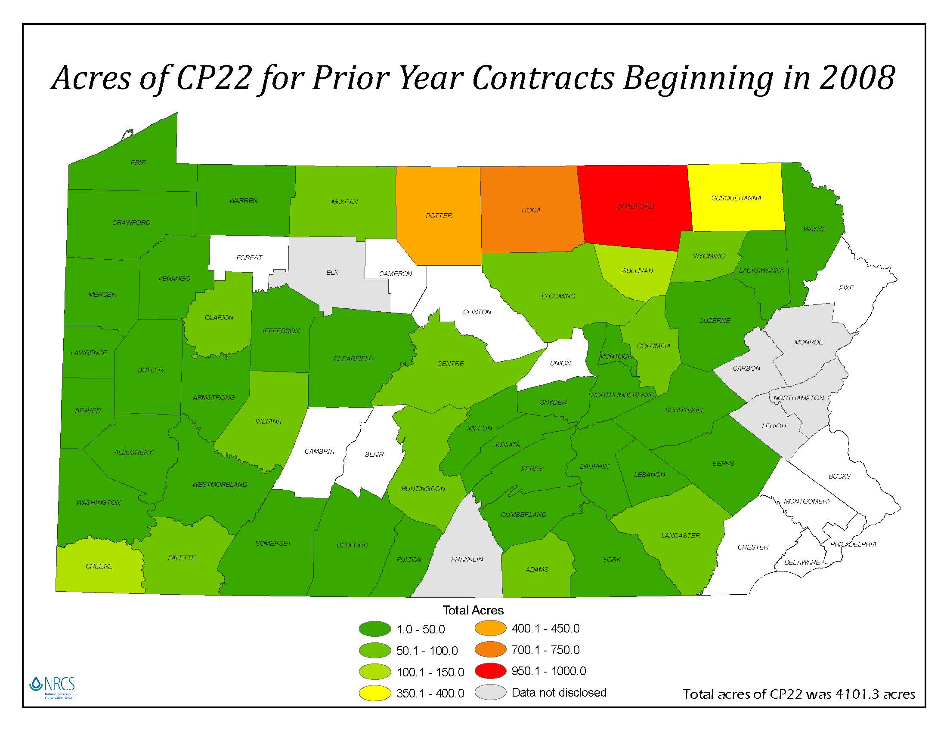

Slide 24
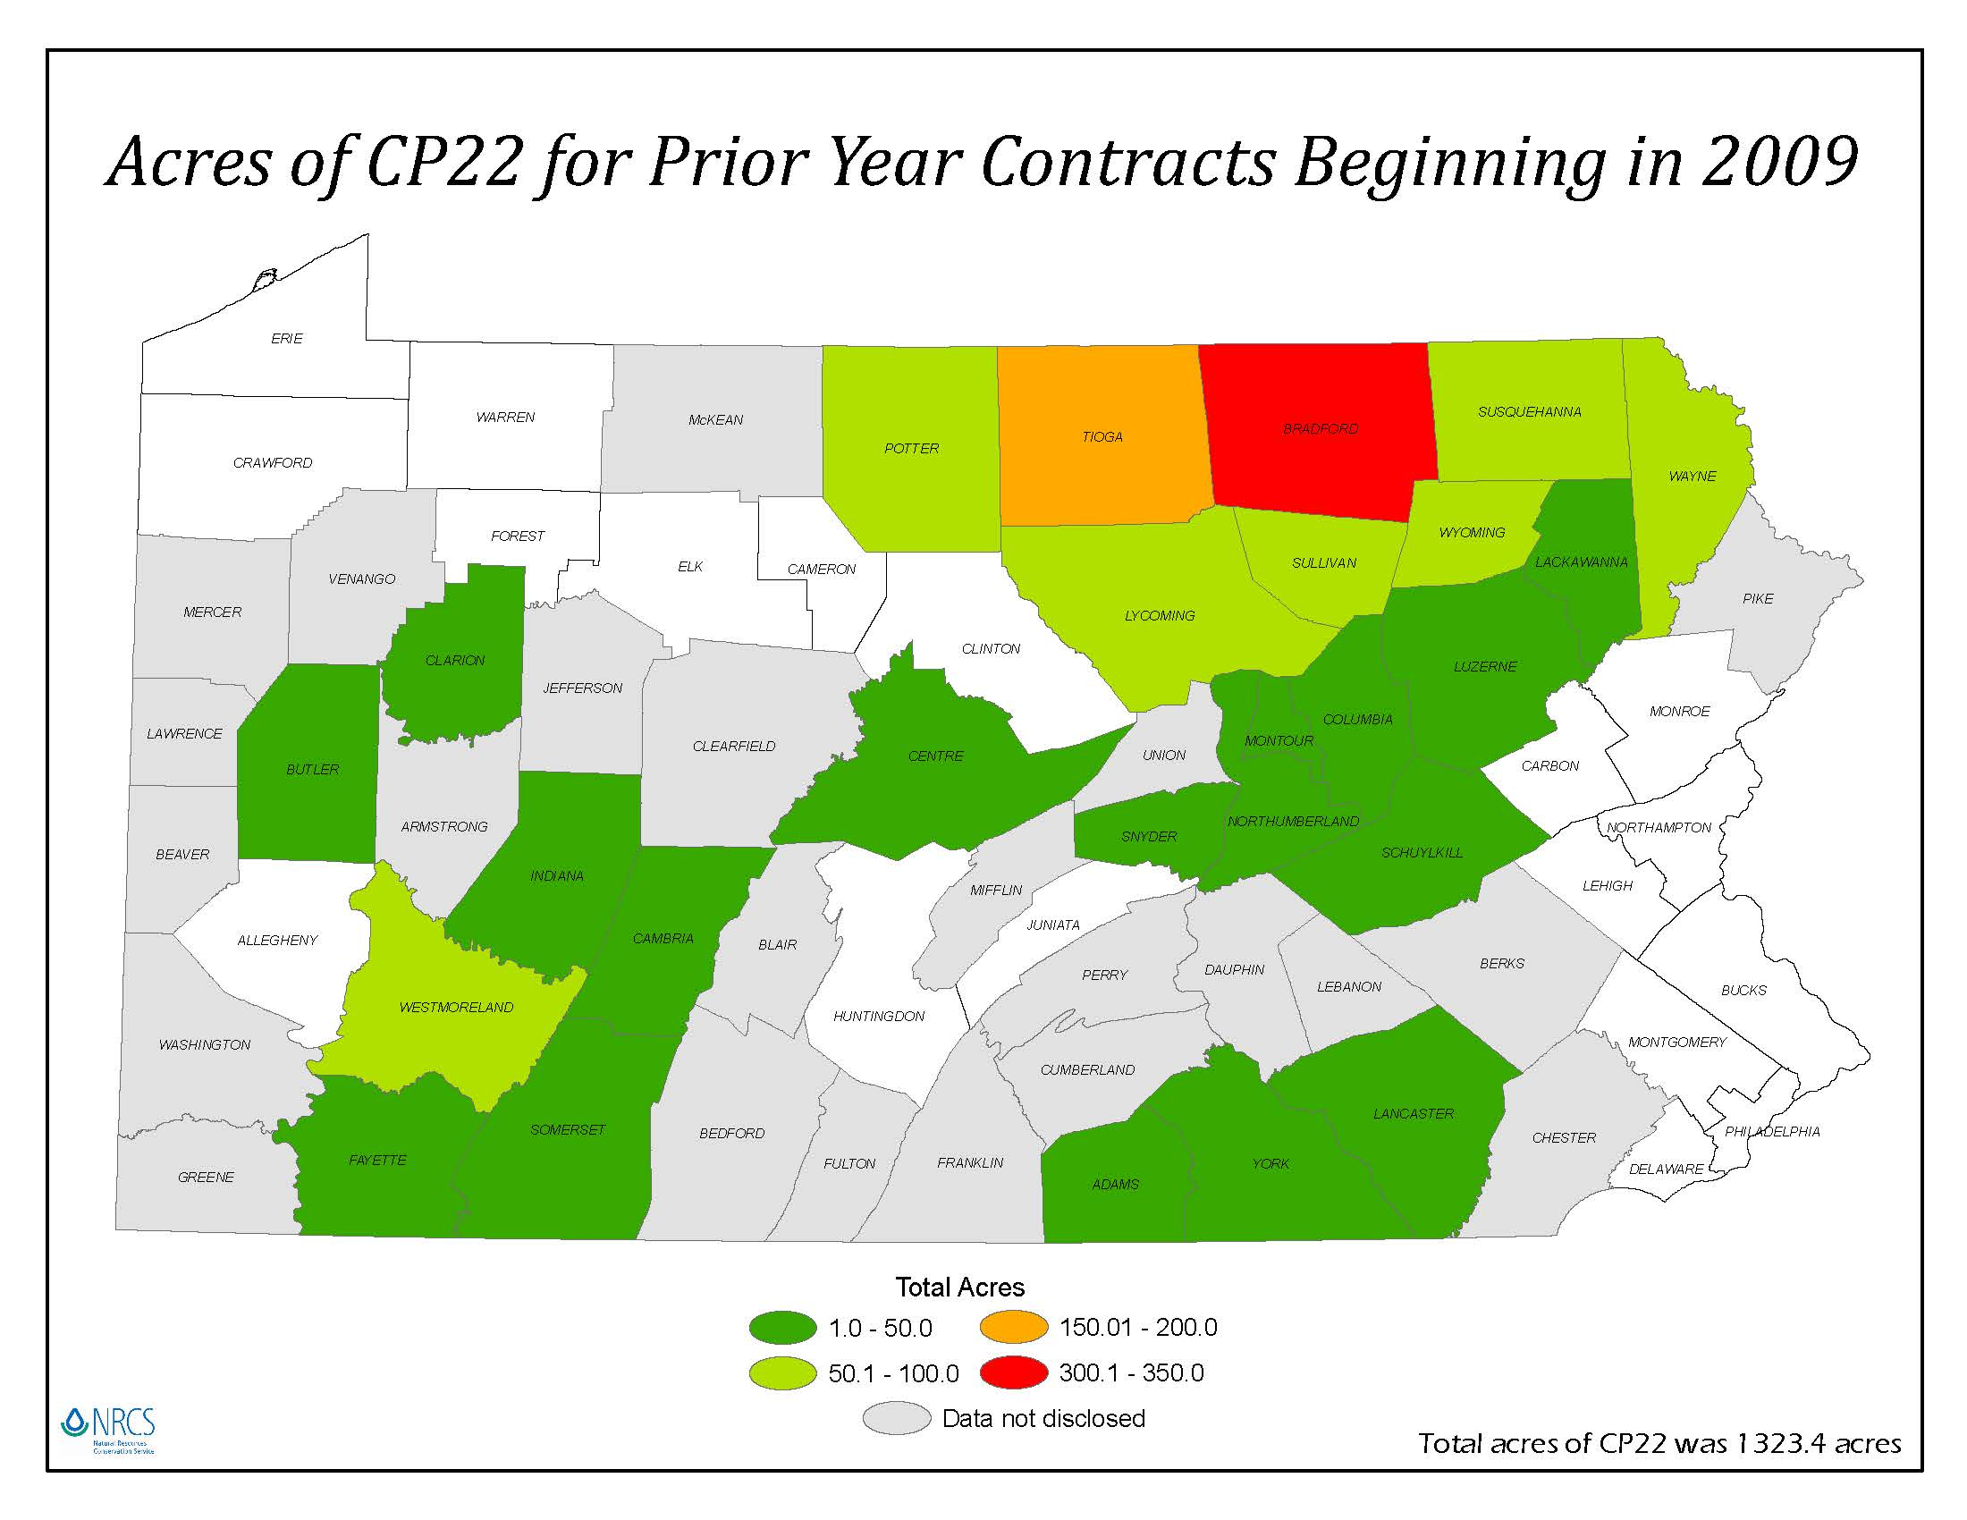

Slide 25
Future
Continue to send out postcard 2-3 years before the buffer contract expires.
Maintain partnership agreements to assist with technical work for CREP applicants and contract holders.
Work with the CRP readiness team on training for Technical Service Providers, NRCS and FSA employees.
Provide revisions and update to the CREP website webmaster.

Slide 26
Future
Do buffer visits with participants through out the contract in order to assist with maintenance.
Encourage participants to re-enroll or to keep the buffer in place for environmental reasons.
Educate CREP participants about the value of buffers.

Slide 27
Katrina Thompson
NRCS- Natural Resources Conservation Service
717-237-2260 katrina.thompson@pa.usda.gov
QUESTIONS??

