Slide 1

Citizen Stewardship Outcome Kick Off Meeting
11/18/2014
Notes:
Welcome and thank you for participating in today’s meeting. We’re here today to begin to develop management strategies for 3 outcomes in the recently signed Chesapeake Bay agreement. – healthy watersheds, land use metrics, and land use options.
Before we start – let’s go around the room and on the phone to know who is with us today. Introduce myself.
How many of you have already started this process with a different outcome – terrific, we’ll be looking to you to share your expertise as we move forward.

Slide 2
Agenda for today
Review our overall task: Management Strategy development process
Discuss “What is Citizen Stewardship?”
Identify opportunities and barriers to increasing citizen stewardship
Discuss how can we measure progress
Identify next steps for Management Strategy development

Slide 3
Chesapeake Bay Watershed Agreement
Signed on June 16th, 2014 by the Chesapeake Bay Program Executive Council.
Identifies the Partnership’s collective commitments for restoring and protecting the watershed through 10 goals and 31 outcomes.
- Goals articulate the high level aspects of the partner’s vision
- Outcomes express specific, time-bound, measurable targets that directly contribute to each goal

Slide 4
Management Strategies
“Within one year the signing of the Chesapeake Bay Watershed Agreement, the CBP’s Goal Implementation Teams will develop Management Strategies for the Outcomes that support the Agreement’s goals.” – Chesapeake Bay Watershed Agreement
A management strategy is a single document that summarizes the CPB “Decision Framework” process and the collective thinking of the CBP Partnership. It outlines the means for accomplishing the outcome as well as monitoring, assessing, reporting progress and coordinating actions among partners and stakeholders.

Slide 5
Management Strategy Document – Key Elements Framework
6) Management approach, including plans for local engagement
7) Monitoring Progress
8) Assessing Progress
9) Adaptively Manage
10) Biennial Workplan
Each MS is expected to include each of the following “key elements”:
1) Executive Summary (to be developed by the CBP Communications Office)
2) Outcomes and Baselines
3) Jurisdictions and agencies participation, including plans for local engagement
4) Factors influencing ability to meet goal
5) Current efforts and gaps

Slide 6
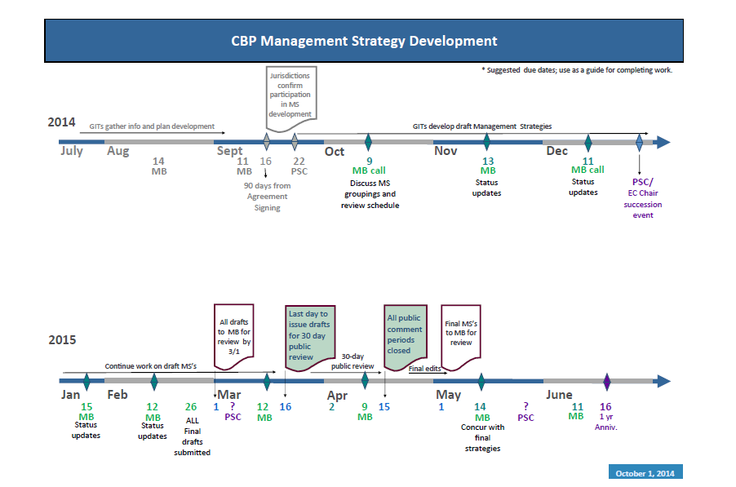
Timeline
All management strategy drafts are due to the Management Board for review by 03/01/2014

Slide 7
Our task:
The Chesapeake Bay Program’s Stewardship Goal Implementation Teams is responsible for developing Management Strategies for the Citizen Stewardship Outcome:
“Increase the number and diversity of trained and mobilized citizen volunteers with the knowledge and skills needed to enhance the health of their local watersheds.”

