Slide 1
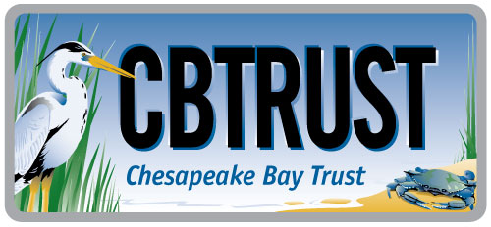

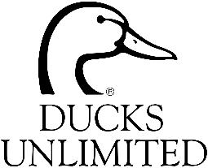
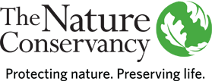

Accelerating Wetland Restoration
in the Chesapeake Bay and Beyond:
Formative Research Conducted among Agricultural Landowners
Presented to Wetland Workgroup
May 26, 2016
Notes:
This presentation summarizes a program of formative research conducted among agricultural landowners in Maryland and Pennsylvania in 2015. A coalition of partners steered this effort, led by the Chesapeake Bay Trust, The Nature Conservancy, Ducks Unlimited, and the National Fish and Wildlife Foundation. The technical aspects of the research were designed and implemented by OpinionWorks LLC, an independent research organization based in Annapolis. University of Maryland Sea Grant Extension provided technical support to the project team, as well.

Slide 2
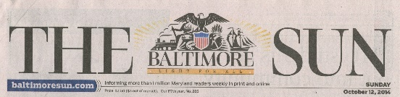
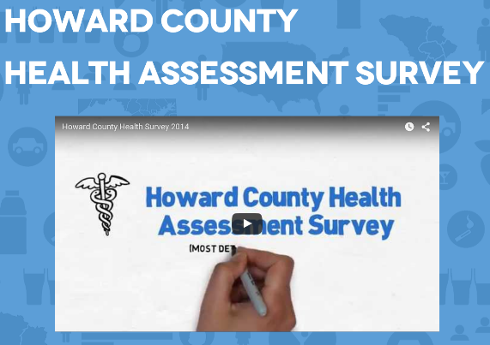
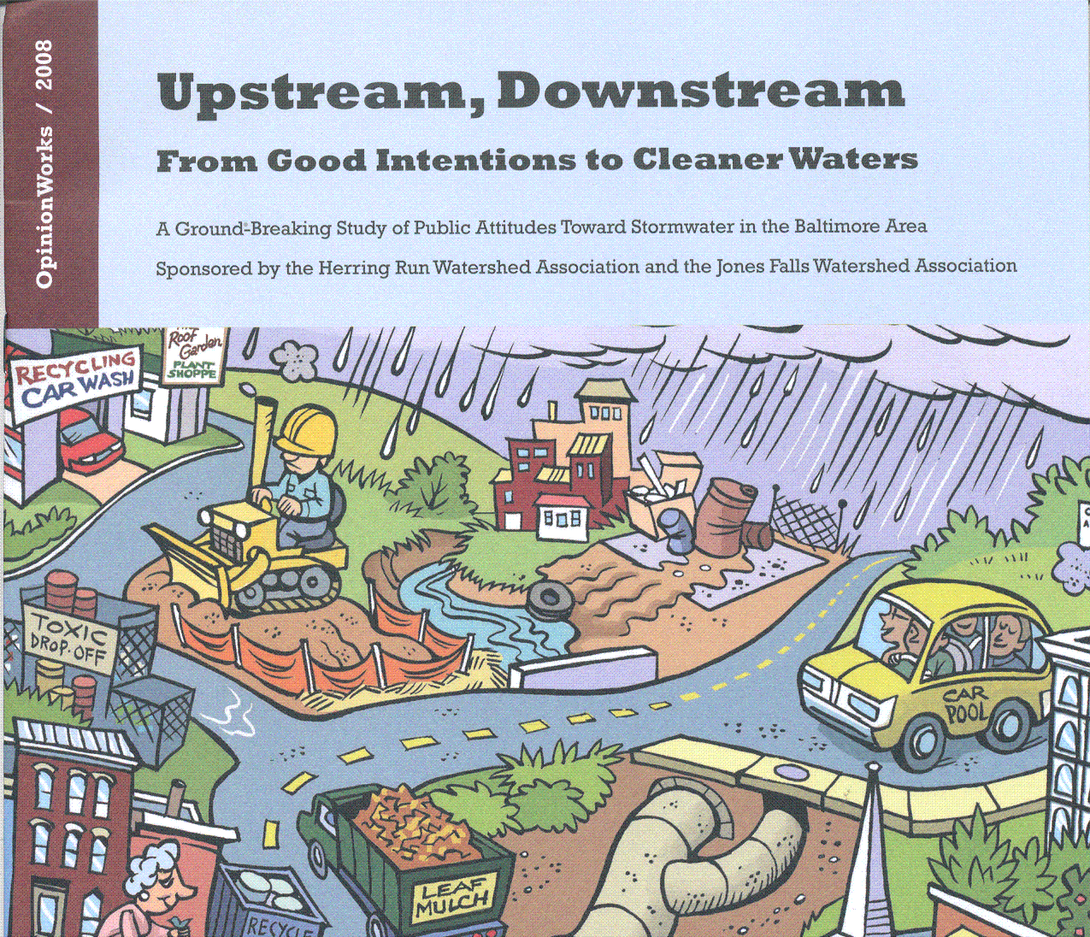
OpinionWorks Credentials
Measure perceptions, behaviors
Random samples, focus groups
  The Baltimore Sun polling
  Delaware Nature Society
    Public attitudes about water protection
  Chesapeake Bay Trust
    Extensive work assessing citizen stewardship
  Horizon Foundation & Partners
    Complex study on behavior health risk factors
  West Virginia Department of Health
    Barriers to cancer screening for low-income women
  Virginia Department of Environmental Quality
    Motivations behind mass release of balloons
Notes:
OpinionWorks is a technical assistance provider based in Annapolis. They serve a mix of environmental and health concerns primarily, for public sector and not-for-profit organizations. Much of their work is focused on individual stewardship and behavior change.

Slide 3
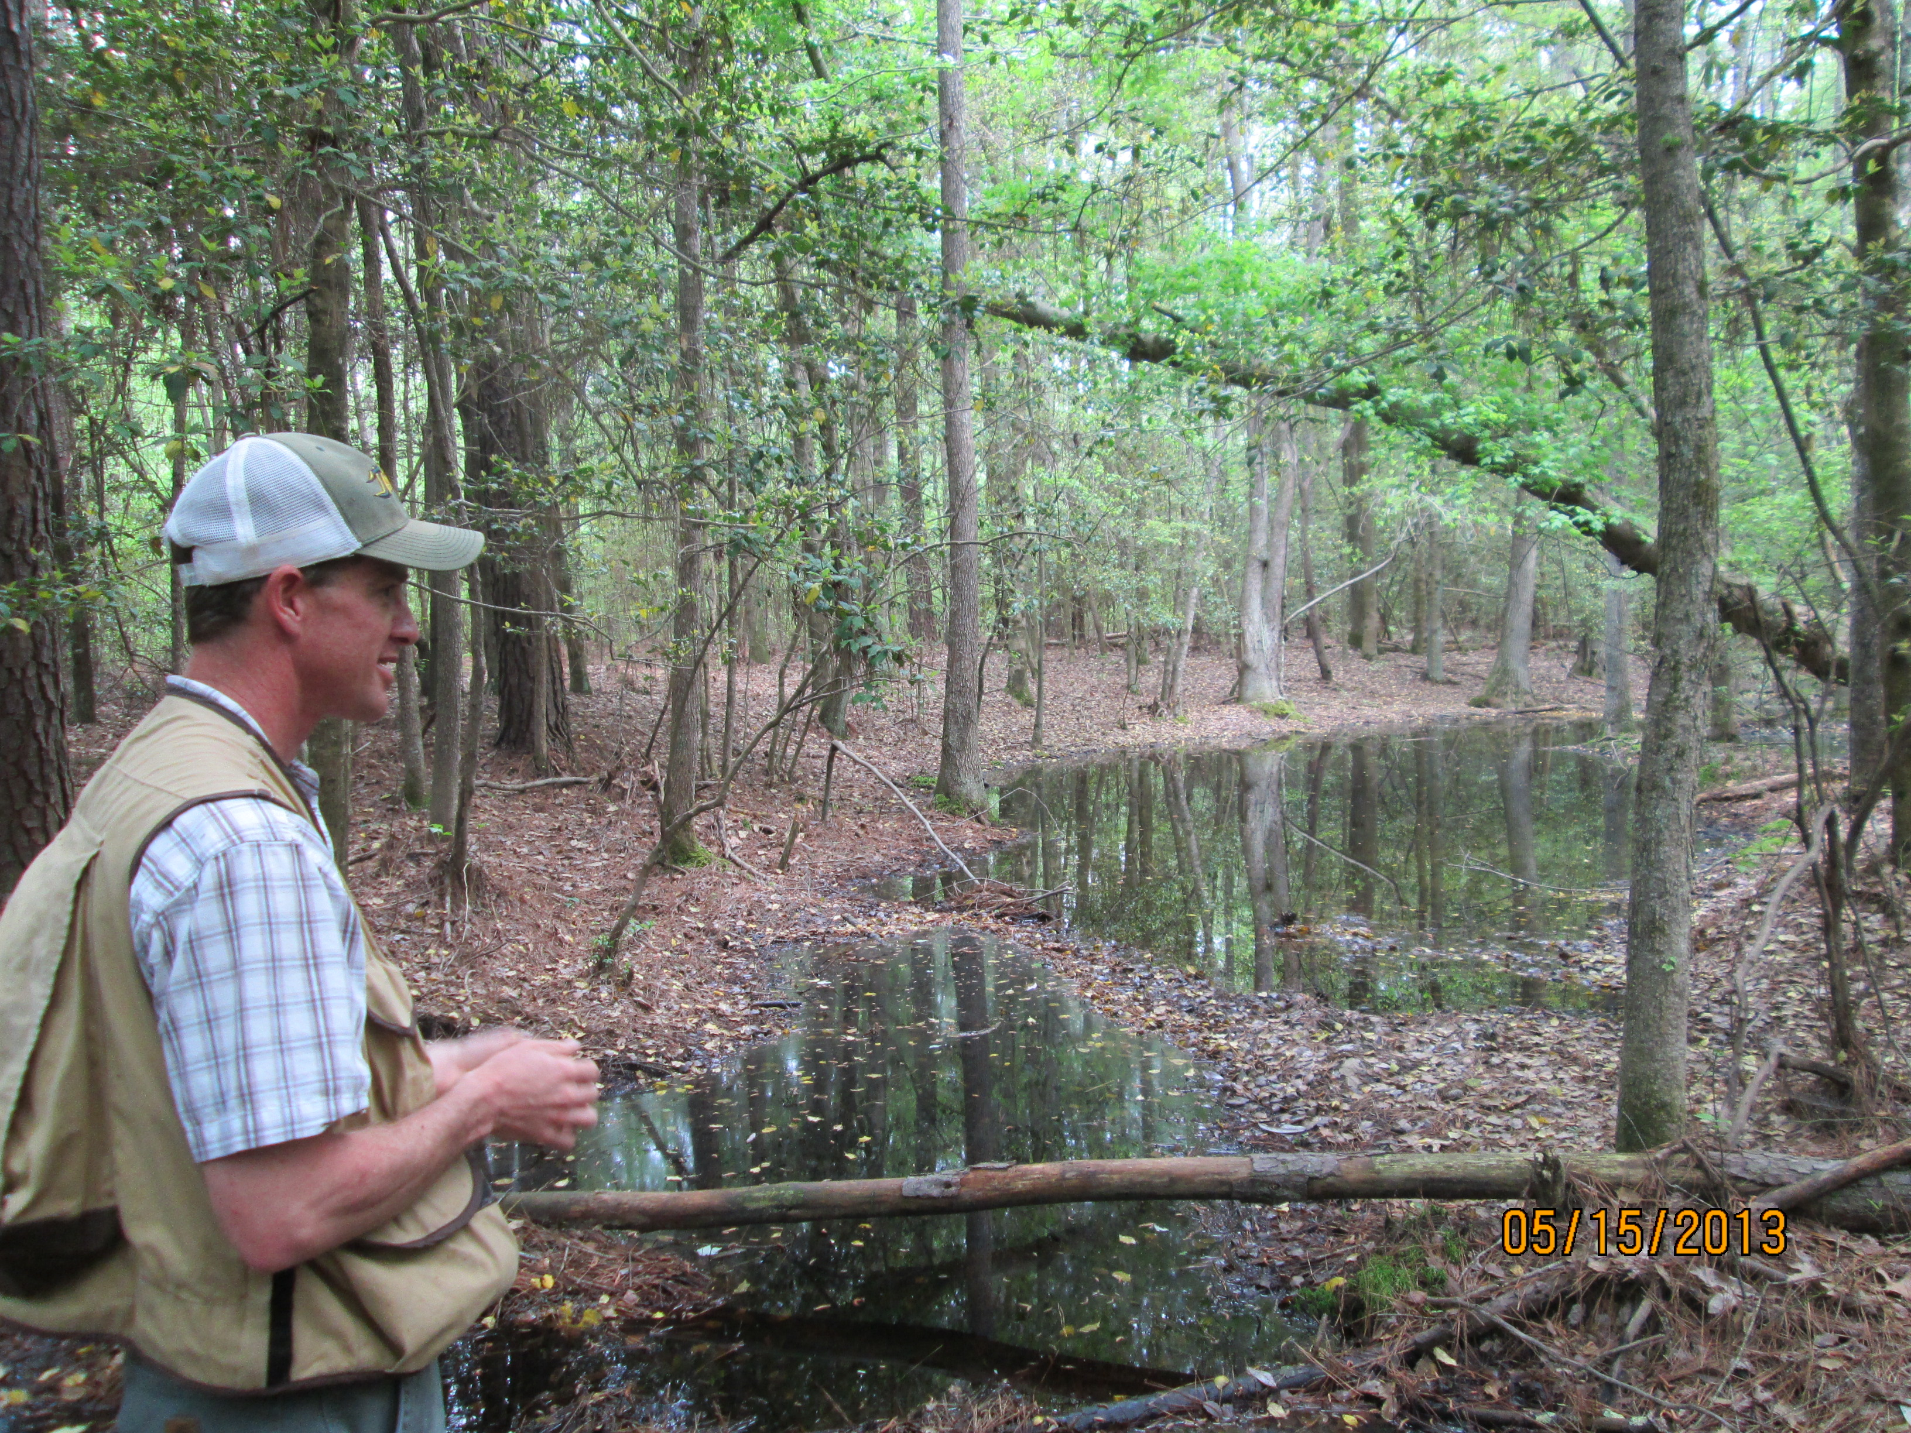

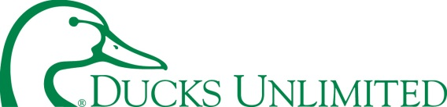
Accelerating Wetland Restoration in the Chesapeake
Interviewed >70 stakeholders
Federal Agency Staff
State Agency Staff
Local/ County Staff
Non-profits
Private Consultants
Notes:
A predecessor study was undertaken by a group of stakeholders led by The Nature Conservancy and Ducks Unlimited. This study focused on practitioners who are engaged with encouraging wetlands restoration on rural lands.

Slide 4
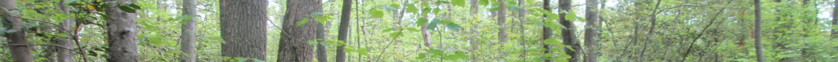


Accelerating Wetland Restoration in the Chesapeake
Obstacle 2: Outreach is limited/ not coordinated
Solutions:
  Designate a local leader for outreach and coordination
  Host annual cross-training for wetland practitioners
  Develop better marketing strategies
Notes:
As one recommendation of this study, it was determined that a better, more coordinated marketing strategy was needed. That lead to the current research among the end audience of agricultural landowners.

Slide 5
Resistant
16%
Credit: Nancy R. Lee, University of Washington & Puget Sound Partnership
Adapted from Everett Rogers, Jay Kassirer, Mike Rothschild, Dave Ward, Kristen Cooley
Notes:
First, let’s familiarize ourselves with several basic social science concepts that have guided this research. This curve is familiar to all of us. In an environmental stewardship context, the share of the population on the left are called “show me” because they just need to be shown what to do and they will do it.
The right side are called “make me,” because they are resistant to environmental initiatives and will probably need to be compelled to take involuntary action.
The vast majority of the public lives in the middle. This is the “help me” audience.

Slide 6
Traditional Public Education
Websites
Brochures
Community meetings
Compulsory Actions
Regulations
Fees & Fines
Legal action
Credit: Nancy R. Lee, University of Washington & Puget Sound Partnership
Adapted from Everett Rogers, Jay Kassirer, Mike Rothschild, Dave Ward, Kristen Cooley
Notes:
The traditional approach to behavior change involves public education, which addresses the show me audience, and punitive or compulsory measures like regulation, fines, or lawsuits to address the make me audience. The help me crowd is left out of this approach.

Slide 7
The Social Marketing Process:
Reaching the Help Me Group
  Know your campaign’s purpose and focus
  Pinpoint your target audience
  Identify the specific behavior you want the audience to take
  Assess the barriers to the action
  Find the benefits and motivators that will overcome those barriers
Notes:
This model begins with these five steps, which the research protocol was designed to address, and which will be outlined in this presentation.

Slide 8
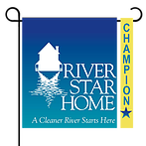
The Social Marketing Process:
Reaching the Help Me Group
  Refine your messages, incentives, and tools, and determine where and how you will deliver them to the target audience
    Product: Social Marketing Tools, Benefits
    Place: Convenience for the Audience
    Price: Incentives, Rebates
    Promotion: Messages, Delivery Channels
  Evaluate and measure your progress
Notes:
Once the formative research has been completed, the effort moves on to developing specific outreach messages, tools, and approaches, and evaluating those.

Slide 9
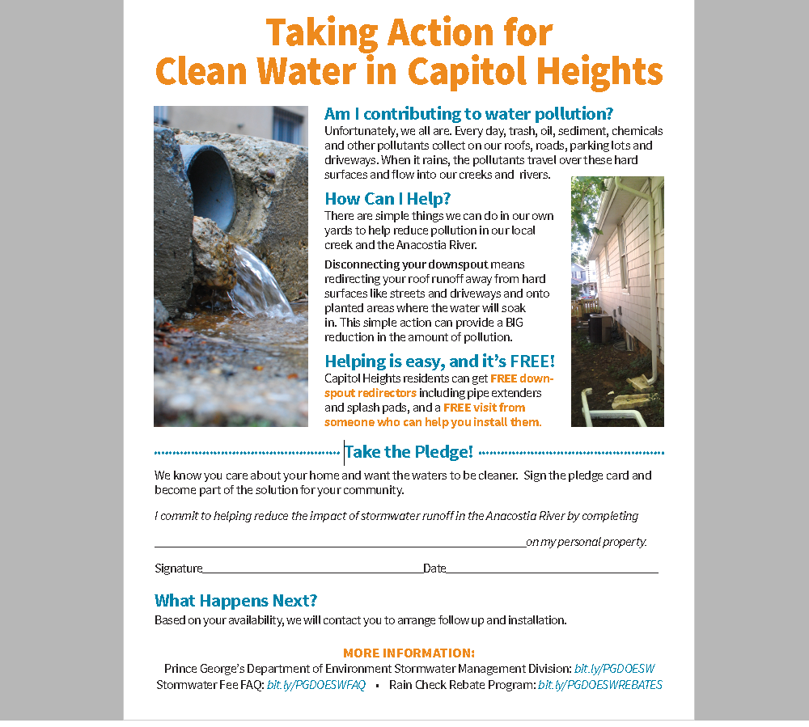
“Free Upgrade”
A/B Test:
Flooding
Water quality
50% of homes visited signed the pledge
Notes:
As one example of this approach, Clean Water Action has taken the results of formative focus groups in Capitol Heights (Prince George’s County), and are using their door-to-door canvassers to promote downspout redirects and disconnects. The results are overwhelmingly encouraging.

Slide 10
Landowner Attitudes Towards Wetland Restoration
Project Purpose and Focus
To increase the adoption
of wetlands restoration
on agricultural lands
in keeping with
the Chesapeake Bay Agreement
Notes:
This formative research was designed to provide information to help increase the adoption of wetlands restoration on agricultural lands, in keeping with the Chesapeake Bay Agreement. The research produced recommendations for outreach, in keeping with the Community Based Social Marketing model.

Slide 11
Landowner Attitudes Towards Wetland Restoration
Target Audience
“Downstream” Audience:
Agricultural landowners
40+ acres
Not enrolled in wetlands restoration program
Targeted counties
Coastal plain to Piedmont
Good infrastructure and other efforts in place
Notes:
The project identified a “downstream” or decision-making audience of agricultural landowners. The focus of this research was landowners of 40 or more acres who are not presently enrolled in a wetlands restoration program, and who live in counties that have an infrastructure in place that would allow for effective education and marketing of the wetlands programs that are available. The targeted counties ranged from the coastal plain of Delmarva to the Piedmont of Central Pennsylvania.

Slide 12
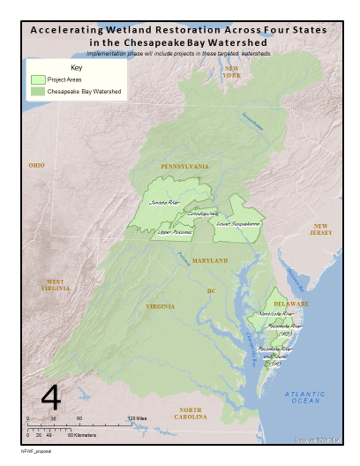
Notes:
The research was generally focused in areas that the National Fish and Wildlife Foundation has previously identified as offering high potential for wetlands adoption. Ultimately, this work was focused in Juniata, York, and Lancaster Counties in Pennsylvania; and Caroline, Kent, Talbot, Dorchester, Somerset, Wicomico, and Worcester Counties in Maryland.

Slide 13
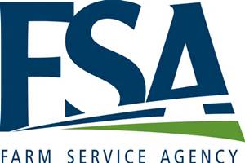



Landowner Attitudes Towards Wetland Restoration
Target Audience
“Midstream” Audience:
Service providers to the agricultural landowners
County agricultural service centers
Notes:
Early in the process, the research identified an important “midstream” audience, consisting of technical assistance providers typically located in county agricultural service centers, and which enjoy high trust from the downstream landowner audience.

Slide 14
Landowner Attitudes Towards Wetland Restoration
Desired Behavior
Enroll in wetlands restoration program
and follow through to installation
Notes:
The desired behavior that is the object of this research is encouraging landowners to enroll in wetlands programs and follow through to the installation of a restored wetland.

Slide 15
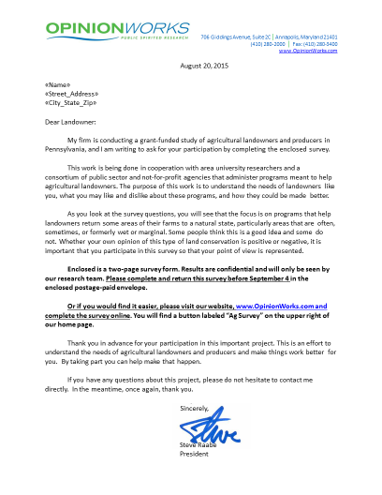
Landowner Attitudes Towards Wetland Restoration
Landowner Survey Methodology
Randomly-selected agricultural landowners in targeted counties
Survey conducted by mail/phone (Aug 2015)
Survey packet mailed
Phone calls to non-responders
409 survey responses
Notes:
The research was conducted in two phases. First, a survey was conducted in August 2015 among agricultural landowners randomly selected from within the targeted counties. Wetlands program non-participant lists were not available to researchers, so landowners were included in the survey regardless of their knowledge or participation in wetlands programs. A survey packet consisting of a cover letter and printed questionnaire was mailed, with a postage paid mail-back mechanism included, as well as a URL where landowners could complete the survey online if they preferred. Telephone calls were subsequently made to non-responders, with the survey was administered by telephone. A total of 409 landowners took part in the survey through these methods.

Slide 16
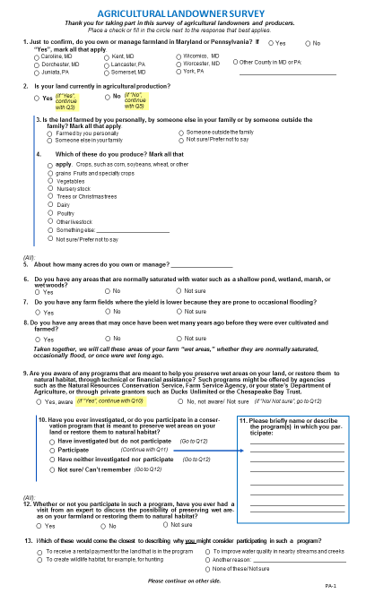
Notes:
The survey questionnaire measured characteristics of the farm, basic impressions of wetlands, knowledge of programs available, factors that might make one more likely to participate in a wetlands program, and the level of trust in various entities that may provide information to a landowner about wetlands.

Slide 17
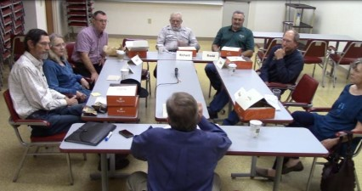
Landowner Attitudes Towards Wetland Restoration
Landowner Focus Groups
4 Locations (Sep, Nov 2015)
  Juniata County, PA
  Lancaster/York Counties, PA
  Mid-Shore, MD
  Lower Shore, MD
120-minute sessions, professionally facilitated
Tested:
  Attitudes, Perceptions
  Expectations, Barriers
  Messages, Outreach Techniques
Notes:
Subsequently, four focus groups were conducted between September and November 2015. They ranged from Juniata County in the Central Pennsylvania Piedmont down to the lower Eastern Shore (Salisbury) in Maryland. Six to eight landowners participated in each group, which was a probing discussion of relevant issues, and designed to identify the motivators and incentives that could overcome the barriers to enrolling in wetlands programs. Each session was facilitated by a trained moderator who is skilled at leading such a discussion and helping the group pinpoint key observations.

Slide 18
Landowner Attitudes Towards Wetland Restoration
Barriers to Adopting Wetlands Programs
Landowners do not know how to start the process, or where to go for information.
Mistrust of government agencies.
Loss of control over what happens on my land.
Strong preference for peer-to-peer validation, at the expense of many other messengers.
Significant privacy concerns.
Smaller farms challenged because they do not want to give up limited tillable land.
“Wetland” is not a positive term, yet it is used extensively in program literature and parlance.
Heavy reliance on postal communication, which introduces limitations on outreach.
Very busy people; hard to reach.
Don’t want people showing up on their land unannounced.
Perceived inflexibility of these programs.
Fear that the land will be out of production forever; may affect future sale price or next generation of landowners.
Mosquitos.
Loss of income.
Variability of crop prices introduces uncertainty.
Landowners’ prevailing view that all land must be “useful.”
Landowners are not being approached with this information.
Very uneven knowledge about program availability, and uneven commitment to selling these programs, among local ag service providers and other advocates.
Notes:
Through this research, we learned of many barriers to enrollment in wetlands programs. These included lack of knowledge, significant privacy concerns and mistrust of government, misperceptions and negative impressions of wetlands, tremendous concerns for loss of flexibility and control over one’s property, loss of tillable acreage, and a constant uncertainty of future commodity prices, which makes the cost-benefit calculation for these programs extremely difficult in the out years. Barriers are many and easy to identify.

Slide 19
Landowner Attitudes Towards Wetland Restoration Barriers to Adopting Wetlands Programs
Lack of information/advocacy
Privacy and trust concerns
Financial uncertainty
Extreme need for flexibility
Audience is hard to reach
Notes:
Boiling down this long list of barriers into broad topics, these five categories suggest themselves.
The audience lacks deep awareness of wetlands-specific programs, despite widespread familiarity with one program - CREP. Furthermore and importantly, in the early phases of this research it became clear that some in the midstream audience of agricultural service providers also lack knowledge of the program specifics, and therefore are not in a position to market the programs effectively.
The landowner audience voiced strong and repeated concerns for their privacy, and expressed general cynicism about the public sector. They would not welcome overtures from messengers they did not already know and trust.
The financial uncertainty of future rental payments given the variability of commodity prices undermines the appeal of the financial benefit of these programs.
Landowners want flexibility. They want to control what happens on their land in the immediate term, and do not want to lock themselves into a long-term contract that may burden their heirs or reduce the market value of their land.
Importantly, this is a busy audience and hard to reach. By and large, most were not digitally inclined and not very phone responsive. Traditional mail and in-person contact remain the best ways to interact with this audience, which can make marketing and outreach more cumbersome and expensive.

Slide 20
Landowner Attitudes Towards Wetland Restoration
Barriers to Adopting Wetlands Programs
“wetland”
“wildlife pond”
Notes:
The focus group work made clear that the term “wetland” is not a positive one in the minds of many agricultural landowners. It conjured negative images of unusable land, mosquitos, and more. In discussion, it appeared that the term “wildlife pond” was a more comfortable vernacular that several focus group participants introduced and which others accepted. An early finding of this work is that the terminology may need to change in the marketing of these programs.

Slide 21
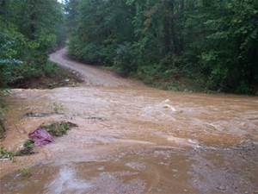
Landowner Attitudes Towards Wetland Restoration
Underlying Concerns of the Audience
Water impairment (Delmarva)
Erosion/Flash flooding (PA)
Encroaching development
Notes:
The focus group discussion provided clues to motivators that could help overcome these barriers. In Delmarva, landowners expressed strong concern for water quality in the creeks and streams surrounding their properties and in their groundwater. They understood that wetlands can play a role in helping restore natural waters around their property.
In Pennsylvania, concerns were much more oriented towards erosion and flash flooding. In addition to erosion, Pennsylvania landowners focused on other signs of stream health such as presence of fish and water temperature.
Encroaching development was a significant concern in both the Lancaster/York and the Mid-Shore focus groups. There, wetlands restoration was seen by some as a way to buffer against sprawling development, perhaps saving their own farm for future generations.

Slide 22
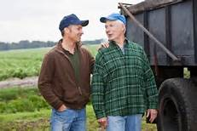
Landowner Attitudes Towards Wetland Restoration
Observation: Implication for Outreach
This audience is social.
Notes:
As a general observation and a clue to outreach strategy, it should noted that the landowners were highly social with each other and enjoyed talking about farming. New friendships were formed in the focus group room. Keying on this natural sociability, it makes sense that an outreach strategy to promote wetlands would include peer-to-peer interaction.

Slide 23
Level of Trust in Information
1-5 scale; Top 8
“Please indicate how much you would trust information from each of these organizations and individuals about preservation and restoration of natural areas on your land.” (5-point scale of trust.)
Notes:
The survey contributed some refined understanding of the most trusted messengers. A total of 15 entities that might provide information about wetlands were tested on a 1 to 5 scale of trust, with 5 being highest. Here, the top eight are shown. As is often the case, family members rank highest. Just below them are the agricultural agencies that farmers tend to see as their sounding boards and advocates, and which are generally found in the county agricultural services office. Ducks Unlimited also made the top tier.

Slide 24
Level of Trust in Information
1-5 scale; Second Tier
“Please indicate how much you would trust information from each of these organizations and individuals about preservation and restoration of natural areas on your land.” (5-point scale of trust.)
Notes:
Non-agricultural entities, private sector parties, and environmental organizations make up the lower tier.

Slide 25
Awareness of Wetlands Programs
“Are you aware of any programs that are meant to help you preserve wet areas on your land, or restore them to natural habitat, through technical or financial assistance? Such programs might be offered by agencies such as the Natural Resources Conservation Service, Farm Service Agency, or your state’s Department of Agriculture, or through private grantors such as Ducks Unlimited or the Chesapeake Bay Trust.”
Notes:
While 60% of landowners said they were “aware of…programs that are meant to help you preserve wet areas on your land, or restore them to natural habitat,” four in ten were not aware at all of the existence of wetlands restoration programs. This of course identifies a most fundamental barrier to program adoption among the unaware landowners, and points out the need to do much more marketing.

Slide 26
Participation in Wetlands Programs
29% Participate
or Have Investigated
“Have you ever investigated, or do you actually participate in a conservation program that is meant to preserve wet areas on your land or restore them to natural habitat?”
Notes:
Among the full survey sample, 13% said they currently “participate in a conservation program that is meant to preserve wet areas on your land or restore them to natural habitat.” Most commonly, those landowners were referring to CREP. Another 16% they have investigated such a program in the past but do not participate.
The rest of the sample (71%) have never investigated or are unaware of wetlands restoration programs.

Slide 27
Ever Had a Visit from an Expert
Fewer than one in five have ever had
a consultation on their land
“Whether or not you participate in such a program, have you ever had a visit from an expert to discuss the possibility of preserving wet areas on your farmland or restoring them to natural habitat?”
Notes:
About one in five landowners (18%) have “had a visit from an expert to discuss the possibility of preserving wet areas on your farmland or restoring them to natural habitat.”

Slide 28
Landowner Attitudes Towards Wetland Restoration
Why You Might Consider Wetlands
“Which of these would come the closest to describing why you might consider participating in such a program:
To receive a rental payment for the land that is in the program,
To create wildlife habitat, for example, for hunting,
To improve water quality in nearby streams and creeks,
Or some other reason?”
Notes:
Broadly, the survey tested three major motivations that might cause a landowner to participate in a wetlands restoration program. Survey participants were allowed to choose more than one motivation if they chose to do that.

Slide 29
Why Landowners Might Consider Wetlands
“Which of these would come the closest to describing why you might consider participating in such a program:
To receive a rental payment for the land that is in the program,
To create wildlife habitat, for example, for hunting,
To improve water quality in nearby streams and creeks,
Or some other reason?”
Notes:
Improving water quality (36%) and receiving a rental payment (35%) scored equally well in the survey. Only a short distance behind was the idea that a wetland would create wildlife habitat that might be useful for hunting.
It should be noted that water quality is the top concern by a much larger margin in Pennsylvania (more than 10 percentage points). Hunting related to waterfowl is very popular on the Eastern Shore of Maryland.

Slide 30
Landowner Interest in Wetlands Program
Asked of Those Not Currently Participating in a Program
“If you were told about a program to help you preserve or restore wet areas on your land as a way of providing wildlife habitat and protecting local streams, and if the program paid enough to cover your costs of participating, without forcing you to give up too much control of what happens on your land, how likely would you be to seriously consider it?”
Notes:
As a bottom line, despite lack of knowledge, interest is quite encouraging in “a program to help you preserve or restore wet areas on your land as a way of providing wildlife habitat and protecting local streams.” Among those who said they are not currently participating in such a program, 8% said they would “definitely would…seriously consider it” and another 23% said they “probably would.” These are very promising numbers and suggest that an effective, coordinated outreach effort could achieve much increased adoption.

Slide 31
Landowner Attitudes Towards Wetland Restoration
Recommendation 1:
Focus the Message on Core Benefits
1. Water Quality/Stream Health
  Erosion Control (PA)
2. Wildlife/Waterfowl Habitat
  Hunting/Hunting Leases (MD)
3. Hedge against Encroachment
Notes:
At its core, this effort can be built around landowners’ strong concern for water quality. In Pennsylvania, this can take the specific added dimension of addressing flash flooding and erosion control.
Wildlife habitat and the potential for hunting leases are a powerful motivator in Maryland, and to a lesser extent upstream in Pennsylvania.
In agricultural areas that have a development threat, the hedge against the encroachment of future development is an additional motivator for some landowners.
Note that despite their importance, rental payments are not presented as a core motivation because of the uncertainty of future commodity prices, which weighs on the decision-making process of many agricultural landowners, as was made clear in the focus groups. While not a leading message, financial benefits are a decision-making factor and need to be presented in a supporting way.

Slide 32
Landowner Attitudes Towards Wetland Restoration
Recommendation 2:
Mitigate the Key Barriers
Lack of Awareness
4 in 10 unaware of programs
Loss of Control
Landowners feel locked in by some programs
Want a greater say over what happens on their land
Consider offering shorter contracts
Ability to choose contractor; involvement with site design
Financial Uncertainty
Address through program design
Notes:
The leading barrier is lack of information. Four agricultural landowners in ten are unaware of the availability of wetlands restoration programs, suggesting that additional resources need to be brought to bear on this marketing challenge. Seven in ten landowners are unaware or, if aware, have never investigated the possibilities.
When presented with information, landowners expressed significant concerns about losing control of what happens on their land and locking themselves in to long-term contracts that may hamper them, or their heirs, down the road. Program sponsors would be well-advised to consider building in greater flexibility in future program design, perhaps offering shorter contracts, ability to specify a contractor, greater say over site design, etc.

Slide 33
Landowner Attitudes Towards Wetland Restoration
Recommendation 3:
Rely on the Most Trusted Messengers
Rural
Landowner
Trusted
Specialist
Foster this critical conversation to:
Build comfort
Answer questions
Assess alternatives
Notes:
Critical to the success of the outreach effort is engaging the trusted midstream audience, and fostering direct, personal conversations between landowners and their local agricultural specialists. This may require some training for the specialists to bring them up-to-speed on the wetlands programs that are available in their county, and to provide them with talking points drawn from the findings of this study.
In this research it became clear that landowners view this as a complicated decision. Multiple programs are available, and individual programs themselves are complex and offer variations. A focus group participant likened the difficulty of making this decision with choosing a health insurance plan, where a conversation with a knowledgeable expert can help sort out the many details and crystallize the plan that is best for the individual household. The comparison is apt and underlines the importance of fostering the conversation between landowner and a knowledgeable, trusted specialist.

Slide 34
Landowner Attitudes Towards Wetland Restoration
Recommendation 4:
Prompt and Support This Conversation
Direct mail to spark initial interest
Neighbor ambassadors who already participate
Web portal with overview of program options
Training for specialists in wetlands programs
All point to initiating conversation with the trusted specialist
Notes:
Traditional postal mail into the homes of agricultural landowners will be helpful to raise awareness of these programs and encourage the landowners to initiate conversations with local county ag agents.
Peer-to-peer communication will also be helpful, enlisting the help of local farmers who participate in wetlands programs and understand the benefits.
As a tool, a web portal with an overview of locally-available programs is critical. Such a portal can offer links to deep information on specific programs for those who want that. This portal does not exist today, and it was clear from this research that it would be invaluable to the specialists who are responsible for marketing these programs, as well as the landowners themselves who would like to explore their options.

Slide 35
Conclusion
and Discussion
Notes:
This research suggests that awareness of programs is low, and that wetlands adoption is also hampered by many serious barriers. The community of specialists who could market these programs need basic tools to help them offer and describe these programs, and a coordinated outreach effort is needed to encourage landowners to initiate these conversations.
As a next step, the resources must be found to develop and implement this effort on a pilot basis, to determine how successful we can be in increasing program adoption with the right outreach techniques and messengers.

