Slide 1

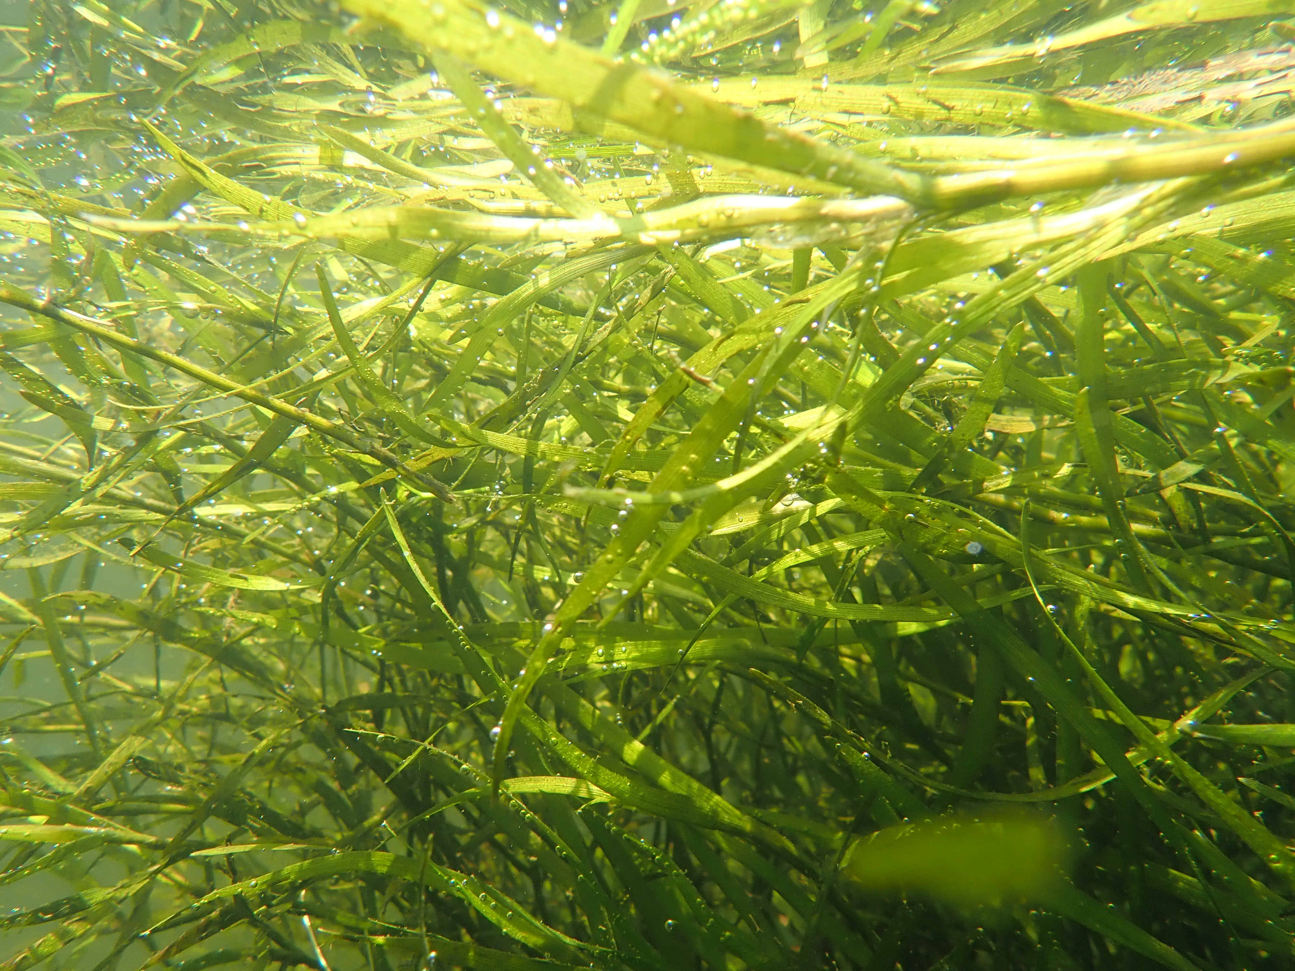
HGIT Spring Meeting – May 7th, 2020
Chesapeake Bay Program
Submerged Aquatic Vegetation Management Strategy and Workplan Updates 2020-2021
Brooke Landry
Maryland DNR
SAV Workgroup Chair

Slide 2
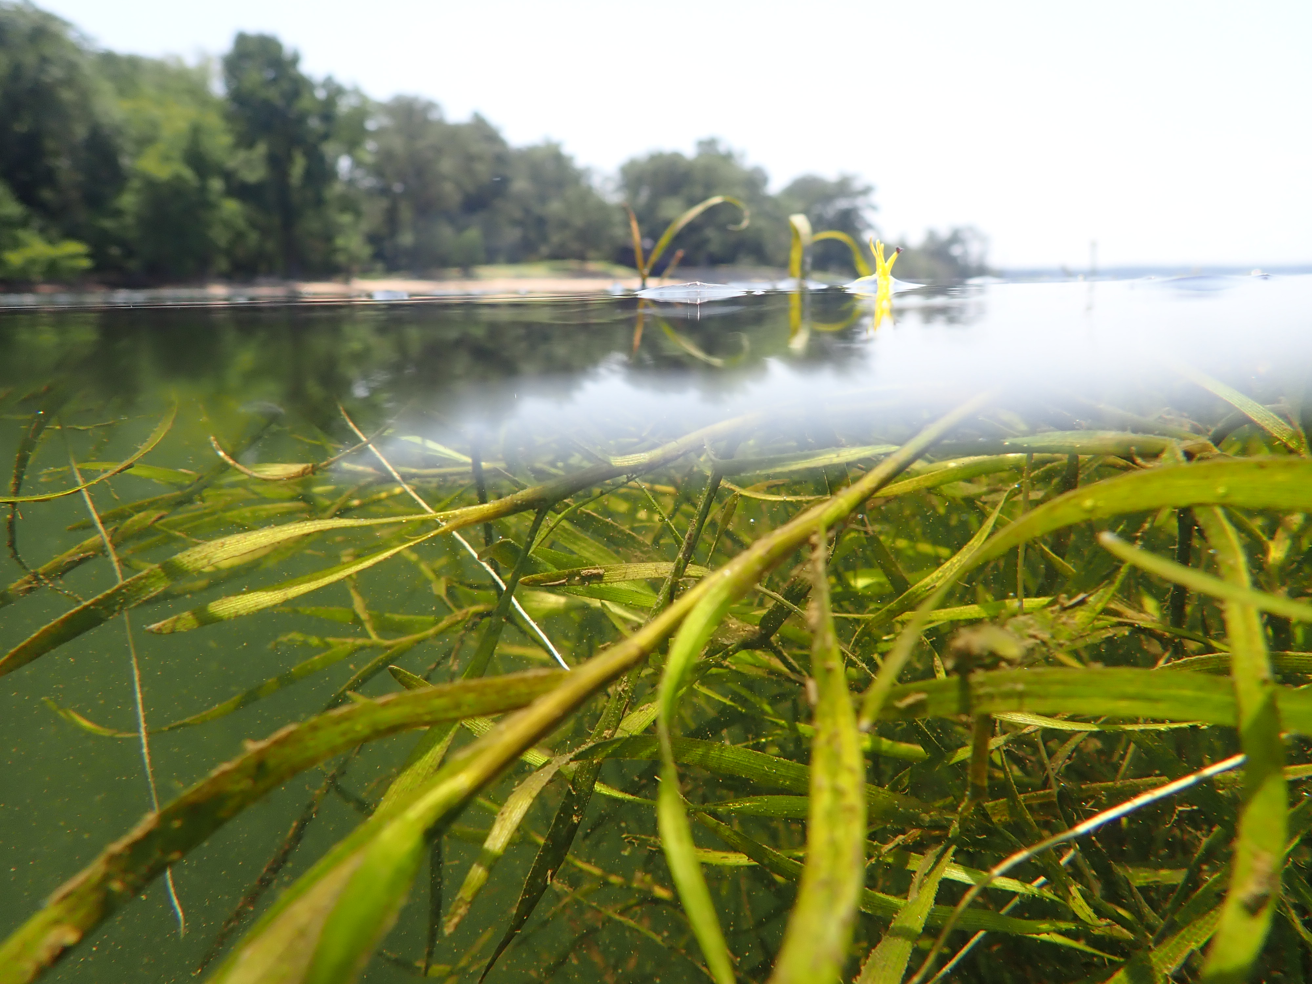
Through the Chesapeake Bay Watershed Agreement, the Chesapeake Bay Program has committed to…
Goal: Vital Habitats
Outcome:
Sustain and increase the habitat benefits of SAV in the Chesapeake Bay. Achieve and sustain the ultimate outcome of 185,000 acres of SAV Bay-wide necessary for a restored Bay. Progress toward this ultimate outcome will be measured against a target of 90,000 acres by 2017 and 130,000 acres by 2025.

Slide 3
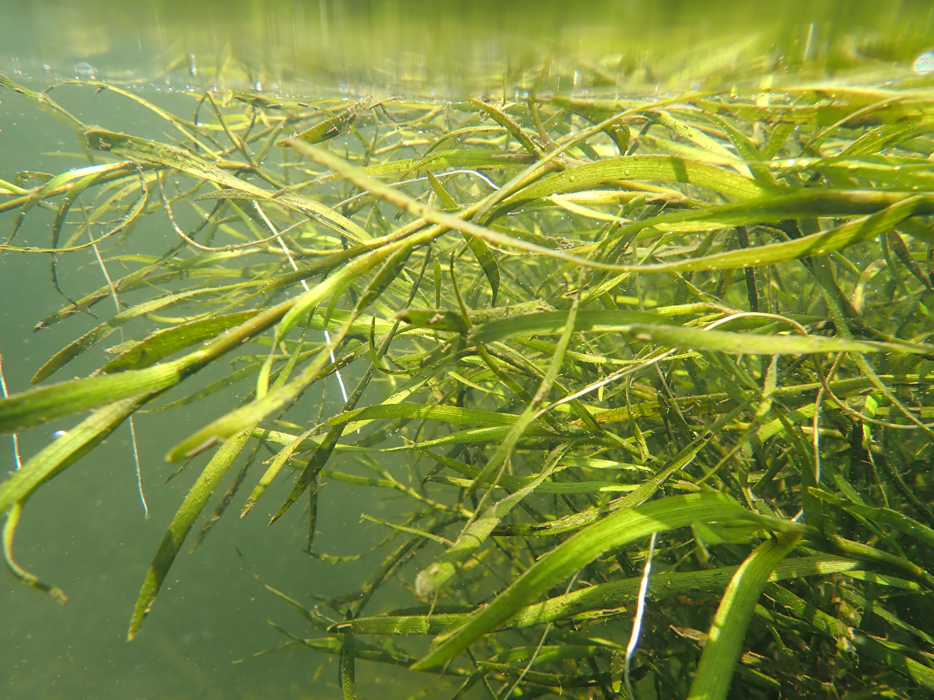
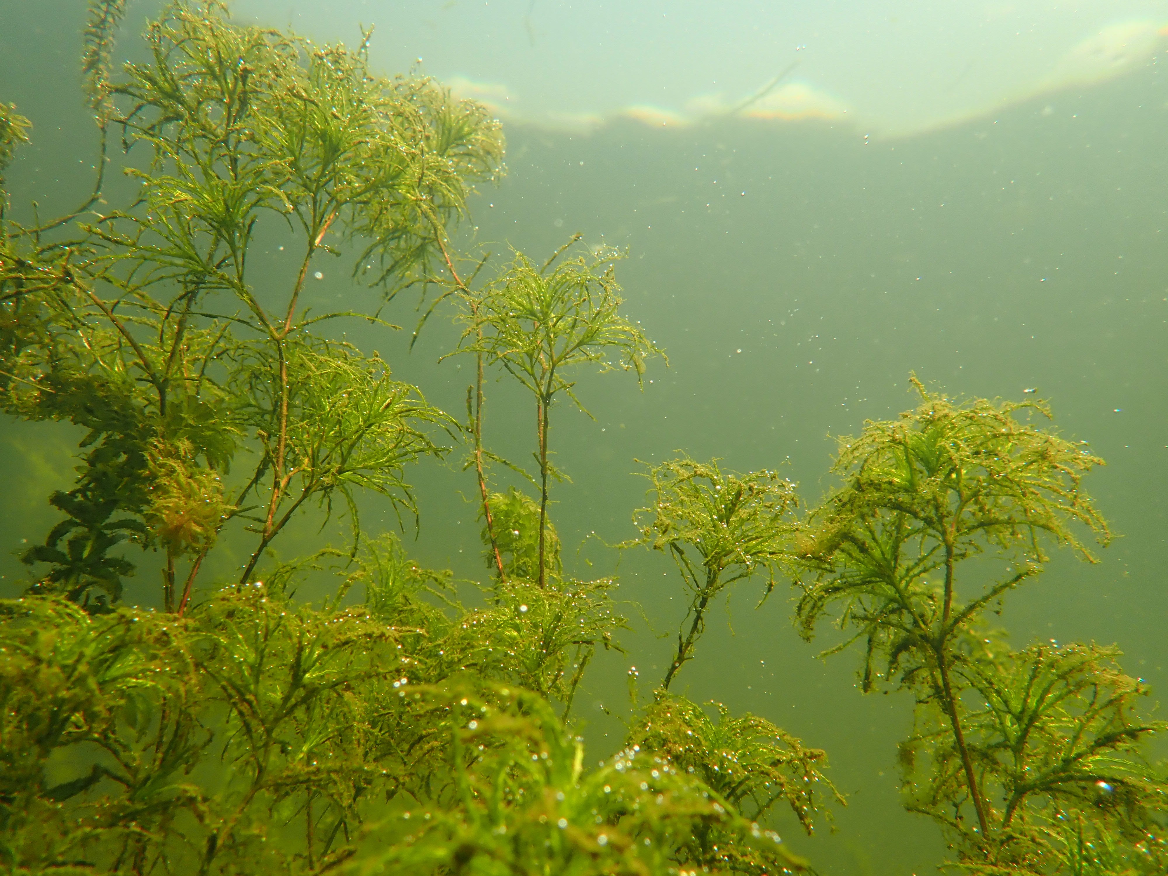
Factors Influencing Success
SAV Management Strategy V3
Habitat Conditions and Availability
Protection of Existing and Recovering SAV
SAV Restoration Potential and Activity
SAV Research and Monitoring
Public Perception, Knowledge, and Engagement

Slide 4
Current Efforts and Gaps
SAV Management Strategy V3
Habitat Conditions and Availability
Protection of Existing and Recovering SAV
SAV Restoration Potential and Activity
SAV Research and Monitoring
Public Perception, Knowledge, and Engagement

Slide 5
Management Approaches
SAV Management Strategy V3
Support Efforts to Conserve and Restore Current and Future SAV Habitat and Habitat Conditions
Protect Existing and Recovering SAV
Restore SAV
Enhance SAV Research and Monitoring
Enhance Citizen Involvement, Education, and Outreach

Slide 6
SAV Workplan 2020-2021; Actions to go with the approaches
MA 1: Support efforts to conserve and restore current and future SAV habitat and SAV habitat conditions in the Chesapeake Bay
1.1: Support the WQ GIT in their efforts to achieve water clarity/SAV standards in areas designated for SAV use.
-Enhance WQ Monitoring
1.2: Encourage/Promote the use of BMPs within local planning efforts that benefit SAV
-Promote use of new SAV Fact Sheets on Data Dashboard
-Promote use of SAV: Principles for WIPs
-Convene meeting to discuss shallow water use conflicts, determine beneficial path forward (6/3/20)
1.3: Consider implications of shallow water use conflicts
-Mapping exercise to determine escape route for SAV from climate impacts
-Zostera v Ruppia research project. Will loss of eelgrass affect blue crabs in polyhaline?
1.4: Evaluate the potential for SAV to reach restoration goals and provide relevant ES in ace of climate change impacts

Slide 7
SAV Workplan 2020-2021; Actions to go with the approaches
MA 2: Protect Existing and Recovering SAV in the Chesapeake Bay
2.1: Convene bi-annually to discuss priorities, review status updates, update the SAV Management Strategy, and implement Workplan actions.
- The SAV Workgroup will meet and produce meeting reports and summaries.
2.2: Review and consider implementation of recommendations in Regulatory review (HGIT funded project
- Meet with various state representatives to review and consider recommendations for regulatory upgrades
2.3: Encourage management of invasive species detrimental to SAV
- Control mute swans, water chestnut and include in education and outreach materials

Slide 8
SAV Workplan 2020-2021; Actions to go with the approaches
MA 3: Restore SAV in the Chesapeake Bay
- Create Technical Guidance Manual and Foster Collaboration
3.1: Develop “Small-scale SAV Restoration in Chesapeake Bay: A Protocol and Technical Guidance Manual”. (2020 GIT Funded Project)
- Work with Riverkeepers and Watershed Organizations to use the guidance document and expand SAV restoration capacity in the CB
3.2: Continue SAV restoration efforts through direct plantings of seeds. SAV restoration is also an outreach and education tool for citizen stewardship involvement (see MA V).
- Md DNR, VIMS, and other partner organizations will continue direct planting in appropriate sites in Maryland, Virginia, and DC.

Slide 9
SAV Workplan 2020-2021; Actions to go with the approaches
MA 4: Enhance SAV Research and Monitoring in the Chesapeake Bay
- Hold SAV Workgroup meetings with dedicated time for SAV research updates.
4.1: Track advancements in SAV knowledge and prioritize research needs.
- Facilitate inter-agency/institution working session to prioritize research topics and agenda (SERC is hosting)
- Continue support for Bay-wide SAV survey; integrate satellite data into the SAV survey (STAC Workshop)
- Continue monitoring long-term transects
4.2: Monitor SAV throughout the Bay. SAV conservation, restoration, and research all rely on effective and efficient monitoring of the resource.
- Develop and implement SAV Sentinel Site Program (GIT funding?)
- Continue implementation of CB SAV Watchers Program (GIT funded)
- promote use of 3-tiered hierarchical monitoring approach

Slide 10
SAV Workplan 2020-2021; Actions to go with the approaches
MA 5: Enhance citizen involvement, education, and outreach in the Chesapeake Bay
- Market the importance of SAV through websites, social media, informational signage at ramps, perception survey, etc.
5.1: Develop a communication strategy that enhances the public's knowledge of and appreciation for SAV in the Chesapeake Bay.
- Participate in CBSM Project with Comms group (GIT funded project)
- Recruit Riverkeepers, watershed organizations, independent volunteers, and schools to participate in the program
5.2: Implement Chesapeake Bay SAV Watchers Program (see MA #4.3.d) (GIT Funded Project)
- Hold training events to certify CB SAV Watcher “Trainers” via the CB SAV Watchers Trainer Certification Program (6/16 and 6/18)

Slide 11

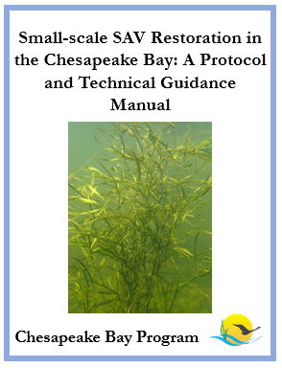
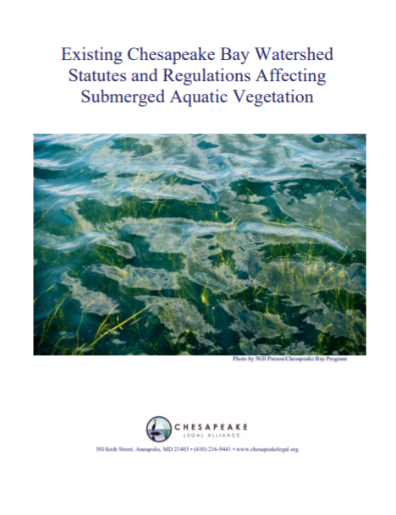
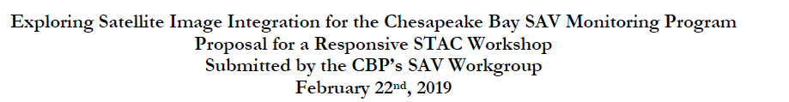
Plans for 2020-2021
Integration of Satellite Data into CBP SAV Monitoring Program (STAC Workshop) – will hopefully reduce costs
SAV Restoration Protocol and Technical Guidance Document
SAV Watchers Monitoring and Certification Program
Recruit additional organizations and volunteers
Certify additional trainers
SAV Regulatory Review
Review report
Consider recs by CLA
Notes:
INSTRUCTIONS: This slide should briefly summarize your answer to narrative analysis question #3.
FROM NARRATIVE ANALYSIS (FOR YOUR REFERENCE ONLY):
“3. What scientific, fiscal and policy-related developments will influence your work over the next two years?
This may include information learned at the previous biennial SRS meeting or more specific information about your outcome such as an increase or decrease in funding, new programs that address gaps, and new scientific data or research. Describe how these developments are likely to impact your recommended measure(s) of progress, the factors you believe impact your ability to succeed, and newly created or filled gaps. These changes should be reflected in the first three columns of your revised logic and action plan after your quarterly progress meeting.”
The SAV Workgroup has completed or is on track to complete the majority of the actions established in the 2018-2019 workplan. The primary obstacle to completing all actions was time and manpower; the workplan was admittedly overly ambitious although most tasks were completed regardless. The next iteration of the workplan (2020-2021) will focus on implementing the programs developed in the 2018-2019 workplan and completing the projects recently begun. New and continued items will include but are not limited to the following:
1. Run STAC-funded Workshop on Integration of Satellite Data into CBP SAV Monitoring Program (complete)
2. Develop SAV Restoration Protocol and Technical Guidance Document (complete, begin implementation potentially)
3. Implement Chesapeake Bay SAV Watchers Monitoring and Certification Program. Recruit additional watershed organizations.
4. Continue work to establish CB SAV Sentinel Sites. Protocol has been drafted, need to fully establish program and identify funding for implementation.
5. SAV Monitoring and Restoration – both will be included in next iteration as continuous efforts.
6. Co-host International Seagrass Biology Workshop and World Seagrass Conference in August 2020.
7. Continue work on Communications Strategy
8. Continue work to develop and establish SAV restoration finance strategy
9. Continue management of invasive species that impact SAV
10. Promote use of segment descriptions for WIP/BMP/local management decisions
11. Review recent report on statutes and regulations impacting SAV in the Bay. Consider recommendations provided by CLA and move forward accordingly.
12. Prioritize research agenda.
To reach our SAV restoration goal, the most important thing is to continue implementation of BMPs that reduce N/P/TSS to the Bay. Any fiscal or policy-related development that impacts our capacity for load reduction will impact SAV recovery, especially in a Bay that’s more and more influenced by climate change impacts such as extreme storms and increased precipitation. With improved water clarity, all other efforts, such as active restoration, will serve to accelerate recovery. Without improved water quality and clarity, other direct restoration efforts will have reduced rates of success.

Slide 12
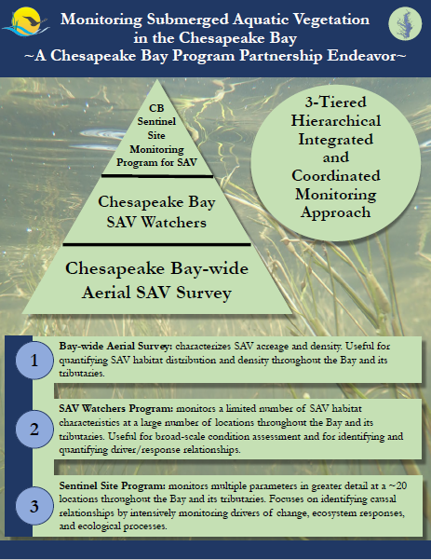
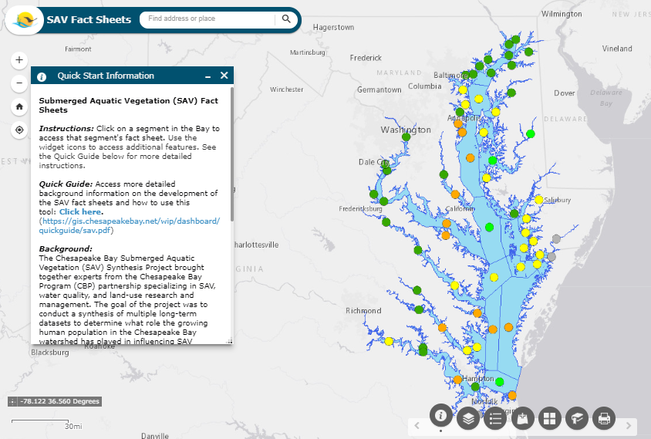
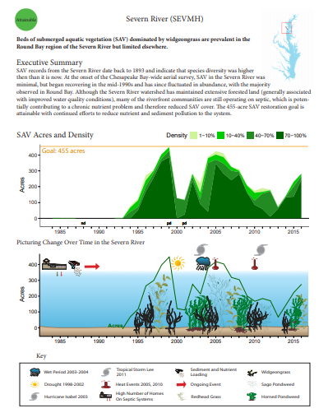
Plans for 2020-2021
Update and Prioritize Research Agenda
Impact of shallow water use conflicts
Update habitat requirements
Widgeongrass v. eelgrass ES
Freshwater species research
CB SAV Sentinel Sites
Finalize site selection and protocol
Identify stewards for all sites
Develop website (funding pending)
Implement program (hopefully with
GIT funding!)
3-Tiered Hierarchical Monitoring Approach
SAV Fact Sheets
Notes:
INSTRUCTIONS: This slide should briefly summarize your answer to narrative analysis question #3.
FROM NARRATIVE ANALYSIS (FOR YOUR REFERENCE ONLY):
“3. What scientific, fiscal and policy-related developments will influence your work over the next two years?
This may include information learned at the previous biennial SRS meeting or more specific information about your outcome such as an increase or decrease in funding, new programs that address gaps, and new scientific data or research. Describe how these developments are likely to impact your recommended measure(s) of progress, the factors you believe impact your ability to succeed, and newly created or filled gaps. These changes should be reflected in the first three columns of your revised logic and action plan after your quarterly progress meeting.”
The SAV Workgroup has completed or is on track to complete the majority of the actions established in the 2018-2019 workplan. The primary obstacle to completing all actions was time and manpower; the workplan was admittedly overly ambitious although most tasks were completed regardless. The next iteration of the workplan (2020-2021) will focus on implementing the programs developed in the 2018-2019 workplan and completing the projects recently begun. New and continued items will include but are not limited to the following:
1. Run STAC-funded Workshop on Integration of Satellite Data into CBP SAV Monitoring Program (complete)
2. Develop SAV Restoration Protocol and Technical Guidance Document (complete, begin implementation potentially)
3. Implement Chesapeake Bay SAV Watchers Monitoring and Certification Program. Recruit additional watershed organizations.
4. Continue work to establish CB SAV Sentinel Sites. Protocol has been drafted, need to fully establish program and identify funding for implementation.
5. SAV Monitoring and Restoration – both will be included in next iteration as continuous efforts.
6. Co-host International Seagrass Biology Workshop and World Seagrass Conference in August 2020.
7. Continue work on Communications Strategy
8. Continue work to develop and establish SAV restoration finance strategy
9. Continue management of invasive species that impact SAV
10. Promote use of segment descriptions for WIP/BMP/local management decisions
11. Review recent report on statutes and regulations impacting SAV in the Bay. Consider recommendations provided by CLA and move forward accordingly.
12. Prioritize research agenda.
To reach our SAV restoration goal, the most important thing is to continue implementation of BMPs that reduce N/P/TSS to the Bay. Any fiscal or policy-related development that impacts our capacity for load reduction will impact SAV recovery, especially in a Bay that’s more and more influenced by climate change impacts such as extreme storms and increased precipitation. With improved water clarity, all other efforts, such as active restoration, will serve to accelerate recovery. Without improved water quality and clarity, other direct restoration efforts will have reduced rates of success.

Slide 13
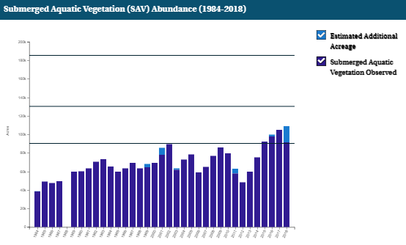
What is our Expected and Actual Progress?
2017 Target (90,000 acres) reached!
On track to achieve 130,000 acres by 2025*
Management actions to reduce N and P facilitated recovery (Lefcheck et al. 2018)
*2019 will be a bad year for SAV due to the extreme and prolonged precipitation and resultant nutrient and sediment pollution in 2018 and 2019. There was a near total loss of eelgrass in 2019 and a substantial decline in widgeongrass in the poly and lower mesohaline

