Slide 1
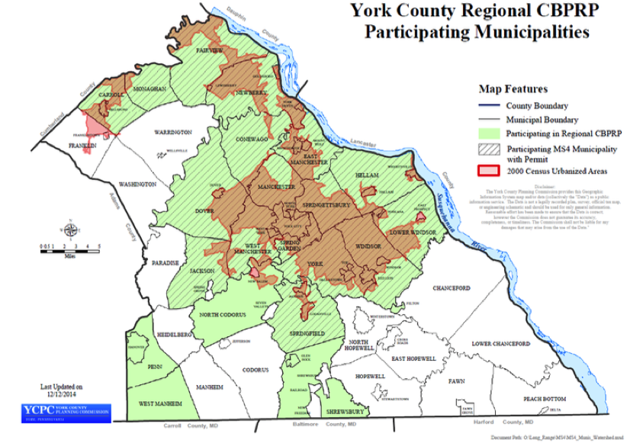
York County Stormwater BMP Tool
Colin Stief
Senior Applications Designer
Chesapeake Conservancy

Slide 2

Technology for effective and science-based conservation
Data, analysis, tools
Training and support

Slide 3


High-res Data
Land cover
Flow paths
Web Applications
All sectors
Local, state, national

Slide 4
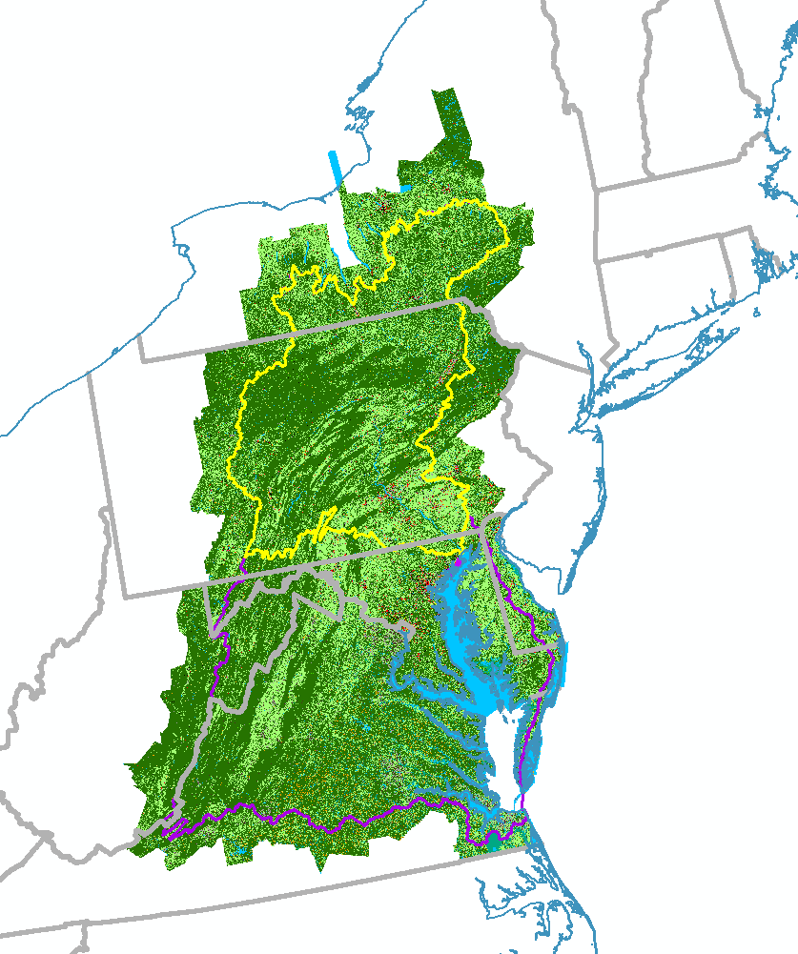
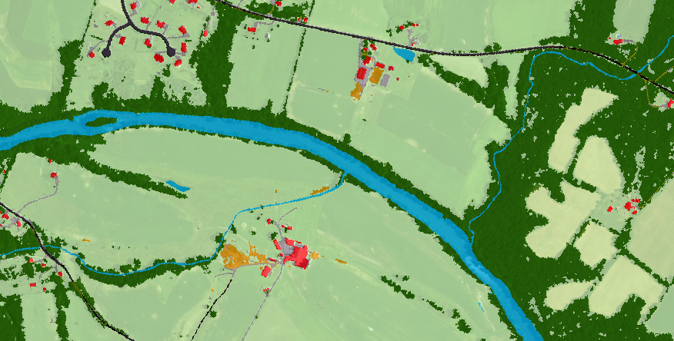
High-res Data: Land cover
Freely available
1-meter resolution
100,000+ square miles

Slide 5
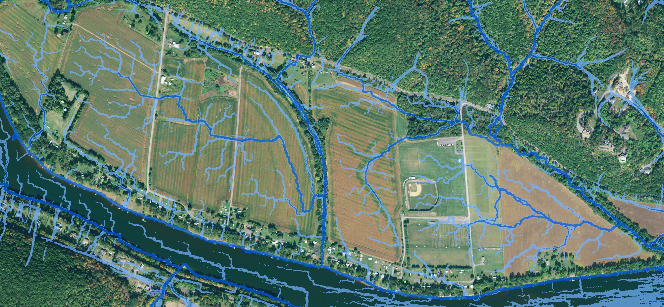
High-res Data: Flow paths

Slide 6
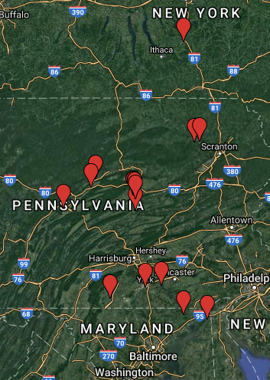

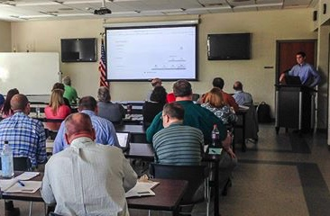
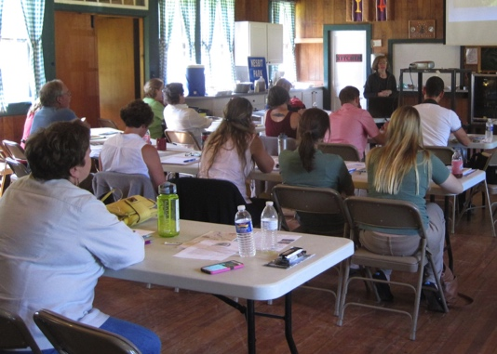

Outreach: Data workshops
Gettysburg, PA
Tunkhannock, PA
Darlington, MD
Wrightsville, PA
Elkton, MD
Selinsgrove, PA
Annapolis, MD
Annapolis, MD
Lock Haven, PA
Lewisburg, PA
Lewisburg, PA
State College, PA
Lewisburg, PA
Tunkhannock, PA
Lewisburg, PA
Mill Hall, PA
Cortland, NY
York, PA

Slide 7
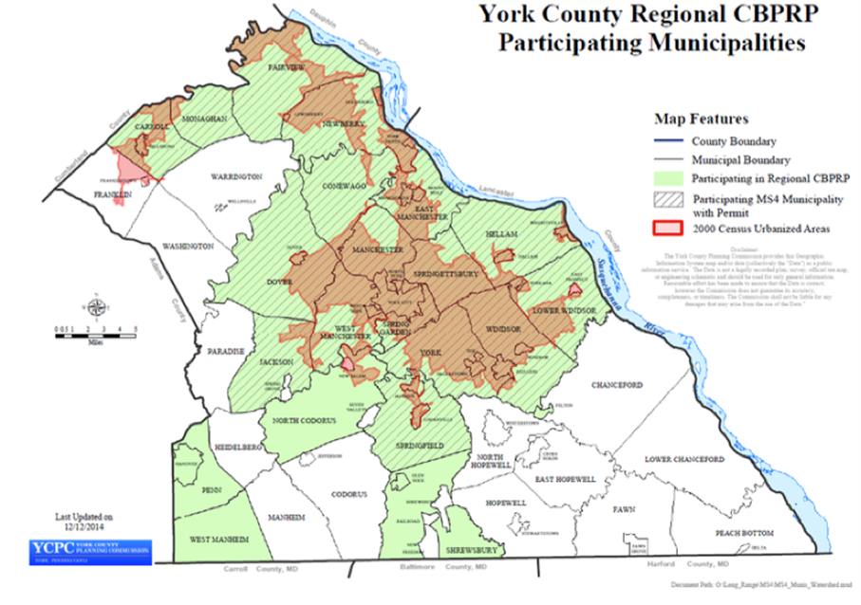
Over 40 MS4 regulated municipalities
Inconsistent reduction calculation
Reporting process outdated

Slide 8


York County Web Application
1. Site-level data
2. Reporting system

Slide 10
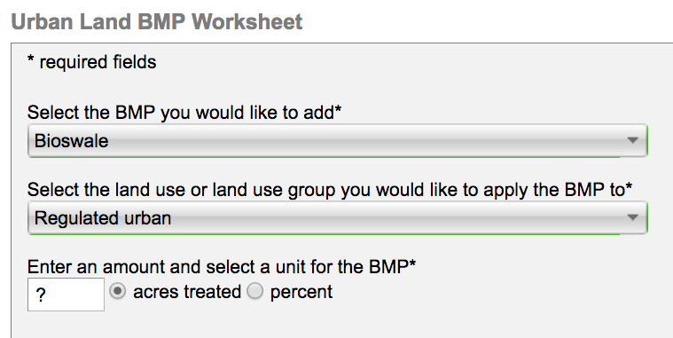
BayFAST reduction calculator
Land cover
“Treatment area”

Slide 11
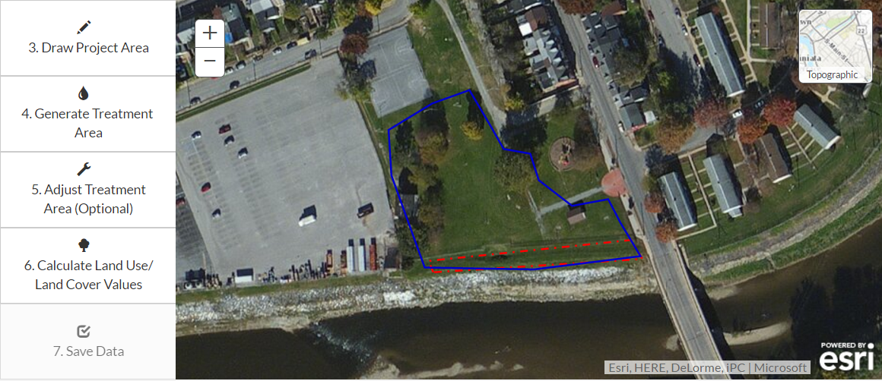
Treatment area
Project area

Slide 12
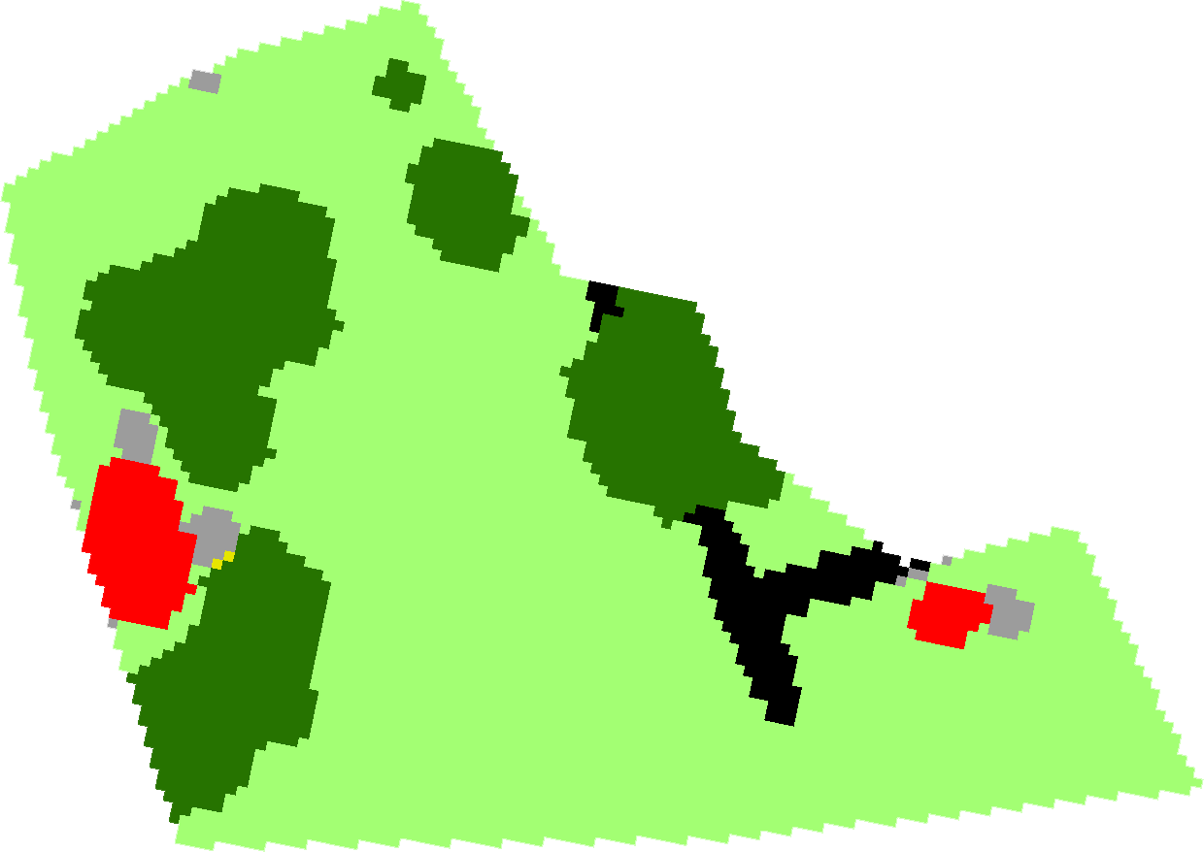
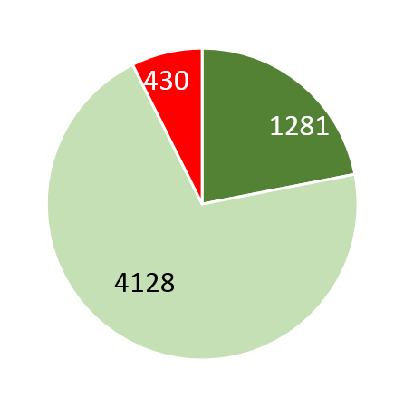
Treatment area
0.15 acres
0.32 acres
Project area
1.02 acres

Slide 13
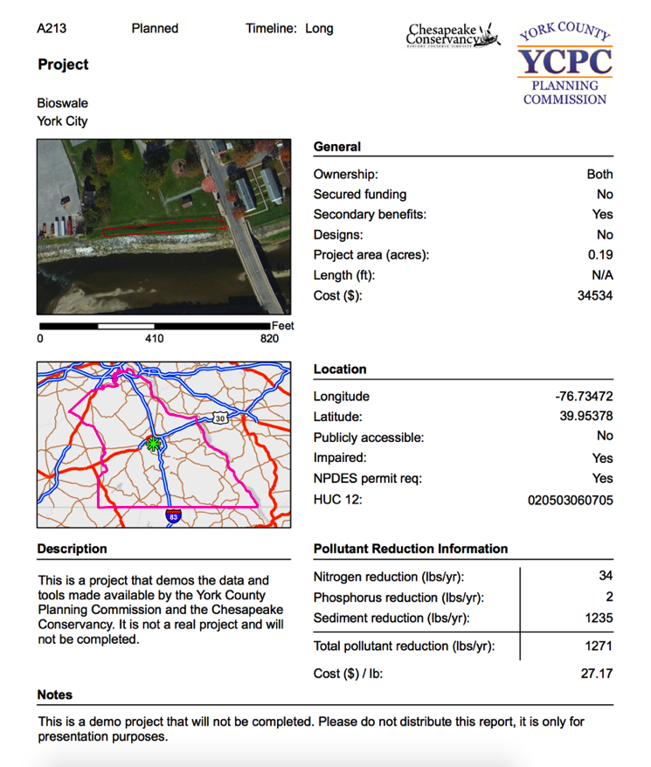
Web applications: BMP Tool
Estimated reductions and cost per lb
York County
BMP Tool

Slide 14
Takeaways
Ownership over data/tools
Cost and time savings
Capacity building and institutional learning

Slide 15
Takeaways
Ownership over data/tools
Cost and time savings
Capacity building and institutional learning

Slide 16
“The first reporting cycle using the Chesapeake Conservancy’s web-based tool increased the efficiency of the reporting process. Reports were submitted more timely and the data could easily be downloaded into an excel spreadsheet for analysis and PA Department of Environmental Protection (DEP) reporting purposes”
Pam Shellenberger
York County Planning Commission Chief of Long Range Planning

Slide 17
Takeaways
Ownership over data/tools
Cost and time savings
Capacity building and institutional learning

Slide 18
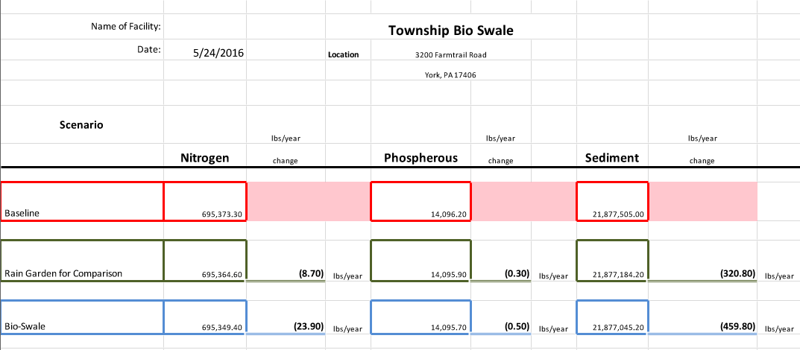
Zoning & Planning Officer project comparison sheet

Slide 20
What was the cost of developing the tool?
about $20,000
Does this duplicate other tools?
Tools that do individual aspects... This uniquely combines (1) mapping analysis, (2) reduction estimates, and (3) project mgt. in an (4) easy to use, (5) all web-based platform

Slide 21
Will it work with reporting systems in other jurisdictions?
Not in current form… but it could
How would the cost be determined if other jurisdictions wanted to use it?
Dependent on data availability… more accessible data means less work... requirements gathering is essential

Slide 22
Questions?
Colin Stief
Senior Applications Designer
Chesapeake Conservancy
cstief@chesapeakeconservancy.org
(240) 762-1730

