Slide 1
The Chesapeake Bay Stewardship Fund:
Meeting the Needs of Local Governments for Watershed Restoration
Local Government Advisory Committee
Friday, December 5th, 2014
Jake Reilly
Director, Chesapeake Bay Programs
National Fish and Wildlife Foundation

Slide 2
How is CBSF currently supporting local governments?
How can we better serve local governments?
How can LGAC be more engaged in CBSF grants programs?

Slide 3
CBSF Program Delivery Cycle
Assess Conservation Needs and Capacity
“Technical Capacity” Grants
Muni SW Training and Outreach
Supporting Networking and Information Sharing
Build Local Capacity for Restoration
Small Watershed Grants
Monitor and Assess Project Implementation
Support On-The-Ground Restoration and Conservation Efforts
Innovation Grants

Slide 4
Building Local Capacity for Restoration
A Brief History
Targeted at activities that precipitate local implementation efforts (via planning, design, assessment, prioritization, etc.)
Relatively smaller grants and short term projects
Delivered through a cadre of registered “Technical Assistance Providers”
Eligibility restricted to local governments, conservation/watershed organizations, and conservation districts
Many iterations over the years, evolving recently into a competitive “technical assistance” grants program
Need to refine and formalize this program to enhance the impact and strategic alignment with NFWF and partner objectives

Slide 5
Revamped “Technical Capacity” Program
Proposed Program Goals:
Deliver technical capacity to local partners for water quality and stewardship implementation projects through CBSF and other funding sources
Catalyze increased and more targeted local investment of restoration and protection project funding through strategic planning, design, assessment, and prioritization efforts
Support the establishment of long-term strategies for program delivery and implementation through program design and review, financing strategies, etc.
Proposed Program Details:
Annual RFP, with staged application periods for each “sector”
Roughly $1 million available
Conservation districts are explicitly eligible
Awards capped at $40-50k
Projects capped at 12 months
How can this program best serve local gov’t?

Slide 6
Revamped “Technical Capacity” Program
How can this program best serve local gov’t?
Some Ideas:
Financial and programmatic reviews and assessment for stormwater management
Developing programs to credit NDGI and brader efforts to comply with CBP verification frameworks
Assessment of legacy stormwater BMPs, prioritization of retrofits, training on cost estimation
Structured analysis and development of municipal homeowner outreach programs
Review and assessment of local codes and ordinances for water quality
Incorporating local citizen-based monitoring into municipal watershed restoration efforts
Translating existing urban tree canopy assessments into implementation plans

Slide 7
Supporting On-the-Ground Restoration
CBSF Implementation Grants
Small Watershed Grants
Grants of $20k-$200k
25% match requirement
Local governments and nonprofits eligible
Improve local waters that contribute to Bay health
About $3 million awarded per year to approximately 30 grantees
Approx. 25-30% of proposals are funded
Innovative Nutrient and Sediment Reduction Grants
Grants of $200k - $500k
1:1 match requirement
Local governments, NGOs, State agencies, and universities eligible
Innovative approaches to reduce nutrient and sediment pollution to the Bay
$6 - $8 million awarded per year to approximately 15-20 grantees
15-20% of proposals are funded

Slide 8
CBSF Implementation Grants

Slide 9
CBSF Implementation Grants
2014 Implementation Grant Priorities
Targeted River and Watershed Restoration: Special focus on the Choptank and Nanticoke, Juniata, Shenandoah and Upper Potomac, and VA Middle Peninsula and Northern Neck
Likely to shift somewhat in 2015
Green Infrastructure in Urban Landscapes:
MS4 Communities: Integrating “green infrastructure” approaches into capital programs
Non-MS4: Assisting local governments in the demonstration and development of projects and programs that mitigate stormwater impacts
Residential and Commercial Properties: Increase adoption of green infrastructure practices on residential and commercial properties in targeted communities.
Innovation on Crosscutting Issues: New technologies for stormwater management and agricultural conservation; new models for technical assistance and outreach to agricultural producers and homeowners
How these align with LGAC priorities for implementation grant funding?

Slide 10
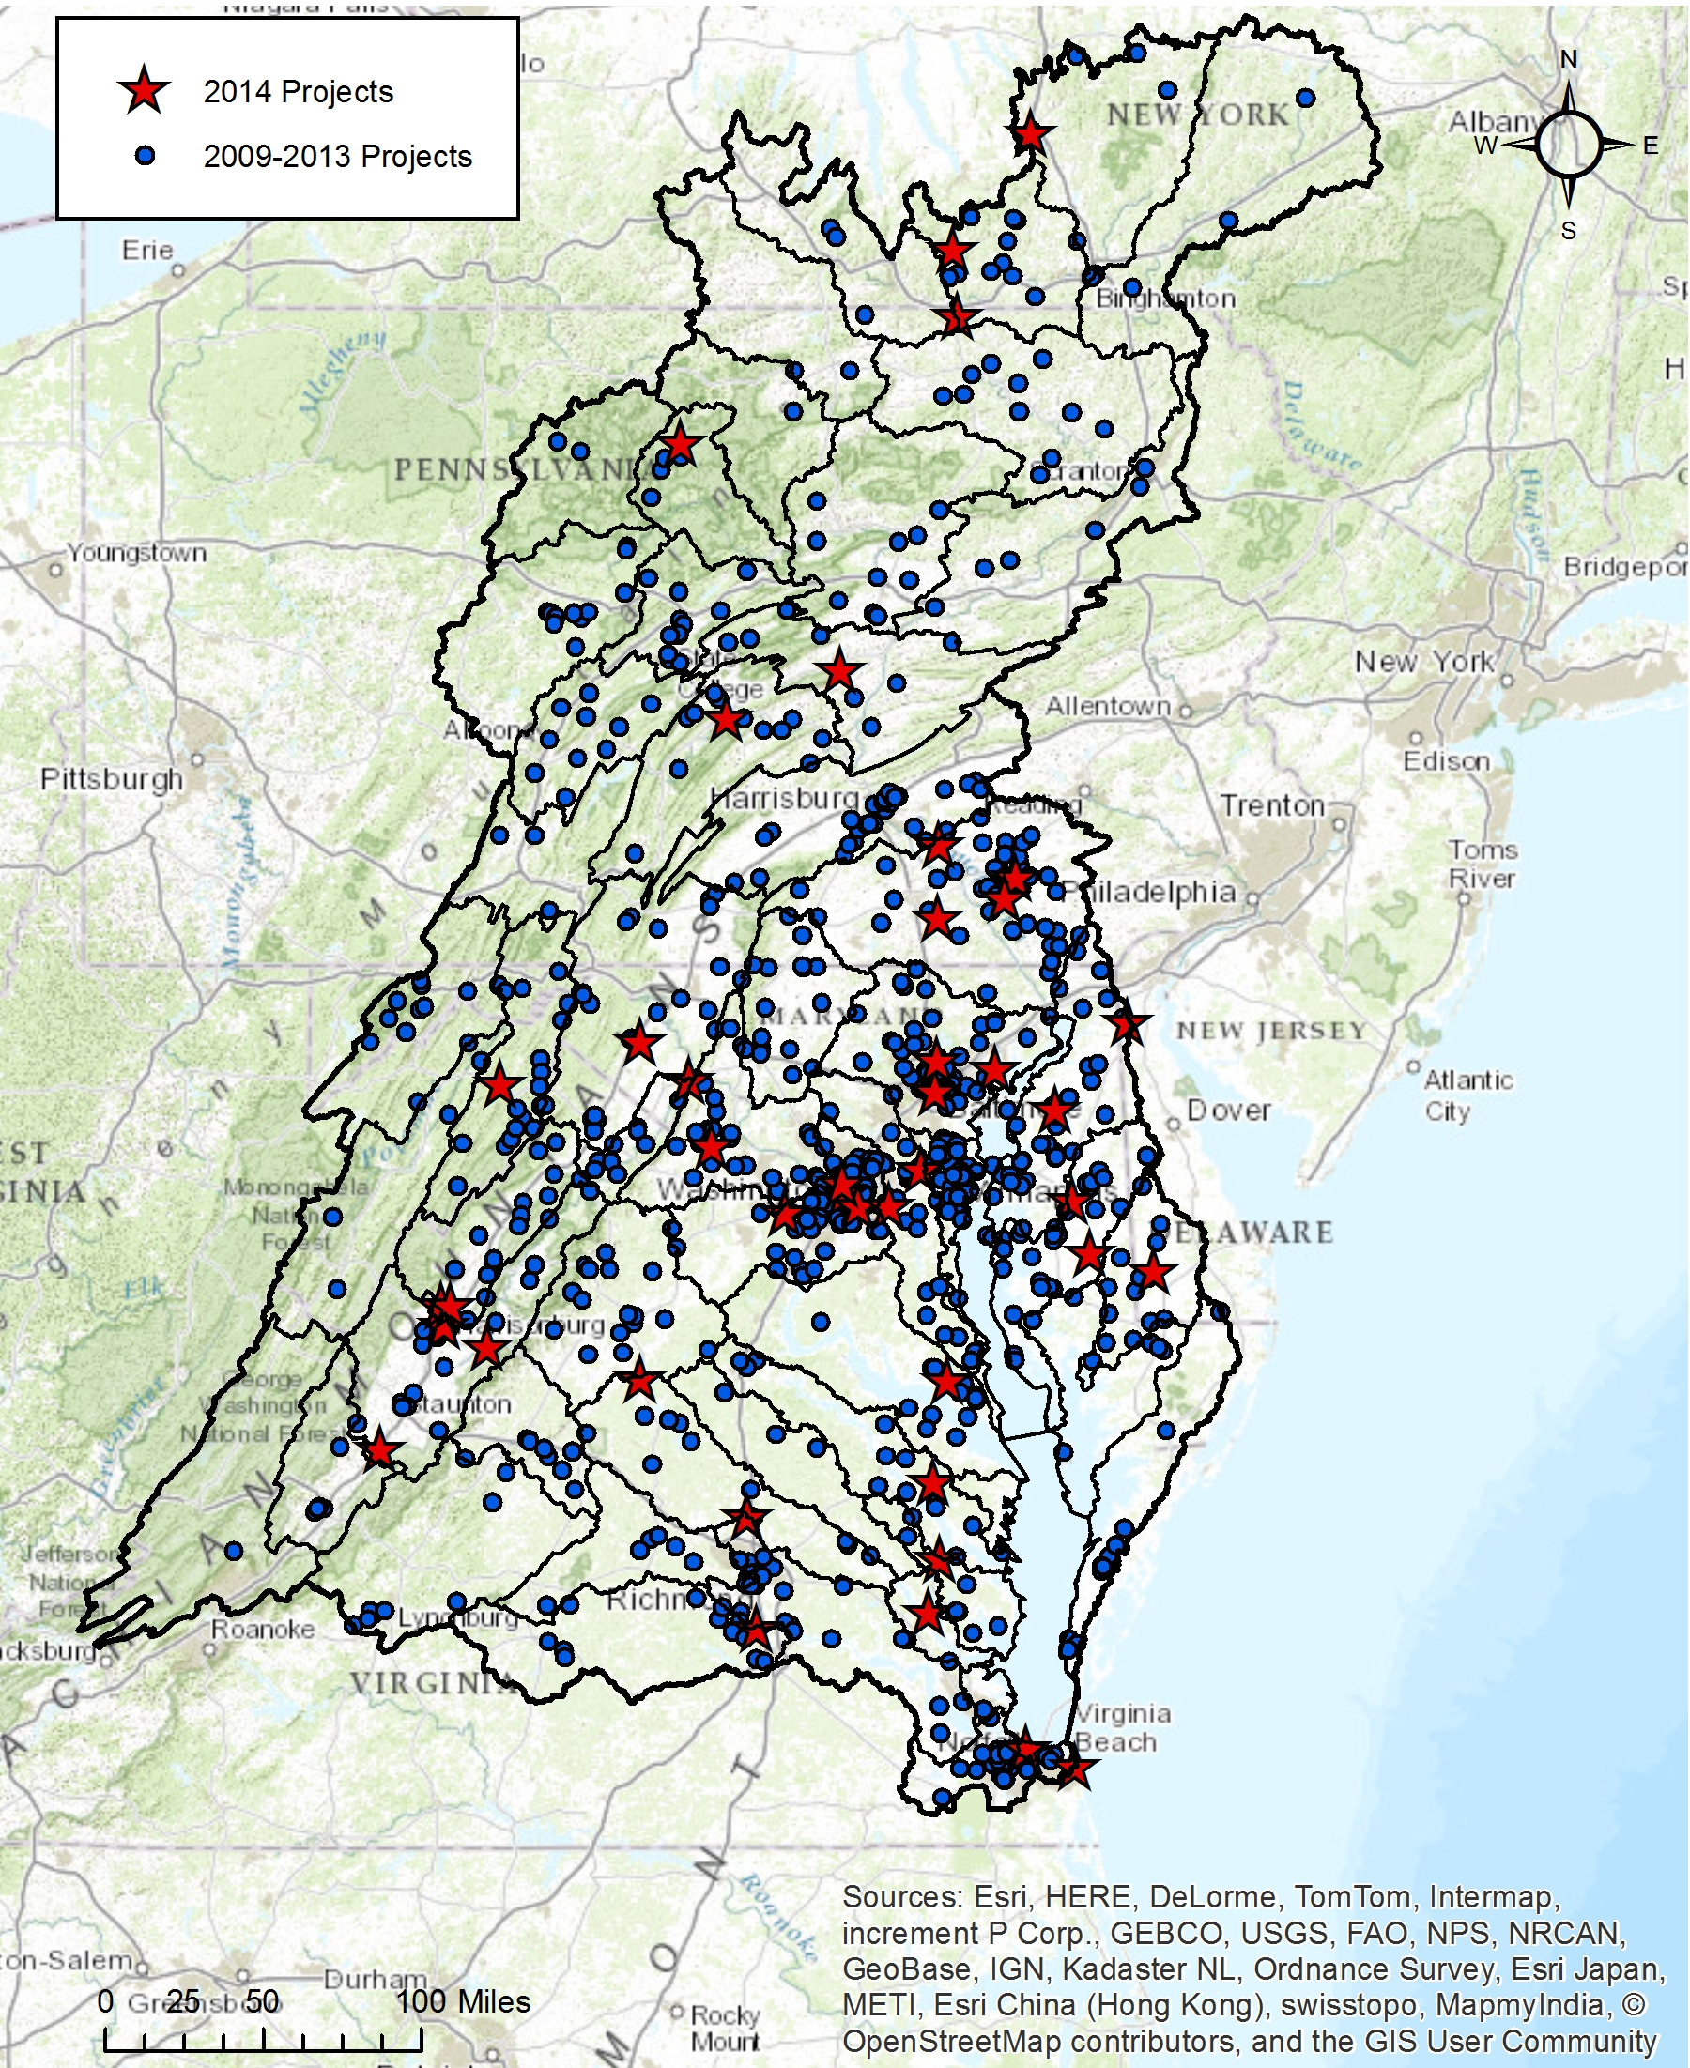
CBSF Implementation Grants
2014 Grant Investments
$9.8 million in awards
  $7.8 million in EPA funding
  $700k in other Federal funding (USFS, NRCS, NOAA)
  $1.25 million in private funding
45 grants
  INSR: $5.8 million to 18 projects
  SWG: $3.9 million to 27 projects
  Leveraging roughly $19 million in local match
  Direct Local Government Recipients
  DC Dept. of the Environment
  Sussex Conservation District (DE)
  Prince George’s County (MD)
  Tioga County Soil and Water Conservation District (NY)
  Town of Ashland (VA)
  City of Norfolk (VA)

Slide 11
Delaware
Kent County Conservation District
Sussex Conservation District
Town of Bridgeville
Town of Greenwood
Maryland
Anne Arundel County
Baltimore City
Baltimore County
Calvert County
Cecil Soil Conservation District
Charles County
City of Annapolis
City of Bowie
City of Cumberland
City of Gaithersburg
City of Greenbelt
City of Rockville
City of Salisbury
City of Takoma Park
Frederick County
Harford County
Montgomery County
Prince George's County
Queen Anne's County
Talbot Soil Conservation District
Town of Centreville
Town of Forest Heights
Town of Highland Beach
Town of Myersville
Town of Oxford
Wicomico County
New York
City of Binghampton
Otsego County Soil and Water Cons. District
Schuyler County Soil and Water Cons. District
Tioga County Soil and Water Cons. District
Tompkins County Conservation District
District of Columbia
DC Dept. of the Environment
DC Fire & Emergency Management Services
Pennsylvania
Adams County Conservation District
Blair County Conservation District
Boggs Township
Borough of Camp Hill
Borough of Chambersburg
Bradford County Conservation District
Cameron County Conservation District
Centre County Conservation District
City of Lancaster
Clearfield County Conservation District
Clinton County Conservation District
County of Lycoming
Dauphin County Conservation District
Fulton County Conservation District
Graham Township
Jackson Township
Juniata County Conservation District
Lancaster County Conservation District
Lancaster Township
Mifflin County Conservation District
Northern Lebanon School District
Rush Township
Sullivan Township
Union County Conservation District
Wyoming County Conservation District
York County Conservation District
West Virginia
Eastern Panhandle Soil Conservation District
Jefferson County
Martinsburg-Berkeley Co. Parks & Rec. Board
Morgan County Planning Commission
Town of Bath
Virginia
City of Charlottesville
City of Lexington
City of Norfolk
City of Virginia Beach
City of Waynesboro
Virginia (cont)
County of Arlington
County of Albemarle
County of Clarke
County of Gloucester
County of Loudoun
County of Prince Edward
County of Rappahannock
County of York
Crater Planning District Commission
Culpeper Soil & Water Conservation District
Eastern Shore Soil & Water Conservation District
Fauquier County
Gloucester County
Hampton Roads Planning District Commission
Hanover-Caroline Soil & Water Cons. District
Henrico Soil & Water Conservation District
James City County
Loudoun Soil and Water Conservation District
Mathews County
Middle Peninsula Planning District Commission
Monacan Soil and Water Conservation District
New Kent County
Northern Neck Soil and Water Cons. District
Northern Shen. Valley Regional Commission
Page County Tree Board
Peter Francisco Soil & Water Cons. District
Piedmont Soil and Water Conservation District
Rappahanock-Rapidan Regional Commission
Robert E. Lee Soil and Water Cons. District
Thomas Jefferson Planning District Commission
Three Rivers Soil & Water Conservation District
Town of Ashland
Town of Cape Charles
Town of Luray
Westmoreland County

Slide 12
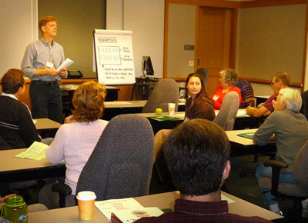
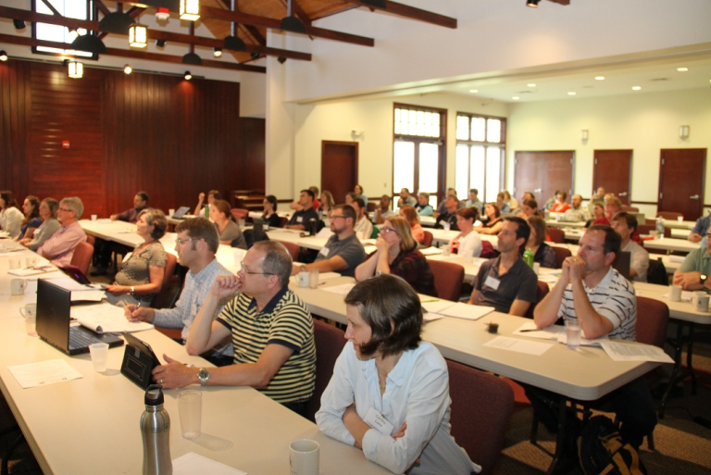
Supporting Networking and Information Sharing
Convening Restoration Partners
Chesapeake Watershed Forum, Forum+
  Pre-forum workshops
Grantee Roundtables
  Stormwater Partners Retreat
  Agricultural Networking Forum
Supporting Ongoing Networking
Chesapeake Network
Advancing Clean Water Actions
Choose Clean Water Coalition
Promoting Restoration Successes
Bay Journal Inserts
Local “stars of the Bay” press outreach

Slide 13
Engaging LGAC in CBSF Grant Programs
Ideas for consideration:
Formal role in developing implementation and technical capacity grants RFP priorities (late fall and late winter)
Formal role in reviewing grant applications from local government applicants (early summer)
Opportunities to help frame content at networking and information-sharing events, media and press outreach (ongoing)
Others?

