Slide 1
Outreach & Engagement with Local Decision-Makers
Local Government Advisory Committee
CBP Local Leadership Workgroup
Working together
Notes:
Jennifer Intro after menti polls

Slide 2
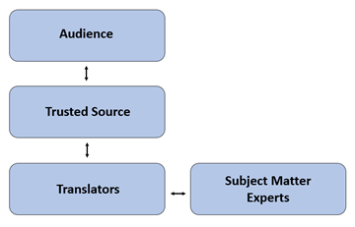
CBP Local Engagement Strategy
The Local Engagement Strategy presents a road map for engagement with local government leaders, but the model can be applied to all local audiences. The strategy defines the roles of different players involved and articulates a mechanism for creation and delivery of messages.
Notes:
Laura explain
Mention local engagement team

Slide 3
Focus: Concepts & Approaches to Connecting Locally
Engage where Locals go for information (trusted sources)
Understand local priorities and share information in that priority format
Share case studies as examples
Tour BMPs for visual learning
Host local roundtable discussions to share priorities
Seek Peer to Peer opportunities for learning
Provide written information that’s clear, concise and visually appealing
Time “asks and needs” to when locals are making decisions - budget time
Keep senior staff in the loop
Notes:
Jennifer - using the strategy

Slide 4
LGAC and LLWG
LGAC Mission:
To share the views and insights of local elected officials with state and federal decision‐makers and to enhance the flow of information among local governments about the health and restoration of the Chesapeake Bay watershed.
LLWG Mission: implementation of the CBP Local Leadership Outcome
Continually increase the knowledge and capacity of local officials on issues related to water resources and in the implementation of economic and policy incentives that will support local conservation actions.
Local Officials=elected, appointed or senior staff
Notes:
Jennifer

Slide 5
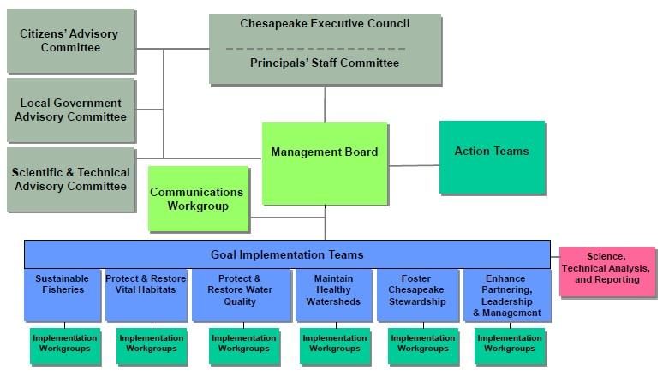
Notes:
Jennifer

Slide 6
Membership
LGAC-Appointed by Governors and DC Mayor
Delaware - 1
District of Columbia - 3
Maryland - 6
New York - 1
Pennsylvania - 6
New York - 1
Virginia - 6
West Virginia - 1
LLWG-Invited to Participate
Jurisdiction Representatives
Local Governments
Local Government Associations
Other Trusted Sources
CBP Representatives

Slide 7
Staffing of LGAC and LLWG….
Alliance for the Chesapeake Bay’s Local Government Initiatives Team
Jennifer Starr, LGAC Coordinator
Ola-Imani Davis, LGAC Staffer
Laura Cattell Noll, LLWG Coordinator
  {CRC Staffer supports the LLWG (position open right now)}
Jennifer is the Team Director and the Team works very closely together to support and collaborate with each other and keep workplans on track.
Notes:
Jennifer

Slide 8
Staff Philosophy on the role of LGAC vs LLWG
completely unofficial ;)
LGAC=High Level--advise the Executive Council on how to effectively implement projects and engage the support of the local governments to achieve the goals of the Bay Agreement.
LLWG=On the Ground--working to expand baseline watershed-related knowledge of local decision makers so they understand and can support implementing restoration efforts.
Notes:
LGAC is focused on providing insight and advice on ALL of the outcomes. LLWG is laser focused on just the Local Leadership Outcome

Slide 9
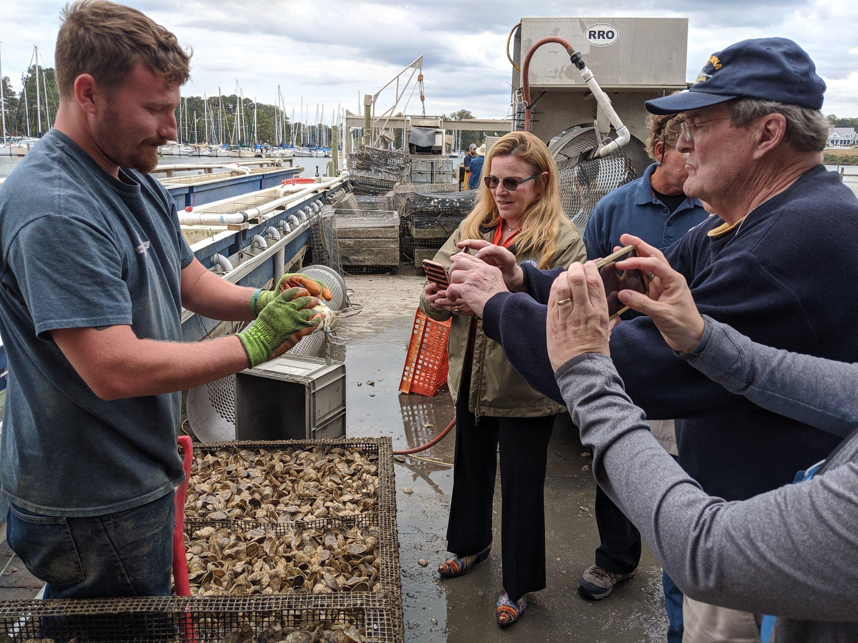
Peer to Peer Learning Exchange Bus Tours
Goal: facilitate peer to peer discussion and experiential learning
LGAC’s role: host, provide direction, introduce to key partners, invite peers
LLWG’s role: organize logistics, coordinate with state agencies, recruitment via trusted sources

Slide 10
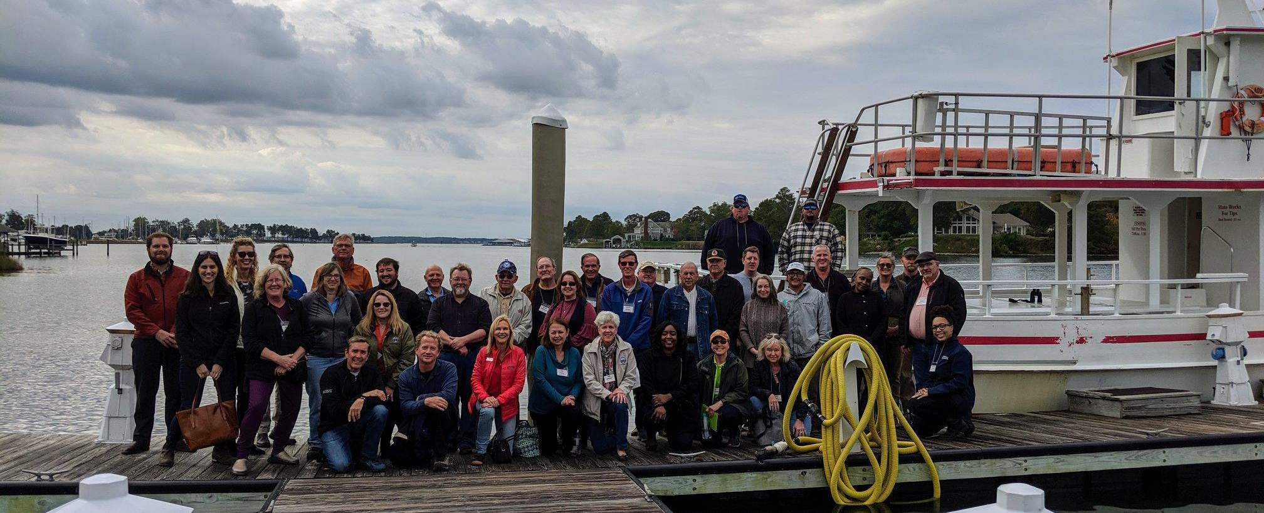
Thank you! Questions?
Jennifer Starr
LGAC Coordinator
jstarr@allianceforthebay.org
Laura Cattell Noll
LLWG Coordinator
lnoll@allianceforthebay.org

