Slide 1
Maintaining healthy watersheds in the Chesapeake
LGAC meeting
December 4, 2014
Mark Bryer
The Nature Conservancy
Chair, Healthy Watershed Goal Team

Slide 2
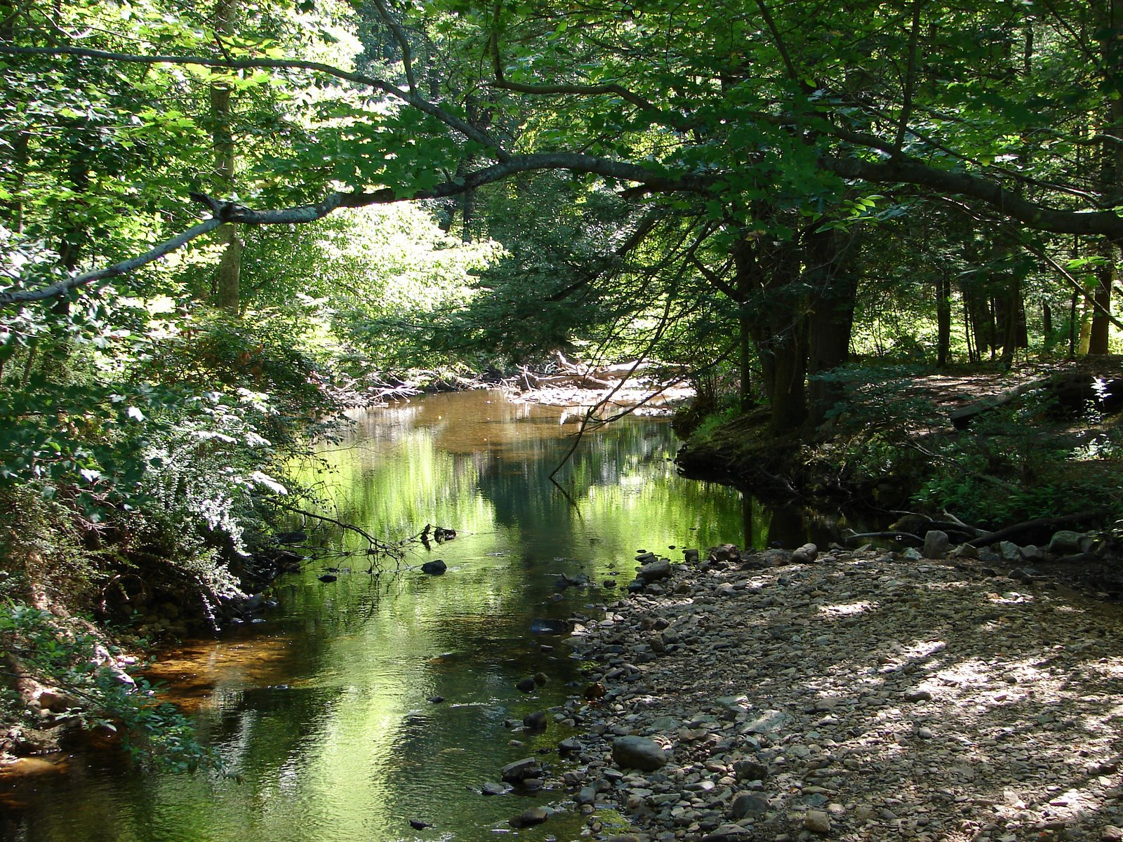
© Doug Cook
Notes:
Places that we all know and love…

Slide 3
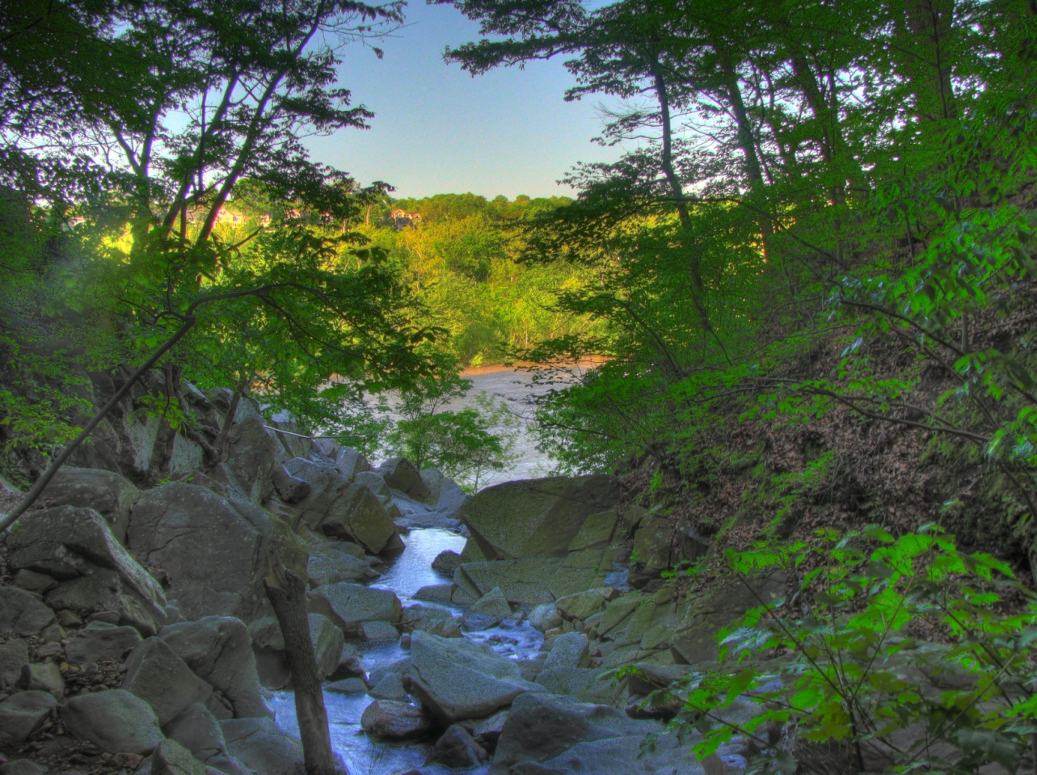

Slide 4
What are healthy watersheds…
waters and watersheds, recognized for their exceptional quality and/or high ecological value
Notes:
This is a broad definition meant to incorporate many values – fish and wildlife, water quality, vegetation, in-stream flows, etc.

Slide 5
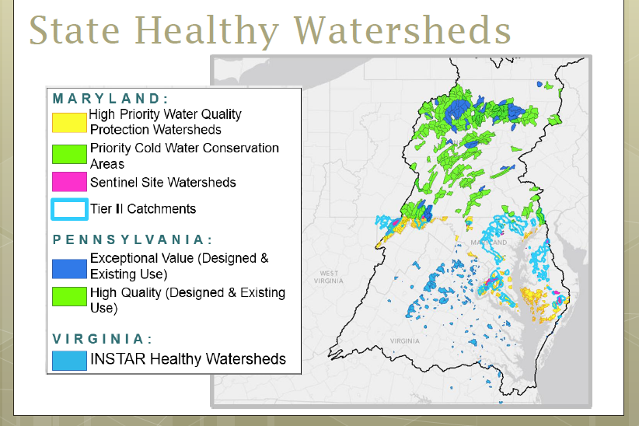
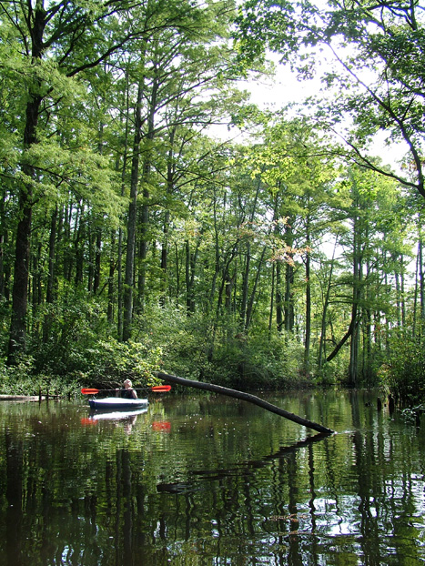
Definitions and more info at http://stat.chesapeakebay.net/
Notes:
States across the bay have programs to both design and protect healthy streams and their watersheds
John Wolf is going to go into much more detail about this
See website for more detail

Slide 6
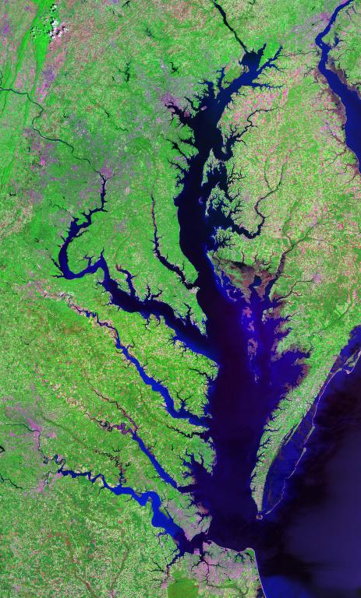
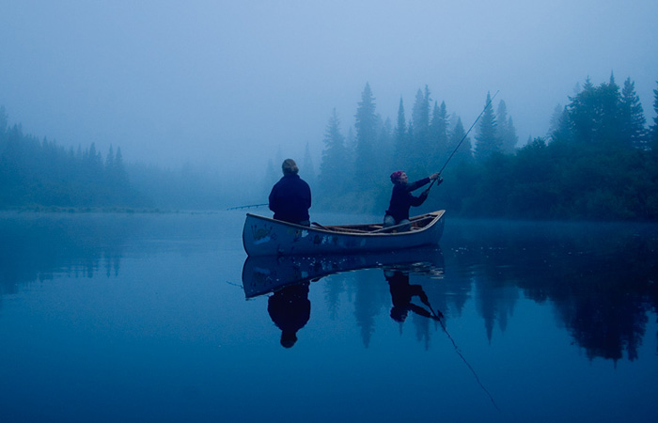
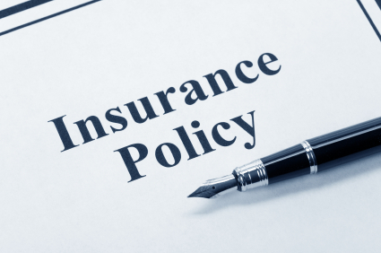
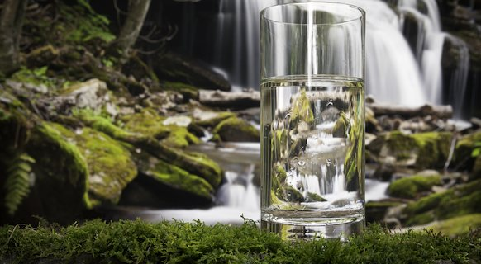
Why healthy watersheds matter…
Notes:
Balanced investment strategy - Restoration of the Bay depends on the protection of resource lands that maintain watershed health.
Cheaper than restoration - protecting what’s still good is far more cost effective than trying to restoring it.
Meaningful “up-watershed” - majority of people in the watershed connect to the health of their local streams, not the Bay.

Slide 7
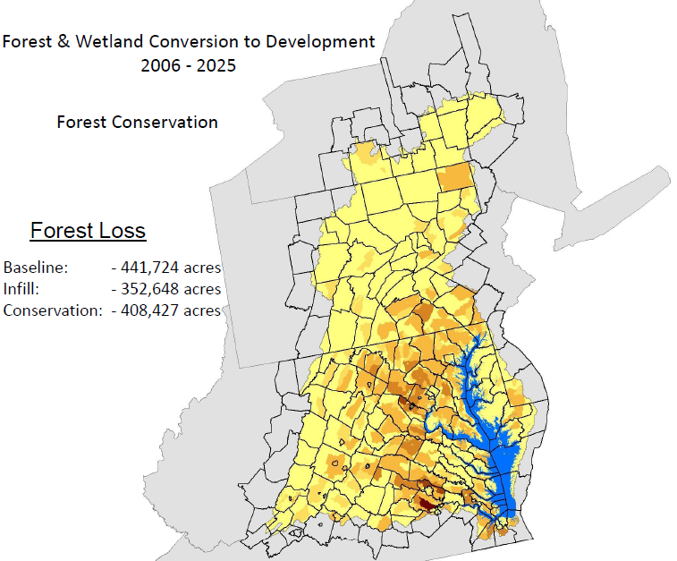
8 million new pounds of nitrogen
(10% of the TMDL)
$28 billion in offsets
Map courtesy of Peter Claggett, USGS

Slide 8
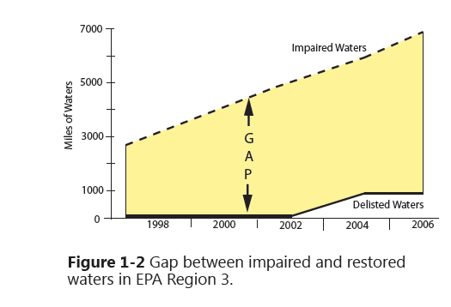
Restoration is not an easy answer
The cost of repairing damaged ecosystems is high and has a low success rate

Slide 9
Healthy Watersheds Goal Team is responsible for:
Healthy Watersheds Outcome
Land Use Methods and Metrics Outcome
Land Use Options Evaluation Outcome

Slide 10
Healthy Watersheds Outcome
100 percent of state-identified currently healthy waters and watersheds remain healthy.
Notes:
Signatories: MD, VA, DC, PA, DE, WV, NY, CBC

Slide 11




Outcome: 100% of state-identified currently healthy waters and watersheds remain healthy
Direct protection
Build and maintain inventory; track progress
Tracking
Where are the healthy waters and how are they doing?
Action!
Activities that secure the health of waters and watersheds
Policies and programs
Local community engagement
We will not achieve this outcome without effective local community engagement
Notes:
Not sure if this would be useful. We talked about a visual diagram showing the two tracks we need to take to achieve our outcome; circles are examples of factors influencing these tracks, but do not include everything

Slide 12
Questions
Do you know about healthy watersheds in your jurisdiction?
Do you consider them an asset? Why or why not?
What do you need to secure healthy watersheds and the benefits they provide?

Slide 13
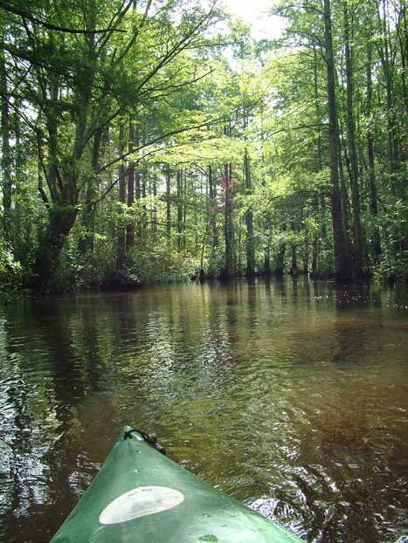
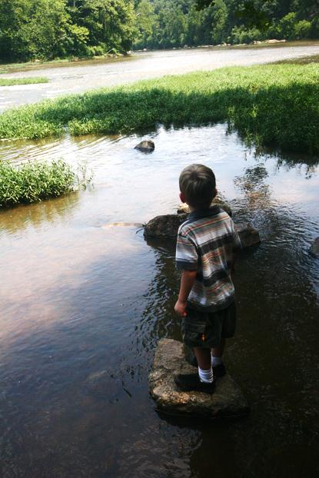
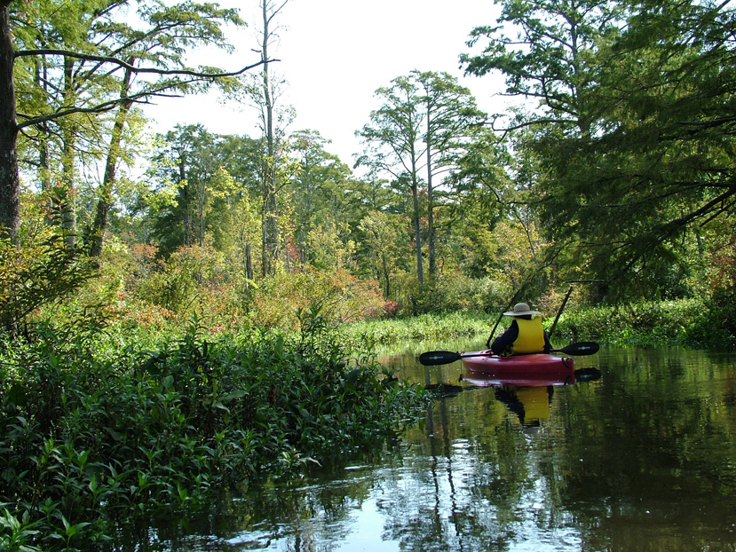
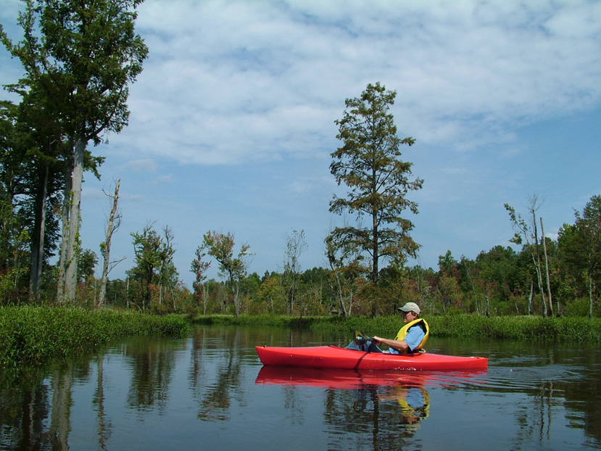
Notes:
How do we get there? Through: land conservation, land use planning, habitat connectivity, in-stream flow protection…

Slide 14
Land Use Methods and Metrics Outcome
Continually improve the knowledge of land conversion and the associated impacts throughout the watershed. By 2016, develop a Chesapeake Bay watershed-wide methodology and local level metrics for characterizing the rate of farmland, forest and wetland conversion, measuring the extent and rate of change in impervious surface coverage and quantifying the potential impacts of land conversion to water quality, healthy watersheds and communities. Launch a public awareness campaign to share this information with citizens, local governments, elected officials and stakeholders.
Notes:
Signatories: DC, PA, DE, CBC

Slide 15
Land Use Options Evaluation Outcome
By the end of 2017, with the direct involvement of local governments or their representatives, evaluate policy options, incentives and planning tools that could assist them in continually improving their capacity to reduce the rate of conversion of agricultural lands, forests and wetlands as well as the rate of changing landscapes from more natural lands that soak up pollutants to those that are paved over, hardscaped or otherwise impervious. Strategies should be developed for supporting local governments’ and others’ efforts in reducing these rates by 2025 and beyond.
Notes:
Signatories: DC, PA, DE, CBC

Slide 16
Define what is meant by a healthy watershed (show map and explain how each jurisdiction defines)
Talk about why this Outcome is in the Agreement (only outcome focused on protection)
Ask if they know whether their community is in a healthy watershed (or contains any healthy watersheds)
Talk briefly about cost of protection versus restoration (Beth McGee is doing lunch presentation on CBF's Economic Benefits report so this will be fresh in their minds)
Talk about threats (or theory of change)
Solicit their ideas for the management strategy (you could focus on the following Key Elements: 3.a, 4.a and 5.a)

Slide 17
I've suggested that others use items 3.a., 4.a., and 5.a in the Key Elements as the place to focus your questions, unless you have something very specific you need input on. Here are those elements:
Include a statement about whether there is a general or specific role for local governments, watershed associations, nonprofits, the private sector or others in achieving the outcome. When relevant, include a brief description of the role and level of participation of each entity (3.a).
Identify specific actions, tools or technical support needed at the local level (4.a).
If relevant, describe what steps will be taken to facilitate greater local participation, including underserved and underrepresented communities as a way to include more diverse participation, in achieving the outcome, including what actions, tools or technical support will be provided to empower local governments and others to do their part (5.a).

Slide 18
Management Strategy Issues – Action
  Healthy Watersheds Management Strategies are connected to Management Strategies of other Outcomes
Healthy Watersheds
Stream Health
Fish Passage
Climate Change
WIPs
Brook Trout
Wetlands
Forest Buffers
Tree Canopy
Stewardship
Protected Lands
Land Use Options

Slide 19
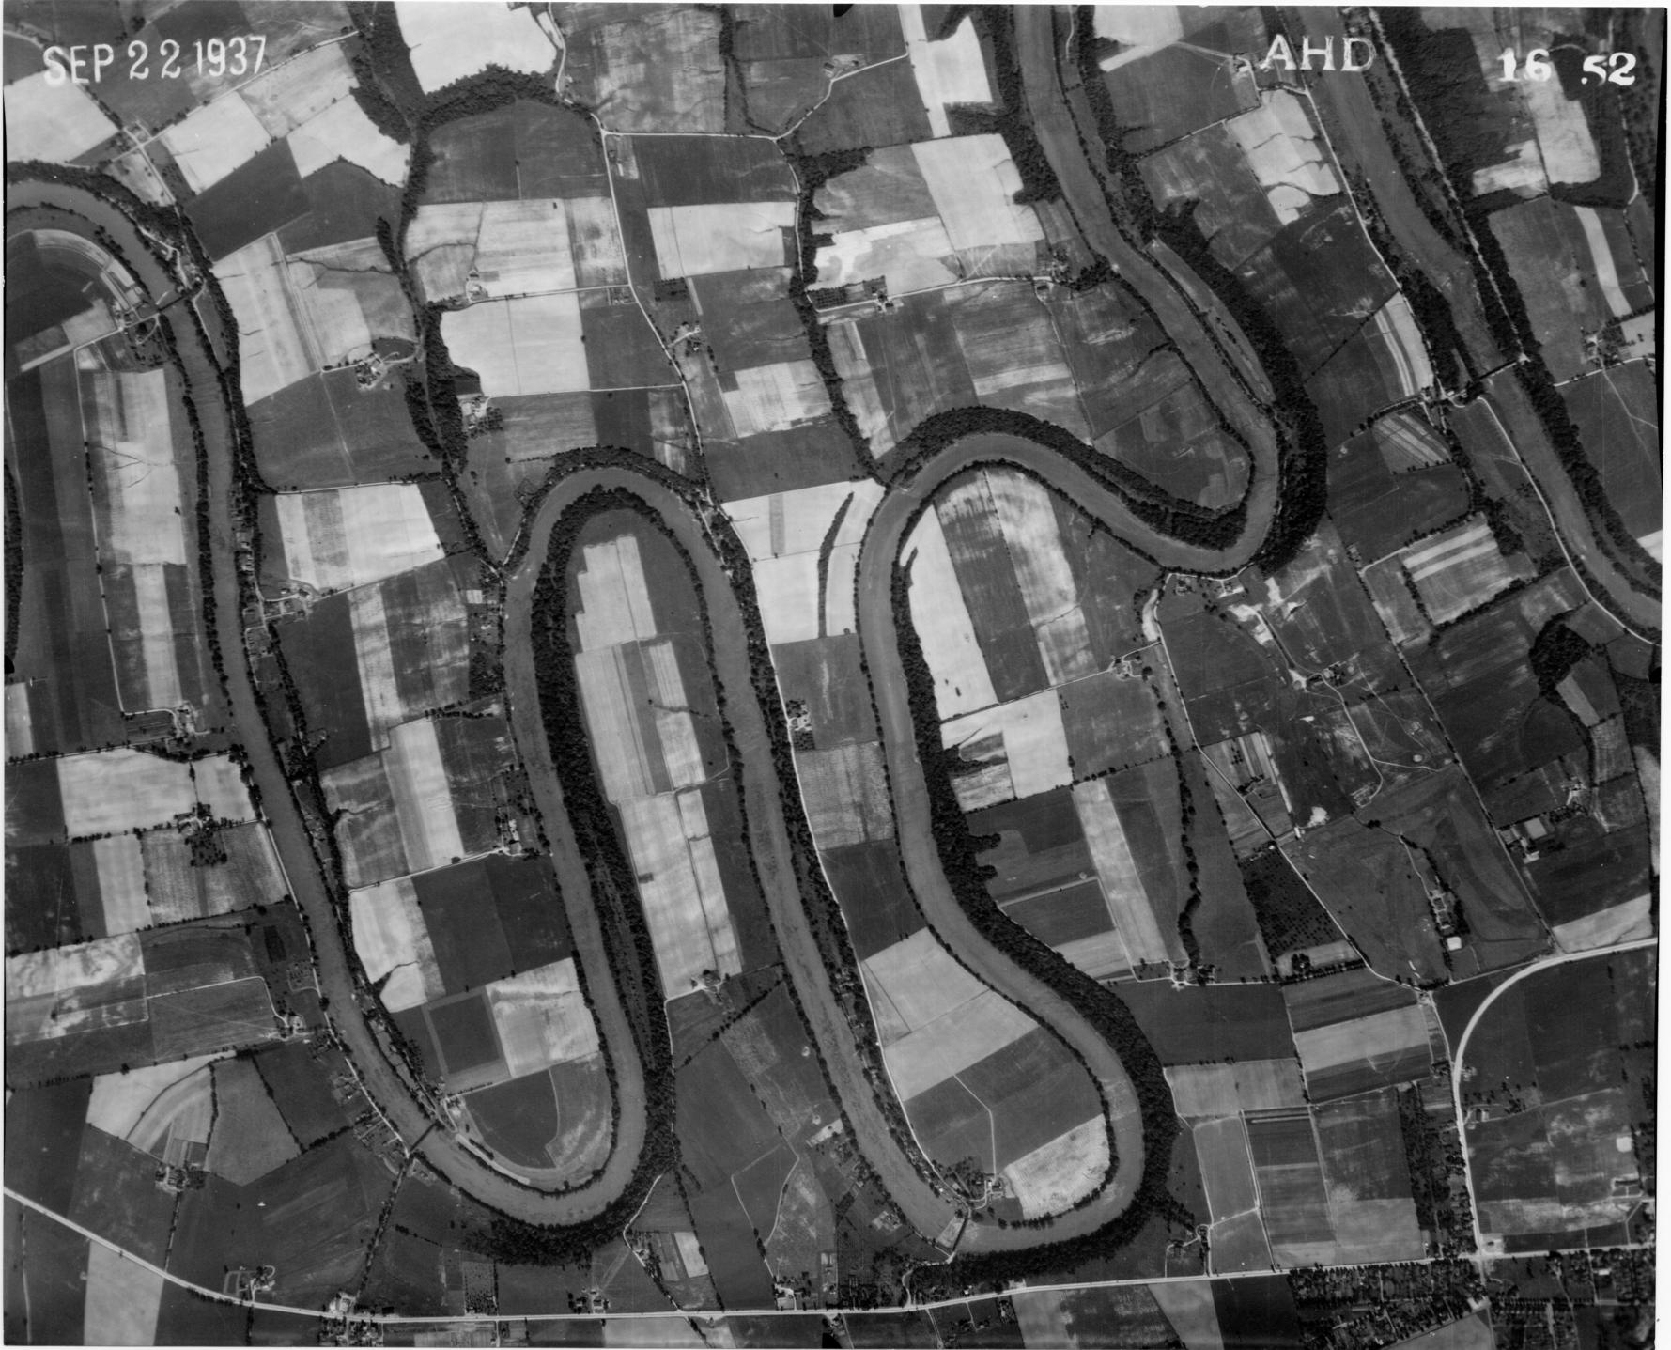

Slide 20
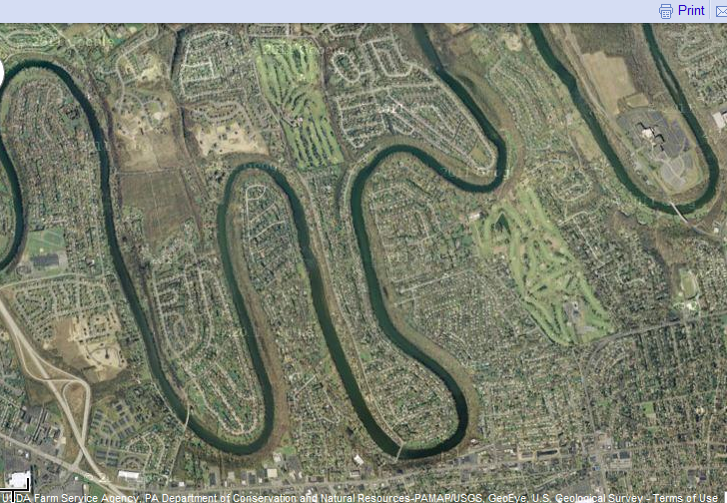

Slide 21
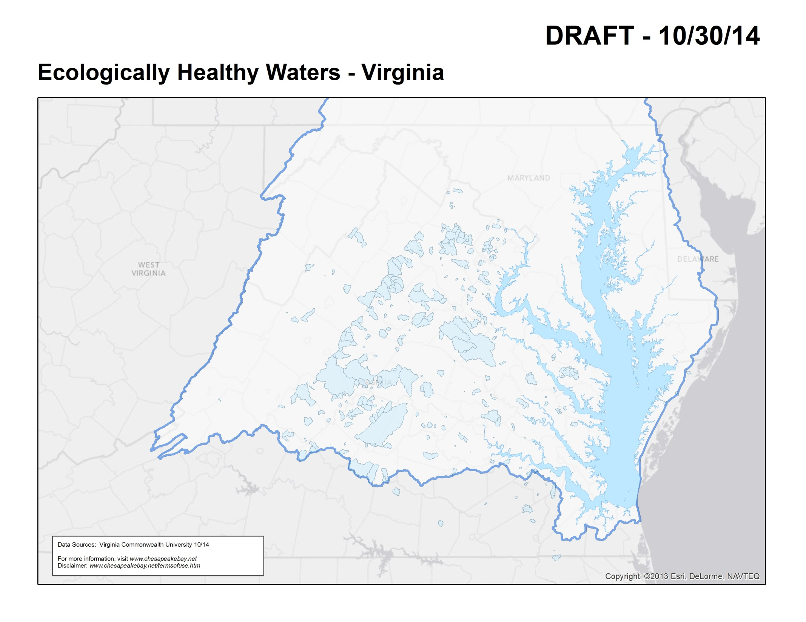
Virginia’s Ecologically Healthy Waters Criteria:
Driven by fish and macroinvertebrate community composition and abundance at stream locations throughout the state.
Partnership between Virginia Commonwealth University, VA DCR, and VA DEQ

Slide 22
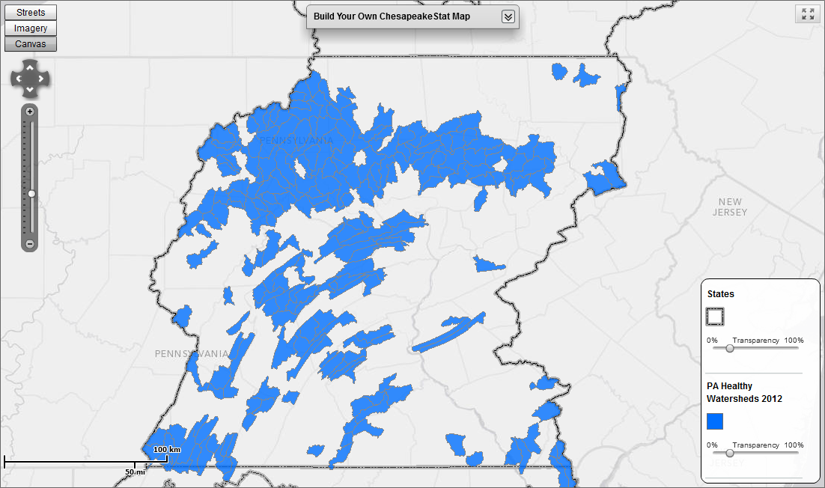
Pennsylvania Healthy Watershed Criteria:
Water quality criteria are used to protect designated water uses, such as fish and aquatic life, recreation, and water supply.
State designations of Exceptional Value or High Quality were used as the basis for identifying Healthy Watersheds.
Pennsylvania DEP makes designations.

Slide 23
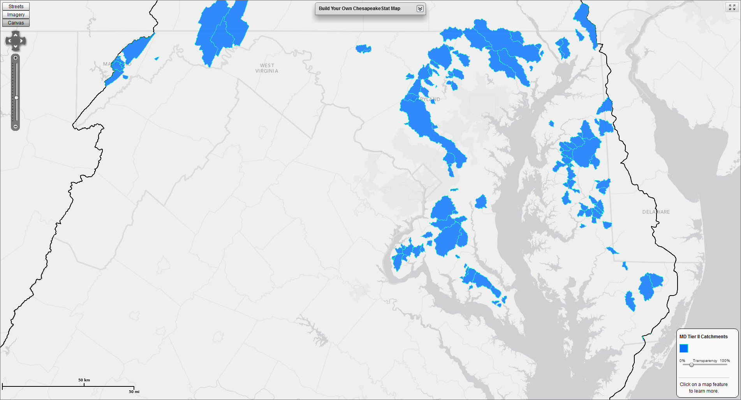
Maryland Tier II Catchments
Non-tidal watersheds, under regulatory anti-degradation protection, that exceed minimum applicable water quality criteria and standards. Currently, Tier II streams are identified according to fish and benthic indices of biotic integrity.

Slide 24
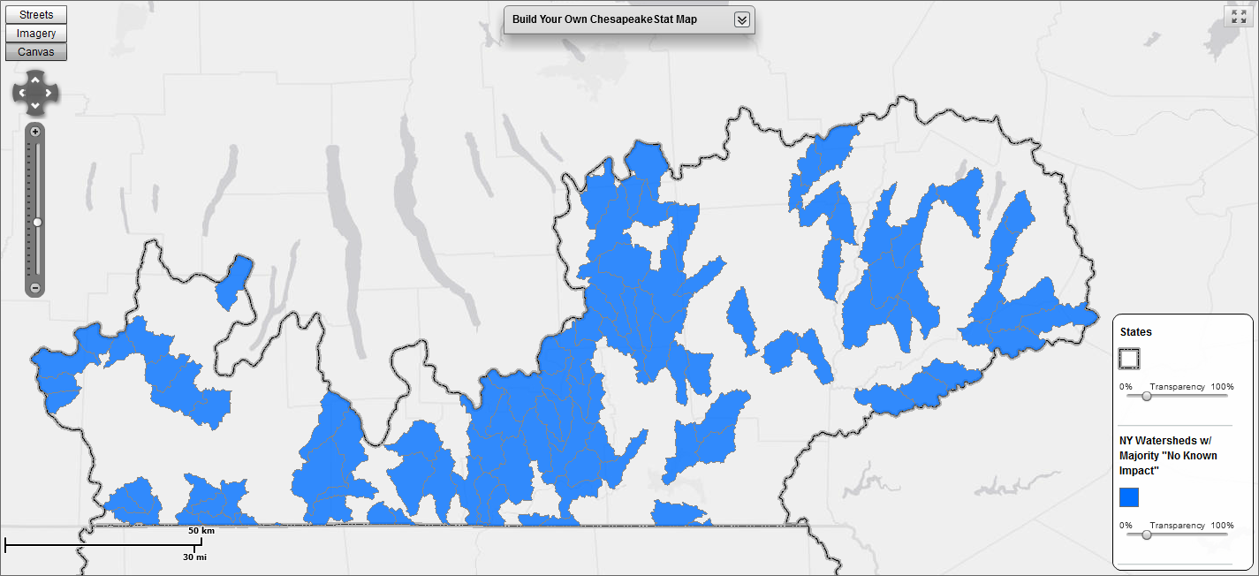
New York Healthy Watershed Criteria:
The Waterbody Inventory/Priority Waterbodies List (WI/PWL) is an inventory of the state's surface water quality. The category of "No Known Impact" represents "segments where monitoring data and information indicate that there are no use restrictions or other water quality impacts/issues.“
(Source: New York State Department of Environmental Conservation)

Slide 25
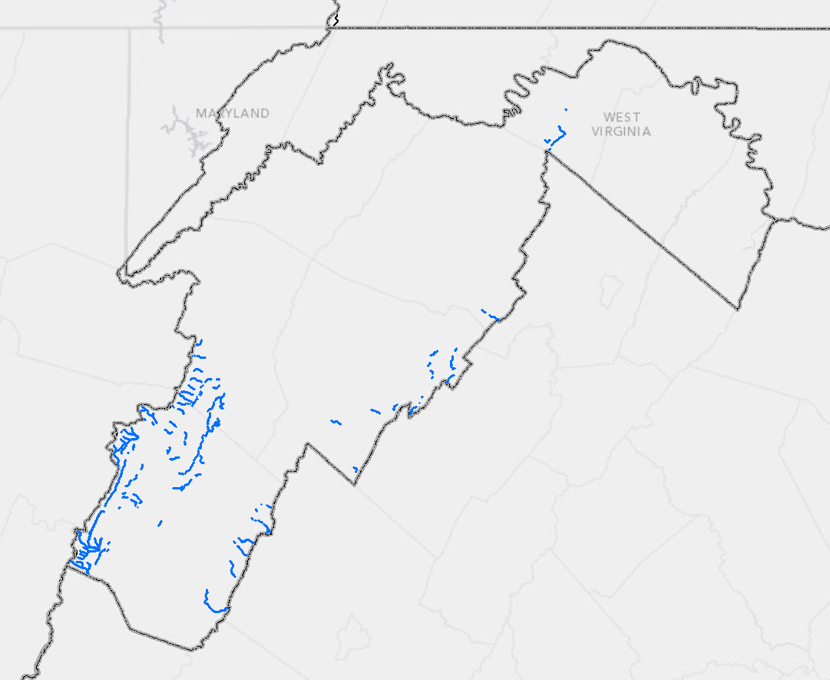
West Virginia Healthy Watershed Criteria:
West Virginia does not have a state defined "healthy watersheds" program or definition. West Virginia's anti-degradation rule can be applied to help define this category of streams. West Virginia's Tier 3 waters, are known as "outstanding national resource waters."
These include waters in Federal Wilderness Areas, specifically designated federal waters, and high quality waters or naturally reproducing trout streams in state parks, national parks, and national forests.
(Source: West Virginia Department of Environmental Protection)

