Slide 1
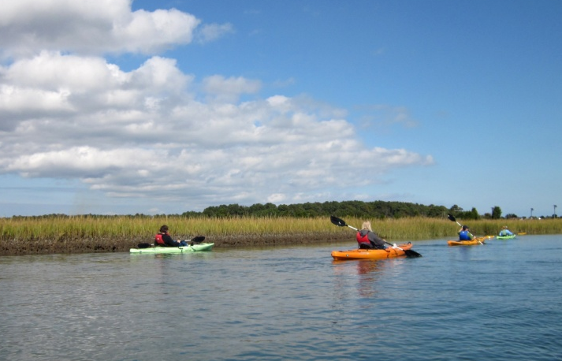

CBP Program Update
Local Government Advisory Committee
March 14, 2014
Nick DiPasquale, Director
Chesapeake Bay Program Office
(EPA)

Slide 2
Topics
Draft Chesapeake Watershed Agreement Timeline
FY 14 Chesapeake Bay Program Budget
TMDL and WIP Implementation
  Milestones
  BMP Verification
  Homeowner BMPs
  Mid Point Assessment
Other Reports and Activities

Slide 3
Watershed Agreement Timeline and Comments

Slide 4
Timeline for Addressing Comments and Finalizing Chesapeake Bay Watershed Agreement
45 Day public comment period through March 17.
Comments are wide ranging; significant amount of comments addressing toxic contaminants and climate change.
  Work with partners to incorporate comments for review by Principals Staff Committee (PSC) in mid-April.
  Executive Council will review and finalize agreement in June 2014
  One year from Agreement signing management strategies are due to address the outcomes

Slide 5
FY14 CBP Budget

Slide 6
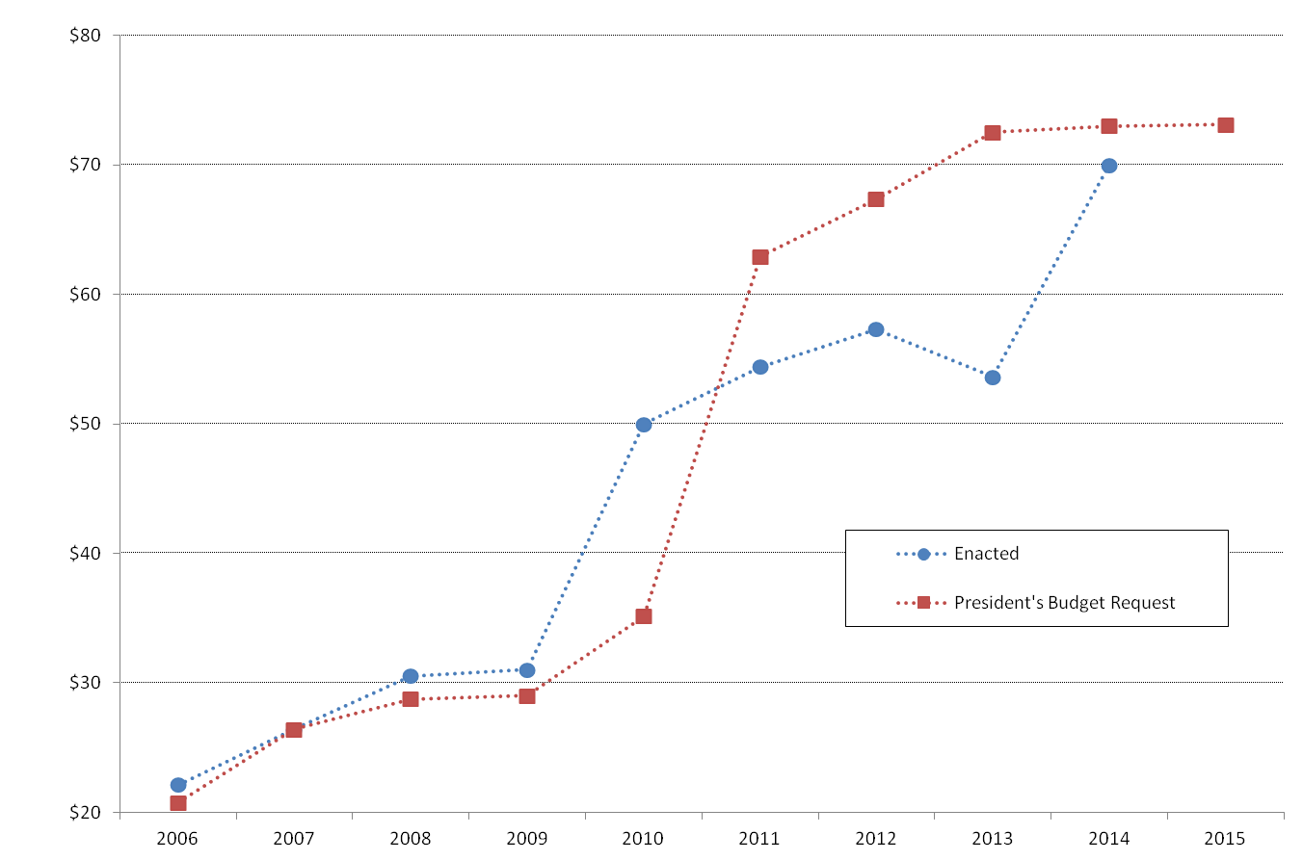
Chesapeake Bay Program Funding
(in millions)
E.O. 13508

Slide 7
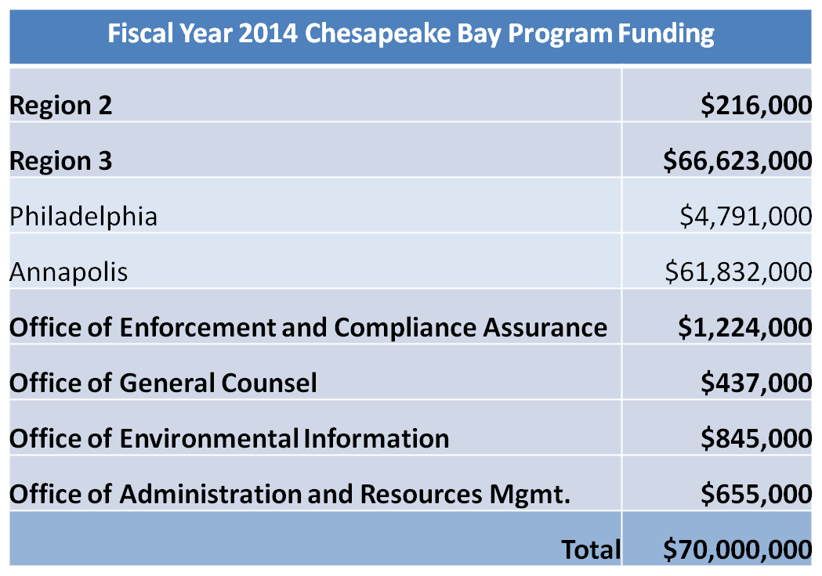

Slide 8
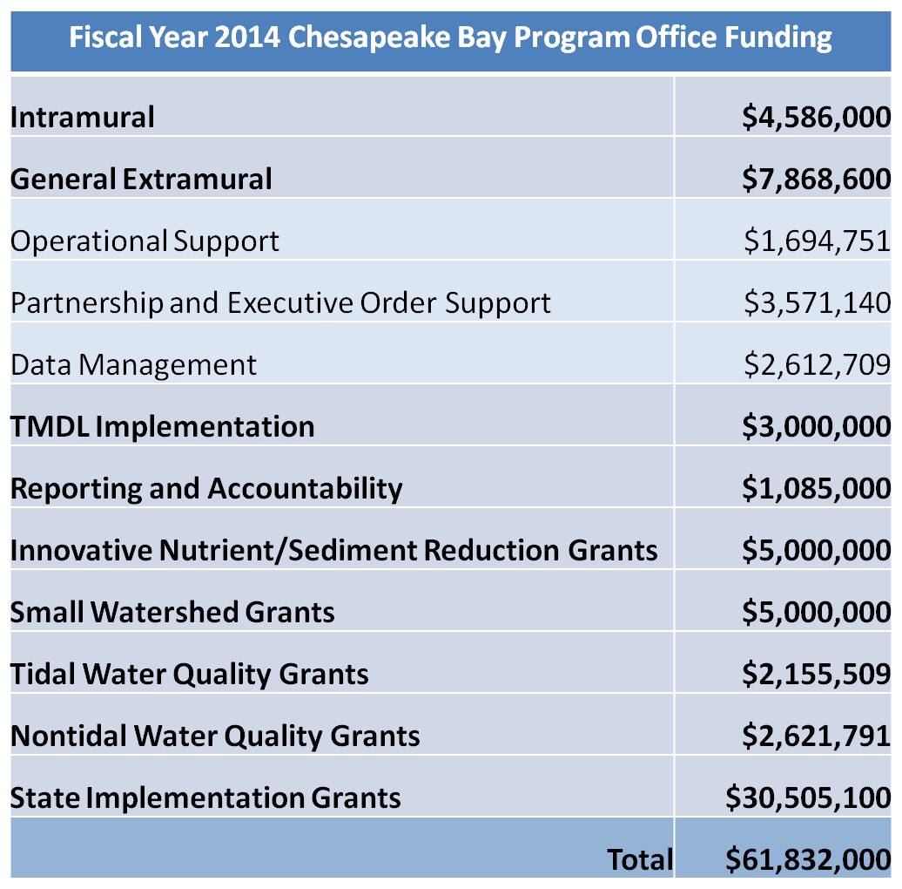

Slide 9
FY2014 CBP Budget
FY13 ($54 mil) FY14 ($70 mil)
  State Grants
  Almost 80% of increase going to state grants
  Local government “set-aside” for implementation ($5 mil)
  Increase for New Agreement implementation
    Headwaters states
    Signatory states
    Restore monitoring funding to FY12 levels ($4.8 mil + $300k SAV)
    $5 mil for Innovative and $5 mil for Small Watershed grants

Slide 10
FY2014 CBP Budget
Other Investment Areas
  Goal Implementation Team Support ($750k)
    Management Strategy Development
    Implementation Projects & Tools
  BMP Expert Panels
  BMP Verification Programs
  CAST/FAST Tools
  Climate Change
  Citizen Monitoring Initiative
  Financing Workshops
  Trading Program Support ($1 mil)
  FY2015 - $73 million PresBud Request

Slide 11
Next Steps
Share Final FY14 CBP Operating Plan with Management Board – Spring
Management Board works with GITs to develop process to review GIT Funding Project Proposals ($750k) – Spring
Issue Addendum to Grant Guidance for Local Government Funding – Late Spring
Provide CBIG/CBRAP funding levels to jurisdictions (including local government allocations) – Late Spring
Jurisdictions submit FY14 CBIG/CBRAP workplans to CBPO – Early Summer 2014

Slide 12
TMDL and WIP Implementation

Slide 13
Timeline for Evaluation of 2012-2013 Milestones and Development of 2014-2015 Milestones
EPA is currently evaluating progress toward meeting the 2012-2013 milestones
  Completed evaluations expected in June 2014
Jurisdictions are currently setting new milestone targets to be achieved by 2015
  Targets include programmatic changes and on the ground implementation of BMPs

Slide 14
BMP Verification Accomplishments
BMP verification principles adopted
BMP Verification Review Panel convened
Source sector verification guidance drafted
  Agriculture
  Forestry
  Stormwater
  Wastewater/septic systems
  Wetlands
  Streams

Slide 15
BMP Verification Accomplishments
12 framework elements drafted
  BMP verification principles
  BMP verification review panel
  Source sector/habitat specific verification guidance
  Practice life spans
  Ensuring full access to federal cost shared data
  Enhanced reporting of fed cost shared practices
  Accounting for non-cost shared practices
  Jurisdictions’ procedures for preventing double counting
  Clean-up of historical practice data
  Partnership process for evaluation/oversight
  Development/documentation of jurisdictions’ programs
  Communications and outreach strategy
Complete versions of framework document drafted (7/15/2013; 2/12/2014)

Slide 16
BMP Verification Schedule
April 1-2: BMP Verification Panel and Committee agreement on framework
Spring/Summer: Partnership review
  Water Quality, Habitat, and Fisheries Goal Implementation Teams
  CBP Advisory Committees: LGAC, CAC and STAC
  Management Board
Fall: PSC review and approval of framework

Slide 17
BMP Verification Schedule
Fall/Winter 2014: Jurisdictions complete development of their enhanced BMP tracking, verification, and reporting programs
Spring/Summer 2015: CBP BMP Verification Review Panel meets with the jurisdictions and review their proposed enhanced BMP tracking, verification, and reporting programs
Fall/Winter 2015: CBP BMP Verification Review Panel presents the Principals’ Staff Committee with its recommendations on the jurisdictions’ proposed enhanced BMP tracking, verification, and reporting programs

Slide 18
Homeowner BMP Crediting
Almost 50 communities and watershed groups offer incentives and/or technical assistance to homeowners in Chesapeake Watershed
Provides a way for individual residents to play a role in Bay restoration and could yield “green jobs”
Individual practices have small impact, but collectively may effectively reduce pollution
Credit: Chesapeake Stormwater Network
Notes:
Pilot:
Led by UMD Extension, Howard County, Chesapeake Stormwater Network. Congressman Sarbanes Office and EPA helped to convene
Mainly testing Stormwater Management and Restoration Tracker (SMART) reporting tool developed by UMD Extension
Howard County interested in linking homeowner BMPs to discount in stormwater fee – financial incentive
Protocol:
- Approved by Urban Stormwater WG in Dec 2013 and Watershed Technical WG in Feb 2014
- Consistent w/ Urban Stormwater WG’s proposed verification protocols
- PARTNERSHIP approval
Moving Forward
- EPA willing to work w/ stakeholders to explore how we/CBP can most help
- Giving credit toward TMDL?
- Recognition programs?

Slide 19
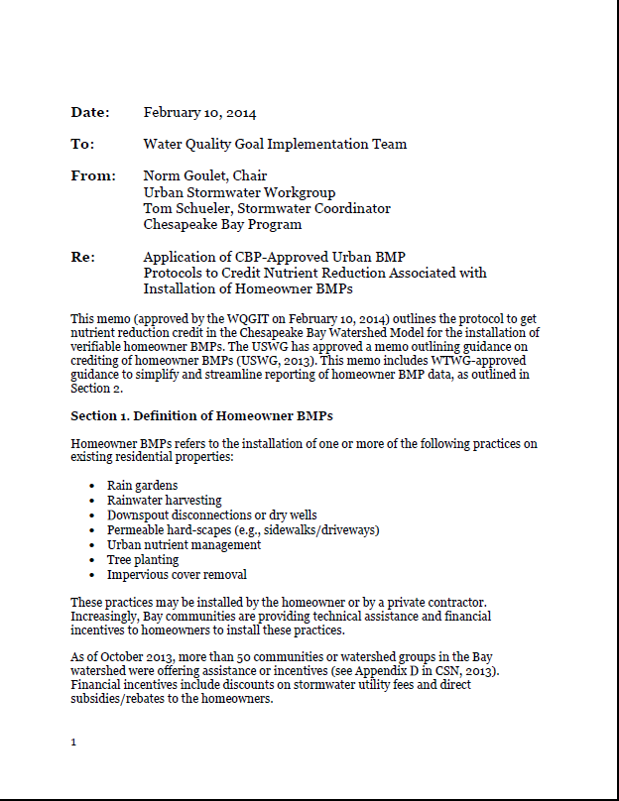
Recent Efforts
Summer/Fall 2013: Piloted use of innovative tracking tools and smart phone apps to streamline BMP reporting in Howard County, MD
February 2014: Water Quality Goal Implementation Team approved protocol for crediting homeowner BMPs in CBP models
Moving Forward: EPA willing to help convene stakeholders to identify strategies to support homeowner BMP programs
Notes:
Pilot:
Led by UMD Extension, Howard County, Chesapeake Stormwater Network. Congressman Sarbanes Office and EPA helped to convene
Mainly testing Stormwater Management and Restoration Tracker (SMART) reporting tool developed by UMD Extension
Howard County interested in linking homeowner BMPs to discount in stormwater fee – financial incentive
Protocol:
- Approved by Urban Stormwater WG in Dec 2013 and Watershed Technical WG in Feb 2014
- Consistent w/ Urban Stormwater WG’s proposed verification protocols
- PARTNERSHIP approval
Moving Forward
- EPA willing to work w/ stakeholders to explore how we/CBP can most help
- Giving credit toward TMDL?
- Recognition programs?

Slide 20
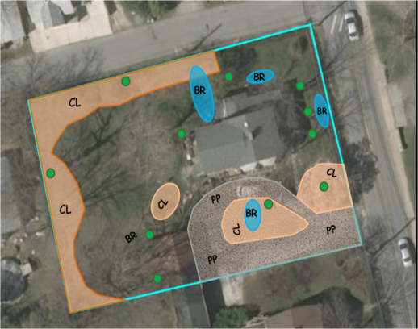
What Can Receive Credit
UNM Plan for 9200 Bradford Pear Lane: 0.5 acres
1 | Get Expert Lawn Advice | ✓
2 | Maintain Dense Cover on Turf | ✓
3 | Choose NOT to fertilize | ✓
4 | Recycle Lawn Clippings and Compost Fallen Leaves | ✓
5 | Correct Fertilizer Timing | N/A
6 | Use Slow Release Fertilizer | N/A
7 | Set Mower Height at 3 inches | ✓
8 | No off-target fertilization | N/A
9 | Fertilizer free buffer zones around water features | ✓
10 | Increase soil porosity and infiltration | ✓
Urban Nutrient Mgmt
Rain gardens
Rainwater Harvesting
Downspout Disconnection
Tree Planting
Permeable Driveways
Notes:
Homeowner BMPs can all be tied to practices that are currently simulated by the Chesapeake Bay Program models
Nutrient reduction values based on recent expert panel reports (Urban Nutrient Management - 2013, Urban Retrofits – 2012. Tree planting – existing values but expert panel underway

Slide 21
Reporting Process
Homeowner
Locality or 3rd Party Group
State
    Chesapeake Bay Program
Notes:
WQGIT homeowner BMP crediting protocol seeks balance b/t accountability and not overwhelming homeowners, localities, and states w/ burdensome reporting requirements
Homeowners install practice (can receive assistance) and report to locality or 3rd Party (eg, watershed group)
Locality or third party organization (eg, watershed group) verifies data, aggregates, and reports to state
Verification practices will need to be consistent w/ state verification protocols, which will be developed based on CBP verification guidelines that are currently under development
Options for verification given homeowner BMPs so small yet numerous.
State aggregates data across other localities and reports to CBP as part of annual progress run submission
Homeowner BMPs get special identifier in NEIEN
CBP calculates pollutant load reductions as part of progress run

Slide 23
Local Land Use Data Request
Phase 1 (Feb 2013 – Sept. 2014)
  Collect readily available land use and related datasets from localities
  Evaluate similarities and differences among received datasets.
Phase 2 (Oct. 2013 – July 2014)
  Identify gaps in the types and locations of data received.
  CBP solicits local agencies directly for data
Phase 3 (July 2014 – March 2015)
  Solicit and accept updates to data received from localities.

Slide 24
Phase 2: Data Request
Priority datasets
Impervious surfaces
Tree cover/ canopy
Land use
Parcel polygons (e.g., tax parcels)
Sewer service area boundaries (present and planned)
Zoning
Stream centerlines (finer than 1:24,000 scale)

Slide 25
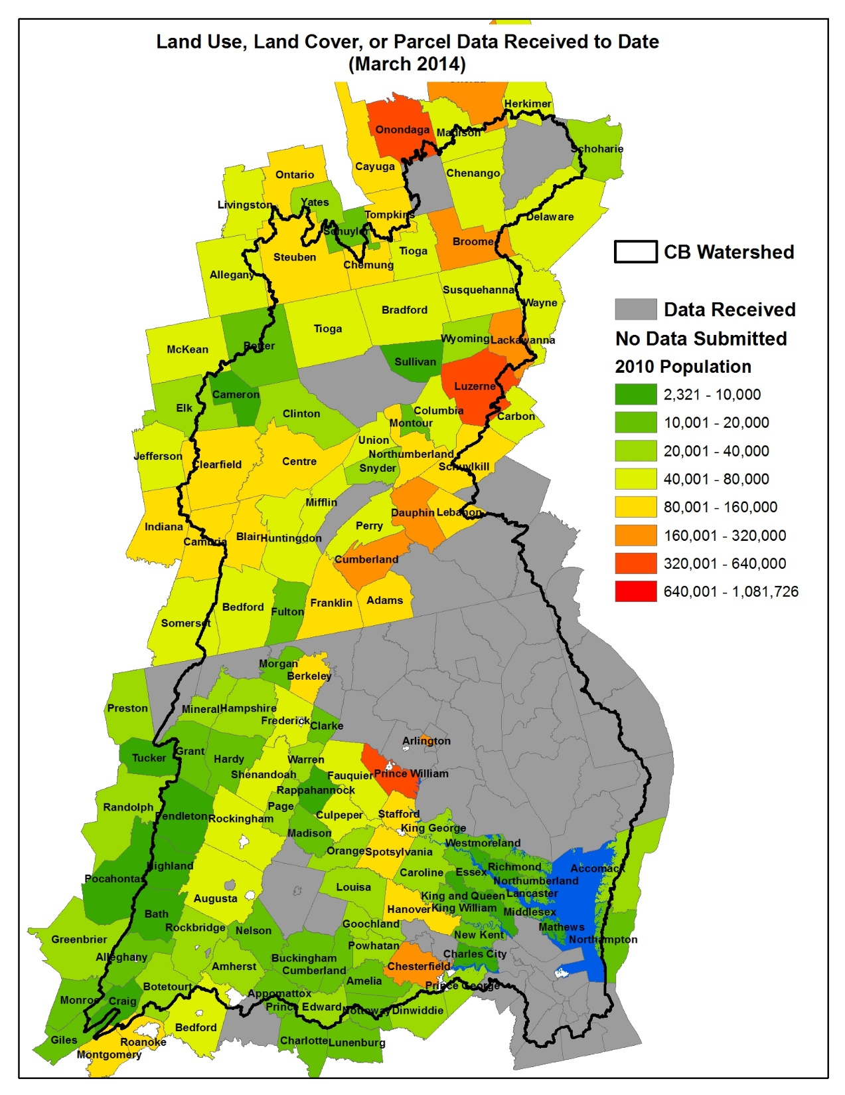
Phase 1: Data Request

Slide 26
Local Government Input to Assure Accurate Land Use for Watershed Model
Significant progress getting land use from high density jurisdictions.
LU Workgroup authorized CBPO to contact local governments for data (via Tetratech, LGAC,others)
Recommended CBPO work through VGIN
Sufficient data for MD and DE
LU Workgroup specifically requests LGAC assistance in getting the following priority datasets:
  Impervious surfaces
  Tree Cover/canopy
  Land Use
  Parcel polygons
  Sewer service area boundaries
  Zoning
  Stream centerlines

Slide 27
Other Reports and Activities

Slide 28
2013 CBP Report to Congress
Submitted by EPA on behalf of CBP every five years as a requirement of the Clean Water Act, Section 117(h) – covers 2008-2013 time frame
Status and Trends of the Chesapeake Bay Ecosystem
  Signs of Continuing Recovery
  Resilience
  Not Always Seeing Expected Response to Management Actions
Management Strategies Effectiveness
  Building an Effective Partnership
  Management Strategies
  The Transition Years
Recommendations for Improved Management (new Agreement)
Conclusion

Slide 29
Action Plan and Progress Report for Chesapeake Bay Executive Order
Combined Action Plan for FY14 and Progress Report for FY13 activities
Planned to go out for public review next week
Includes planned Federal budget for FY14 activities in all goal areas
  Fisheries
  Habitat
  Water Quality
  Land Conservation and Public Access

Slide 30
New Insights Report
Science-based evidence shows that
  Improvements to wastewater treatment plants
  Reductions in amounts of nitrogen coming from the atmosphere
  Reductions in nutrients from various forms of agricultural runoff

