Slide 1
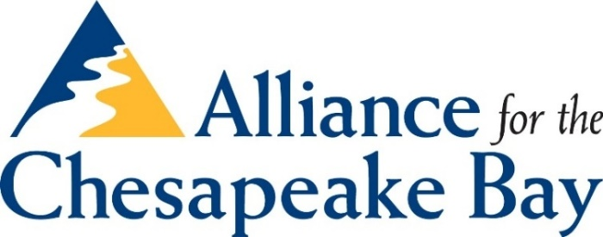
Restoration practices: one size does not fit all
LGAC Presentation
Lancaster, PA
Kate Fritz, Executive Director
Alliance for the Chesapeake Bay
December 14, 2017

Slide 2

My restoration experience
Local government – Prince George’s County, MD
Development Review (natural resource inventories)
Long-Range Planning (water resources plan, General Development Plan)
Implementation
Certified Watershed Steward (Anne Arundel, MD)
South River Federation (Annapolis, MD)
Alliance for the Chesapeake Bay

Slide 3
In order for us to meet our communities goals, we must apply both/and thinking to the problem.

Slide 4

BOTH/AND – multiple benefits

Slide 5
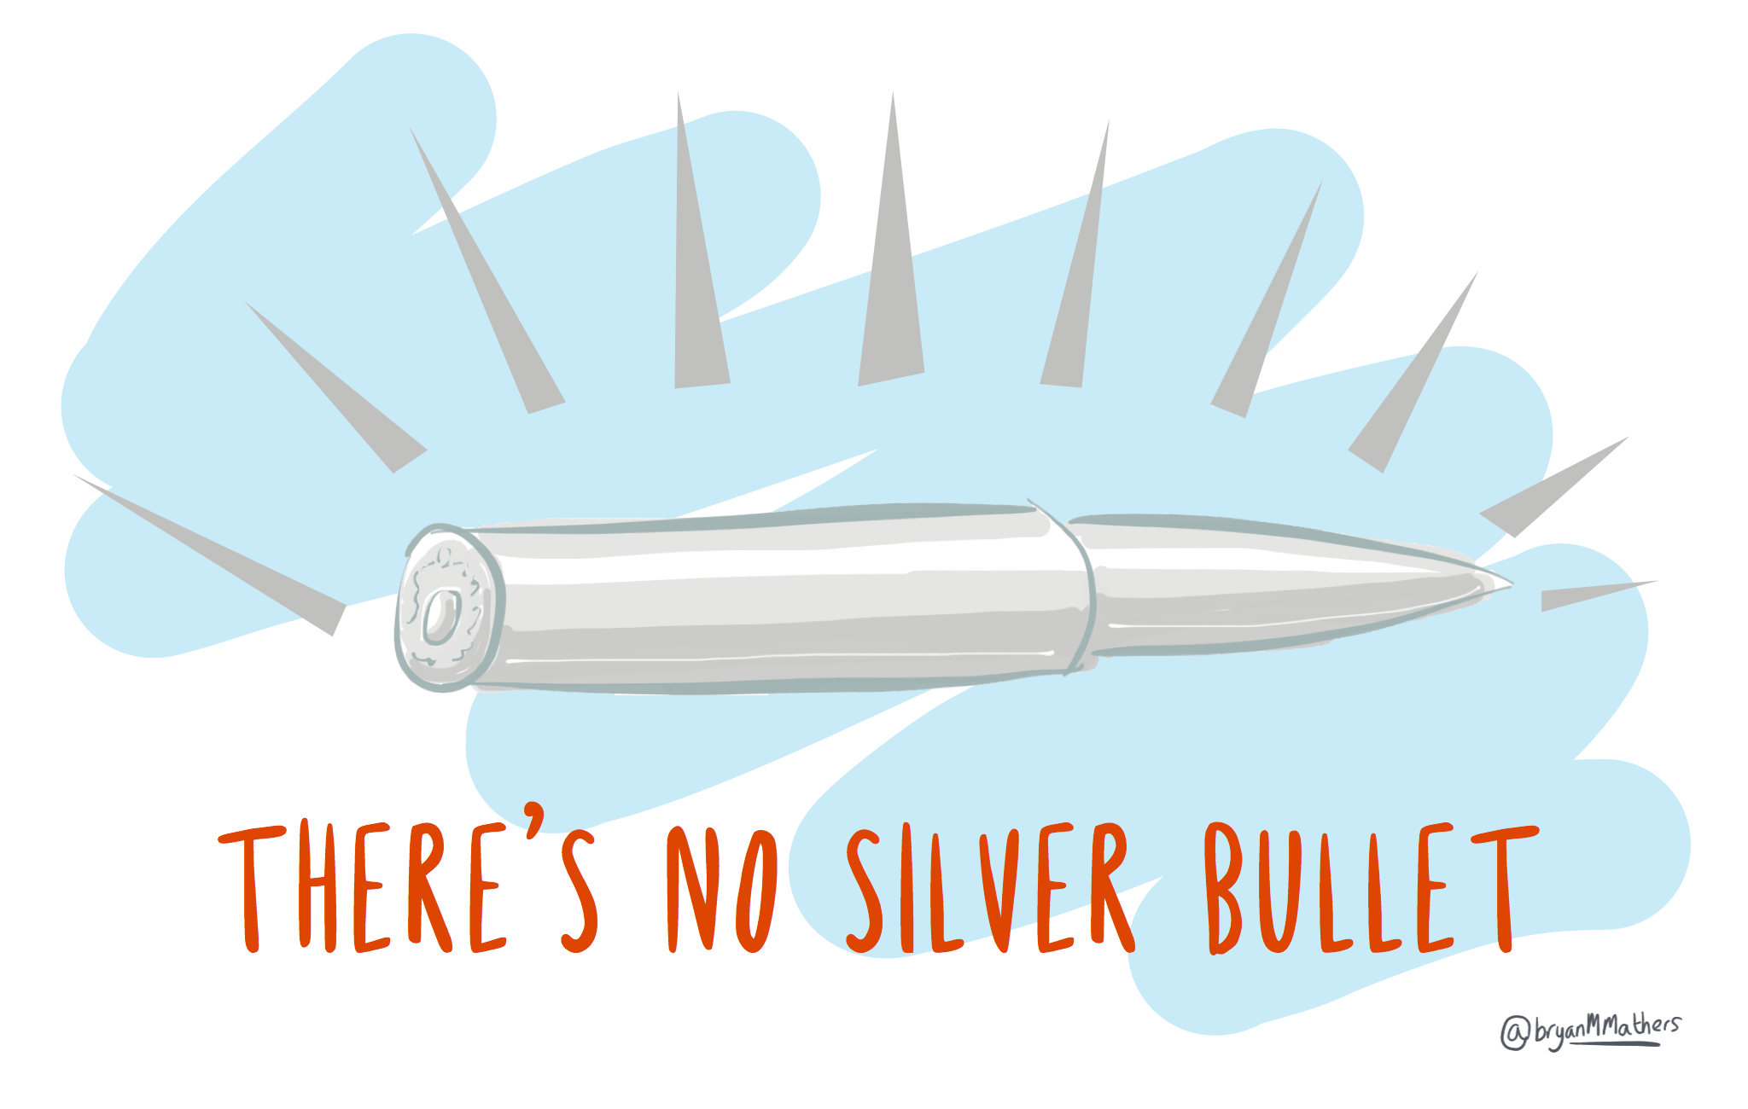

Slide 6
3 General Practices
Upland
Edge of Stream
In-Stream

Slide 7
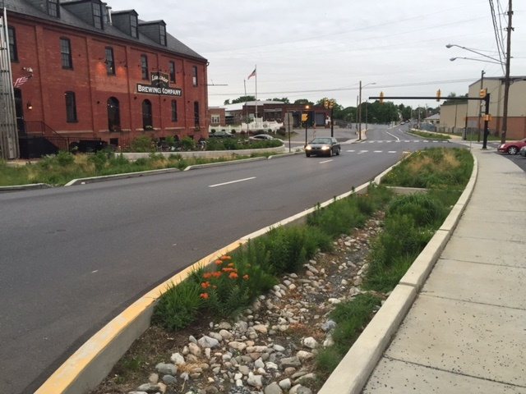
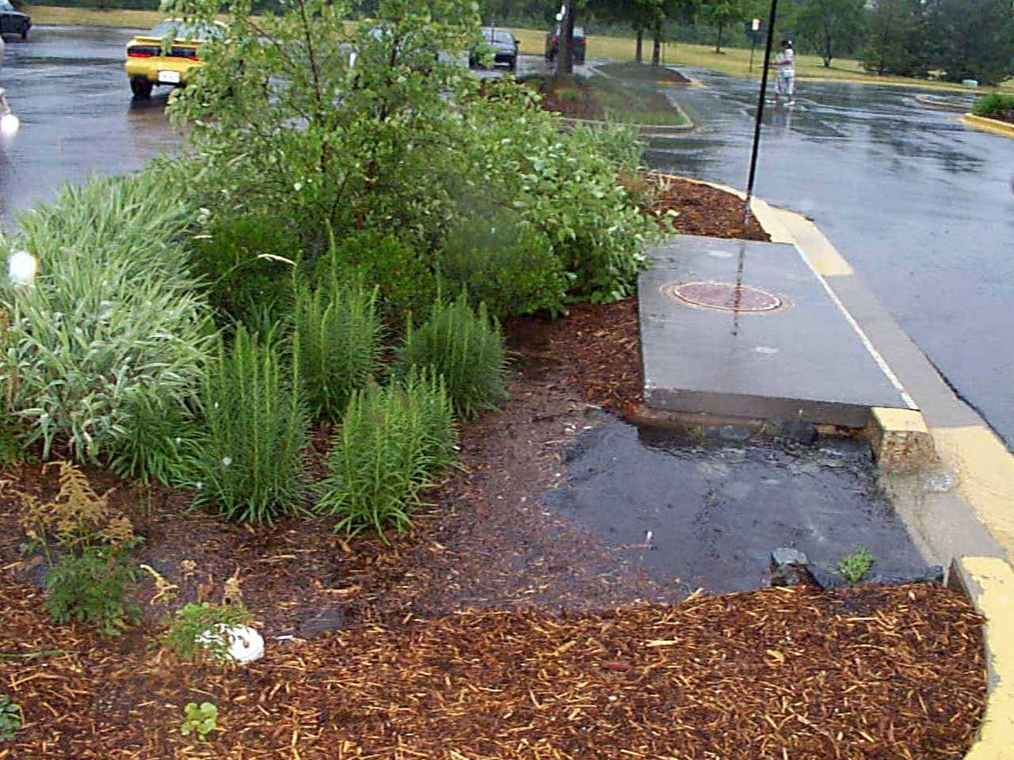
Upland Green Infrastructure (rain gardens, bioretention systems, etc)
Photo: The Bay Journal
Photo: The Bay Journal
Notes:
BENEFITS:
-generally easier for the community to understand (once they understand that if they’re built correctly, they aren’t mosquito pits)
-minimal annual maintenance requirement
-shorter permitting time
CHALLENGES:
-lower reduction rates mean that more practices need to be installed (more landowners, more money needed, more maintenance) to meet higher reduction goals
-effective for lower volume storms, larger storms still create a downstream erosion issue

Slide 8
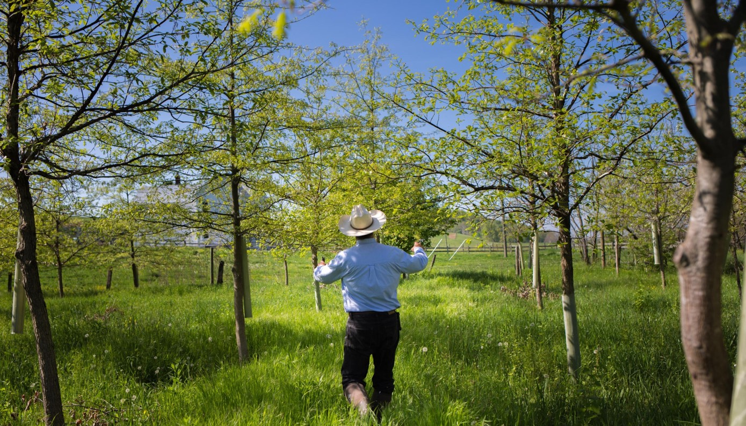
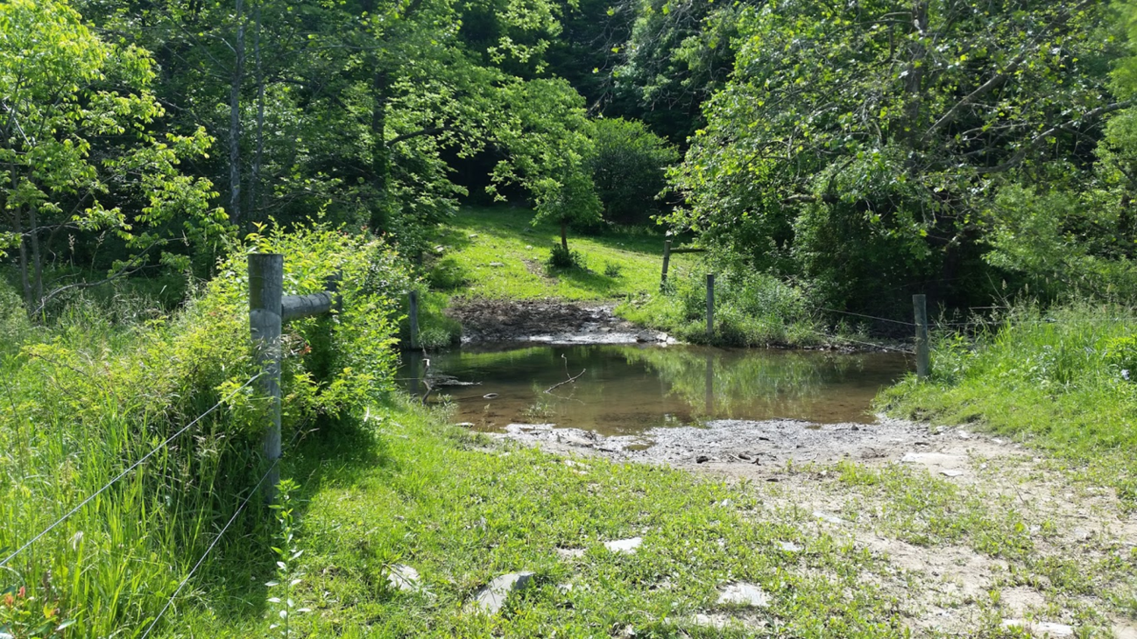
Edge of Stream (forested and grassed buffers)
Photo: Ryan Davis, Alliance for the Chesapeake Bay
Photo: Ryan Davis, Alliance for the Chesapeake Bay
Notes:
BENEFITS:
-cost efficient
-easy to install, low maintenance requirements
-provides multiple benefits: stabilize stream banks, provide in-stream shade for fish habitat, can plant pollinators or nut/fruit trees
CHALLENGES:
-needs maintenance annually, especially in order to first establish
-less room/space for planting in urban setting – might need to couple with another practice

Slide 9
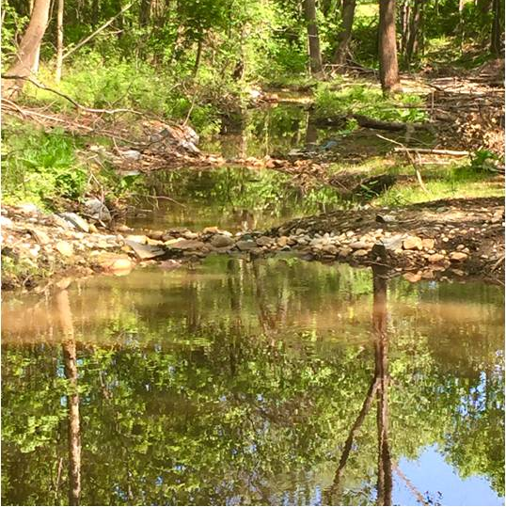
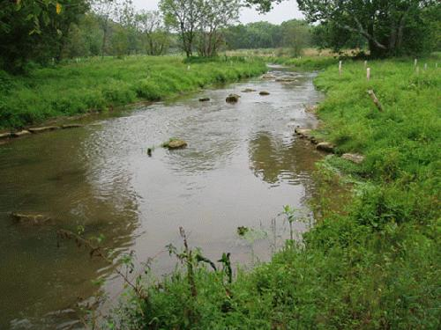
In-Stream (legacy sediment removal, floodplain reconnection)
Photo: South River Federation
Photo: LandStudies
Notes:
BENEFITS: potentially fewer land owners, immediate reduction in sediment, low maintenance once established, reduces in-stream bank erosion (a major sediment contributor)
CHALLENGES:
-the cost,
-unknown life space for maintenance
-engineering and permitting can be a multi-year process
-sometimes large trees have to come down

Slide 10
Upland
Edge of Stream
In-Stream
Together is better!
Notes:
All of these practices should work together, as a treatment train. This is why having a watershed plan in place is incredibly important – it will help prioritize and phase the projects across your jurisdiction.
The focus might be on one stream. The focus might be on one type of restoration technique.

Slide 11
Right Practice
To consider:
Financing mechanisms
Long-term maintenance
Permitting challenges
Partnership opportunities
Community willingness
Opportunity to install multiple practices/projects (treatment train)

Slide 12
Right Place
To Consider:
Perpetual access to the property
Future land use changes upstream
Level of community interest (local champions)
# of property owners involved
Ability to add more projects to same subwatershed

Slide 13
Right Reason
To Consider:
Defined goals of the project
MS4
Habitat creation
Ecological uplift
Flood abatement
Aesthetic uplift
Commitment to maintenance in perpetuity
Steward of project

Slide 14
So, how do we make these decisions?
Through our existing plans!
General Development Plans
Stormwater Management Plans
Transportation master plans
MS4 permit requirements
Water and Sewer Plans
Forest Conservation Plans
Recreation and Park Plans
Proposed developments in the pipeline

Slide 15
Your thoughts?
Thank you!
Kate Fritz
Kfritz@allianceforthebay.org
443-949-0575

Slide 16
How the Alliance can help!
Chesapeake Forests Program
Craig Highfield, Director
Annapolis, MD
Ryan Davis, Project Coordinator
Lancaster, PA
Jenny McGarvey, Program Manager
Richmond, VA
Holly May, Watershed Forester
Inwood, WV

