Slide 1
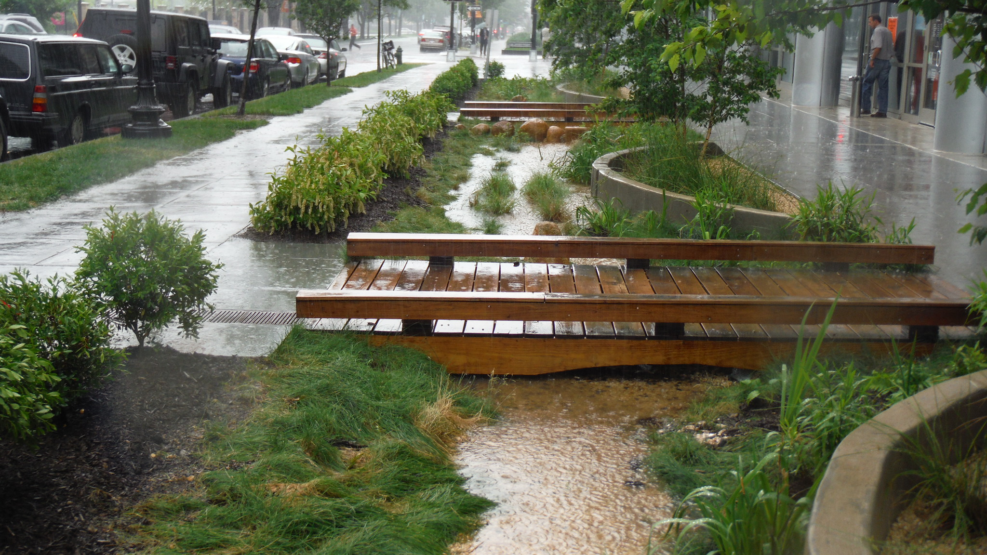
Tools for Resilience to Climate Related Flooding: Engineering, Education and Local Ordinances
Local Leadership Workgroup
August 24, 2021

Slide 2
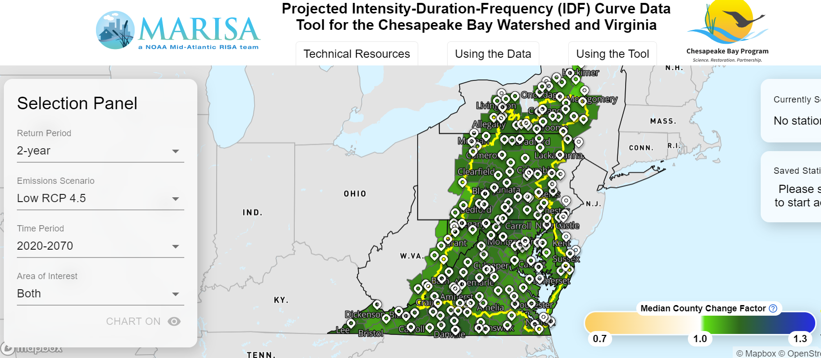
Tool #1: Climate Change-Informed IDF Curves
Data Tool: https://midatlantic-idf.rcc-acis.org/
Webinar: https://chesapeakestormwater.net/events/projected-chesapeake-idf-curves/

Slide 3
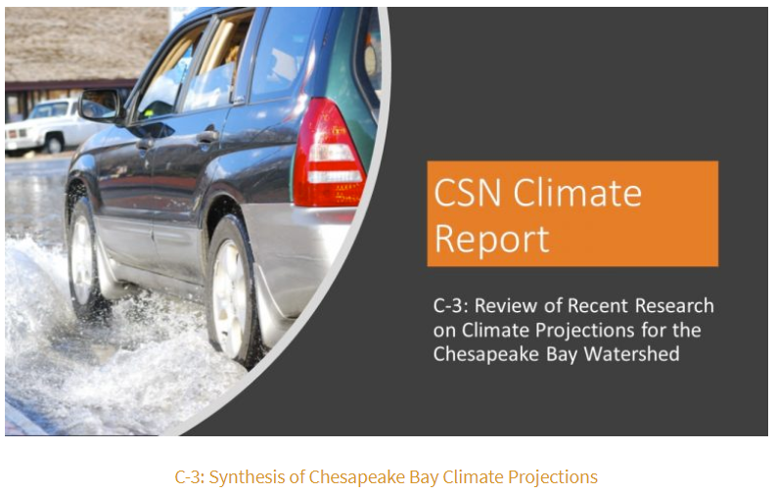
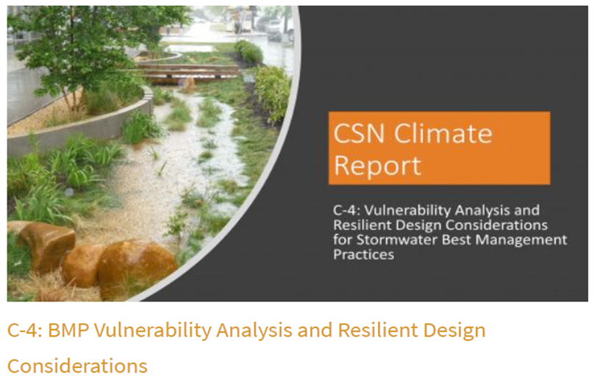
Tool #2: CSN Climate and Stormwater Reports
Reports: https://chesapeakestormwater.net/climate-change-and-stormwater-management/
Webinar: https://chesapeakestormwater.net/events/bmp_vunerability_resilience/

Slide 4
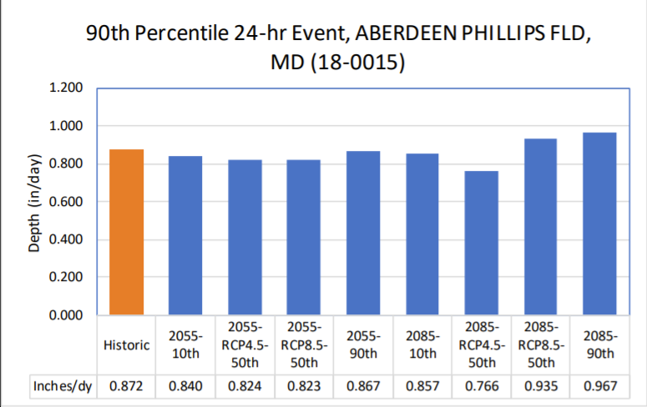
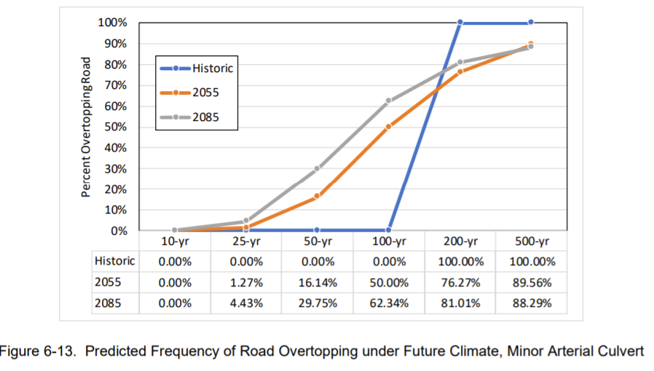
Tool #3: Climate Impacts to Restoration Practices
Report: https://cbtrust.org/wp-content/uploads/Grant16928-Deliverable11-FinalProjectReport_120820.pdf
Fact Sheet: https://cbtrust.org/wp-content/uploads/Fact-Sheet-RestorationResearch_Grant16928_formatted_100120.pdf

Slide 5
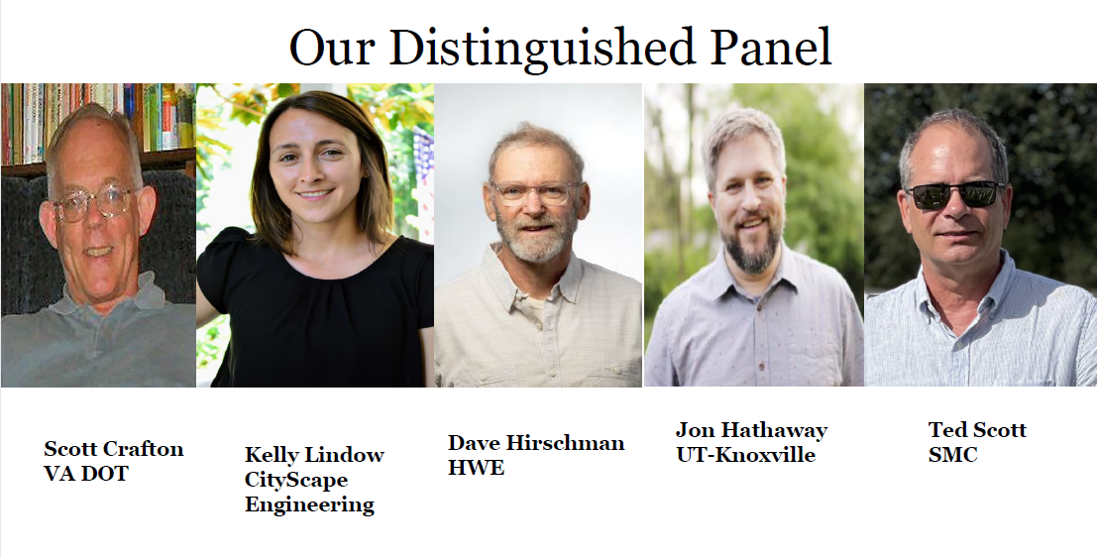

Tool #4: CSN Runoff Rendezvous Webinars
Climate Change and Extreme Rainfall: Translating Future Projections into More Resilient Urban Communities
New Paradigms to Manage Future Urban Floods in the Bay Watershed
Developing the Next Generation of Stormwater Design Criteria

Slide 6
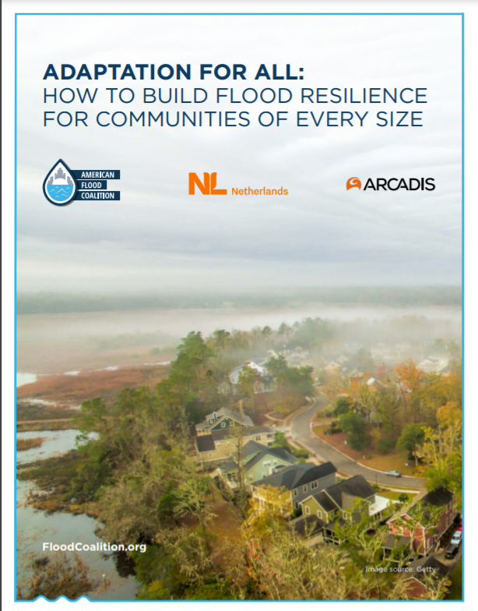
Tool #5: Case Studies
NYC Stormwater Resilience Plan: https://www1.nyc.gov/assets/orr/pdf/publications/stormwater-resiliency-plan.pdf
ADAPTATION FOR ALL: HOW TO BUILD FLOOD RESILIENCE FOR COMMUNITIES OF EVERY SIZE
Virginia Beach Public Works Stormwater Design Manual: https://www.adaptationclearinghouse.org/resources/virginia-beach-public-works-design-standards-manual-sea-level-rise-and-precipitation-adjustments-for-stormwater-management-design.html

Slide 7
Questions?
David Wood
Chesapeake Stormwater Network
Wood.CSN@Outlook.com

