Slide 1

Financing and Funding Resilience New (and Old!) Tools in Toolboxes
Tuesday, August 24, 2021
Brandy Espinola
bespinol@umd.edu
Notes:
Greenland? First time on record – summit 2 miles above sea level, precipitation fell as rain not snow, an extreme rain event that dumped 7 billion tons of water – enough to fill the Reflecting Pool at the National Mall almost 250,000 times. I don’t know about you, but figuring out how to respond to a global crisis of this magnitude feels overwhelming and immobilizing to me, but this is not something that is randomly happening in a remote place. With increasing frequency, your streets are flooding, your business districts are inaccessible, your residents are exposed to extreme heat and your first responders are being asked to do more than ever before. We do our part by doing what can locally.
Perhaps the only thing more daunting than thinking about how you are going to address the types of climate challenges you are facing in your communities is figuring out how you are going to pay for them. I am going to talk a little about some new tools for resilience finance, but we are not throwing out the old ones, because many of those can still be critical components of your resilience financing strategies.

Slide 2

What is in the toolbox?
Old tools
They can still work with a little oil and sharpening
New tools
Not magical, but it can be nice to have more specialized options
Notes:
There are a couple of different ways we can approach how we think about how we are going to pay for resilience projects:
The OLD TOOLS - funding sources and financing tools that we are familiar with that may just need a little adapting to meet our resilience needs
And the NEW TOOLS like some of the ones you heard about today that are more specifically intended for this purpose (Resilience Authorities, Resilience Revolving Loan Funds)

Slide 3

What is in the piggy bank?
Existing money
Modify or redirect existing and future investments
Avoid future harm and costs
Meet adaptation needs
Better leverage other funding sources
New money
Develop new sources of revenue, obtain grants, attract private investment, pursue low-interest loans
Notes:
Another way to think about it is changing how we spend the money we already have vs. obtaining additional money
You are already making decisions with your dollars; there are things you can do to aim these decision-making processes in the direction of achieving resilience outcomes.

Slide 4

A comprehensive resilience financing strategy will use a combination of tools
Cost Savers
Integrated Planning
Capital Improvement Programs
Asset Management
Procurement Partnerships and Resource Sharing
Public Private Partnerships
Rebates and Tax Credits
Regulations and Policy
Sources of funding
Taxes
Fees
Bonds and Loans
Grants
Crowdfunding
Notes:
There is no getting around the fact that developing resilience financing strategies that are sufficient, sustainable and equitable is hard work.
There is no simple, single solution, but by looking at these problems in a holistic way and integrating plans and projects, communities can potentially reduce costs and increase the chances of accessing new sources of funding.
Successful strategies tend to rely on a combination of tools the mix of which is specifically appropriate to the community. It is important to be thinking about how you are going to pay for your resilience efforts as early in the process as possible. Waiting to think about he financing strategy until a plan is complete can result in missed opportunities.

Slide 5
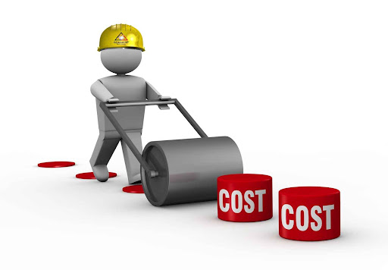
Cost Reducers for Resilience
Integrated Planning
Integrating with Comprehensive Plan, Hazard Mitigation Plans, other Community Plans
Integrating with regional and state plans
Embedding Resilience into Current Processes
Asset Management
Assessing vulnerability
Updating maintenance and replacement schedules
Updating infrastructure design standards and plans
Budget and Procurement
Establishing resilience criteria as priority
Assessing long-term viability
Bundling Projects
Portfolio of projects
Coordinating with neighboring jurisdictions
Notes:
Cost reduction strategies are designed to increase efficiency and reduce costs. Think holistically and creatively across community priorities to incorporate multiple objectives and long-term needs. This is the Dig Once idea – for example, when a road is getting torn up, or a municipal asset like a park or building is being renovated, are there opportunities to incorporate resilience practices? Costs can be reduced by aligning efforts to avoid duplicating projects, integrating projects into the annual budgeting process, sharing resources and technical services across jurisdictions, leveraging private partners, adopting strategic policy goals, incentivize private property owners to take action – municipalities cannot do this on their own – need some combination of carrots and sticks.
Planning
Cross walk your existing plans and planning processes – comprehensive, hazard mitigation, parks, trails, etc - for the opportunity to fold in resilience needs to create efficiency and diversify the funding options available to you
Making sure your resilience plan is well-aligned with regional, state and federal priorities will ensure your plan will qualify for resources those entities make available.
Embedding Into Current Processes
Consider resilience needs in your asset management planning. Stay on top of maintenance needs and understand how climate impacts will affect assets over time to reduce chances of critical asset failure. Preventive maintenance is ALWAYS cheaper.
Steer your current funding decisions towards investments that will have a mid-to-long term benefit and consider establishing resilience criteria for budget and procurement decision making to ensure dollars are going to sound investment.
Bundling Projects
This approach, either internally or with other jurisdictions, can help reduce cost by increasing economies of scale – this can be particularly effective for procuring design, engineering, build and maintenance services. This is also be appealing to grant funders who will see the potential for reduced risk, greater collective impact, and less administrative burdens than multiple, disparate proposals.
Regional Climate Collaboratives are a great example of this strategy. To address the problems of increasing extreme weather events, communities across the country have started to work together at a regional scale to put in place-coordinated policies across multiple jurisdictions. By moving beyond fragmented planning and development programs, communities can achieve integrated solutions to address climate change while overcoming limited resources and technical capacity needs.
(MWCOG 9/24, Eastern Shore Climate Adaptation Partnership 6, Greater Boston, Greater Chicago, FL, NH, MN, WA, CA)

Slide 6

Revenue Streams for Resilience
Taxes & Fees
New taxes or special assessments
Enterprise funds
Special Improvement Districts
Utility fees
Bonds
Municipal, Green, Impact
Loan Programs
Clean Water SRF & Drinking Water SRF
New Resilience Revolving Loan Funds: Federal STORM Act & Resilient Maryland Revolving Loan Fund
Notes:
Local governments have traditionally relied on funding or financing infrastructure through general funds, grants and debt, but the scale of resilience needs may call for something more dedicated, cohesive and intentional. To develop a sustainable financing and funding strategy, you will want to consider your desired activities and associated budget needs, existing sources of funding or in-kind support, and your community’s appetite for new revenue programs.
The path that some other communities have taken include – new taxes and fees - the upside of these is that unlike general funds, the funds collected will be dedicated specifically to resilience needs. The “revenueshed’ for these taxes or fees can be structured to ensure they are capturing those that are contributing to resilience challenges and those who are benefitting from the implementation of resilience projects.
Green/Climate Bonds are bonds whose proceeds are intended specifically for green projects and are backed by the taxing authority of the community or a state and
Environmental Impact Bonds (EIB) which are a pay-for-success mechanism where returns are based on outcomes. In other words, investors collect a return on their investment if the project proves to be successful. They have an additional “performance payment” made to investors if projects achieve greater-than-expected performance.
Loan programs – CW and DW SRF programs, can be a vehicle for resilience projects providing critical upfront capital for projects that can then be paid off at a very low interest rate over time, capturing payments from future benefiters. And then leg passed earlier this year at the federal level allowed FEMA to provide funds to state to set up resilience and haz mit revolving loan funds which in Maryland will take the form of the Resilient Maryland RLF that MEMA will capitalize with flow through FEMA funds.

Slide 7
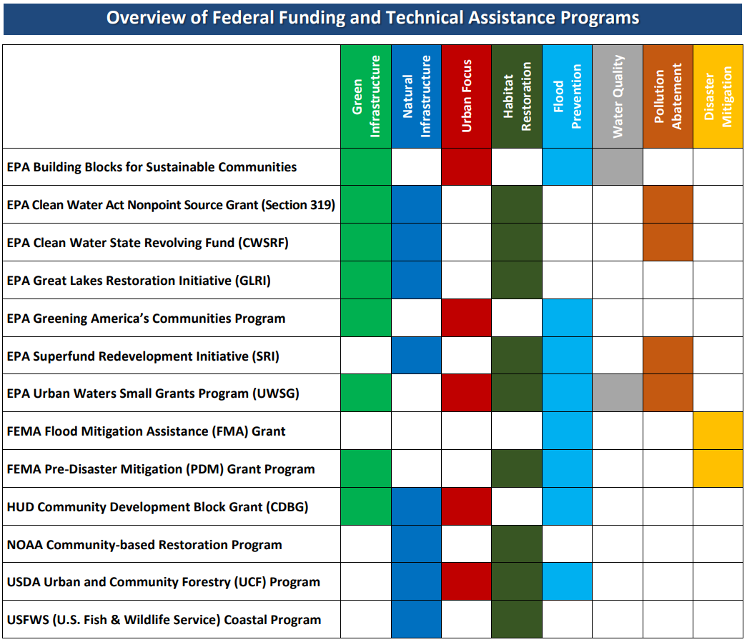
Federal Funding and Technical Assistance Programs
Note: FEMA Pre-Disaster Mitigation (PDM) Grant Program is now Building Resilient Infrastructure and Communities (BRIC)
Notes:
Environmental and Energy Study Institute
Federal Resources for Nature-Based Solutions to Climate Change (February 2020)
This fact sheet provides a survey of federal funding and technical assistance available to help state and local governments and agencies, tribes, non-governmental organizations, universities, and individuals implement nature-based solutions for climate resilience.
Many of these sources of federal support allow communities to develop projects which draw on the multiple, interrelated benefits of nature-based solutions. This fact sheet also identifies the types and attributes of projects the programs support.
With new federal funds being announced, this fact sheet is out of date but still a good starting point. It gives an idea of the breath of opportunities

Slide 8

New Funding to Incorporate into Resilience Efforts
FEMA Building Resilient Infrastructure and Communities (BRIC)
Formerly Pre-Disaster Mitigation (PDM) Grant Program; now with more flexibility and money
CARES Act
New Infrastructure Bill
Work on identifying potential projects and cost share sources now, so that you are ready to take advantage of these federal dollars!
Notes:
The process of winning a grant can be quite competitive and time consuming and usually requires writing proposals, following strict specific guidelines, which are then evaluated by the funding agency.
BRIC is more flexible and has more money but demand has VASTLY exceeded supply so far
Many of you likely used your CARES act funding for resilience projects
And while there is still a need for more clarity on what the new infrastructure funding can and cannot be used for, the bottom line is having projects ready to hit the ground and cost share identified will facilitate getting these dollars on the ground in your community quickly and effectively.

Slide 9
 |  |  |  | Requires |  |  | Consider using for Projects that are focused on
Financing Mechanisms | Brief Description | Cost Reducer | Revenue Stream | Enabling Legislation | Access to Debt | Cost Share | Coordination/ Planning | Small -Mid Size | Large Size
Comprehensive Planning | Incorporate hazard mitigation and climate resilience solutions into integrated long-term plans. | x |  | x |  |  | x | x | x
Capital Improvement Programs | Prioritize hazard mitigation and climate resilience needs in publicly financed infrastructure. | x |  |  |  |  | x |  | x
Cooperative Procurement and Inter-local Resource Sharing | Share hazard mitigation and climate resilience related procurement contracts and/or service responsibility with other jurisdictions. | x |  |  |  |  | x | x | x
Public Private Partnerships | Contract with a private company for the implementation of public hazard mitigation and resilience infrastructure. | x |  |  |  | x | x |  | x
Rebates and Tax Credits | Offer a monetary concession to stimulate private investment in hazard mitigation and resilience projects. | x |  |  |  | x |  | x
Regulations and Policy | Require specific hazard mitigation and resilience solutions for the public and private sector. | x |  | x |  |  | x | x | x
Taxes | Use cash or other current assets to fund hazard mitigation and climate resilience projects. |  | x | x |  |  |  | x
Fees | Impose the cost of providing a specific hazard mitigation and climate resilience service exclusively on the beneficiaries of that service. |  | x |  |  |  |  | x
Bonds and Loans | Borrow money to pay for a specific hazard mitigation and climate resilience project and spread the repayment over time. |  | x |  | x |  |  |  | x
Grants | Apply for funds that are disbursed or gifted by one party to another to support specific hazard mitigation and climate resilience projects. |  | x |  |  | x |  | x
Crowdfunding | Raise cash, awareness and public support for hazard mitigation and climate resilience projects. |  | x |  |  | x | x | x
Offsite Crediting Programs | Develop and/or enhance natural habitat for the purpose of compensating for unavoidable resource losses in advance of development actions. |  | x |  |  |  | x |  | x

Slide 10
Big Takeaways
There is no magic bullet
Develop more resilient finance and budgeting decision-making processes
Consider your funding options earlier in the planning process
Diversify funding options by adopting integrated planning efforts
Be prepared to take advantage of grants
Establish a portfolio of viable implementation projects
Start planning for cost share
Don’t be afraid to explore new opportunities
Revolving loan funds
Green bonds
Develop a blended finance strategy by mixing various funding and finance strategies to implement projects
Notes:
There is no simple single solution but by looking at these problems in a holistic way, communities can potentially reduce their costs of dealing with these challenges and increase the chances of accessing new sources of funding.
You are already making decisions with your dollars; so make them count. Develop more resilient processes to ensure smart long-term decision making.
Consider cost early on in the planning process, look for ways to reduce costs, explore opportunities to work with your neighbors.
Remain flexible and assess a variety of funding and financing sources to determine which ones may be accessible and worth implementing given the realities of your particular jurisdiction Work to identify potential sources of revenue early on in the planning process and understand if there are ways to combine multiple sources.

Slide 11
Questions?
Brandy Espinola
bespinol@umd.edu

