Slide 1
Local Leadership Workgroup
(Lightening updates to keep you up to speed!)

Slide 2
Local Leadership Logic and Action Plan
On track or complete – 13 actions
Risk of Getting Off-Track – 2 actions
  Local Leadership Baseline Survey – still waiting on OMB approval
  Peer to peer learning exchange bus tours in MD and PA – planned for October 2021, but status in question due to COVID-19 global pandemic
Off Track – 0 actions

Slide 3
Webinar on American Rescue Plan: Opportunities to Fund Water Infrastructure Priorities
September 14th 10am – 11:30am
Invited Speakers:
  Diana Esher, EPA Region 3 Acting Director
  Adam Pugh, National Association of Counties
  Jasmine Gore, Local Government Advisory Committee Chair
Agenda → overview of ARP and water/sewer infrastructure eligible uses, case studies highlight local government use of funds

Slide 4
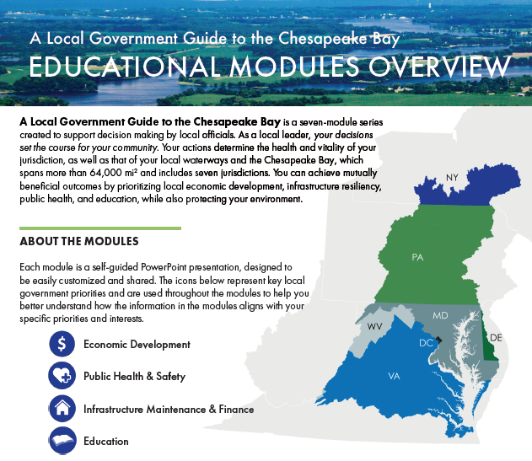
A Local Government Guide to the Chesapeake Bay
Roll-out continues:
  PA - Handouts for CCAP and PSATS conference panels – summer 2021
  NY -Tailoring for webinar this fall
  VA - Rappahannock Roundtable Sept 8
  MD - MML/MACo’s Academy for Excellence in Local Governance – elective course this fall
We look forward to hearing how you use these materials!

Slide 5
A Local Government Guide 2.0?
Develop 3 - 4 additional educational modules → potential topics include: environmental/public health, flooding, outdoor recreation, agriculture etc.
Online database of educational materials and resources → including but not limited to: case studies, funding, technical assistance, educational materials, webinars, model ordinances etc.
Train the trainer → Half day training on resources available and how to use them

Slide 6
Thank you!

