Slide 1
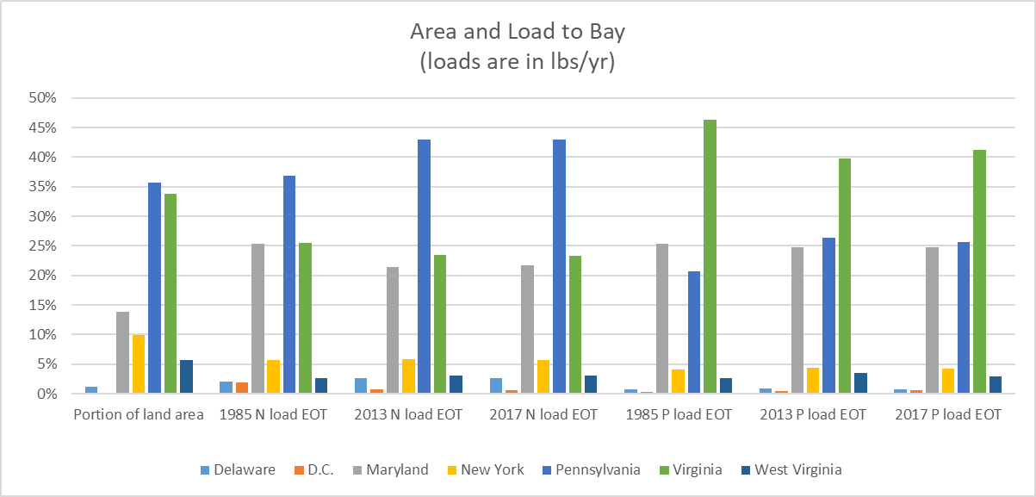
Data from CAST, public reports

