Slide 1
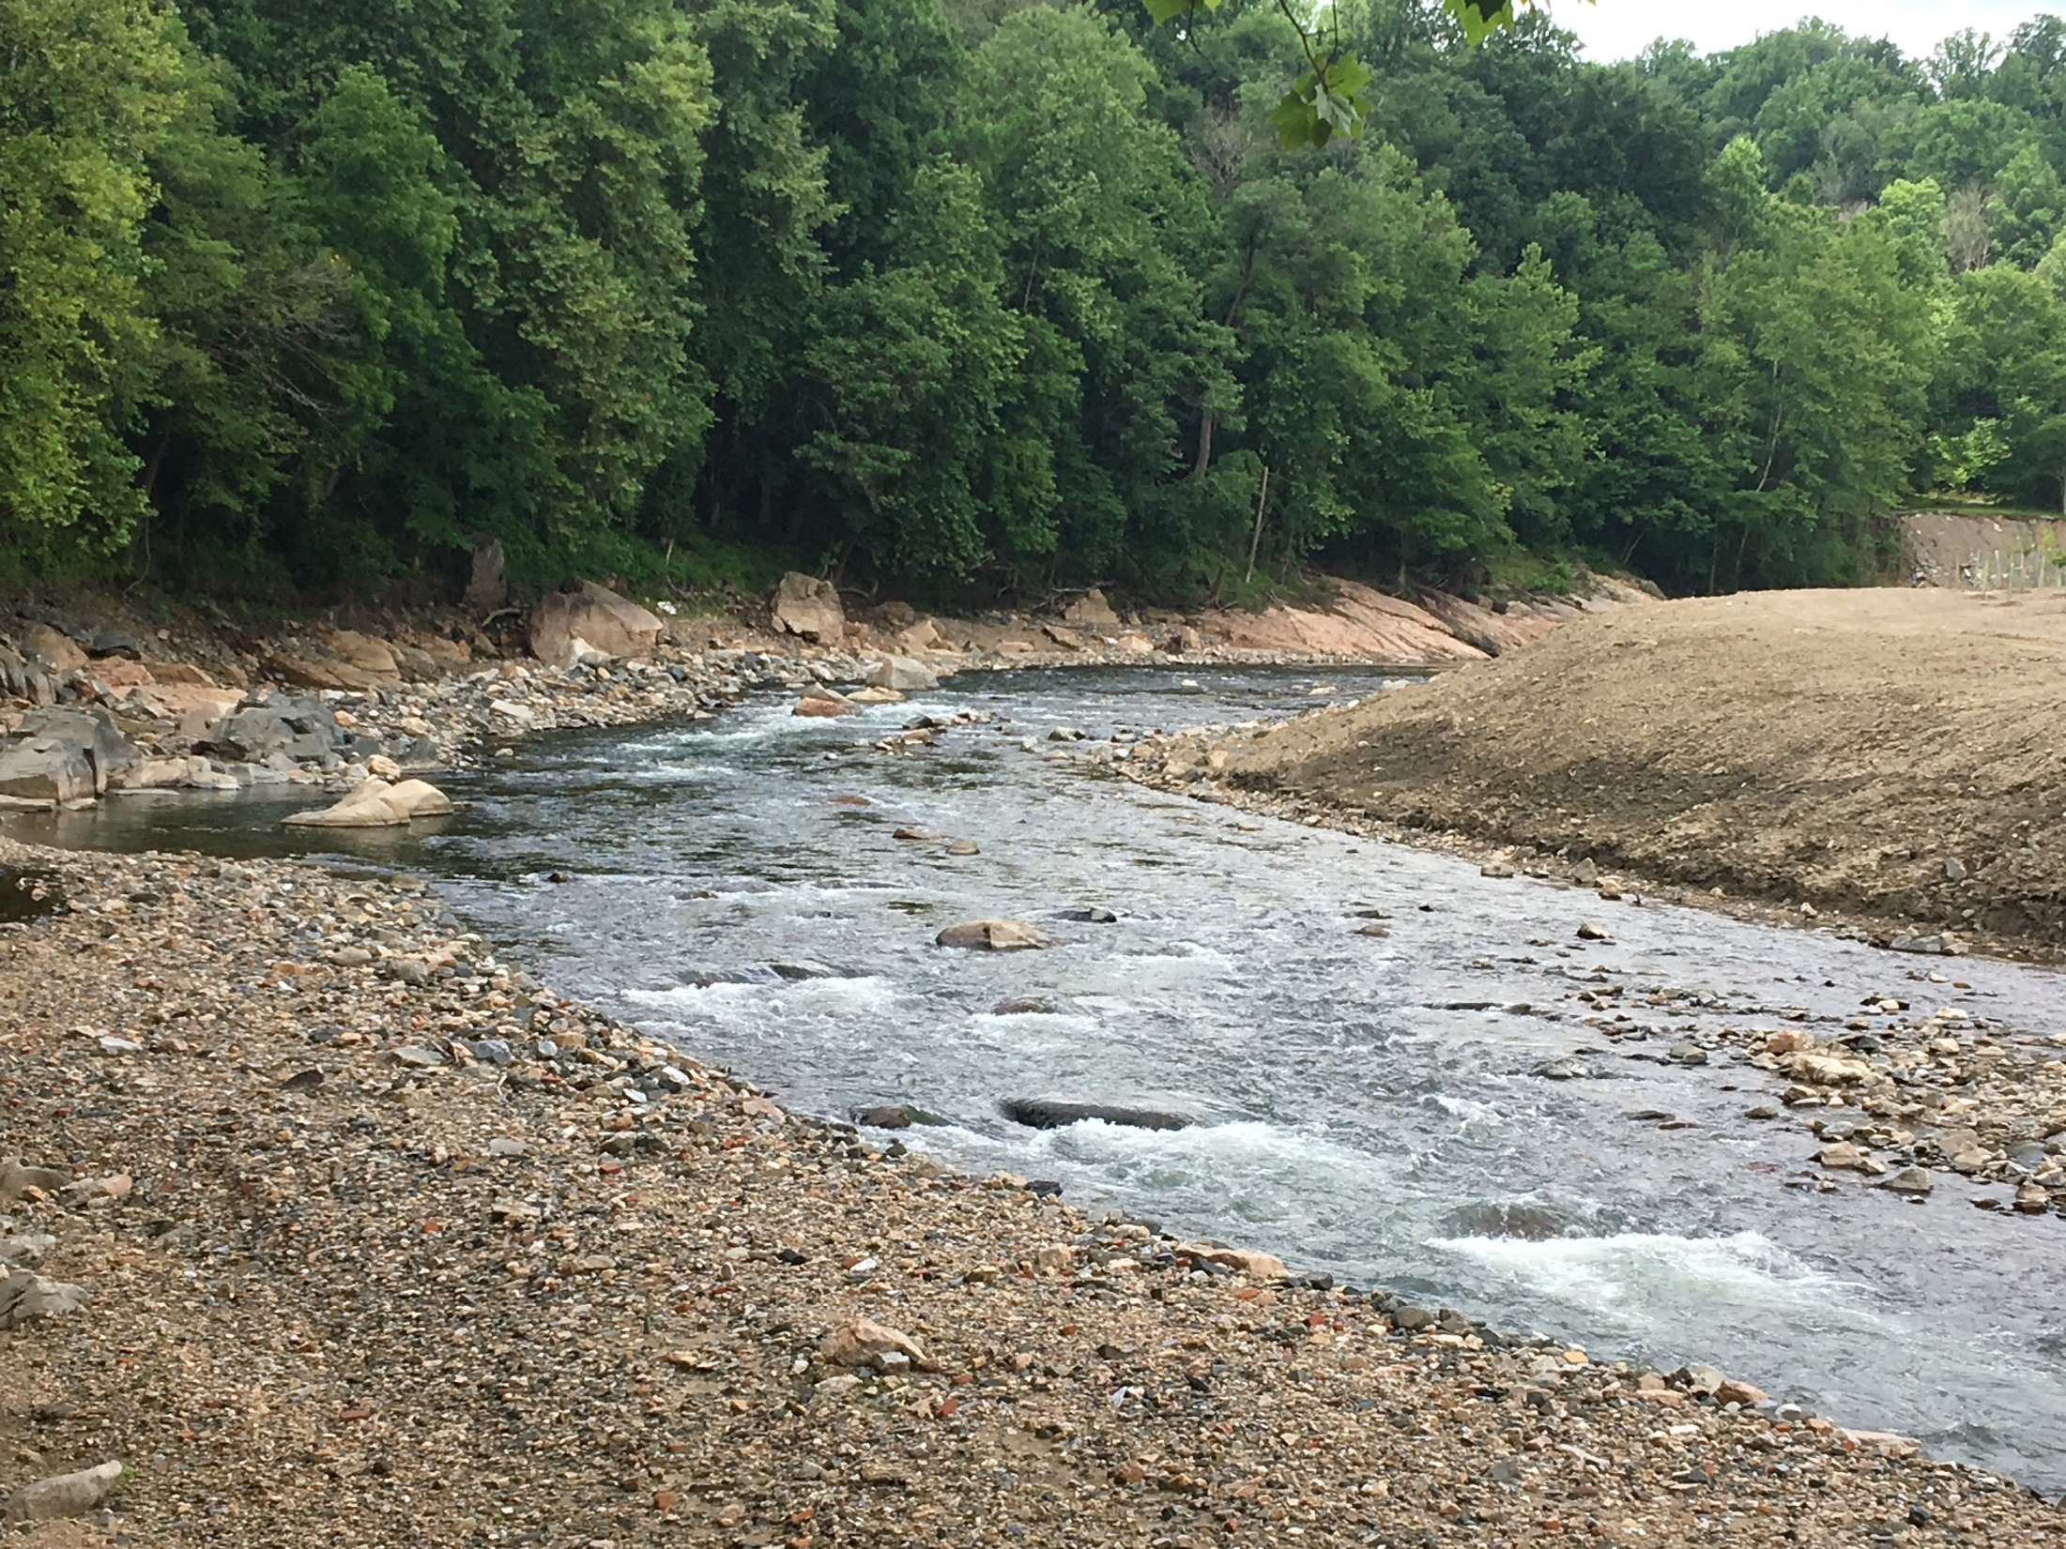
Fish Passage
Workgroup Updates
Mary Andrews, P.E.
Chair, Fish Passage Workgroup
NOAA Restoration Center
Mary.andrews@noaa.gov

Slide 2
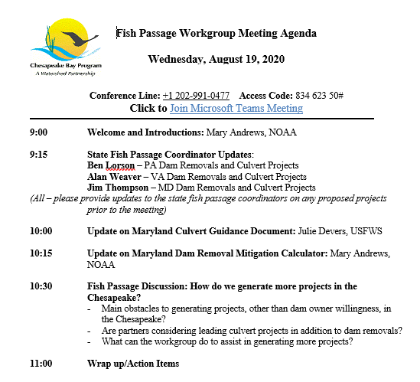
Agenda

Slide 3
Fish Passage Outcome Changes
PREVIOUS FISH PASSAGE OUTCOME: Restore historical fish migratory routes by opening 1,000 additional stream miles by 2025, with restoration success indicated by the presence of river herring, American shad, Hickory shad, Brook Trout and/or American eel.
NEW FISH PASSAGE OUTCOME: By 2025, restore historical fish migratory routes at a rate of opening 132 miles every two years, with restoration success indicated by the presence of alewife, blueback herring, American shad, hickory shad, American eel and brook trout, to be monitored in accordance with available agency resources and collaboratively developed methods.
NOTE: All web site materials need to be updated with new outcomes.

Slide 4
Chesapeake Bay Fish Passage
Future discussion on invasive species management at dams
USFWS offering technical assistance on concept plans and design efforts. Speak to Julie Devers if interested.
American Rivers and NOAA planning a Sedimentation Workshop
Possible new funding – Stimulus? Infrastructure?
Survey results shown in 2nd half of this meeting

Slide 5
Dam Removal Mitigation Calculator
Intended to be a “carrot approach” to generate more dam removal projects
Culverts are not included in the calculator at this time; however, future discussion on culverts is expected
Jim Thompson proposed an approach similar to Bloede Dam Removal Crediting
USACE insisted the calculator be tied to the stream mitigation calculator
In the process of negotiating best metrics
Metrics currently being evaluated:
  Upstream Functional Network from tool
  Dam Ranking in the tool (high priority versus low priority
  Priority species multipliers
  Impoundment length and quality (from stream calculator)

Slide 6
Survey Results
Impediments to Development of New Projects
  Dam owner willingness (stick and carrot approach)
  Funding
    Funding for salaries to develop new projects hard to find
    Funding for design is near impossible to get
    Piece meal funding is not optimal
    Lack of dam safety support (PA example)

Slide 7
Survey Results
Suggestions to overcome limited projects
  Sedimentation Workshop (AR/NOAA lead)
  Need for better Federal Program on Dam Removals?? Coordinated Funding?
  Mitigation Calculator and State Tax Credits (carrot approach)
  Continued work with Dam Safety (stick approach)
    PA is fine here; need new fish passage coordinator
    MD needs a mind set change
    VA has ongoing efforts

Slide 8
Survey Results
Culverts
  Federal agencies – absolutely yes spend more time on culverts
  State agencies – yes (and no) but not at the expense of dam removals; permit route seems to work
  Non-profits – yes and no. Adequate time already.
  State culvert guidance is needed (MD’s underway)
  And lots more – suggest hosting a workshop specific to culverts

Slide 9
Topics for Future Meetings
  WORKSHOPS
  Sedimentation Workshop (AR/NOAA)
  Culvert Workshop (USFWS)
  Facilitating NAACC Trainings (USFWS?)
  DISCUSSIONS
  Monitoring at fish passage sites including eDNA (SERC?)
  Dam Removal Mitigation Bank (MD DNR)
  Invasive Species Discussion (USFWS?)
  PA Fish Passage and Dam Safety Coordination (on hold)

