Slide 1



Chesapeake Bay Program Updates Citizens Advisory Committee Quarterly—September 2021
Martha Shimkin
Deputy Director,
EPA Chesapeake Bay Program

Slide 2
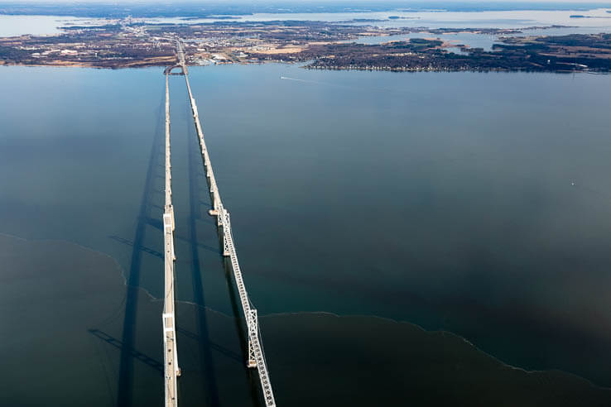
PSC Highlights
CBP DEIJ Implementation Plan
Infrastructure Investment and
Jobs Act
AGENDA

Slide 3
Principals’ Staff Committee Meeting –
November 23rd
DEIJ Implementation Plan Acceptance and Support
EC Meeting Planning – EC Chair Announcement
Conowingo WIP Milestone Updates
Outcome Attainability Progress Update
Monitoring Fund Needs
Bay Program Budget

Slide 4
DEIJ Implementation Plan see the link
Focus Area 1: Strengthening the CBP’s authorizing environment for DEIJ
- updating governance documents
- updating management strategies
Focus Area 2: Advancing DEIJ internally
- staff, appointees, volunteer bodies
- building understanding and capacity
Focus Area 3: Advance DEIJ through mission-related work
- building relationships with underrepresented communities
- Advancing DEIJ in management strategies and workplans
Focus Area 4: Advance DEIJ performance of partners
- training, capacity-building, outreach, guidance
- accountability

Slide 5

DEIJ Implementation Plan Public Comment Period
Public Comment Period (Aug. 23-Sept. 27)
Featured Story on Chesapeakebay.net
Social media announcements (Twitter, Facebook)
Email to MB, PSC, Diversity Workgroup, Action Team distribution list
DEIJ Action Team webpage
CBP DEIJ Implementation Plan Backgrounder
Action Team member outreach
Support student-led efforts
Who provided comments?
State of Maryland
Delaware DNREC
NOAA (NCBO)
Choose Clean Water Coalition
Center for Community Engagement, Environmental Justice and Health
Residents (2)
CBP partnership
Local Leadership Workgroup
5 responses to internal feedback form

Slide 6
Public Comments Received
*some comments paraphrased
Strengths
Weaknesses
Communicates the commitment of CBP leadership to bring meaningful change in the regular business of the CBP.
Concerned that there is not enough existing capacity to complete this work…Most action falls on Diversity Workgroup.
Comprehensive in scope and represents a first step toward creating a more diverse, equitable, inclusive, and just restoration effort.
Goals and actions are voluntary… the plan lacks clear system of accountability.
A valuable tracking tool to hold the CBP accountable to its intention of effecting meaningful change.
CBP should take meaningful action to identify internal DEIJ issues [within the partnership organization] before rushing into external projects.

Slide 7
Addressing Challenges
CHALLENGES
SOLUTIONS
Capacity and equity
Priorities and Sequencing
01
Not enough capacity. Most actions fall on Diversity Workgroup.
Foundational actions that will help advance other tasks and organizational “readiness”.
01
Accountability
Accountability Framework
02
Lacking performance measures and a system for ensuring implementation.
Management Board “Champions”. Reporting frequencies. Performance metrics.
02
CBP Scope
Right-sizing
03
What is “internal” and what can CBP ask of partner organizations, each other?
Reflect authorities, organizational scope, and role of CBP.
03

Slide 8

Tracking and Implementation
Collecting and organizing tracking information, leading implementation
DEIJ Coordinator/Contractor/Consultant
partnership-wide implementation
collaboration with the Diversity Workgroup
Management Board “Champions”
leadership accountability for implementation and support for DEIJ Coordinator
Cross organization collaboration
regular meetings with representatives from partnership entities (Goal Teams, workgroups, advisory committees)

Slide 9
Performance Measures
The information and targets upon which progress will be measured.
Track implementation actions
performance targets identified in the plan
DEIJ Readiness Assessment baseline and scoring system
Track progress towards quantifiable long-term targets
Includes Diversity Goal
Develop additional quantifiable impact metrics/targets
moving forward

Slide 10
Frequency of DEIJ Reporting
How often information will be “reported” and by whom.
GITs and Workgroups submit descriptions of efforts during SRS Quarterly Progress Meetings.
Other Program bodies report on efforts on annual basis.
Signatories update partnership on DEIJ efforts and outcomes annually at Management Board Meeting
DEIJ Coordinator develops annual report summarizing partnership outcomes.
Could this be part of the State of the Program report presented to the EC?

Slide 11
Infrastructure and Other

Slide 12

Questions? Martha Shimkin, shimkin.martha@epa.gov

