Slide 1

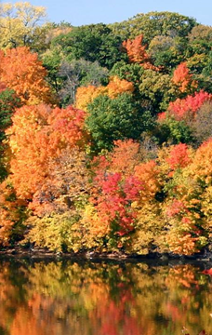

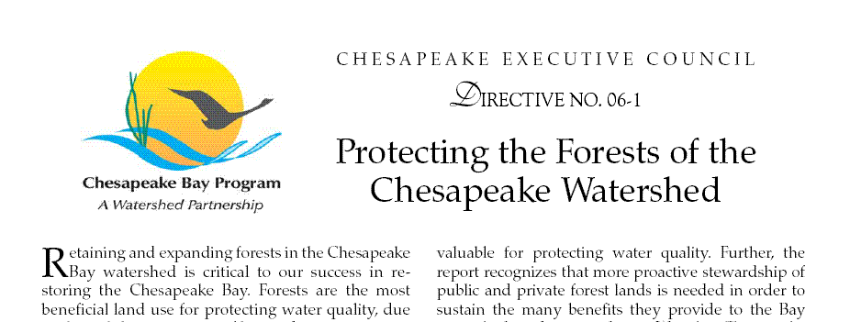
Chesapeake Tree Canopy Strategy & workPLAN UPDATE Citizen’s Advisory Committee, February 17, 2016
Julie Mawhorter
Mid-Atlantic Urban & Community Forestry Coordinator
jmawhorter@fs.fed.us

Slide 2
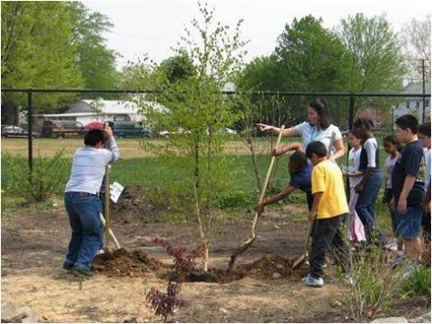
Overview
Background on Urban Tree Canopy goals and progress
Tree Canopy “credit” in the TMDL context
Chesapeake Tree Canopy Management Strategy & 2 Year Workplan

Slide 3
Where we’ve been…
2003 Chesapeake Executive Council Directive
…WE FURTHER RECOGNIZE THAT URBAN TREE CANOPY COVER offers stormwater control and water quality benefits for municipalities in the Chesapeake Bay watershed…
By 2010, work with at least 5 local jurisdictions in each state to complete an assessment of urban forests, adopt a local goal to increase urban tree canopy cover and encourage measures to attain the established goals…
And in 2007 Forest Conservation Directive…
By 2020, accelerate reforestation and conservation in urban and suburban areas, by increasing the number of communities with commitments to tree canopy expansion goals to 120.

Slide 4
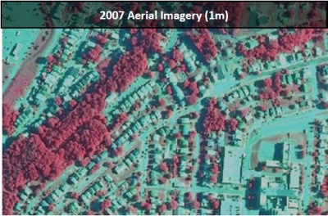
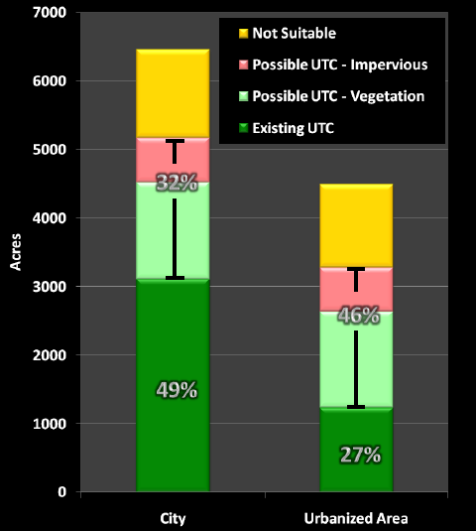
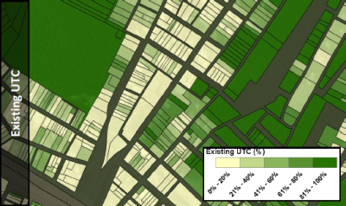
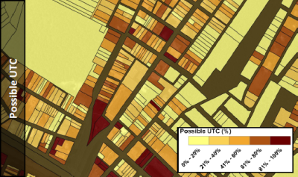
Progress: Urban Tree Canopy Assessments
(Cumberland, MD, J. O’Neil-Dunne)

Slide 5
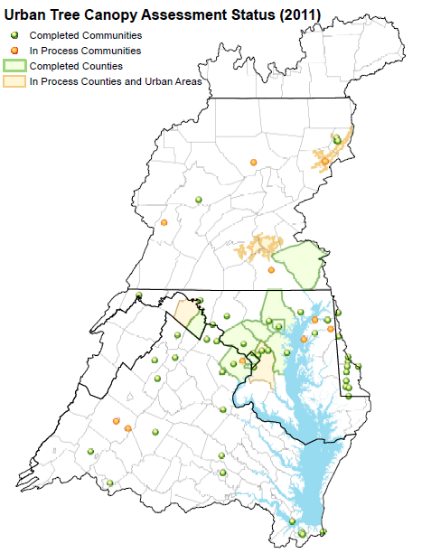
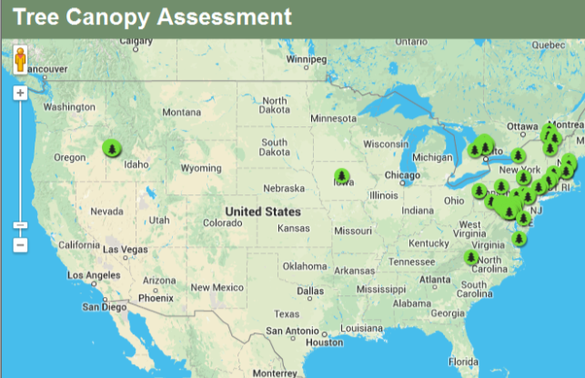
UTC Assessments in the Chesapeake Bay Watershed
~ 70 cities/towns
9 counties
* Watershed-wide high resolution data in 2016!

Slide 6
Progress: UTC Goals
5 Counties and ~40 Cities/Towns have set UTC Goals
EXAMPLES – UTC GOALS

Slide 7
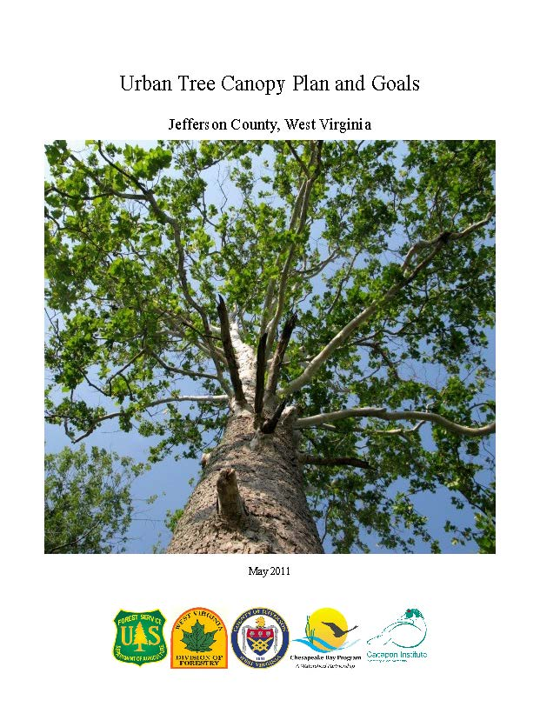
Progress: Implementation Plans
Over 20 UTC Implementation Plans completed, more in progress

Slide 8
Progress: On the ground?
??? ???
Assess →Set Goal → Plan → Implement → Monitor
We don’t have good information on actions taken and progress made in protecting and expanding urban tree canopy.

Slide 9
2014 CHESAPEAKE BAY AGREEMENT
TREE CANOPY OUTCOME
Continually increase urban tree canopy capacity to provide air quality, water quality and habitat benefits throughout the watershed.
Expand urban tree canopy by 2,400 acres by 2025.
Must be 2,400 acres net gain, after accounting for canopy losses
For reporting, 1 acre = 100 trees planted
Tracked using tree planting data submitted to Chesapeake Bay model, cross-checked with periodic canopy assessments

Slide 10
Tree Canopy Outcome- State Targets
State | Annual Target (New Acres) | 2025 Target (New Acres)
Delaware | 5 | 60
DC | 40 | 480
Maryland | 45 | 540
New York | 5 | 60
Pennsylvania | 60 | 720
Virginia | 40 | 480
West Virginia | 10 | 120
TOTAL | 205 | 2460

Slide 11

Chesapeake TMDL – Credit for Trees?
Current Approach: Urban Tree Planting is a credited BMP for TMDL
Expert Panel is reviewing this credit and will issue recommendations in April; credit likely to be reduced from current “Forest” credit

Slide 12
Chesapeake TMDL – Credit for Trees?
New Approach: Capturing existing Tree Canopy as new land uses in the Chesapeake Bay model, to account for water quality benefits and incentivize protection
Must quantify pollutant loading rate reflecting benefit of tree canopy over turf and impervious surfaces
Aim for Water Quality Goal Team approval on 3/14

Slide 13
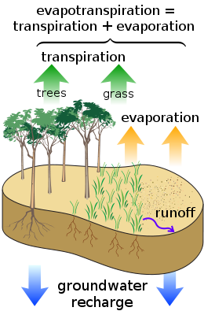
Expert Panel Science Review
Studies organized by type of benefit:
Hydrologic
Interception
Evapotranspiration
Infiltration
Runoff reduction
Water quality
Pollutant uptake & removal
Leaf litter
Interception
Infiltration
Source: Tree Canopy Expert Panel, Center for Watershed Protection

Slide 14
Tree Canopy Loading Rate
Tree Canopy Loading Rate Webinar on 2/11
Recording, slides, literature synthesis and methodology posted at http://www.chesapeakebay.net/calendar/event/23466/
Taking comments, briefing workgroups, finalizing recommendations for approval by Water Quality Goal Implementation Team on 3/14
Land Use | Pollution Reduction (%) DRAFT
Canopy over Turfgrass | 26.0
Canopy over Impervious | Minimum 7.1, TBD

Slide 15
Tree Canopy and TMDL – NEXT STEPS
Work with states to develop tracking systems to capture local tree planting efforts for annual BMP reporting (2016)
Include tree canopy targets in 2017 Milestones and Phase 3 Watershed Implementation Plans
When credits are finalized, work with state and local stormwater programs to better integrate tree canopy into WIP goals

Slide 16
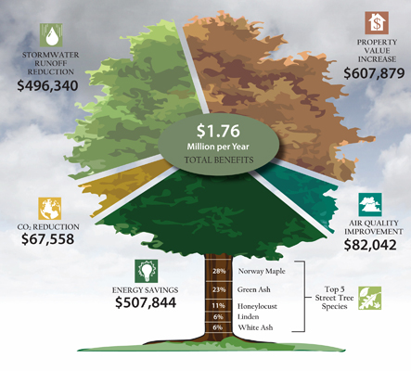
But, Beyond the tmdl… trees are the ultimate multi-tasker
iTree Analysis, Fond du Lac, Wisconson, itreetools.org

Slide 17
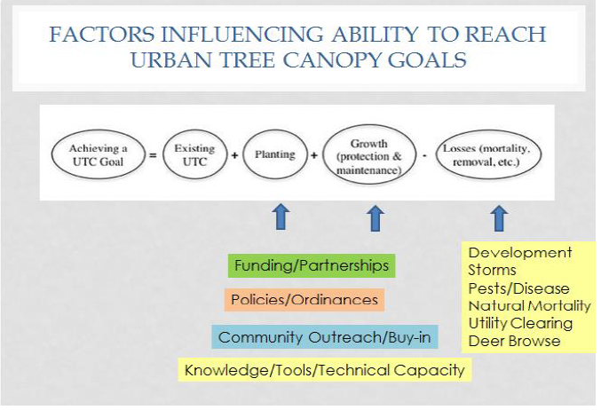

Slide 18
Chesapeake TREE cANOPY STRATEGY & WORKPLAN
Draft Tree Canopy 2-Year Workplan out for public input through March 7 (view full draft workplan)
http://www.chesapeakebay.net/managementstrategies/strategy/tree_canopy
Actions organized by:
Funding & Partnerships
Policy & Ordinances
Technical Capacity & Knowledge
Community Outreach & Education
Appendix of Additional State Actions provides full detail on state programs

Slide 19
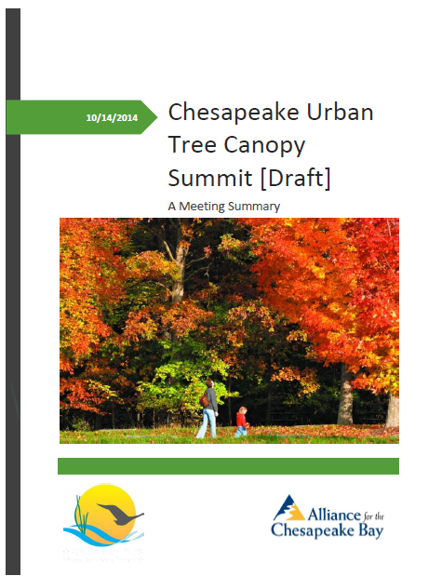
Chesapeake Urban Tree Canopy Summit October 14-15, 2014
80+ local, state, federal, and nongovernmental participants from across watershed
Meeting summary report and recorded presentations are posted online:
http://forests.allianceforthebay.org/what-were-doing/forest-restoration/ urban-tree-canopy-summit-proceedings/

Slide 20
Key Issues: Funding & Partnerships
What are the best local funding strategies to pursue for planting and maintenance?

Slide 21
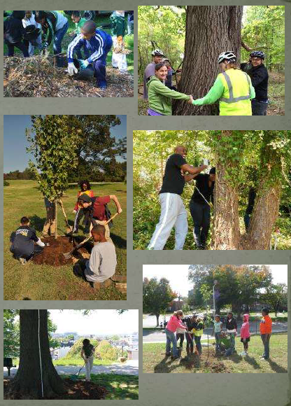
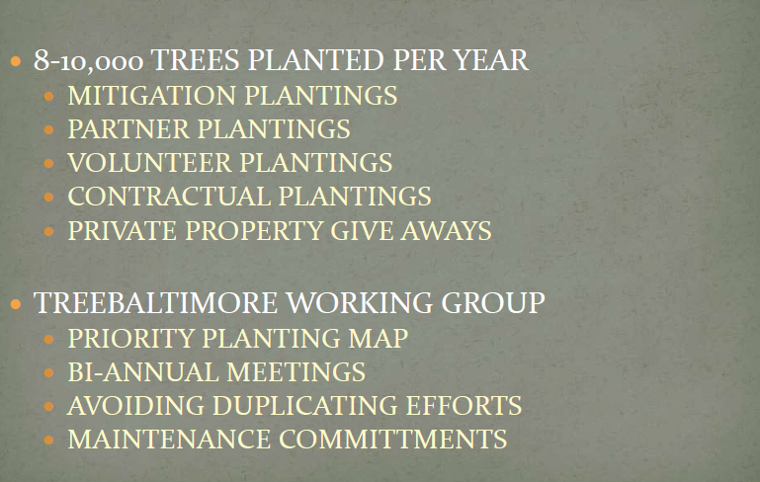
partnerships: treebaltimore
Credit: Charlie Murphy, TreeBaltimore

Slide 22
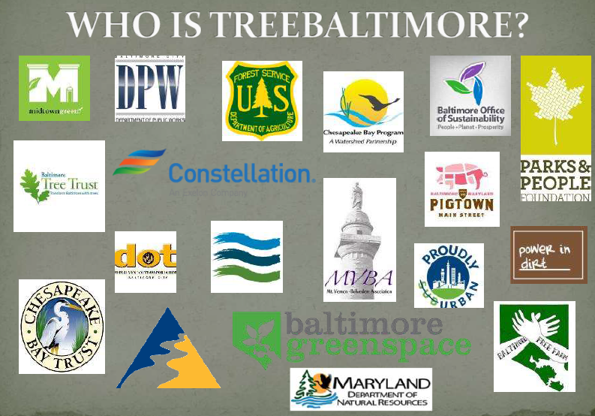
partnerships: Treebaltimore
Credit: Charlie Murphy, TreeBaltimore

Slide 23
Key Issues: Stormwater
How to make tree canopy a priority in TMDL & stormwater programs?

Slide 24
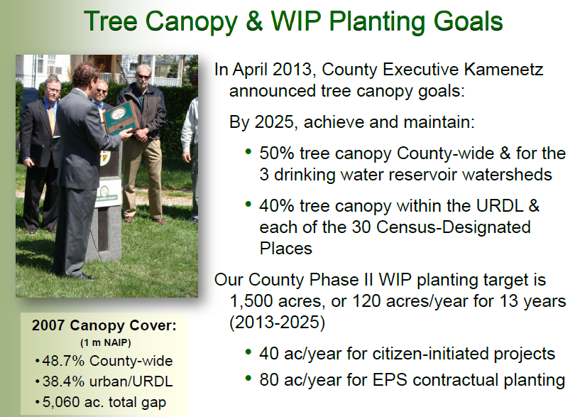
Stormwater: Baltimore County
Credit: Don Outen, Baltimore County

Slide 25
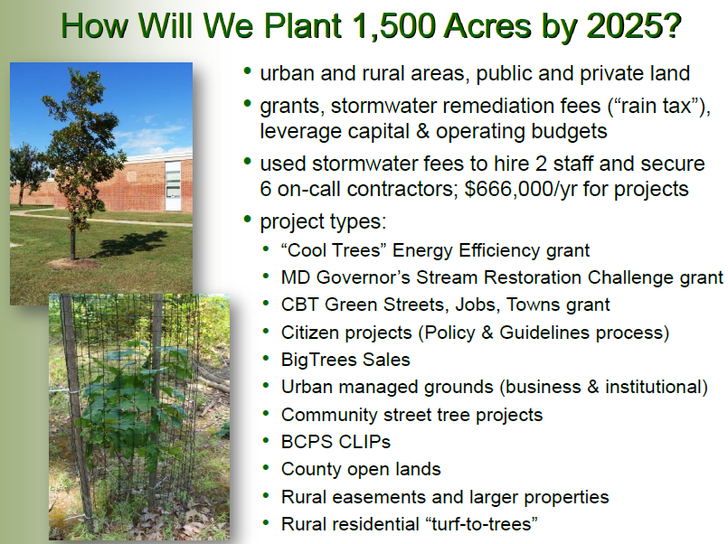
stormwater: Baltimore County
Credit: Don Outen, Baltimore County

Slide 26
Key Issues: Tree Canopy Protection
What are the best options for protecting tree canopy? (policy, ordinances, etc.)

Slide 27
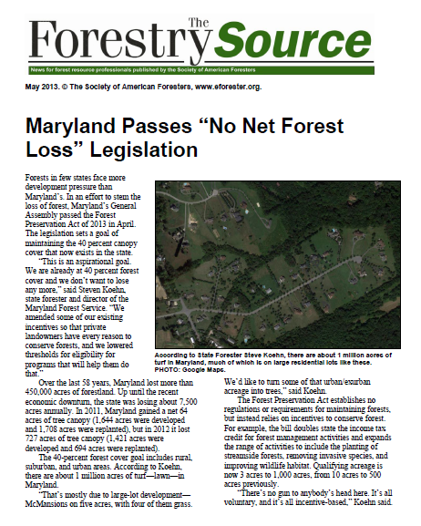
canopy protection: state policy
Protect and Mitigate

Slide 28
Key Issues: Outreach & Engagement
How to effectively engage communities in low canopy areas?

Slide 29

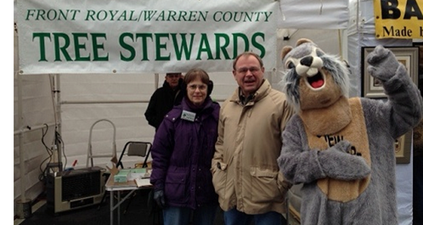
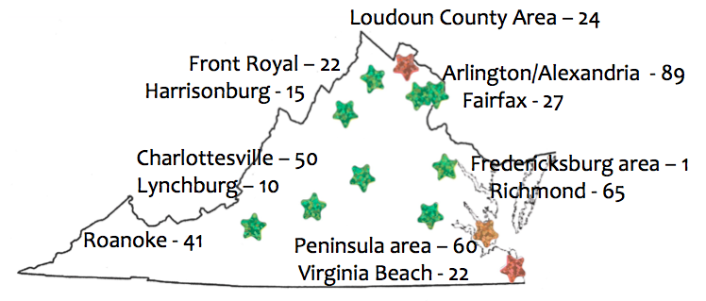
Engagement: Virginia Tree Stewards
Trees Virginia Model
Master Gardener Model

Slide 30
NEW: CHESAPEAKE TREE CANOPY NETWORK
One stop website resource with funding information, best practices, tools, case studies, etc. – spring 2016
STORMWATER
SCHOOLS
UTILITIES
LOCAL LEADERSHIP
CHURCHES
PRIVATE SECTOR
HOMEOWNER ASSOCIATIONS

Slide 31
Questions? Get involved:
Julie Mawhorter
jmawhorter@fs.fed.us, 410-267-5708

