Slide 1

Draft/Discussion
Biennial Work Plan Template and Development Process
June 19, 2015

Slide 3
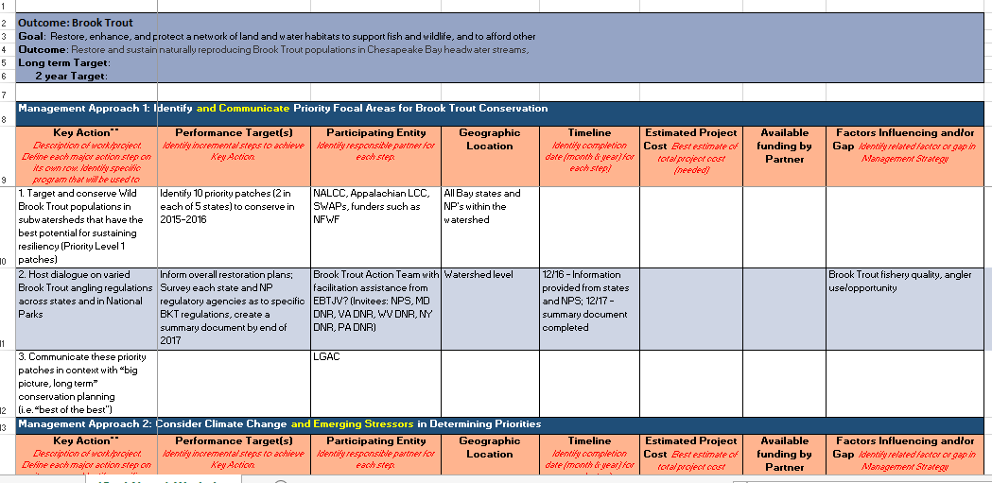

Slide 4
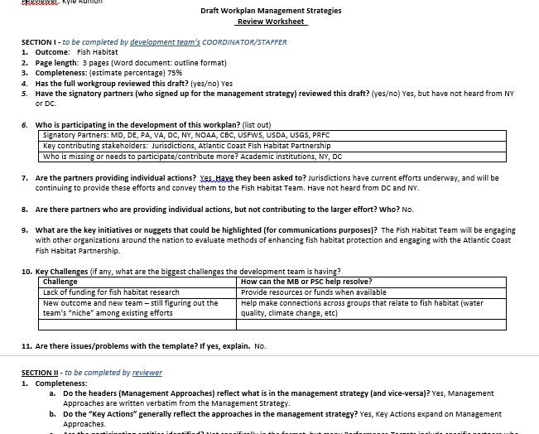

Slide 5
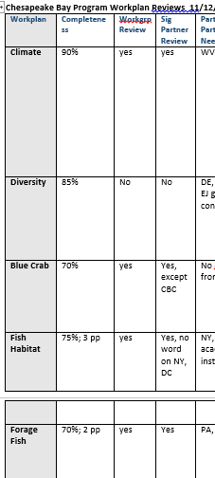
Completeness
Almost all were at least 75% complete…
For what is expected by the Nov. 2 deadline
A few 60% or less complete -
* Black Duck, Brook Trout, Water Quality, Healthy Watersheds, Land use options

Slide 6
Reviewed by Workgroup
Most have been shared or are in progress of review
6 of 25 have not

Slide 7
Review by Signatory Partners
All but 2 have been shared with the Partners

Slide 8
Partner Input Lacking
About half NEED PARTNER INPUT
Shared table of commitments for management strategies and cut-paste… please check to make sure you are participating where you said you would

Slide 9
Individual Actions Provided
All but 3 reported that the partners are providing individual actions.

Slide 10
MS Approaches and Key Actions Reflected
Yes, generally

Slide 11
Geographic Locations Identified?
Yes, in most workplans; more expected.

Slide 12
Timelines added to workplans?
Most yes, BUT
Many only provide year

Slide 13
Cross-Outcome Actions: Climate
About half include; half don’t

Slide 14
Cross-Outcome Actions: Diversity
About 8 don’t include any actions for diversity

Slide 15
Cross-Outcome Actions: Local Engagement
All but 4 include sufficient actions for local engement

Slide 16
Generally, on the right track?
Most: Yes
BUT…still need a lot of work, need more info or refinements

Slide 17
Key Challenges
Funding - #1
For monitoring, research, local partners
Information overload – difficult to develop workplans from varied actions
Difficult to hone in on Priorities
Lack of partner participation or committed development team
Finding specific orgs to carry out actions
Jurisdiction commitments are just business as usual

Slide 18
Key Challenges
Will not meet 2016 deadline (LU methods)
Need more local leaders
Need to clarify how we will report progress
Need process for measuring baselines (help from STAC?);
Uncoordinated and extensive amount of content (need partner participation in inventory and gap analysis

Slide 19
Cross-Outcome Collaboration Opps
Diversity: Toxic Contaminants Workgroup on fish advisories.
Public Access and climate resiliency teams to help identify potential sites in diverse communities.
Blue Crab: Stewardship and diversity
Fish Habitat: overlap with the Brook Trout outcome on an online mapping tool
Forage Fish: monitoring efforts could be combined with those of the Fish Passage Workgroup; Specific management decisions that address sustainability of the forage base….Healthy Watersheds/Stream Health
Tree Canopy: opportunities with Diversity, Local Leadership, and Environmental Literacy Outcomes.
Healthy Watershed: Fish Habitat is working to identify key stressors and identify areas of high habitat value
Land Use: Fish GIT has interest and can share experiences working with the planning communities in MD and VA
Protected Lands: opportunities for cross collaboration with wetlands, climate, diversity, habitat and water quality, tree canopy, and forest buffers.

Slide 20
Questions?

Slide 21
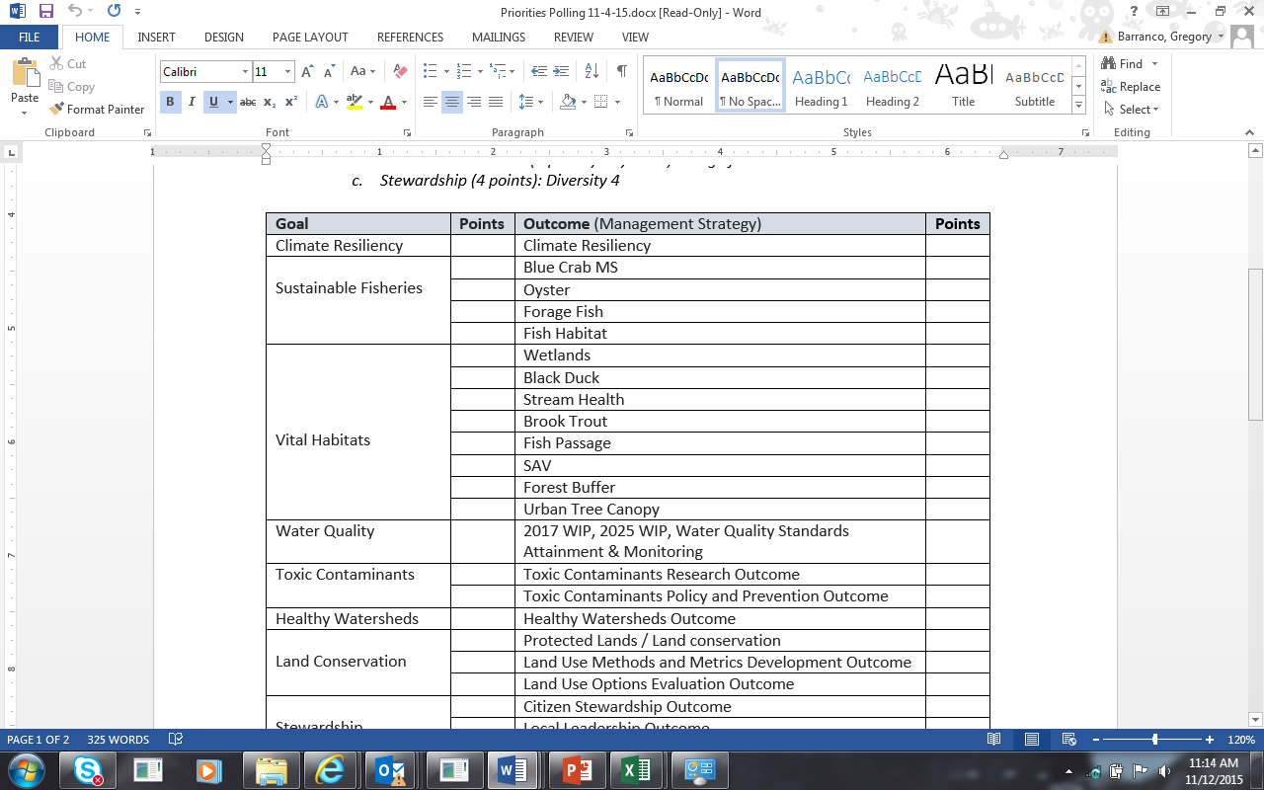
Survey of Partner Priorities
3
10
5
2

