Slide 1
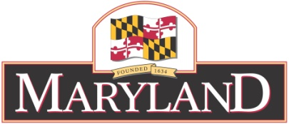
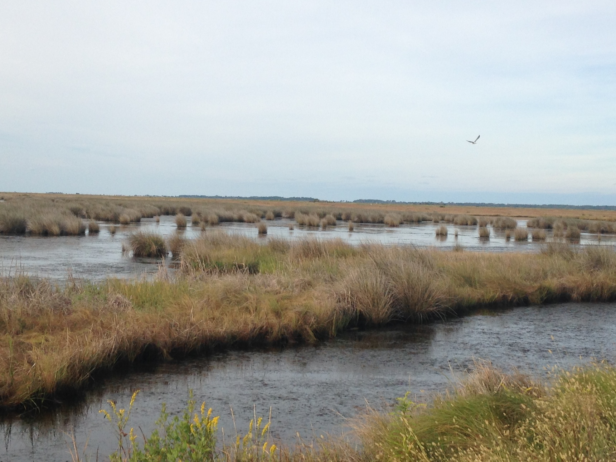

Chesapeake Bay Program
Environmental Literacy Update December 2016
Britt Slattery, Maryland Department of Natural Resources
Donna Balado, Maryland State Department of Education

Slide 2

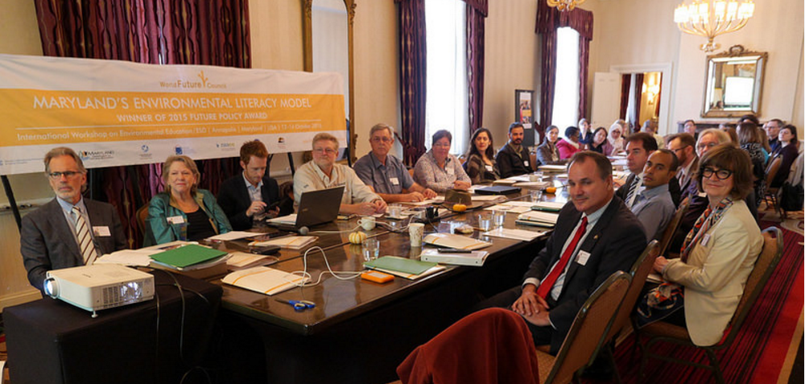
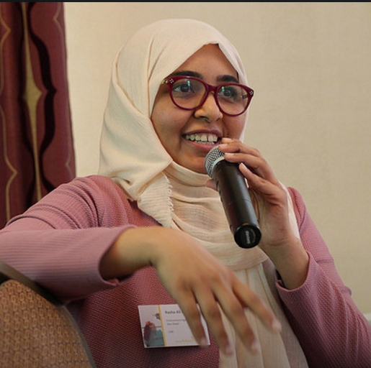
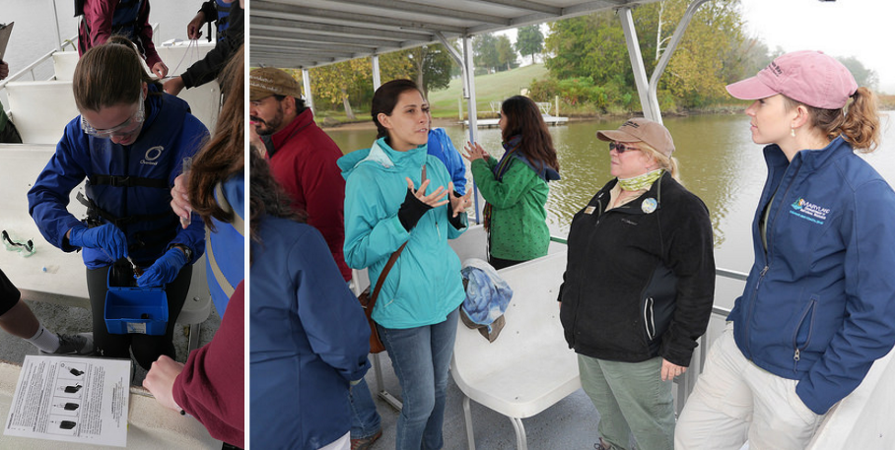
Major Accomplishments in Maryland
Environmental Literacy Update – Maryland – December 2016
(1) World Future Council international workshop (Oct)
Notes:
The World Future Council’s Rights of Children team brought together Ministries and legislators from around the world (16 countries) with interest in learning first-hand about Maryland's Environmental Literacy Standards pioneering model in an international workshop in Maryland (October 2016). It helped us see and reflect on our program through others’ eyes, and we learned about other programs that focus on education for sustainability.

Slide 3
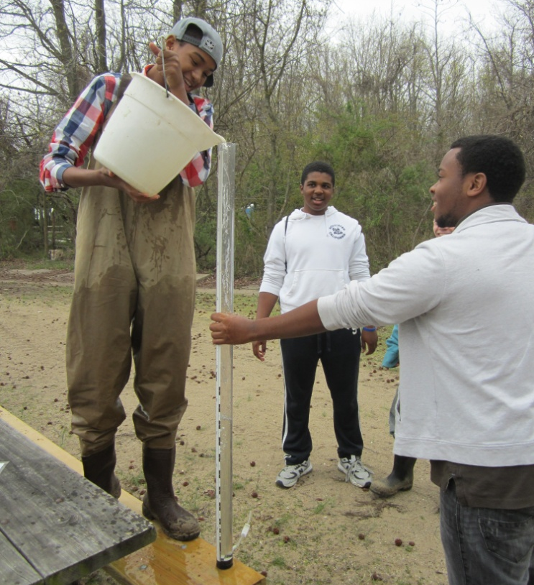
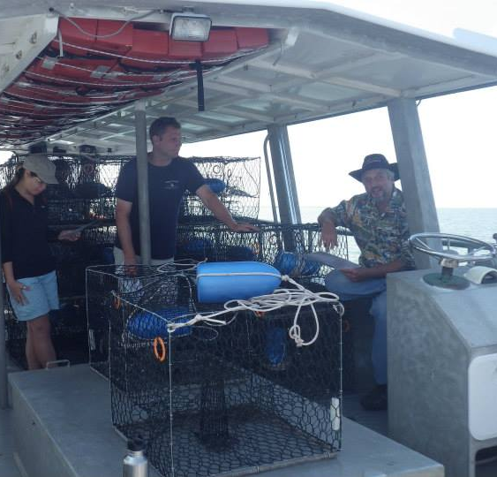
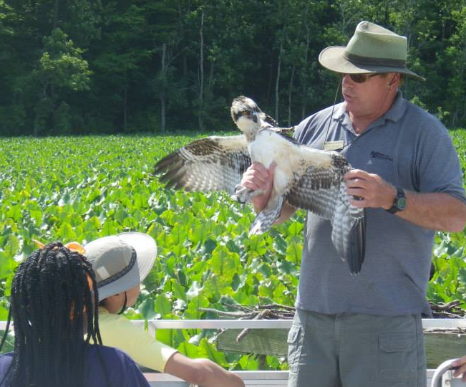
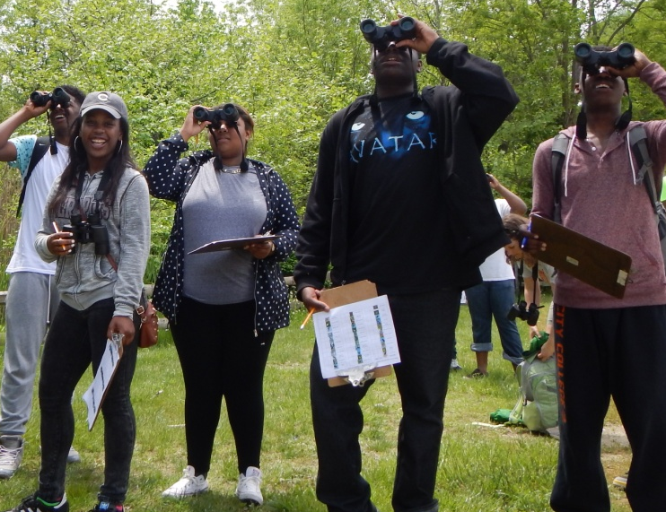
Major Accomplishments in Maryland
Environmental Literacy Update – Maryland – December 2016
(1) World Future Council international workshop (Oct)
(2) Conservation Career Pathways Forum (Dec)
Notes:
This event brought together a wide variety of entities offering programs that connect youth to the environmental field. The overall goal is to ultimately improve the pathways to conservation jobs and careers for more (and more diverse) youth, including strategies and actions to help advance career awareness, preparedness, and opportunities in environmental conservation fields. Participants in the forum discussed existing programs and current needs, and together identified ideas that can become recommendations to address gaps. [follow up will be important, group wants to meet again]

Slide 4
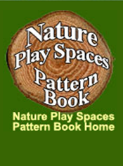
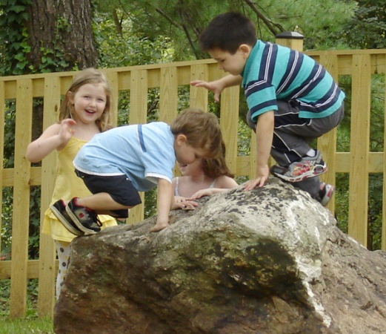
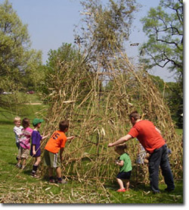
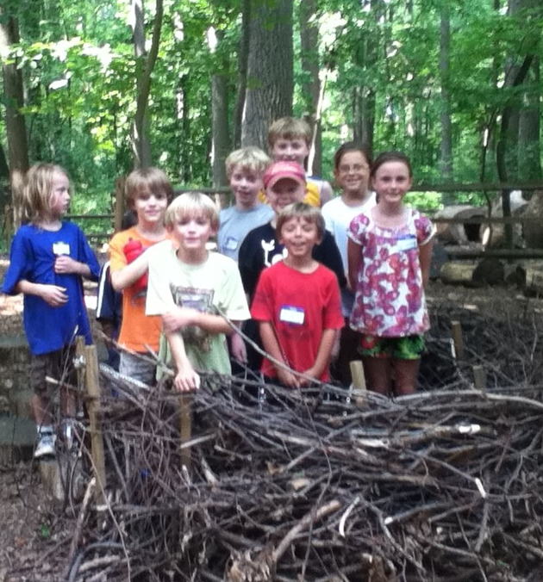
Successful Approaches
Environmental Literacy Update – Maryland – December 2016
Nature Play Spaces… CIN as “influencer” (example)
Notes:
The Nature Play Spaces Workgroup met in July with the MD State Department of Education Office of Childcare at their bi-monthly meetings of regional managers and supervisors. The workgroup shared presentations on the science behind the benefits of nature play, the growing example of nature play spaces at child care facilities in Maryland, and how these spaces fit into the licensing guidelines and COMAR regulations. The group led an interactive discussion and was well received by the MSDE staff. The Chief of Licensing then invited the workgroup to present the same material at the statewide meeting of licensing supervisors in fall of 2016. A regional workshop was given in Dec for southern MD child care providers, which was met with enthusiasm.

Slide 5
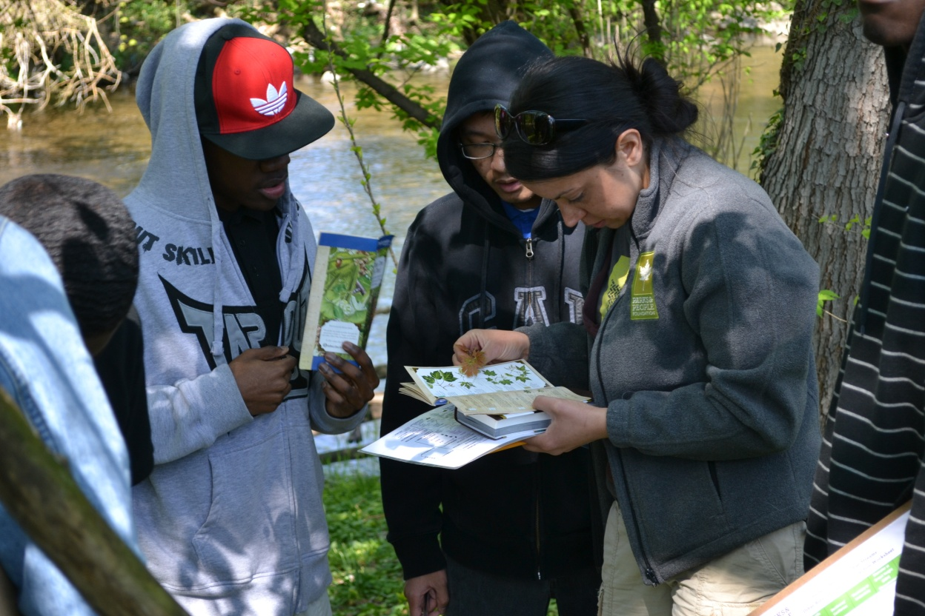
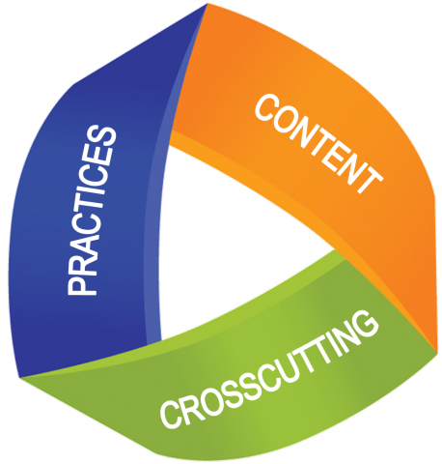
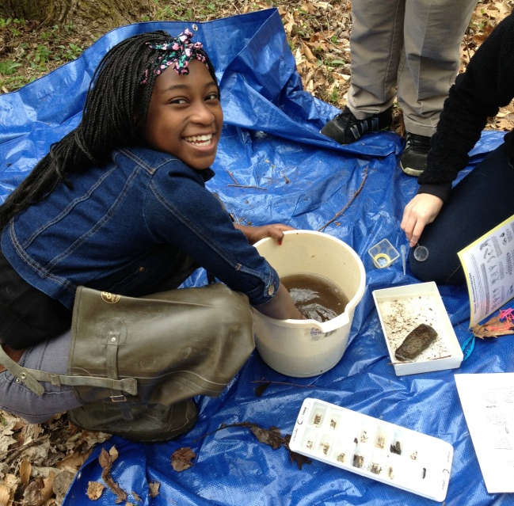
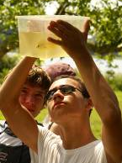
Successful Approaches
Environmental Literacy Update – Maryland – December 2016
Nature Play Spaces …
(2) Integrating E-Lit w/ NGSS

Slide 6
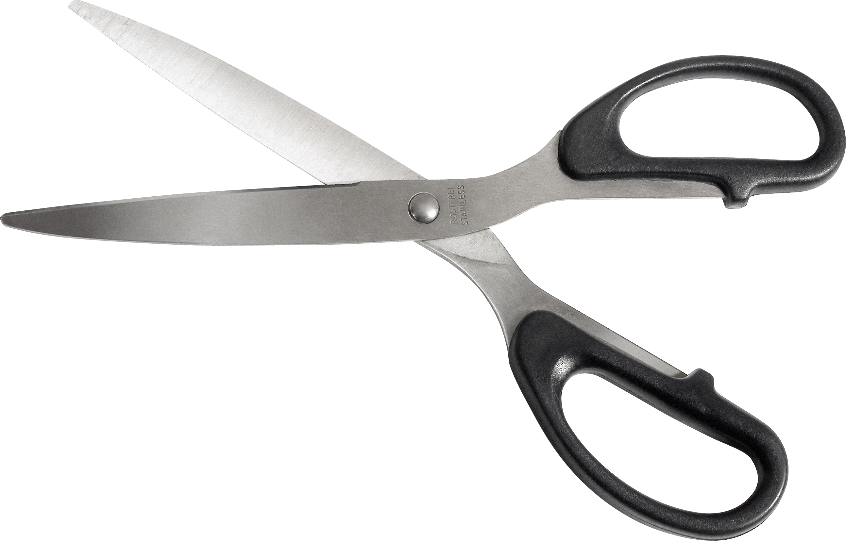
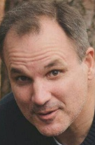
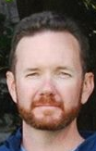
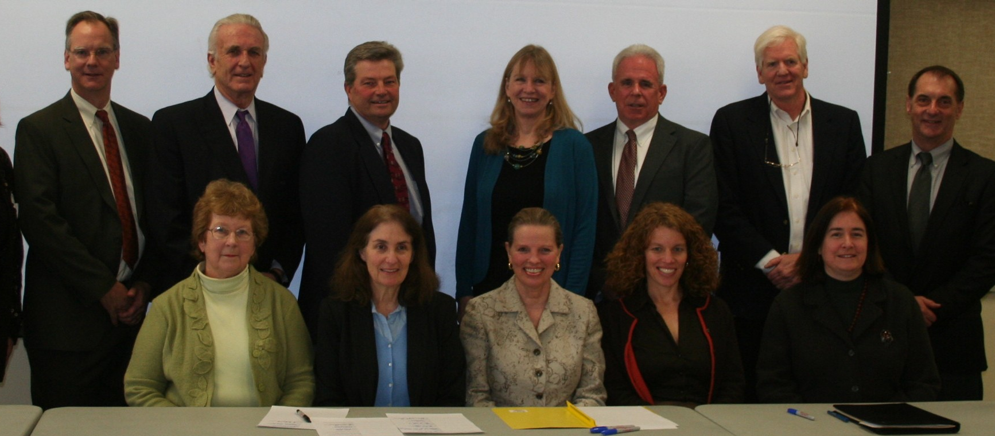
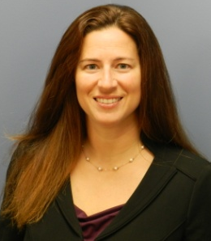
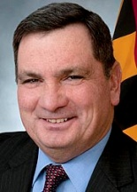
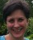
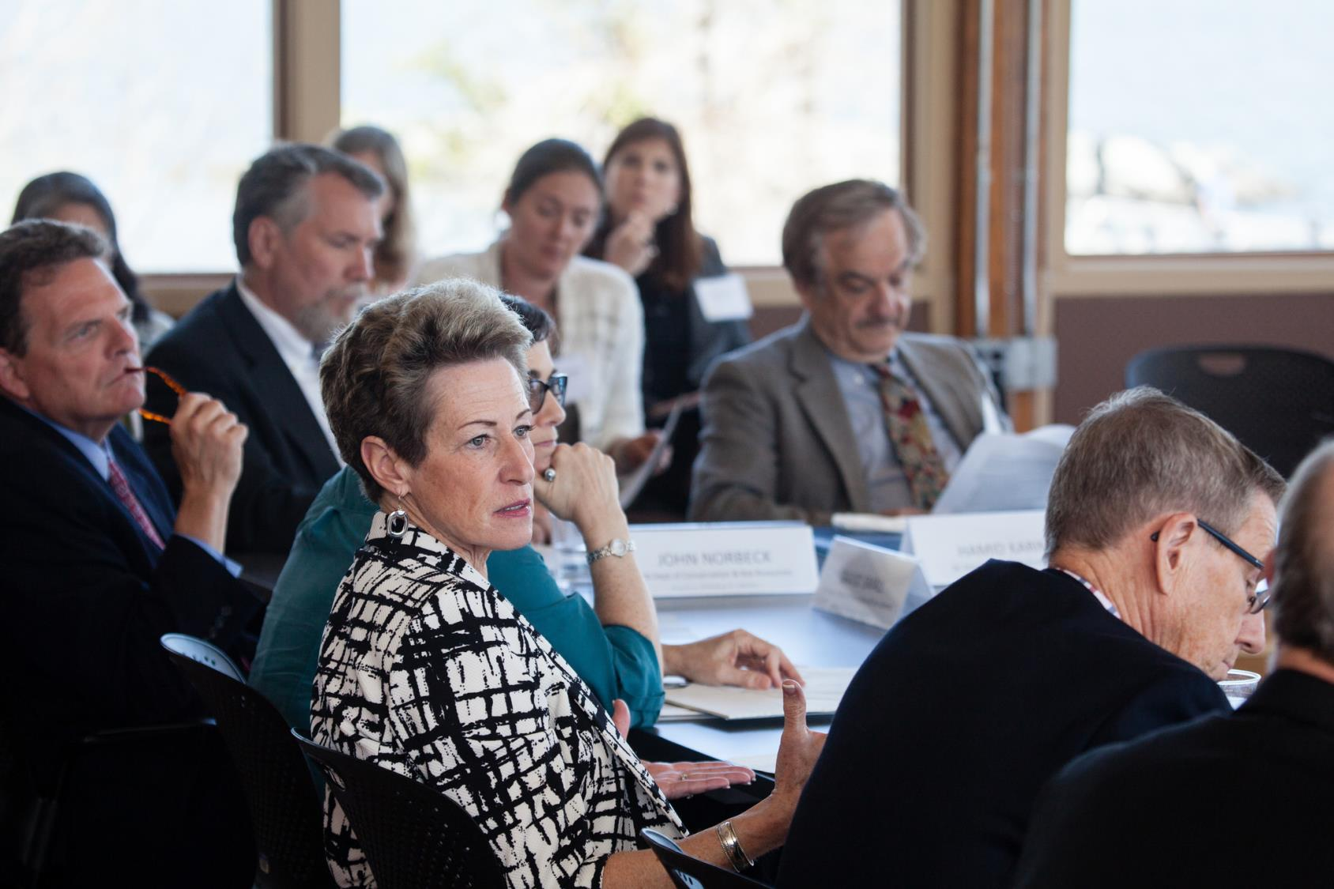
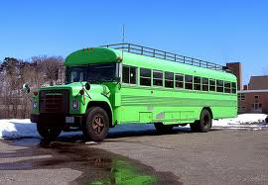
Challenges
Environmental Literacy Update – Maryland – December 2016
(1) Personnel changes
(2) Overly ambitious Action Plan
(3) Student field experiences away from school
-- transportation, logistics, etc.
Notes:
Almost every individual connected to the Partnership from MSDE changed from May - September 2016, along with additional changes among partners. The Partnership has been re-thinking capacity and priorities to determine whether some actions need to be scaled back or re-directed
Student field experiences = an ongoing issue - reference 10/26 meeting, need to follow up, engaging new partners / agencies and linking creative entities for opportunities. Would like to find a way to better use ELIT survey to help w/ data on this.

Slide 7
Opportunities to collaborate
Environmental Literacy Update – Maryland – December 2016
How do other jurisdictions bring in additional partners and engage them to accomplish goals?

